Slide 1
Bone Tissue
tissues and organs of the skeletal system
histology of osseous tissue
bone development
physiology of osseous tissue
bone disorders

Slide 2
Bone as a Tissue
osteology – the study of bone
skeletal system - composed of bones, cartilages, and ligaments
form strong flexible framework of the body
cartilage – forerunner of most bones
covers many joint surfaces of mature bone
ligaments – hold bones together at the joints
tendons – attach muscle to bone

Slide 3
Functions of the Skeleton
support – hold the body up, supports muscles, mandible and maxilla support teeth
protection – brain, spinal cord, heart, lungs
movement – limb movements, breathing, action of muscle on bone
electrolyte balance – calcium and phosphate ions
acid-base balance – buffers blood against excessive pH changes
blood formation – red bone marrow is the chief producer of blood cells

Slide 4
Bones and Osseous Tissue
bone (osseous tissue) - connective tissue with the matrix hardened by calcium phosphate and other minerals
mineralization or calcification – the hardening process of bone
individual bones consist of bone tissue, bone marrow, cartilage, adipose tissue, nervous tissue, and fibrous connective tissue
continually remodels itself and interacts physiologically with all of the other organ systems of the body
permeated with nerves and blood vessels, which attests to its sensitivity and metabolic activity

Slide 5
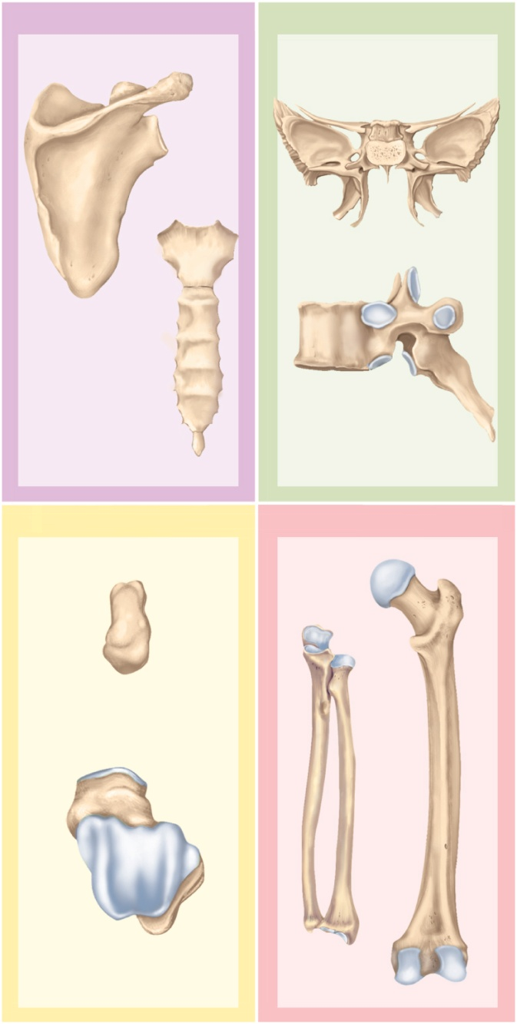
Shapes of Bones
Copyright © The McGraw-Hill Companies, Inc. Permission required for reproduction or display.
Flat bones
Irregular bones
long bones
longer than wide
rigid levers acted upon by muscles
short bones
equal in length and width
glide across one another in multiple directions
flat bones
protect soft organs
curved but wide & thin
irregular bones
elaborate shapes that don’t fit into the other categories
Sphenoid bone
Scapula
Vertebra
Sternum
Short bones
Long bones
Femur
Ulna
Capitate
(carpal) bone
Talus
Radius
Figure 7.1

Slide 6
General Features of Bones
compact (dense) bone – outer shell of long bone
diaphysis (shaft) - cylinder of compact bone to provide leverage
medullary cavity (marrow cavity) - space in the diaphysis of a long bone that contains bone marrow
epiphyses - enlarged ends of a long bone
enlarged to strengthen joint and attach ligaments and tendons
spongy (cancellous) bone covered by more durable compact bone
skeleton about three-fourths compact and one-fourth spongy bone by weight
spongy bone found in ends of long bones, and the middle of nearly all others
articular cartilage – a layer of hyaline cartilage that covers the joint surface where one bone meets another
allows joint to move more freely and relatively friction free
nutrient foramina – minute holes in the bone surface that allows blood vessels to penetrate

Slide 7
General Features of Bones
periosteum – external sheath that covers bone except where there is articular cartilage
outer fibrous layer of collagen
some outer fibers continuous with the tendons that attach muscle to bone
perforating (Sharpey’s) fibers – other outer fibers that penetrate into the bone matrix
strong attachment and continuity from muscle to tendon to bone
inner osteogenic layer of bone forming cells
important to growth of bone and healing of fractures
endosteum – thin layer of reticular connective tissue lining marrow cavity
has cells that dissolve osseous tissue and others that deposit it
epiphyseal plate (growth plate) – area of hyaline cartilage that separates the marrow spaces of the epiphysis and diaphysis
enables growth in length
epiphyseal line – in adults, a bony scar that marks where growth plate used to be

Slide 8
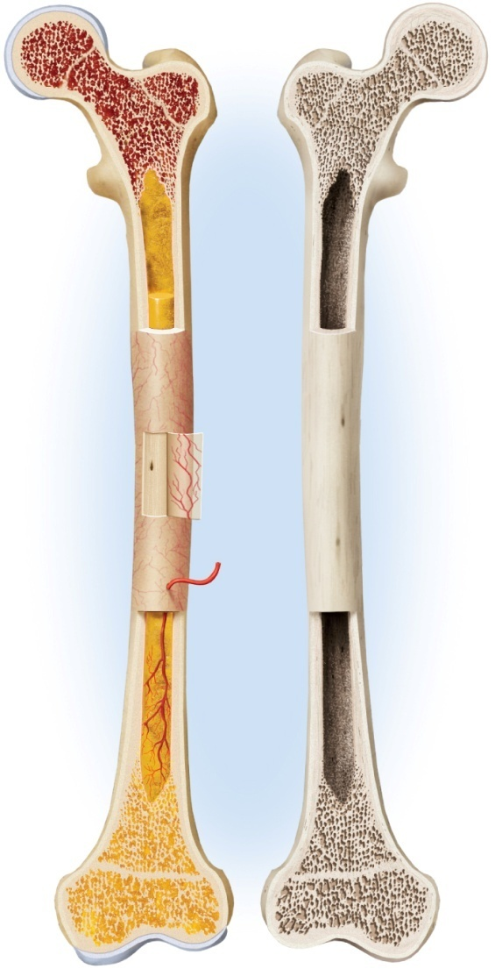
Structure of a Long Bone
Copyright © The McGraw-Hill Companies, Inc. Permission required for reproduction or display.
Articular
cartilage
epiphyses and diaphysis
compact and spongy bone
marrow cavity
articular cartilage
periosteum
Epiphysis
Red bone
marrow
Epiphyseal
line
Marrow cavity
Yellow bone marrow
Periosteum
Nutrient foramen
Diaphysis
Site of endosteum
Compact bone
Spongy bone
Epiphyseal
line
Epiphysis
Articular
cartilage
(a) Living
(b) Dried
Figure 7.2

Slide 9
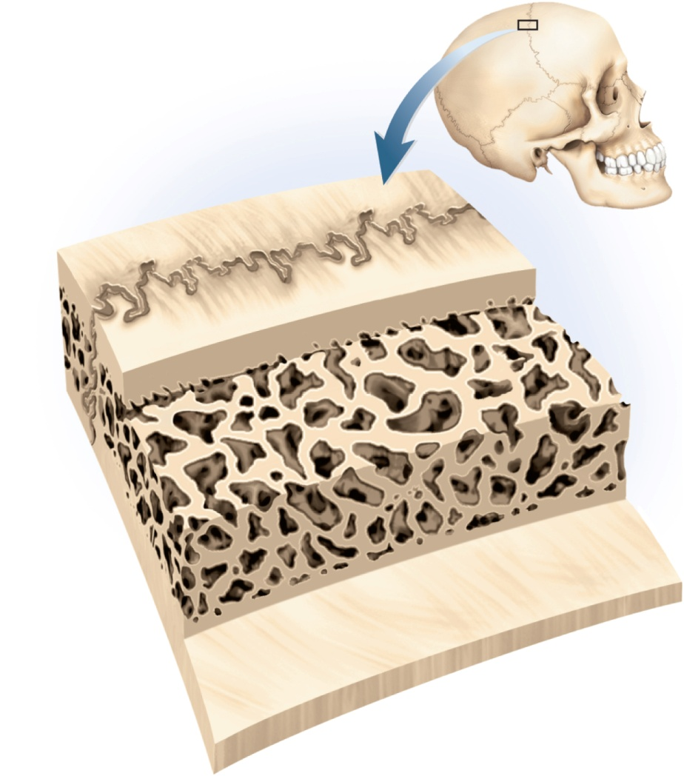
Structure of a Flat Bone
Copyright © The McGraw-Hill Companies, Inc. Permission required for reproduction or display.
sandwich-like construction
two layers of compact bone enclosing a middle layer of spongy bone
both surfaces of flat bone covered with periosteum
diploe – spongy layer in the cranium
absorbs shock
marrow spaces lined with endosteum
Suture
Outer compact
bone
Spongy bone
(diploe)
Trabeculae
Inner compact
bone
Figure 7.3

Slide 10
Histology of Osseous Tissue
Copyright © The McGraw-Hill Companies, Inc. Permission required for reproduction or display.
Osteogenic cell
Osteoblast
Osteocyte
Rough
endoplasmic
reticulum
Secretory
vesicles
Nucleus
Mitochondrion
Figure 7.4a
(a) Osteocyte development
bone is connective tissue that consists of cells, fibers and ground substance
four principal types of bone cells
osteogenic (osteoprogenator) cells
osteoblasts
osteocytes
osteoclasts
osteogenic (osteoprogenator) cells - stem cells found in endosteum, periosteum, and in central canals
arise from embryonic mesenchymal cells
multiply continuously to produce new osteoblasts

Slide 11
Histology of Osseous Tissue
osteoblasts – bone forming cells
line up as single layer of cells under endosteum and periosteum
are nonmitotic
synthesize soft organic matter of matrix which then hardens by mineral deposition
stress and fractures stimulate osteogenic cells to multiply more rapidly and increase number of osteocytes to reinforce or rebuild bone
secrete osteocalcin – thought to be the structural protein of bone
stimulates insulin secretion of pancreas
increases insulin sensitivity in adipocytes which limit the growth of adipose tissue
osteocytes – former osteoblasts that have become trapped in the matrix they have deposited
lacunae – tiny cavities where osteocytes reside
canaliculi – little channels that connect lacunae
cytoplasmic processes reach into canaliculi
some osteocytes reabsorb bone matrix while others deposit it
contribute to homeostatic mechanism of bone density and calcium and phosphate ions
when stressed, produce biochemical signals that regulate bone remodeling

Slide 12
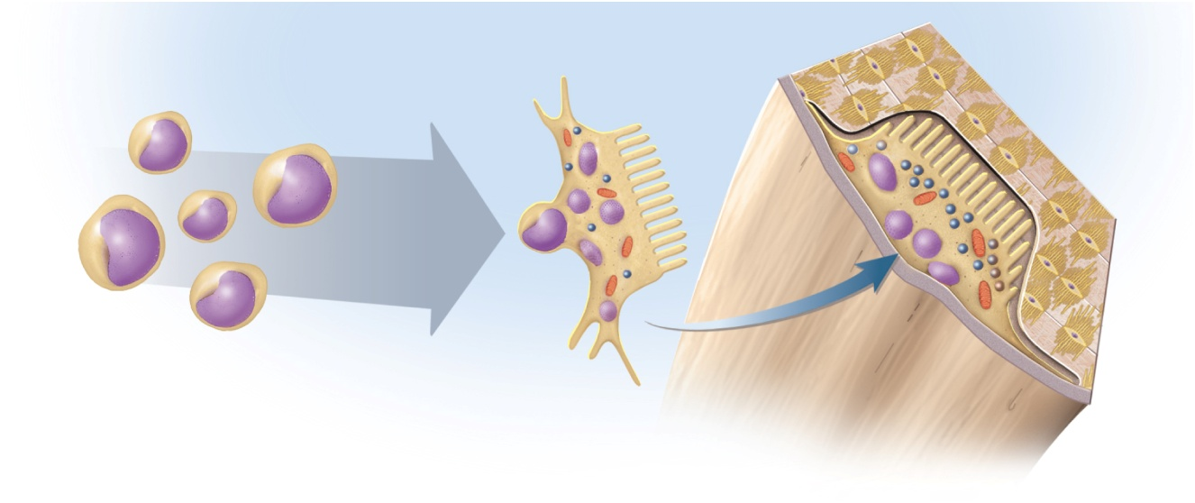
Cells of Osseous Tissue
Copyright © The McGraw-Hill Companies, Inc. Permission required for reproduction or display.
Osteocyte
Osteoclast
Osseous
tissue
Stem cells
Periosteum
Resorption
bay
Nuclei
Fusion
Osteoclast
Lysosomes
Ruffled
border
(b) Osteoclast development
Figure 7.4b
osteoclasts – bone-dissolving cells found on the bone surface
osteoclasts develop from same bone marrow stem cells that give rise to blood cells
different origin from rest of bone cells
unusually large cells formed from the fusion of several stem cells
typically have 3 to 4 nuclei, may have up to 50
ruffled border – side facing bone surface
several deep infoldings of the plasma membrane which increases surface area and resorption efficiency
resorption bays (Howship lacunae) – pits on surface of bone where osteoclasts reside
remodeling – results from combined action of the bone-dissolving osteoclasts and the bone-depositing osteoblasts

Slide 13
The Matrix
matrix of osseous tissue is, by dry weight, about one-third organic and two-thirds inorganic matter
organic matter – synthesized by osteoblasts
collagen, carbohydrate – protein complexes, such as glycosaminoglycans, proteoglycans, and glycoproteins
inorganic matter
85% hydroxyapatite (crystallized calcium phosphate salt)
10% calcium carbonate
other minerals (fluoride, sodium, potassium, magnesium)
bone is a composite – combination of two basic structural materials, a ceramic and a polymer
combines optimal mechanical properties of each component
bone combines the polymer, collagen, with the ceramic, hydroxyapatite and other minerals
ceramic portion allows the bone to support the body weight, and protein portion gives bone some degree of flexibility
rickets – soft bones due to deficiency of calcium salts
osteogenesis imperfecta or brittle bone disease – excessively brittle bones due to lack of protein, collagen

Slide 14
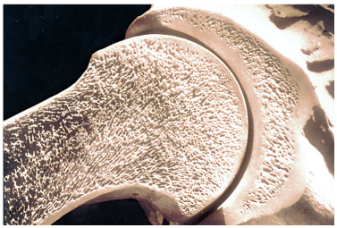
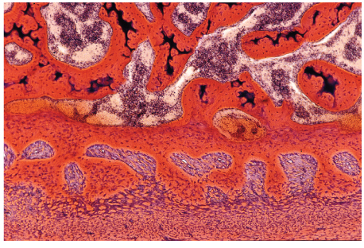
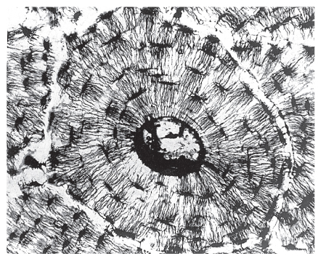
Histology of Compact and Spongy Bone
Copyright © The McGraw-Hill Companies, Inc. Permission required for reproduction or display.
Bone marrow
T
rabecula
Pelvic bone
Head of
femur
Spongy bone
Compact bone
(a)
Figure 7.5a
(c)
Figure 7.5c
Lamella
Lacunae
Canaliculi
Central
canal
Figure 7.5d
(d)
20 μm
a,c: © Dr. Don W. Fawcett/Visuals Unlimited; d: Visuals Unlimited

Slide 15
Compact Bone
osteon (haversian system) – the basic structural unit of compact bone
formed by a central canal and its concentric lamella connected to each other by canaliculi
a cylinder of tissue around a central canal
perforating (Volkmann) canals are transverse or diagonal passages along the length of the osteon
collagen fibers “corkscrew” down the matrix of the lamella giving it a helical arrangement
helices coil in one direction in one lamella and in the opposite direction in the next lamella for added strength
blood flow - skeleton receives about half a liter of blood per minute
nutrient foramina – on the surface of bone tissue that allow blood vessels and nerves to enter the bone
open into the perforating canals that cross the matrix and feed into the central canals
innermost osteocytes near central canal receive nutrients and pass them along through their gap junction to neighboring osteocytes
they also receive wastes from their neighbors and transfer them to the central canal maintaining a two-way flow of nutrients and waste
not all of the matrix is organized into osteons
circumferential lamellae - inner and outer boundaries of dense bone
– run parallel to bone surface
interstitial lamellae – remains of old osteons that broke down as bone grew and remodeled itself

Slide 16
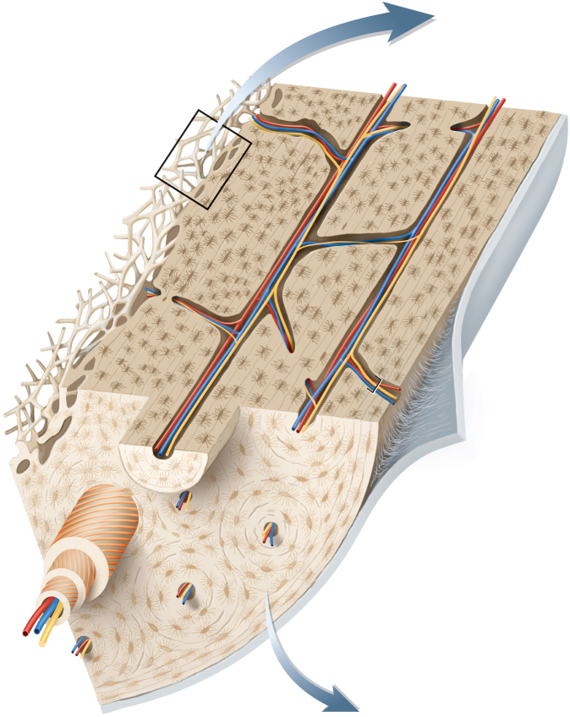
Blood Vessels of Bone
Copyright © The McGraw-Hill Companies, Inc. Permission required for reproduction or display.
nutrient foramina – on bone surface
perforating (Volkmann’s) canals – transverse or diagonal canals
central canals – vertical canals
circumferential lamellae
interstitial lamellae
Nerve
Blood vessel
Spicules
Trabeculae
Spongy bone
Endosteum
Periosteum
Perforating fibers
Perforating canal
Central
canal
Osteon
Lacuna
Collagen
fibers
Concentric
lamellae
Circumferential
lamellae
Figure 7.5b
(b)

Slide 17
Spongy Bone
sponge-like appearance
spongy bone consists of:
slivers of bone called spicules
thin plates of bone called trabeculae
spaces filled with red bone marrow
few osteons and no central canals
all osteocytes close to bone marrow
provides strength with minimal weight
trabeculae develop along bone’s lines of stress

Slide 18
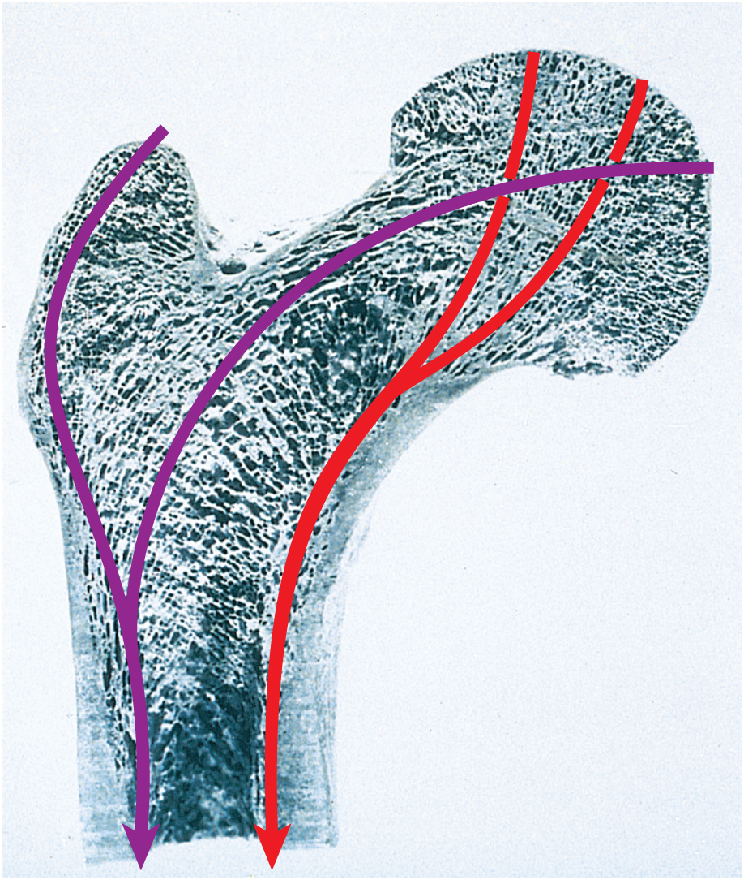
Design of Spongy Bone
Copyright © The McGraw-Hill Companies, Inc. Permission required for reproduction or display.
Greater trochanter
Head
Trabeculae of
spongy bone
Compact bone
Lines of stress
Shaft (diaphysis)
Figure 7.6
© Robert Calentine/Visuals Unlimited

Slide 19
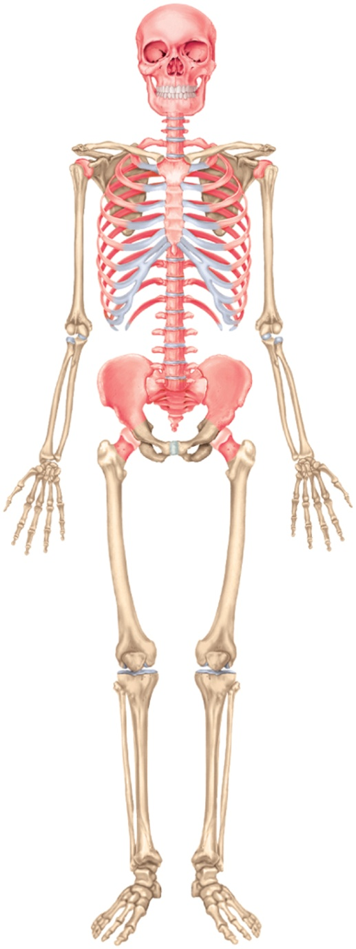
Bone Marrow
bone marrow – general term for soft tissue that occupies the marrow cavity of a long bone and small spaces amid the trabeculae of spongy bone
red marrow (myeloid tissue)
in nearly every bone in a child
hemopoietic tissue - produces blood cells and is composed of multiple tissues in a delicate, but intricate arrangement that is an organ to itself
in adults, found in skull, vertebrae, ribs, sternum, part of pelvic girdle, and proximal heads of humerus and femur
yellow marrow found in adults
most red marrow turns into fatty yellow marrow
no longer produces blood
Copyright © The McGraw-Hill Companies, Inc. Permission required for reproduction or display.
Figure 7.7

Slide 20
Bone Development
ossification or osteogenesis – the formation of bone
in the human fetus and infant, bone develops by two methods:
intramembranous ossification
endochondral ossification

Slide 21
Intramembranous Ossification
intramembranous ossification – produce the flat bones of the skull and most of the clavicle (collar bone)
these bones develop within a fibrous sheet similar to epidermis of the skin (dermal bones)
mesenchyme – embryonic connective tissue condenses into a layer of soft tissue with dense supply of blood capillaries
mesenchymal cells differentiate into osteogenic cells
regions of mesenchyme become a network of soft sheets – trabeculae
osteogenic cells differentiate into osteoblasts
these cells deposit organic matrix – osteoid tissue
as trabeculae grow thicker, calcium phosphate is deposited in the matrix
mesenchyme close to the surface of a trabecula remains uncalcified
becomes denser and more fibrous, forming periosteum
osteoblasts continue to deposit minerals
producing a honeycomb of bony trabeculae
some persist as permanent spongy bone
osteoclasts resorb and remodel others to form a marrow cavity in the middle of bone
trabeculae at the surface continue to calcify until the spaces between them are filled in, converting spongy bone to compact bone
gives rise to the sandwich-like arrangement of mature flat bone

Slide 22
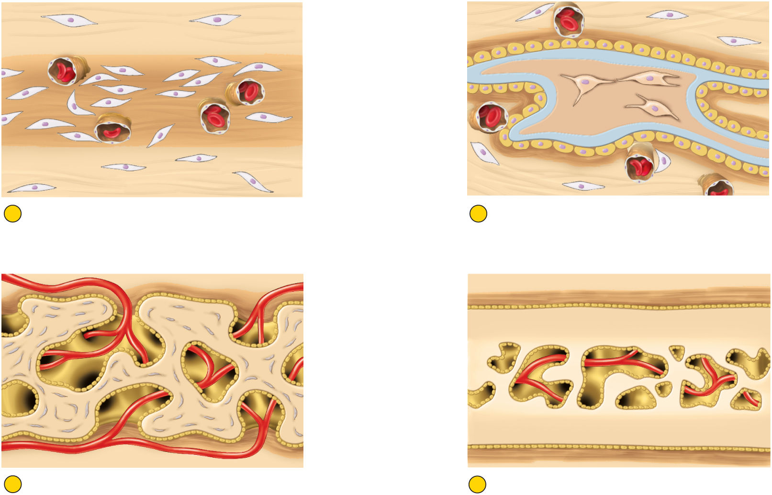
Intramembranous Ossification
Copyright © The McGraw-Hill Companies, Inc. Permission required for reproduction or display.
Mesenchymal cell
Osteocyte
Osteoblasts
Sheet of condensing
mesenchyme
Trabecula
Calcified bone
Blood capillary
Osteoid tissue
Fibrous periosteum
1
Condensation of mesenchyme into soft sheet
permeated with blood capillaries
2
Deposition of osteoid tissue by osteoblasts
on mesenchymal surface; entrapment of first
osteocytes; formation of periosteum
Osteoblasts
Fibrous periosteum
T
rabeculae
Osteoblasts
Osteocytes
Spongy bone
Marrow cavity
Compact bone
3
Honeycomb of bony trabeculae formed by
continued mineral deposition; creation of
spongy bone
4
Surface bone filled in by bone deposition,
converting spongy bone to compact bone.
Persistence of spongy bone in the middle layer.
Figure 7.8
produces flat bones of skull and clavicle

Slide 23
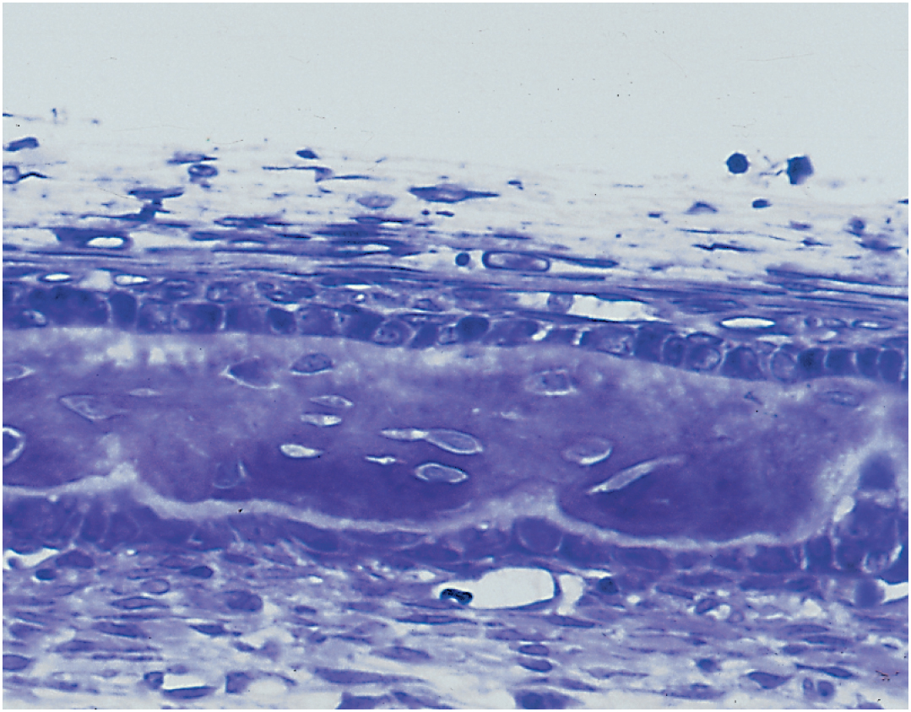
Intramembranous Ossification
Copyright © The McGraw-Hill Companies, Inc. Permission required for reproduction or display.
Periosteum:
Fibrous layer
Osteogenic
layer
Osteoid tissue
Osseous tissue
(bone)
Osteoblasts
Osteocytes
© Ken Saladin
Figure 7.9
note the periosteum and osteoblasts.

Slide 24
Endochondral Ossification
endochondral ossification – process in which bone develops from pre-existing cartilage model
beginning the 6th fetal week and ending in early 20’s
most bones develop by this process
mesenchyme develops into a body of hyaline cartilage in location of future bone
covered with fibrous perichondrium
perichondrium produces chondrocytes initially, and later produces osteoblasts
osteoblasts form a bony collar around middle of cartilage model
former perichondrium is now considered to be periosteum
primary ossification center - chondrocytes in the middle of the model enlarge
matrix between lacunae are reduced to thin walls
walls of this thin matrix ossify and block nutrients from reaching chondrocytes
they die and their lacunae merge into a single cavity in the middle of the model
blood vessels penetrate the bony collar and invade primary ossification center
primary marrow cavity – forms from blood and stem cells filling hollow cavity

Slide 25
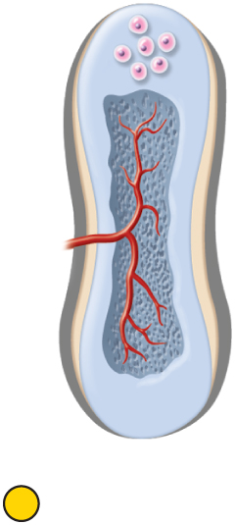
Primary Ossification Center and Primary Marrow Cavity
Copyright © The McGraw-Hill Companies, Inc. Permission required for reproduction or display.
Secondary
ossification
center
Enlarging
chondrocytes
Bony collar
Primary
marrow
cavity
Primary
ossification
center
Periosteum
2
Formation of
primary
ossification center,
bony collar, and
periosteum
3
Vascular invasion,
formation of primary
marrow cavity, and
appearance of
secondary
ossification center
Figure 7.10 (2-3)

Slide 26
Endochondral Ossification
blood vessels penetrate the bony collar and invade primary ossification center
primary marrow cavity – forms from blood and stem cells filling hollow cavity
stem cells give rise to osteoblasts and osteoclasts
osteoblasts line cavity and deposit osteoid tissue and calcify it
forming temporary network of trabeculae
wave of cartilage death progresses toward the ends
osteoclasts follow the wave dissolving the cartilage remnants enlarging the marrow cavity
metaphysis – region of transition from cartilage to bone at each end of primary marrow cavity
secondary ossification center – created by chondrocyte enlargement and death in the epiphyses
become hollowed out by the same process generating a secondary marrow cavity in epiphyses
cavity expands outward from the center in all directions

Slide 27
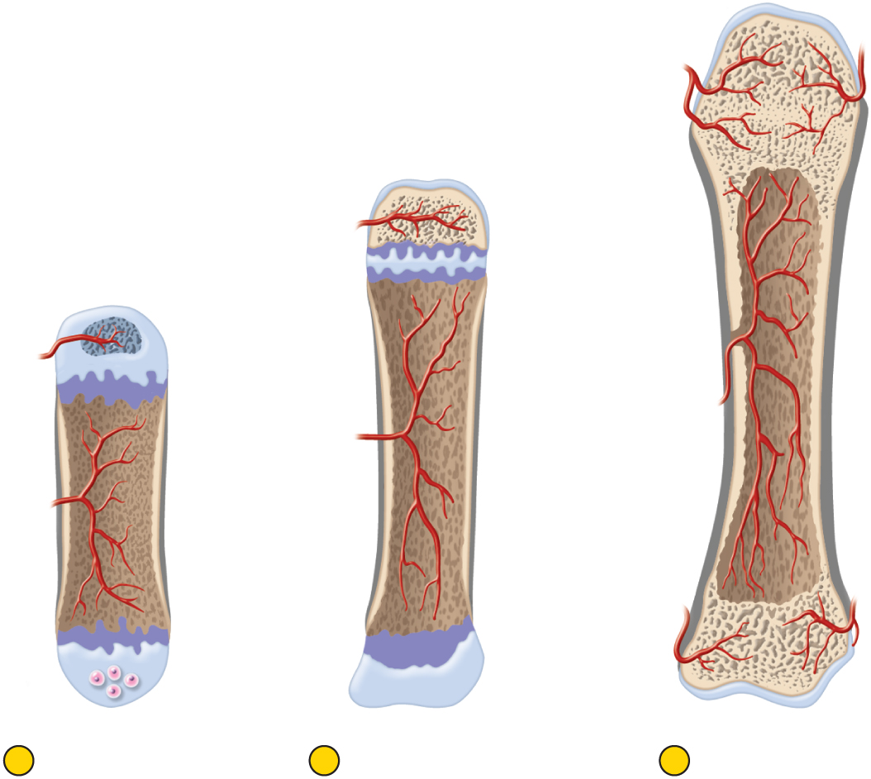
Secondary Ossification Centers and Secondary Marrow Cavities
Copyright © The McGraw-Hill Companies, Inc. Permission required for reproduction or display.
Articular
cartilage
Spongy bone
Epiphyseal
line
Secondary
marrow cavity
Epiphyseal
plate
Periosteum
Epiphysis
Nutrient
foramen
Marrow cavity
Metaphysis
Compact bone
Blood
vessel
Diaphysis
Secondary
ossification
center
Metaphysis
Cartilage
4
Bone at birth, with
enlarged primary
marrow cavity and
appearance of
secondary marrow
cavity in one epiphysis
5
Bone of child, with
epiphyseal plate at
distal end
6
Adult bone with a
single marrow
cavity and closed
epiphyseal plate
Figure 7.10 (4-6)

Slide 28
Endochondral Ossification
during infancy and childhood, the epiphyses fill with spongy bone
cartilage limited to the articular cartilage covering each joint surface, and to the epiphyseal plate
a thin wall of cartilage separating the primary and secondary marrow cavities
epiphyseal plate persists through childhood and adolescence
serves as a growth zone for bone elongation
by late teens to early twenties, all remaining cartilage in the epiphyseal plate is generally consumed
gap between epiphyses and diaphysis closes
primary and secondary marrow cavities unite into a single cavity
bone can no longer grow in length

Slide 29
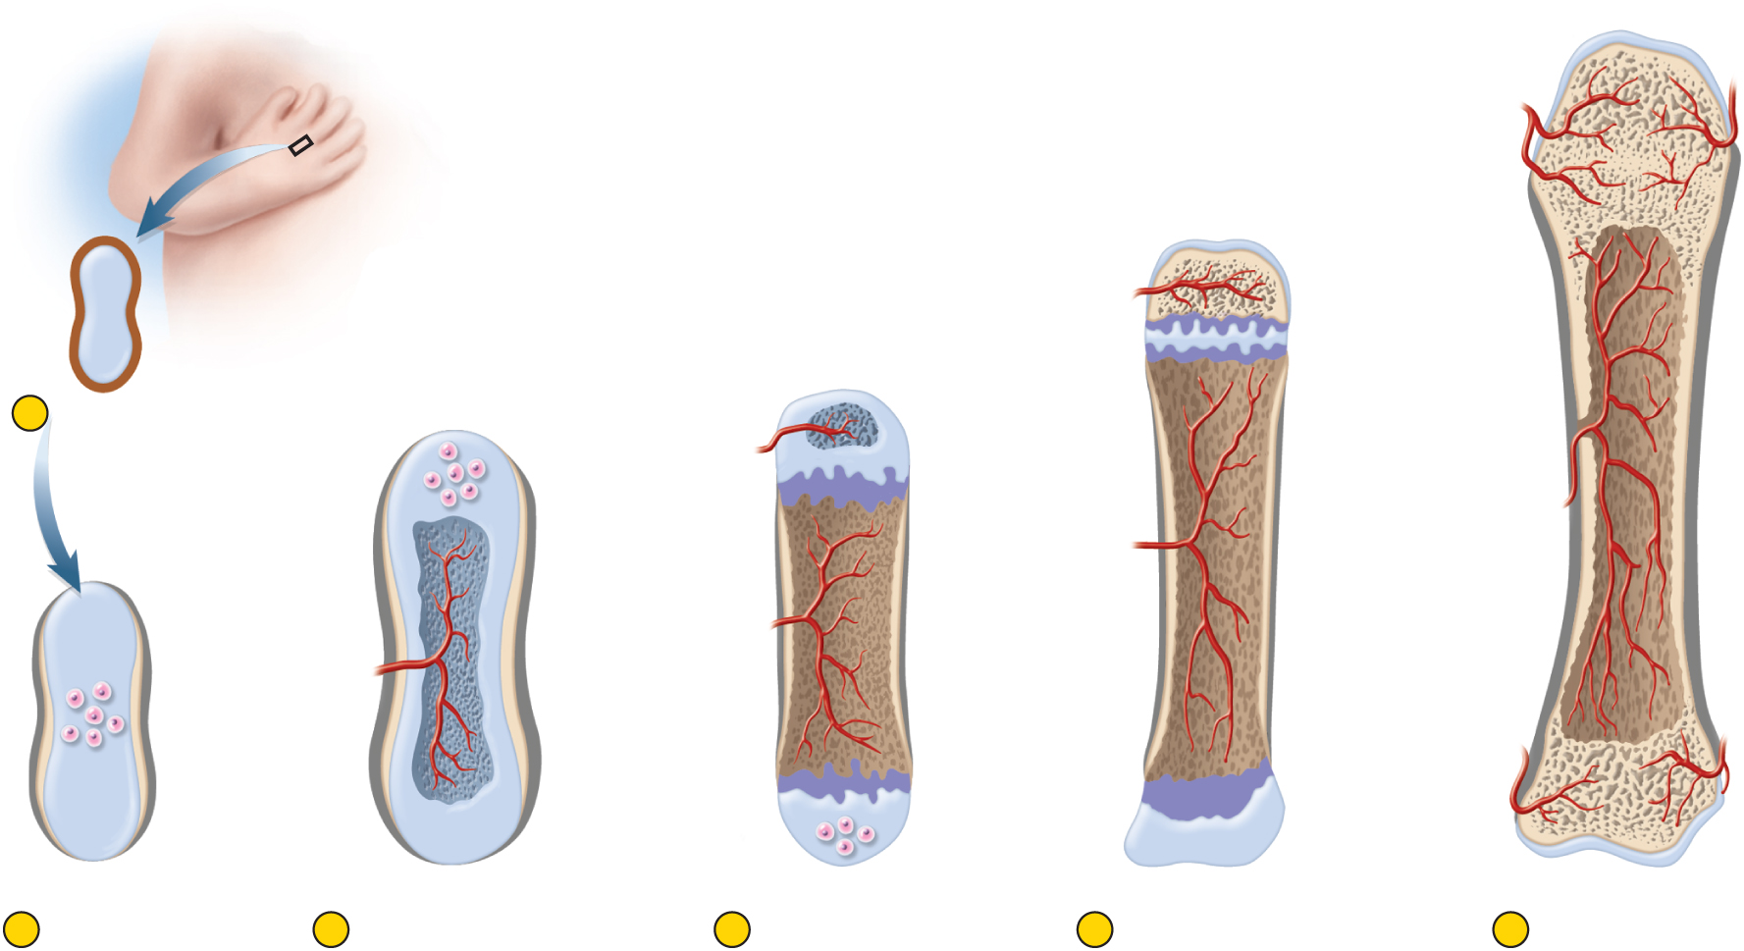
Stages of Endochondral Ossification
Copyright © The McGraw-Hill Companies, Inc. Permission required for reproduction or display.
Articular
cartilage
Spongy bone
Epiphyseal
line
Perichondrium
Hyaline
cartilage
Secondary
marrow cavity
Epiphyseal
plate
Periosteum
1
Early cartilage model
Epiphysis
Nutrient
foramen
Secondary
ossification
center
Marrow cavity
Metaphysis
Compact bone
Enlarging
chondrocytes
Blood
vessel
Bony collar
Diaphysis
Primary
marrow
cavity
Primary
ossification
center
Secondary
ossification
center
Metaphysis
Periosteum
Cartilage
2
Formation of
primary
ossification center,
bony collar, and
periosteum
3
Vascular invasion,
formation of primary
marrow cavity, and
appearance of
secondary
ossification center
4
Bone at birth, with
enlarged primary
marrow cavity and
appearance of
secondary marrow
cavity in one epiphysis
5
Bone of child, with
epiphyseal plate at
distal end
6
Adult bone with a
single marrow
cavity and closed
epiphyseal plate
Figure 7.10

Slide 30
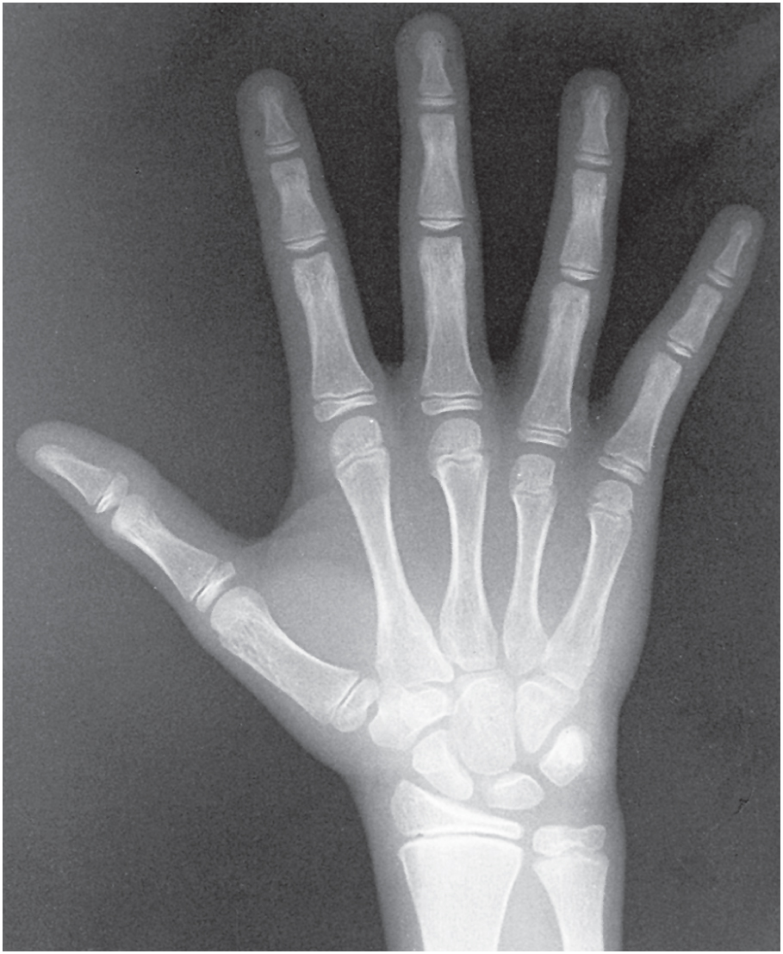
Cartilaginous Epiphyseal Plates
Copyright © The McGraw-Hill Companies, Inc. Permission required for reproduction or display.
Diaphysis
Epiphysis
Epiphyseal
plate
Metacarpal
bone
Epiphyseal
plates
Figure 7.12
Courtesy of Utah Valley Regional Medical Center, Department of Radiology

Slide 31
Bone Growth and Remodeling
ossification continues throughout life with the growth and remodeling of bones
bones grow in two directions: length and width
bone elongation
epiphyseal plate – a region of transition from cartilage to bone
functions as growth zone where the bones elongate
consists of typical hyaline cartilage in the middle
with a transition zone on each side where cartilage is being replaced by bone
metaphysis is the zone of transition facing the marrow cavity

Slide 32
Histology of Metaphysis
zone of reserve cartilage
typical hyaline cartilage farthest from marrow cavity
shows no sign of transforming into bone
zone of proliferation
chondrocytes multiply forming columns of flat lacunae
zone of hypertrophy
chondrocyte enlargement
matrix between lacunae become very thin
zone of calcification
mineral deposited in the matrix between columns of lacunae
temporary support for cartilage
zone of bone deposition
chondrocytes die, longitudinal columns fill with osteoblasts and blood vessels, osteoclasts dissolve the calcified cartilage
osteons and spongy bone are created by osteoblasts

Slide 33
Zones of the Metaphysis

Slide 34
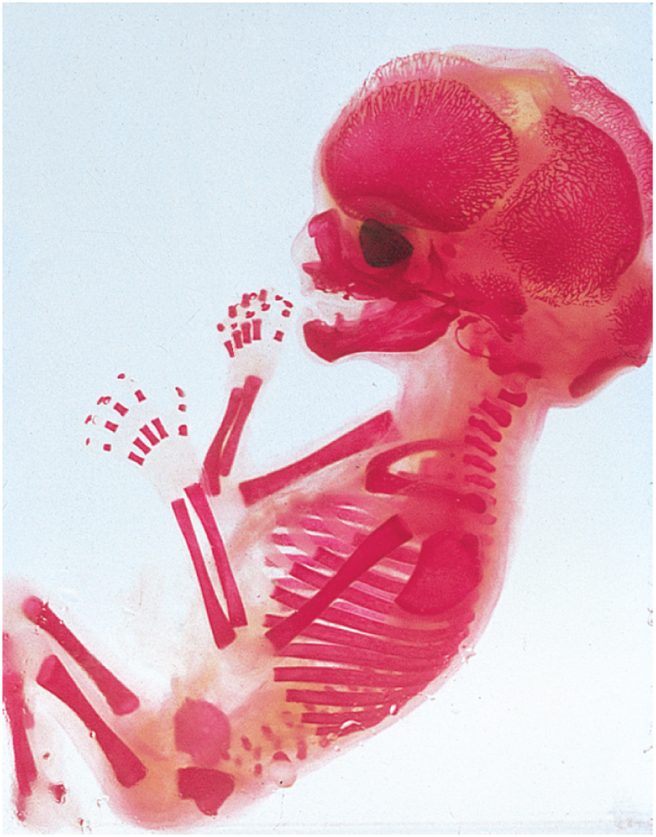
Fetal Skeleton at 12 Weeks
Copyright © The McGraw-Hill Companies, Inc. Permission required for reproduction or display.
Cranial
bones
Mandible
Humerus
Vertebrae
Radius
Ulna
Scapula
Ribs
Femur
Pelvis
Figure 7.11
© Biophoto Associates/Photo Researchers, Inc.

Slide 35
Bone Growth and Remodeling
interstitial growth - bones increase in length
bone elongation is really a result of cartilage growth within epiphyseal plate
epiphyses close when cartilage is gone – epiphyseal line
length-wise growth is finished
occurs at different ages in different bones
appositional growth - bones increase in width throughout life
the deposition of new bone at the surface
osteoblasts on deep side of periosteum deposit osteoid tissue
Become trapped as tissue calcifies
lay down matrix in layers parallel to surface
forms circumferential lamellae over surface
osteoclasts of endosteum enlarge marrow cavity
bone remodeling occurs throughout life - 10% per year
repairs microfractures, releases minerals into blood, reshapes bones in response to use and disuse
Wolff’s law of bone - architecture of bone determined by mechanical stresses placed on it and bones adapt to withstand those stresses
remodeling is a collaborative and precise action of osteoblasts and osteoclasts
bony processes grow larger in response to mechanical stress

Slide 36
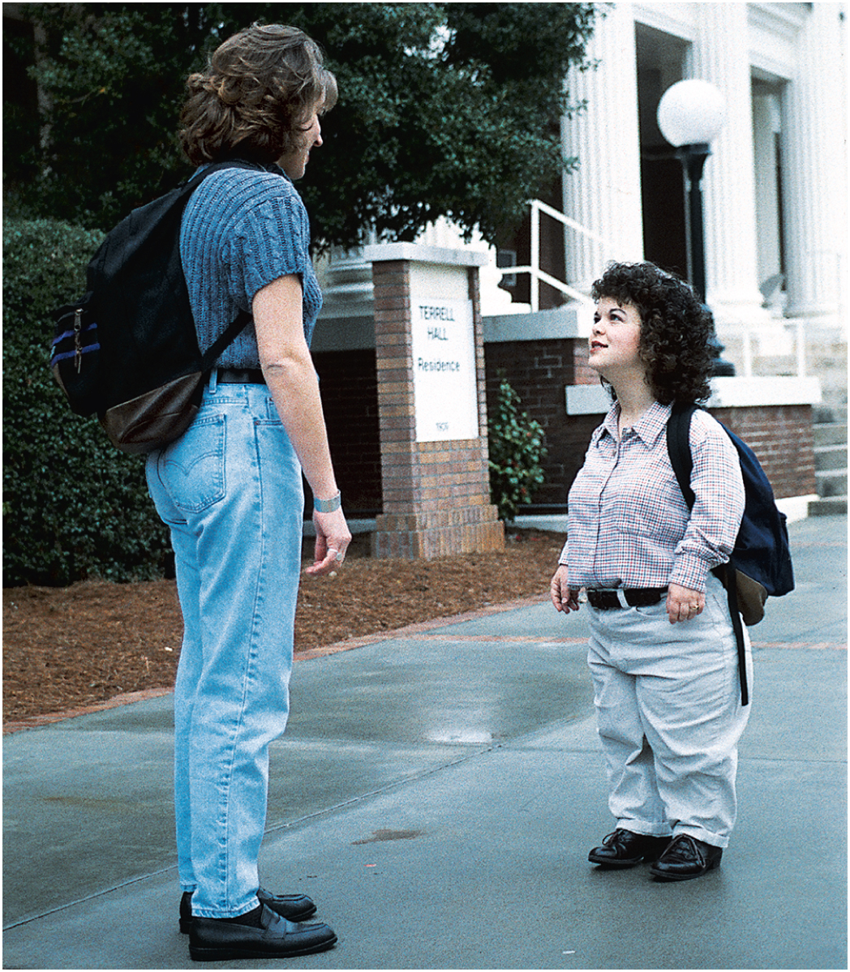
Dwarfism
Copyright © The McGraw-Hill Companies, Inc. Permission required for reproduction or display.
achondroplastic dwarfism
long bones stop growing in childhood
normal torso, short limbs
failure of cartilage growth in metaphysis
spontaneous mutation produces mutant dominant allele
pituitary dwarfism
lack of growth hormone
normal proportions with short stature
© The McGraw-Hill Companies, Inc./Joe DeGrandis, photographer
Figure 7.14

Slide 37
Physiology of Osseous Tissue
a mature bone remains a metabolically active organ
involved in its own maintenance of growth and remodeling
exerts a profound influence over the rest of the body by exchanging minerals with tissue fluid
disturbance of calcium homeostasis in skeleton disrupts function of other organ systems
especially nervous and muscular

Slide 38
Mineral Deposition
mineral deposition (mineralization) - a crystallization process in which calcium phosphate, and other ions are taken from the blood plasma and deposited in bone tissue
osteoblasts produce collagen fibers that spiral the length of the osteon
fibers become encrusted with minerals that harden the matrix
calcium and phosphate (hydroxyapatite) from blood plasma are deposited along the fibers
the calcium and phosphate ion concentration must reach a critical value called the solubility product for crystal formation to occur
most tissues have inhibitors to prevent this so they do not become calcified
osteoblasts neutralize these inhibitors and allow salts to precipitate in the bone matrix
first few crystals (seed crystals) attract more calcium and phosphate from solution
abnormal calcification (ectopic ossification)
may occur in lungs, brain, eyes, muscles, tendons or arteries (arteriosclerosis)
calculus – calcified mass in an otherwise soft organ such as the lung

Slide 39
Mineral Resorption
mineral resorption – the process of dissolving bone and releasing minerals into the blood
performed by osteoclasts at the “ruffled border”
hydrogen pumps in membrane secrete hydrogen into space between the osteoclast and bone surface
chloride ions follow by electrical attraction
hydrochloric acid (pH 4) dissolves bone minerals
acid phosphatase enzyme digests the collagen
orthodontic appliances (braces) reposition teeth
tooth moves because osteoclasts dissolve bone ahead of the tooth, where the pressure on the bone is the greatest
osteoblasts deposit bone more slowly in the low-pressure zone behind the tooth

Slide 40
Calcium Homeostasis
calcium and phosphate are used for much more than bone structure
phosphate is a component of DNA, RNA, ATP, phospholipids, and pH buffers
calcium needed in neuron communication, muscle contraction, blood clotting, and exocytosis
minerals are deposited in the skeleton and withdrawn when they are needed for other purposes
about 1100g of calcium in adult body
99% in the skeleton
as easily exchangeable calcium ions and more stable hydroxyapatite reserve
18% of adult skeleton exchanged with blood each year
normal calcium concentration in blood plasma is normally 9.2 to 10.4 mg/dl – 45% as Ca²⁺ can diffuse across capillary walls and affect other tissues – rest in reserve, bound to plasma proteins
hypocalcemia - blood calcium deficiency
causes excess excitability of muscle, tremors, spasms or tetany (inability to relax)
Na⁺ enters cells too easily and excites nerves and muscles
hypercalcemia - blood calcium excess
sodium channels less responsive and nerve and muscle less excitable than normal (sluggish reflexes, depression)

Slide 41
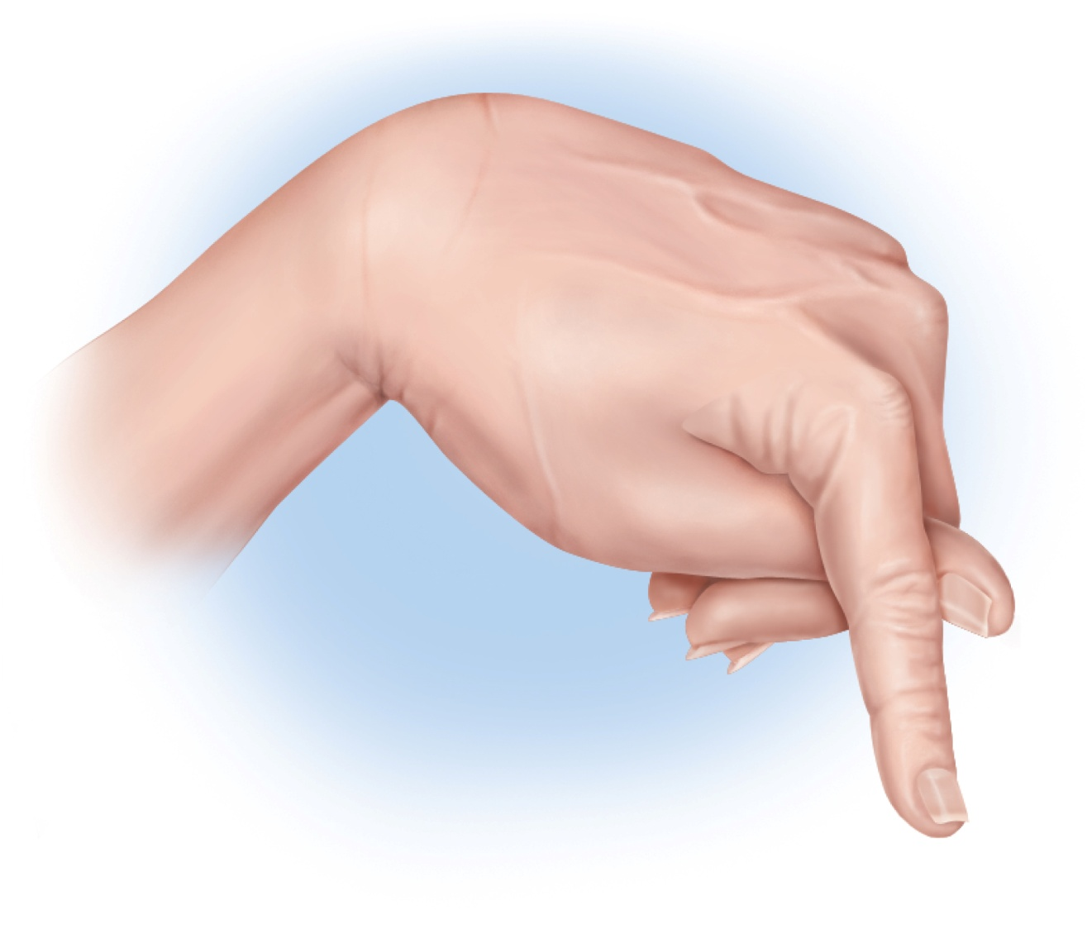
Carpopedal Spasm
Copyright © The McGraw-Hill Companies, Inc. Permission required for reproduction or display.
Figure 7.15
hypocalcemia demonstrated by muscle spasm of hands and feet

Slide 42
Ion Imbalances
hypercalcemia is rare
hypocalcemia has a wide variety of causes
vitamin D deficiency
diarrhea
thyroid tumors
underactive parathyroids
pregnancy and lactation
accidental removal of parathyroid glands during thyroid surgery
calcium homeostasis depends on a balance between dietary intake, urinary and fecal loses, and exchanges between osseous tissue
calcium homeostasis is regulated by three hormones:
calcitriol, calcitonin, and parathyroid hormone

Slide 43
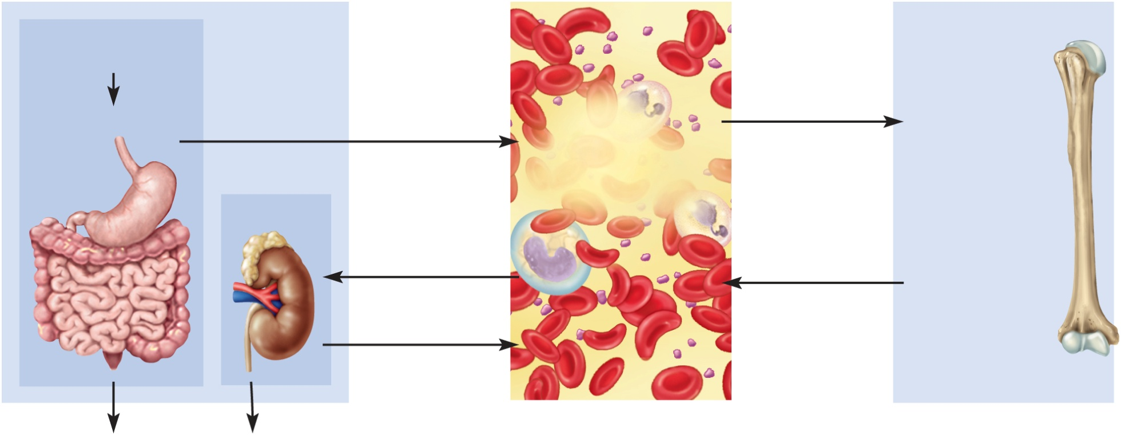
Hormonal Control of Calcium
Copyright © The McGraw-Hill Companies, Inc. Permission required for reproduction or display.
Calcium Intake and Excretion
Blood
Bone
Dietary requirement
1,000 mg/day
Deposition by
osteoblasts
Digestive tract
Absorption by
digestive tract
Calcitonin
(weak effect)
Calcitriol
Ca²⁺
(9.2–10.4 mg/dL)
Hydroxyapatite
Ca₁₀(PO₄)₆(OH)₂
Kidneys
Calcium carbonate
CaCO₃
Filtration
by kidneys
Resorption by
osteoclasts
Calcitriol
PTH
Reabsorption
by kidneys
Calcitriol
(weak effect)
PTH
Fecal loss
350 mg/day
Urinary loss
650 mg/day
Figure 7.17
calcitriol, calcitonin, and PTH maintain normal blood calcium concentration

Slide 44
Calcitriol (Activated Vitamin D)
calcitriol – a form of vitamin D produced by the sequential action of the skin, liver, and kidneys
produced by the following process:
epidermal keratinocytes use UV radiation to convert a steroid, 7-dehydrocholesterol to previtamin D₃
liver adds a hydroxyl group converting it to calcidiol
kidneys adds another hydroxyl group, converting that to calcitriol
(most active form of vitamin D) – also from fortified milk
calcitriol behaves as a hormone that raises blood calcium concentration
increases calcium absorption by small intestine
increases calcium resorption from the skeleton
increases stem cell differentiation into osteoclasts which liberates calcium and phosphate from bone
promotes kidney reabsorption of calcium ions, so less lost in urine
necessary for bone deposition – need adequate calcium and phosphate
abnormal softness of bones (rickets) in children and (osteomalacia) in adults without adequate vitamin D

Slide 45
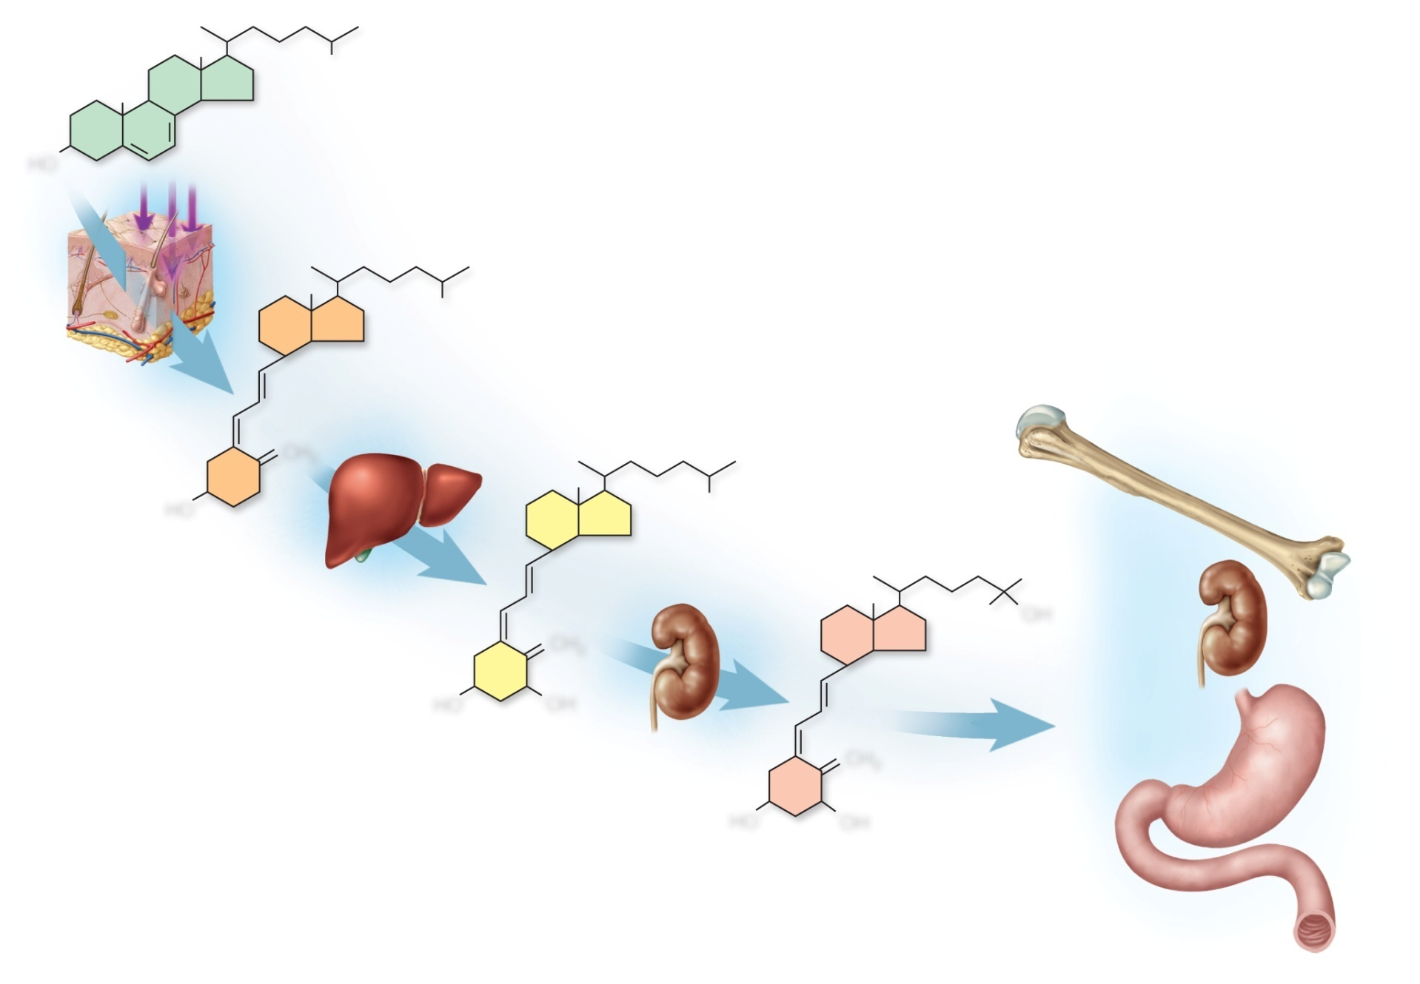
Calcitriol Synthesis and Action
Copyright © The McGraw-Hill Companies, Inc. Permission required for reproduction or display.
7-dehydrocholesterol
HO
Ultraviolet
light
Vitamin D₃
(cholecalciferol)
CH₂
HO
Bone
resorption
Calcidiol
OH
Reduced
excretion
of Ca²⁺
CH₂
HO
OH
Calcitriol
Absorption
of Ca²⁺ and
phosphate
CH₂
HO
OH
Figure 7.16
7-45

Slide 46
Calcitonin
calcitonin - secreted by C cells (clear cells) of the thyroid gland when calcium concentration rises too high
lowers blood calcium concentration in two ways:
osteoclast inhibition
reduces osteoclast activity as much as 70%
less calcium liberated from bones
osteoblast stimulation
increases the number and activity of osteoblasts
deposits calcium into the skeleton
important in children, weak effect in adults
osteoclasts more active in children due to faster remodeling
deficiency does not cause disease in adults
reduces bone loss in women during pregnancy & lactation

Slide 47
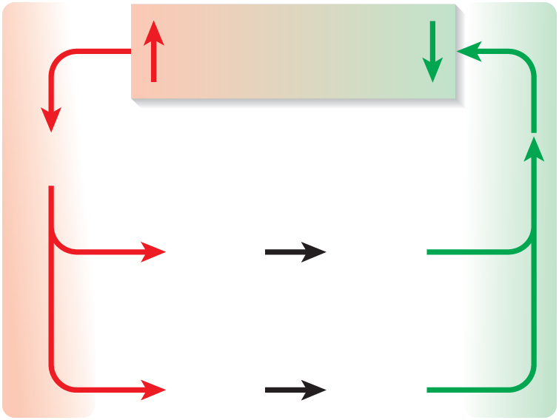
Correction for Hypercalcemia
Copyright © The McGraw-Hill Companies, Inc. Permission required for reproduction or display.
Blood Ca²⁺
excess
Blood Ca²⁺
returns to
normal
Calcitonin
secretion
Reduced
osteoclast
activity
Less bone
resorption
Increased
osteoblast
activity
More bone
deposition
Figure 7.18a
(a) Correction for hypercalcemia

Slide 48
Parathyroid Hormone
parathyroid hormone (PTH) – secreted by the parathyroid glands which adhere to the posterior surface of thyroid gland
PTH released with low calcium blood levels
PTH raises calcium blood level by four mechanisms
binds to receptors on osteoblasts
stimulating them to secrete RANKL which raises the osteoclast population
promotes calcium reabsorption by the kidneys, less lost in urine
promotes the final step of calcitriol synthesis in the kidneys, enhancing calcium raising effect of calcitriol
inhibits collagen synthesis by osteoblasts, inhibiting bone deposition
sporadic injection or secretion of low levels of PTH causes bone deposition, and can increase bone mass

Slide 49
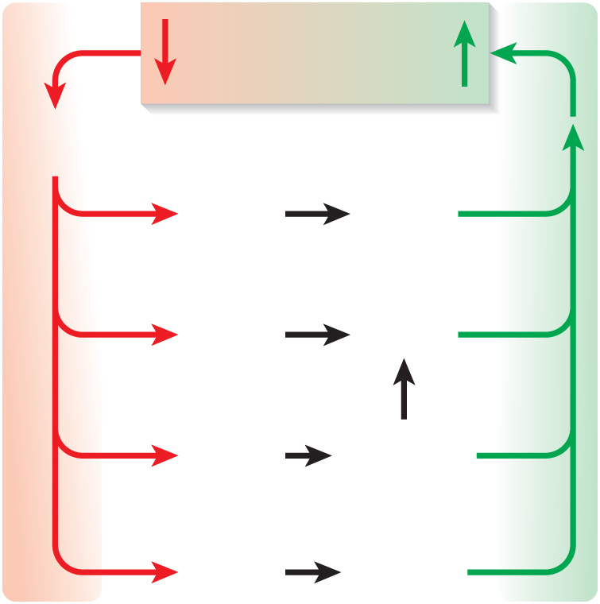
Correction for Hypocalcemia
Copyright © The McGraw-Hill Companies, Inc. Permission required for reproduction or display.
Blood Ca²⁺
deficiency
Blood Ca²⁺
returns to
normal
Parathyroid
hormone
secretion
Increased
osteoclast
activity
More bone
resorption
Reduced
osteoblast
activity
Less bone
deposition
More urinary
phosphate
excretion
Prevention of
hydroxyapatite
formation
Figure 7.18b
Less urinary
calcium
excretion
Conservation
of calcium
(b) Correction for hypocalcemia

Slide 50
Phosphate Homeostasis
average adult has 500 – 800 g of phosphorus
85-90% of phosphate is in the bones
normal plasma concentration is 3.5 – 4.0 mg/dl
occurs in two principal forms:
HPO₄²⁻ and H₂PO₄⁻ (monohydrogen & dihydrogen phosphate ions)
phosphate levels are not regulated as tightly as calcium levels
no immediate functional disorders
calcitriol promotes its absorption by small intestine & promotes bone deposition
PTH lowers blood phosphate level by promoting its urinary excretion

Slide 51
Other Factors Affecting Bone
at least 20 or more hormones, vitamins, and growth factors affect osseous tissue
bone growth especially rapid in puberty & adolescence
surges of growth hormone, estrogen, and testosterone occur and promote ossification
these hormones stimulate multiplication of osteogenic cells, matrix deposition by osteoblasts, and chondrocyte multiplication and hypertrophy in metaphyses
girls grow faster than boys and reach full height earlier
estrogen stronger effect than testosterone on bone growth
males grow for a longer time and taller
anabolic steroids cause growth to stop
epiphyseal plate “closes” prematurely
results in abnormally short adult stature

Slide 52
Fractures and Their Repair
stress fracture – break caused by abnormal trauma to a bone
falls, athletics, and military combat
pathological fracture – break in a bone weakened by some other disease
bone cancer or osteoporosis
usually caused by stress that would not break a healthy bone
fractures classified by structural characteristics
direction of fracture line
break in the skin
multiple pieces

Slide 53
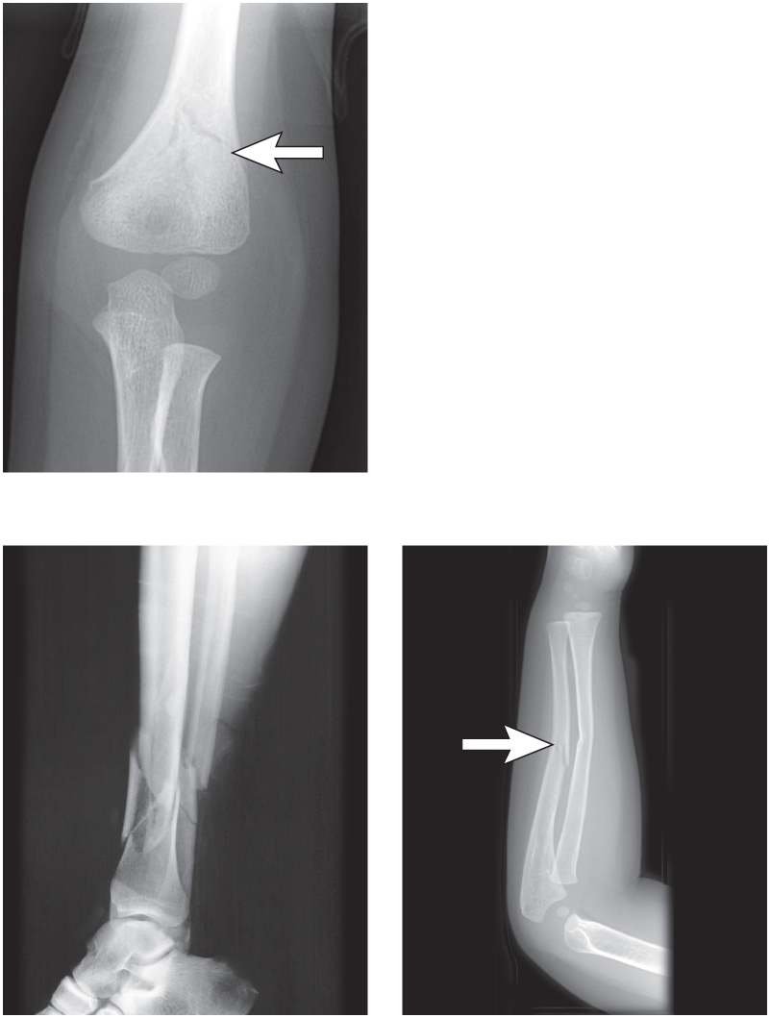
Types of Bone Fractures
Copyright © The McGraw-Hill Companies, Inc. Permission required for reproduction or display.
(a) Nondisplaced
Figure 7.19
(c) Comminuted
(d) Greenstick
a: Custom Medical Stock Photo, Inc.; c: © Lester V. Bergman/Corbis; d: Custom Medical Stock Photo, Inc.

Slide 54
Healing of Fractures
uncomplicated fractures normally 8 - 12 weeks
longer in elderly
stages of healing bone fractures
fracture hematoma and granulation tissue
bleeding of a broken bone forms a clot – fracture hematoma
blood capillaries, fibroblasts, macrophages, osteoclasts, and osteogenic cells invade clot
granulation tissue – soft fibrous mass produced by capillary and cellular invasion after about 48 hours after injury
soft callus formation
formed by fibroblasts and chondroblasts depositing collagen and fibrocartilage into granulation tissue
conversion to hard callus
osteoblasts produce a bony collar in 6 weeks called a hard callus
hard callus is cemented to dead bone around the injury site and acts as a temporary splint to join broken ends together
4 - 6 weeks for hard callus to form and immobilization is necessary
remodeling
hard callus persists for 3 – 4 months
osteoclasts dissolve fragments of broken bone
osteoblasts deposit spongy bone to bridge to gap between the broken ends, transformed gradually into compact bone that is thicker in fracture area

Slide 55
Healing of Fractures
Copyright © The McGraw-Hill Companies, Inc. Permission required for reproduction or display.
Marrow
cavity
Fibrocartilage
Hard
callus
Hematoma
Soft callus
Spongy
bone
New blood
vessels
Compact bone
1
Hematoma formation
The hematoma is converted
to granulation tissue by invasion
of cells and blood capillaries.
2
Soft callus formation
Deposition of collagen and
fibrocartilage converts granulation
tissue to a soft callus.
3
Hard callus formation
Osteoblasts deposit a temporary
bony collar around the fracture to
unite the broken pieces while
ossification occurs.
4
Bone remodeling
Small bone fragments are
removed by osteoclasts, while
osteoblasts deposit spongy
bone and then convert it to
compact bone.
Figure 7.20

Slide 56
Treatment of Fractures
closed reduction – procedure in which the bone fragments are manipulated into their normal positions without surgery
open reduction – involves surgical exposure of the bone and the use of plates, screws, or pins to realign the fragments
cast – normally used to stabilize and immobilize healing bone
traction used to treat fractures of the femur in children
aligns bone fragments by overriding force of the strong thigh muscles
risks long-term confinement to bed
rarely used for the elderly
hip fractures are usually pinned in elderly and early ambulation (walking) is encouraged to promote blood circulation and healing
electrical stimulation accelerates repair
suppresses the effects of parathyroid hormone
orthopedics – the branch of medicine that deals with prevention and correction of injuries and disorders of the bones, joints, and muscles

Slide 57
Fractures and Their Repairs
Copyright © The McGraw-Hill Companies, Inc. Permission required for reproduction or display.

Slide 58
Osteoporosis
osteoporosis – the most common bone disease
severe loss of bone density
bones lose mass and become brittle due to loss of organic matrix and minerals
affects spongy bone the most since it is the most metabolically active
subject to pathological fractures of hip, wrist and vertebral column
kyphosis (widow’s hump) – deformity of spine due to vertebral bone loss
complications of loss of mobility are pneumonia and thrombosis
postmenopausal white women at greatest risk
begin to lose bone mass as early as 35 yoa
by age 70, average loss is 30% of bone mass
risk factors - race, age, gender, smoking, diabetes mellitus, diets poor in calcium, protein, vitamins C and D

Slide 59
Osteoporosis
estrogen maintains density in both sexes inhibits resorption by osteoclasts
testes and adrenals produce estrogen in men
in women, rapid bone loss after menopause since estrogen blood level drops below 30 ng/mL
osteoporosis is common in young female athletes with low body fat causing them to stop ovulating and ovarian estrogen secretion is low
treatments
estrogen replacement therapy (ERT) slows bone resorption, but increases risk of breast cancer, stroke and heart disease
drugs Fosamax/Actonel destroys osteoclasts
PTH slows bone loss if given as daily injection
Forteo (PTH derivative) increases density by 10% in 1 year
may promote bone cancer so use is limited to 2 years
best treatment is prevention - exercise and calcium intake (1000 mg/day) between ages 25 and 40

Slide 60
Spinal Osteoporosis

