Slide 1
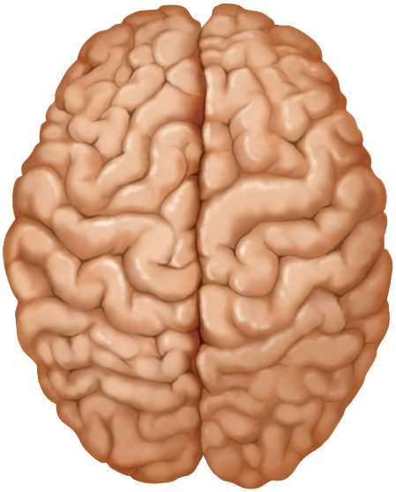
Central Nervous System
overview of the brain
meninges, ventricles, cerebrospinal fluid and blood supply
hindbrain and midbrain
forebrain
integrative functions
the cranial nerves
Copyright © The McGraw-Hill Companies, Inc. Permission required for reproduction or display.
Cerebral
hemispheres
Frontal lobe
Central sulcus
Parietal lobe
Occipital lobe
Longitudinal fissure
(a) Superior view

Slide 2
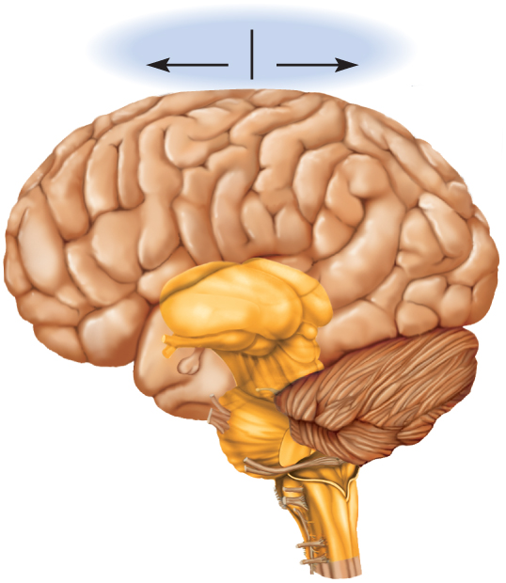
Directional Terms and Landmarks
rostral - toward the forehead
caudal - toward the spinal cord
brain weighs about 1600 g (3.5 lb) in men, and 1450 g in women
three major portions of the brain - cerebrum, cerebellum, brainstem
cerebrum is 83% of brain volume; cerebral hemispheres, gyri and sulci, longitudinal fissure, corpus callosum
cerebellum contains 50% of the neurons; second largest brain region, located in posterior cranial fossa
brainstem the portion of the brain that remains if the cerebrum and cerebellum are removed; diencephalon, midbrain, pons, and medulla oblongata
Copyright © The McGraw-Hill Companies, Inc. Permission required for reproduction or display.
Rostral
Caudal
Central sulcus
Gyri
Cerebrum
Lateral sulcus
Temporal lobe
Cerebellum
Brainstem
Spinal cord
(b) Lateral view

Slide 3
Cerebrum
Copyright © The McGraw-Hill Companies, Inc. Permission required for reproduction or display.
longitudinal fissure – deep groove that separates cerebral hemispheres
gyri - thick folds
sulci - shallow grooves
corpus callosum – thick nerve bundle at bottom of longitudinal fissure that connects hemispheres
Cerebral
hemispheres
Frontal lobe
Central sulcus
Parietal lobe
Occipital lobe
Longitudinal fissure
(a) Superior view

Slide 4
Cerebellum
occupies posterior cranial fossa
marked by gyri, sulci, and fissures
about 10% of brain volume
contains over 50% of brain neurons

Slide 5
Brainstem
brainstem – what remains of the brain if the cerebrum and cerebellum are removed
major components
diencephalon
midbrain
pons
medulla oblongata

Slide 6
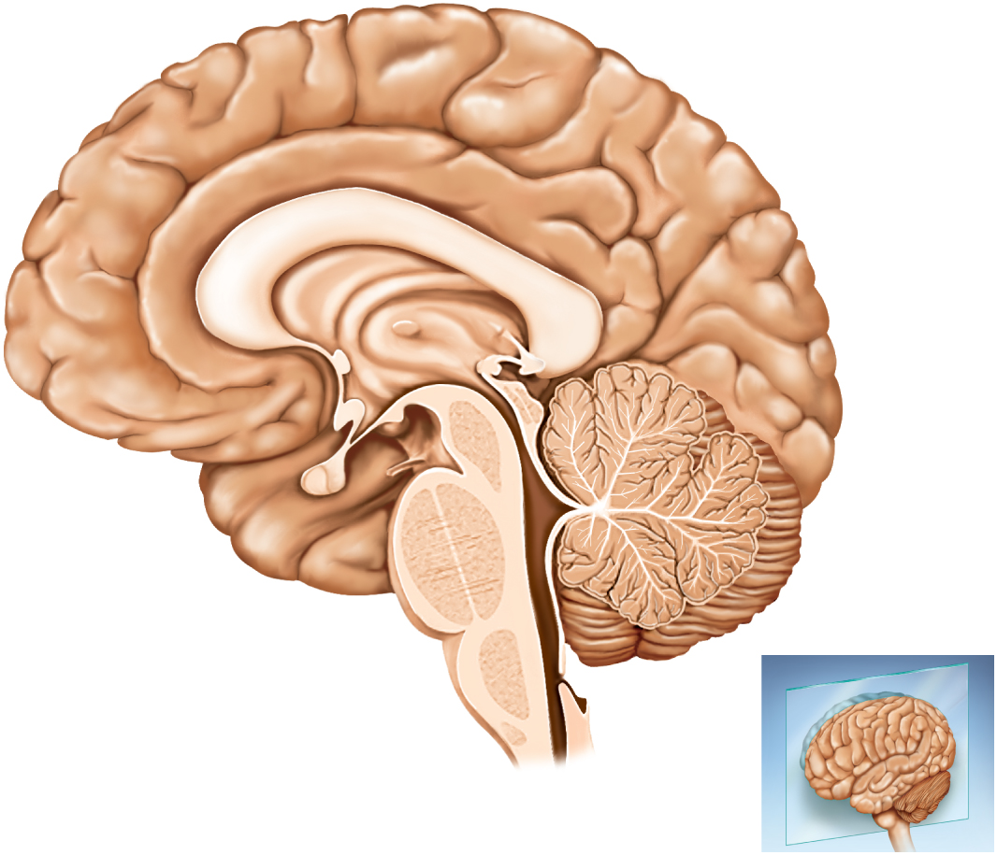
Median Section of the Brain
Copyright © The McGraw-Hill Companies, Inc. Permission required for reproduction or display.
Central sulcus
Cingulate gyrus
Parietal lobe
leaves
Corpus callosum
Frontal lobe
Parieto–occipital sulcus
Thalamus
Occipital lobe
Anterior
commissure
Habenula
Epithalamus
Pineal gland
Hypothalamus
Optic chiasm
Posterior commissure
Mammillary body
Cerebral aqueduct
Pituitary gland
Fourth ventricle
Temporal lobe
Midbrain
Cerebellum
Pons
Medulla
oblongata
(a)

Slide 7
Gray and White Matter
gray matter – the seat of neuron cell bodies, dendrites, and synapses
dull white color when fresh, due to little myelin
forms surface layer, cortex, over cerebrum and cerebellum
forms nuclei deep within brain
white matter - bundles of axons
lies deep to cortical gray matter, opposite relationship in the spinal cord
pearly white color from myelin around nerve fibers
composed of tracts, bundles of axons, that connect one part of the brain to another, and to the spinal cord

Slide 8
Meninges
meninges – three connective tissue membranes that envelop the brain
lies between the nervous tissue and bone
as in spinal cord, they are the dura mater, arachnoid mater, and the pia mater
protect the brain and provide structural framework for its arteries and veins
dura mater
in cranial cavity - 2 layers
outer periosteal – equivalent to periosteum of cranial bones
inner meningeal – continues into vertebral canal and forms dural sac around spinal cord
cranial dura mater is pressed closely against cranial bones
no epidural space
not attached to bone except: around foramen magnum, sella turcica, the crista galli, and sutures of the skull
layers separated by dural sinuses – collect blood circulating through brain
folds inward to extend between parts of the brain
falx cerebri separates the two cerebral hemispheres
tentorium cerebelli separates cerebrum from cerebellum
falx cerebelli separates the right and left halves of cerebellum

Slide 9
Meninges
arachnoid mater and pia mater are similar to those in the spinal cord
arachnoid mater
transparent membrane over brain surface
subarachnoid space separates it from pia mater below
subdural space separates it from dura mater above in some places
pia mater
very thin membrane that follows contours of brain, even dipping into sulci
not usually visible without a microscope

Slide 10
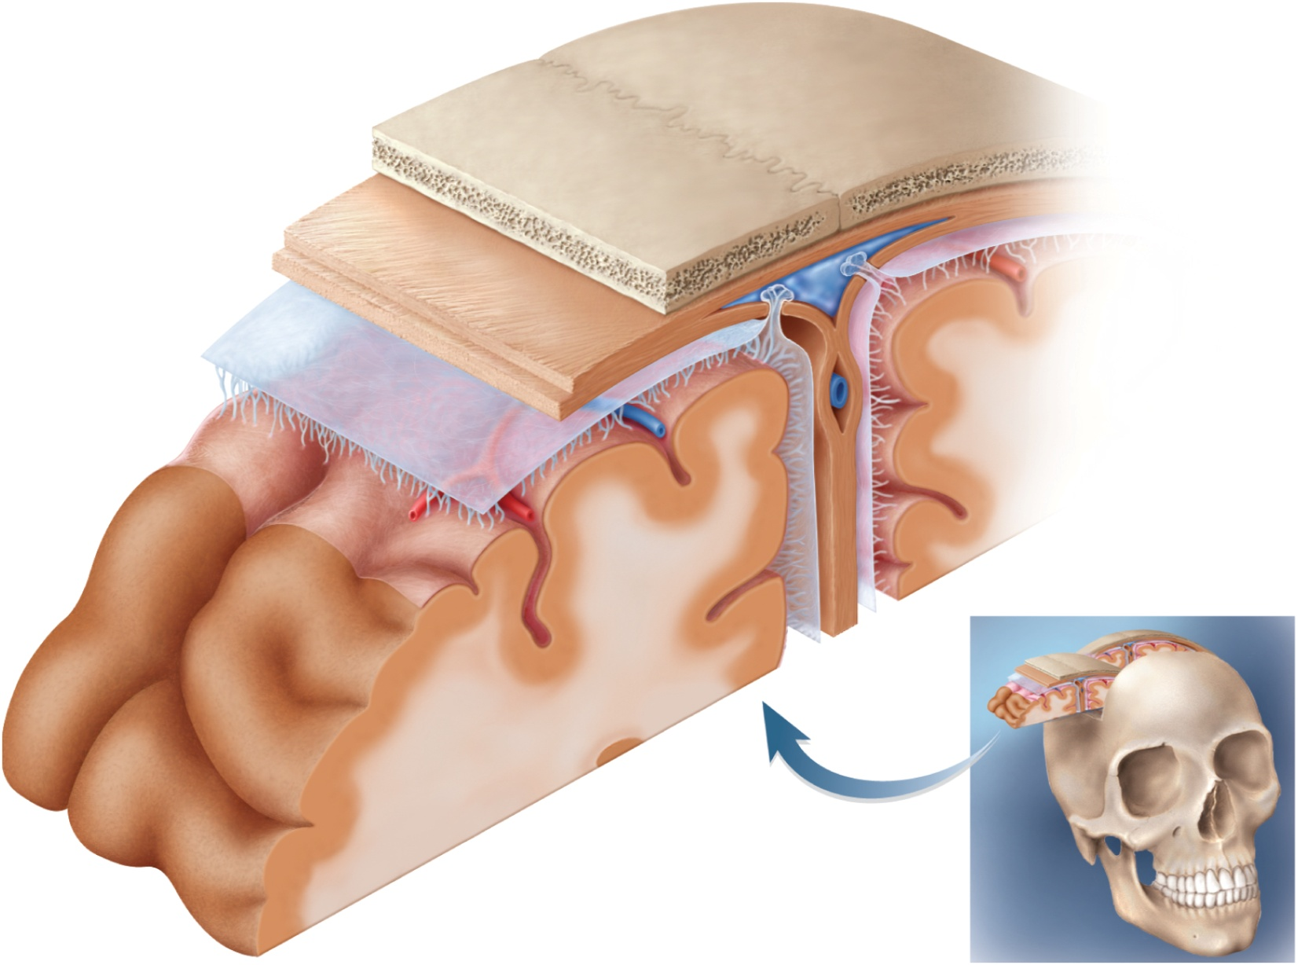
Meninges of the Brain
Copyright © The McGraw-Hill Companies, Inc. Permission required for reproduction or display.
Skull
Dura mater:
Periosteal layer
Subdural space
Meningeal layer
Subarachnoid
space
Arachnoid villus
Arachnoid mater
Superior sagittal
sinus
Blood vessel
Pia mater
Falx cerebri
(in longitudinal
fissure only)
Brain:
Gray matter
White matter
Figure 14.5

Slide 11
Meningitis
meningitis - inflammation of the meninges
serious disease of infancy & childhood
especially between 3 months and 2 years of age
caused by bacterial and virus invasion of the CNS by way of the nose and throat
pia mater and arachnoid are most often affected
bacterial meningitis can cause swelling the brain, enlarging the ventricles, and hemorrhage
signs include high fever, stiff neck, drowsiness, and intense headache and may progress to coma – death within hours of onset
diagnosed by examining the CSF for bacteria
lumbar puncture (spinal tap) draws fluid from subarachnoid space between two lumbar vertebrae

Slide 12
Brain Ventricles

Slide 13
Ventricles of the Brain

Slide 14
Ventricles and Cerebrospinal Fluid
ventricles – four internal chambers within the brain
two lateral ventricles – one in each cerebral hemisphere
interventricular foramen - a tiny pore that connects to third ventricle
third ventricle - single narrow medial space beneath corpus callosum
cerebral aqueduct runs through midbrain and connects third to fourth ventricle
fourth ventricle – small triangular chamber between pons and cerebellum
connects to central canal runs down through spinal cord
choroid plexus – spongy mass of blood capillaries on the floor of each ventricle
ependyma – neuroglia that lines the ventricles and covers choroid plexus
produces cerebrospinal fluid

Slide 15
Cerebrospinal Fluid (CSF)
cerebrospinal fluid (CSF) – clear, colorless liquid that fills the ventricles and canals of CNS
bathes its external surface
brain produces and absorbs 500 mL/day
100 – 160 mL normally present at one time
40% formed in subarachnoid space external to brain
30% by the general ependymal lining of the brain ventricles
30% by the choroid plexuses
production begins with the filtration of blood plasma through the capillaries of the brain
ependymal cells modify the filtrate, so CSF has more sodium and chloride than plasma, but less potassium, calcium, glucose, and very little protein

Slide 16
Cerebrospinal Fluid (CSF) Circulation
CSF continually flows through and around the CNS
driven by its own pressure, beating of ependymal cilia, and pulsations of the brain produced by each heartbeat
CSF secreted in lateral ventricles flows through intervertebral foramina into third ventricle
then down the cerebral aqueduct into the fourth ventricle
third and fourth ventricles add more CSF along the way
small amount of CSF fills the central canal of the spinal cord
all escapes through three pores
median aperture and two lateral apertures
leads into subarachnoid space of brain and spinal cord surface
CSF is reabsorbed by arachnoid villi
cauliflower-shaped extension of the arachnoid meninx
protrudes through dura mater
into superior sagittal sinus
CSF penetrates the walls of the villi and mixes with the blood in the sinus

Slide 17
Functions of CSF
buoyancy
allows brain to attain considerable size without being impaired by its own weight
if it rested heavily on floor of cranium, the pressure would kill the nervous tissue
protection
protects the brain from striking the cranium when the head is jolted
shaken child syndrome and concussions do occur from severe jolting
chemical stability
flow of CSF rinses away metabolic wastes from nervous tissue and homeostatically regulates its chemical environment

Slide 18
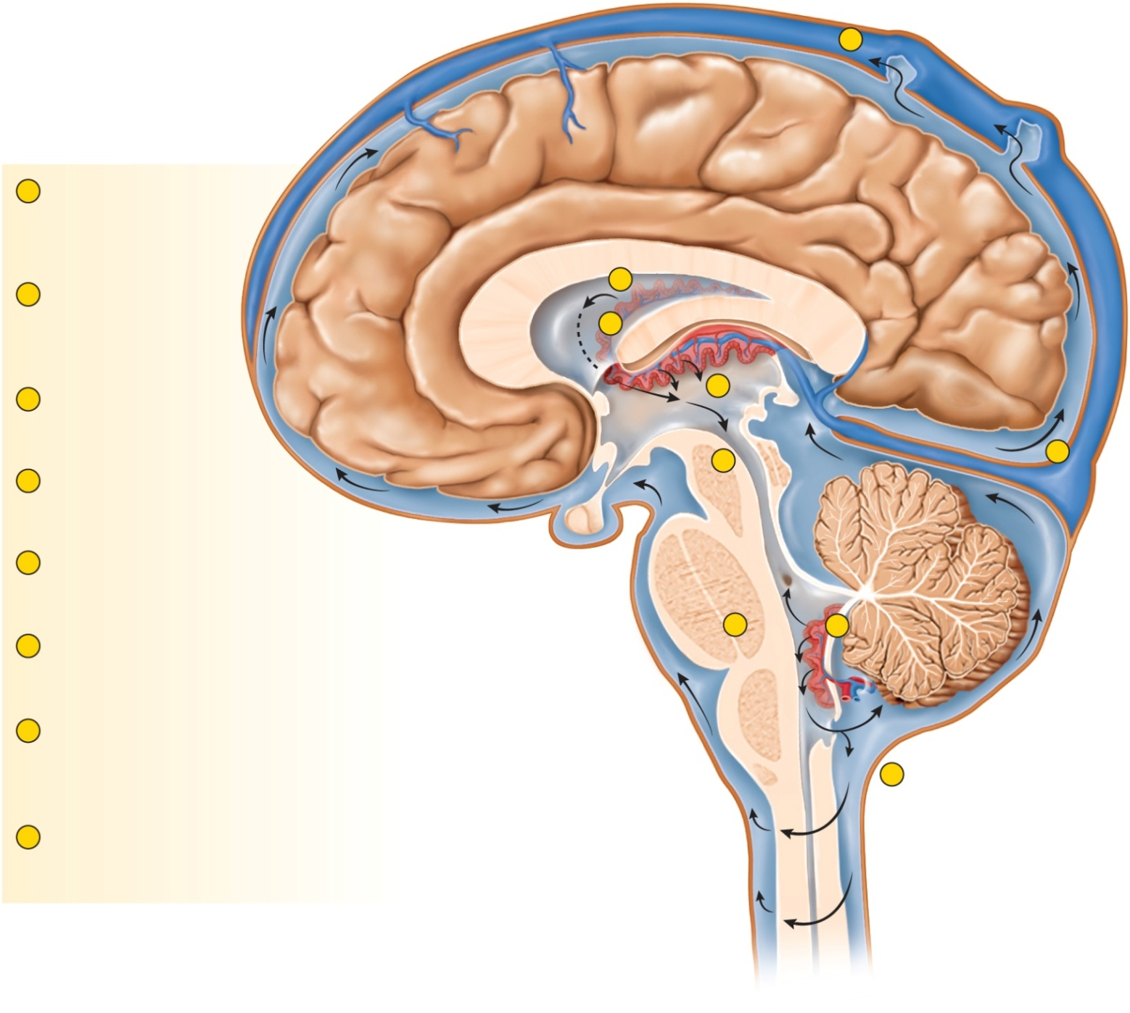
Flow of Cerebrospinal Fluid
Copyright © The McGraw-Hill Companies, Inc. Permission required for reproduction or display.
8
Arachnoid villus
Superior
sagittal
sinus
Arachnoid mater
1
CSF is secreted by
choroid plexus in
each lateral ventricle.
Subarachnoid
space
1
Dura mater
2
CSF flows through
Interventricular foramina
into third ventricle.
2
Choroid plexus
3
Choroid plexus in third
ventricle adds more CSF.
3
Third ventricle
4
7
Cerebral
aqueduct
4
CSF flows down cerebral
aqueduct to fourth ventricle.
Lateralaper ture
5
Choroid plexus in fourth
ventricle adds more CSF.
Fourth ventricle
6
CSF flows out two lateral apertures
and one median aperture.
6
5
7
CSF fills subarachnoid space and
bathes external surfaces of brain
and spinal cord.
Median aperture
7
8
At arachnoid villi, CSF is reabsorbed
into venous blood of dural
venous sinuses.
Centralcanal
of spinal cord
Figure 14.7
Subarachnoid
space of
spinal cord

Slide 19
Blood Supply to the Brain
brain is only 2% of the adult body weight, and receives 15% of the blood
750 mL/min
neurons have a high demand for ATP, and therefore, oxygen and glucose, so a constant supply of blood is critical to the nervous system
10 second interruption of blood flow may cause loss of consciousness
1 – 2 minute interruption can cause significant impairment of neural function
4 minutes with out blood causes irreversible brain damage

Slide 20
Brain Barrier System
blood is also a source of antibodies, macrophages, bacterial toxins, and other harmful agents
brain barrier system – strictly regulates what substances can get from the bloodstream into the tissue fluid of the brain
two points of entry must be guarded:
blood capillaries throughout the brain tissue
capillaries of the choroid plexus
blood-brain barrier - protects blood capillaries throughout brain tissue
consists of tight junctions between endothelial cells that form the capillary walls
astrocytes reach out and contact capillaries with their perivascular feet
induce the endothelial cells to form tight junctions that completely seal off gaps between them
anything leaving the blood must pass through the cells, and not between them
endothelial cells can exclude harmful substances from passing to the brain tissue while allowing necessary ones to pass

Slide 21
Brain Barrier System
blood-CSF barrier - protects the brain at the choroid plexus
form tight junctions between the ependymal cells
tight junctions are absent from ependymal cells elsewhere
important to allow exchange between brain tissue and CSF
blood barrier system is highly permeable to water, glucose, and lipid-soluble substances such as oxygen, carbon dioxide, alcohol, caffeine, nicotine, and anesthetics
slightly permeable to sodium, potassium, chloride, and the waste products urea and creatinine
obstacle for delivering medications such as antibiotics and cancer drugs
trauma and inflammation can damage BBS and allow pathogens to enter brain tissue
circumventricular organs (CVOs) – places in the third and fourth ventricles where the barrier is absent
blood has direct access to the brain
enables the brain to monitor and respond to fluctuations in blood glucose, pH, osmolarity, and other variables
CVOs afford a route for invasion by the human immunodeficiency virus (HIV)

Slide 22
Hindbrain - Medulla Oblongata
embryonic myelencephalon becomes medulla oblongata
begins at foramen magnum of the skull
extends for about 3 cm rostrally and ends at a groove between the medulla and pons
slightly wider than spinal cord
pyramids – pair of external ridges on anterior surface
resembles side-by-side baseball bats
olive – a prominent bulge lateral to each pyramid
posteriorly, gracile and cuneate fasciculi of the spinal cord continue as two pair of ridges on the medulla
all nerve fibers connecting the brain to the spinal cord pass through the medulla
four pairs of cranial nerves begin or end in medulla - IX, X, XI, XII
Copyright © The McGraw-Hill Companies, Inc. Permission required for reproduction or display.
Central sulcus
Cingulate gyrus
Parietal lobe
leaves
Corpus callosum
Frontal lobe
Parieto–occipital sulcus
Thalamus
Occipital lobe
Anterior
commissure
Habenula
Epithalamus
Pineal gland
Hypothalamus
Posterior commissure
Optic chiasm
Mammillary body
Cerebral aqueduct
Pituitary gland
Fourth ventricle
Temporal lobe
Midbrain
Cerebellum
Pons
Medulla
oblongata
(a)
Figure 14.2a

Slide 23
Hindbrain - Medulla Oblongata
cardiac center
adjusts rate and force of heart
vasomotor center
adjusts blood vessel diameter
respiratory centers
control rate and depth of breathing
reflex centers
for coughing, sneezing, gagging, swallowing, vomiting, salivation, sweating, movements of tongue and head

Slide 24
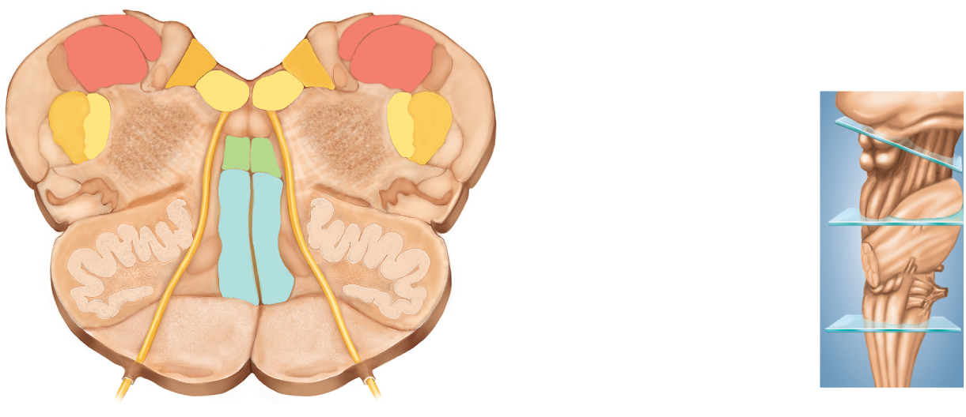
Medulla Oblongata
Copyright © The McGraw-Hill Companies, Inc. Permission required for reproduction or display.
Nucleus of
hypoglossal nerve
Gracile nucleus
Fourth ventricle
Cuneate nucleus
Nucleus of
vagus nerve
Posterior spinocerebellar
tract
Trigeminal nerve:
(a) Midbrain
Nucleus
Tract
Reticular formation
Medial lemniscus
Tectospinal tract
(b) Pons
Inferior olivary
nucleus
Olive
(c) Medulla
Hypoglossal nerve
Corticospinal tract
Pyramids of medulla
Figure 14.9c
(c) Medulla oblongata
pyramids contain descending fibers called corticospinal tracts
carry motor signals to skeletal muscles
inferior olivary nucleus – relay center for signals to cerebellum
reticular formation - loose network of nuclei extending throughout the medulla, pons and midbrain
contains cardiac, vasomotor & respiratory centers

Slide 25
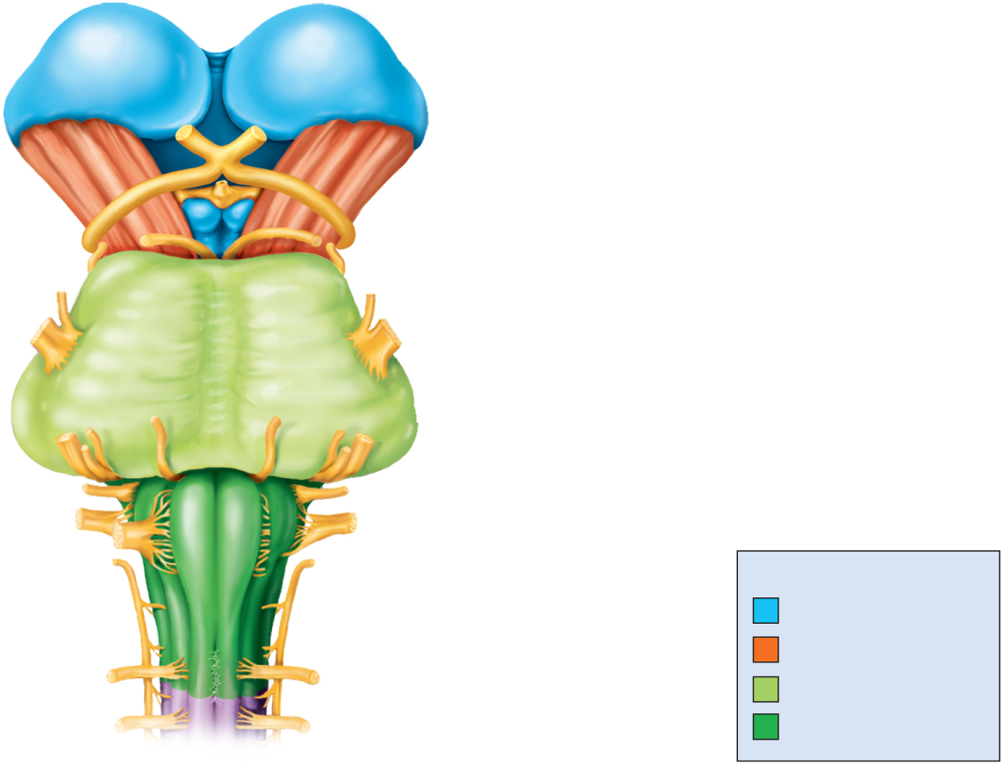
Medulla and Pons
Copyright © The McGraw-Hill Companies, Inc. Permission required for reproduction or display.
Diencephalon:
Thalamus
Infundibulum
Mammillary body
Optic tract
Cranial nerves:
Midbrain:
Optic nerve (II)
Cerebral peduncle
Oculomotor nerve (III)
Trochlear nerve (IV)
Trigeminal nerve (V)
Pons
Abducens nerve (VI)
Facial nerve (VII)
Vestibulocochlear nerve (VIII)
Glossopharyngeal nerve (IX)
Vagus nerve (X)
Medulla oblongata:
Accessory nerve (XI)
Regions of the brainstem
Pyramid
Hypoglossal nerve (XII)
Diencephalon
Anterior median fissure
Pyramidal decussation
Midbrain
Spinal nerves
Pons
Spinal cord
Medulla oblongata
(a) Anterior view
Figure 14.8a

Slide 26
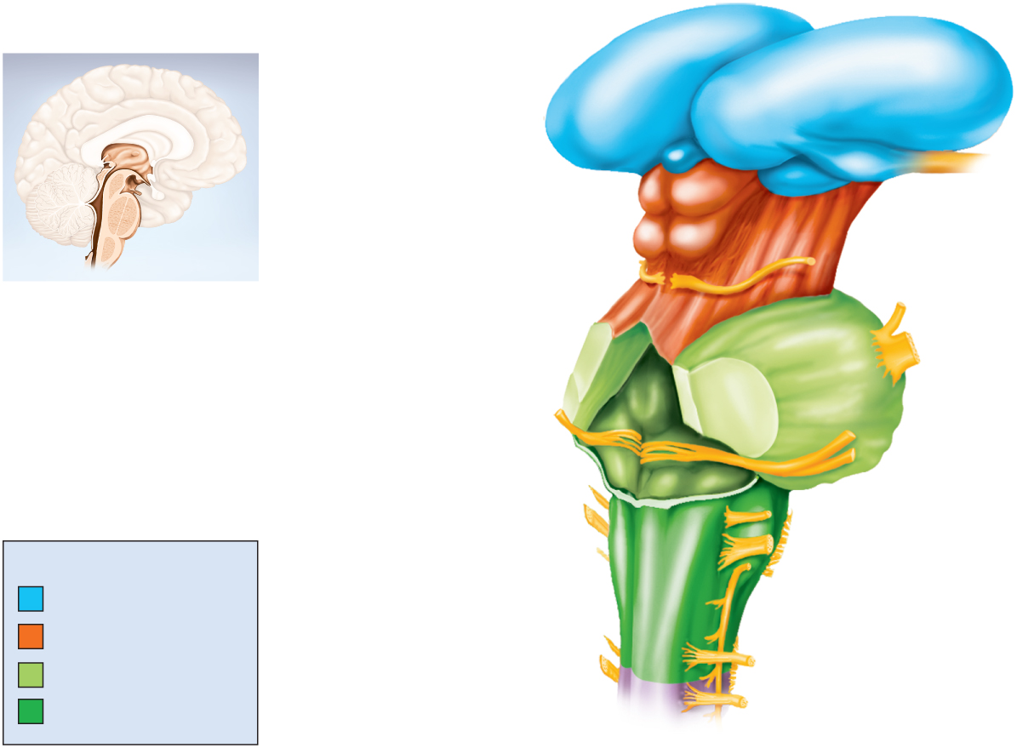
Posterolateral View of Brainstem
Copyright © The McGraw-Hill Companies, Inc. Permission required for reproduction or display.
Diencephalon:
Thalamus
Lateral geniculate body
Pineal gland
Medial geniculate body
Optic tract
Midbrain:
Superior colliculus
Inferior colliculus
Cerebral peduncle
Pons
Superior cerebellar
peduncle
Fourth ventricle
Middle cerebellar
peduncle
Inferior cerebellar
peduncle
Medulla
oblongata
Olive
Regions of the brainstem
Cuneate fasciculus
Diencephalon
Midbrain
Gracile fasciculus
Pons
Spinal cord
Medulla oblongata
Figure 14.8b
(b) Posterolateral view

Slide 27
Pons
Copyright © The McGraw-Hill Companies, Inc. Permission required for reproduction or display.
Central sulcus
Cingulate gyrus
Parietal lobe
leaves
Corpus callosum
Frontal lobe
Parieto–occipital sulcus
Thalamus
Occipital lobe
Anterior
commissure
Habenula
Epithalamus
Pineal gland
Hypothalamus
Optic chiasm
Posterior commissure
Mammillary body
Cerebral aqueduct
Pituitary gland
Fourth ventricle
Temporal lobe
Midbrain
Cerebellum
Pons
Medulla
oblongata
Figure 14.2a
(a)
metencephalon - develops into the pons and cerebellum
pons – anterior bulge in brainstem, rostral to medulla
cerebral peduncles – connect cerebellum to pons and midbrain

Slide 28
Pons
ascending sensory tracts
descending motor tracts
pathways in and out of cerebellum
cranial nerves V, VI, VII, and VIII
sensory roles – hearing, equilibrium, taste, facial sensations
motor roles – eye movement, facial expressions, chewing, swallowing, urination, and secretion of saliva and tears
reticular formation in pons contains additional nuclei concerned with:
sleep, respiration, and posture

Slide 29
Midbrain
mesencephalon becomes one mature brain structure, the midbrain
short segment of brainstem that connects the hindbrain to the forebrain
contains cerebral aqueduct
contains continuations of the medial lemniscus and reticular formation
contains the motor nuclei of two cranial nerves that control eye movements – CN III (oculomotor) and CN IV (trochlear)
tectum – roof-like part of the midbrain posterior to cerebral aqueduct
exhibits four bulges, the corpora quadrigemina
upper pair, the superior colliculi function in visual attention, tracking moving objects, and some reflexes
lower pair, the inferior colliculi receives signals from the inner ear
relays them to other parts of the brain, especially the thalamus
cerebral peduncles – two stalks that anchor the cerebrum to the brainstem anterior to the cerebral aqueduct

Slide 30
Midbrain
cerebral peduncles
each consists of three main components
tegmentum, substantia nigra, and cerebral crus
tegmentum
dominated by the red nucleus
pink color due to high density of blood vessels
connections go to and from cerebellum
collaborates with cerebellum for fine motor control
substantia nigra
dark gray to black nucleus pigmented with melanin
motor center that relays inhibitory signals to thalamus & basal nuclei preventing unwanted body movement
degeneration of neurons leads to tremors of Parkinson disease
cerebral crus
bundle of nerve fibers that connect the cerebrum to the pons
carries corticospinal tracts

Slide 31
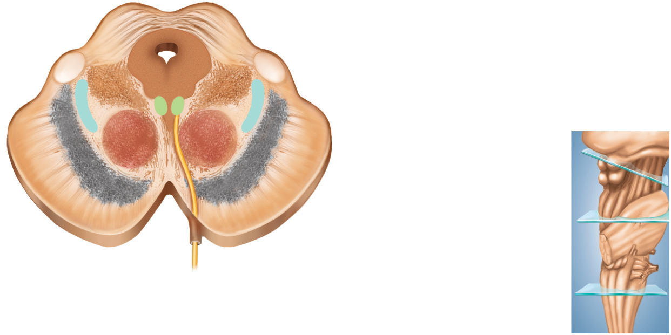
Midbrain -- Cross Section
Copyright © The McGraw-Hill Companies, Inc. Permission required for reproduction or display.
Posterior
Superior colliculus
Tectum
leaves
Cerebral aqueduct
Medial geniculate nucleus
Reticular formation
Central gray matter
Cerebral peduncle:
Oculomotor nucleus
Tegmentum
Medial lemniscus
Red nucleus
(a) Midbrain
Substantia nigra
Cerebral crus
(b) Pons
Oculomotor nerve (III)
Anterior
(c) Medulla
(a) Midbrain
Figure 14.9a

Slide 32
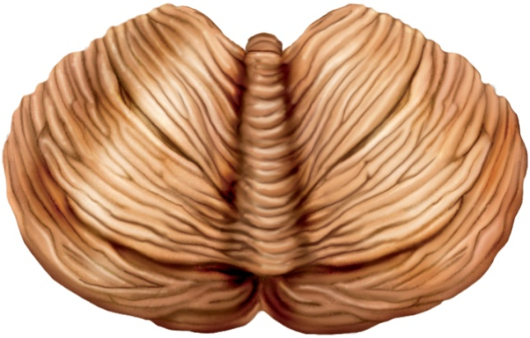
Cerebellum
Copyright © The McGraw-Hill Companies, Inc. Permission required for reproduction or display.
Anterior
Vermis
leaves
Anterior lobe
Posterior lobe
Cerebellar
hemisphere
Posterior
Folia
Figure 14.11b
(b) Superior view
the largest part of the hindbrain and the second largest part of the brain as a whole
consists of right and left cerebellar hemispheres connected by vermis
cortex of gray matter with folds (folia) and four deep nuclei in each hemisphere
contains more than half of all brain neurons, about 100 billion
granule cells and Purkinje cells synapse on deep nuclei
white matter branching pattern is called arbor vitae

Slide 33
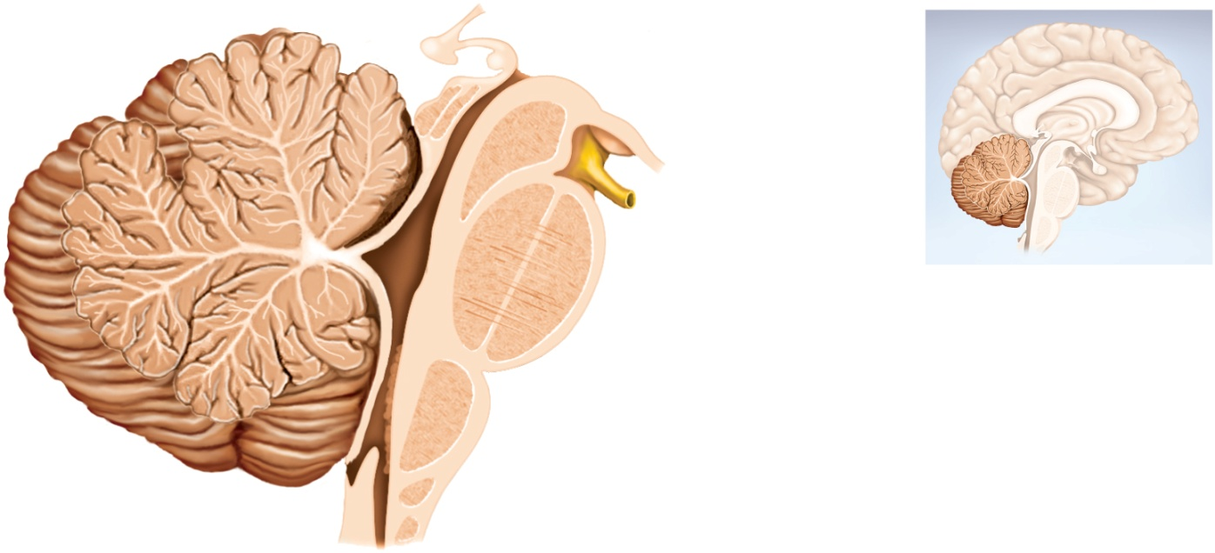
Cerebellum
Copyright © The McGraw-Hill Companies, Inc. Permission required for reproduction or display.
Superior colliculus
Inferior colliculus
Pineal gland
Posterior commissure
Cerebral aqueduct
Mammillary body
White matter
(arbor vitae)
Midbrain
Oculomotor nerve
Gray matter
Fourth ventricle
Pons
Medulla oblongata
Figure 14.11a
(a) Median section
cerebellar peduncles – three pairs of stalks that connect the cerebellum to the brainstem
inferior peduncles – connected to medulla oblongata
most spinal input enters the cerebellum through inferior peduncle
middle peduncles – connected to the pons
most input from the rest of the brain enters by way of middle peduncle
superior peduncles – connected to the midbrain
carries cerebellar output
consist of thick bundles of nerve fibers that carry signals to and from the cerebellum

Slide 34
Cerebellar Functions
monitors muscle contractions and aids in motor coordination
evaluation of sensory input
comparing textures without looking at them
spatial perception and comprehension of different views of 3D objects belonging to the same object
timekeeping center
predicting movement of objects
helps predict how much the eyes must move in order to compensate for head movements and remain fixed on an object
hearing
distinguish pitch and similar sounding words
planning and scheduling tasks
lesions may result in emotional overreactions and trouble with impulse control

Slide 35
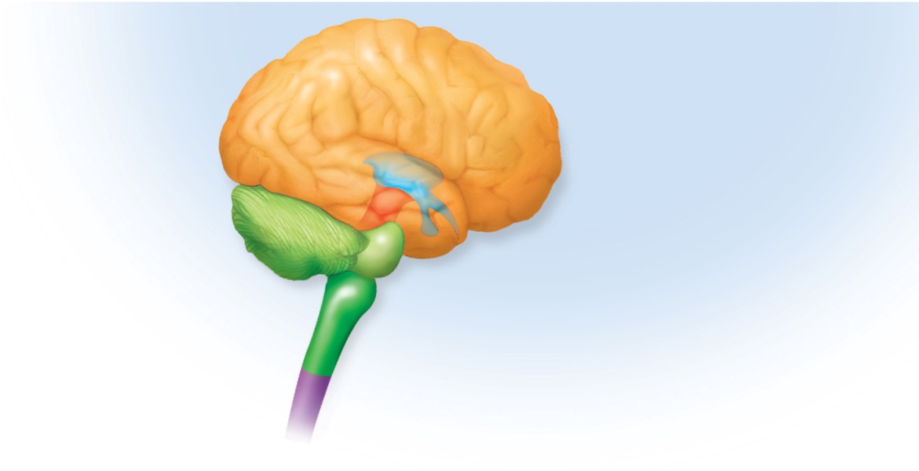
The Forebrain
forebrain consists of :
the diencephalon
encloses the third ventricle
most rostral part of the brainstem
has three major embryonic derivatives
thalamus
hypothalamus
epithalamus
the telencephalon
develops chiefly into the cerebrum
Copyright © The McGraw-Hill Companies, Inc. Permission required for reproduction or display.
Telencephalon
Forebrain
Diencephalon
Mesencephalon
Midbrain
Pons
Metencephalon
Cerebellum
Hindbrain
Myelencephalon
(medulla oblongata)
Spinal cord
(c) Fully developed
Figure 14.4c

Slide 36
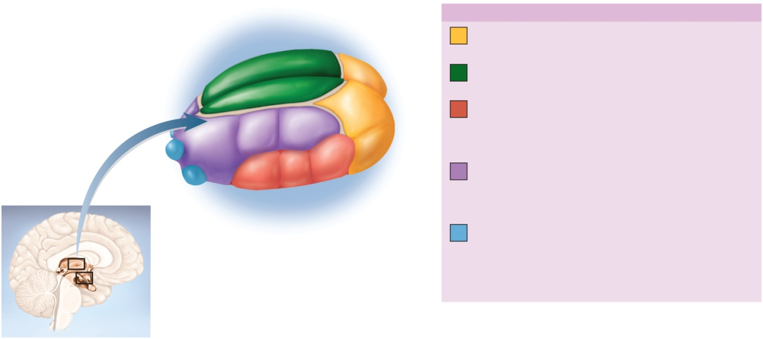
Diencephalon: Thalamus
Copyright © The McGraw-Hill Companies, Inc. Permission required for reproduction or display.
Thalamic Nuclei
leaves
Anterior group
Part of limbic system;
memory and emotion
Medial group
Emotional output to prefrontal
cortex; awareness of emotions
Ventral group
Somesthetic output to
postcentral gyrus; signals
from cerebellum and basal
nuclei to motor areas of cortex
Figure 14.12a
Lateral group
Somesthetic output to
association areas of cortex;
contributes to emotional function
of limbic system
Lateral geniculate nucleus
Medial geniculate nucleus
Posterior group
Relay of visual signals to
occipital lobe (via lateral
geniculate nucleus) and auditory
signals to temporal lobe (via
medial geniculate nucleus)
(a) Thalamus
thalamus – ovoid mass on each side of the brain perched at the superior end of the brainstem beneath the cerebral hemispheres
constitutes about four-fifths of the diencephalon
two thalami are joined medially by a narrow intermediate mass
composed of at least 23 nuclei – we will consider five major functional groups
the “gateway to the cerebral cortex” – nearly all input to the cerebrum passes by way of synapses in the thalamic nuclei, filters information on its way to cerebral cortex
plays key role in motor control by relaying signals from cerebellum to cerebrum and providing feedback loops between the cerebral cortex and the basal nuclei
involved in the memory and emotional functions of the limbic system – a complex of structures that include some cerebral cortex of the temporal and frontal lobes and some of the anterior thalamic nuclei

Slide 37
Diencephalon: Hypothalamus
hypothalamus – forms part of the walls and floor of the third ventricle
extends anteriorly to optic chiasm and posteriorly to the paired mammillary bodies
each mammillary body contains three or four mammillary nuclei
relay signals from the limbic system to the thalamus
infundibulum – a stalk that attaches the pituitary gland to the hypothalamus
major control center of autonomic nervous system and endocrine system
plays essential roll in homeostatic regulation of all body systems

Slide 38
Diencephalon: Hypothalamus
functions of hypothalamic nuclei
hormone secretion
controls anterior pituitary
regulates growth, metabolism, reproduction ,and stress responses
autonomic effects
major integrating center for the autonomic nervous system
influences heart rate, blood pressure, gastrointestinal secretions and motility, and others
thermoregulation
hypothalamic thermostat monitors body temperature
activates heat-loss center when temp is too high
activates heat-promoting center when temp is too low
food and water intake
hunger and satiety centers monitor blood glucose and amino acid levels
produce sensations of hunger and satiety
thirst center monitors osmolarity of the blood
rhythm of sleep and waking
controls 24 hour circadian rhythm of activity
memory
-mammillary nuclei receive signals from hippocampus
emotional behavior
anger, aggression, fear, pleasure, and contentment

Slide 39
Diencephalon: Epithalamus
epithalamus – very small mass of tissue composed of:
pineal gland – endocrine gland
habenula – relay from the limbic system to the midbrain
thin roof over the third ventricle

Slide 40
Telencephalon: Cerebrum
cerebrum – largest and most conspicuous part of the human brain
seat of sensory perception, memory, thought, judgment, and voluntary motor actions

Slide 41
Cerebrum - Gross Anatomy
Copyright © The McGraw-Hill Companies, Inc. Permission required for reproduction or display.
Cerebral
hemispheres
Rostral
Caudal
Central sulcus
Gyri
Cerebrum
Frontal lobe
Lateral sulcus
Central sulcus
Temporal lobe
Cerebellum
Parietal lobe
Brainstem
Occipital lobe
Spinal cord
Figure 14.1a,b
Longitudinal fissure
(b) Lateral view
(a) Superior view
two cerebral hemispheres divided by longitudinal fissure
connected by white fibrous tract the corpus callosum
gyri and sulci – increases amount of cortex in the cranial cavity
gyri increases surface area for information processing capability
some sulci divide each hemisphere into five lobes named for the cranial bones that overly them

Slide 42
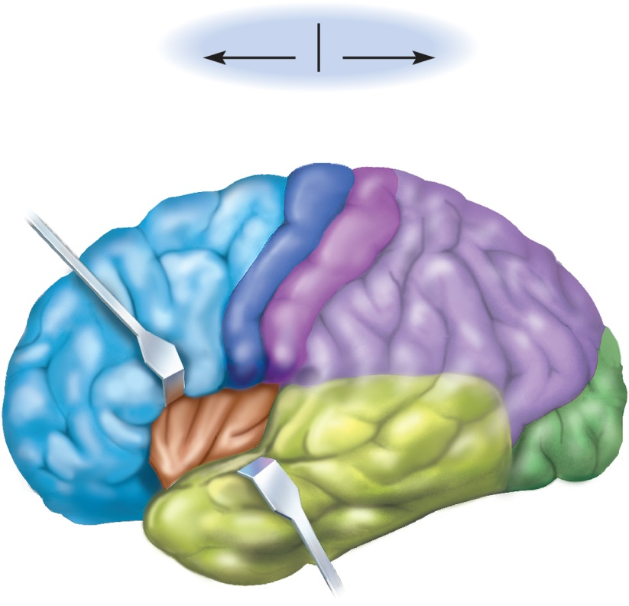
Functions of Cerebrum - Lobes
frontal lobe
voluntary motor functions
motivation, foresight, planning, memory, mood, emotion, social judgment, and aggression
parietal lobe
receives and integrates general sensory information, taste and some visual processing
occipital lobe
primary visual center of brain
temporal lobe
areas for hearing, smell, learning, memory, and some aspects of vision and emotion
insula (hidden by other regions)
understanding spoken language, taste and sensory information from visceral receptors
Copyright © The McGraw-Hill Companies, Inc. Permission required for reproduction or display.
Rostral
Caudal
Frontal lobe
Parietal lobe
Precentral
gyrus
Postcentral gyrus
Central
sulcus
Insula
Occipital lobe
Lateral sulcus
Temporal lobe
Figure 14.13

Slide 43
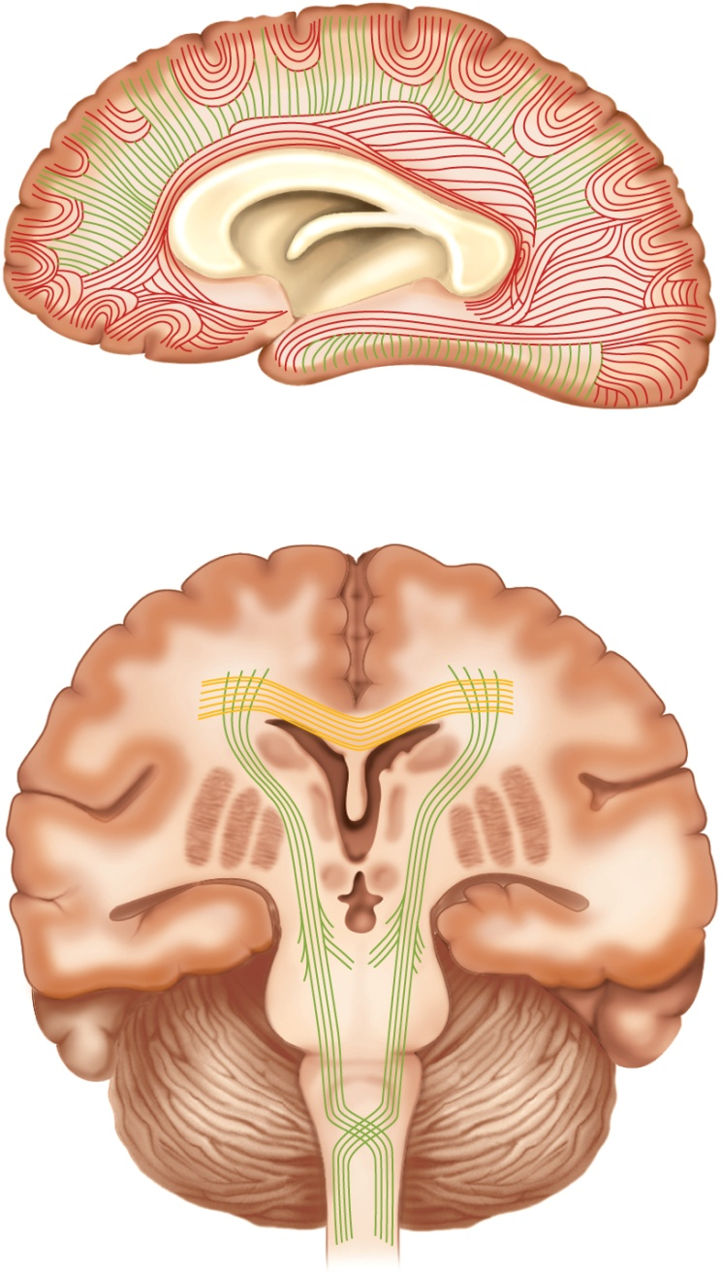
Cerebral White Matter
Copyright © The McGraw-Hill Companies, Inc. Permission required for reproduction or display.
Association tracts
Projection tracts
Frontal lobe
Corpus callosum
Parietal lobe
Temporal lobe
Occipital lobe
(a) Sagittal section
Longitudinal fissure
Corpus callosum
Commissuralta tracts
Lateral ventricle
Basal nuclei
Thalamus
Third ventricle
Cerebral peduncle
Mammillary body
Projection tracts
pons
Pyramid
Decussation in pyramids
Medulla oblongata
Figure 14.14
(b) Frontal section

Slide 44
The Cerebral White Matter
most of the volume of cerebrum is white matter
glia and myelinated nerve fibers transmitting signals from one region of the cerebrum to another and between cerebrum and lower brain centers
three types of tracts
projection tracts
extends vertically between higher and lower brain and spinal cord centers
carries information between cerebrum and rest of the body
commissural tracts
cross from one cerebral hemisphere through bridges called commissures
most pass through corpus callosum
anterior and posterior commissures
enables the two sides of the cerebrum to communicate with each other
association tracts
connect different regions within the same cerebral hemisphere
long association fibers – connect different lobes of a hemisphere to each other
short association fibers – connect different gyri within a single lobe

Slide 45
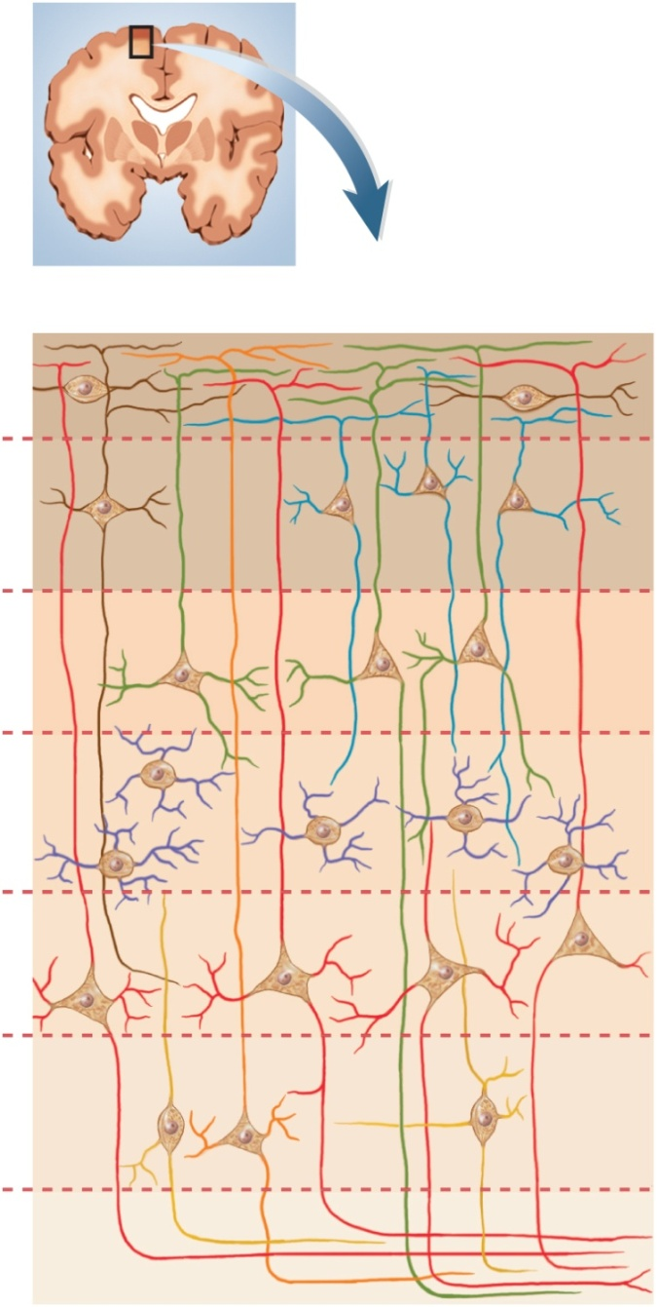
Cerebral Cortex
Copyright © The McGraw-Hill Companies, Inc. Permission required for reproduction or display.
neural integration is carried out in the gray matter of the cerebrum
cerebral gray matter found in three places
cerebral cortex
basal nuclei
limbic system
cerebral cortex – layer covering the surface of the hemispheres
only 2 – 3 mm thick
cortex constitutes about 40% of the mass of the brain
contains 14 – 16 billion neurons
Figure 14.15
Cortical surface
I
Small pyramidal
cells
II
III
Stellate cells
IV
Large pyramidal
cells
V
VI
White
matter

Slide 46
Cerebral Cortex
contains two principal types of neurons
stellate cells
have spheroid somas with dendrites projecting in all directions
receive sensory input and process information on a local level
pyramidal cells
tall, and conical, with apex toward the brain surface
a thick dendrite with many branches with small, knobby dendritic spines
include the output neurons of the cerebrum
only neurons that leave the cortex and connect with other parts of the CNS
neocortex – six layered tissue that constitutes about 90% of the human cerebral cortex
relatively recent in evolutionary origin
Figure 14.15
Cortical surface
I
Small pyramidal
cells
II
III
Stellate cells
IV
Large pyramidal
cells
V
VI
White
matter

Slide 47
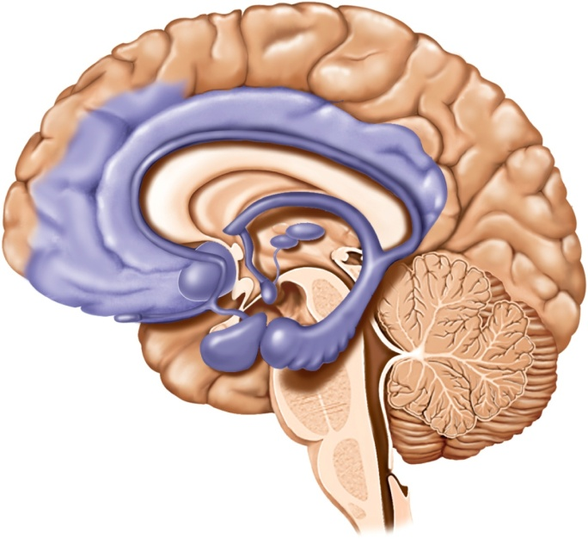
Limbic System
limbic system – important center of emotion and learning
most anatomically prominent components are:
cingulate gyrus – arches over the top of the corpus callosum in the frontal and parietal lobes
hippocampus – in the medial temporal lobe - memory
amygdala – immediately rostral to the hippocampus - emotion
limbic system components are connected through a complex loop of fiber tracts allowing for somewhat circular patterns of feedback
limbic system structures have centers for both gratification and aversion
gratification – sensations of pleasure or reward
aversion –sensations of fear or sorrow
Copyright © The McGraw-Hill Companies, Inc. Permission required for reproduction or display.
Medial
prefrontal
cortex
Corpus
callosum
Fornix
Cingulate
gyrus
Thalamic
nuclei
Orbitofrontal
cortex
Mammillary
body
Basal nuclei
Hippocampus
Amygdala
Temporal lobe
Figure 14.17

Slide 48
Higher Brain Functions
higher brain functions - sleep, memory, cognition, emotion, sensation, motor control, and language
involve interactions between cerebral cortex and basal nuclei, brainstem and cerebellum
functions of the brain do not have easily defined anatomical boundaries
integrative functions of the brain focuses mainly on the cerebrum, but involves combined action of multiple brain levels

Slide 49
The Electroencephalogram
electroencephalogram (EEG) – monitors surface electrical activity of the brain waves
useful for studying normal brain functions as sleep and consciousness
in diagnosis of degenerative brain diseases, metabolic abnormalities, brain tumors, etc.
brain waves – rhythmic voltage changes resulting from synchronized postsynaptic potentials at the superficial layer of the cerebral cortex
4 types distinguished by amplitude (mV) and frequency (Hz)
persistent absence of brain waves is common clinical and legal criterion of brain death

Slide 50
Brain Waves
alpha waves 8 – 13 Hz
awake and resting with eyes closed and mind wandering
suppressed when eyes open or performing a mental task
beta waves 14 – 30 Hz
eyes open and performing mental tasks
accentuated during mental activity and sensory stimulation
theta waves 4 – 7 Hz
drowsy or sleeping adults
if awake and under emotional stress
delta waves high amplitude, less than 3.5 Hz
deep sleep in adults

Slide 51
Sleep
sleep occurs in cycles called circadian rhythms
events that reoccur at intervals of about 24 hours
sleep - temporary state of unconsciousness from which one can awaken when stimulated
characterized by stereotyped posture
lying down with eyes closed
sleep paralysis - inhibition of muscular activity
resembles unconsciousness but can be aroused by sensory stimulation
coma or hibernation – states of prolonged unconsciousness where individuals cannot be aroused from those states by sensory stimulation
restorative effect
brain glycogen and ATP levels increase in non-REM sleep
memories strengthened in REM sleep
synaptic connections reinforced

Slide 52
Four Stages of Sleep
Stage 1
feel drowsy, close our eyes, begin to relax
often feel drifting sensation, easily awakened if stimulated
alpha waves dominate EEG
Stage 2
pass into light sleep
EEG declines in frequency but increases in amplitude
exhibits sleep spindles – high spikes resulting from interactions between neurons
of the thalamus and cerebral cortex
Stage 3
moderate to deep sleep
about 20 minutes after stage 1
theta and delta waves appear
muscles relax and vital signs (body temperature, blood pressure, heart and respiratory rate) fall
Stage 4
called slow-wave-sleep (SWS) – EEG dominated by low-frequency, high amplitude delta waves
muscles now very relaxed, vital signs at their lowest, and we become more difficult to awaken

Slide 53
Rhythm of Sleep
rhythm of sleep controlled by a complex interaction between the cerebral cortex, thalamus, hypothalamus, and reticular formation
arousal induced in the upper reticular formation, near junction of pons and midbrain
sleep induced by nuclei below pons, and in ventrolateral preoptic nucleus in the hypothalamus
sleep has a restorative effect, and sleep deprivation can be fatal to experimental animals
bed rest alone does not have the restorative effect of sleep…why must we lose consciousness?
sleep may be the time to replenish such energy sources as glycogen and ATP
REM sleep may consolidate and strengthen memories by reinforcing some synapses, and eliminating others

Slide 54
Sleep Stages

Slide 55
Cognition
cognition – the range of mental processes by which we acquire and use knowledge
such as sensory perception, thought, reasoning, judgment, memory, imagination, and intuition
association areas of cerebral cortex has above functions
constitutes about 75% of all brain tissue
studies of patients with brain lesions, cancer, stroke, and trauma yield information on cognition
parietal lobe association area – perceiving stimuli
contralateral neglect syndrome – unaware of objects on opposite side of their body
temporal lobe association area – identifying stimuli
agnosia – inability to recognize, identify, and name familiar objects
prosopagnosia – person cannot remember familiar faces
frontal lobe association area – planning our responses and personality – inability to execute appropriate behavior

Slide 56
Memory
information management requires
learning – acquiring new information
memory – information storage and retrieval
forgetting – eliminating trivial information; as important as remembering
amnesia – defects in declarative memory – inability to describe past events
procedural memory – ability to tie your shoes
anterograde amnesia – unable to store new information
retrograde amnesia – cannot recall things they knew before the injury
hippocampus – important memory-forming center
does not store memories
organizes sensory and cognitive information into a unified long-term memory
memory consolidation – the process of “teaching the cerebral cortex” until a long-term memory is established
long-term memories are stored in various areas of the cerebral cortex
vocabulary and memory of familiar faces stored in superior temporal lobe
memories of one’s plans and social roles stored in the prefrontal cortex
cerebellum – helps learn motor skills
amygdala - emotional memory

Slide 57
Emotion
emotional feelings and memories are interactions between prefrontal cortex and diencephalon
prefrontal cortex - seat of judgment, intent, and control over expression of emotions
feelings come from hypothalamus and amygdala
nuclei generate feelings of fear or love
amygdala receives input from sensory systems
role in food intake, sexual behavior, and drawing attention to novel stimuli
one output goes to hypothalamus influencing somatic and visceral motor systems
heart races, raises blood pressure, makes hair stand on end, induce vomiting
other output to prefrontal cortex important in controlling expression of emotions
ability to express love, control anger, or overcome fear
behavior shaped by learned associations between stimuli, our responses to them, and the reward or punishment that results

Slide 58
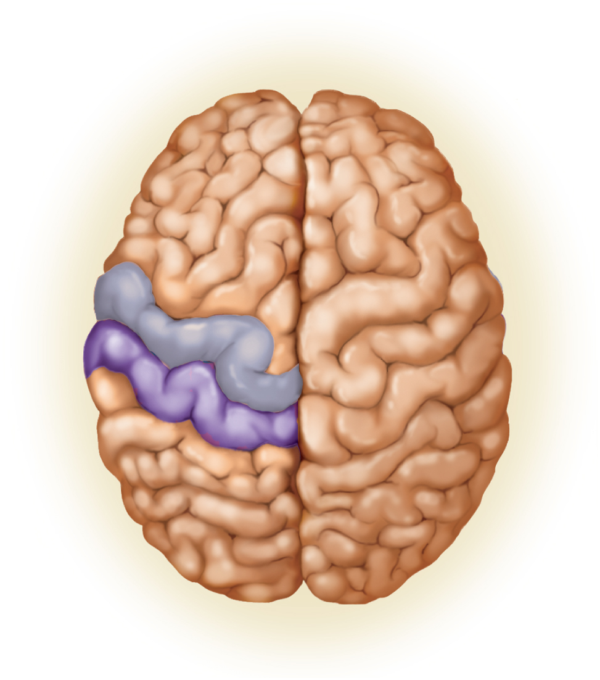
Sensation
primary sensory cortex - sites where sensory input is first received and one becomes conscious of the stimulus
association areas nearby to sensory areas that process and interpret that sensory information
primary visual cortex is bordered by visual association area which interprets and makes cognitive sense of visual stimuli
multimodal association areas – receive input from multiple senses and integrate this into an overall perception of our surroundings
Copyright © The McGraw-Hill Companies, Inc. Permission required for reproduction or display.
Anterior
Frontal
lobe
Precentral
gyrus
Central
sulcus
Postcentral
gyrus
Parietal
lobe
Occipital
lobe
Posterior
(a)
Figure 14.22a

Slide 59
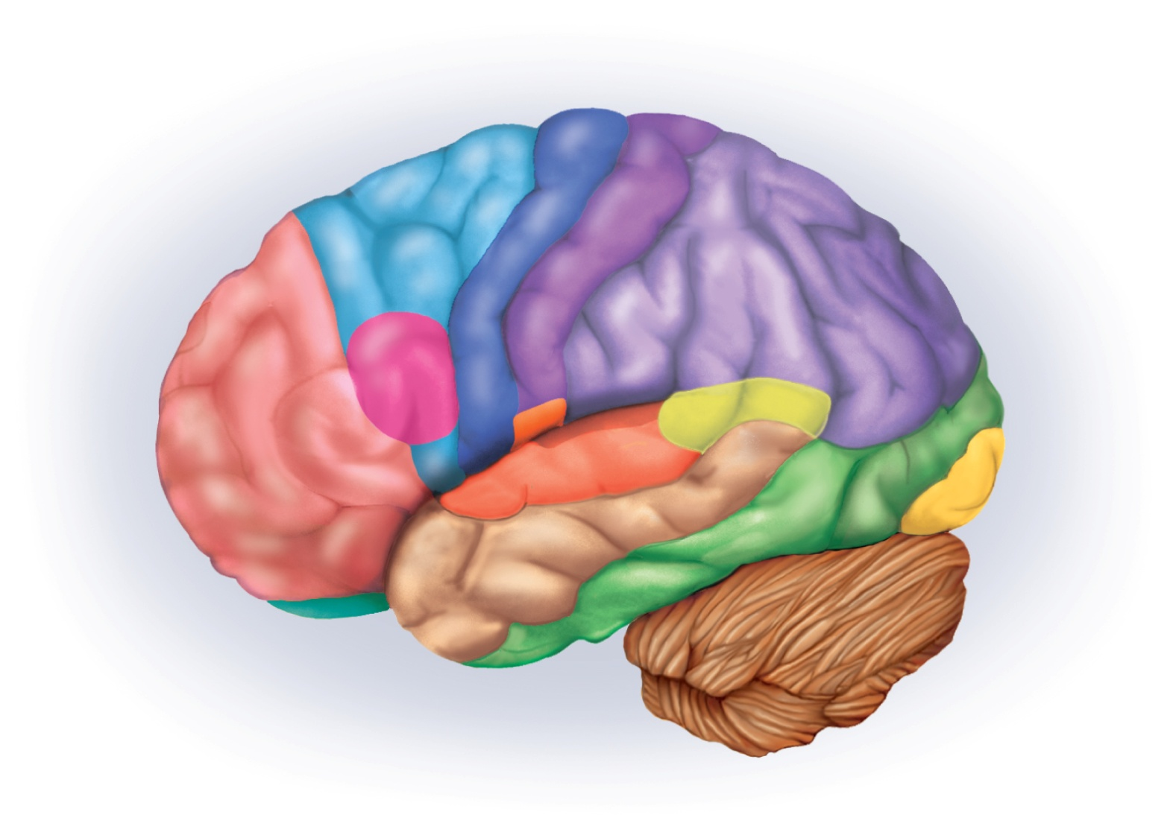
Functional Regions of Cerebral Cortex
Copyright © The McGraw-Hill Companies, Inc. Permission required for reproduction or display.
Primary somesthetic
cortex
Primary motor
cortex
Somesthetic
association area
Motor association
area
Primary gustatory
cortex
Wernicke area
Broca area
Prefrontal
cortex
Visual association
area
Primary
visual cortex
Olfactory
association
area
Primary
auditory cortex
Auditory
association area
Figure 14.21

Slide 60
Motor Control
the intention to contract a muscle begins in motor association (premotor) area of frontal lobes
where we plan our behavior
where neurons compile a program for degree and sequence of muscle contraction required for an action
program transmitted to neurons of the precentral gyrus (primary motor area)
most posterior gyrus of the frontal lobe
neurons send signals to the brainstem and spinal cord
ultimately resulting in muscle contraction
precentral gyrus also exhibits somatotopy
neurons for toe movement are deep in the longitudinal fissure of the medial side of the gyrus
the summit of the gyrus controls the trunk, shoulder, and arm
the inferolateral region controls the facial muscles
motor homunculus has a distorted look because the amount of cortex devoted to a given body region is proportional to the number of muscles and motor units in that body region

Slide 61
Motor Control
pyramidal cells of the precentral gyrus are called upper motor neurons
their fibers project caudally
about 19 million fibers ending in nuclei of the brainstem
about 1 million forming the corticospinal tracts
most fibers decussate in lower medulla oblongata
form lateral corticospinal tracts on each side of the spinal cord
in the brainstem or spinal cord, the fibers from upper motor neurons synapse with lower motor neurons whose axons innervate the skeletal muscles
basal nuclei and cerebellum are also important in muscle control

Slide 62
Motor Control
basal nuclei
determines the onset and cessation of intentional movements
repetitive hip and shoulder movements in walking
highly practiced, learned behaviors that one carries out with little thought
writing, typing, driving a car
lies in a feedback circuit from the cerebrum to the basal nuclei to the thalamus and back to the cerebrum
dyskinesias – movement disorders caused by lesions in the basal nuclei
cerebellum
highly important in motor coordination
aids in learning motor skills
maintains muscle tone and posture
smoothes muscle contraction
coordinates eye and body movements
coordinates the motions of different joints with each other
ataxia – clumsy, awkward gait

Slide 63
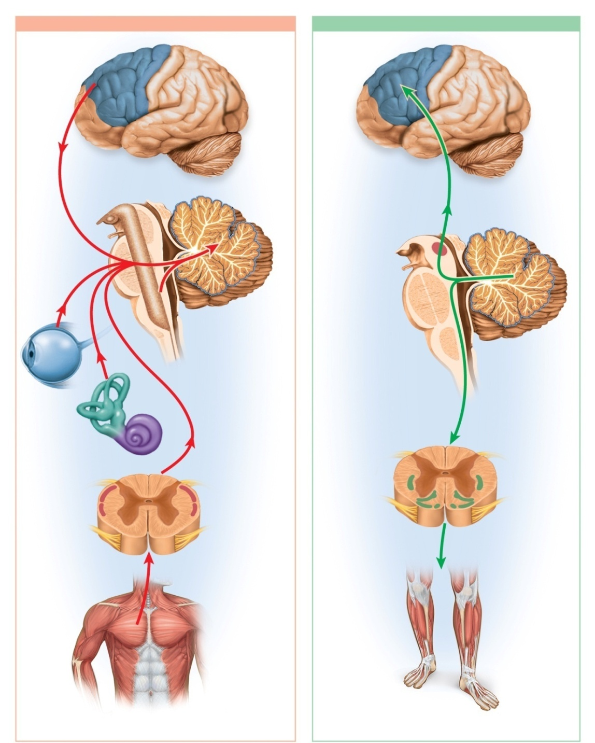
Input and Output to Cerebellum
Copyright © The McGraw-Hill Companies, Inc. Permission required for reproduction or display.
(a) Input to cerebellum
(b) Output from cerebellum
Motor cortex
Cerebrum
Cerebrum
Cerebellum
Reticular formation
Brainstem
Cerebellum
Eye
Brainstem
Inner ear
Reticulospinal
and vestibulospinal
tracts of spinal cord
Figure 14.24
Spinocerebellar
tracts of spinal cord
Muscle and joint proprioceptors
Limb and postural
muscles

Slide 64
Language
language include several abilities: reading, writing, speaking, and understanding words assigned to different regions of the cerebral cortex
Wernicke area
permits recognition of spoken and written language and creates plan of speech
when we intend to speak, Wernicke area formulates phases according to learned rules of grammar
transmits plan of speech to Broca area
Broca area
generates motor program for the muscles of the larynx, tongue, cheeks and lips
transmits program to primary motor cortex for commands to the lower motor neurons that supply relevant muscles
Affective language area lesions produce aprosody - flat emotionless speech

Slide 65
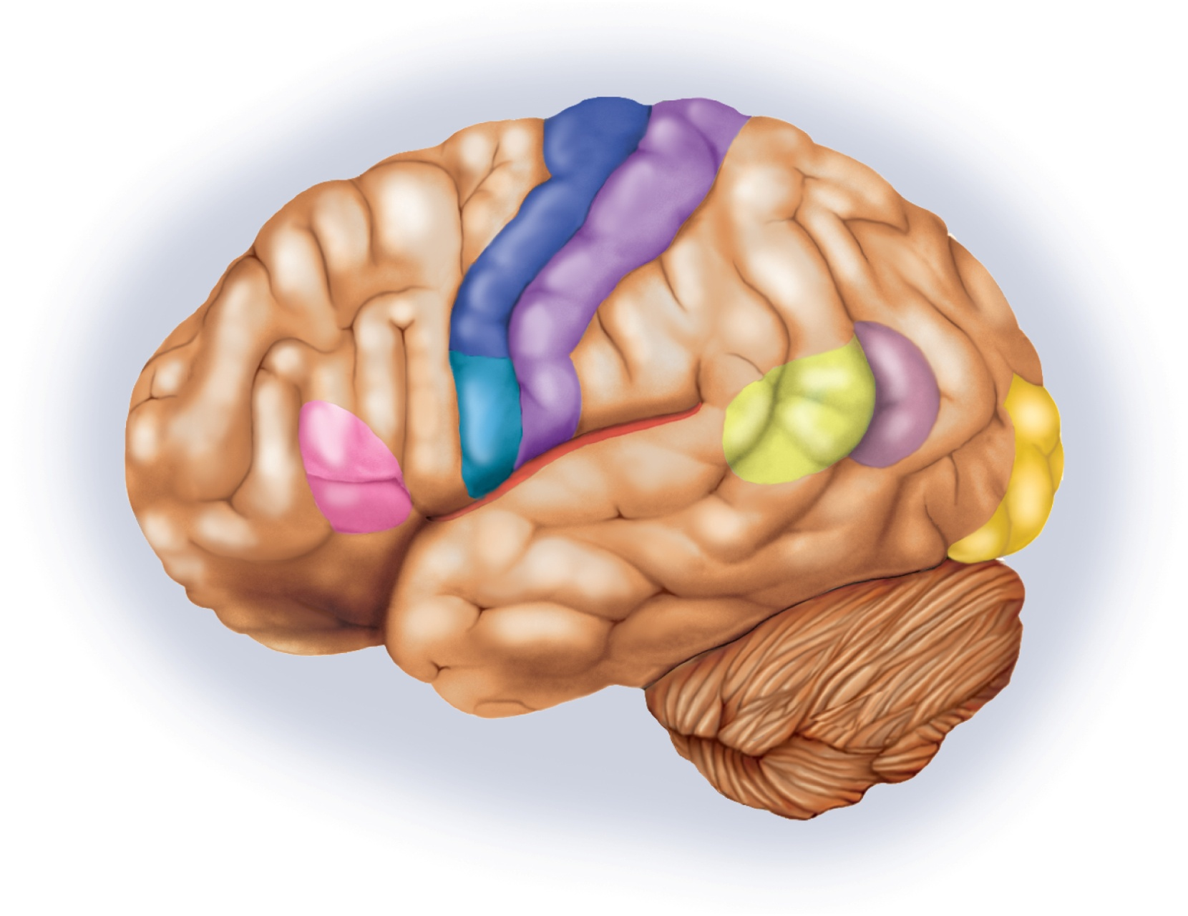
Language Centers
Copyright © The McGraw-Hill Companies, Inc. Permission required for reproduction or display.
Anterior
Posterior
Precentral gyrus
leaves
Postcentral
gyrus
Speech center of
primary motor cortex
Angular
gyrus
Primary auditory
cortex
(in lateral sulcus)
Primary
visual cortex
Broca
area
Wernicke
area
Figure 14.25

Slide 66
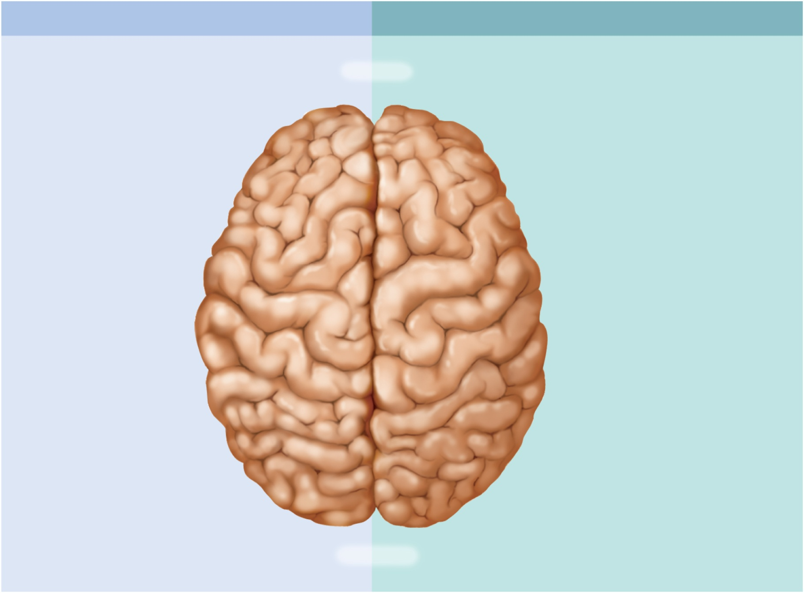
Cerebral Lateralization
Copyright © The McGraw-Hill Companies, Inc. Permission required for reproduction or display.
Left hemisphere
Right hemisphere
Olfaction, right nasal cavity
Anterior
Olfaction, left nasal cavity
Verbal memory
Memory for shapes
leaves
(Limited language
comprehension, mute)
Speech
Left hand motor control
Right hand
motor control
Feeling shapes with
left hand
Feeling shapes
with right hand
Hearing nonvocal sounds
(left ear advantage)
Hearing vocal sounds
(right ear advantage)
Musical ability
Rational, symbolic
thought
Intuitive, nonverbal thought
Superior language
comprehension
Superior recognition of
faces and spatial
relationships
Vision, right field
Posterior
Vision, left field
Figure 14.26

Slide 67
Cerebral Lateralization
cerebral lateralization – the difference in the structure and function of the cerebral hemispheres
left hemisphere - categorical hemisphere
specialized for spoken and written language
sequential and analytical reasoning (math and science)
breaks information into fragments and analyzes it in a linear way
right hemisphere - representational hemisphere
perceives information in a more integrated holistic way
seat of imagination and insight
musical and artistic skill
perception of patterns and spatial relationships
comparison of sights, sounds, smells, and taste
highly correlated with handedness
left hemisphere is the categorical one in 96% of right-handed people
right hemisphere in 4%
left handed people – right hemisphere is categorical in 15% and left in 70%
lateralization develops with age
males exhibit more lateralization than females and suffer more functional loss when one hemisphere is damaged

Slide 68
Cranial Nerves
the brain must communicate with the rest of the body
most of the input and output travels by way of the spinal cord
12 pairs of cranial nerves arise from the base of the brain
exit the cranium through foramina
lead to muscles and sense organs located mainly in the head and neck

Slide 69
Cranial Nerve Pathways
most motor fibers of the cranial nerves begin in nuclei of brainstem and lead to glands and muscles
sensory fibers begin in receptors located mainly in head and neck and lead mainly to the brainstem
sensory fibers for proprioception may travel to brain in a different nerve from motor nerve
most cranial nerves carry fibers between brainstem and ipsilateral receptors and effectors
lesion in left brainstem causes sensory or motor deficit on same side
exceptions are: optic nerve where half the fibers decussate, and trochlear nerve where all efferent fibers lead to a muscle of the contralateral eye

Slide 70
Cranial Nerve Classification
some cranial nerves are classified as motor, some sensory, others mixed
sensory (I, II, and VIII)
motor (III, IV, VI, XI, and XII)
stimulate muscle but also contain fibers of proprioception
mixed (V, VII, IX, X)
sensory functions may be quite unrelated to their motor function
facial nerve (VII) has sensory role in taste and motor role in facial expression

Slide 71
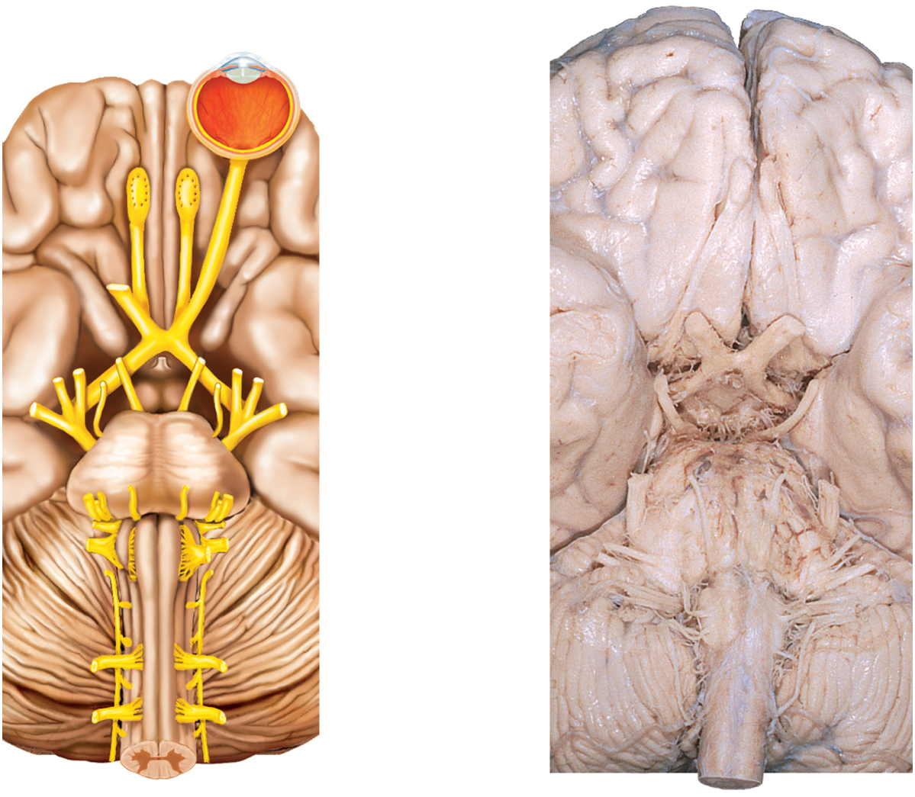
Cranial Nerves
Figure 14.27a-b
Copyright © The McGraw-Hill Companies, Inc. Permission required for reproduction or display.
Frontal lobe
Frontal lobe
Cranial nerves:
leaves
Longitudinal
fissure
Olfactory bulb
(from olfactory nerve, I)
Olfactory tract
Olfactory tract
Optic chiasm
Optic nerve (II)
Temporal lobe
Temporal lobe
Oculomotor nerve (III)
Infundibulum
Trochlear nerve (IV)
Trigeminal nerve (V)
Optic chiasm
Pons
Abducens nerve (VI)
Facial nerve (VII)
Medulla
Pons
Vestibulocochlear nerve (VIII)
Glossopharyngeal nerve (IX)
Cerebellum
Vagus nerve (X)
Medulla
oblongata
Hypoglossal nerve (XII)
Accessory nerve (XI)
Cerebellum
Spinal cord
Spinal cord
(a)
(b)
b: © The McGraw-Hill Companies, Inc./Rebecca Gray, photographer/Don Kincaid, dissections

Slide 72
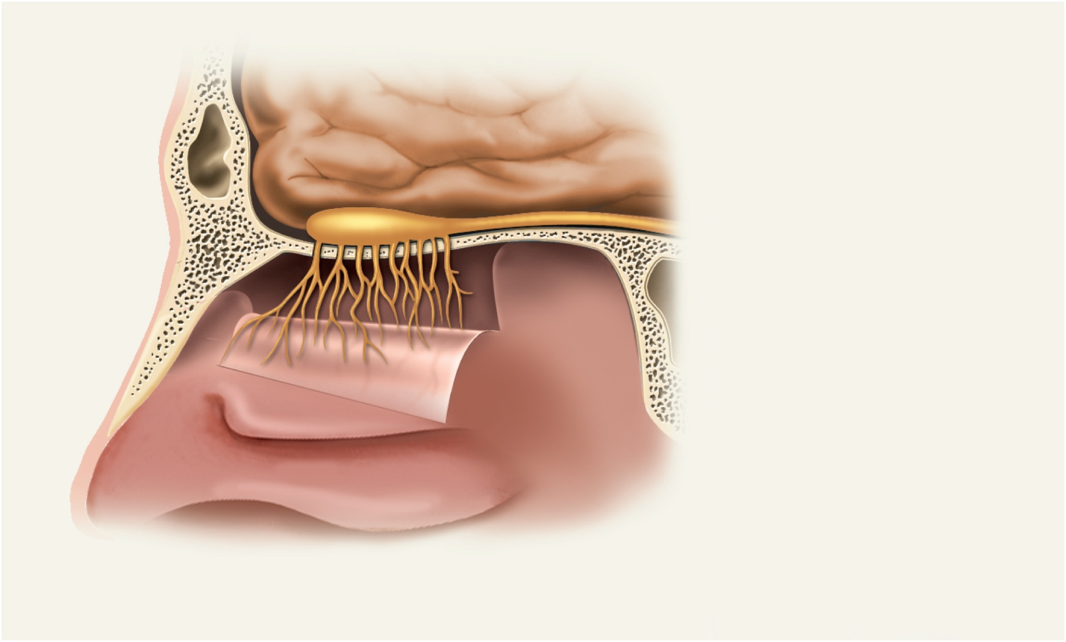
I Olfactory Nerve
Copyright © The McGraw-Hill Companies, Inc. Permission required for reproduction or display.
Olfactory bulb
Olfactory tract
Cribriform plate of
ethmoid bone
Fascicles of
olfactory nerve (I)
Nasal mucosa
Figure 14.28
sense of smell
damage causes impaired sense of smell

Slide 73
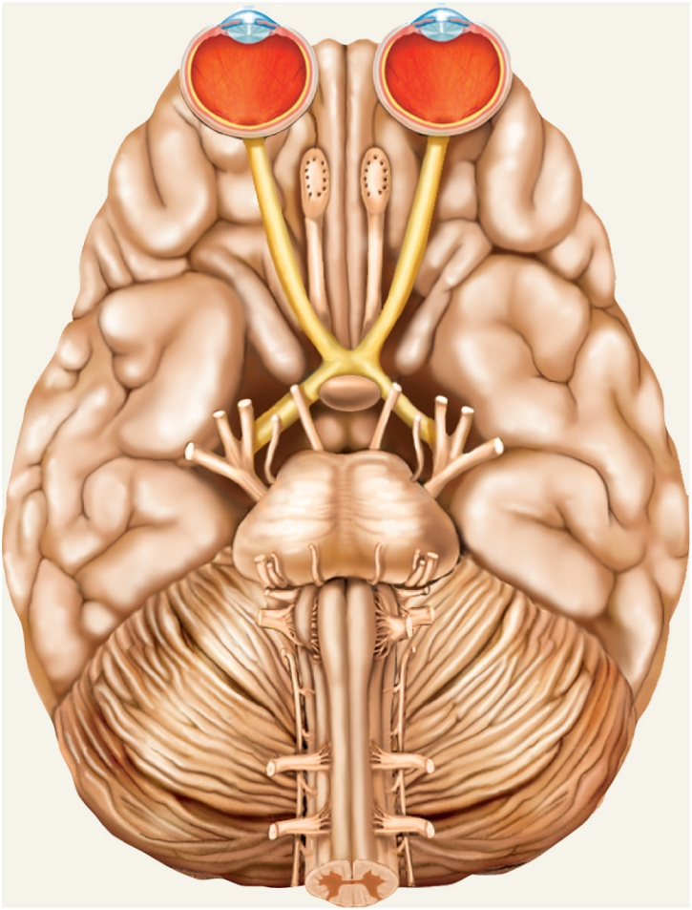
II Optic Nerve
Copyright © The McGraw-Hill Companies, Inc. Permission required for reproduction or display.
Eyeball
Optic nerve (II)
Optic chiasm
Optic tract
Pituitary gland
Figure 14.29
provides vision
damage causes blindness in part or all of the visual field

Slide 74
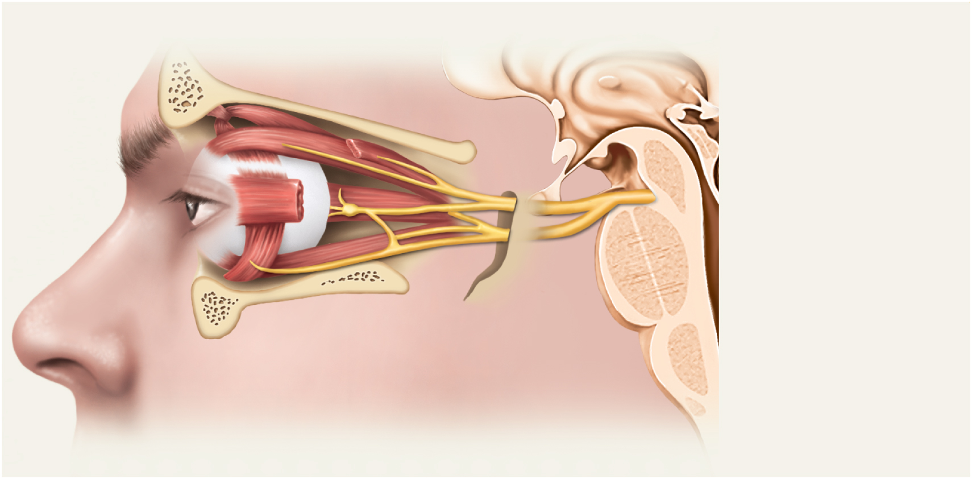
III Oculomotor Nerve
Copyright © The McGraw-Hill Companies, Inc. Permission required for reproduction or display.
Oculomotor nerve (III):
Superior branch
Inferior branch
Ciliary ganglion
Superior orbital fissure
Figure 14.30
controls muscles that turn the eyeball up, down, and medially, as well as controlling the iris, lens, and upper eyelid
damage causes drooping eyelid, dilated pupil, double vision, difficulty focusing and inability to move eye in certain directions

Slide 75
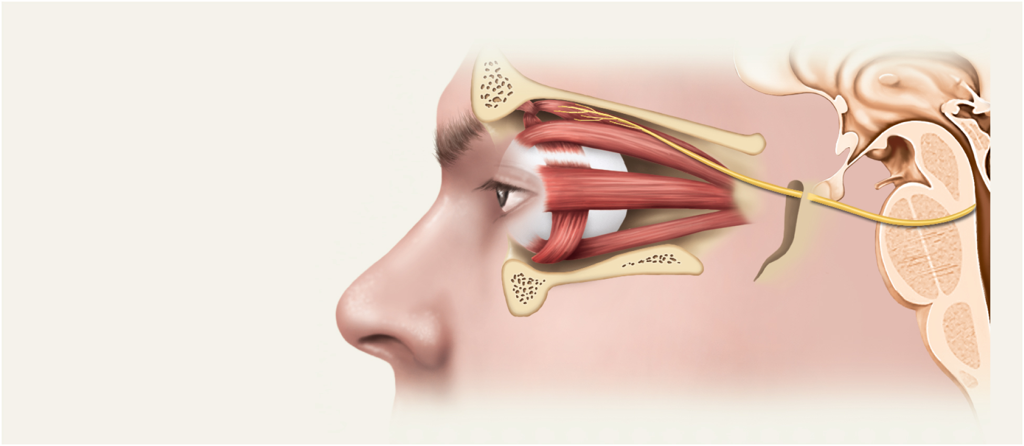
IV Trochlear Nerve
Copyright © The McGraw-Hill Companies, Inc. Permission required for reproduction or display.
Superior oblique muscle
Superior orbital fissure
Trochlear nerve (IV)
Figure 14.31
eye movement (superior oblique muscle)
damage causes double vision and inability to rotate eye inferolaterally

Slide 76
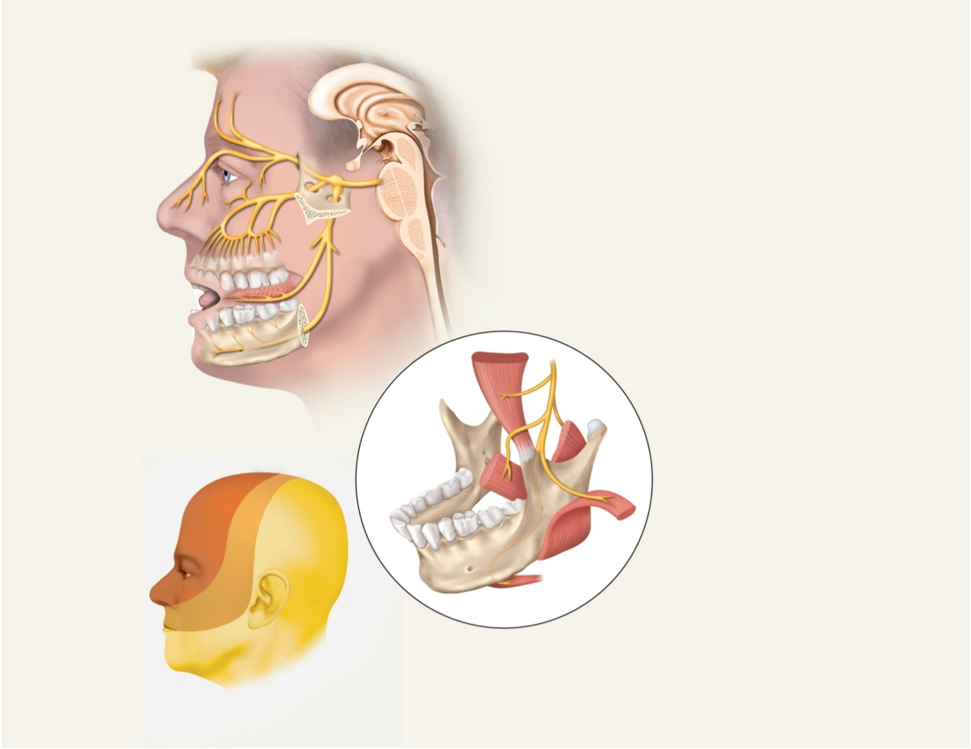
V Trigeminal Nerve
largest of the cranial nerves
most important sensory nerve of the face
forks into three divisions:
ophthalmic division (V₁) – sensory
maxillary division (V₂) – sensory
mandibular division (V₃) - mixed
Copyright © The McGraw-Hill Companies, Inc. Permission required for reproduction or display.
Superior orbital fissure
Ophthalmic division (V₁)
Trigeminal ganglion
Trigeminal nerve (V)
Infraorbital
nerve
Maxillary division (V₂)
Superior
alveolar nerves
Foramen ovale
Mandibular division (V₃)
Foramen rotundum
Lingual nerve
1
Anterior trunk of V₃ to
chewing muscles
Inferior
alveolar nerve
Temporalis muscle
Lateral pterygoid muscle
Medial pterygoid muscle
V₁
V₃
Masseter muscle
V₂
Anterior belly of
digastric muscle
Motor branches of the
mandibular division (V₃)
Distribution of sensory
fibers of each division
Figure 14.32

Slide 77
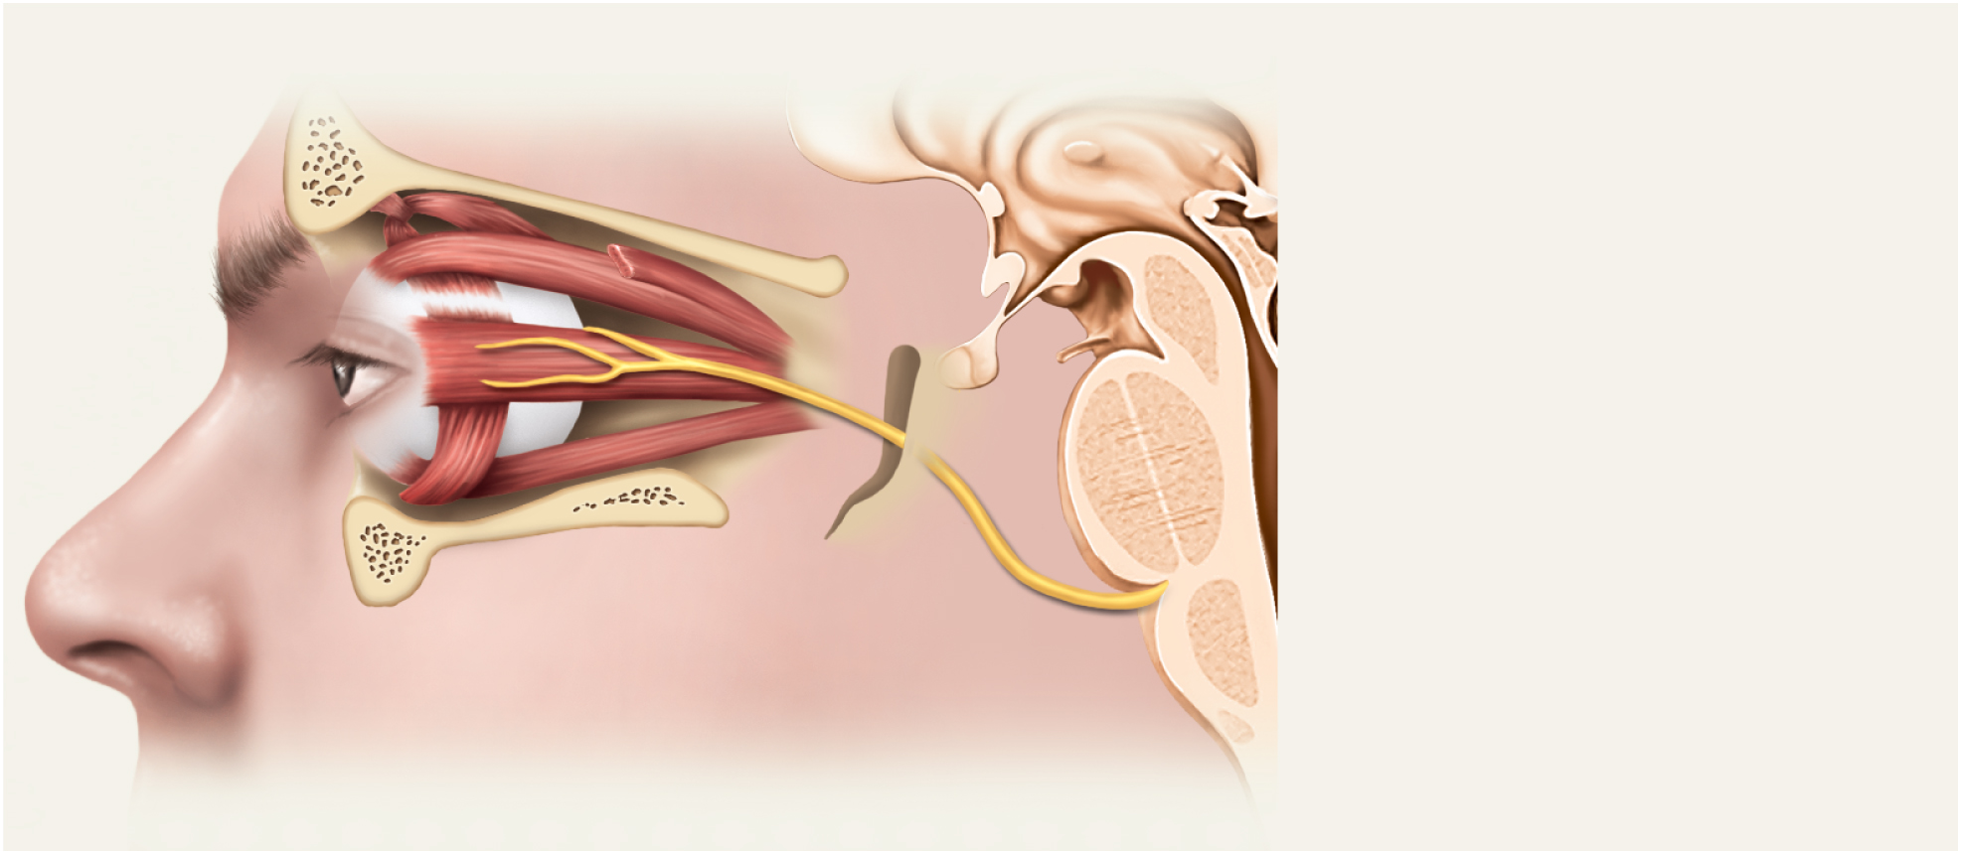
VI Abducens Nerve
Copyright © The McGraw-Hill Companies, Inc. Permission required for reproduction or display.
Lateral rectus muscle
Superior orbital fissure
Abducens nerve (VI)
Figure 14.33
provides eye movement (lateral rectus m.)
damage results in inability to rotate eye laterally and at rest eye rotates medially

Slide 78
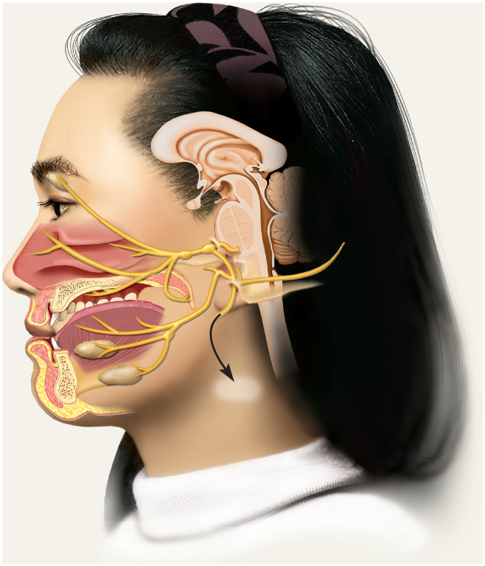
VII Facial Nerve
Copyright © The McGraw-Hill Companies, Inc. Permission required for reproduction or display.
Facial nerve (VII)
Internal acoustic meatus
Geniculate ganglion
Pterygopalatine ganglion
Lacrimal (tear) gland
Chorda tympani
branch (taste and
salivation)
Submandibular ganglion
Motor branch
to muscles of
facial expression
Sublingual gland
Parasympathetic fibers
to (b)
Submandibular gland
Stylomastoid foramen
Figure 14.34a
(a)
motor – major motor nerve of facial muscles: facial expressions; salivary glands and tear, nasal and palatine glands
sensory - taste on anterior 2/3’s of tongue
damage produces sagging facial muscles and disturbed sense of taste (no sweet and salty)

Slide 79
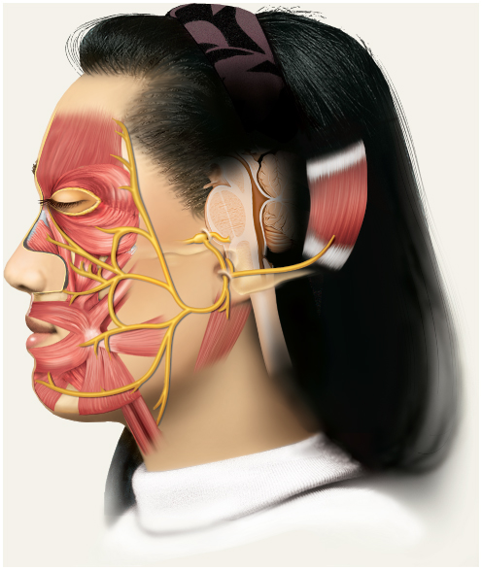
Five Branches of Facial Nerve
Copyright © The McGraw-Hill Companies, Inc. Permission required for reproduction or display.
Temporal
Zygomatic
Buccal
Mandibular
Cervical
(b)
© The McGraw-Hill Companies, Inc./Joe DeGrandis, photographer
(c)
Figure 14.34 b-c
clinical test: test anterior 2/3’s of tongue with substances such as sugar, salt, vinegar, and quinine; test response of tear glands to ammonia fumes; test motor functions by asking subject to close eyes, smile, whistle, frown, raise eyebrows, etc.

Slide 80
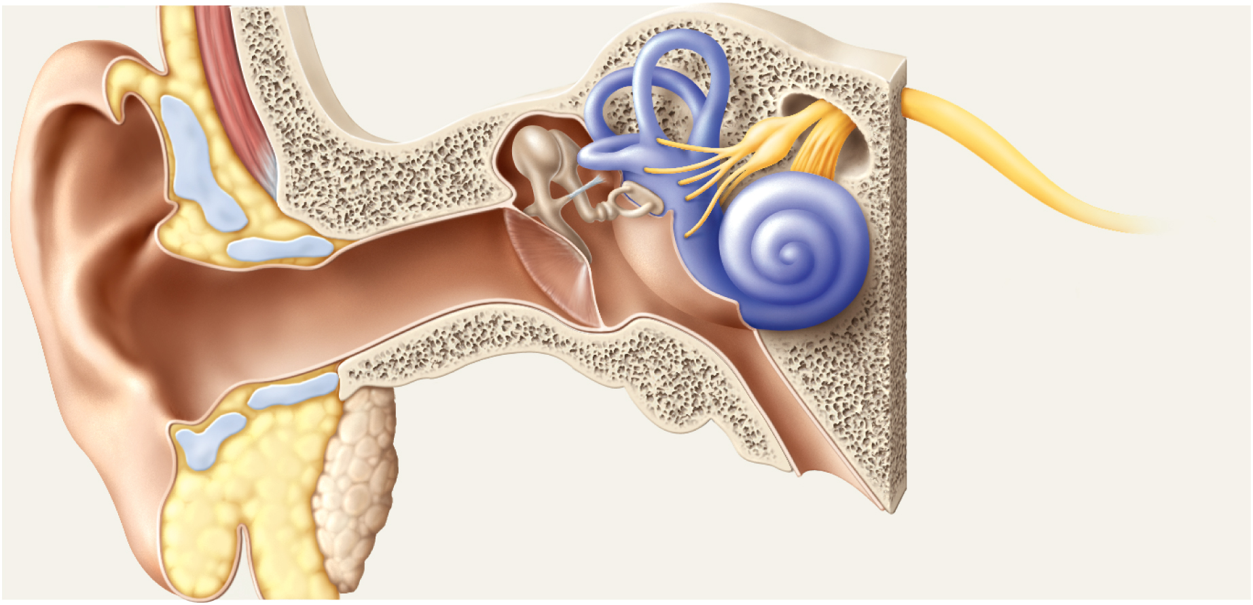
VIII Vestibulocochlear Nerve
Copyright © The McGraw-Hill Companies, Inc. Permission required for reproduction or display.
Vestibular ganglia
Vestibular nerve
Semicircular
ducts
leaves
Cochlear nerve
Vestibulocochlear
nerve (VIII)
Internal
acoustic meatus
Cochlea
Vestibule
Figure 14.35
nerve of hearing and equilibrium
damage produces deafness, dizziness, nausea, loss of balance and nystagmus (involuntary rhythms oscillation of the eyes from side to side

Slide 81
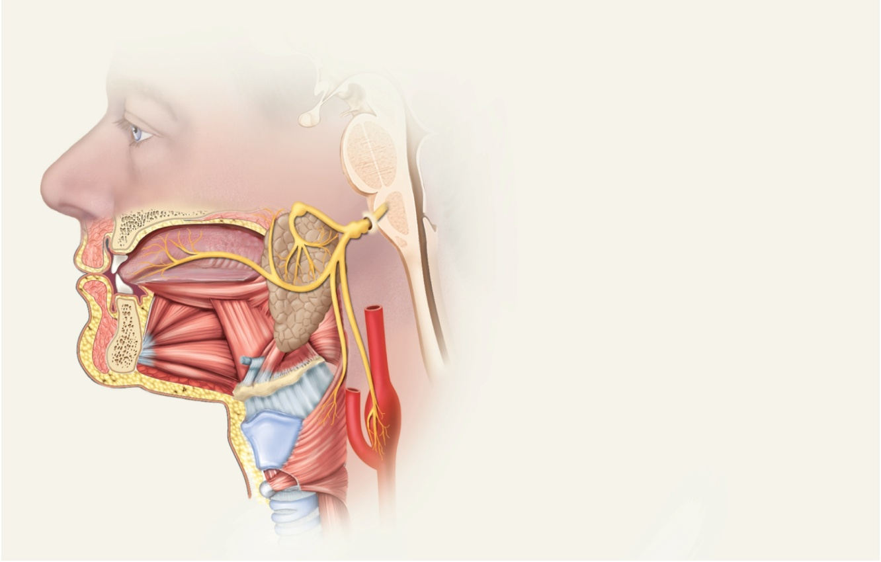
IX Glossopharyngeal Nerve
Copyright © The McGraw-Hill Companies, Inc. Permission required for reproduction or display.
swallowing, salivation, gagging, control of BP and respiration
sensations from posterior 1/3 of tongue
damage results in loss of bitter and sour taste and impaired swallowing
Glossopharyngeal nerve (IX)
Jugular foramen
Superior ganglion
Inferior ganglion
Otic ganglion
Parotid salivary gland
Carotid sinus
Pharyngeal muscles
Figure 14.36

Slide 82
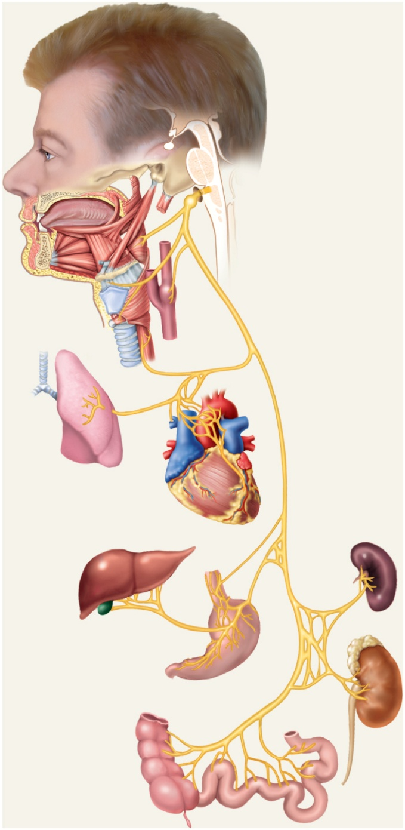
X Vagus Nerve
Copyright © The McGraw-Hill Companies, Inc. Permission required for reproduction or display.
most extensive distribution of any cranial nerve
major role in the control of cardiac, pulmonary, digestive, and urinary function
swallowing, speech, regulation of viscera
damage causes hoarseness or loss of voice, impaired swallowing and fatal if both are cut
Jugular foramen
Pharyngeal nerve
Laryngeal nerve
Carotid sinus
Vagus nerve (X)
Lung
Heart
Spleen
Liver
Kidney
Stomach
Colon
(proximal portion)
Figure 14.37
Small intestine

Slide 83
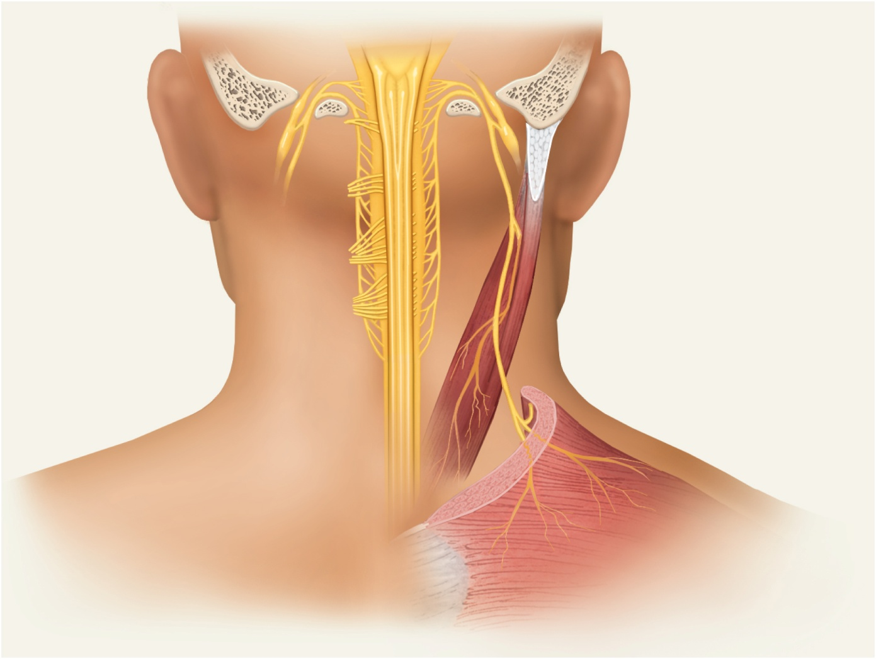
XI Accessory Nerve
Copyright © The McGraw-Hill Companies, Inc. Permission required for reproduction or display.
Jugular
foramen
Cranial root of XI
Vagus nerve
Foramen
magnum
Accessory nerve (XI)
Spinal root of XI
Spinal nerves
C3 and C4
Sternocleidomastoid
muscle
Trapezius muscle
Posterior view
Figure 14.38
swallowing, head, neck and shoulder movement
damage causes impaired head, neck, shoulder movement; head turns towards injured side

Slide 84
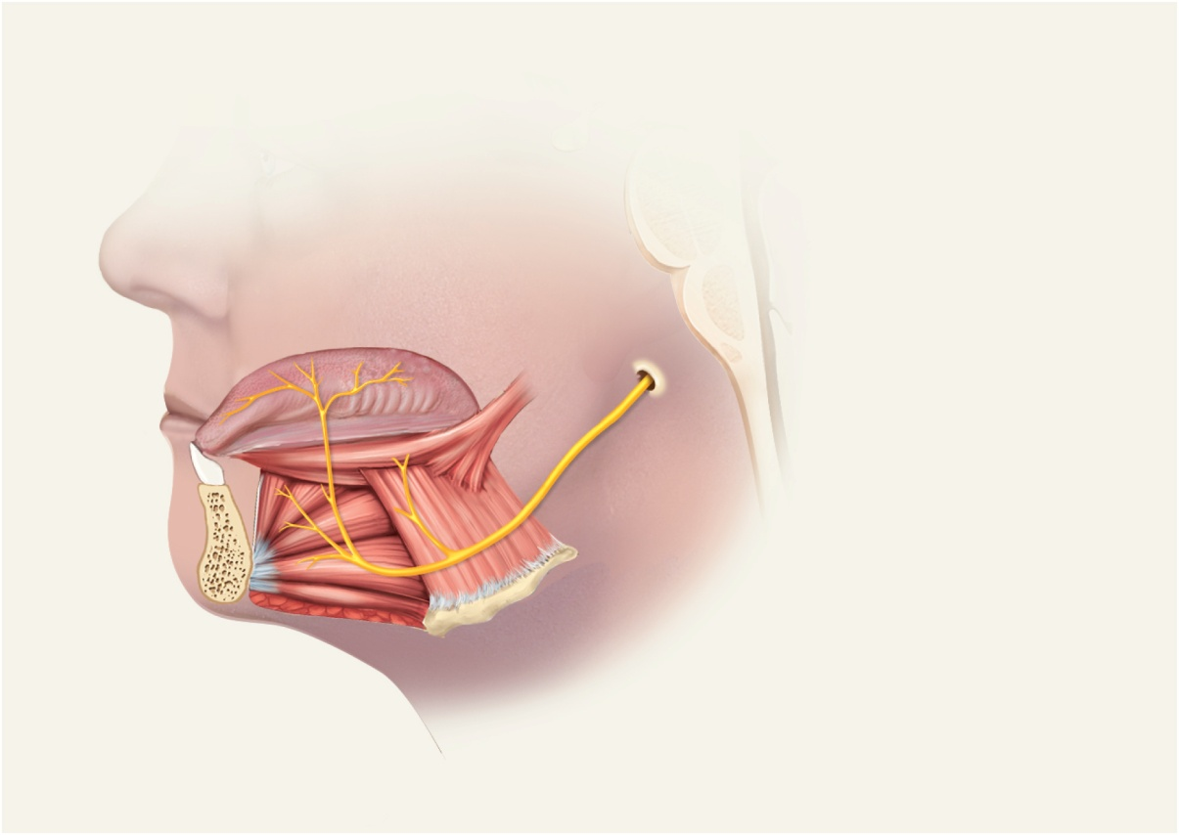
XII Hypoglossal Nerve
Copyright © The McGraw-Hill Companies, Inc. Permission required for reproduction or display.
Hypoglossal canal
Intrinsic muscles
of the tongue
Extrinsic muscles
of the tongue
Hypoglossal nerve (XII)
Figure 14.39
tongue movements for speech, food manipulation and swallowing
if both are damaged – can’t protrude tongue
if one side is damaged – tongue deviates towards injured side; see ipsilateral atrophy

Slide 85
Cranial Nerve Disorders
Trigeminal neuralgia (tic douloureux)
recurring episodes of intense stabbing pain in trigeminal nerve area (near mouth or nose)
pain triggered by touch, drinking, washing face
treatment may require cutting nerve
Bell palsy
degenerative disorder of facial nerve causes paralysis of facial muscles on one side
may appear abruptly with full recovery within 3 - 5 weeks

Slide 86
Images of the Mind
positron emission tomography (PET) and MRI visualize increases in blood flow when brain areas are active
injection of radioactively labeled glucose
busy areas of brain “light up”
functional magnetic resonance imaging (fMRI) looks at increase in blood flow to an area (additional glucose is needed in active area) – magnetic properties of hemoglobin depend on how much oxygen is bound to it (additional oxygen is there due to additional blood flow)
quick, safe and accurate method to see brain function

