Slide 1
Endocrine System
Overview
Hypothalamus and Pituitary Gland
Other Endocrine Glands
Hormones and Their Actions
Stress and Adaptation
Eicosanoids and Paracrine Signaling
Endocrine Disorders

Slide 2
Overview of Cell Communications
internal communication is necessary for coordination of cell activities
four principal mechanisms of communication between cells
gap junctions
pores in cell membrane allow signaling molecules, nutrients, and electrolytes to move from cell to cell
neurotransmitters
released from neurons to travel across synaptic cleft to second cell
paracrine (local) hormones
secreted into tissue fluids to affect nearby cells
hormones
chemical messengers that travel in the bloodstream to other tissues and organs

Slide 3
Endocrine System Components
endocrine system - glands, tissues, and cells that secrete hormones
endocrinology – the study of this system and the diagnosis and treatment of its disorders
endocrine glands – organs that are traditional sources of hormones
hormones - chemical messengers that are transported by the bloodstream and stimulate physiological responses in cells of another tissue or organ, often a considerable distance away
Copyright © The McGraw-Hill Companies, Inc. Permission required for reproduction or display.
Endocrine
cells
Target cells
Hormone in
bloodstream
(b) Endocrine system
Figure 17.2b

Slide 4
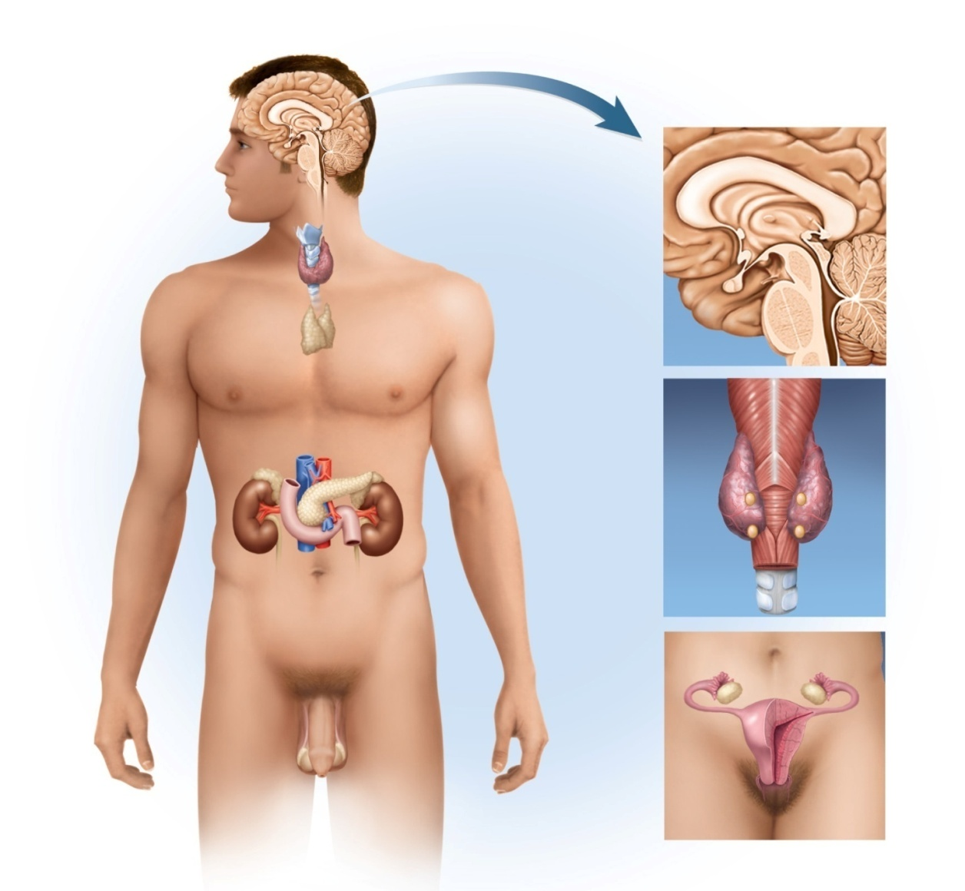
Endocrine Organs
Copyright © The McGraw-Hill Companies, Inc. Permission required for reproduction or display.
Pineal gland
Hypothalamus
Pituitary gland
Thyroid gland
Thymus
Adrenal gland
Pancreas
Parathyroid
glands
Posterior
view
Trachea
Gonads:
Ovary (female)
Testis (male)
Figure 17.1
major organs of endocrine system

Slide 5
Comparison of Endocrine and Exocrine Glands
exocrine glands
have ducts carry secretion to an epithelial surface or the mucosa of the digestive tract – ‘external secretions’
extracellular effects (food digestion)
endocrine glands
no ducts
contain dense, fenestrated capillary networks which allows easy uptake of hormones into bloodstream
‘internal secretions’
intracellular effects such as altering target cell metabolism
liver cells defy rigid classification – releases hormones, releases bile into ducts, releases albumin and blood-clotting factors into blood (not hormones)

Slide 6
Comparison of Nervous and Endocrine Systems (Differences)
both serve for internal communication
nervous - both electrical and chemical
endocrine - only chemical
speed and persistence of response
nervous - reacts quickly (1 - 10 msec), stops quickly
endocrine - reacts slowly (hormone release in seconds or days), effect may continue for weeks
adaptation to long-term stimuli
nervous - response declines (adapts quickly)
endocrine - response persists (adapts slowly)
area of effect
nervous - targeted and specific (one organ)
endocrine - general, widespread effects (many organs)

Slide 7
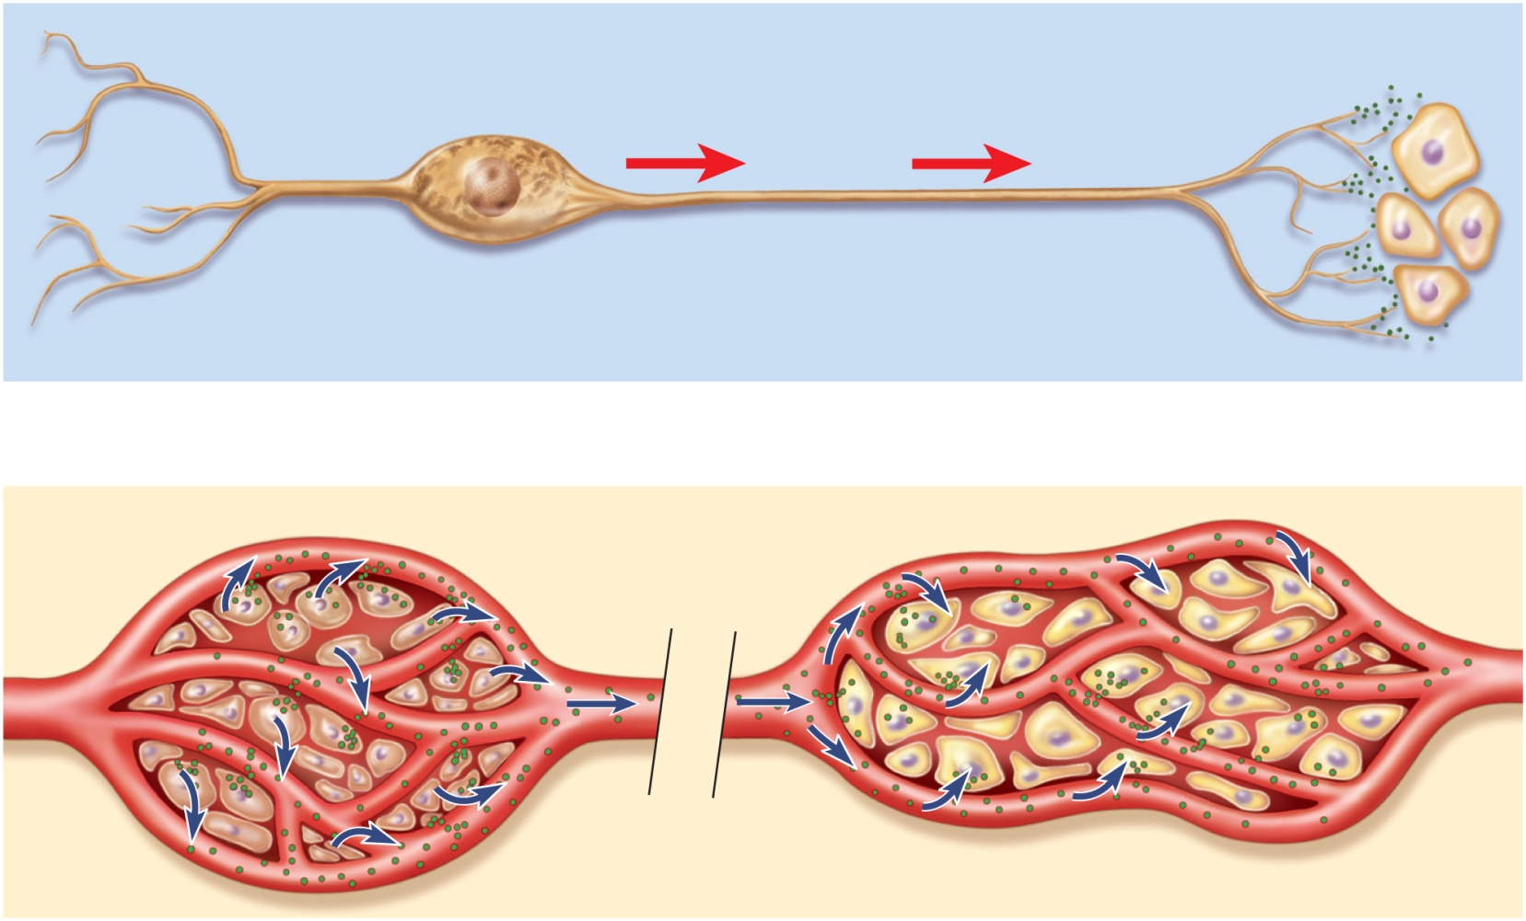
Communication by the Nervous and Endocrine Systems
Copyright © The McGraw-Hill Companies, Inc. Permission required for reproduction or display.
Neurotransmitter
Nerve impulse
Neuron
Target cells
(a) Nervous system
Endocrine
cells
Target cells
Hormone in
bloodstream
(b) Endocrine system
Figure 17.2 a-b

Slide 8
Nervous and Endocrine Systems (Similarities)
several chemicals function as both hormones and neurotransmitters
norepinephrine, cholecystokinin, thyrotropin-releasing hormone, dopamine and antidiuretic hormone
some hormones secreted by neuroendocrine cells (neurons) that release their secretion into the bloodstream
oxytocin and catecholamines
both systems with overlapping effects on same target cells
norepinephrine and glucagon cause glycogen hydrolysis in liver
systems regulate each other
neurons trigger hormone secretion
hormones stimulate or inhibit neurons
target organs or cells – those organs or cells that have receptors for a hormone and can respond to it.

Slide 9
Anatomy of Hypothalamus
shaped like a flattened funnel
forms floor and walls of third ventricle of the brain
regulates primitive functions of the body from water balance and thermoregulation to sex drive and childbirth
many of its functions carried out by pituitary gland

Slide 10
Pituitary Gland (Hypophysis)
suspended from hypothalamus by a stalk – infundibulum
location and size
housed in sella turcica of sphenoid bone
size and shape of kidney bean
composed of two structures with independent origins and separate functions
adenohypophysis (anterior pituitary)
arises from hypophyseal pouch (outgrowth of pharynx)
neurohypophysis (posterior pituitary)
downgrowth from brain

Slide 11
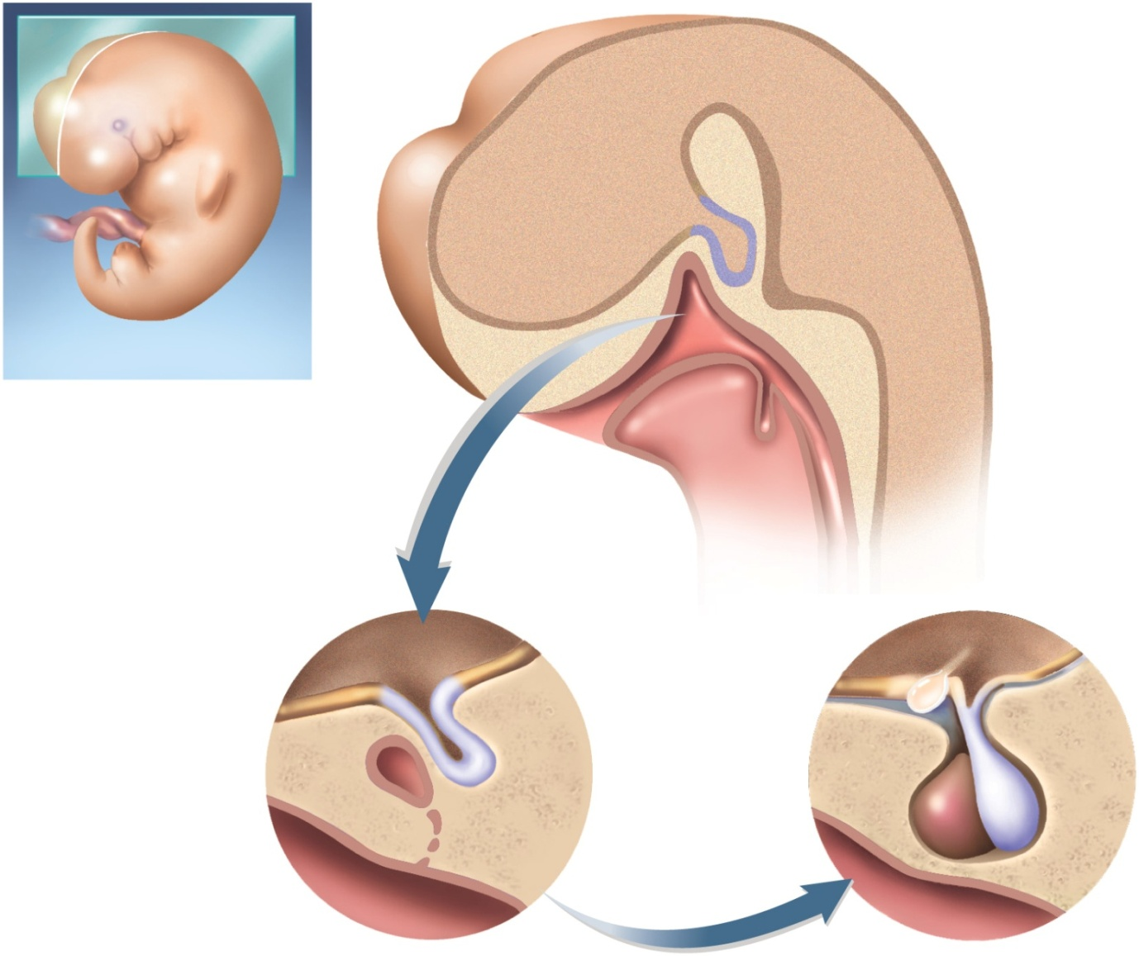
Embryonic Development
Copyright © The McGraw-Hill Companies, Inc. Permission required for reproduction or display.
Telencephalon of brain
Future hypothalamus
Neurohypophyseal bud
Hypophyseal pouch
Pharynx
Tongue
Future thyroid
gland
Mouth
Figure 17.3 a-c
(a) 4 weeks
Hypothalamus
Hypothalamus
Optic chiasm
Neurohypophyseal
bud
Pituitary stalk
Posterior lobe
Hypophyseal pouch
Anterior lobe
Sphenoid bone
Pharynx
Pharynx
(b) 8 weeks
(c) 16 weeks

Slide 12
Adenohypophysis & Neurohypophysis
adenohypophysis constitutes anterior three-quarters of pituitary
has two segments:
anterior lobe (pars distalis)
pars tuberalis small mass of cells adhering to stalk
linked to hypothalamus by hypophyseal portal system
primary capillaries in hypothalamus connected to secondary capillaries in adenohypophysis by portal venules
hypothalamic hormones regulate adenohypophysis cells
neurohypophysis constitutes the posterior one-quarter of the pituitary
has 3 parts:
median eminence, infundibulum, and the posterior lobe (pars nervosa)
nerve tissue, not a true gland
nerve cell bodies in hypothalamus pass down the stalk as hypothalamo-hypophyseal tract and end in posterior lobe
hypothalamic neurons secrete hormones that are stored in neurohypophysis until released into blood

Slide 13
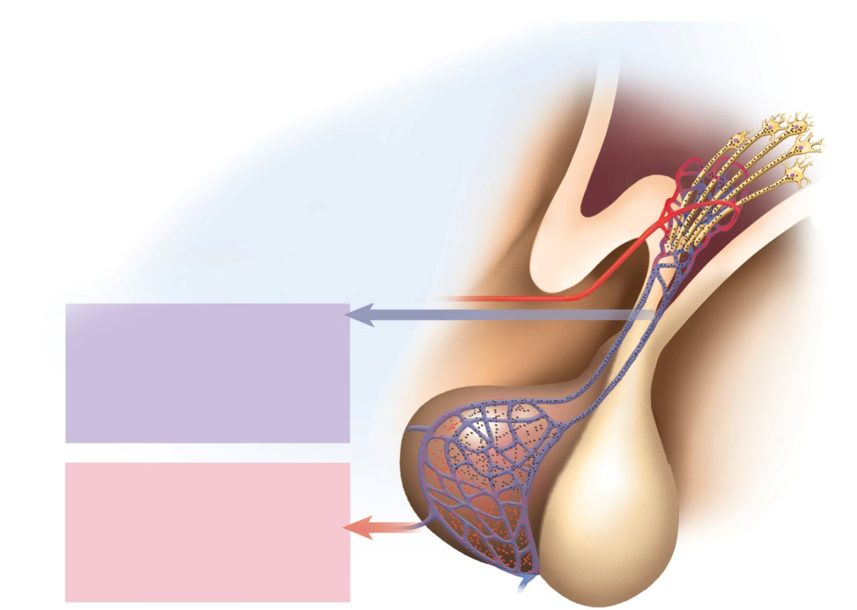
Hypophyseal Portal System
Copyright © The McGraw-Hill Companies, Inc. Permission required for reproduction or display.
Axons to
primary
capillaries
Neuron
cell body
Superior hypophyseal
artery
Hypothalamic hormones
Hypophyseal
portal system:
Gonadotropin-releasing hormone
Thyrotropin-releasing hormone
Corticotropin-releasing hormone
Prolactin-inhibiting hormone
Growth hormone–releasing hormone
Somatostatin
Primary capillaries
Portal venules
Secondary
capillaries
Anterior lobe hormones
Anterior lobe
Figure 17.4b
Follicle-stimulating hormone
Luteinizing hormone
Thyroid-stimulating hormone (thyrotropin)
Adrenocorticotropic hormone
Prolactin
Growth hormone
Posterior lobe
(b)
hypothalamic releasing and inhibiting hormones travel in hypophyseal portal system from hypothalamus to anterior pituitary
hormones secreted by anterior pituitary

Slide 14
Hypothalamic Hormones
eight hormones produced in hypothalamus
six regulate the anterior pituitary
two are released into capillaries in the posterior pituitary when hypothalamic neurons are stimulated (oxytocin and antidiuretic hormone)
six releasing and inhibiting hormones stimulate or inhibit the anterior pituitary
TRH, CRH, GnRH, and GHRH are releasing hormones that affect anterior pituitary secretion of TSH, PRL, ACTH, FSH, LH, and GH
PIH inhibits secretion of prolactin, and somatostatin inhibits secretion growth hormone & thyroid stimulating hormone by the anterior pituitary (see Table 17.3)

Slide 15
Hypothalamic Hormones
two other hypothalamic hormones are oxytocin (OT) and antidiuretic hormone (ADH)
both stored and released by posterior pituitary
right and left paraventricular nuclei produce oxytocin (OT)
supraoptic nuclei produce antidiuretic hormone (ADH)
posterior pituitary does not synthesize them

Slide 16
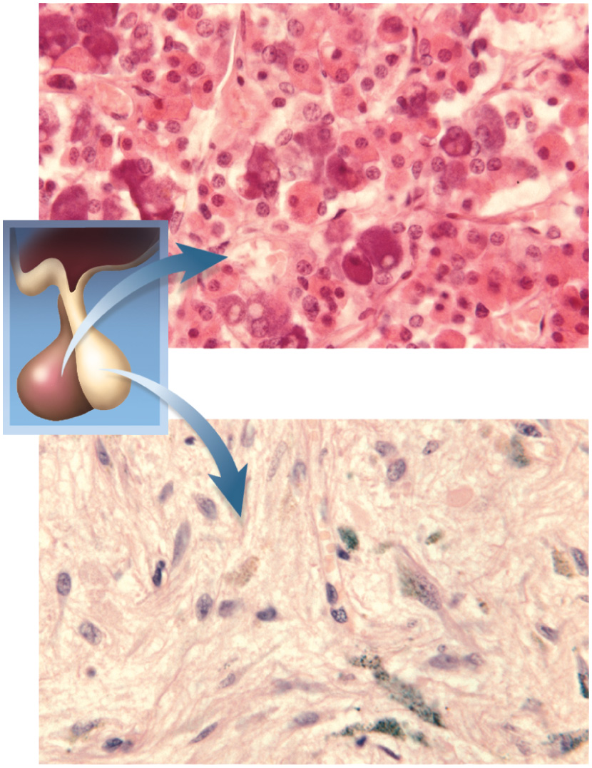
Histology of Pituitary Gland
Copyright © The McGraw-Hill Companies, Inc. Permission required for reproduction or display.
Chromophobe
Figure 17.5a (2)
Basophil
Acidophil
Figure 17.5 (1)
(a) Anterior pituitary
Unmyelinated
nerve fibers
Glial cells
(pituicytes)
Figure 17.5b (3)
(b) Posterior pituitary
a: © Dr. John D. Cunningham/Visuals Unlimited; b: © Science VU/Visuals Unlimited

Slide 17
Anterior Pituitary Hormones
anterior lobe of the pituitary synthesizes and secretes six principal hormones
two gonadotropin hormones that target gonads
FSH (follicle stimulating hormone)
stimulates secretion of ovarian sex hormones, development of ovarian follicles, and sperm production
LH (luteinizing hormone)
stimulates ovulation, stimulates corpus luteum to secrete progesterone, stimulates testes to secrete testosterone
TSH (thyroid stimulating hormone)
stimulates secretion of thyroid hormone
ACTH (adrenocorticotropic hormone)
stimulates adrenal cortex to secrete glucocorticoids
PRL (prolactin)
after birth stimulates mammary glands to synthesize milk, enhances secretion of testosterone by testes
GH (growth hormone)
stimulates mitosis and cellular differentiation

Slide 18
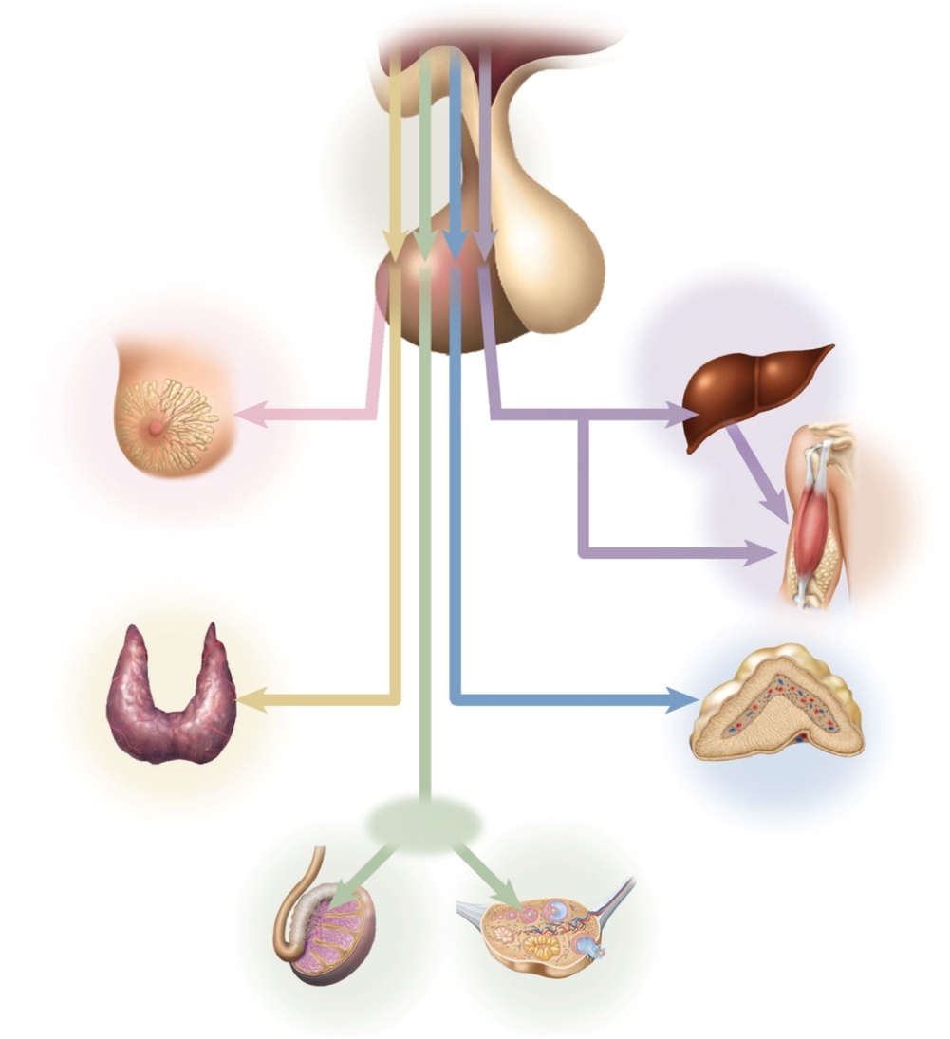
Hypothalamo-Pituitary-Target Organ Relationships
Copyright © The McGraw-Hill Companies, Inc. Permission required for reproduction or display.
Hypothalamus
TRH
GnRH
CRH
Figure 17.6
GHRH
Liver
PRL
GH
Mammary
gland
IGF
Fat,
muscle,
bone
TSH
ACTH
Thyroid
Adrenal cortex
LH
FSH
Figure 17.6
Testis
Ovary
principle hormones and target organs

Slide 19
Pars Intermedia
present in fetus; absent in adult
produces melanocyte stimulating hormone in animals influencing pigmentation of skin, hair, or feathers
not apparently present nor functioning in humans
remnant cells in adult anterior lobe
produce POMC (proopiomelanocortin)
not secreted
processed within the pituitary to yield smaller fragments such as ACTH and pain-inhibiting endorphins

Slide 20
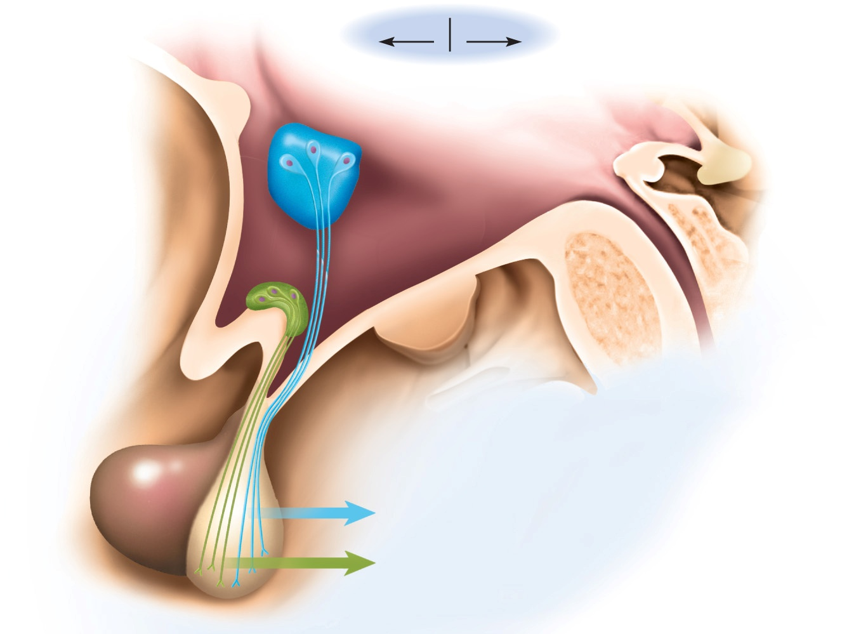
Posterior Pituitary Hormones
Copyright © The McGraw-Hill Companies, Inc. Permission required for reproduction or display.
Anterior
Posterior
Third ventricle of brain
Floor of
hypothalamus
Pineal gland
Nuclei of hypothalamus:
Paraventricular nucleus
Supraoptic nucleus
Cerebral aqueduct
Mammillary body
Optic chiasm
Neurohypophysis:
Adenohypophysis:
Median eminence
Pars tuberalis
Hypothalamo–hypophyseal tract
Anterior lobe
Stalk (infundibulum)
Posterior lobe
Oxytocin
(a)
Antidiuretic hormone
Figure 17.4a

Slide 21
Posterior Pituitary Hormones
produced in hypothalamus
transported by hypothalamo-hypophyseal tract to posterior lobe
releases hormones when hypothalamic neurons are stimulated
ADH (antidiuretic hormone)
increases water retention thus reducing urine volume and prevents dehydration
also called vasopressin because it can cause vasoconstriction
OT (oxytocin)
surge of hormone released during sexual arousal and orgasm
stimulate uterine contractions and propulsion of semen
promotes feelings of sexual satisfaction and emotional bonding between partners
stimulates labor contractions during childbirth
stimulates flow of milk during lactation
promotes emotional bonding between lactating mother and infant

Slide 22
Control of Pituitary Secretion
rates of secretion are not constant
regulated by hypothalamus, other brain centers, and feedback from target organs
Hypothalamic and Cerebral Control
anterior lobe control - releasing hormones and inhibiting hormones from hypothalamus
in cold weather, pituitary stimulated by hypothalamus to release TSH, leads to generation of body heat
posterior lobe control - neuroendocrine reflexes
neuroendocrine reflex - hormone release in response to nervous system signals
suckling infant→ stimulates nerve endings → hypothalamus → posterior lobe → oxytocin → milk ejection
hormone release in response to higher brain centers
milk ejection reflex can be triggered by a baby's cry
emotional stress can affect secretion of gonadotropins, disrupting ovulation, menstruation, and fertility

Slide 23
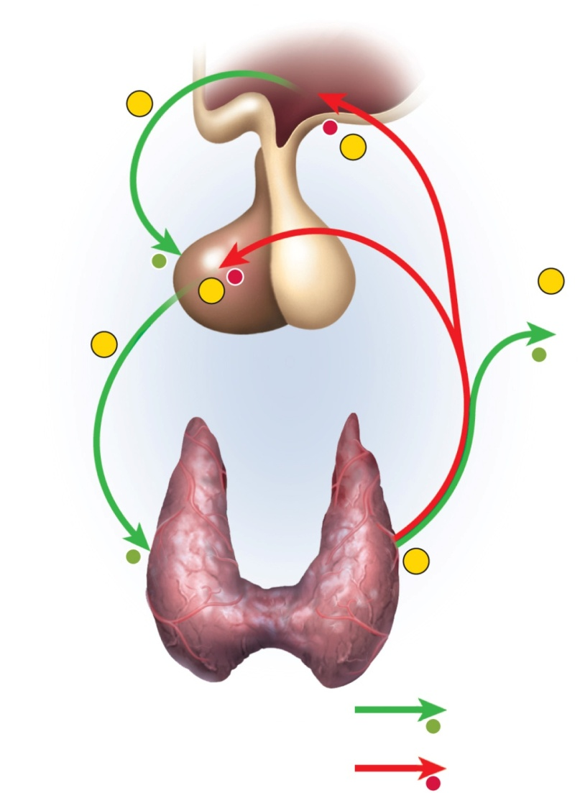
Control of Pituitary: Feedback from Target Organs
Copyright © The McGraw-Hill Companies, Inc. Permission required for reproduction or display.
negative feedback -increased target organ hormone levels inhibits release of hormones
1
−
TRH
6
Negative feedback
inhibition
+
−
4
5
Target organs
2
+
positive feedback -
stretching of uterus
increases OT release,
causes contractions,
causing more stretching
of uterus, etc. until
delivery
TSH
Thyroid hormone
+
3
+
Stimulatory effect
Figure 17.7
–
Inhibitory effect

Slide 24
Growth Hormone
GH has widespread effects on the body tissues
especially cartilage, bone, muscle, and fat
induces liver to produce growth stimulants
insulin-like growth factors (IGF-I) or somatomedins (IGF-II)
stimulate target cells in diverse tissues
IGF-I prolongs the action of GH
hormone half-life – the time required for 50% of the hormone to be cleared from the blood
GH half-life 6 – 20 minutes - IGF-I half-life about 20 hours
protein synthesis increases -- boosts transcription of DNA, production of mRNA, amino acid uptake into cells, suppresses protein catabolism
lipid metabolism increased – fat catabolized by adipocytes (protein-sparing effect) – provides energy for growing tissues

Slide 25
Growth Hormone
carbohydrate metabolism – by mobilizing fatty acids for energy, GH produces glucose-sparing makes glucose available for glycogen synthesis and storage
electrolyte balance – promotes Na⁺, K⁺, & Cl⁻ retention by kidneys, enhances Ca⁺² absorption in intestine
bone growth, thickening, and remodeling influenced, especially during childhood and adolescence
secretion high during first two hours of sleep
can peak in response to vigorous exercise
GH levels decline gradually with age
average 6 ng/ml during adolescence, 1.5 ng/mg in old age
lack of protein synthesis contributes to aging of tissues and wrinkling of the skin
age 30, average adult body is 10% bone, 30% muscle, 20% fat
age 75, average adult body is 8% bone, 15% muscle, 40% fat

Slide 26
Pineal Gland
pineal gland - attached to roof of third ventricle beneath the posterior end of corpus callosum
after age 7, it undergoes involution (shrinkage)
down 75% by end of puberty
tiny mass of shrunken tissue in adults
may synchronize physiological function with 24-hour circadian rhythms of daylight and darkness
synthesizes melatonin from serotonin during the night
fluctuates seasonally with changes in day length
may regulate timing of puberty in humans
seasonal affective disorder (SAD) occurs in winter or northern climates
symptoms - depression, sleepiness, irritability and carbohydrate craving
2 to 3 hours of exposure to bright light each day reduces the melatonin levels and the symptoms (phototherapy)

Slide 27
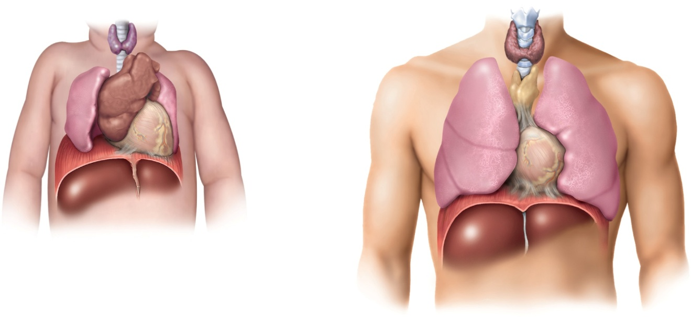
Thymus
thymus plays a role in three systems: endocrine, lymphatic, and immune
bilobed gland in the mediastinum superior to the heart
goes through involution after puberty
site of maturation of T cells important in immune defense
secretes hormones (thymopoietin, thymosin, and thymulin) that stimulate development of other lymphatic organs and activity of T-lymphocytes
Copyright © The McGraw-Hill Companies, Inc. Permission required for reproduction or display.
Thyroid
Trachea
Thymus
Lung
Heart
Diaphragm
(a) Newborn
Liver
Figure 17.8 a-b
(b) Adult

Slide 28
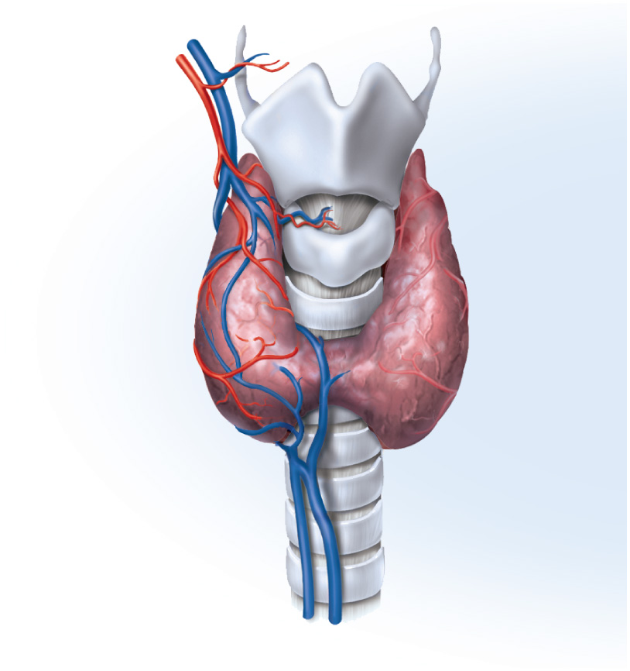
Thyroid Gland Anatomy
largest endocrine gland
composed of two lobes and an isthmus below the larynx
dark reddish brown color due to rich blood supply
thyroid follicles – sacs that compose most of thyroid
contain protein rich colloid
follicular cells – simple cuboidal epithelium that lines follicles
secretes thyroxine (T₄ because of 4 iodine atoms) and triiodothyronine (T₃) – T₄ which is converted to T₃
increases metabolic rate, O₂ consumption, heat production (calorigenic effect), appetite, growth hormone secretion, alertness and quicker reflexes
parafollicular (C or clear) cells secrete calcitonin with rising blood calcium
stimulates osteoblast activity and bone formation
Copyright © The McGraw-Hill Companies, Inc. Permission required for reproduction or display.
Superior thyroid
artery and vein
Thyroid
cartilage
Thyroid
gland
Isthmus
Inferior thyroid vein
Trachea
(a)
Figure 17.9a

Slide 29
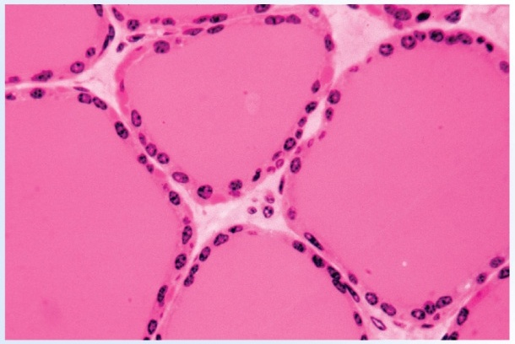
Histology of the Thyroid Gland
Copyright © The McGraw-Hill Companies, Inc. Permission required for reproduction or display.
Follicular
cells
Colloid of
thyroglobulin
C (parafollicular)
cells
Follicle
(b)
Figure 17.9b
© Robert Calentine/Visuals Unlimited
thyroid follicles are filled with colloid and lined with simple cuboidal epithelial cells (follicular cells).

Slide 30
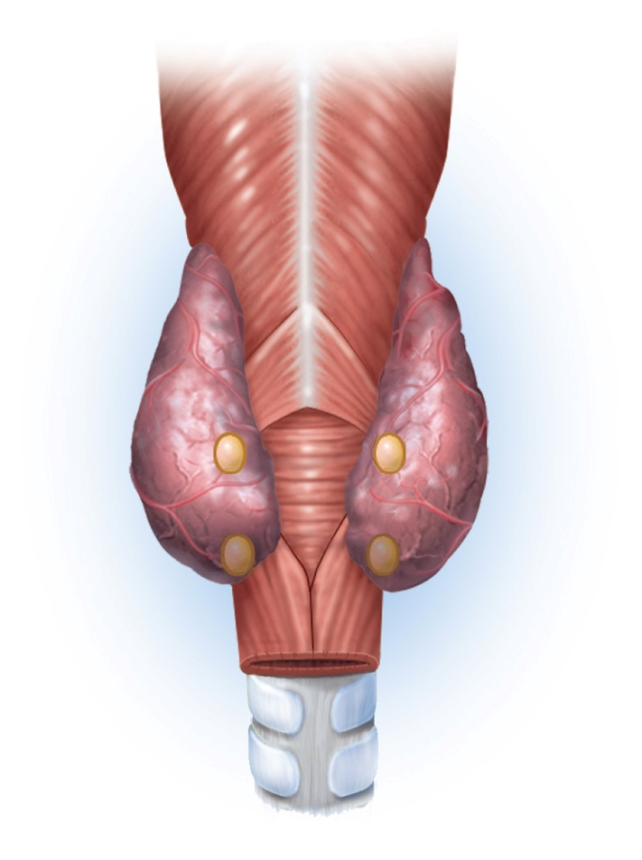
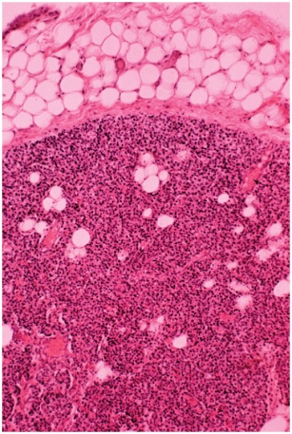
Parathyroid Glands
usually four glands partially embedded in posterior surface of thyroid gland
can be found from as high as hyoid bone to as low as aortic arch
secrete parathyroid hormone (PTH)
increases blood Ca²⁺ levels
promotes synthesis of calcitriol
increases absorption of Ca²⁺
decreases urinary excretion
increases bone resorption
Copyright © The McGraw-Hill Companies, Inc. Permission required for reproduction or display.
Pharynx
(posterior view)
Thyroid gland
Parathyroid
glands
Copyright © The McGraw-Hill Companies, Inc. Permission required for reproduction or display.
Esophagus
Adipose tissue
Trachea
Figure 17.10b
Parathyroid
capsule
Parathyroid gland
cells
(a)
Adipocytes
Figure 17.10a
(b)
© John Cunningham/Visuals Unlimited

Slide 31
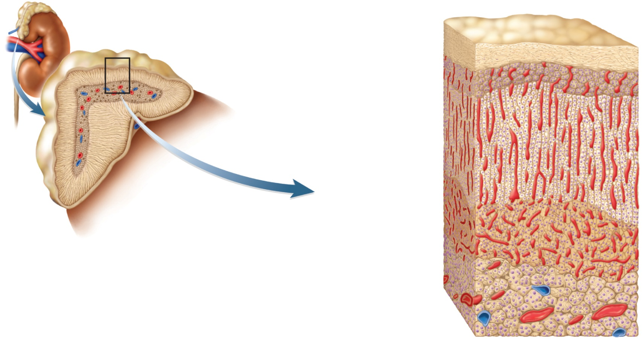
Adrenal Gland
Copyright © The McGraw-Hill Companies, Inc. Permission required for reproduction or display.
Adrenal gland
Suprarenal vein
Kidney
Connective
tissue capsule
Adrenal cortex
Zona
glomerulosa
Adrenal medulla
Adrenal cortex
Zona
fasciculata
(a)
Zona
reticularis
Figure 17.11
Adrenal medulla
(b)
small gland that sits on top of each kidney
they are retroperitoneal like the kidney
adrenal cortex and medulla formed by merger of two fetal glands with different origins and functions

Slide 32
Adrenal Medulla
adrenal medulla – inner core, 10% to 20% of gland
has dual nature acting as an endocrine gland and sympathetic ganglion of sympathetic nervous system
innervated by sympathetic preganglionic fibers
consists of modified sympathetic postganglionic neurons called chromaffin cells
when stimulated release catecholamines (epinephrine and norepinephrine) and a trace of dopamine directly into the bloodstream
effect is longer lasting than neurotransmitters
increases alertness and prepares body for physical activity –
mobilize high energy fuels, lactate, fatty acids, and glucose
glycogenolysis and gluconeogenesis boost glucose levels
glucose-sparing effect because inhibits insulin secretion
muscles use fatty acids saving glucose for brain
increases blood pressure, heart rate, blood flow to muscles, pulmonary air flow and metabolic rate
decreases digestion and urine production

Slide 33
Adrenal Cortex
surrounds adrenal medulla and produces more than 25 steroid hormones called corticosteroids or corticoids
secretes 5 major steroid hormones from three layers of glandular tissue
zona glomerulosa (thin, outer layer)
cells are arranged in rounded clusters
secretes mineralocorticoid – regulate the body’s electrolyte balance
zona fasciculata (thick, middle layer)
cells arranged in fascicles separated by capillaries
secretes glucocorticoids
zona reticularis (narrow, inner layer)
cells in branching network
secretes sex steroids

Slide 34
Categories of Corticosteroids
mineralocorticoids – zona glomerulosa
regulate electrolyte balance
aldosterone stimulates Na⁺ retention and K⁺ excretion, water is retained with sodium by osmosis, so blood volume and blood pressure are maintained
glucocorticoids – zona fasciculata
regulate metabolism of glucose and other fuels
especially cortisol, stimulates fat and protein catabolism, gluconeogenesis (glucose from amino acids and fatty acids) and release of fatty acids and glucose into blood
helps body adapt to stress and repair tissues
anti-inflammatory effect becomes immune suppression with long-term use
sex steroids – zona reticularis
androgens – sets libido throughout life; large role in prenatal male development (includes DHEA which other tissues convert to testosterone)
estradiol – small quantity, but important after menopause for sustaining adult bone mass; fat converts androgens into estrogen

Slide 35
Adrenal Gland Interactions
medulla and cortex of adrenal gland are not functionally independent
medulla atrophies without the stimulation of cortisol
some chromaffin cells of medullary origin extend into the cortex
they stimulate the cortex to secrete corticosteroids when stress activates the sympathetic nervous system

Slide 36
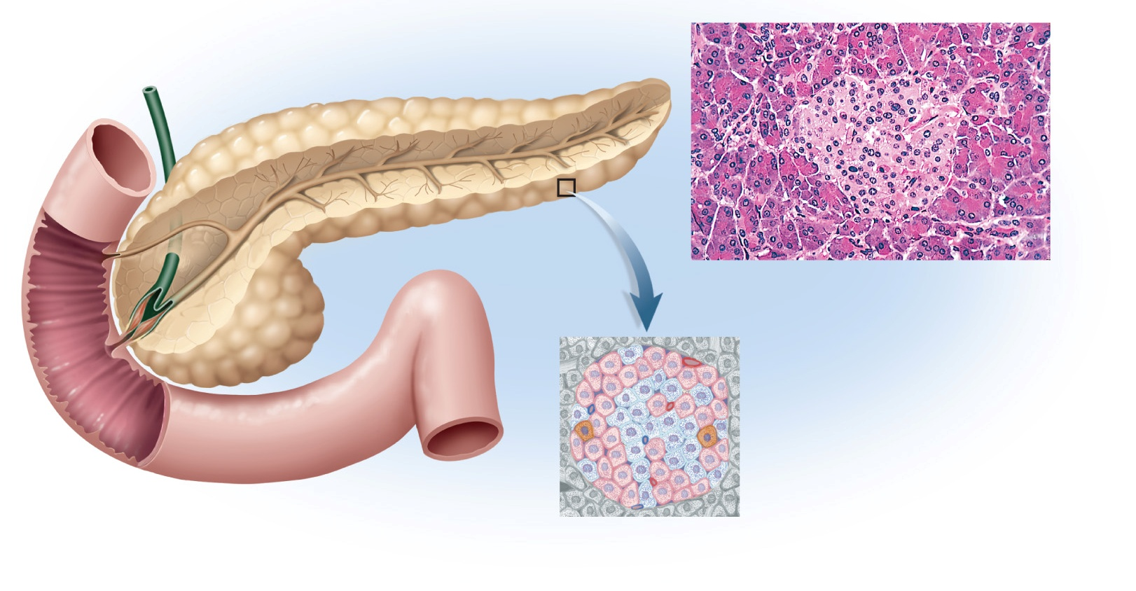
Pancreas
Copyright © The McGraw-Hill Companies, Inc. Permission required for reproduction or display.
Tail of pancreas
Bile duct
(c)
Pancreatic islet
Exocrine acinus
Pancreatic
ducts
Duodenum
Head of
pancreas
Beta cell
Figure 17.12 a-c
(a)
Alpha cell
Delta cell
(b) Pancreatic islet
c: © Ed Reschke
exocrine digestive gland and endocrine cell clusters (pancreatic islets) found retroperitoneal, inferior and posterior to stomach.

Slide 37
Pancreatic Hormones
1-2 million pancreatic islets (Islets of Langerhans) produce hormones
other 98% of pancreas cells produces digestive enzymes
insulin secreted by B or beta (β) cells
secreted during and after meal when glucose and amino acid blood levels are rising
stimulates cells to absorb these nutrients and store or metabolize them lowering blood glucose levels
promotes synthesis glycogen, fat, and protein
suppresses use of already stored fuels
brain, liver, kidneys and RBCs absorb glucose without insulin, but other tissues require insulin
insufficiency or inaction is cause of diabetes mellitus

Slide 38
Pancreatic Hormones
glucagon – secreted by A or alpha (α) cells
released between meals when blood glucose concentration is falling
in liver, stimulates gluconeogenesis, glycogenolysis, and the release of glucose into the circulation raising blood glucose level
in adipose tissue, stimulates fat catabolism and release of free fatty acids
glucagon also released to rising amino acid levels in blood, promotes amino acid absorption, and provides cells with raw material for gluconeogenesis
somatostatin secreted by D or delta (δ) cells
partially suppresses secretion of glucagon and insulin
inhibits nutrient digestion and absorption which prolongs absorption of nutrients
pancreatic polypeptide secreted by PP cells or F cells)
inhibits gallbladder contraction and secretion pancreatic digestive enzymes
gastrin secreted by G cells
stimulates stomach acid secretion, motility and emptying

Slide 39
Pancreatic Hormones
hyperglycemic hormones raise blood glucose concentration
glucagon, growth hormone, epinephrine, norepinephrine, cortisol, and corticosterone
hypoglycemic hormones lower blood glucose
insulin

Slide 40
The Gonads
ovaries and testes are both endocrine and exocrine
exocrine product – whole cells - eggs and sperm (cytogenic glands)
endocrine product - gonadal hormones – mostly steroids
ovarian hormones
estradiol, progesterone, and inhibin
testicular hormones
testosterone, weaker androgens, estrogen and inhibin

Slide 41
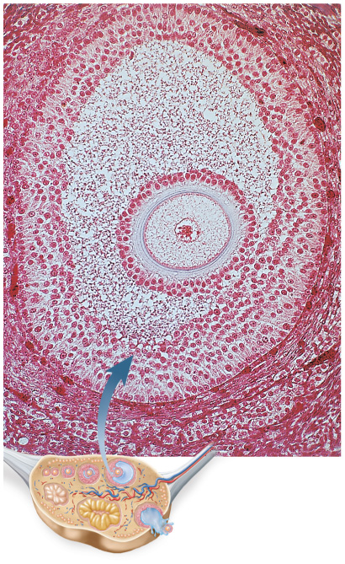
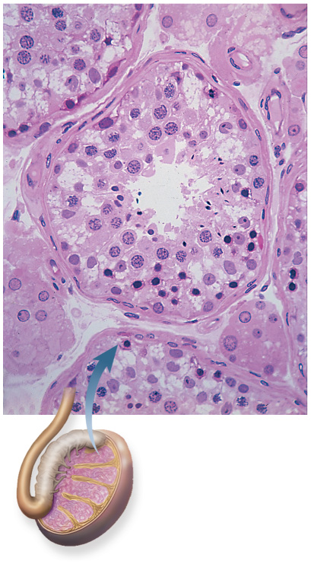
Histology of Ovary
Copyright © The McGraw-Hill Companies, Inc. Permission required for reproduction or display.
Copyright © The McGraw-Hill Companies, Inc. Permission required for reproduction or display.
Blood vessels
Granulosa cells
(source of
estrogen)
Seminiferous
tubule
Germ cells
Egg nucleus
Connective tissue
wall of tubule
Egg
Sustentacular
cells
Theca
Interstitial cells
(source of
testosterone)
Testis
50 µm
100 µm
Figure 17.13b
Ovary
Figure 17.13a
(a)
© Manfred Kage/Peter Arnold, Inc.
(b)
© Ed Reschke
follicle - egg surrounded by granulosa cells and a capsule (theca)

Slide 42
Ovary
theca cells synthesize androstenedione
converted to mainly estradiol by theca and granulosa cells
after ovulation, the remains of the follicle becomes the corpus luteum
secretes progesterone for 12 days following ovulation
follicle and corpus luteum secrete inhibin
functions of estradiol and progesterone
development of female reproductive system and physique including adolescent bone growth
regulate menstrual cycle, sustain pregnancy
prepare mammary glands for lactation
inhibin suppresses FSH secretion from anterior pituitary

Slide 43
Testes
microscopic seminiferous tubules produce sperm
tubule walls contain sustentacular (Sertoli) cells
Leydig cells (interstitial cells) lie in clusters between tubules
testicular hormones
testosterone and other steroids from interstitial cells (cells of Leydig) nestled between the tubules
stimulates development of male reproductive system in fetus and adolescent, and sex drive
sustains sperm production
inhibin from sustentacular (Sertoli) cells
limits FSH secretion in order to regulate sperm production

Slide 44
Endocrine Functions of Other Organs
skin
keratinocytes convert a cholesterol-like steroid into cholecalciferol using UV from sun
liver – involved in the production of at least five hormones
converts cholecalciferol into calcidiol
secretes angiotensinogen (a prohormone)
precursor of angiotensin II (a regulator of blood pressure)
secretes 15% of erythropoietin (stimulates bone marrow)
hepcidin – promotes intestinal absorption of iron
source of IGF-I that controls action of growth hormone
kidneys – plays role in production of three hormones
converts calcidiol to calcitriol, the active form of vitamin D
increases Ca²⁺ absorption by intestine and inhibits loss in the urine
secrete renin that converts angiotensinogen to angiotensin I
angiotensin II created by converting enzyme in lungs
constricts blood vessels and raises blood pressure
produces 85% of erythropoietin –
stimulates bone marrow to produce RBCs

Slide 45
Endocrine Functions of Other Organs
heart
cardiac muscle secretes atrial (ANP and BNP) and brain natriuretic peptides in response to an increase in blood pressure
decreases blood volume and blood pressure by increasing Na⁺ and H₂O output by kidneys – opposes action of angiotensin II
lowers blood pressure
stomach and small intestine secrete at least ten enteric hormones secreted by enteroendocrine cells
coordinate digestive motility and glandular secretion
cholecystokinin, gastrin, Ghrelin, and peptide YY
adipose tissue secretes leptin
slows appetite
osseous tissue – osteocalcin secreted by osteoblasts
increases number of pancreatic beta cells, pancreatic output of insulin, and insulin sensitivity of other body tissues
inhibits weight gain and onset of type II diabetes mellitus
placenta
secretes estrogen, progesterone and others
regulate pregnancy, stimulate development of fetus and mammary glands

Slide 46
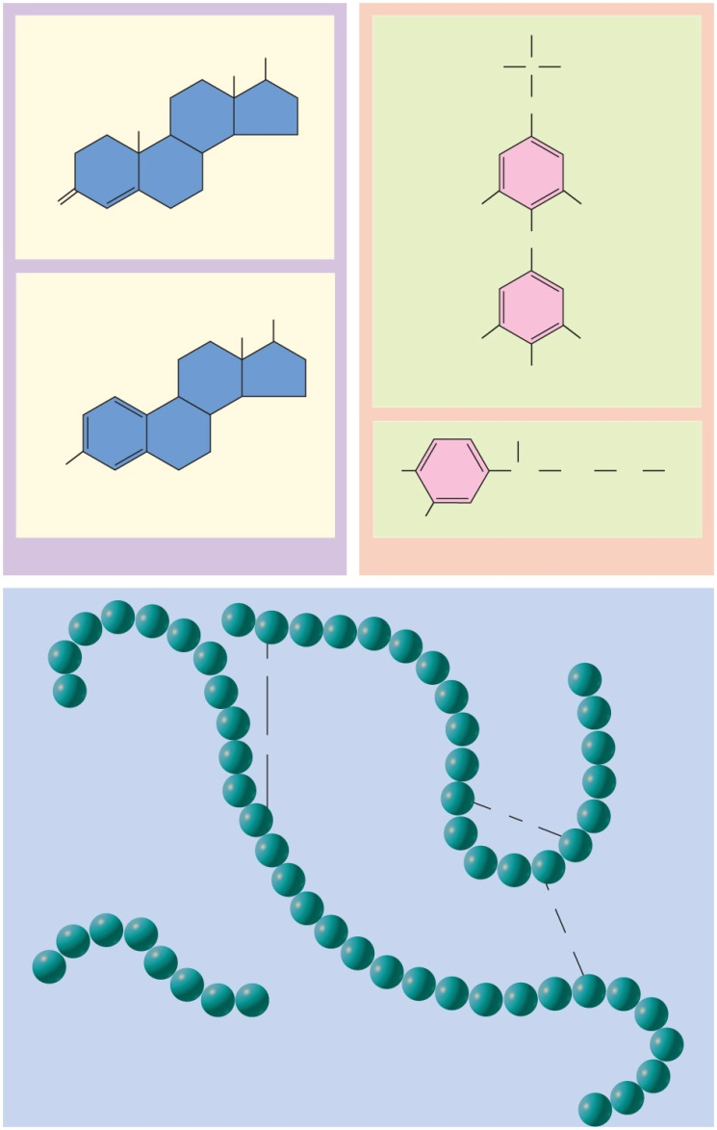
Hormone Chemistry
three chemical classes
steroids
derived from cholesterol
secreted by gonads and adrenal glands
estrogens, progesterone, testosterone, cortisol, corticosterone, aldosterone, DHEA, and calcitriol
peptides and glycoproteins
created from chains of amino acids
secreted by pituitary and hypothalamus
oxytocin, antidiuretic hormone, releasing and inhibiting hormones, and anterior pituitary hormones
monoamines (biogenic amines)
derived from amino acids
secreted by adrenal, pineal, and thyroid glands
epinephrine, norepinephrine, melatonin, and thyroid hormone
all hormones are made from either cholesterol or amino acids with carbohydrate added to make glycoproteins.
Copyright © The McGraw-Hill Companies, Inc. Permission required for reproduction or display.
OH
H
CH₃
H₂N
C
COOH
CH₃
CH₂
O
Testosterone
I
I
O
CH₃
OH
I
I
OH
Thyroxine
OH
HO
HO
CH
CH₂
NH
CH₂
Estradiol
HO
Epinephrine
(a) Steroids
(b) Monoamines
Pro
Thr
Tyr
Phe
Asn
Cys
Tyr
Asn
Glu
Leu
Lys
Phe
S
Gln
Gly
Thr
Gly
Tyr
lle
Arg
S
Leu
Val
Insulin
Glu
Ser
Glu
Gly
Cys
Cys
S
Gln
Val
lle
S
Cys
Leu
Ser
Thr
Cys
Val
Tyr
Leu
S
Arg
Tyr
lle
Ala
S
Asp
His
Glu
Val
Leu
Gly
Cys
Leu
Angiotensin II
Pro
Phe
His
Ser
His
Asn
Gln
(c) Peptides
Phe
Val
Figure 17.14 a-c

Slide 47
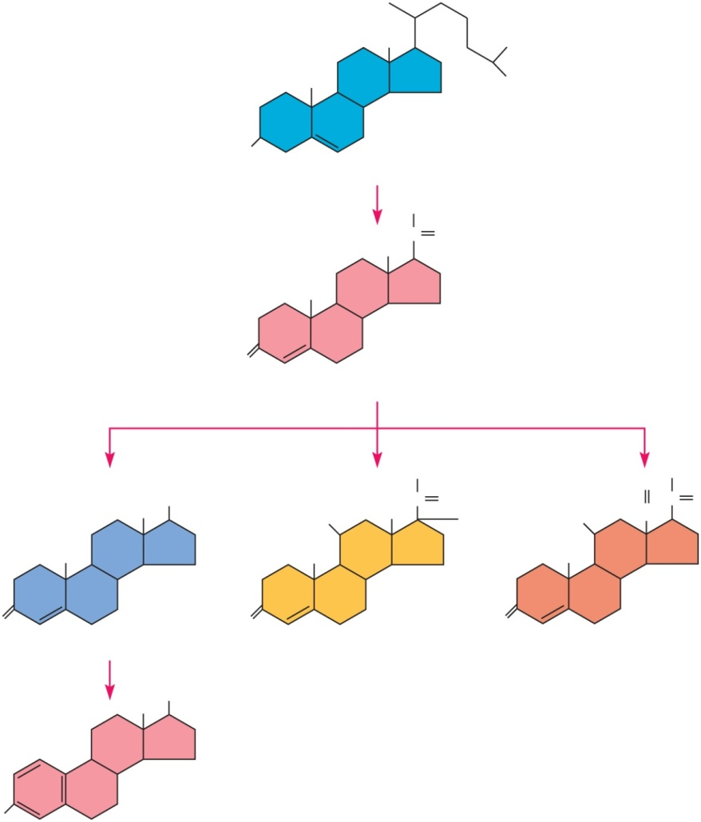
Hormone Synthesis: Steroid Hormones
Copyright © The McGraw-Hill Companies, Inc. Permission required for reproduction or display.
CH₃
CH₃
CH₃
CH₃
HO
Cholesterol
CH₃
CH₃
C
O
CH₃
O
Progesterone
CH₂OH
O
CH₂OH
CH₃
OH
HO
CH₃
C
O
OH
HO
HC
C
O
CH₃
CH₃
CH₃
O
O
O
Testosterone
Cortisol (hydrocortisone)
Aldosterone
CH₃
OH
Figure 17.16
HO
Estradiol
synthesized from cholesterol – differs in functional groups attached to 4-ringed steroid backbone

Slide 48
Peptides
synthesized in same way as any protein
at first is an inactive preprohormone
first several amino acids is a signal peptide that guides it into cisterna of rough endoplasmic reticulum
signal peptide removed to form prohormone
Golgi does final transformation to hormone packaged for secretion

Slide 49
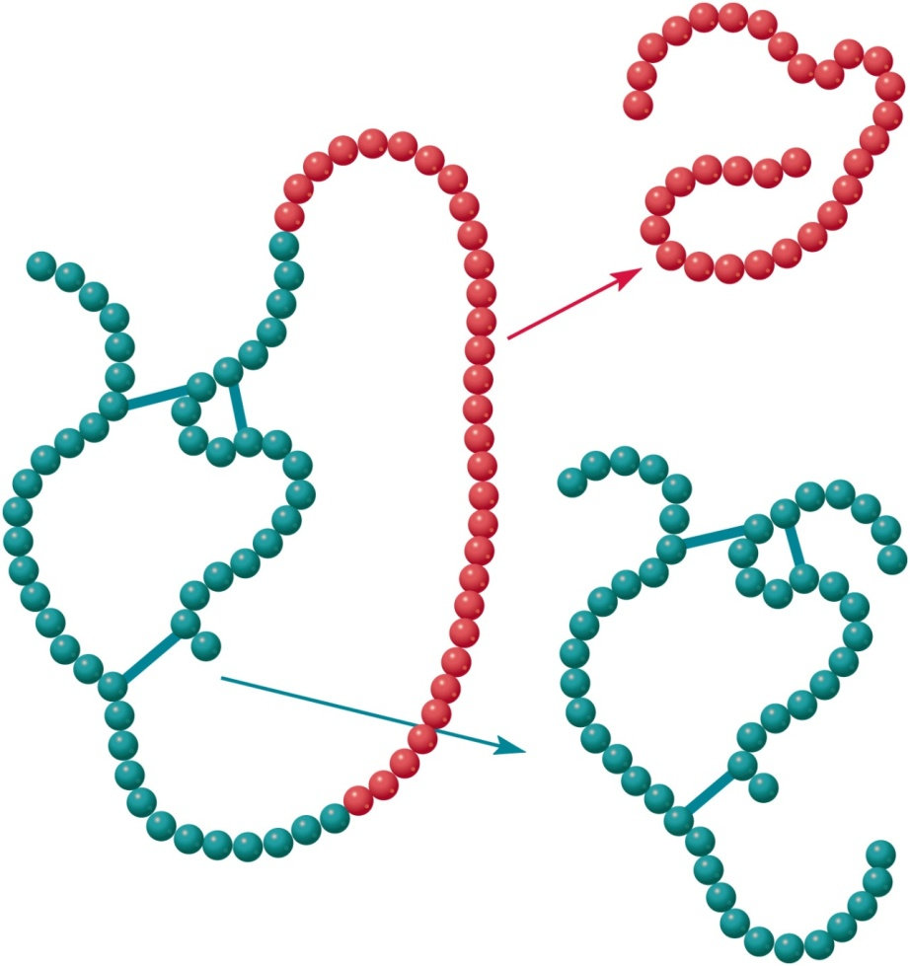
Hormone Synthesis: Insulin
begins as preproinsulin, then becomes proinsulin
when connecting peptide is removed, two polypeptide chains are formed that make up insulin
Copyright © The McGraw-Hill Companies, Inc. Permission required for reproduction or display.
C peptide
Proinsulin
Figure 17.17
Insulin

Slide 50
Monoamines
melatonin is synthesized from amino acid tryptophan, and other monoamines from amino acid tyrosine
thyroid hormone is composed of 2 tyrosines

Slide 51
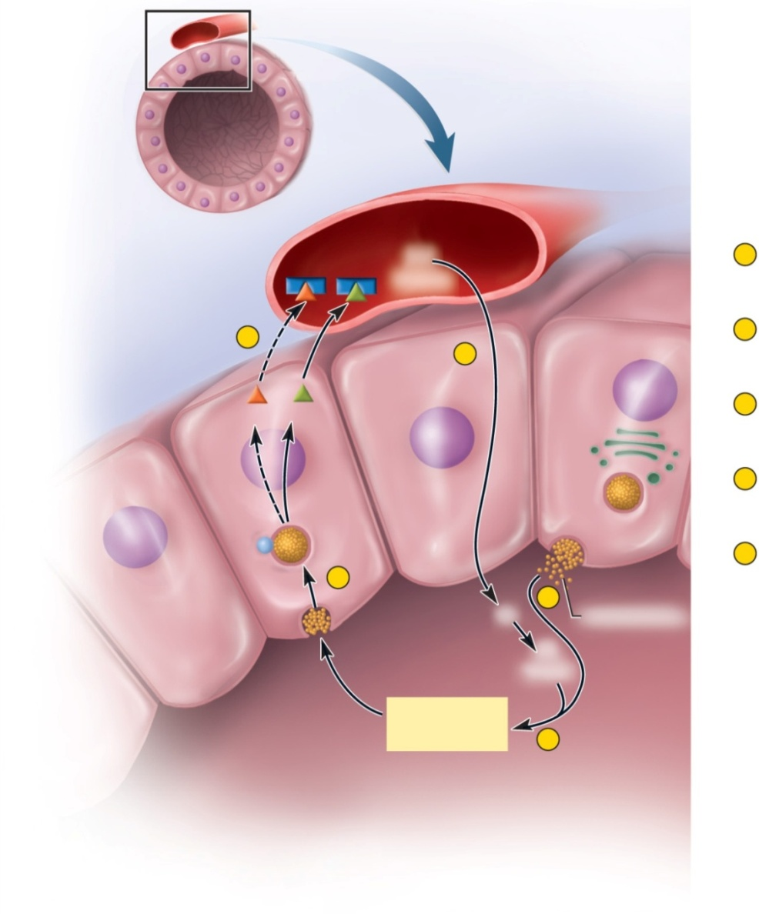
Thyroid Hormone Synthesis
Thyroid Hormone Synthesis
Copyright © The McGraw-Hill Companies, Inc. Permission required for reproduction or display.
Blood capillary
Thyroid follicle
Transport
proteins
I⁻
Iodide
1
Iodide absorption and oxidation
5
1
Follicle cell
2
Thyroglobulin synthesis and secretion
T₃
T₄
3
Iodine added to tyrosines of thyroglobulin
4
Thyroglobulin uptake and hydrolysis
4
5
Release of T₄ and a small amount of T₃ into
the blood
Lysosome
2
I–
Thyroglobulin
I*
Iodine
Stored
thyroglobulin
3
Figure 17.18

Slide 52
T₃ and T₄ Synthesis
follicular cells
absorb iodide (I⁻) ions from blood and store in lumen as a reactive form of iodine
synthesize thyroglobulin and store in lumen
forms colloid
contains lots of tyrosine
tyrosine and iodine combine to form thyroxine (T₄) bound to thyroglobulin
stored in follicle
TSH
stimulates follicular cells to remove T₄ from thyroglobulin for release into plasma
most T₃ is produced in liver or by target cells removing an iodine from circulating T₄
95% T₄ and 5% T₃

Slide 53
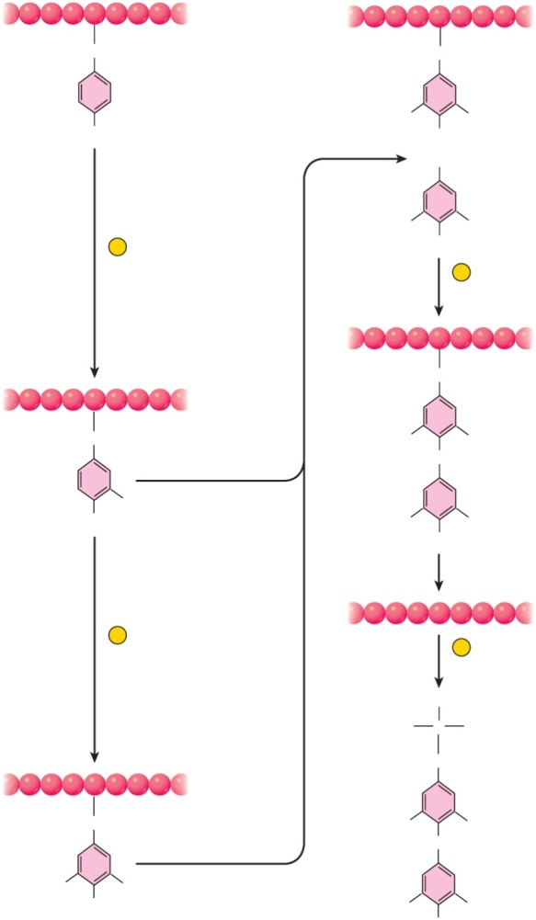
Chemistry of Thyroid Hormone
Copyright © The McGraw-Hill Companies, Inc. Permission required for reproduction or display.
Thyroglobulin
CH₂
CH₂
Tyrosine
DIT
l
l
OH
OH
+
DIT
l
l
1
Addition of iodine to
tyrosine to form MIT
OH
3
Two DITs
combine to
form thyroxine (T4)
CH₂
Figure 17.19
CH₂
l
O
l
MIT
I
OH
l
OH
l
2
Addition of another
iodine to form DIT
4
Thyroxine
released from
thyroglobulin
H₂N
H
COOH
C
CH₂
Figure 17.19
CH₂
l
O
l
DIT
l
l
OH
l
OH
l
MIT contains one iodine atom, DIT has two
T₃ - combination of MIT plus DIT
T₄ - combination of two DITs

Slide 54
Hormone Transport
most monoamines and peptides are hydrophilic
mix easily with blood plasma
steroids and thyroid hormone are hydrophobic
bind to transport proteins (albumins and globulins synthesized by the liver)
bound hormones have longer half-life
protected from liver enzymes and kidney filtration
only unbound hormone leaves capillaries to reach target cell
transport proteins protect circulating hormones from being broken down by enzymes in the plasma and liver, and from being filtered out of the blood by the kidneys
thyroid hormone binds to three transport proteins in the plasma
albumin, thyretin and TGB (thyroxine-binding globulin)
more than 99% of circulating TH is protein bound
steroid hormones bind to globulins
transcortin – the transport protein for cortisol
aldosterone - short half-life; 85% unbound, 15% binds weakly to albumin and others

Slide 55
Hormone Receptors
hormones stimulate only those cells that have receptors for them
receptors are protein or glycoprotein molecules:
on plasma membrane, in the cytoplasm, or in the nucleus
receptors act like switches turning on metabolic pathways when hormone binds to them
usually each target cell has a few thousand receptors for a given hormone
receptor-hormone interactions exhibit specificity and saturation
specific receptor for each hormone
saturated when all receptor molecules are occupied by hormone molecules

Slide 56
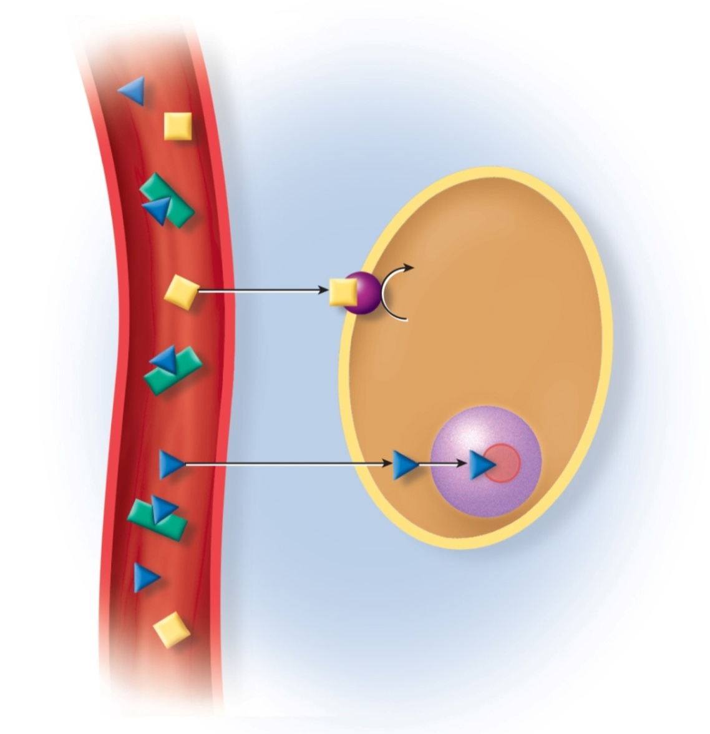
Hormone Mode of Action
Copyright © The McGraw-Hill Companies, Inc. Permission required for reproduction or display.
hydrophobic hormones
penetrate plasma membrane and enter nucleus
act directly on the genes changing target cell physiology
estrogen, progesterone, thyroid hormone act on nuclear receptors
take several hours to days to show effect due to lag for protein synthesis
hydrophilic hormones
cannot penetrate into target cell
must stimulate physiology indirectly
Hydrophilic
hormone
Receptor in
plasma
membrane
Target
cell
Transport
protein
Second-
messenger
activation
Free
hormones
Bound
hormone
Hydrophobic
hormone
Receptor in
nucleus
Tissue fluid
Blood
Figure 17.20

Slide 57
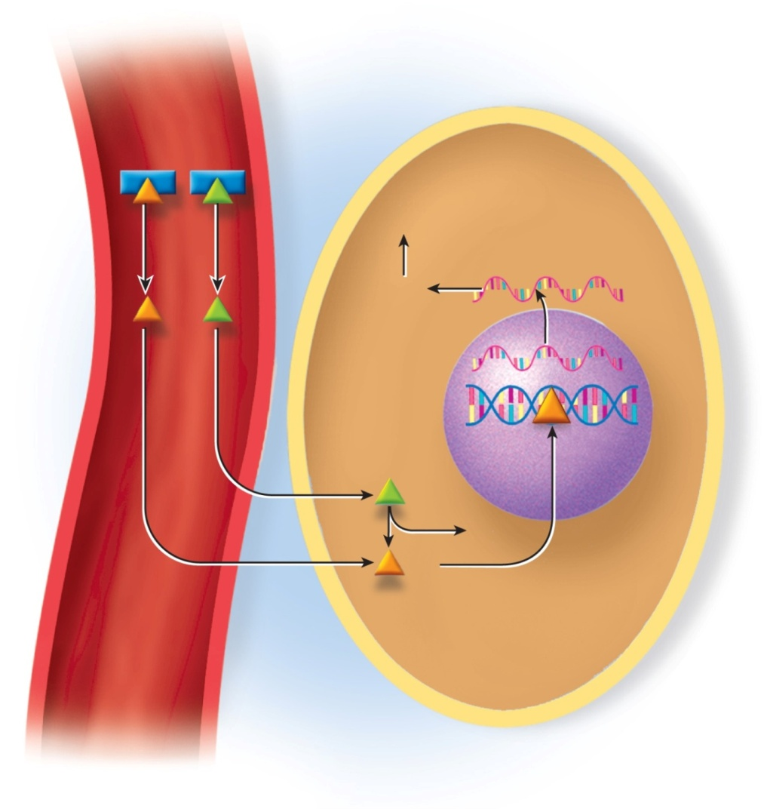
Thyroid Hormone
thyroid hormone enters target cell by diffusion – mostly as T₄ with little metabolic effect
within target cell, T₄ is converted to more potent T₃
T₃ enters target cells and binds to receptors in chromatin
activates genes
make a muscle protein (myosin) enhancing cardiac muscle response to sympathetic stimulation
strengthening heartbeat
Copyright © The McGraw-Hill Companies, Inc. Permission required for reproduction or display.
TBG
T₃
T₄
Various
metabolic effects
Protein
synthesis
mRNA
DNA
T₄
I
T₃
Blood
Tissue fluid
Target cell
Figure 17.21

Slide 58
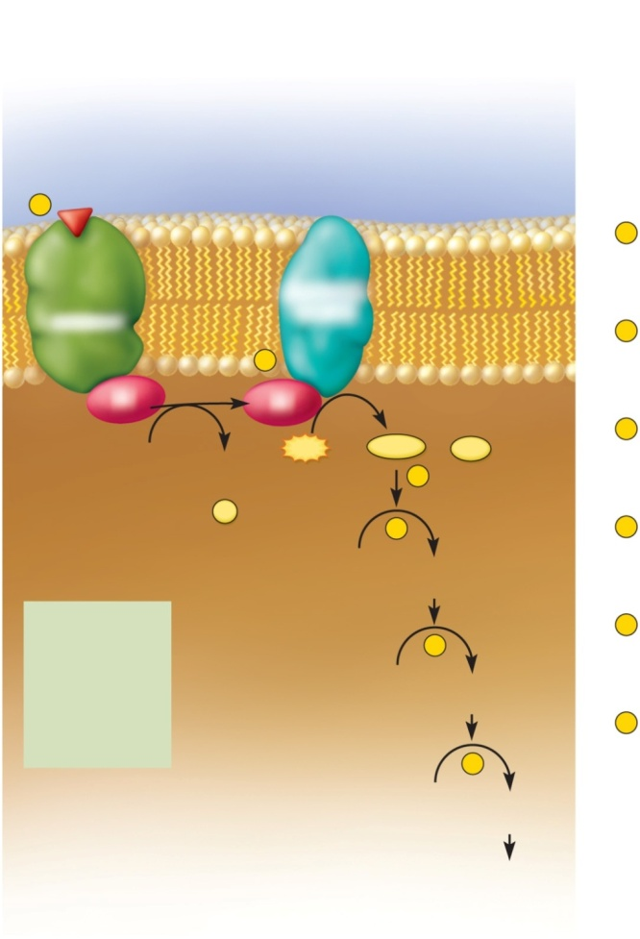
Peptides and Catecholamines: Hydrophilic
hormone binds to cell-surface receptor
receptor linked to second messenger system on other side of the membrane
activates G protein which
activates adenylate cyclase
produces cAMP
activates or inhibits enzymes
metabolic reactions:
synthesis
secretion
change membrane potentials
Copyright © The McGraw-Hill Companies, Inc. Permission required for reproduction or display.
Hormone
1
G protein
1
Hormone–receptor binding
activates a G protein.
Adenylate
cyclase
Receptor
2
G protein activates adenylate cyclase.
2
G
G
GTP
ATP
cAMP
+
PP_{i}
3
Adenylate cyclase produces cAMP.
GDP
3
+
P_{i}
4
4
cAMP activates protein kinases.
Inactive protein
kinase
Activated protein
kinase
ACTH
5
Protein kinases phosphorylate enzymes.
This activates some enzymes and
deactivates others.
FSH
5
LH
PTH
Inactive
enzymes
Activated
enzymes
TSH
Glucagon
6
Activated enzymes catalyze metabolic
reactions with a wide range of possible
effects on the cell.
Calcitonin
Catecholamines
6
Enzyme
substrates
Enzyme
products
Various
metabolic
effects
Figure 17.22

Slide 59
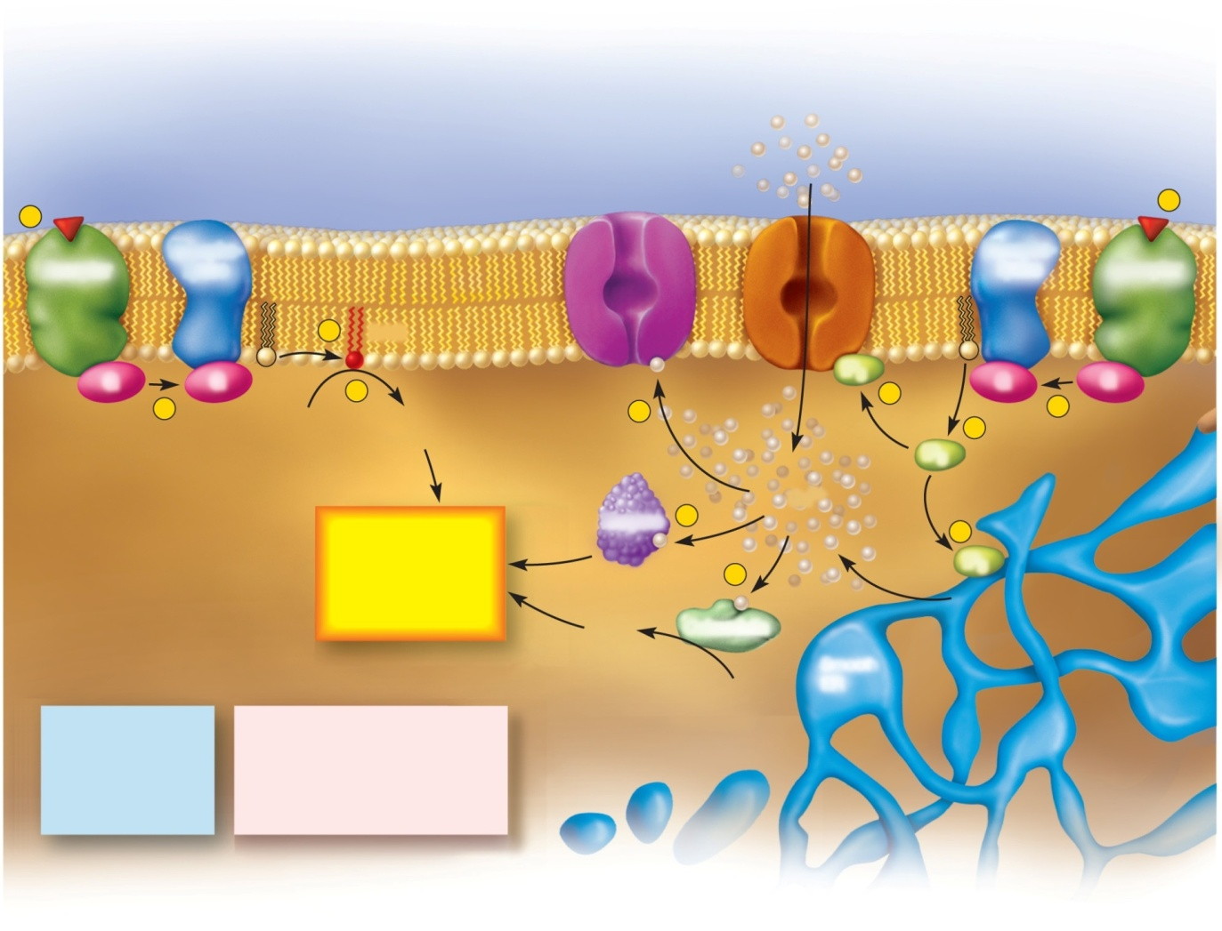
Other Second Messengers
Copyright © The McGraw-Hill Companies, Inc. Permission required for reproduction or display.
Diacylglycerol (DAG) pathway
Inositol triphosphate (IP₃) pathway
Hormone
Ca²⁺-gated
ion channel
Ca²⁺
Hormone
1
IP₃-gated Ca²⁺ channeI
1
Receptor
Phospho-
lipase
Phospho-
lipase
Receptor
3
DAG
G
G
4
IP₃
6
G
G
2
Inactive
PK
Activated
PK
8
5
2
IP₃
Enzyme
9
Ca²⁺
Various
metabolic
effects
7
IP₃
10
Activated
PK
Calmodulin
Inactive
PK
Smooth
ER
Hormones
Key
ADH
DAG
Diacylglycerol
TRH
G
G protein
OT
IP₃
Inositol triphosphate
LHRH
PK
Protein kinase
Figure 17.23
Catecholamines
diacylglycerol (diglyceride) second-messenger system
inositol triphosphate second-messenger system
act on cell metabolism in a variety of ways

Slide 60
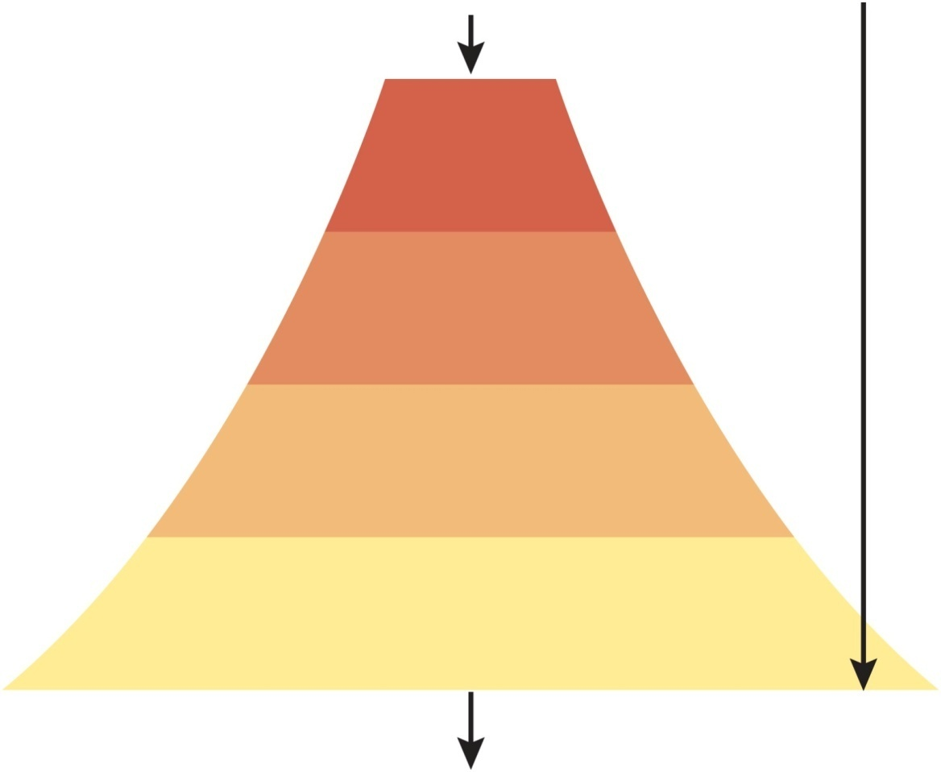
Enzyme Amplification
hormones are extraordinarily potent chemicals
one hormone molecule can trigger the synthesis of many enzyme molecules.
very small stimulus can produce very large effect
circulating concentrations very low
Copyright © The McGraw-Hill Companies, Inc. Permission required for reproduction or display.
Small stimulus
Hormone
cAMP and
protein kinase
Activated enzymes
Reaction cascade (time)
Metabolic product
Figure 17.24
Great effect

Slide 61
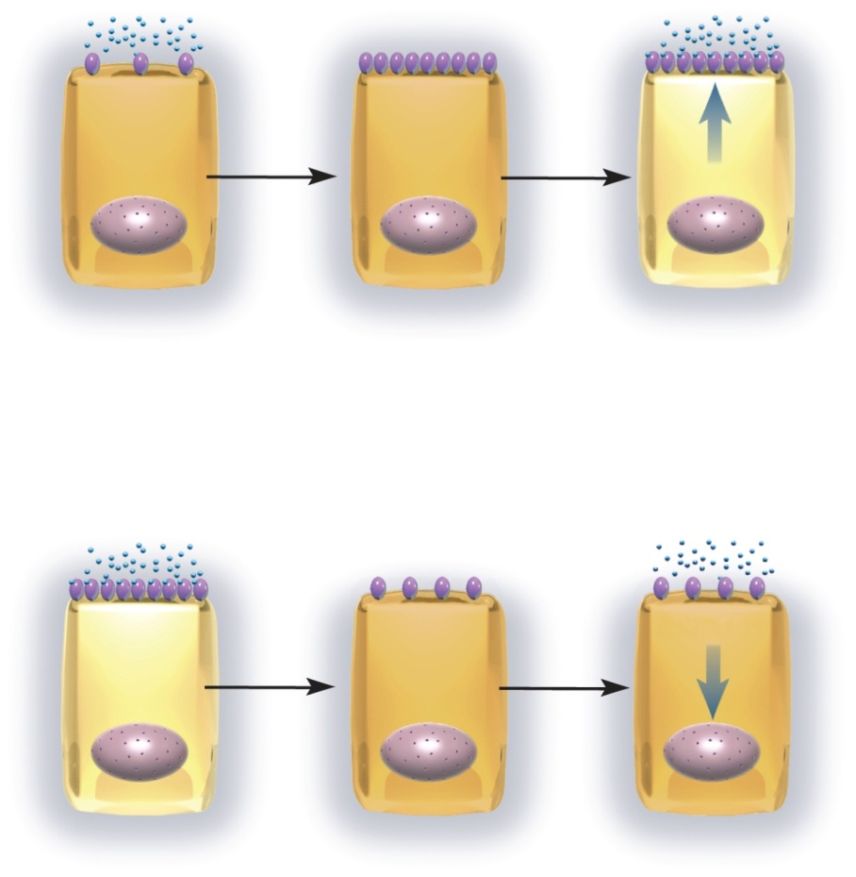
Modulation of Target Cell Sensitivity
Copyright © The McGraw-Hill Companies, Inc. Permission required for reproduction or display.
target cell sensitivity adjusted by changing the number of receptors
up-regulation means number of receptors is increased
sensitivity is increased
down-regulation reduces number of receptors
cell less sensitive to hormone
happens with long-term exposure to high hormone concentrations
bind to other receptors
converted to different hormone
Hormone
Receptor
Response
Low receptor density
Weak response
Increased receptor density
Increased sensitivity
Stronger response
(a ) Up-regulation
Response
High receptor density
Strong response
Reduced receptor density
Reduced sensitivity
Diminished response
(b ) Down-regulation
Figure 17.25

Slide 62
Hormone Interactions
most cells sensitive to more than one hormone and exhibit interactive effects
synergistic effects
multiple hormones act together for greater effect
synergism between FSH and testosterone on sperm production
permissive effects
one hormone enhances the target organ’s response to a second later hormone
estrogen prepares uterus for action of progesterone
antagonistic effects
one hormone opposes the action of another
insulin lowers blood glucose and glycogen raises it

Slide 63
Hormone Clearance
hormone signals must be turned off when they have served their purpose
most hormones are taken up and degraded by liver and kidney
excreted in bile or urine
metabolic clearance rate (MCR)
rate of hormone removal from the blood
half-life - time required to clear 50% of hormone from the blood
faster the MCF, the shorter is the half-life

Slide 64
Stress and Adaptation
stress - caused by any situation that upsets homeostasis and threatens one’s physical or emotional well-being
injury, surgery, infection, intense exercise, pain, grief, depression, anger, etc
general adaptation syndrome (GAS)
the consistent way body reacts to stress – typically involves elevated levels of epinephrine and glucocorticoids (especially cortisol)
occurs in three stages:
alarm reaction
stage of resistance
stage of exhaustion

Slide 65
Alarm Reaction
initial response
mediated by norepinephrine from the sympathetic nervous system and epinephrine from the adrenal medulla
prepare body to fight or flight
stored glycogen is consumed
increase in aldosterone and angiotensin levels
angiotensin helps raise blood pressure
aldosterone promotes sodium and water conservation

Slide 66
Stage of Resistance
after a few hours, glycogen reserves gone, but brain still needs glucose
provide alternate fuels for metabolism
stage dominated by cortisol
hypothalamus secretes corticotropin-releasing hormone
pituitary secretes an increase in ACTH
stimulates the adrenal cortex to secrete cortisol and other glucocorticoids
promotes the breakdown of fat and protein into glycerol, fatty acids, and amino acids – for gluconeogenesis
cortisol has glucose-sparing effect – inhibits protein synthesis leaving free amino acids for gluconeogenesis
adverse effects of excessive cortisol
depresses immune function
Increases susceptibility to infection and ulcers
lymphoid tissues atrophy, antibody levels drop, and wounds heal poorly

Slide 67
Stage of Exhaustion
when stress continues several months, and fat reserves are gone, homeostasis is overwhelmed
marked by rapid decline and death
protein breakdown and muscle wasting
loss of glucose homeostasis because adrenal cortex stops producing glucocorticoids
aldosterone promotes water retention and hypertension
conserves sodium and hastens elimination of K⁺ and H⁺
hypokalemia and alkalosis leads to death
death results from heart and kidney infection or overwhelming infection

Slide 68
Paracrine Secretions
paracrines - chemical messengers that diffuse short distances and stimulate nearby cells
unlike neurotransmitters not produced in neurons
unlike hormones not transported in blood
a single chemical can act as a hormone, paracrine, or even neurotransmitter in different locations
histamine
from mast cells in connective tissue
causes relaxation of blood vessel smooth muscle
nitric oxide
from endothelium of blood vessels, causes vasodilation
somatostatin
from gamma cells, inhibits secretion of alpha and beta cells
catecholamines
diffuse from adrenal medulla to cortex

Slide 69
Eicosanoids: a Family of Paracrine Secretions
eicosanoids – important family of paracrines
derived from fatty acid called arachidonic acid
lipoxygenase converts arachidonic acid into leukotrienes
leukotrienes
mediates allergic and inflammatory reactions
cyclooxygenase converts arachidonic acid to three other types of eicosanoids
prostacyclin
inhibits blood clotting and vasoconstriction
thromboxanes
produced by blood platelets after injury
overrides prostacyclin
stimulates vasoconstriction and clotting
prostaglandins includes:
PGE: relaxes smooth muscle in bladder, intestines, bronchioles, uterus and stimulates contraction of blood vessels
PGF: opposite effects

Slide 70
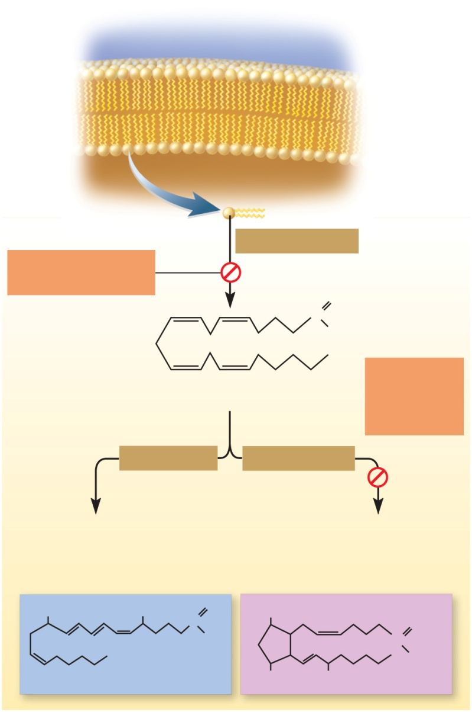
Eicosanoid Synthesis
Copyright © The McGraw-Hill Companies, Inc. Permission required for reproduction or display.
Phospholipids of
plasma membrane
Phospholipase A₂
Blocked by cortisol
and SAIDs
O
C
OH
Blocked by
NSAIDs such
as aspirin
and ibuprofen
Arachidonic acid
Lipoxygenase
Cyclooxygenase
Leukotrienes
Prostacyclin
Thromboxanes
Prostaglandins
Figure 17.26
OH
OH
C
O
OH
O
OH
C
OH
Leukotriene B₄
OH
OH
PGF_{2α}

Slide 71
Anti-inflammatory Drugs
cortisol and corticosterone
steroidal anti-inflammatory drugs (SAIDs)
inhibit inflammation by blocking release of arachidonic acid from plasma membrane and inhibit synthesis of eicosanoids
disadvantage – produce symptoms of Cushing syndrome
aspirin, ibuprofen, & celecoxib (Celebrex)
nonsteroidal anti-inflammatory drugs (NSAIDs)
COX inhibitors since block cyclooxygenase (COX)
do not affect lipoxygenase function or leukotriene production
useful in treatment of fever and thrombosis
inhibit prostaglandin and thromboxane synthesis

Slide 72
Endocrine Disorders
variations in hormone concentration and target cell sensitivity have noticeable effects on body
hyposecretion – inadequate hormone release
tumor or lesion destroys gland or interferes with its ability to receive signals from another gland
head trauma affects pituitary gland’s ability to secrete ADH
diabetes insipidus - chronic polyuria
autoantibodies fail to distinguish gland from foreign matter
hypersecretion – excessive hormone release
tumors or autoimmune disorder
pheochromocytoma – tumor of adrenal medulla secretes excessive epinephrine and norepinephrine
toxic goiter (graves disease) – autoantibodies mimic effect of TSH on the thyroid causing thyroid hypersecretion

Slide 73
Pituitary Disorders
hypersecretion of growth hormone (GH)
acromegaly - thickening of bones and soft tissues in adults
especially hands, feet and face
problems in childhood or adolescence
gigantism if hypersecretion
pituitary dwarfism if hyposecretion – rare since growth hormone is now made by genetically engineered bacteria
Copyright © The McGraw-Hill Companies, Inc. Permission required for reproduction or display.
Age 9
Age 16
Age 33
Age 52
Figure 17.27 1-5
From Clinical Pathological Conference Acromegaly, Diabetes, Hypermetabolism, Protein Use and Heart Failure in American Journal of Medicine, 20:133, 1986. Copyright © 1986 by Excerpta Media, Inc.

Slide 74
Thyroid Gland Disorders
congenital hypothyroidism (decreased TH)
hyposecretion present a birth (formerly cretinism)
treat with oral thyroid hormone
myxedema (decreased TH)
adult hypothyroidism
treat with oral thyroid hormone
goiter – any pathological enlargement of the thyroid gland
endemic goiter
dietary iodine deficiency, no TH, no - feedback, increased TSH stimulates hypertrophy
toxic goiter (Graves disease)
autoantibodies mimic the effect of TSH on the thyroid causing hypersecretion
overgrown thyroid produces functional TH

Slide 75
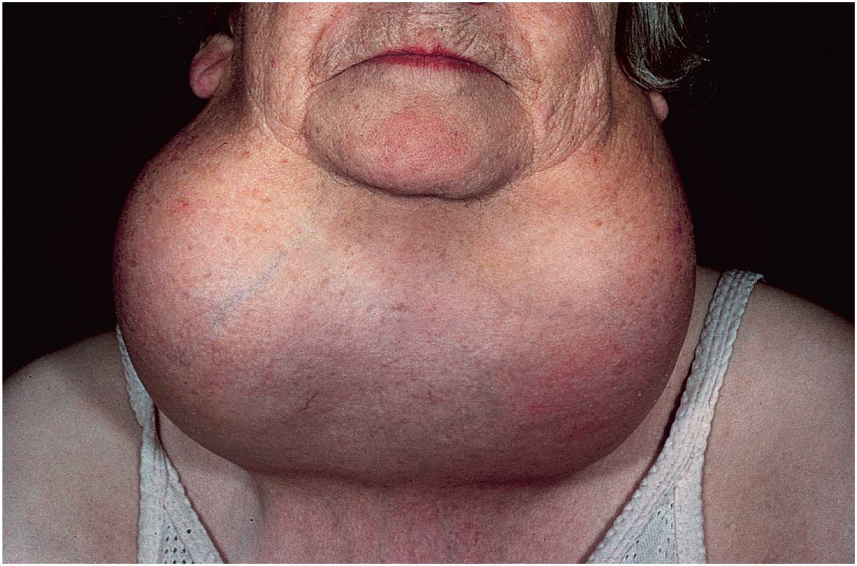
Endemic Goiter
Copyright © The McGraw-Hill Companies, Inc. Permission required for reproduction or display.
Figure 17.28
© CNR/Phototake

Slide 76
Parathyroid Disorders
hypoparathyroidism
surgical excision during thyroid surgery
fatal tetany in 3 - 4 days due to rapid decline in blood calcium level
hyperparathyroidism - excess PTH secretion
parathyroid tumor
bones become soft, fragile, and deformed
Ca²⁺ and phosphate blood levels increase
promotes renal calculi formation

Slide 77
Adrenal Disorders
Cushing syndrome - excess cortisol secretion
hyperglycemia, hypertension, weakness, edema
rapid muscle and bone loss due to protein catabolism
abnormal fat deposition
moon face and buffalo hump
adrenogenital syndrome (AGS)
adrenal androgen hypersecretion (accompanies Cushing)
enlargement of external sexual organs in children and early onset of puberty
newborn girls exhibit masculinized genitalia
masculinizing effects on women
increased body hair, deeper voice and beard growth

Slide 78
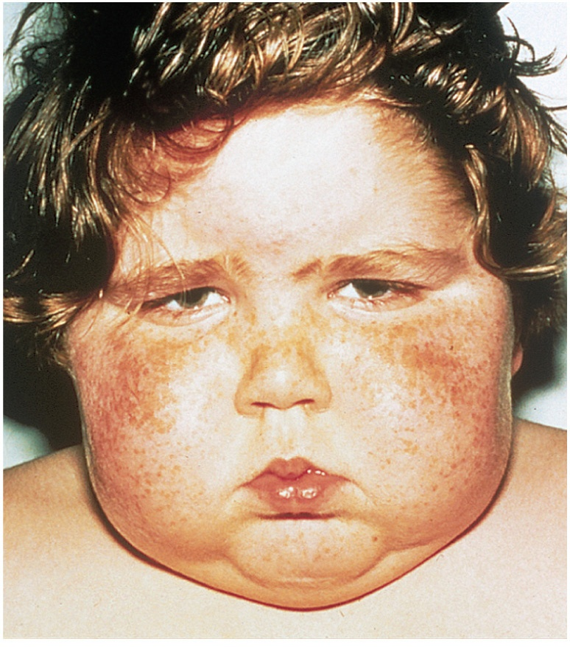
Cushing Syndrome
Copyright © The McGraw-Hill Companies, Inc. Permission required for reproduction or display.
Figure 17.29b
(b)
From: Atlas of Pediatric Physical Diagnosis, 3/e by Zitelli & Davis, fig 9-17 1997, with permission from Elsevier

Slide 79
Diabetes Mellitus
most prevalent metabolic disease in world
disruption of metabolism due to hyposecretion or inaction of insulin
symptoms:
polyuria (excess urine output), polydipsia (intense thirst) and polyphagia (hunger)
revealed by elevated blood glucose, glucose in urine and ketones in the urine
transport maximum – limit to how fast the glucose transporters can work to reabsorb
excess glucose enters urine and water follows it
causes polyuria, dehydration, and thirst

Slide 80
Types of Diabetes Mellitus
Type 1 (IDDM) – 5 to 10% of cases in US
insulin is always used to treat Type 1
insulin injections, insulin pump, or dry insulin inhaler
monitoring blood glucose levels and controlled diet
hereditary susceptibility if infected with certain viruses (rubella, cytomegalovirus)
autoantibodies attack and destroy pancreatic beta cells
Type 2 (NIDDM) – 90 to 95% of diabetics
problem is insulin resistance
failure of target cells to respond to insulin
risk factors are heredity, age (40+),obesity, and ethnicity – Native American, Hispanic, and Asian
treated with weight loss program and exercise since:
loss of muscle mass causes difficulty with regulation of glycemia
adipose signals interfere with glucose uptake into most cells
oral medications improve insulin secretion or target cell sensitivity

Slide 81
Pathology of Diabetes
pathogenesis: cells cannot absorb glucose, must rely on fat and proteins for energy needs - weight loss and weakness
fat catabolism increases free fatty acids and ketones in blood
ketonuria promotes osmotic diuresis, loss of Na⁺ and K^{+,} irregular heartbeat, and neurological issues
ketoacidosis occurs as ketones decrease blood pH
deep, gasping breathing and diabetic coma are terminal result
chronic pathology (chronic hyperglycemia)
leads to neuropathy and cardiovascular damage from atherosclerosis and microvascular disease
arterial damage in retina and kidneys (common in type I), atherosclerosis leads to heart failure (common in type II)
diabetic neuropathy – nerve damage from impoverished blood flow can lead to erectile dysfunction, incontinence, poor wound healing, and loss of sensation from area

