Slide 1
Defenses Against Pathogens
pathogens – environmental agents capable of producing disease
infectious organisms, toxic chemicals, and radiation
three lines of defenses against pathogens:
first line of defense – external barriers, skin and mucous membranes
second line of defense – several nonspecific defense mechanisms
leukocytes and macrophages, antimicrobial proteins, immune surveillance, inflammation, and fever
effective against a broad range of pathogens
third line of defense – the immune system
defeats a pathogen, and leaves the body of a ‘memory’ of it so it can defeat it faster in the future

Slide 2
Nonspecific Resistance and Immunity
nonspecific resistance – guards equally against a broad range of pathogens
their effectiveness does not depend on prior exposure
skin and mucous membranes
leukocytes and macrophages, antimicrobial proteins, immune surveillance, inflammation, and fever
immunity – specific defense because it results from prior exposure to a pathogen
usually provides future protection only against that particular one

Slide 3
External Barriers
skin
makes it mechanically difficult for microorganisms to enter the body
toughness of keratin
too dry and nutrient-poor to support microbial growth
defensins – peptides that kill microbes by creating holes in their membranes
acid mantle – thin film of lactic acid from sweat which inhibits bacterial growth
mucous membranes
digestive, respiratory, urinary, and reproductive tracts are open to the exterior and protected by mucous membranes
mucus physically traps microbes
lysozyme - enzyme destroys bacterial cell walls
subepithelial areolar tissue
viscous barrier of hyaluronic acid
hyaluronidase - enzyme used by pathogens to make hyaluronic acid less viscous

Slide 4
Leukocytes and Macrophages
phagocytes – phagocytic cells with a voracious appetite for foreign matter
five types of leukocytes
neutrophils
eosinophils
basophils
monocytes
lymphocytes

Slide 5
Neutrophils
wander in connective tissue killing bacteria
phagocytosis and digestion
produces a cloud of bactericidal chemicals
create a killing zone
degranulation
lysosomes discharge into tissue fluid
respiratory burst – neutrophils rapidly absorb oxygen
toxic chemicals are created (O₂^{.-}, H₂O₂, HClO)
kill more bacteria with toxic chemicals than phagocytosis

Slide 6
Eosinophils
found especially in the mucous membranes
stand guard against parasites, allergens (allergy causing agents), and other pathogens
kill tapeworms and roundworms by producing superoxide, hydrogen peroxide, and toxic proteins
promote action of basophils and mast cells
phagocytize antigen-antibody complexes
limit action of histamine and other inflammatory chemicals

Slide 7
Basophils
secrete chemicals that aid mobility and action of WBC other leukocytes
leukotrienes – activate and attract neutrophils and eosinophils
histamine – a vasodilator which increases blood flow
speeds delivery of leukocytes to the area
heparin – inhibits the formation of clots
would impede leukocyte mobility
mast cells also secrete these substances
type of connective tissue cell very similar to basophils

Slide 8
Lymphocytes
three basic categories
circulating blood contains
80% T cells
15% B cells
5% NK cells
many diverse functions

Slide 9
Monocytes
monocytes - emigrate from the blood into the connective tissue and transform into macrophages
macrophage system – all the body’s avidly phagocytic cells, except leukocytes
wandering macrophages – actively seeking pathogens
widely distributed in loose connective tissue
fixed macrophages – phagocytize only pathogens that come to them
microglia – in central nervous system
alveolar macrophages – in lungs
hepatic macrophages – in liver

Slide 10
Antimicrobial Proteins
proteins that inhibit microbial reproduction and provide short-term, nonspecific resistance to pathogenic bacteria and viruses
two families of antimicrobial proteins:
interferons
complement system

Slide 11
Interferons
interferons - secreted by certain cells infected by viruses
of no benefit to the cell that secretes them
alert neighboring cells and protect them from becoming infected
bind to surface receptors on neighboring cells
activate second-messenger systems within
alerted cell synthesizes various proteins that defend it from infection
breaks down viral genes or preventing replication
also activates NK cells and macrophages
destroy infected cell before they can liberate a swarm of newly replicated viruses
activated NK cells destroy malignant cells

Slide 12
Complement System
complement system – a group of 30 or more globular proteins that make powerful contributions to both nonspecific resistance and specific immunity
synthesized mainly by the liver
circulate in the blood in inactive form
activated by presence of the pathogen
activated complement brings about four methods of pathogen destruction
inflammation
immune clearance
phagocytosis
cytolysis
three routes of complement activation
classical pathway
alternative pathway
lectin pathway

Slide 13
Complement System
classical pathway
requires antibody molecule to get started
thus part of specific immunity
antibody binds to antigen on surface of the pathogenic organism
forms antigen-antibody (Ag-Ab) complex
changes the antibody’s shape
exposing a pair of complement-binding sites
binding of the first complement (C1) sets off a reaction cascade called complement fixation
results in a chain of complement proteins attaching to the antibody
alternative pathway
nonspecific, do not require antibody
C3 breaks down in the blood to C3a and C3b
C3b binds directly to targets such as human tumor cells, viruses, bacteria, and yeasts
triggers cascade reaction with autocatalytic effect where more C3 is formed
lectin pathway
lectins – plasma proteins that bind to carbohydrates
bind to certain sugars of a microbial cell surface
sets off another cascade of C3 production

Slide 14
Complement System
mechanisms of action of complement proteins
inflammation
C3a stimulates mast cells and basophils to secrete histamine and other inflammatory chemicals
activates and attracts neutrophils and macrophages
speed pathogen destruction in inflammation
immune clearance
C3b binds with antigen-antibody complexes to red blood cells
these RBCs circulate through the liver and spleen
macrophages of those organs strip off and destroy the Ag-Ab complexes leaving RBCs unharmed
principal means of clearing foreign antigens from the bloodstream

Slide 15
Complement System
mechanisms of action of complement proteins
phagocytosis
neutrophils and macrophages cannot phagocytize “naked” bacteria, viruses, or other pathogens
C3b assist them by opsonization
coats microbial cells and serves as binding sites for phagocyte attachment
makes the foreign cell more appetizing
cytolysis
C3b splits other complement proteins
bind to enemy cell
attract more complement proteins – membrane attack complex forms
forms a hole in the target cell
electrolytes leak out, water flows in rapidly, and cell ruptures

Slide 16
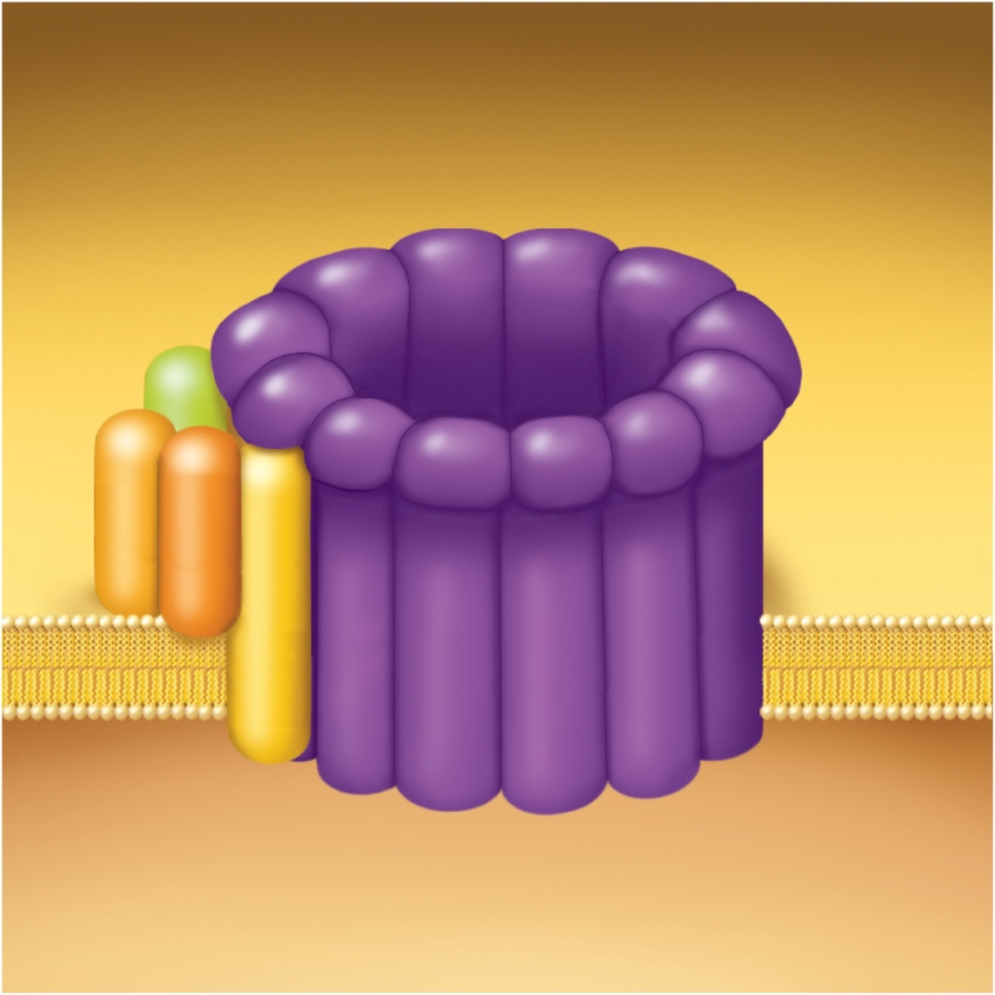
Membrane Attack Complex
Copyright © The McGraw-Hill Companies, Inc. Permission required for reproduction or display.
C5b
C6
C7
C8
C9
C9
C9
C9
C9
Figure 21.16

Slide 17
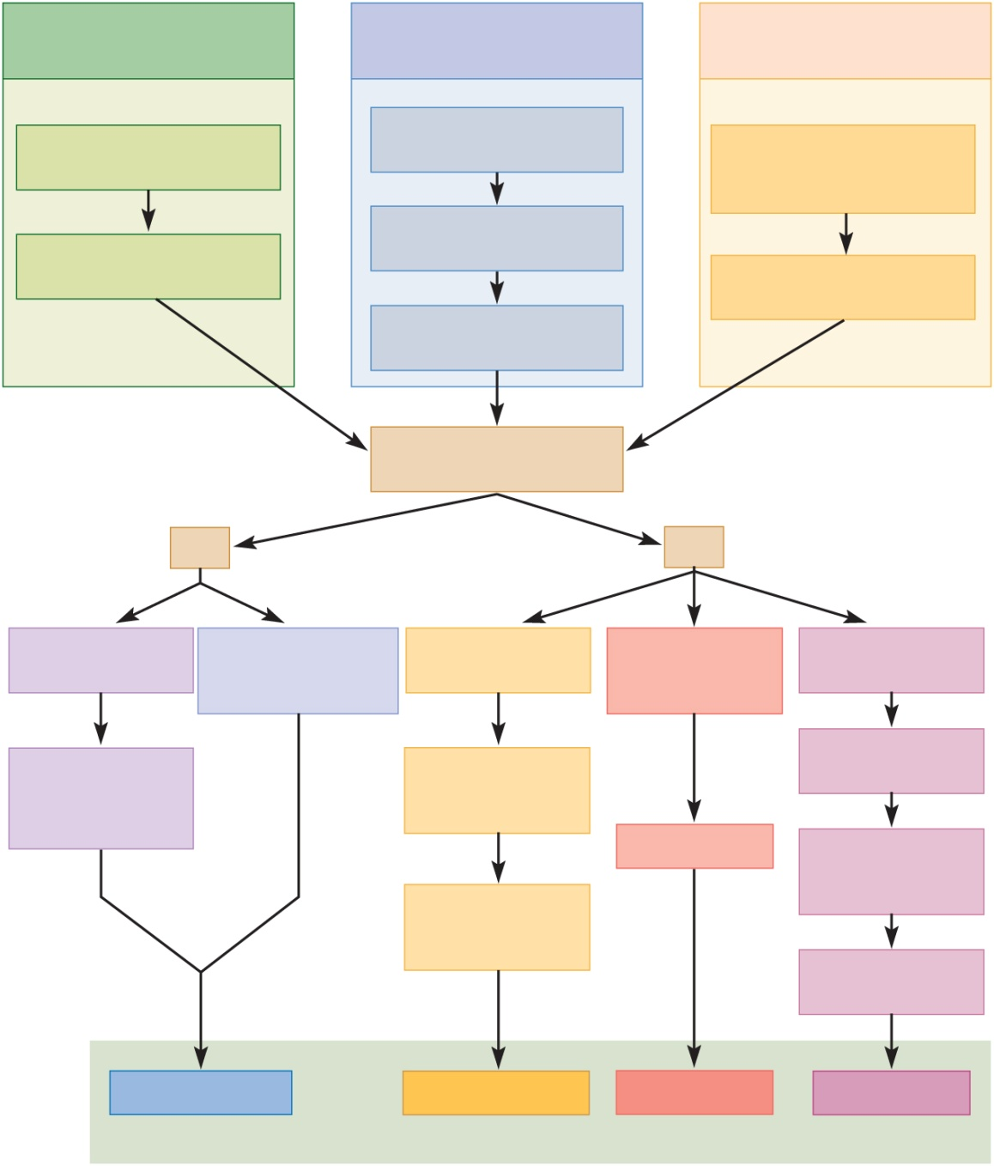
Complement Activation
Copyright © The McGraw-Hill Companies, Inc. Permission required for reproduction or display.
Classical pathway
(antibody-dependent)
Alternative pathway
(antibody-independent)
Lectin pathway
(antibody-independent)
Antigen–antibody complexes
form on pathogen surface
C3 dissociates into
fragments C3a and C3b
Lectin binds to
carbohydrates on
pathogen surface
Reaction cascade
(complement fixation)
C3b binds to
pathogen surface
Reaction cascade
Reaction cascade and
autocatalytic effect
C3 dissociates into
C3a and C3b
Figure 21.15
C3a
C3b
Binds to basophils
and mast cells
Stimulates neutrophil
and macrophage
activity
Binds Ag–Ab
complexes to RBCs
Coats bacteria,
viruses, and other
pathogens
Splits C5 into
C5a and C5b
Release of
histamine and
other inflammatory
chemicals
RBCs transport
Ag–Ab complexes
to liver and spleen
C5b binds
C6, C7, and C8
Opsonization
C5b678 complex
binds ring of C9
molecules
Phagocytes remove
and degrade
Ag–Ab complexes
Membrane
attack complex
Inflammation
Immune
clearance
Phagocytosis
Cytolysis
Four mechanisms of pathogen destruction

Slide 18
Membrane Attack Complex
complement proteins form ring in plasma membrane of target cell causing cytolysis
Copyright © The McGraw-Hill Companies, Inc. Permission required for reproduction or display.
C5b
C6
C7
C8
C9
C9
C9
C9
C9
Figure 21.16

Slide 19
Immune Surveillance
immune surveillance – a phenomenon in which natural (NK) killer cells continually patrol the body on the lookout for pathogens and diseased host cells.
natural killer (NK) cells attack and destroy:
bacteria, cells of transplanted organs, cells infected with viruses, and cancer cells
recognizes enemy cell
NK cells bind to it
release proteins called perforins
polymerize a ring and create a hole in its plasma membrane
secrete a group of protein degrading enzymes – granzymes
enter through pore and degrade cellular enzymes and induce apoptosis

Slide 20
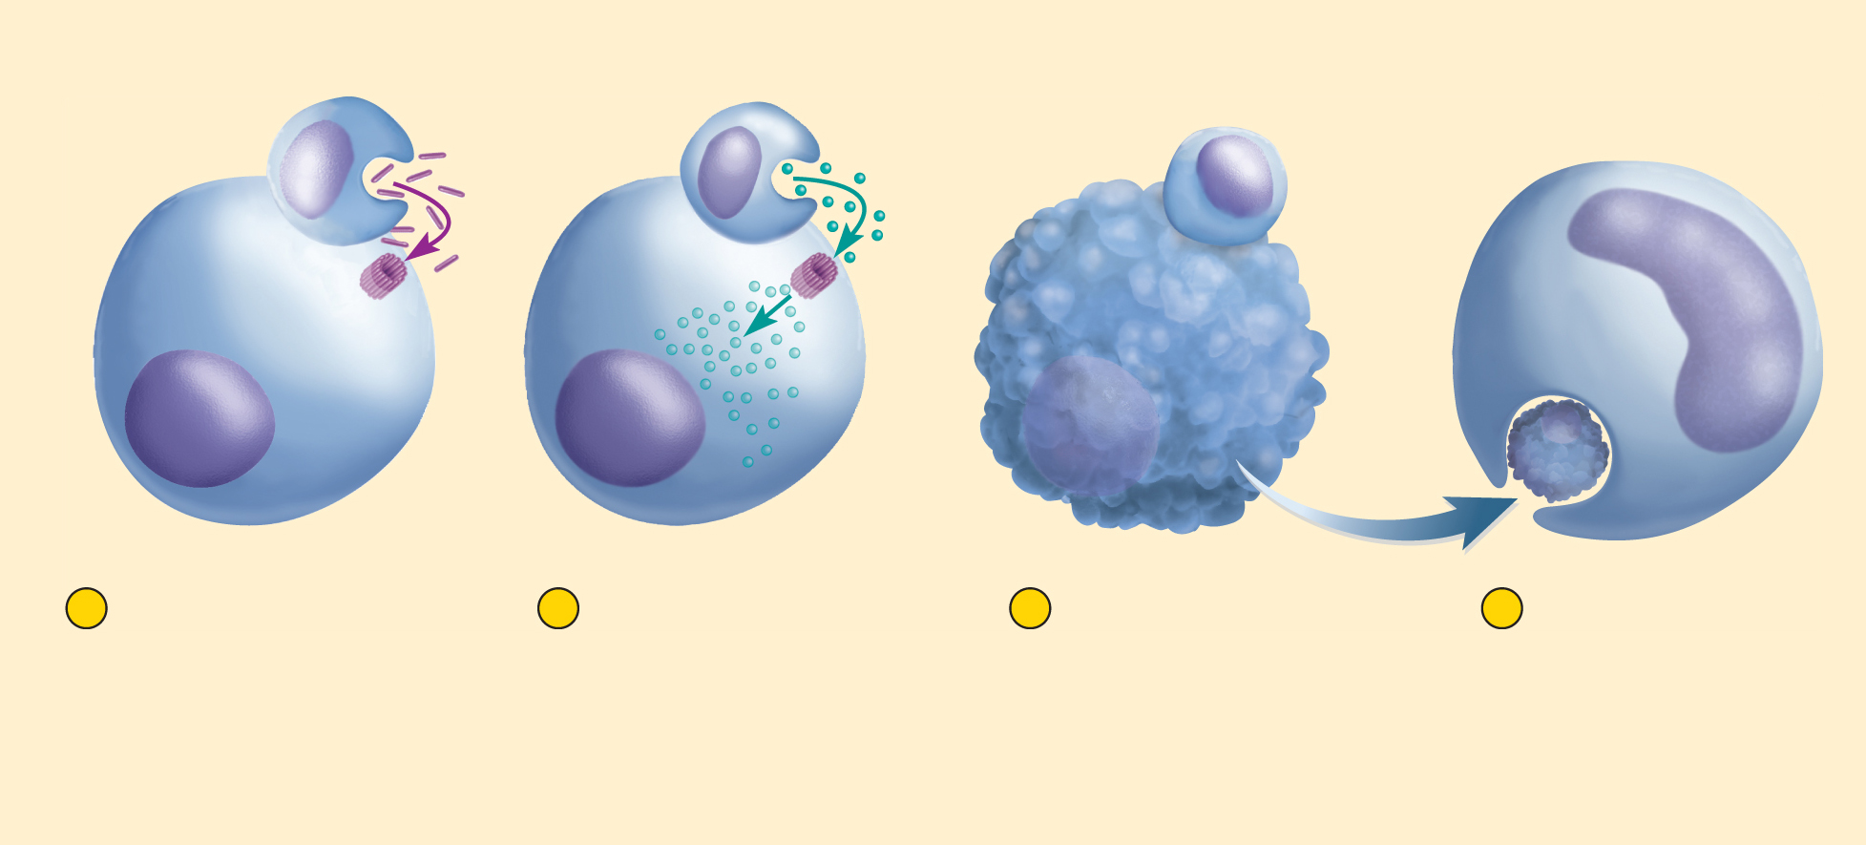
Action of NK cell
Copyright © The McGraw-Hill Companies, Inc. Permission required for reproduction or display.
NK cell
Perforins
Granzymes
Enemy cell
Macrophage
1
NK cell releases
perforins, which
polymerize and
form a hole in the
enemy cell
membrane.
2
Granzymes from
NK cell enter
perforin hole and
degrade enemy
cell enzymes.
3
Enemy cell dies
by apoptosis.
4
Macrophage
engulfs and
digests dying
cell.
Figure 21.17

Slide 21
Fever
fever – an abnormally elevation of body temperature
pyrexia, febrile
results from trauma, infections, drug reactions, brain tumors, and other causes
fever is an adaptive defense mechanism, in moderation, does more good than harm
promotes interferon activity
elevates metabolic rate and accelerates tissue repair
inhibits reproduction of bacteria and viruses
antipyretic – fever-reducing medications by inhibiting PGE₂
initiation of fever by exogenous pyrogens – fever producing agents
glycolipids on bacterial and viral surfaces
attacking neutrophils and macrophages secrete chemicals, interleukins, interferons, and others that act as endogenous pyrogens
stimulate neurons in the anterior hypothalamus to secrete prostaglandin E₂
PGE₂ raises hypothalamic set point for body temperature
stages of fever
onset, stadium, defervescence

Slide 22
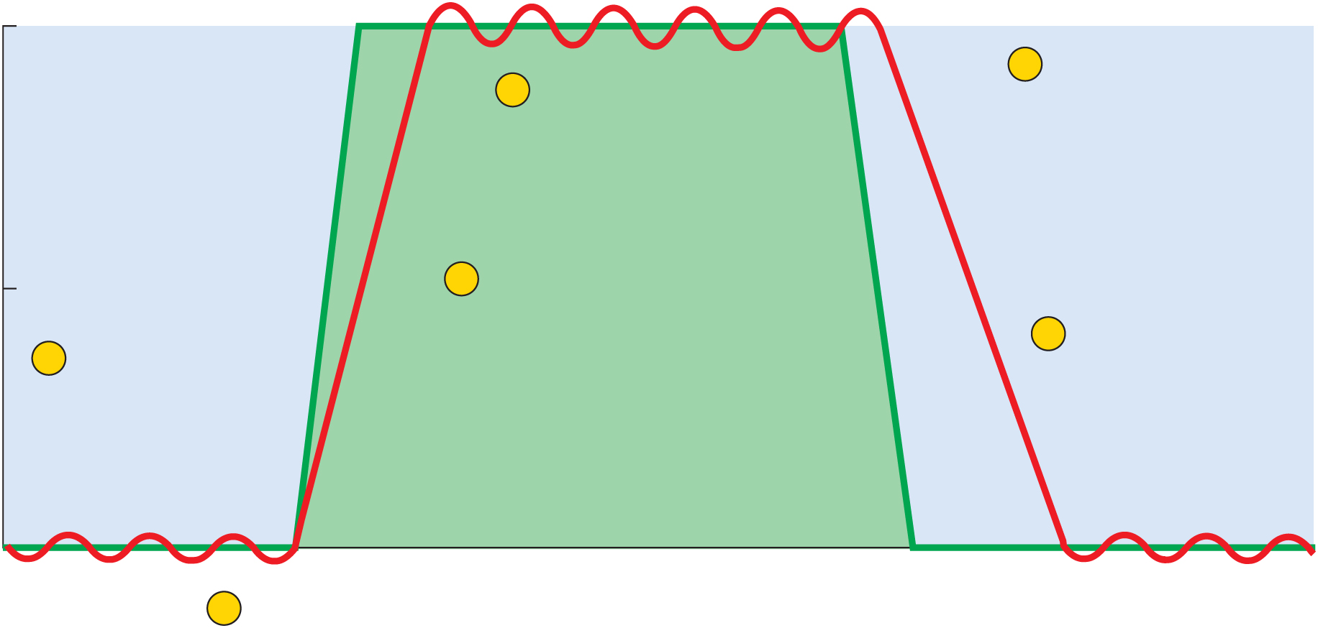
Course of a Fever
Copyright © The McGraw-Hill Companies, Inc. Permission required for reproduction or display.
39
5
Infection ends,
set point returns
to normal
4
Stadium
(body temperature
oscillates around
new set point)
38
3
Onset
(body temperature rises)
Temperature (°C)
6
Defervescence
(body temperature
returns to normal)
2
Hypothalamic
thermostat is
reset to higher
set point
37
Normal body
temperature
1
Infection and
pyrogen secretion
Figure 21.18

Slide 23
Reye Syndrome
Reye Syndrome – serious disorder in children younger than 15 following an acute viral infection such as chicken pox or influenza
swelling of brain neurons
fatty infiltration of liver and other viscera
pressure of swelling brain
nausea, vomiting, disorientation, seizures and coma
30% die, survivors sometimes suffer mental retardation
can be triggered by the use of aspirin to control fever
never give aspirin to children with chickenpox or flulike symptoms

Slide 24
Inflammation
inflammation – local defensive response to tissue injury of any kind, including trauma and infection
general purposes of inflammation
limit spread of pathogens, then destroys them
remove debris from damaged tissue
initiate tissue repair
four cardinal signs of inflammation
- redness - swelling - heat - pain

Slide 25
Inflammation
suffix -itis denotes inflammation of specific organs: arthritis, pancreatitis, dermatitis
cytokines – class of chemicals that regulate inflammation and immunity
secreted mainly by leukocytes
alter the physiology or behavior of receiving cell
act at short range, neighboring cells (paracrines) or the same cell that secretes them (autocrines)
include interferon, interleukins, tumor necrosis factor, chemotactic factors, and others

Slide 26
Processes of Inflammation
three major processes of inflammation
mobilization of body defenses
containment and destruction of pathogens
tissue cleanup and repair

Slide 27
Mobilization of Defenses
most immediate requirement for dealing with tissue injury is to get the defensive leukocytes to the site quickly
local hyperemia – increasing blood flow beyond normal rate is a way to do this
local vasodilation due to vasoactive chemicals
histamine, leukotrienes, and other cytokines
secreted by basophils, mast cells, cells damaged by trauma, toxins, or organisms triggering inflammation
hyperemia washes toxins and metabolic waste from the site more rapidly
vasoactive chemicals dilate local blood vessels
endothelial cells separate increasing capillary permeability
fluid, leukocytes, and plasma proteins leave the bloodstream
complement, antibodies, and clotting proteins

Slide 28
Mobilization of Defenses
selectins – cell-adhesion molecules made by endothelial cells that aid in the recruitment of leukocytes
make membranes sticky and snag leukocytes
margination – adhesion of the leukocytes to the vessel wall
diapedesis or emigration - leukocytes crawl through gaps in the endothelial cells and enter tissue fluid
extravasated – cells and chemicals that have let the bloodstream
basis for the four cardinal signs of inflammation
heat – results from hyperemia
redness – due to hyperemia, and extravasated RBCs in the tissue
swelling (edema) – due to increased fluid filtration from the capillaries
pain – from direct injury to the nerves, pressure on the nerves from edema, stimulation of pain receptors by prostaglandins, bacterial toxins, and a kinin called bradykinin

Slide 29
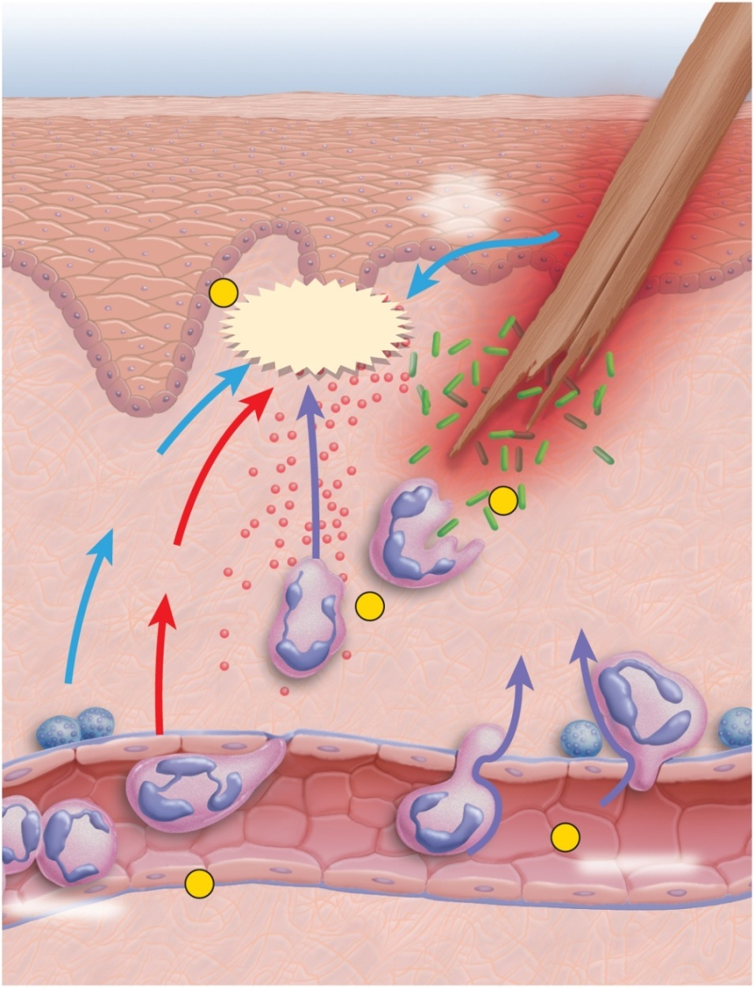
Mobilization of Defenses
Copyright © The McGraw-Hill Companies, Inc. Permission required for reproduction or display.
leukocyte behavior
margination
selectins cause leukocytes to adhere to blood vessel walls
diapedesis (emigration)
leukocytes squeeze between endothelial cells into tissue space
Splinter
From
damaged
tissue
1
Inflammatory
chemicals
Bacteria
From
mast
cells
5
Phagocytosis
From
blood
4
Chemotaxis
Mast cells
Increased
permeability
3
2
Diapedesis
Neutrophils
Margination
Blood capillary
or venule
Figure 21.19

Slide 30
Containment and Destruction of Pathogens
a priority of inflammation is to prevent the pathogens from spreading throughout the body
fibrinogen that filters into tissue fluid clots
forms a sticky mesh that walls off microbes
heparin prevents clotting at site of injury
pathogens are in a fluid pocket surrounded by clot
attacked by antibodies, phagocytes, and other defenses
neutrophils, the chief enemy of bacteria, accumulate at the injury site within an hour
after leaving the bloodstream, they exhibit chemotaxis

Slide 31
Containment and Destruction of Pathogens
chemotaxis – attraction to chemicals such as bradykinin and leukotrienes that guide them to the injury site
neutrophils are quickest to respond and kill bacteria by:
phagocytosis
respiratory burst
secrete cytokines for recruitment of macrophages and additional neutrophils
macrophages and T cells secrete colony-stimulating factor to stimulate leukopoiesis
neutrophilia – 5000 cells/μL to 25,000 cells/μL in bacterial infection
eosinophilia – elevated eosinophil count in allergy or parasitic infection

Slide 32
Tissue Cleanup
monocytes the primary agents of tissue cleanup and repair
arrive in 8 to 12 hours and become macrophages
engulf and destroy bacteria, damaged host cells, and dead and dying neutrophils
edema contributes to tissue cleanup
swelling compresses veins and reduces venous drainage
forces open valves of lymphatic capillaries promoting lymphatic drainage
lymphatics collect and remove bacteria, dead cells, proteins, and tissue debris better than blood capillaries
pus – accumulation of dead neutrophils, bacteria, other cellular debris, and tissue fluid form a pool of yellowish fluid
abscess – accumulation of pus in a tissue cavity

Slide 33
Tissue Repair
platelet-derived growth factor secreted by blood platelets and endothelial cells in injured area
stimulates fibroblasts to multiply
synthesize collagen
hyperemia delivers oxygen, amino acids, and other necessities for protein synthesis
increased heat increases metabolic rate, speeds mitosis, and tissue repair
fibrin clot forms a scaffold for tissue reconstruction
pain makes us limit the use of a body part so it has a chance to rest and heal.

Slide 34
Specific Immunity
immune system – composed of a large population of widely distributed cells that recognize foreign substances and act to neutralize or destroy them
two characteristics distinguish immunity from nonspecific resistance
specificity – immunity directed against a particular pathogen
memory – when re-exposed to the same pathogen, the body reacts so quickly that there is no noticeable illness
two types of immunity
cellular (cell-mediated) immunity: (T cells)
lymphocytes directly attack and destroy foreign cells or diseased host cells
means of ridding the body of pathogens that reside inside human cells, where they are inaccessible to antibodies
kills cells that harbor them
humoral (antibody-mediated) immunity: (B cells)
mediated by antibodies that do not directly destroy a pathogen
indirect attack where antibodies assault the pathogen
can only work against the extracellular stage of infectious microorganisms

Slide 35
Life History of B and T Cells
Copyright © The McGraw-Hill Companies, Inc. Permission required for reproduction or display.
Classical pathway
(antibody-dependent)
Alternative pathway
(antibody-independent)
Lectin pathway
(antibody-independent)
Antigen–antibody complexes
form on pathogen surface
C3 dissociates into
fragments C3a and C3b
Lectin binds to
carbohydrates on
pathogen surface
Reaction cascade
(complement fixation)
C3b binds to
pathogen surface
Reaction cascade
Reaction cascade and
autocatalytic effect
C3 dissociates into
C3a and C3b
Figure 21.15
C3a
C3b
Binds to basophils
and mast cells
Stimulates neutrophil
and macrophage
activity
Binds Ag–Ab
complexes to RBCs
Coats bacteria,
viruses, and other
pathogens
Splits C5 into
C5a and C5b
Release of
histamine and
other inflammatory
chemicals
RBCs transport
Ag–Ab complexes
to liver and spleen
C5b binds
C6, C7, and C8
Opsonization
C5b678 complex
binds ring of C9
molecules
Phagocytes remove
and degrade
Ag–Ab complexes
Membrane
attack complex
Inflammation
Immune
clearance
Phagocytosis
Cytolysis
Four mechanisms of pathogen destruction

Slide 36
Passive and Active Immunity
natural active immunity
production of one’s own antibodies or T cells as a result of infection or natural exposure to antigen
artificial active immunity
production of one’s own antibodies or T cells as a result of vaccination against disease
vaccine – consists of dead or attenuated (weakened) pathogens that stimulate the immune response without causing the disease
booster shots – periodic immunizations to stimulate immune memory to maintain a high level of protection
natural passive immunity
temporary immunity that results from antibodies produced by another person
fetus acquires antibodies from mother through placenta, milk
artificial passive immunity
temporary immunity that results from the injection of immune serum (antibodies) from another person or animal
treatment for snakebite, botulism, rabies, tetanus, and other diseases

Slide 37
Antigens
antigen – any molecule that triggers an immune response
large molecular weights of over 10,000 amu
complex molecules with structures unique to the individual
proteins, polysaccharides, glycoproteins, glycolipids
can distinguish ‘self’ molecules from foreign
epitopes (antigenic determinants) – certain regions of an antigen molecule that stimulate immune responses
haptens - to small to be antigenic in themselves
must combine with a host macromolecule
create a unique complex that the body recognizes as foreign
cosmetics, detergents, industrial chemicals, poison ivy, and animal dander
penicillin binds to host proteins in allergic individuals

Slide 38
Lymphocytes
major cells of the immune system
lymphocytes
macrophages
dendritic cells
especially concentrated in strategic places such as lymphatic organs, skin, and mucous membranes
three categories of lymphocytes
natural killer (NK) cells – immune surveillance
T lymphocytes (T cells)
B lymphocytes (B cells)

Slide 39
Life Cycle of T cells
involves three stages and three anatomical stations in the body
‘born’ in the red bone marrow
descendant of the pluripotent stem cells (PPSCs)
released into the blood as still-undifferentiated stem cells that colonize the thymus
mature in thymus
thymosins stimulate maturing T cells to develop surface antigen receptors
with receptors in place, the T cells are now immunocompetent – capable of recognizing antigens presented to them by APCs
reticuloendothelial cells in the thymus test T cells by presenting ‘self’ antigens to them
two ways to fail the test:
inability to recognize the RE cells, especially their MHC antigens
would be incapable of recognizing a foreign attack on the body
reacting to the self antigen
T cells would attack one’s own tissues

Slide 40
Life Cycle of T cells
negative selection - T cells that fail either test must be eliminated
two forms of negative selection
clonal deletion – self-reactive T cells die and macrophages phagocytize them
anergy – self-reactive T cells remain alive but unresponsive
negative selection leaves the body in a state of self-tolerance in which the surviving T cells respond only to foreign antigens, and tolerating our own
2% of the T cells that reach the thymus leave as immunocompetent T cells
move to thymus medulla and undergo positive selection – they multiply and form clones of identical T cells programmed to respond to a specific antigen
naïve lymphocyte pool – immunocompetent T cells but have not yet encountered the foreign antigens
deployment
naïve T cells leave thymus and colonize lymphatic tissues and organs everywhere in the body

Slide 41
B Lymphocytes (B cells)
site of development
group fetal stem cells remain in bone marrow
develop into B cells
B cell selection
B cells that react to self antigens undergo either anergy or clonal deletion same as T cell selection
self-tolerant B cells synthesize antigen surface receptors, divide rapidly, produce immunocompetent clones
leave bone marrow and colonize same lymphatic tissues and organs as T cells

Slide 42
Antigen-Presenting Cells (APCs)
T cells can not recognize their antigens on their own
antigen-presenting cells (APCs) are required to help
dendritic cells, macrophages, reticular cells, and B cells function as APCs
function of APCs depends on major histocompatibility complex (MHC) proteins
act as cell ‘identification tags’ that label every cell of your body as belonging to you
structurally unique for each individual, except for identical twins
antigen processing
APC encounters antigen
internalizes it by endocytosis
digests it into molecular fragments
displays relevant fragments (epitopes) in the grooves of the MHC protein

Slide 43
Antigen-Presenting Cells (APCs)
antigen presenting
wandering T cells inspect APCs for displayed antigens
if APC only displays a self-antigen, the T cell disregards it
if APC displays a nonself-antigen, the T cell initiates an immune attack
APCs alert the immune system to the presence of foreign antigen
key to successful defense is to quickly mobilize immune cells against the antigen
with so many cell types involved in immunity, they require chemical messengers to coordinate their activities – interleukins
chemical signals from one leukocyte to another

Slide 44
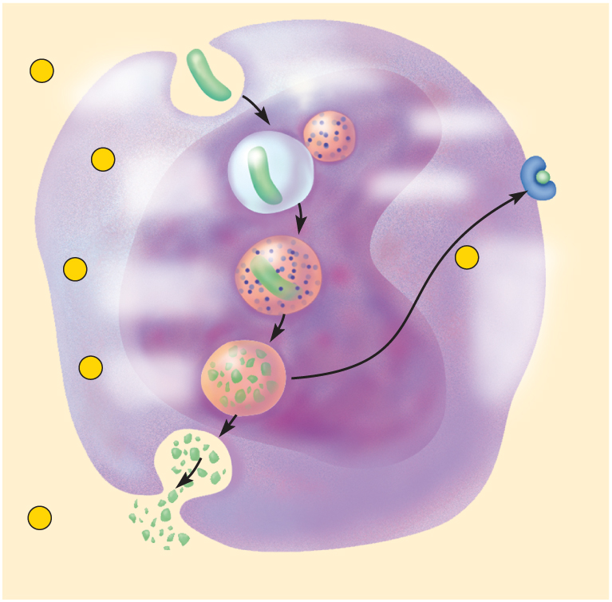
Antigen Processing
Copyright © The McGraw-Hill Companies, Inc. Permission required for reproduction or display.
1
Phagocytosis
of antigen
Lysosome
Epitopes
MHC protein
2
Lysosome
fuses with
phagosome
Phagosome
3
Antigen and
enzyme mix in
phagolysosome
6
Processed
antigen
fragments
(epitopes)
displayed on
macrophage
surface
4
Antigen is
degraded
Figure 21.21a
5
Antigen
residue is
voided by
exocytosis
(a)

Slide 45
Cellular Immunity
cellular (cell-mediated) immunity – a form of specific defense in which the T lymphocytes directly attack and destroy diseased or foreign cells, and the immune system remembers the antigens and prevents them from causing disease in the future

Slide 46
Cellular Immunity
cellular immunity involves four classes of T cells
cytotoxic T (T_{C}) cells – killer T cells (T8, CD8, or CD8+)
the ‘effectors’ of cellular immunity
carry out attack on enemy cells
helper T (T_{H}) cells (T4, CD4, CD4+)
help promote T_{C} cell and B cell action and nonspecific resistance
regulatory T (T_{R}) cells – T-regs
inhibit multiplication and cytokine secretion by other T cells
limit immune response
memory (T_{M}) cells
descend from the cytotoxic T cells
responsible for memory in cellular immunity

Slide 47
Immunity
both cellular and humoral immunity occur in three stages:
recognition
attack
memory
thought of as the ‘three Rs of immunity’
recognize
react
remember

Slide 48
T Cell Recognition
recognition phase has two aspects: antigen presentation and T cell activation
antigen presentation
APC encounters and processes an antigen
migrates to nearest lymph node
displays it to the T cells
when T cell encounters its displayed antigen on the MHC protein, they initiate the immune response
T cells respond to two classes of MHC proteins
MHC – I proteins
occur on every nucleated cells in the body
constantly produced by our cells, transported to, and inserted on plasma membrane
normal self antigens that do not elicit and T cell response
viral proteins or abnormal cancer antigens do elicit a T cell response
infected or malignant cells are then destroyed before they can do further harm to the body
MHC – II proteins (human leukocyte antigens – HLAs)
occur only on APCs and display only foreign antigens
T_{C} cells respond only to MHC – I proteins
T_{H} cells respond only to MHC – II proteins

Slide 49
T Cell Recognition
T cell activation
begins when T_{C} or T_{H} cell binds to a MHCP displaying an epitope that the T cell is programmed to recognize
T cell must then bind to another APC protein related to the interleukins
T cell must check twice to see if it is really bound to a foreign antigen – costimulation
helps insure the immune system does not launch an attack in the absence of an enemy
would turn against one’s own body and injury our tissues
successful costimulation will trigger clonal selection
activated T cell undergoes repeated mitosis
gives rise to a clone of identical T cells programmed against the same epitope
some cells of the clone become effector cells and carry out the attack
other cells become memory cells

Slide 50
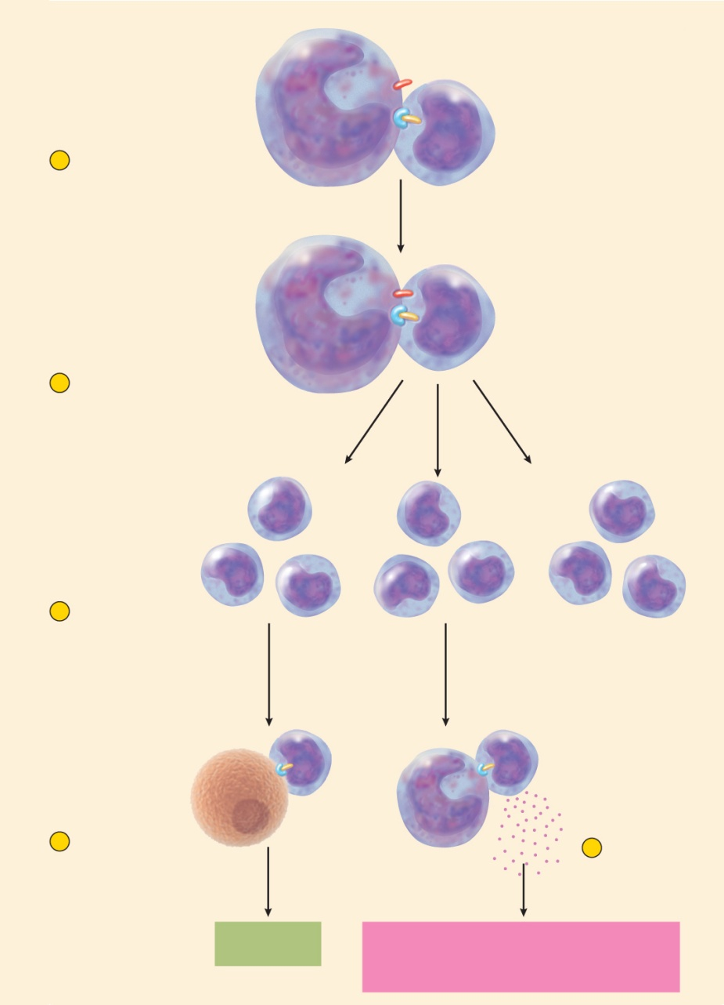
T cell Activation
Copyright © The McGraw-Hill Companies, Inc. Permission required for reproduction or display.
APC
Costimulation
protein
MHC protein
Antigen
1
Antigen
recognition
T_{C} or T_{H}
APC
2
Costimulation
T_{C} or T_{H}
T_{C}
T_{H}
T_{M}
or
T_{H}
T_{M}
T_{C}
T_{C}
T_{H}
T_{M}
3
Clonal selection
Effector cells
Memory
T cells
T_{C}
T_{H}
Figure 21.22
MHC-II
protein
MHC-I
protein
4
Lethal hit
Enemy
cell
APC
4
Interleukin
secretion
or
Destruction of
enemy cell
Activity of NK, B, or T_{C} cells
Development of memory T cells
Inflammation and other nonspecific defenses

Slide 51
Attack : Role of Helper T (T_{H}) Cells
helper and cytotoxic T cells play different roles in the attack phase
helper T cell necessary for most immune responses
play central role in coordinating both cellular and humoral immunity
when helper T cell recognizes the Ag-MHCP complex:
secrete interleukins that exert three effects:
attract neutrophils and NK cells
attract macrophages, stimulate their phagocytic activity, and inhibit them from leaving the area
stimulate T and B cell mitosis and maturation

Slide 52
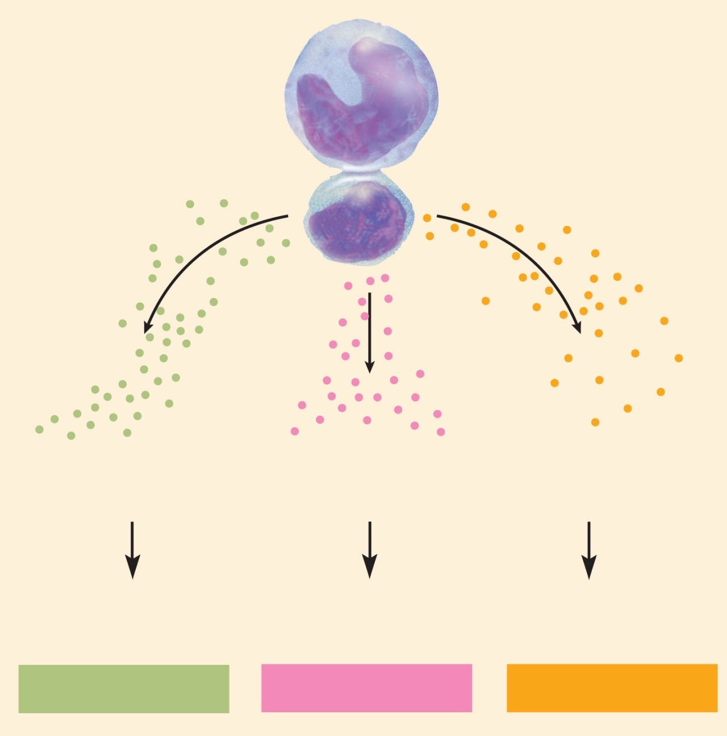
Attack : Role of Helper T (T_{H}) Cells
Copyright © The McGraw-Hill Companies, Inc. Permission required for reproduction or display.
Macrophage,
B cell, or other
antigen-presenting cell
Helper T (T₄) cell
Macrophage-
activating factor
Other cytokines
Interleukin-2
Other cytokines
Interleukin-1
Other cytokines
Figure 21.23
Macrophage activity
Leukocyte chemotaxis
Inflammation
Clonal selection
of B cells
Clonal selection of
cytotoxic T cells
Nonspecific defense
Humoral immunity
Cellular immunity

Slide 53
Attack : Cytotoxic T (T_{C}) Cells
cytotoxic T (T_{C}) cell are the only T cells directly attack other cells
when T_{C} cell recognizes a complex of antigen and MHC – I protein on a diseased or foreign cell it ‘docks’ on that cell
delivers a lethal hit of toxic chemicals
perforin and granzymes – kill cells in the same manner as NK cells
interferons – inhibit viral replication
recruit and activate macrophages
tumor necrosis factor (TNF) – aids in macrophage activation and kills cancer cells
goes off in search of another enemy cell while the chemicals do their work

Slide 54
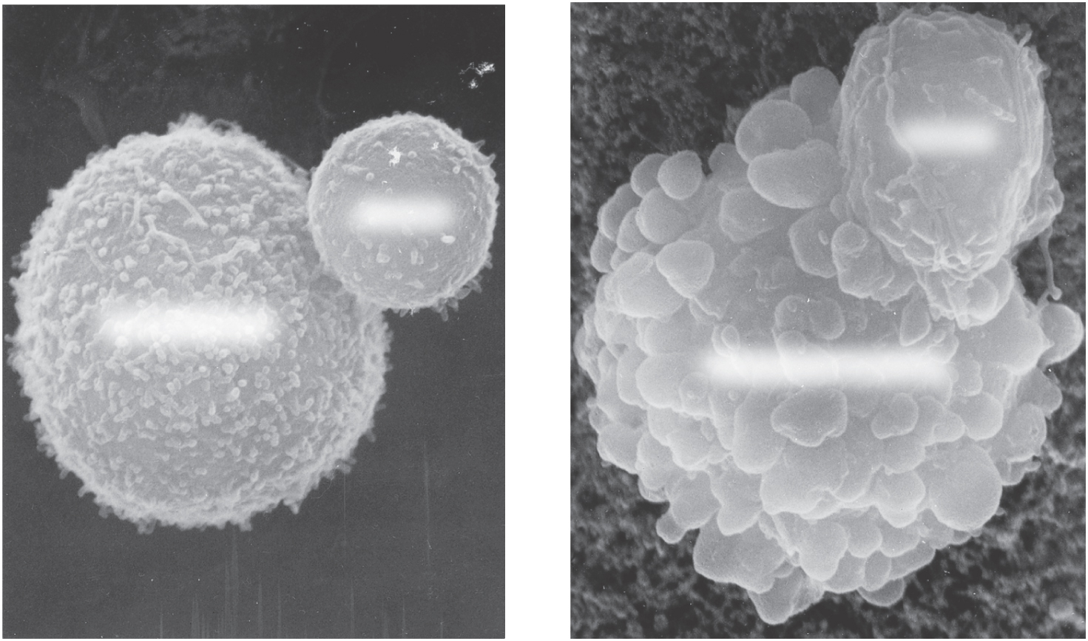
Cytotoxic T Cell Function
Copyright © The McGraw-Hill Companies, Inc. Permission required for reproduction or display.
T cell
T cell
Cancer cell
Dying cancer cell
(a)
10 µm
(b)
Figure 21.24 a-b
Dr. Andrejs Liepins
cytotoxic T cell binding to cancer cell

Slide 55
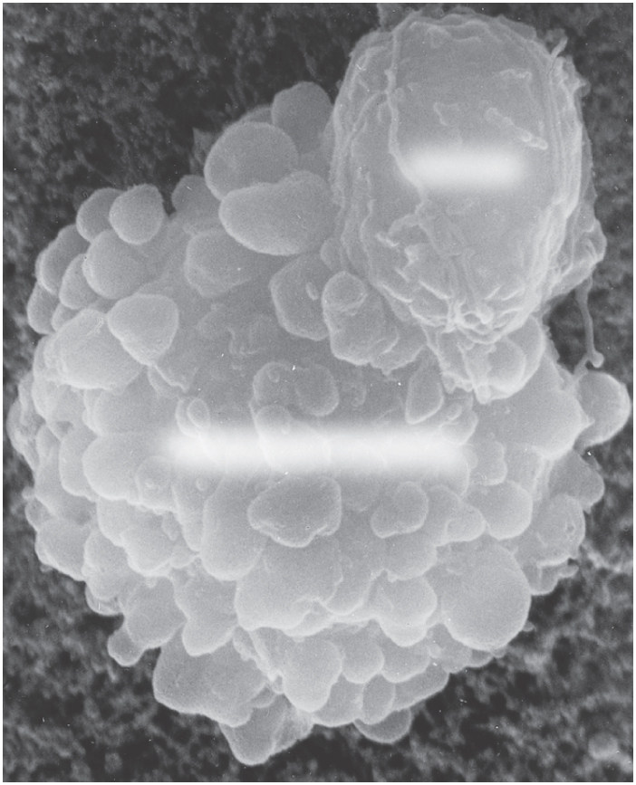
Destruction of Cancer Cell
Copyright © The McGraw-Hill Companies, Inc. Permission required for reproduction or display.
T cell
Dying cancer cell
Figure 21.24b
(b)
Dr. Andrejs Liepins

Slide 56
Memory
immune memory follows primary response
following clonal selection, some T_{C} and T_{H} cells become memory cells
long-lived
more numerous than naïve T cells
fewer steps to be activated, so they respond more rapidly
T cell recall response
upon re-exposure to same pathogen later in life, memory cells launch a quick attack so that no noticeable illness occurs
the person is immune to the disease

Slide 57
Humoral Immunity
humoral immunity is a more indirect method of defense than cellular immunity
B lymphocytes of humoral immunity produce antibodies that bind to antigens and tag them for destruction by other means
cellular immunity attacks the enemy cells directly
works in three stages like cellular immunity
recognition
attack
memory

Slide 58
Humoral Immunity
recognition
immunocompetent B cell has thousands of surface receptors for one antigen
activation begins when an antigen binds to several of these receptors
links them together
taken into the cell by receptor-mediated endocytosis
small molecules are not antigenic because they cannot link multiple receptors together
B cell processes (digests) the antigen
links some of the epitopes to its MHC–II proteins
displays these on the cell surface
usually B cell response goes no further unless a helper T cell binds to this Ag-MHCP complex
bound T_{H} cell secretes interleukins that activate B cell

Slide 59
Humoral Immunity
recognition
triggers clonal selection
B cell mitosis gives rise to an entire battalion of identical B cells programmed against the same antigen
most differentiate into plasma cells
larger than B cells and contain an abundance of rough ER
secrete antibodies at a rate of 2,000 molecules per second during their life span of 4 to 5 days
antibodies travel through the body in the blood or other body fluids
first exposure antibodies IgM, later exposures to the same antigen, IgG
attack
antibodies bind to antigen, render it harmless, ‘tag it’ for destruction
memory
some B cells differentiate into memory cells

Slide 60
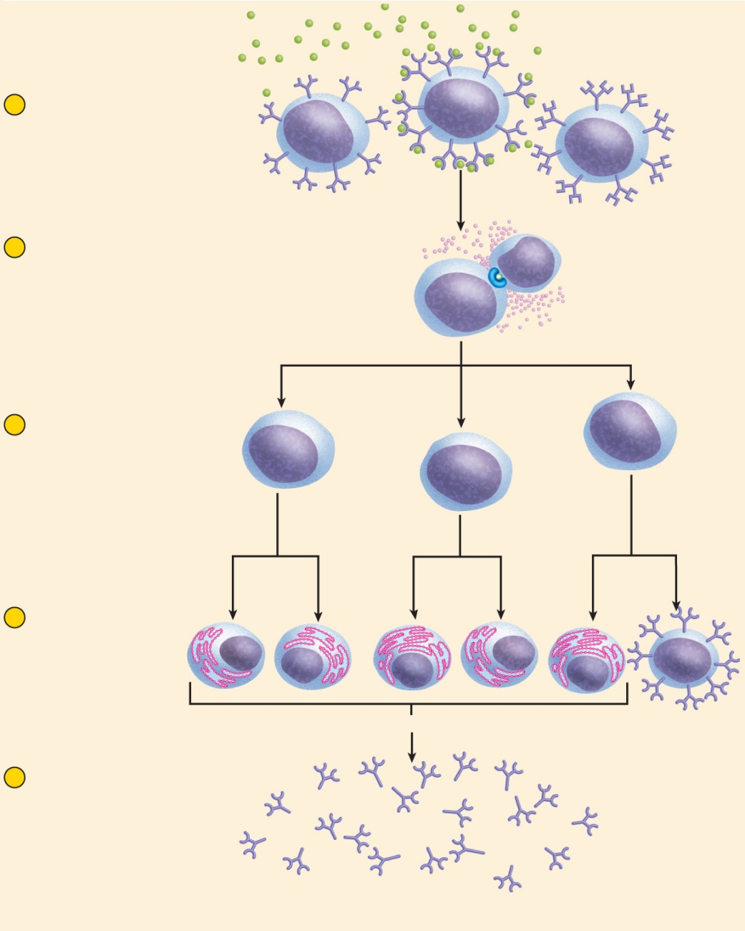
Humoral Immunity - Recognition
Copyright © The McGraw-Hill Companies, Inc. Permission required for reproduction or display.
Antigen
Receptor
Lymphocyte
1
Antigen recognition
Immunocompetent B cells
exposed to antigen. Antigen
binds only to B cells with
complementary receptors.
2
Antigen presentation
B cell internalizes antigen
and displays processed
epitope. Helper T cell binds
to B cell and secretes
interleukin.
Helper T cell
B cell
Epitope
MHC-II protein
Interleukin
3
Clonal selection
Interleukin stimulates
B cell to divide repeatedly
and form a clone.
4
Differentiation
Some cells of the
clone become
memory B cells.
Most differentiate
into plasma cells.
Figure 21.25
Plasma cells
Memory
B cell
5
Attack
Plasma cells synthesize
and secrete antibody.
Antibody employs various
means to render antigen
harmless.
Antibody

Slide 61
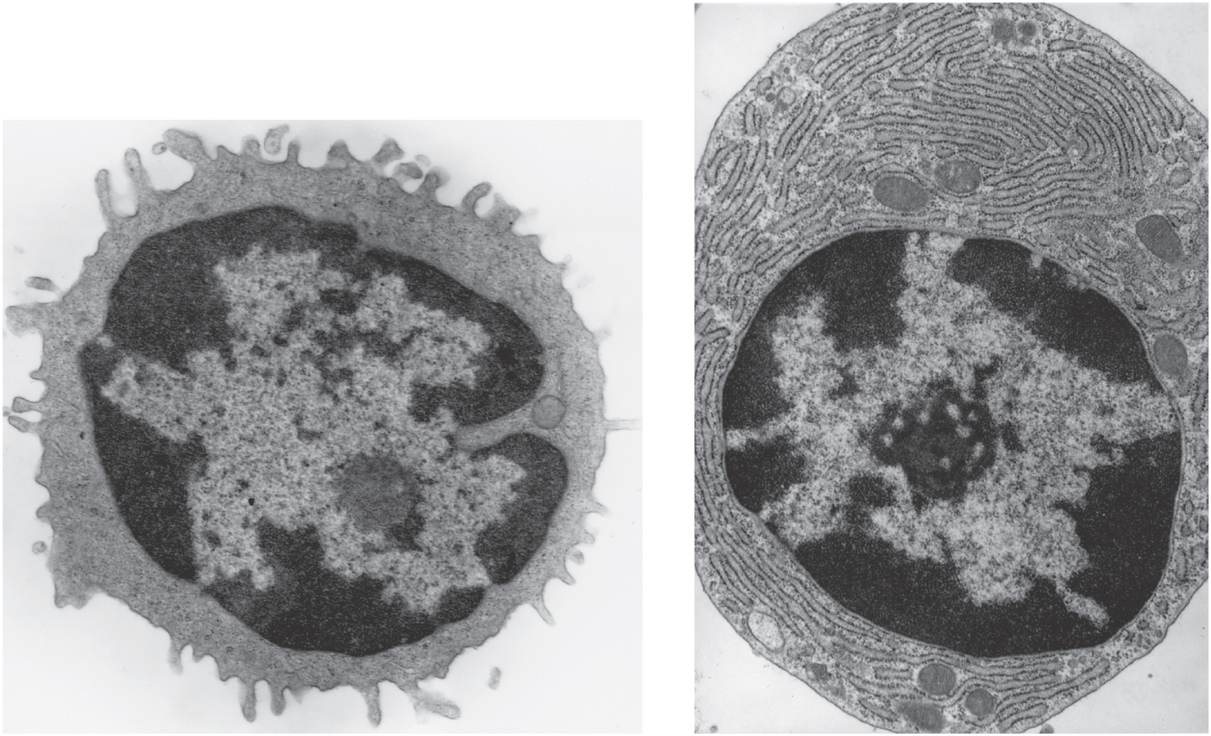
B cells and Plasma cells
Copyright © The McGraw-Hill Companies, Inc. Permission required for reproduction or display.
Rough endoplasmic
reticulum
Mitochondria
Nucleus
(a) B cell
2 µm
(b) Plasma cell
2 µm
© Dr. Don W. Fawcett/Visuals Unlimited
Figure 21.26 a-b

Slide 62
Antibodies
immunoglobulin (Ig) – an antibody is a defensive gamma globulin found in the blood plasma, tissue fluids, body secretions, and some leukocyte membranes
antibody monomer – the basic structural unit of an antibody
composed of four polypeptide chains linked by disulfide (-S-S-) bonds
two larger heavy chains about 400 amino acids long
heavy chains have a hinge region where antibody is bent
two light chains about half as long
variable (V) region in all four chains
gives the antibody its uniqueness
antigen binding site – formed from the V regions of the heavy and light chain on each arm
attaches to the epitope of an antigen molecule
constant (C) region has the same amino acid sequence within one person and determines mechanism of antibody action

Slide 63
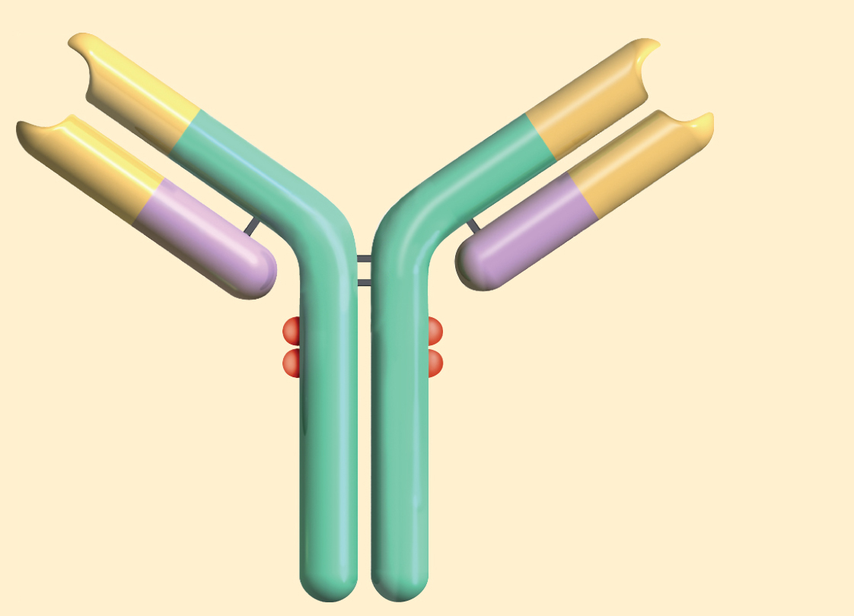
Antibody Structure
Copyright © The McGraw-Hill Companies, Inc. Permission required for reproduction or display.
Disulfide
bonds
Antigen-
binding
site
Light chain
Variable
(V) regions
Hinge region
Complement-binding site
Constant
(C) regions
Heavy chain
(a)
Figure 21.27a

Slide 64
Five Classes of Antibodies
named for the structure of their C region
IgA - monomer in plasma; dimer in mucus, saliva, tears, milk, and intestinal secretions
prevents pathogen adherence to epithelia and penetrating underlying tissues
provides passive immunity to newborns
IgD - monomer; B cell transmembrane antigen receptor
thought to function in B cell activation by antigens
IgE - monomer; transmembrane protein on basophils and mast cells
stimulates release of histamine and other chemical mediators of inflammation and allergy
attracts eosinophils to parasitic infections
produces immediate hypersensitivity reactions
IgG - monomer; constitutes 80% of circulating antibodies
crosses placenta to fetus, secreted in secondary immune response, complement fixation
IgM – pentamer in plasma and lymph
secreted in primary immune response, agglutination, complement
fixation

Slide 65
Antibody Diversity
human immune system capable of as many as 1 trillion different antibodies
accustomed to ‘one gene, one protein’ thinking
35,000 genes in human genome
somatic recombination
DNA segments shuffled and form new combinations of base sequences to produce antibody genes
somatic hypermutation
B cells in lymph nodules rapidly mutate creating new sequences

Slide 66
Humoral Immunity - Attack
neutralization
antibodies mask pathogenic region of antigen
complement fixation
antigen binds to IgM or IgG, antibody changes shape, initiates complement binding which leads to inflammation, phagocytosis, immune clearance, or cytolysis
primary defense against foreign cells, bacteria, and mismatched RBCs
agglutination
antibody has 2-10 binding sites; binds to multiple enemy cells immobilizing them from spreading
precipitation
antibody binds antigen molecules (not cells); creates antigen-antibody complex that precipitates, phagocytized by eosinophils

Slide 67
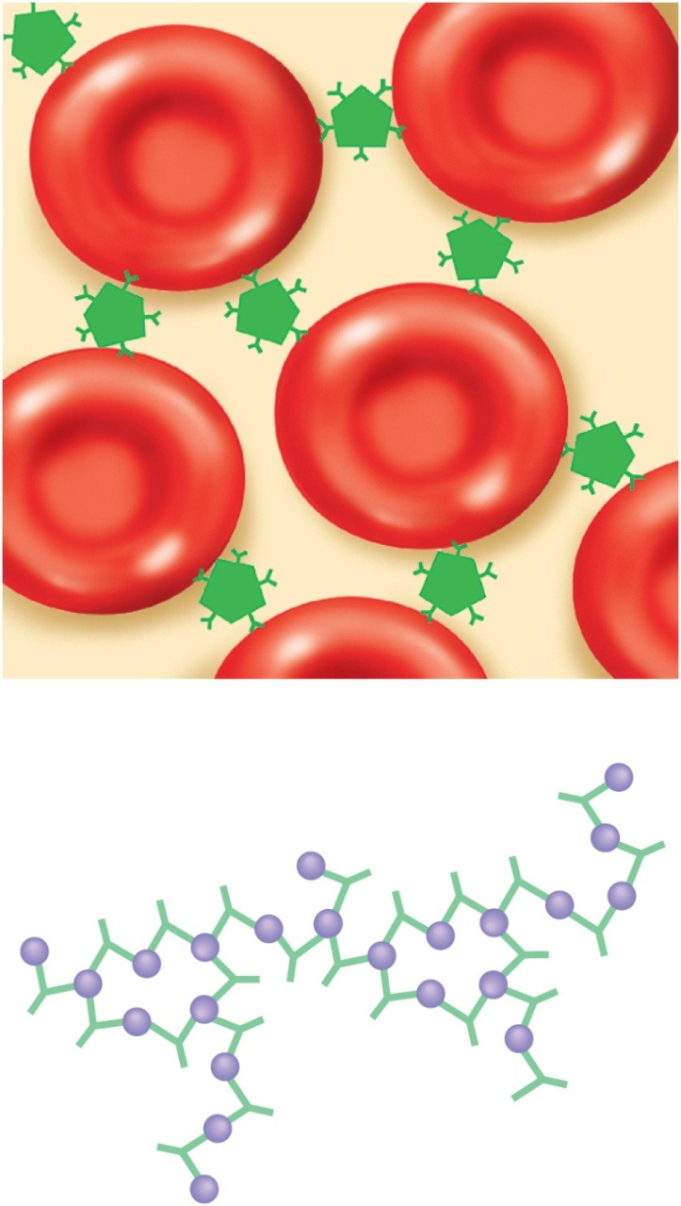
Agglutination and Precipitation
Copyright © The McGraw-Hill Companies, Inc. Permission required for reproduction or display.
Antibodies
(IgM)
(a)
Figure 21.28 a-b
Antigens
Antibody
monomers
(b)

Slide 68
Humoral Immunity - Memory
primary immune response – immune reaction brought about by the first exposure to an antigen
appearance of protective antibodies delayed for 3 to 6 days while naïve B cells multiply and differentiate into plasma cells
as plasma cells produce antibodies, the antibody titer (level in the blood plasma) rises
IgM appears first, peaks in about 10 days, soon declines
IgG levels rise as IgM declines, but IgG titer drops to a low level within a month
primary response leaves one with an immune memory of the antigen
during clonal selection, some of the clone becomes memory B cells
found mainly in germinal centers of the lymph nodes
mount a very quick secondary response

Slide 69
Humoral Immunity - Memory
secondary (anamnestic) response – if re-exposed to the same antigen
plasma cells form within hours
IgG titer rises sharply and peaks in a few days
response is so rapid that the antigen has little chance to exert a noticeable effect on the body
no illness results
low levels of IgM also secreted and quickly declines
IgG remain elevated for weeks to years
conferring long lasting protection
memory does not last as long in humoral immunity as in cellular immunity

Slide 70
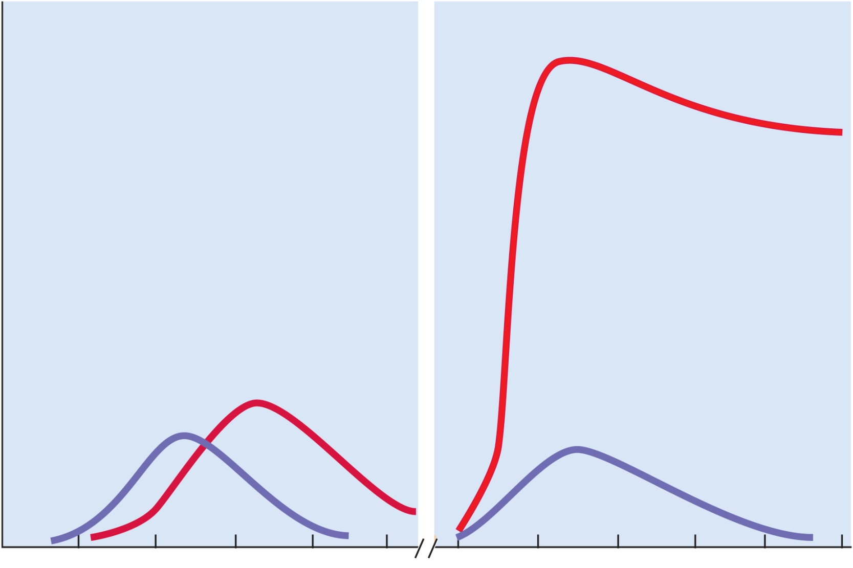
Humoral Immunity Responses
Copyright © The McGraw-Hill Companies, Inc. Permission required for reproduction or display.
Primary response
Secondary response
IgG
Serum antibody titer
IgG
IgM
IgM
0
5
10
15
20
25
0
5
10
15
20
25
Days from first exposure
to antigen
Days from reexposure
to same antigen
Figure 21.29

Slide 71
Immune System Disorders
immune response may be:
too vigorous
too weak
misdirected against wrong targets

Slide 72
Hypersensitivity
hypersensitivity – an excessive immune reaction against antigens that most people tolerate
includes:
alloimmunity - reaction to transplanted tissue from another person
autoimmunity - abnormal reactions to one’s own tissues
allergies – reactions to environmental antigens (allergens) – dust, mold, pollen, vaccines, bee and wasp venom, poison ivy and other plants, foods such as nuts, milk, eggs, and shellfish, drugs such as penicillin, tetracycline, and insulin
four kinds of hypersensitivity based on the type of immune agents involved (antibodies or T cells) and their method of attack on the antigen
Type I acute (immediate) hypersensitivity – very rapid response
Type II and Type III - subacute – slower onset (1 – 3 hours after exposure)
last longer (10 – 15 hours)
Types I, II, and III are quicker antibody mediated responses
Type IV - delayed cell-mediated response

Slide 73
Type I (acute) Hypersensitivity
includes most common allergies
IgE-mediated reaction that begins within seconds of exposure
usually subsides within 30 minutes, although it can be severe to fatal
allergens bind to IgE on the membranes of basophils and mast cells
stimulate them to secrete histamine and other inflammatory and vasoactive chemicals
chemicals trigger glandular secretion, vasodilation, increased capillary permeability, smooth muscle spasms, and other effects
clinical signs include:
local edema, mucus hypersecretion and congestion, watery eyes, runny nose, hives, and sometimes cramps, diarrhea and vomiting
examples: food allergies and asthma – local inflammatory reaction to inhaled allergens

Slide 74
Type I (acute) Hypersensitivity
anaphylaxis
immediate, severe reaction Type I reaction
local anaphylaxis can be relieved with antihistamines
anaphylactic shock
severe, widespread acute hypersensitivity that occurs when an allergen is introduced to the bloodstream of an allergic individual
characterized by bronchoconstriction, dyspnea (labored breathing), widespread vasodilation, circulatory shock, and sometimes death
antihistamines are inadequate by themselves
epinephrine relieves the symptoms by dilating bronchioles, increasing cardiac output, and restoring blood pressure
fluid therapy and respiratory support are sometimes required

Slide 75
Type I (acute) Hypersensitivity
asthma
most common chronic illness in children
allergic (extrinsic) asthma is most common form
respiratory crisis triggered by inhaled allergens
stimulate plasma cells to secrete IgE
binds to most cells in respiratory mucosa
mast cells release a complex mixture of inflammatory chemicals
triggers intense airway inflammation
nonallergic (intrinsic) asthma
triggered by infections, drugs, air pollutants, cold dry air, exercise or emotions
more common in adults, but effects are the same

Slide 76
Type I (acute) Hypersensitivity
asthma
effects:
bronchospasms within minutes
severe coughing, wheezing, and sometimes fatal suffocation
second respiratory crisis often occurs 6 to 8 hours later
interleukins attract eosinophils to bronchial tissue
secrete proteins that paralyze respiratory cilia
severely damage epithelium leading to scarring and long-term damage to the lungs
bronchioles become edematous and plugged with thick, sticky mucous
treatment
epinephrine and other β-adrenergic stimulants to dilate airway and restore breathing, and with inhaled corticosteroids to minimize inflammation and long term damage

Slide 77
Type II Hypersensitivity (Antibody-Dependent Cytotoxic)
occurs when IgG or IgM attacks antigens bound to cell surfaces
reaction leads to complement activation
and lysis or opsonization of the target cell
macrophages phagocytize and destroy opsonized platelets, erythrocytes, or other cells
examples: blood transfusion reaction, pemphigus vulgaris, and some drug reactions

Slide 78
Type III Hypersensitivity (Immune Complex)
occurs when IgG or IgM form antigen-antibody complexes
precipitate beneath endothelium of blood vessels and other tissues
at site, activate complement and trigger intense inflammation
examples: autoimmune diseases - acute glomerulonephritis and in systemic lupus erythematosus, a widespread inflammation of the connective tissues

Slide 79
Type IV Hypersensitivity (Delayed)
cell-mediated reaction in which the signs appear 12 to 72 hour after exposure
begins with APCs in lymph nodes display antigens to helper T cells
T cells secrete interferon and cytokines that activate cytotoxic T cells and macrophages
result is a mixture of nonspecific and immune responses
examples: haptens in cosmetics and poison ivy, graft rejection, TB skin test, beta cell destruction that causes type I diabetes mellitus

Slide 80
Autoimmune Diseases
autoimmune diseases - failures of self-tolerance
immune system fails to distinguish self-antigens from foreign ones
produces autoantibodies that attack the body’s own tissues
three reasons why self-tolerance
cross-reactivity
some antibodies against foreign antigens react to similar self-antigens
rheumatic fever - streptococcus antibodies also react with heart valves
abnormal exposure of self-antigens in the blood
some of our native antigens are not exposed to blood
blood-testes barrier isolates sperm from blood
changes in structure of self-antigens
viruses and drugs may change the structure of self-antigens or cause the immune system to perceive them as foreign
self-reactive T cells
not all are eliminated in thymus and are normally kept in check by regulatory T (T_{R}) cells

Slide 81
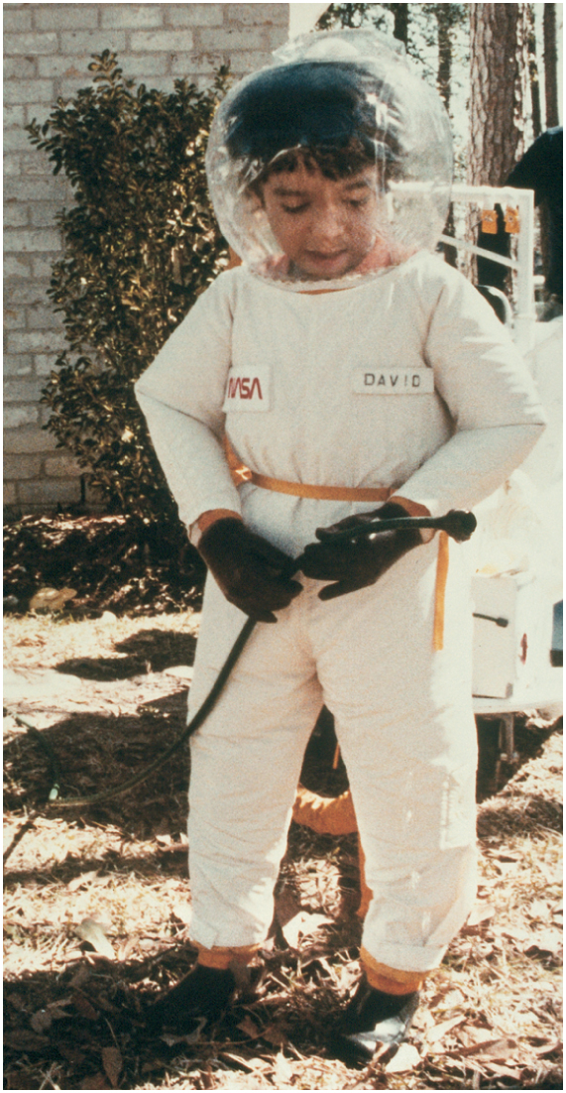
Immunodeficiency Diseases
Copyright © The McGraw-Hill Companies, Inc. Permission required for reproduction or display.
immune system fails to react vigorously enough
Severe Combined Immunodeficiency Disease (SCID)
hereditary lack of T and B cells
vulnerability to opportunistic infection and must live in protective enclosures
© Science VU/Visuals Unlimited
Figure 21.30

Slide 82
Immunodeficiency Diseases
Acquired Immunodeficiency Syndrome (AIDS) – nonhereditary diseases contracted after birth
group of conditions that involve and severely depress the immune response
caused by infection with the human immunodeficiency virus (HIV)
HIV structure (next slide)
invades helper T cells, macrophages and dendritic cells by “tricking” them to internalize viruses by receptor mediated endocytosis
reverse transcriptase (retrovirus) uses viral RNA as template to synthesize DNA
new DNA inserted into host cell DNA (may be dormant for months to years)
when activated, it induces the host cell to produce new viral RNA, capsid proteins, and matrix proteins
they are coated with bits of the host cell’s plasma membrane
adhere to new host cells and repeat the process

Slide 83
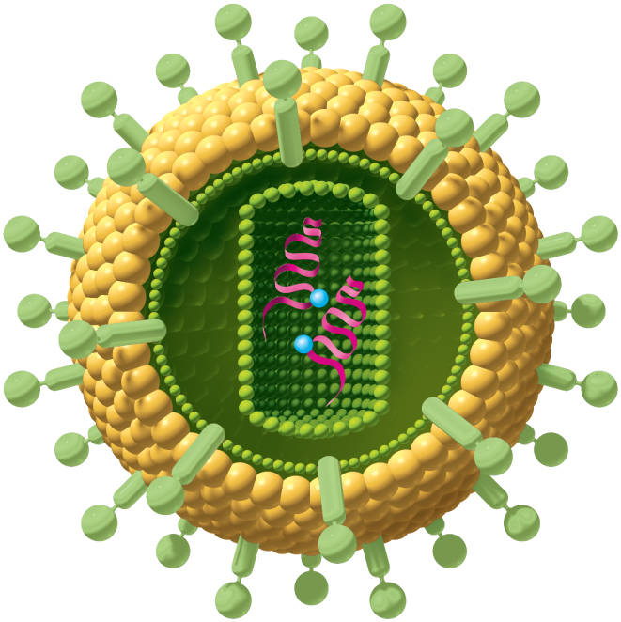
HIV Structure
Copyright © The McGraw-Hill Companies, Inc. Permission required for reproduction or display.
Envelope:
Glycoprotein
Phospholipid
Matrix
Capsid
RNA
Reverse
transcriptase
(a)
Figure 21.31a

Slide 84
AIDS
by destroying T_{H} cells, HIV strikes at the central coordinating agent of nonspecific defense, humoral immunity, and cellular immunity
incubation period ranges from several months to 12 years
signs and symptoms
early symptoms: flulike symptoms of chills and fever
progresses to night sweats, fatigue, headache, extreme weight loss, lymphadenitis
normal T_{H} count is 600 to 1,200 cells/μL of blood, but in AIDS it is less than 200 cells/μL
person susceptible to opportunistic infections (Toxoplasma, Pneumocystis, herpes simplex virus, cytomegalovirus, or tuberculosis)
Candida (thrush): white patches on mucous membranes
Kaposi sarcoma: cancer originates in endothelial cells of blood vessels causes purple lesions in skin

Slide 85
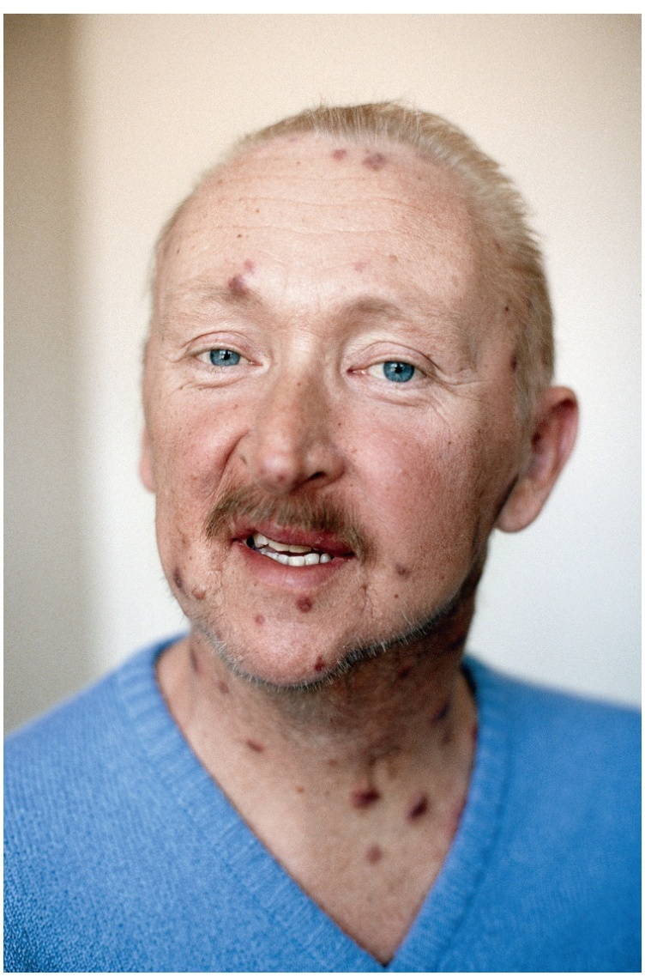
Kaposi Sarcoma
Copyright © The McGraw-Hill Companies, Inc. Permission required for reproduction or display.
© Roger Ressmeyer/Corbis
Figure 21.32

Slide 86
HIV Transmission
through blood, semen, vaginal secretions, breast milk, or across the placenta
most common means of transmission
sexual intercourse (vaginal, anal, oral)
contaminated blood products
contaminated needles
not transmitted by casual contact
undamaged latex condom is an effective barrier to HIV, especially with spermicide nonoxynol-9

Slide 87
Treatment Strategies
prevent binding to CD4 proteins of T_{H} cells
disrupt reverse transcriptase to inhibit assembly of new viruses or their release from host cells
medications
none can eliminate HIV, all have serious side-effects
HIV develops drug resistance
medicines used in combination
AZT (azidothymidine)
first anti-HIV drug - inhibits reverse transcriptase
protease inhibitors
inhibit enzymes HIV needs to replicate
now more than 24 anti-HIV drugs on the market

