Slide 1
Joints
Joints and Their Classification
bony joints
fibrous joints
cartilaginous joints
Synovial Joints
general anatomy
joints and lever systems
movements of synovial joints
Anatomy of Selected Diarthroses
jaw joint
shoulder joint
elbow joint
hip joint
knee joint
ankle

Slide 2
Joints (Articulations)
joint (articulation) – any point where two bones meet, whether or not the bones are movable at that interface
arthrology – science of joint structure, function, and dysfunction
kinesiology – the study of musculoskeletal movement
a branch of biomechanics – deals with a broad variety of movements and mechanical processes in the body, including the physics of blood circulation, respiration, and hearing

Slide 3
Joints and Their Classification
joint name – typically derived from the names of the bones involved
atlanto-occipital joint, glenohumeral joint, radioulnar joint
joints classified according to the manner in which the adjacent bones are bound to each other, with differences in how freely the bones can move
four major joint categories:
bony joints
fibrous joints
catilaginous joints
synovial joints

Slide 4
Bony Joint (Synostosis)
bony joint, or synostosis – an immovable joint formed when the gap between two bones ossify, and they become in effect, a single bone
frontal and mandibular bones in infants
cranial sutures in elderly
attachment of first rib and sternum with old age
can occur in either fibrous or cartilaginous joint

Slide 5
Fibrous Joints (Synarthrosis)
fibrous joint, synarthrosis, or synarthrodial joint – a point at which adjacent bones are bound by collagen fibers that emerge from one bone, cross the space between them, and penetrate into the other
three kinds of fibrous joints
sutures
gomphoses
syndesmoses

Slide 6
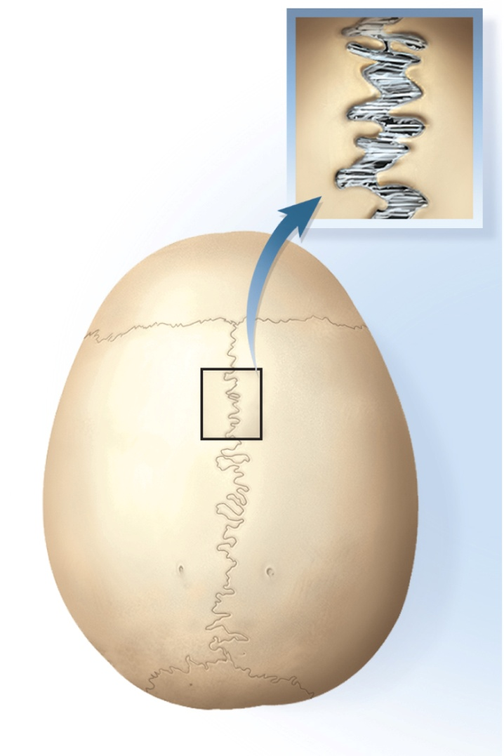
Fibrous Joints - Sutures
sutures - immovable or slightly movable fibrous joints that closely bind the bones of the skull to each other
sutures can be classified as:
serrate – interlocking wavy lines
coronal, sagittal and lambdoid sutures
lap (squamous)- overlapping beveled edges
temporal and parietal bones
plane (butt)- straight, nonoverlapping edges
palatine processes of the maxillae
Fibrous connective tissue

Slide 7
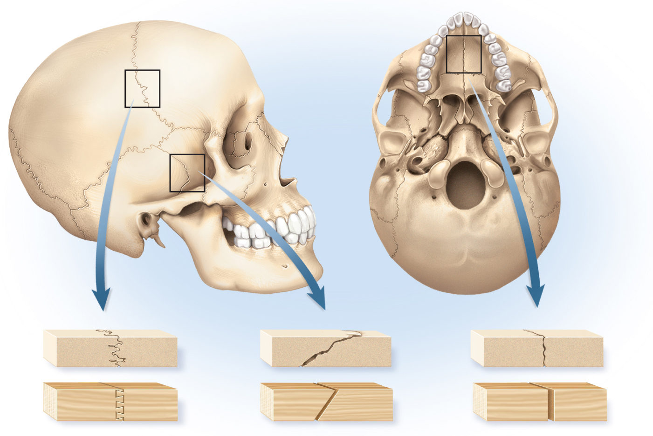
Types of Sutures
Copyright © The McGraw-Hill Companies, Inc. Permission required for reproduction or display.
Figure 9.3
Serrate suture
Lap suture
Plane suture
Bone
Wood
9-7
Dovetail joint
Miter joint
Butt joint

Slide 8
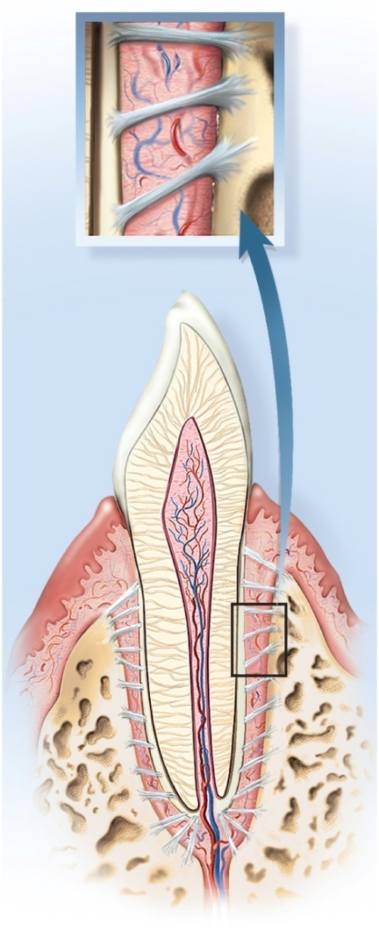
Fibrous Joint - Gomphoses
gomphosis - attachment of a tooth to its socket
held in place by fibrous periodontal ligament
collagen fibers attach tooth to jawbone
allows the tooth to move a little under the stress of chewing
Copyright © The McGraw-Hill Companies, Inc. Permission required for reproduction or display.
Fibrous connective tissue
Figure 9.2b
(b) Gomphosis

Slide 9
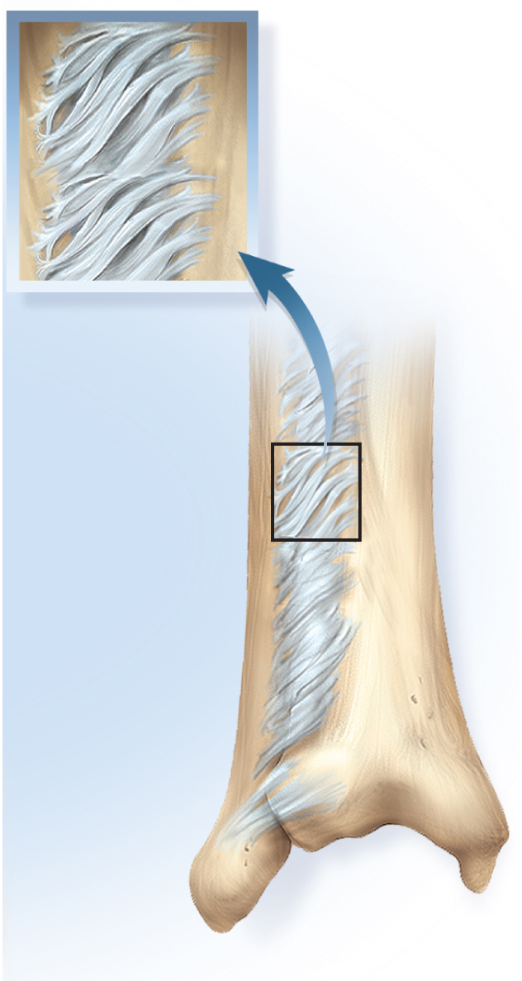
Fibrous Joint - Syndesmosis
Copyright © The McGraw-Hill Companies, Inc. Permission required for reproduction or display.
syndesmosis – a fibrous joint at which two bones are bound by longer collagenous fibers than in a suture or gomphosis giving the bones more mobility
interosseus membrane
most movable syndesmosis
interosseus membranes unite radius to ulna allowing supination and pronation
less movable syndesmosis
tibia to fibula
Fibrous connective tissue
Figure 9.2c
(c) Syndesmosis

Slide 10
Cartilaginous Joints
cartilaginous joint, amphiarthrosis or amphiarthrodial joint – two bones are linked by cartilage
two types of cartilaginous joints
synchondroses
symphyses

Slide 11
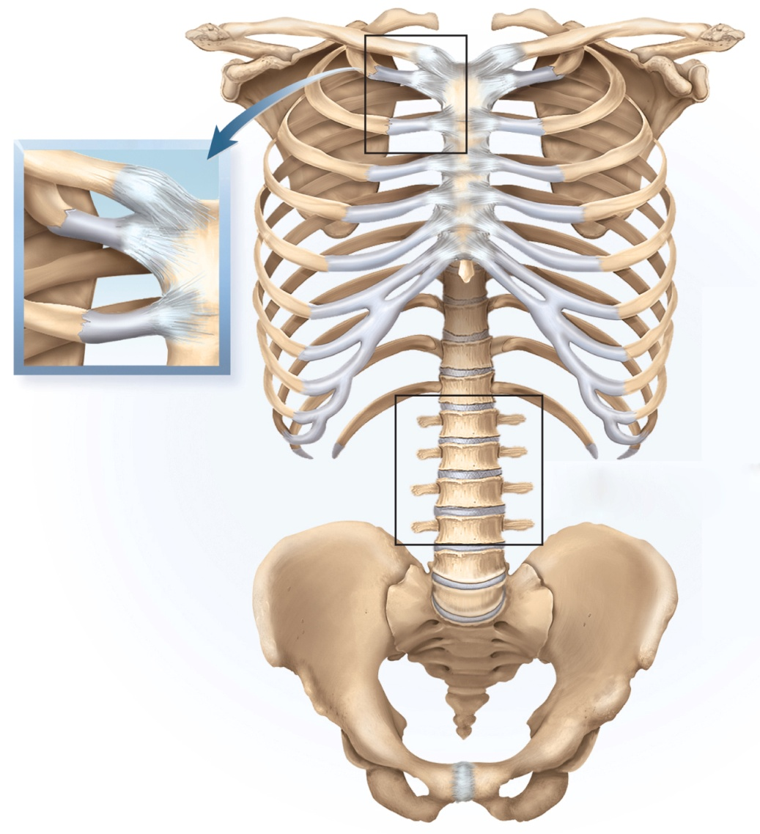
Cartilaginous Joint - Synchondrosis
synchrondrosis - bones are bound by hyaline cartilage
temporary joint in the epiphyseal plate in children
binds epiphysis and diaphysis
first rib attachment to sternum
other costal cartilages are joined to sternum by synovial joints
Copyright © The McGraw-Hill Companies, Inc. Permission required for reproduction or display.
Clavicle
Sternum
Rib 1
Costal
cartilage
(a)
Interpubic disc
(fibrocartilage)
(b)
Pubic symphysis
Figure 9.4a,b

Slide 12
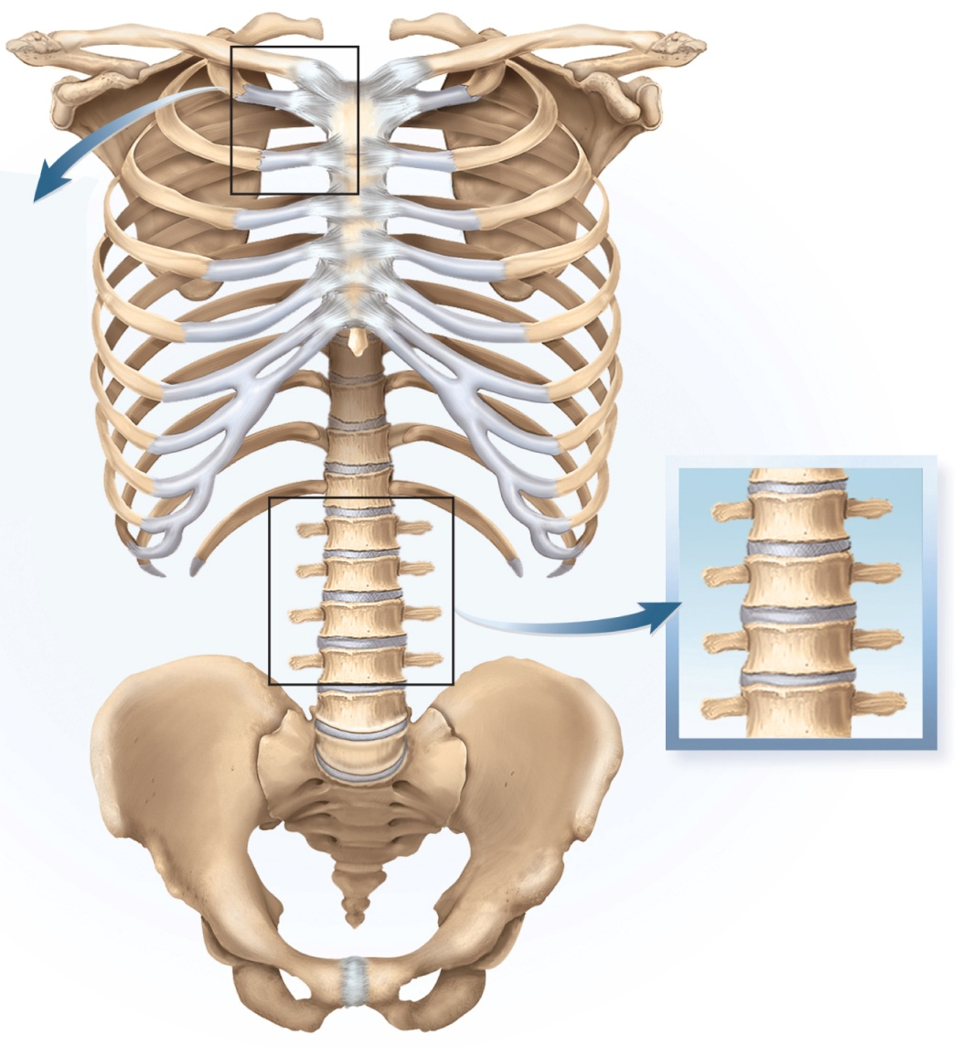
Cartilaginous Joint - Symphysis
symphysis - two bones joined by fibrocartilage
pubic symphysis in which right and left pubic bones joined by interpubic disc
bodies of vertebrae and intervertebral discs
only slight amount of movement between adjacent vertebrae
collective effect of all 23 discs gives spine considerable flexibility
Copyright © The McGraw-Hill Companies, Inc. Permission required for reproduction or display.
Intervertebral
disc (fibrocartilage)
(c)
Body of vertebra
Interpubic disc
(fibrocartilage)
(b)
Pubic symphysis
Figure 9.4b,c

Slide 13
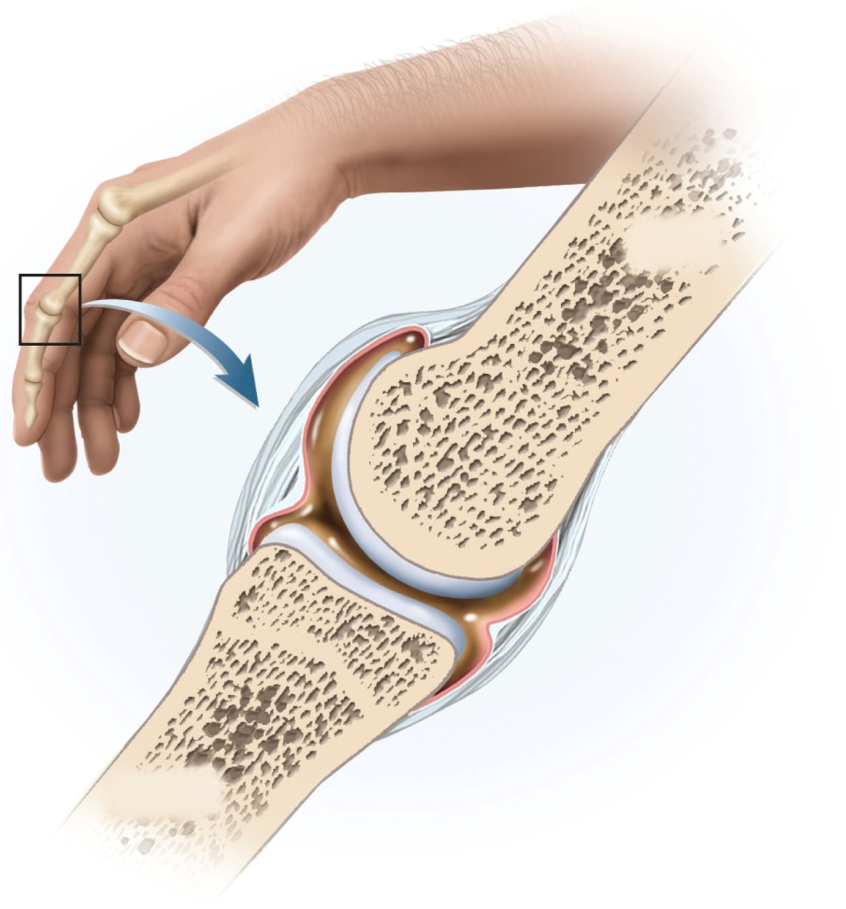
Synovial Joint
synovial joint, diarthrosis or diarthrodial joint – joint in which two bones are separated by a space called a joint cavity
most familiar type of joint
most are freely movable
most structurally complex type of joint
most likely to develop painful dysfunction
most important joints for physical and occupational therapists, athletic coaches, nurses, and fitness trainers
their mobility make them important to quality of life
Copyright © The McGraw-Hill Companies, Inc. Permission required for reproduction or display.
Proximal
phalanx
Ligament
Joint cavity
containing
synovial fluid
Articular
cartilages
Periosteum
Fibrous
capsule
Bone
Synovial
membrane
Joint
capsule
Middle
phalanx
Figure 9.5

Slide 14
General Anatomy
articular cartilage – layer of hyaline cartilage that covers the facing surfaces of two bones
usually 2 or 3 mm thick
joint (articular) cavity – separates articular surfaces
synovial fluid – slippery lubricant in joint cavity
rich in albumin and hyaluronic acid
gives it a viscous, slippery texture like raw egg whites
nourishes articular cartilage and removes waste
makes movement of synovial joints almost friction free
joint (articular) capsule – connective tissue that encloses the cavity and retains the fluid
outer fibrous capsule – continuous with periosteum of adjoining bones
inner, cellular, synovial membrane – composed mainly of fibroblast-like cells that secrete synovial fluid and macrophages that remove debris from the joint cavity

Slide 15
General Anatomy
in a few synovial joints, fibrocartilage grows inward from the joint capsule
articular disc forms a pad between articulating bones that crosses the entire joint capsule
temporomandibular joint, distal radioulnar joints, sternoclavicular and acromioclavicular joints
meniscus – in the knee, two cartilages extend inward from the left and right but do not entirely cross the joint
these cartilages absorb shock and pressure
guide bones across each other
improve the fit between bones
stabilize the joints, reducing the chance of dislocation
accessory structures associated with synovial joints
tendon – a strip or sheet of tough collagenous connective tissue that attaches muscle to bone
the most important structures in stabilizing a joint
ligament – similar tissue that attaches one bone to another
bursa – a fibrous sac filled with synovial fluid, located between adjacent muscles, where tendon passes over bone, or between bone and skin
cushion muscles, helps tendons slide more easily over joints, modify direction of tendon pull
tendon sheaths – elongated cylindrical bursae wrapped around a tendon
in hand and foot

Slide 16
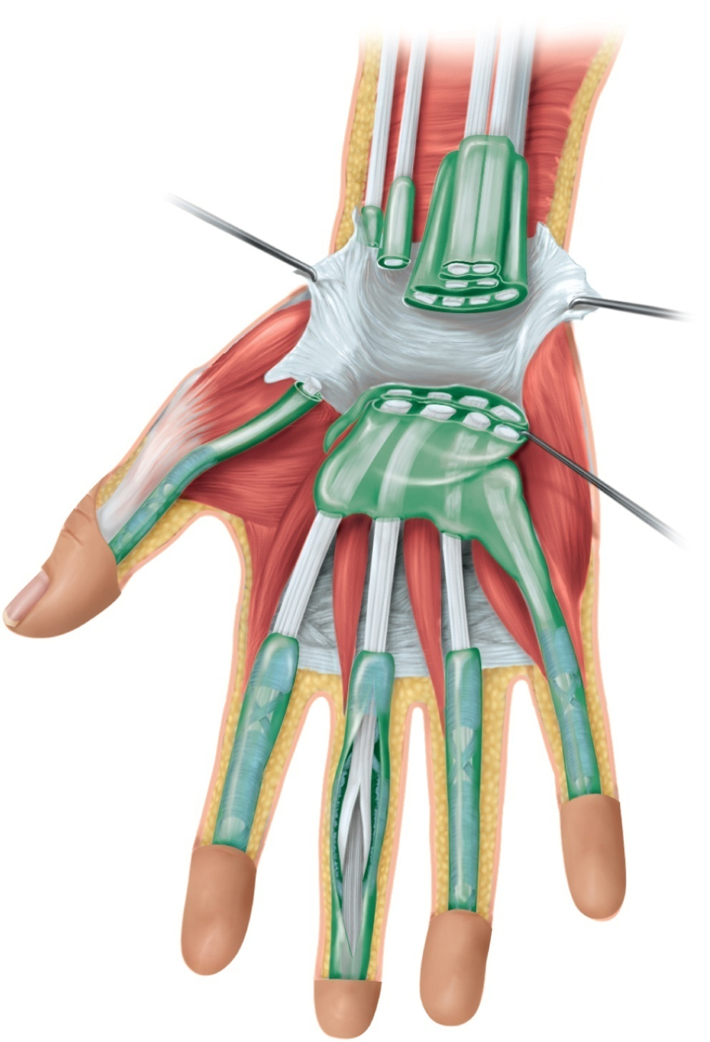
Tendon Sheaths and Bursae
Copyright © The McGraw-Hill Companies, Inc. Permission required for reproduction or display.
Tendon of flexor carpi radialis
Tendons of flexor digitorum superficialis
and flexor digitorum profundus
Tendon of flexor pollicis longus
Ulnar bursa (cut)
Radial bursa (cut)
Flexor retinaculum (cut)
Lumbrical muscles
Tendons of flexor digitorum
superficialis
Tendon sheaths
Tendon sheath (opened)
Tendon of flexor digitorum
superficialis
Tendon of flexor digitorum
profundus
Figure 9.6

Slide 17
Exercise and Articular Cartilage
exercise warms synovial fluid
becomes less viscous and more easily absorbed by articular cartilage
cartilage then swells and provides a more effective cushion against compression
warm-up period before vigorous exercise helps protect cartilage from undue wear and tear
repetitive compression of nonvascular cartilage during exercise squeezes fluid and metabolic waste out of the cartilage
when weight removed, cartilage absorbs synovial fluid like a sponge taking in oxygen and nutrients to the chondrocytes
without exercise, cartilage deteriorates more rapidly from inadequate nutrition and waste removal

Slide 18
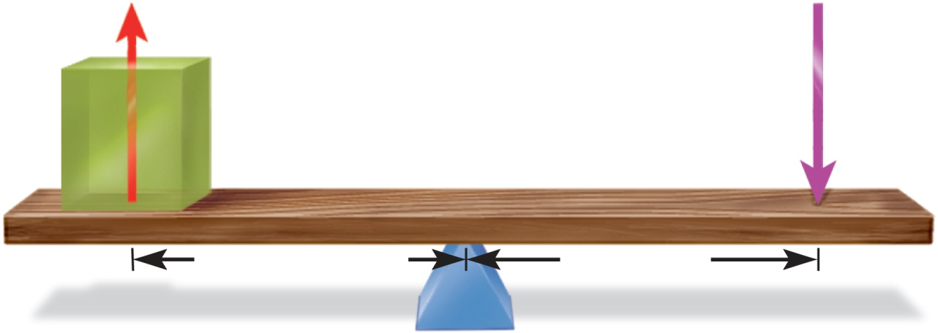
Joints and Lever Systems
long bones act as levers to enhance the speed or power of limb movements
lever – any elongated, rigid object that rotates around a fixed point called a fulcrum
rotation occurs when an effort applied overcomes resistance (load) at some other point
resistance arm and effort arm are described relative to fulcrum
Copyright © The McGraw-Hill Companies, Inc. Permission required for reproduction or display.
Resistance
(load)
Effort
Figure 9.7
R
E
Resistance arm
Effort arm
F
Fulcrum

Slide 19
Mechanical Advantage
advantage conferred by a lever can be of two kinds:
to exert more force against a resisting object than the force applied to the lever
human moving a heavy object with help of crowbar
to move the resisting object farther or faster than the effort arm is moved
movement of rowing a boat
a single lever cannot confer both advantages
as one increases, the other decreases
mechanical advantage (MA) of a lever – the ratio of its output force to its input force

Slide 20
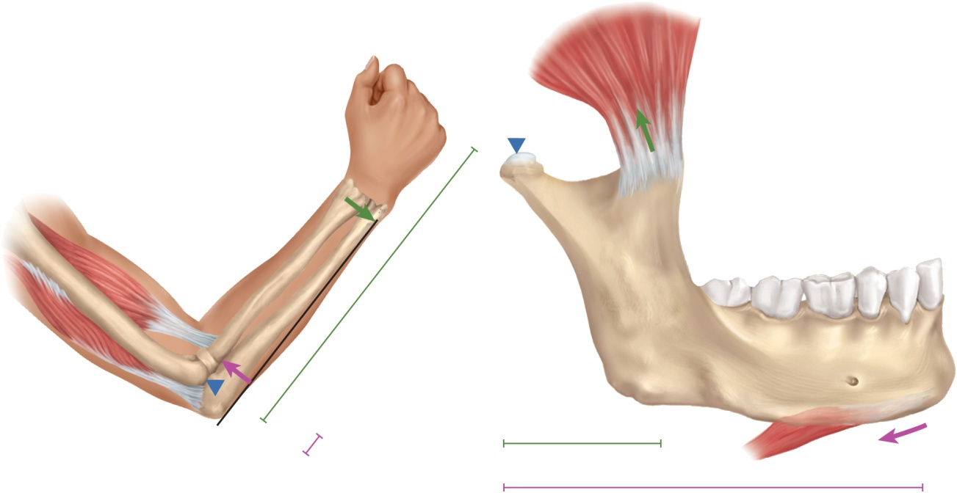
Mechanical Advantage
Copyright © The McGraw-Hill Companies, Inc. Permission required for reproduction or display.
=
L_{E}
=
95 mm
=
2.7
MA
L_{R}
35 mm
High mechanical advantage
High power
L_{E}
50 mm
R
Low speed
MA
=
=
0.15
=
L_{R}
330 mm
Low mechanical advantage
F
Temporalis muscle
Low power
Coronoid process
High speed
R
Condyloid process
Resistance arm (L_{R} = 330 mm)
E
Effort arm (L_{E} = 50 mm)
Figure 9.8
Biceps brachii
F
Radius
E
Resistance arm (L_{R} = 35 mm)
Digastric muscle
(a)
(b)
Effort arm (L_{E} = 95 mm)
mechanical advantage is calculated from the length of the effort arm divided by the length of the resistance arm
MA > 1.0 – the lever produces more force, but less speed and distance, than the force exerted on it
MA < 1.0 – the lever produces more speed or distance, but less force, than the input
contraction of the biceps brachii muscle puts more power into the lever than we get out of it, but the hand to move faster and further (MA <1.0)

Slide 21
First-Class Lever
Copyright © The McGraw-Hill Companies, Inc. Permission required for reproduction or display.
Resistance
Effort
R
Effort
R
E
Resistance
E
F
F
F
Fulcrum
(a) First-class lever
Figure 9.9a
Fulcrum
Resistance
Effort
has fulcrum in the middle between effort and resistance (RFE)
atlanto-occipital joint lies between the muscles on the back of the neck and the weight of the face
loss of muscle tone occurs when you nod off in class

Slide 22
Second-Class Lever
Copyright © The McGraw-Hill Companies, Inc. Permission required for reproduction or display.
Resistance
Resistance
Resistance
R
R
E
F
E
Effort
Fulcrum
Effort
F
F
Fulcrum
(b) Second-class lever
Figure 9.9b
Effort
resistance between fulcrum and effort (FRE)
resistance from the muscle tone of the temporalis muscle lies between the jaw joint and the pull of the digastric muscle on the chin as it opens the mouth quickly

Slide 23
Third-Class Lever
Copyright © The McGraw-Hill Companies, Inc. Permission required for reproduction or display.
Fulcrum
F
Resistance
Effort
R
E
E
Effort
Resistance
Effort
F
Fulcrum
Resistance
R
(c) Third-class lever
Figure 9.9c
F
effort between the resistance and the fulcrum (REF)
most joints of the body
the effort applied by the biceps muscle is applied to the forearm between the elbow joint and the weight of the hand and the forearm

Slide 24
Range of Motion
range of motion (ROM) –the degrees through which a joint can move
an aspect of joint performance
physical assessment of a patient’s joint flexibility
range of motion determined by:
structure of the articular surfaces
elbow – olecranon of ulna fits into olecranon fossa of humerus
strength and tautness of ligaments and joint capsules
stretching of ligaments increases range of motion
double-jointed people have long or slack ligaments
action of the muscles and tendons
nervous system monitors joint position and muscle tone
muscle tone – state of tension maintained in resting muscles

Slide 25
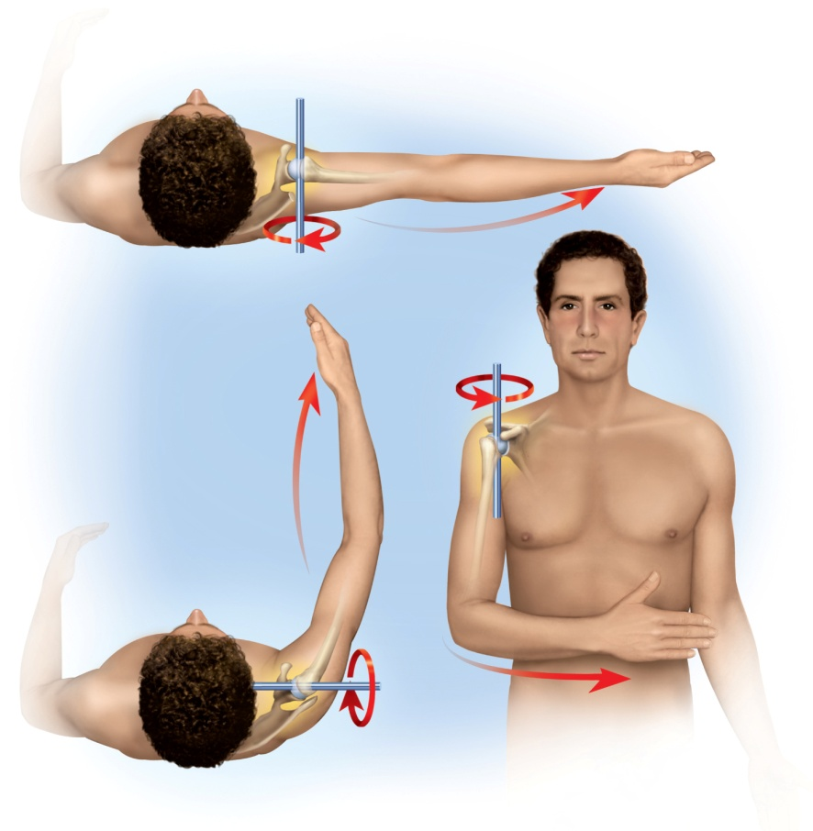
Axes of Rotation
Copyright © The McGraw-Hill Companies, Inc. Permission required for reproduction or display.
(a) Abduction of arm
(c) Internal rotation
of arm
Figure 9.10
(b) Flexion of arm
a moving bone has a relatively stationary axis of rotation that passes through the bone in a direction perpendicular to the plane of movement
multiaxial joint - shoulder joint has three degrees of freedom or axes of rotation
other joints – monoaxial or biaxial

Slide 26
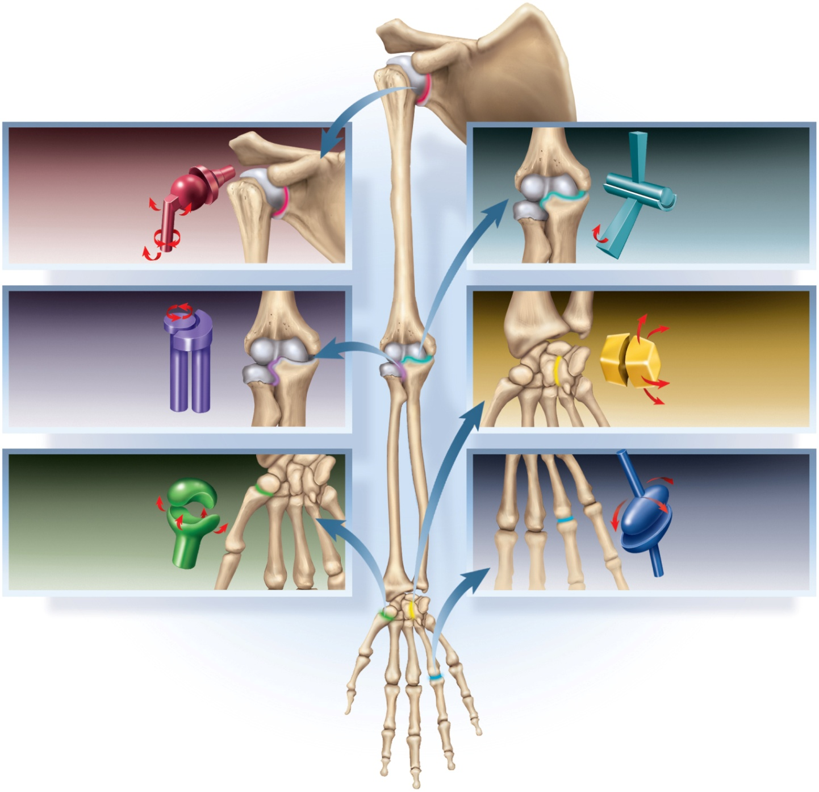
Classes of Synovial Joints
Copyright © The McGraw-Hill Companies, Inc. Permission required for reproduction or display.
Ball-and-socket joint
(humeroscapular)
Humerus
Hinge joint
(humeroulnar)
Head of humerus
Scapula
Ulna
Pivot joint
(radioulnar)
Radius
Plane joint
(intercarpal)
Ulna
Carpal bones
Saddle joint
(trapeziometacarpal)
Carpal bone
Condylar joint
(metacarpophalangeal)
Metacarpal bone
Metacarpal
Phalanx
bone
Figure 9.11

Slide 27
Ball-and-Socket Joints
smooth, hemispherical head fits within a cuplike socket
shoulder joint - head of humerus into glenoid cavity of scapula
hip joint - head of femur into acetabulum of hip bone
the only multiaxial joints in the body

Slide 28
Condyloid (ellipsoid) Joints
oval convex surface on one bone fits into a complementary shaped depression on the other
radiocarpal joint of the wrist
metacarpophalangeal joints at the bases of the fingers
biaxial joints – movement in two planes

Slide 29
Saddle Joints
both bones have an articular surface that is shaped like a saddle, concave in one direction and convex in the other
trapeziometacarpal joint at the base of the thumb
sternoclavicular joint – clavicle articulates with sternum
biaxial joint
more movable than a condyloid or hinge joint forming the primate opposable thumb

Slide 30
Plane (gliding) Joints
flat articular surfaces in which bones slide over each other with relatively limited movement
usually biaxial joint
carpal bones of wrist
tarsal bones of ankle
articular processes of vertebrae
although any one joint moves only slightly, the combined action of the many joints in wrist, ankle, and vertebral column allows for considerable movement

Slide 31
Hinge Joints
one bone with convex surface that fits into a concave depression on other bone
elbow joint - ulna and humerus
knee joint - femur and tibia
finger and toe joints
monoaxial joint – move freely in one plane

Slide 32
Pivot Joints
one bone has a projection that is held in place by a ring-like ligament
bone spins on its longitudinal axis
atlantoaxial joint (dens of axis and atlas)
transverse ligament
proximal radioulnar joint allows the radius to rotate during pronation and supination
anular ligament
monoaxial joint

Slide 33
Movement of Synovial Joints
vocabulary of movements of synovial joints used in kinesiology, physical therapy, and other medical fields
many presented in pairs with opposite or contrasting meanings
need to understand anatomical planes and directional terms
zero position – the position of a joint when a person is in the standard anatomical position
joint movement are described as deviating from the zero position or returning to it

Slide 34
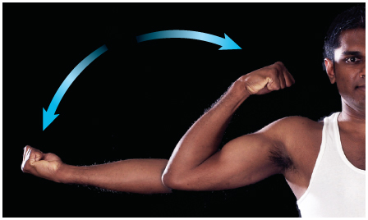
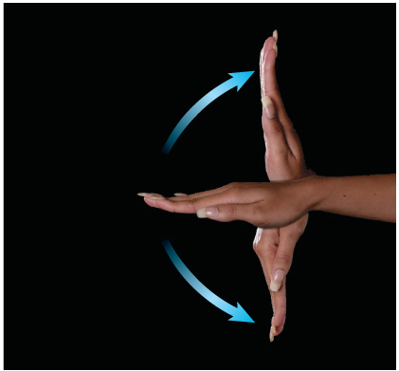
Flexion, Extension and Hyperextension
Copyright © The McGraw-Hill Companies, Inc. Permission required for reproduction or display.
flexion – movement that decreases the a joint angle
common in hinge joints
extension – movement that straightens a joint and generally returns a body part to the zero position
hyperextension – further extension of a joint beyond the zero position
flexion and extension occur at nearly all diarthroses, hyperextension is limited to a few
Flexion
Extension
(a)
© The McGraw-Hill Companies, Inc./Timothy L. Vacula, photographer
Figure 9.12a
Copyright © The McGraw-Hill Companies, Inc. Permission required for reproduction or display.
Hyperextension
Extension
Figure 9.12b
Flexion
(b)
© The McGraw-Hill Companies, Inc./Timothy L. Vacula, photographer

Slide 35
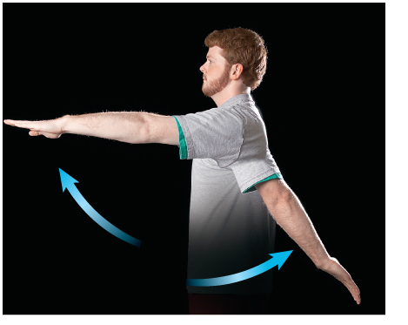
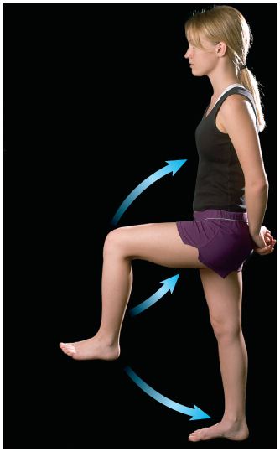
Flexion, Extension and Hyperextension
Copyright © The McGraw-Hill Companies, Inc. Permission required for reproduction or display.
Copyright © The McGraw-Hill Companies, Inc. Permission required for reproduction or display.
Flexion
Hip
flexion
Hyperextension
(c)
© The McGraw-Hill Companies, Inc./Timothy L. Vacula, photographer
Figure 9.12c
Knee
flexion
Extension
Figure 9.12d
(d)
© The McGraw-Hill Companies, Inc./Timothy L. Vacula, photographer

Slide 36
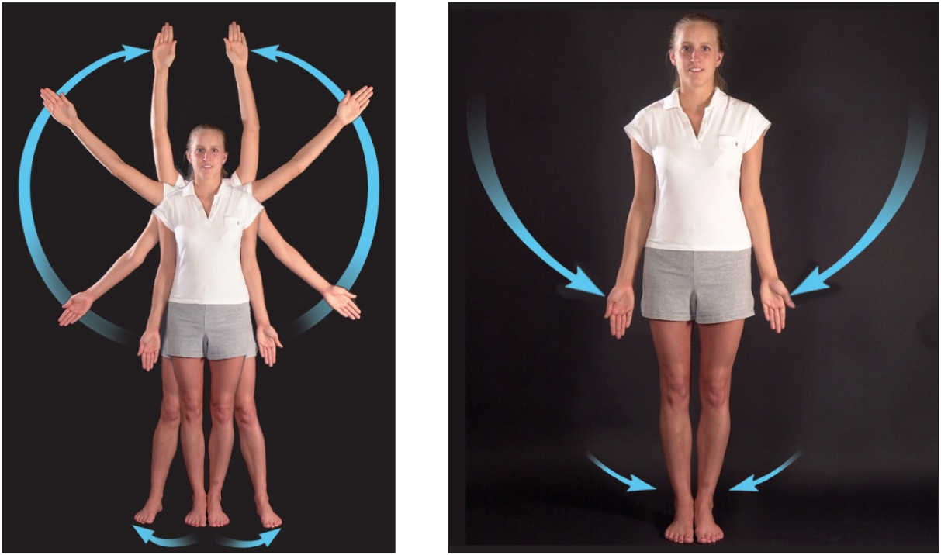
Abduction and Adduction
Copyright © The McGraw-Hill Companies, Inc. Permission required for reproduction or display.
Figure 9.13a,b
(a) Abduction
(b) Adduction
© The McGraw-Hill Companies, Inc./Timothy L. Vacula, photographer
abduction - movement of a body part in the frontal plane away from the midline of the body
hyperabduction – raise arm over back or front of head
adduction - movement in the frontal plane back toward the midline
hyperadduction – crossing fingers, crossing ankles

Slide 37
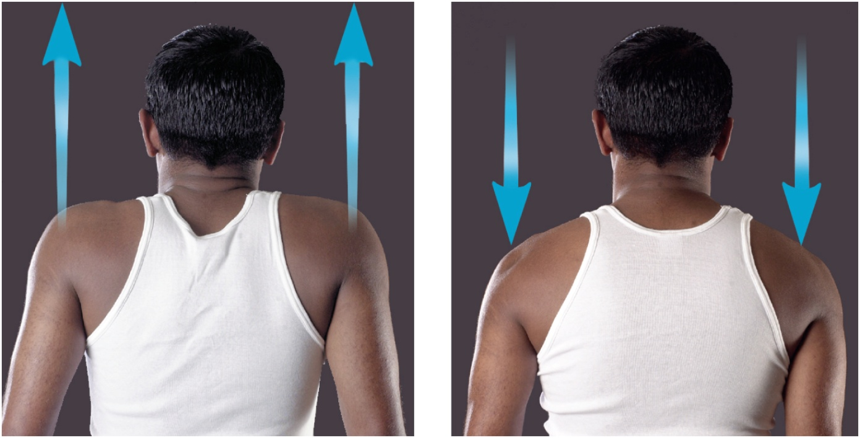
Elevation and Depression
Copyright © The McGraw-Hill Companies, Inc. Permission required for reproduction or display.
(a) Elevation
(b) Depression
Figure 9.14a,b
© The McGraw-Hill Companies, Inc./Timothy L. Vacula, photographer
elevation - a movement that raises a body part vertically in the frontal plane
depression – lowers a body part in the same plane

Slide 38
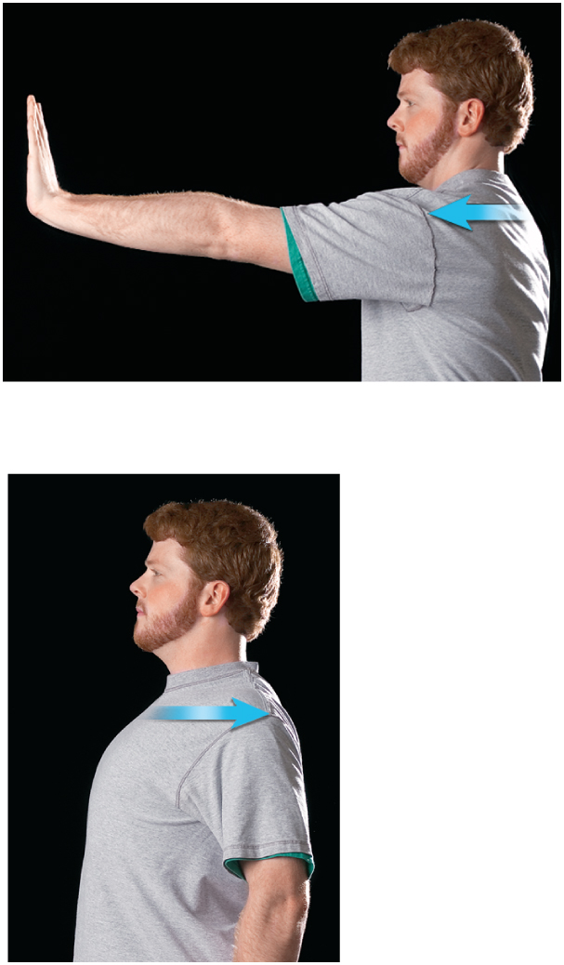
Protraction and Retraction
Copyright © The McGraw-Hill Companies, Inc. Permission required for reproduction or display.
protraction – the anterior movement of a body part in the transverse (horizontal) plane
retraction – posterior movement
(a) Protraction
Figure 9.15a,b
(b) Retraction
© The McGraw-Hill Companies, Inc./Timothy L. Vacula, photographer

Slide 39
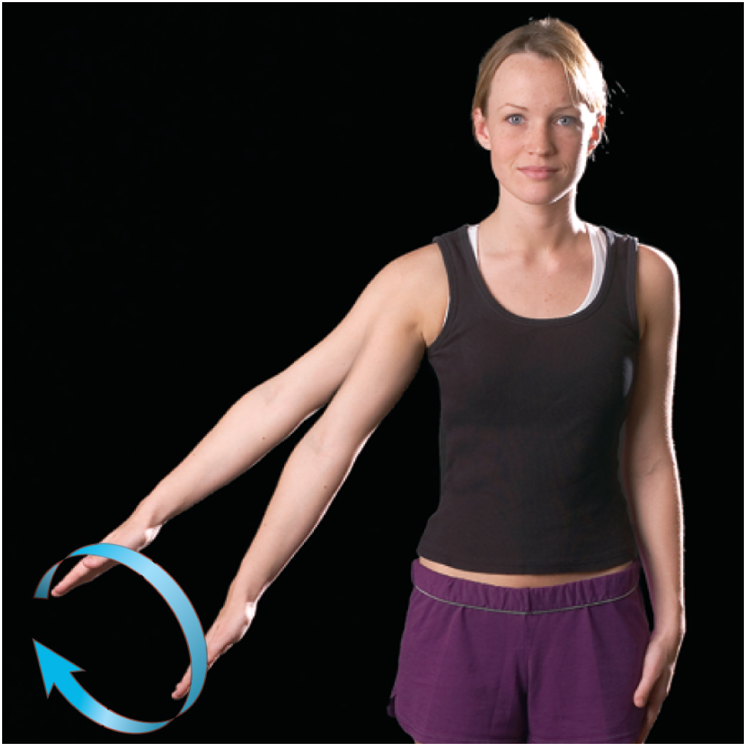
Circumduction
circumduction - one end of an appendage remains stationary while the other end makes a circular motion
sequence of flexion, abduction, extension and adduction movements
baseball player winding up for a pitch
Copyright © The McGraw-Hill Companies, Inc. Permission required for reproduction or display.
© The McGraw-Hill Companies, Inc./Timothy L. Vacula, photographer
Figure 9.16

Slide 40
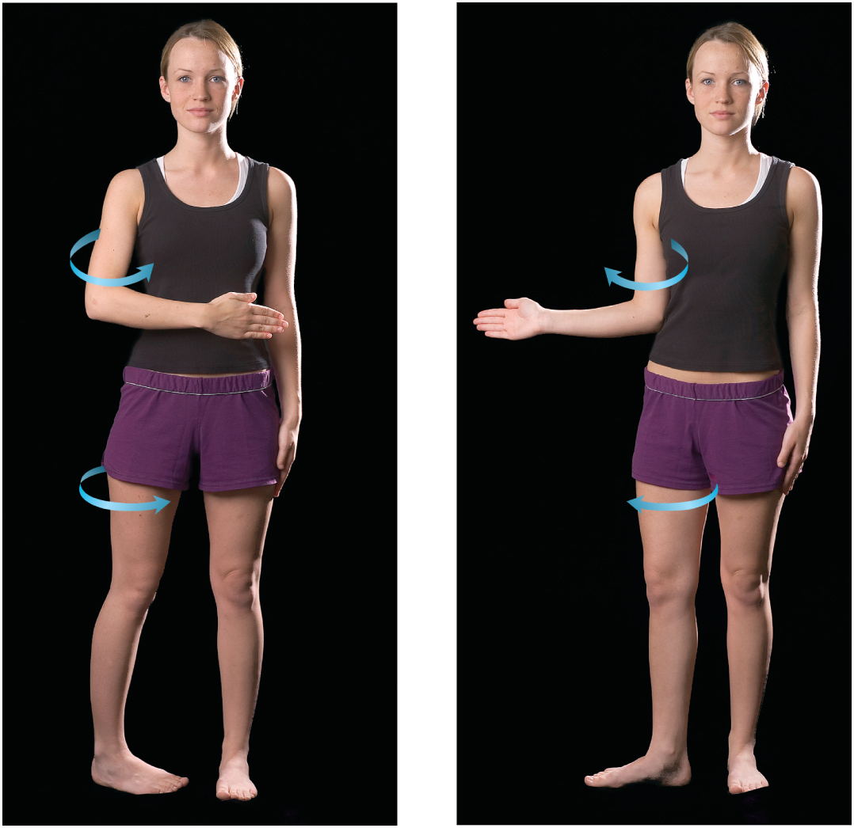
Rotation
rotation – movement in which a bone spins on its longitudinal axis
rotation of trunk, thigh, head or arm
medial (internal) rotation turns the bone inwards
lateral (external) rotation turns the bone outwards
Copyright © The McGraw-Hill Companies, Inc. Permission required for reproduction or display.
(a) Medial (internal) rotation
(b) Lateral (external) rotation
Figure 9.17a,b
© The McGraw-Hill Companies, Inc./Timothy L. Vacula, photographer

Slide 41
Supination and Pronation
primarily forearm movements
supination – forearm movement that turns the palm to face anteriorly or upward
forearm supinated in anatomical position
radius is parallel to the ulna
pronation – forearm movement that turns the palm to face posteriorly or downward
radius spins on the capitulum of the humerus
disc spins in the radial notch of ulna
radius crosses stationary ulna like an X
(a) Supination
(b) Pronation

Slide 42
Movements of Head and Trunk
(a) Flexion
(b) Hyperextension
(c) Lateral flexion
flexion, hyperextension, and lateral flexion of vertebral column

Slide 43
Rotation of Trunk and Head
right and left rotation of trunk
right and left rotation of head

Slide 44
Special Movements of Mandible
Copyright © The McGraw-Hill Companies, Inc. Permission required for reproduction or display.
(a) Protraction
(b) Retraction
(c) Lateral excursion
(d) Medial excursion
© The McGraw-Hill Companies, Inc./Timothy L. Vacula, photographer
lateral excursion – right or left movement from the zero position
medial excursion - movement back to the median, zero position
side-to-side grinding during chewing
protraction – retraction elevation - depression

Slide 45
Special Movement of Hand and Digits
ulnar flexion – tilts the hand toward the little finger
radial flexion – tilts the hand toward the thumb
flexion of fingers – curling them
extension of fingers – straightening them
abduction of the fingers – spread them apart
adduction of the fingers – bring them together again
flexion of thumb – tip of thumb directed toward palm
extension of thumb – straightening the thumb
radial abduction – move thumb away from index finger 90°
palmar abduction – moves thumb away from hand and points it anteriorly
adduction of thumb – moves it to the zero position
opposition – move the thumb to touch the tips of any of the fingers
reposition – return the thumb to the zero position
Copyright © The McGraw-Hill Companies, Inc. Permission required for reproduction or display.
(a) Radial flexion
(b) Ulnar flexion
(c) Abduction of fingers
(d) Palmar abduction of thumb
(e) Opposition of thumb
© The McGraw-Hill Companies, Inc./Timothy L. Vacula, photographer
Figure 9.21

Slide 46
Special Movements of the Foot
Dorsiflexion
Zero position
(b) Inversion
(c) Eversion
Plantar flexion
(a) Flexion of ankle
dorsiflexion – elevation of the toes as you do while swinging the foot forward to take a step (heel strike)
plantar flexion - extension of the foot so that the toes point downward as in standing on tiptoe (toe-off)
inversion - a movement in which the soles are turned medially
eversion - a movement in which the soles are turned laterally
supination of foot – complex combination of plantar flexion, inversion, and adduction
pronation of foot – complex combination of dorsiflexion, eversion, and abduction

Slide 47
Temporomandibular Joint
temporomandibular (jaw) joint (TMJ) – articulation of the condyle of the mandible with the mandibular fossa of the temporal bone
combines elements of condylar, hinge, and plane joints
synovial cavity of the TMJ is divided into superior and inferior chambers by an articular disc
two ligaments support joint
lateral ligament – prevents posterior displacement of mandible
sphenomandibular ligament – on the medial side
deep yawn or strenuous depression can dislocate the TMJ
condyles pop out of fossa and slip forward
relocated by pressing down on molar teeth while pushing the jaw backward

Slide 48
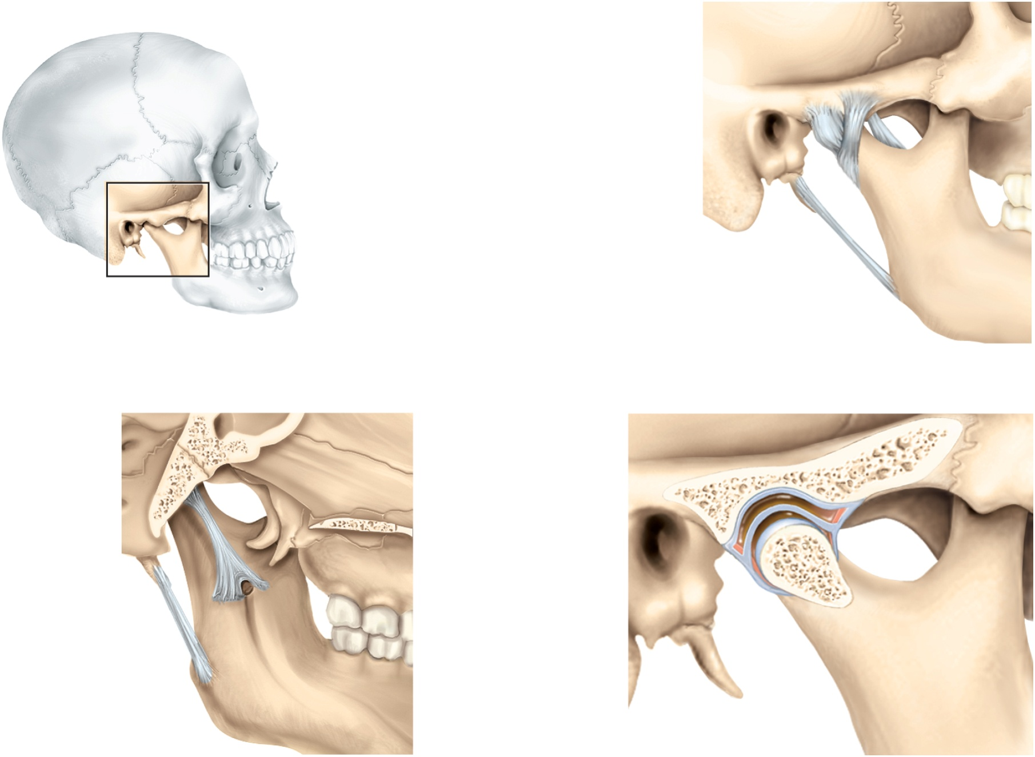
Temporomandibular Joint
Copyright © The McGraw-Hill Companies, Inc. Permission required for reproduction or display.
Sphenomandibular
ligament
Lateral
ligament
Joint capsule
External
acoustic meatus
Styloid process
Stylomandibular
ligament
(a) Lateral view
Sphenoid sinus
Mandibular fossa
of temporal bone
Occipital bone
Superior joint cavity
Sphenomandibular
ligament
Articular disc
Inferior joint cavity
Mandibular condyle
Styloid process
Synovial membrane
Stylomandibular
ligament
Joint capsule
Figure 9.23
9-48
(b) Medial view
(c) Sagittal section

Slide 49
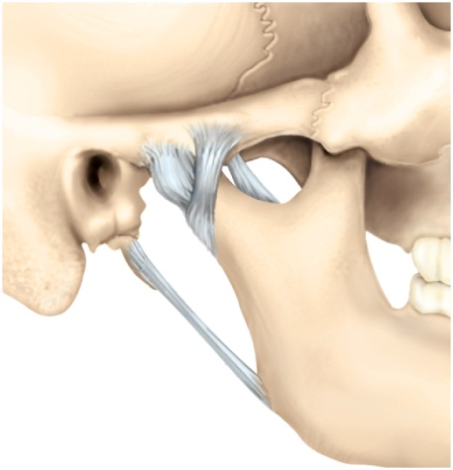
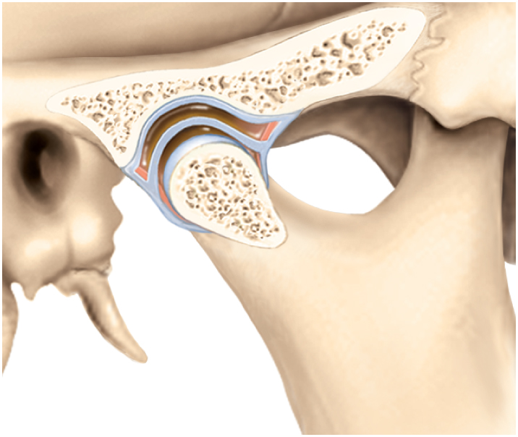
TMJ Syndrome
temporomandibular joint (TMJ) syndrome
may affect as many as 75 million Americans
signs and symptoms
can cause moderate intermittent facial pain
clicking sounds in the jaw
limitation of jaw movement
often severe headaches, vertigo (dizziness), tinnitus (ringing in the ears)
pain radiating from jaw down the neck, shoulders, and back
cause of syndrome
caused by combination of psychological tension and malocclusion (misalignment of teeth)
treatment
psychological management, physical therapy, analgesic and anti-inflammatory drugs, corrective dental appliances to align teeth properly
Copyright © The McGraw-Hill Companies, Inc. Permission required for reproduction or display.
Sphenomandibular
ligament
Lateral
ligament
Joint capsule
External
acoustic meatus
Styloid process
Stylomandibular
ligament
(a) Lateral view
Copyright © The McGraw-Hill Companies, Inc. Permission required for reproduction or display.
Mandibular fossa
of temporal bone
Superior joint cavity
Articular disc
Inferior joint cavity
Mandibular condyle
Synovial membrane
Joint capsule
(c) Sagittal section
Figure 9.23 a,c

Slide 50
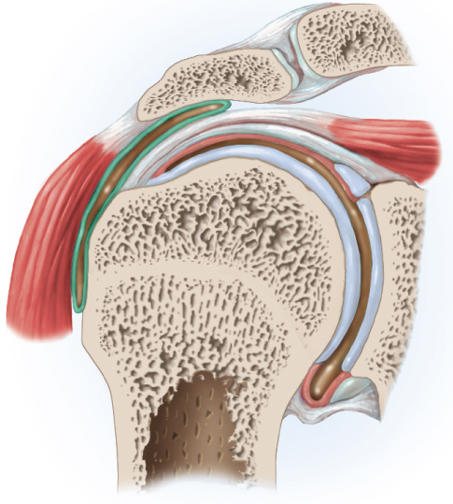
The Shoulder Joint
glenohumeral (humeroscapular) joint – the hemispherical head of the humerus articulates with the glenoid cavity of the scapula
the most freely movable joint in the body
shallow glenoid cavity and loose shoulder joint capsule sacrifice joint stability for freedom of movement
glenoid labrum – fibrocartilage ring that deepens glenoid cavity
shoulder supported by biceps brachii tendon anteriorly and also the rotator cuff tendons
tendons fuse to joint capsule and strengthens it
supraspinatus, infraspinatus, teres minor and subscapularis
five principal ligaments support shoulder
three are called the glenohumeral ligaments
coracohumeral ligament
transverse humeral ligament
four bursa occur at the shoulder
subdeltoid, subacromial, subcoracoid, and subscapular bursae
Copyright © The McGraw-Hill Companies, Inc. Permission required for reproduction or display.
Acromion
Subdeltoid
bursa
Supraspinatus tendon
Capsular ligament
Deltoid
muscle
Glenoid labrum
Synovial
membrane
Glenoid cavity
of scapula
Humerus
Glenoid labrum
(c) Frontal section
Figure 9.24c

Slide 51
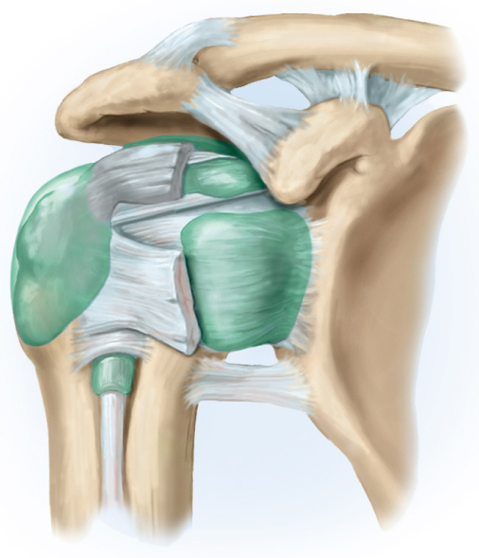
Stabilizers of the Shoulder Joint
Copyright © The McGraw-Hill Companies, Inc. Permission required for reproduction or display.
Acromion
Acromioclavicular ligament
Clavicle
Subacromial
bursa
Coraco-
clavicular
ligament
Supraspinatus
tendon
Coracohumeral
ligament
Coraco-
acromial
ligament
Subdeltoid
bursa
Coracoid
process
Subscapularis
tendon
Transverse
humeral
ligament
Subcoracoid
bursa
Tendon sheath
Subscapular
bursa
Biceps brachii
tendon
(long head)
Glenohumeral
ligaments
Humerus
(b) Anterior view
Figure 9.24b

Slide 52
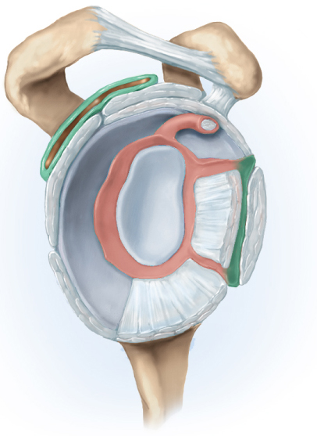
Tendons of Rotator Cuff Muscles
Copyright © The McGraw-Hill Companies, Inc. Permission required for reproduction or display.
Acromion
Supraspinatus
tendon
Coracoid process
Coracohumeral ligament
Subdeltoid
bursa
Superior glenohumeral
ligament
Infraspinatus
tendon
Biceps brachii tendon
(long head)
Glenoid cavity
(articular cartilage)
Subscapular bursa
Subscapularis tendon
Teres minor
tendon
Middle glenohumeral
ligament
Synovial membrane
(cut)
Inferior glenohumeral
ligament
(d) Lateral view , humerus removed
Figure 9.24d

Slide 53
Shoulder Dislocation
very painful and sometimes cause permanent damage
downward displacement of the humerus is the most common shoulder dislocation
rotator cuff protects the joint in all directions but inferiorly
joint protected from above by coracoid process, acromion, and clavicle
dislocations most often occur when the arm is abducted and then receives a blow from above
children especially prone to dislocation
Copyright © The McGraw-Hill Companies, Inc. Permission required for reproduction or display.
Acromion
Subdeltoid
bursa
Supraspinatus tendon
Capsular ligament
Deltoid
muscle
Glenoid labrum
Synovial
membrane
Glenoid cavity
of scapula
Humerus
Glenoid labrum
(c) Frontal section
Figure 9.24c

Slide 54
Dissection of Shoulder Joint
Acromioclavicular
joint
Acromion of scapula
Clavicle
Head of humerus
Coracobrachialis
muscle
Deltoid muscle
(cut and folded back)
Pectoralis major
muscle
Biceps brachii muscle:
Short head
Long head
(a) Anterior dissection

Slide 55
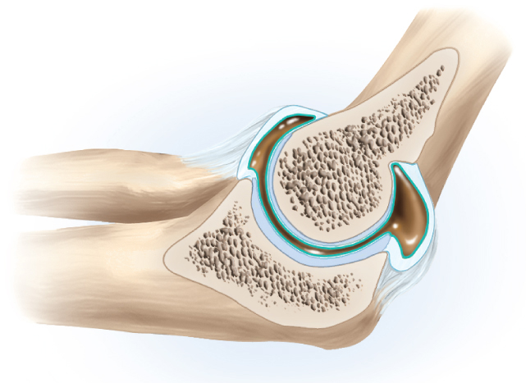
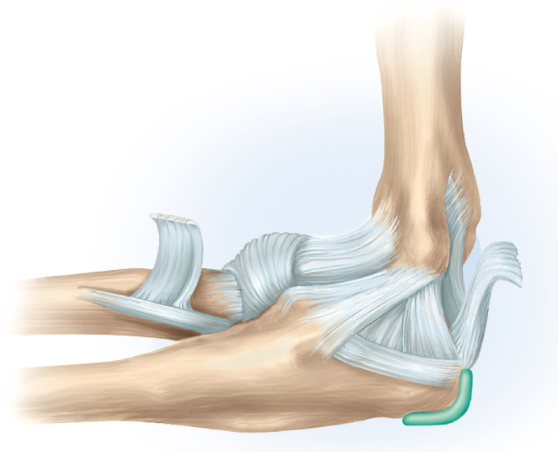
The Elbow Joint
elbow is a hinge joint composed of two articulations:
humeroulnar joint – where the trochlea of the humerus joins the trochlear notch of the ulna
hinge joint
humeroradial joint – where the capitulum of the humerus meets the head of the radius
pivot joint
edge of the disc-like head of the radius fits into the radial notch of the ulna
anular ligament holds the head in place
radial head rotates like a wheel against the ulna as the forearm is supinated and pronated
both enclosed in a single joint capsule
olecranon bursa – on posterior side of the elbow
eases the movement of the tendons over the joint
side-to-side motion of the elbow is restricted by a pair of ligaments
radial (lateral) collateral ligament
ulnar (medial) collateral ligament
Copyright © The McGraw-Hill Companies, Inc. Permission required for reproduction or display.
Joint capsule
Coronoid process
Humerus
Trochlea
Olecranon
bursa
Radius
Articular cartilage
Olecranon
Ulna
Figure 9.25b
(b) Sagittal section
Copyright © The McGraw-Hill Companies, Inc. Permission required for reproduction or display.
Anular ligament
Humerus
Tendon of biceps
brachii (cut)
Joint capsule
Radius
Tendon of
triceps brachii
Coronoid process
Ulnar collateral
ligament
Olecranon
bursa
Ulna
Figure 9.25c
(c) Medial view

Slide 56
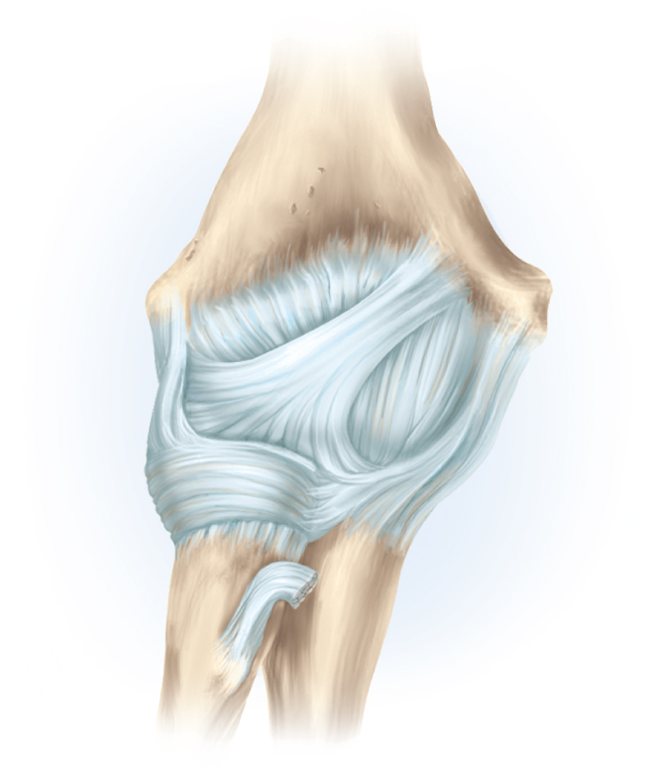
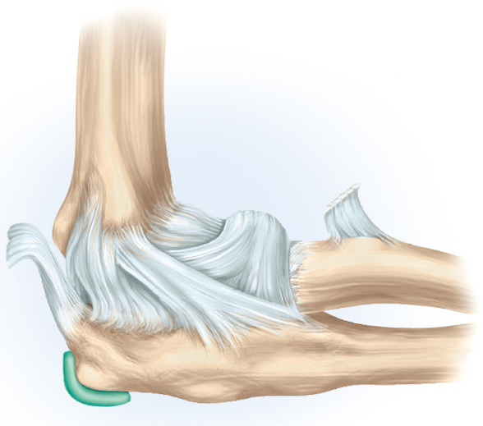
Elbow Joint
Copyright © The McGraw-Hill Companies, Inc. Permission required for reproduction or display.
Humerus
Lateral
epicondyle
Medial
epicondyle
Joint capsule
Copyright © The McGraw-Hill Companies, Inc. Permission required for reproduction or display.
Radial collateral
ligament
Ulnar collateral
ligament
Humerus
Anular
ligament
Anular ligament
Joint capsule
Tendon of
biceps brachii
(cut)
Lateral
epicondyle
Tendon of
biceps brachii
(cut)
Ulna
Radial
collateral
ligament
Radius
Radius
(a) Anterior view
Figure 9.25a
Joint capsule
Olecranon
Ulna
(d) Lateral view
Figure 9.25d

Slide 57
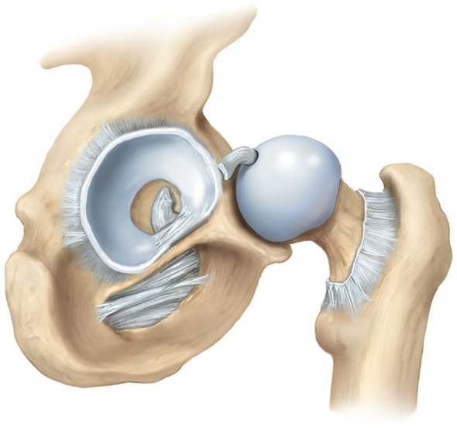
The Coxal (Hip) Joint
coxal (hip) joint – point at which the head of femur inserts into the acetabulum of the hip bone
bears much more weight, have deeper sockets, more stable than shoulder
acetabular labrum – horseshoe-shaped ring of fibrocartilage that deepens socket
dislocations rare: congenital dislocations in infants
ligaments supporting hip joint
iliofemoral and pubofemoral – on anterior
ischiofemoral ligament – on posterior
when standing, the ligaments become twisted and pull head of femur tightly into the acetabulum
transverse acetabular ligament – bridges gap on inferior margin of acetabular labrum
fovea capitis – pit on the head of femur
round ligament, or ligamentum teres – arises from here and attaches to the lower margin of the acetabulum
contains artery that supplies blood to the head of the femur
Copyright © The McGraw-Hill Companies, Inc. Permission required for reproduction or display.
Round
ligament (cut)
Fovea
capitis
Acetabulum
Head of
femur
Labrum
Greater
trochanter
Ischial
tuberosity
Obturator
membrane
Femur
Transverse
acetabular
ligament
(b) Lateral view, femur retracted
Figure 9.26b

Slide 58
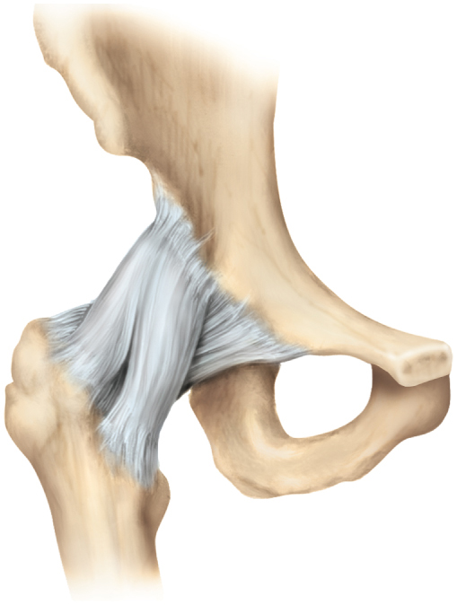
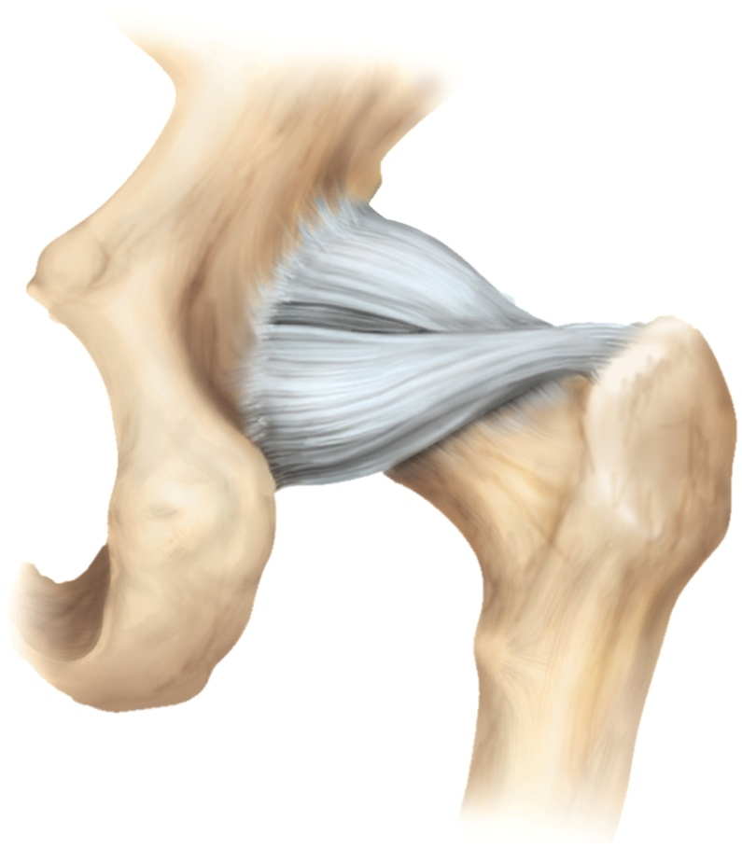
Hip (Coxal) Joint
Copyright © The McGraw-Hill Companies, Inc. Permission required for reproduction or display.
Copyright © The McGraw-Hill Companies, Inc. Permission required for reproduction or display.
Ilium
Iliofemoral
ligament
Ischiofemoral
ligament
Pubofemoral
ligament
Iliofemoral
ligament
Pubis
Greater
trochanter
Greater
trochanter
Ischial
tuberosity
Femur
Lesser
trochanter
Femur
(c) Anterior view
Figure 9.26c,d
(d) Posterior view

Slide 59
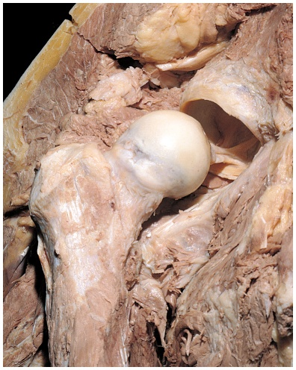
Dissection of Hip Joint
Copyright © The McGraw-Hill Companies, Inc. Permission required for reproduction or display.
Acetabular labrum
Acetabulum
Head of femur
Greater trochanter
Round ligament
Shaft of femur
Figure 9.26a
(a) Anterior dissection
© The McGraw-Hill Companies, Inc./Timothy L. Vacula, photographer

Slide 60
Treatment of Congenital Hip Dislocation

Slide 61
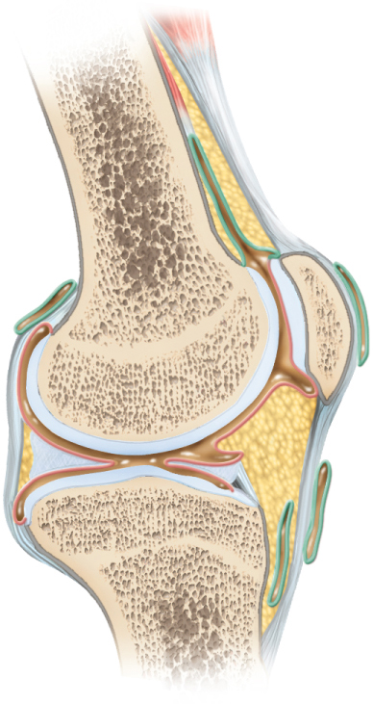
The Knee Joint
tibiofemoral (knee) joint – largest and most complex diarthrosis of the body
primarily a hinge joint
capable of slight rotation and lateral gliding when knee flexed
patellofemoral joint – gliding joint
joint capsule encloses only the lateral and posterior aspects of the knee, not the anterior
anterior covered by patellar ligament and lateral and medial retinacula
all are extensions of the tendon of quadriceps femoris muscle
knee stabilized:
quadriceps tendon in front
tendon of semimembranosus muscle on rear side of thigh
joint cavity contains two C-shaped cartilages
lateral meniscus and medial meniscus
joined by transverse ligament
absorbs shock on the knee
prevents femur from rocking side-to-side on the tibia
Copyright © The McGraw-Hill Companies, Inc. Permission required for reproduction or display.
Quadriceps
femoris
Femur
Quadriceps
femoris tendon
Bursa under lateral
head of gastrocnemius
Suprapatellar
bursa
Joint capsule
Prepatellar bursa
Patella
Articular cartilage
Synovial membrane
Meniscus
Joint cavity
Infrapatellar fat pad
Superficial
infrapatellar bursa
Tibia
Patellar ligament
Deep
infrapatellar bursa
(c) Sagittal section
Figure 9.29c

Slide 62
The Knee Joint
popliteal region of knee
supported by a complex array of:
extracapsular ligaments – external to joint capsule
prevent knee from rotating when joint is extended
fibular (lateral) collateral ligament
tibial (medial) collateral ligament
two intracapsular ligaments deep within joint capsule
synovial membrane folds around them, so they are excluded from the fluid filled synovial cavity
ligaments cross each other to form an X
anterior cruciate ligament (ACL)
prevents hyperextension of knee when ACL is pulled tight
one of the most common sites of knee injury
posterior cruciate ligament (PCL)
prevents femur from sliding off tibia
prevents the tibia from being displaced backward
ability to “lock” the knees
important aspect of human bipedalism
when knee is extended to the fullest degree allowed by ACL
femur rotates medially on the tibia
locks the knee, and all major knee ligaments are twisted and taut
“unlock” knee – popliteus muscle rotates the femur laterally and untwists the ligaments
Copyright © The McGraw-Hill Companies, Inc. Permission required for reproduction or display.
Quadriceps
femoris
Femur
Quadriceps
femoris tendon
Bursa under lateral
head of gastrocnemius
Suprapatellar
bursa
Joint capsule
Prepatellar bursa
Patella
Articular cartilage
Synovial membrane
Meniscus
Joint cavity
Infrapatellar fat pad
Superficial
infrapatellar bursa
Tibia
Patellar ligament
Deep
infrapatellar bursa
(c) Sagittal section
Figure 9.29c

Slide 63
Knee Joint – Sagittal Section
Copyright © The McGraw-Hill Companies, Inc. Permission required for reproduction or display.
Quadriceps
femoris
Femur
Quadriceps
femoris tendon
Bursa under lateral
head of gastrocnemius
Suprapatellar
bursa
Joint capsule
Prepatellar bursa
Patella
Articular cartilage
Synovial membrane
Meniscus
Joint cavity
Infrapatellar fat pad
Superficial
infrapatellar bursa
Tibia
Patellar ligament
Deep
infrapatellar bursa
(c) Sagittal section
Figure 9.29c
knee joint has at least 13 bursae
four anterior: superficial infrapatellar, suprapatellar, prepatellar, and deep infrapatellar
popliteal region: popliteal bursa and semimembranosus bursa
seven more bursae on lateral and medial sides of knee joint

Slide 64
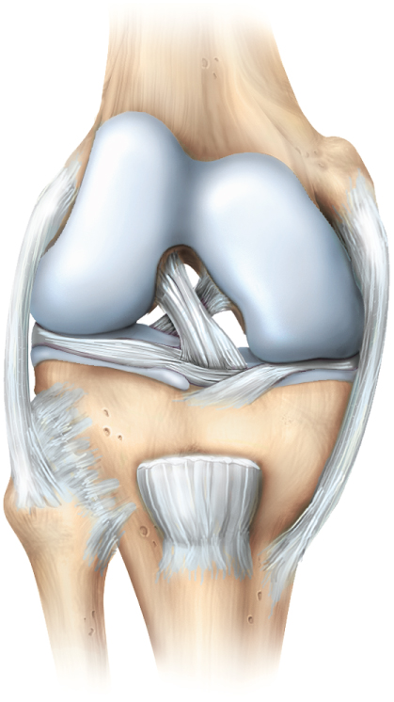
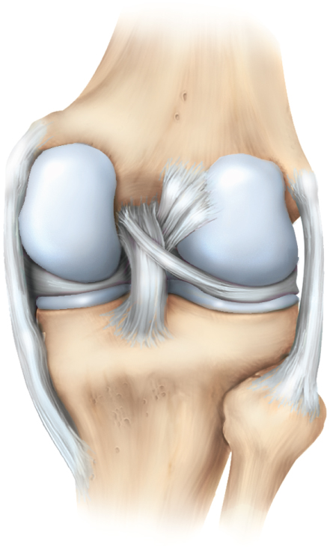
Knee Joint – Anterior and Posterior Views
Copyright © The McGraw-Hill Companies, Inc. Permission required for reproduction or display.
Copyright © The McGraw-Hill Companies, Inc. Permission required for reproduction or display.
Femur
Femur
Patellar surface
Medial
condyle
Lateral
condyle
Medial condyle
Tibial
collateral
ligament
Anterior cruciate
ligament
Posterior cruciate
ligament
Fibular
collateral
ligament
Fibular collateral
ligament
Anterior cruciate
ligament
Medial
meniscus
Lateral
meniscus
Medial meniscus
Lateral meniscus
Tibial collateral
ligament
Posterior
cruciate
ligament
Articular cartilage
of tibia
Transverse
ligament
Patellar ligament
(cut)
Fibula
Fibula
Tibia
Tibia
(a) Anterior view
(b) Posterior view
Figure 9.29a,b

Slide 65
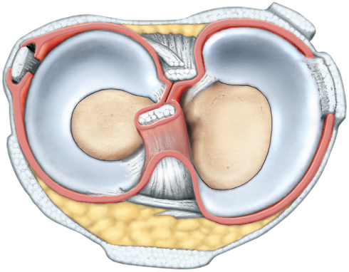
Knee Joint – Superior View
Copyright © The McGraw-Hill Companies, Inc. Permission required for reproduction or display.
Lateral meniscus
Posterior cruciate
ligament
Medial meniscus
Synovial
membrane
Medial condyle
of tibia
Figure 9.29d
Lateral condyle
of tibia
Anterior cruciate
ligament
(d) Superior view of tibia and menisci
medial and lateral meniscus absorb shock and shape joint

Slide 66
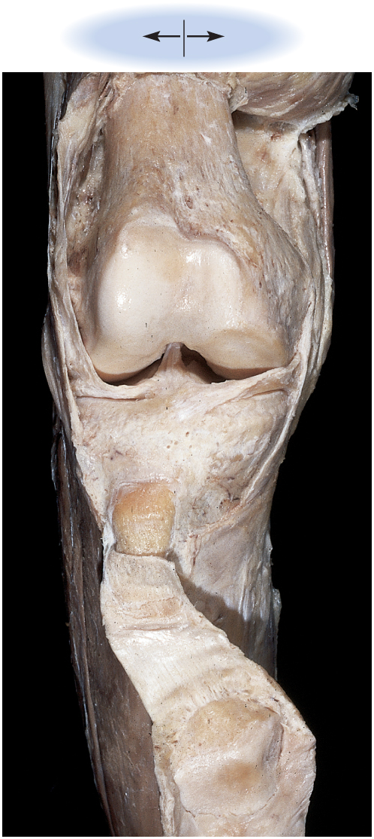
Dissection of Knee Joint
Copyright © The McGraw-Hill Companies, Inc. Permission required for reproduction or display.
Lateral
Medial
Femur:
Shaft
Patellar surface
Medial condyle
Lateral condyle
Joint capsule
Joint cavity:
Anterior cruciate
ligament
Medial meniscus
Lateral meniscus
Tibia:
Lateral condyle
Medial condyle
Tuberosity
Patellar ligament
Figure 9.28
Patella
(posterior surface)
Articular facets
Quadriceps
tendon (reflected)
© The McGraw-Hill Companies, Inc./Rebecca Gray, photographer/Don Kincaid, dissections

Slide 67
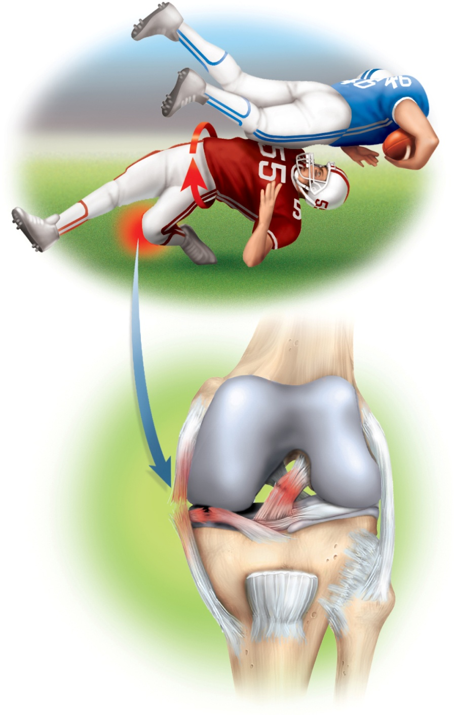
Knee Injuries
Copyright © The McGraw-Hill Companies, Inc. Permission required for reproduction or display.
highly vulnerable to rotational and horizontal stress
most common injuries are to the meniscus and anterior cruciate ligament (ACL)
heal slowly due to scanty blood flow
arthroscopy – procedure in which the interior of the joint is viewed with a pencil-thin arthroscope inserted through a small incision
less tissue damage than conventional surgery
recovery more quickly
arthroscopic ACL repair – about nine months for healing to be complete
Twisting motion
Foot fixed
Anterior cruciate
ligament (torn)
Tibial collateral
ligament (torn)
Medial
meniscus (torn)
Patellar ligament
Figure 9.30

Slide 68
The Ankle Joint
talocrural (ankle) joint – includes two articulations:
medial joint – between tibia and talus
lateral joint – between fibula and talus
both enclosed by one joint capsule
malleoli of tibia and fibula overhang the talus on either side and prevent side-to-side motion
more restricted range of motion than the wrist
ankle ligaments
anterior and posterior tibiofibular ligaments – bind the tibia to fibula
multipart medial (deltoid) ligament – binds the tibia to the foot on the medial side
multipart lateral (collateral) ligament – binds fibula to the foot on the lateral side
calcaneal (Achilles) tendon – extends from the calf muscle to the calcaneus
plantarflexes the foot and limits dorsiflexion
sprains (torn ligaments and tendons) are common at the ankle
pain and immediate swelling

Slide 69
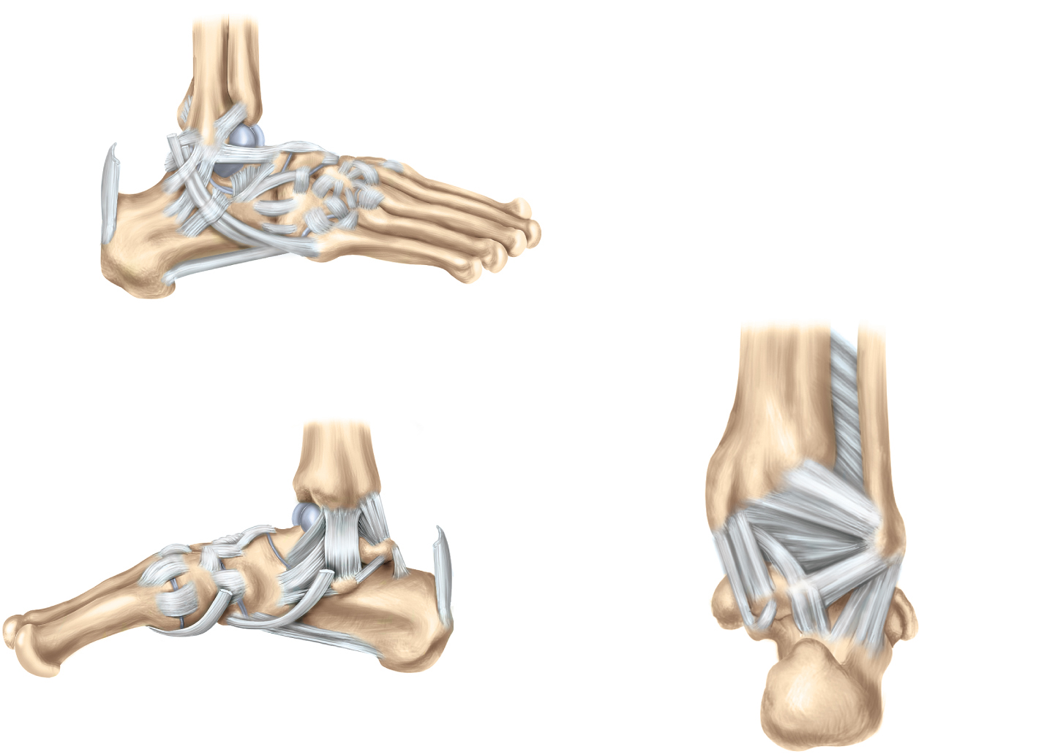
Ankle Joint and Foot Ligaments
Copyright © The McGraw-Hill Companies, Inc. Permission required for reproduction or display.
Fibula
Tibia
Anterior and
posterior tibiofibular
ligaments
Lateral ligament:
Posterior talofibular ligament
Calcaneofibular ligament
Anterior talofibular ligament
Calcaneal
tendon
Calcaneus
Tendons of
fibularis longus
and brevis
Metatarsal v
(a) Lateral view
Tibia
Fibula
Interosseous
membrane
Medial ligament
Tibia
Navicular
Medial
malleolus
Posterior tibiofibular
ligament
Metatarsal I
Lateral malleolus
Calcaneal
tendon
Posterior talofibular
ligament
Calcaneofibular
ligament
Calcaneus
Tendons of
tibialis anterior and posterior
Calcaneus
(c) Medial view
Figure 9.31a,c,d
(d) Posterior view

Slide 70
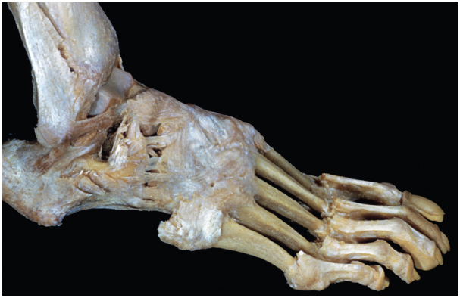
Dissection of the Foot
Copyright © The McGraw-Hill Companies, Inc. Permission required for reproduction or display.
Calcaneofibular ligament
Anterior talofibular ligament
(b) Lateral dissection
© L. Bassett/Visuals Unlimited
Figure 9.31b

Slide 71
Arthritis
arthritis - a broad term for pain and inflammation of a joint
most common crippling disease in the United States
rheumatologists – physicians who treat arthritis and other joint disorders
osteoarthritis (OA) – most common form of arthritis
‘wear-and-tear arthritis’
results from years of joint wear
articular cartilage softens and degenerates
accompanied by crackling sounds called crepitus
bone spurs develop on exposed bone tissue causing pain

Slide 72
Arthritis and Artificial Joints
rheumatoid arthritis (RA) - autoimmune attack against the joint tissues
misguided antibodies (rheumatoid factor) attack synovial membrane, enzymes in synovial fluid degrade the articular cartilage, joint begins to ossify
ankylosis – solidly fused, immobilized joint
remissions occur, steroids and aspirin control inflammation
arthroplasty - the replacement of diseased joint with artificial device called prosthesis

Slide 73
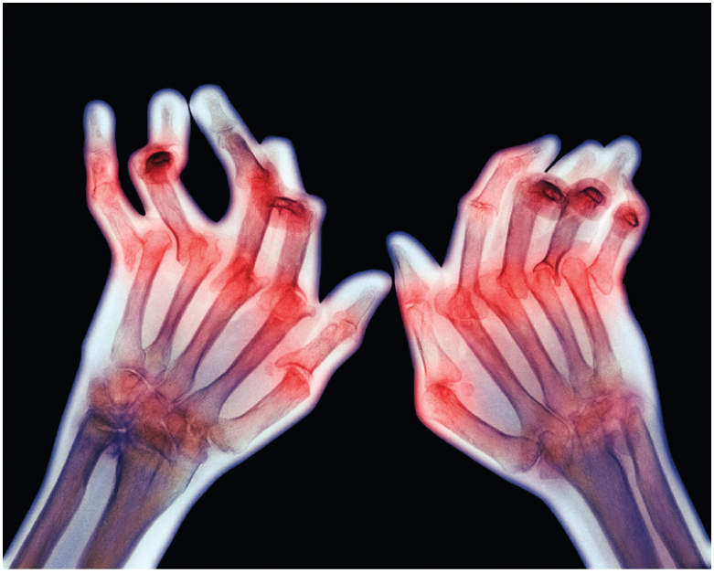
Rheumatoid Arthritis
Copyright © The McGraw-Hill Companies, Inc. Permission required for reproduction or display.
(b)
Figure 9.32b
CNRI/Science Photo Library/Photo Researchers, Inc.

Slide 74
Joint Prostheses

