Slide 1
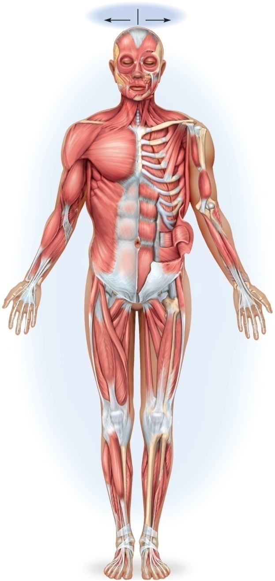
The Muscular System
Copyright © The McGraw-Hill Companies, Inc. Permission required for reproduction or display.
Superficial
Deep
Structural and functional organization of muscles
Muscles of the head and neck
Muscles of the trunk
Muscles acting on the shoulder and upper limb
Muscles acting on the hip and lower limb
Frontalis
Orbicularis oculi
Masseter
Zygomaticus major
Orbicularis oris
Platysma
Sternocleidomastoid
Trapezius
Deltoid
Pectoralis minor
Pectoralis major
Coracobrachialis
Serratus anterior
Biceps brachii
Brachialis
Rectus abdominis
Supinator
Brachioradialis
Flexor digitorum
profundus
Flexor carpi radialis
Flexor pollicis longus
External abdominal
oblique
Transverse abdominal
Tensor
fasciae latae
Internal abdominal
oblique
Pronator quadratus
Adductor longus
Sartorius
Adductors
Rectus femoris
Vastus lateralis
Vastus lateralis
Vastus intermedius
Vastus medialis
Gracilis
Fibularis longus
Gastrocnemius
Tibialis anterior
Soleus
Extensor digitorum longus
Extensor digitorum
longus
Figure 10.4a
(a) Anterior view

Slide 2
Organization of Muscles
about 600 human skeletal muscles
constitute about half of our body weight
three kinds of muscle tissue
skeletal, cardiac, smooth
specialized for one major purpose
converting the chemical energy in ATP into the mechanical energy of motion
myology – the study of the muscular system

Slide 3
The Functions of Muscles
Movement
move from place to place, movement of body parts and body contents in breathing, circulation, feeding and digestion, defecation, urination, and childbirth
role in communication – speech, writing, and nonverbal communications
Stability
maintain posture by preventing unwanted movements
antigravity muscles – resist the pull of gravity and prevent us from falling or slumping over
stabilize joints
Control of openings and passageways
sphincters – internal muscular rings that control the movement of food, bile, blood, and other materials
Heat production by skeletal muscles
as much as 85% of our body heat

Slide 4
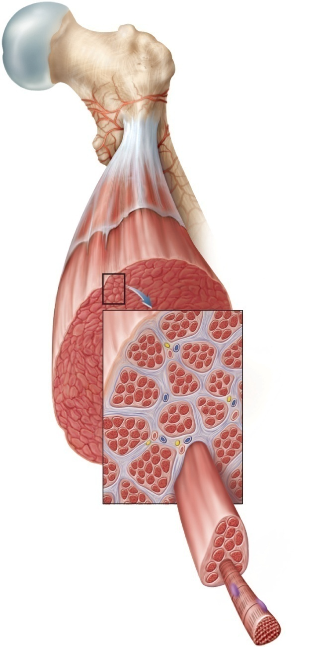
Connective Tissues of a Muscle
Copyright © The McGraw-Hill Companies, Inc. Permission required for reproduction or display.
Tendon
Fascia
Skeletal
muscle
Muscle
fascicle
Nerve
Blood vessels
Epimysium
Perimysium
Endomysium
Muscle fiber
Muscle fascicle
Perimysium
Muscle fiber
(a)

Slide 5
Connective Tissues of a Muscle
endomysium
thin sleeve of loose connective tissue surrounding each muscle fiber
allows room for capillaries and nerve fibers to reach each muscle fiber
perimysium
slightly thicker layer of connective tissue
fascicles – bundles of muscle fibers wrapped in perimysium
carry larger nerves and blood vessels, and stretch receptors
epimysium
fibrous sheath surrounding the entire muscle
outer surface grades into the fascia
inner surface sends projections between fascicles to form perimysium
fascia
sheet of connective tissue that separates neighboring muscles or muscle groups from each other and the subcutaneous tissue

Slide 6
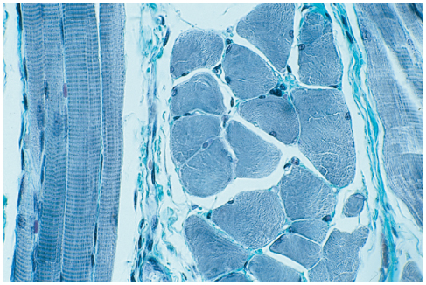
Connective Tissue in a Muscle
Copyright © The McGraw-Hill Companies, Inc. Permission required for reproduction or display.
Perimysium
Endomysium
Muscle fiber, c.s.
Fascicle, c.s.
Muscle fiber, l.s.
Fascicle, l.s.
(c)
Victor Eroschenko
Figure 10.1c

Slide 7
Fascicle Orientation of Muscles
Copyright © The McGraw-Hill Companies, Inc. Permission required for reproduction or display.
Unipennate
T
riangular
Bipennate
Parallel
Multipennate
Fusiform
Tendon
Circular
Belly
Pectoralis major
Palmar interosseous
Tendon
Rectus femoris
Rectus abdominis
Deltoid
Biceps brachii
Figure 10.2
Orbicularis oculi
strength of a muscle and the direction of its pull are
determined partly by the orientation of its fascicles.

Slide 8
Classification of Muscles According to Fascicle Orientation
fusiform muscles
thick in middle and tapered at ends
biceps brachii , gastrocnemius
parallel muscles
have uniform width and parallel fascicles
can span longer distances than other shapes
rectus abdominis, zygomaticus major
triangular (convergent) muscles
fan-shaped, broad at origin and tapering to a narrower insertion
pectoralis major, temporalis
pennate muscles
fascicles insert obliquely on a tendon (feather shaped)
unipennate, bipennate or multipennate
palmar interosseus, rectus femoris and deltoid
circular muscles (sphincters)
ring around body opening
orbicularis oculi, urethral and anal sphincters

Slide 9
Muscle Attachments
indirect attachment to bone
tendons bridge the gap between muscle ends and bony attachment
the collagen fibers of the endo-, peri-, and epimysium continue into the tendon
from there into the periosteum and the matrix of bone
very strong structural continuity from muscle to bone
biceps brachii, Achilles tendon
aponeurosis – tendon is a broad, flat sheet (palmar aponeurosis)
retinaculum – connective tissue band that tendons from separate muscles pass under
direct (fleshy) attachment to bone
little separation between muscle and bone
muscle seems to immerge directly from bone
margins of brachialis, lateral head of triceps brachii
some skeletal muscles do not insert on bone, but in dermis of the skin – muscles of facial expression

Slide 10
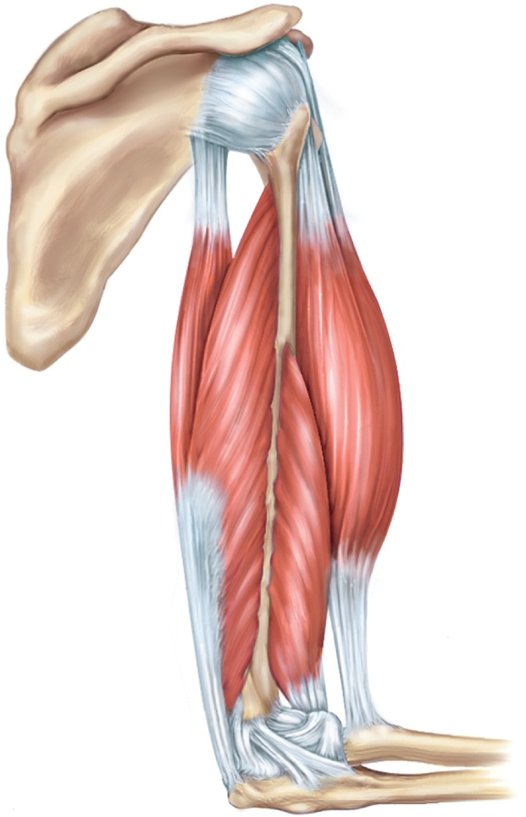
Muscle Origins and Insertions
Copyright © The McGraw-Hill Companies, Inc. Permission required for reproduction or display.
Origin
bony attachment at stationary end of muscle
Belly
thicker, middle region of muscle between origin and insertion
Insertion
bony attachment to mobile end of muscle
Origins
Origins
Scapula
Humerus
Bellies
Extensors:
Flexors:
Triceps brachii
Biceps brachii
Long head
Brachialis
Lateral head
Insertion
Insertion
Radius
Ulna
Figure 10.3

Slide 11
Functional Groups of Muscles
action – the effects produced by a muscle
to produce or prevent movement
prime mover (agonist) - muscle that produces most of force during a joint action
synergist - muscle that aids the prime mover
stabilizes the nearby joint
modifies the direction of movement
antagonist - opposes the prime mover
relaxes to give prime mover control over an action
preventing excessive movement and injury
antagonistic pairs – muscles that act on opposite sides of a joint
fixator - muscle that prevents movement of bone

Slide 12
Muscle Actions Across Elbow
Copyright © The McGraw-Hill Companies, Inc. Permission required for reproduction or display.
prime mover - brachialis
synergist - biceps brachii
antagonist - triceps brachii
fixator - muscle that holds scapula firmly in place
rhomboids
Origins
Origins
Scapula
Humerus
Bellies
Extensors:
Flexors:
Triceps brachii
Biceps brachii
Long head
Brachialis
Lateral head
Insertion
Insertion
Radius
Ulna
Figure 10.3

Slide 13
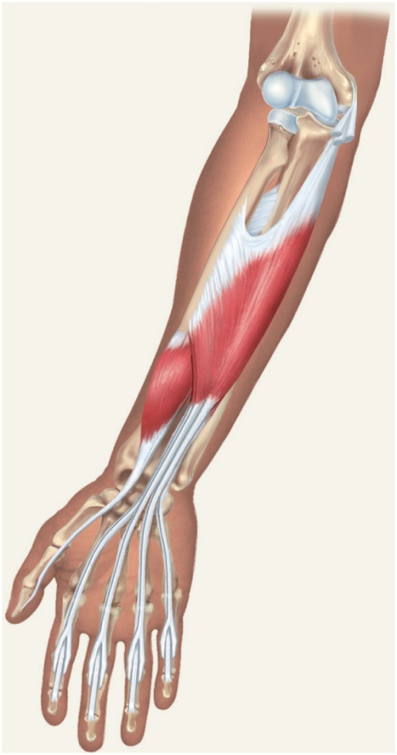
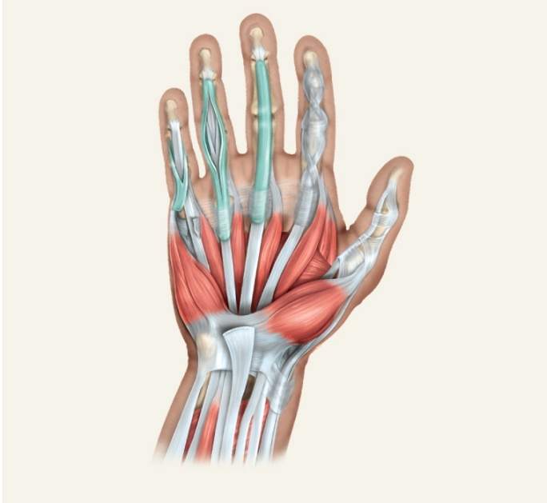
Intrinsic and Extrinsic Muscles
Copyright © The McGraw-Hill Companies, Inc. Permission required for reproduction or display.
intrinsic muscles – entirely contained within a region, such as the hand
both its origin and insertion there
extrinsic muscles – act on a designated region, but has its origin elsewhere
fingers – extrinsic muscles in the forearm
Copyright © The McGraw-Hill Companies, Inc. Permission required for reproduction or display.
Common flexor
tendon
Tendon sheath
First dorsal
interosseous
Tendon of flexor
digitorum profundus
Adductor
pollicis
Tendon of flexor
digitorum superficialis
Tendon of flexor pollicis longus
Flexor
digitorum
superficialis
Lumbricals
Opponens
digiti minimi
Flexor pollicis brevis
Flexor digiti
Abductor pollicis brevis
Flexor
pollicis longus
Abductor digiti
minimi
Opponens pollicis
Flexor retinaculum
T
endons of:
Tendons of:
Abductor pollicis longus
Flexor carpi ulnaris
Flexor carpi radialis
Flexor digitorum
superficialis
Palmaris longus
Flexor pollicis longus
Flexor
digitorum
superficialis
tendons
(a) Palmar aspect, superficial
Figure 10.32a
Flexor
digitorum
profundus
tendons
(b) Intermediate flexor
Figure 10.29b

Slide 14
Muscle Innervation
innervation of a muscle – refers to the identity of the nerve that stimulates it
enables the diagnosis of nerve, spinal cord, and brainstem injuries from their effects on muscle function
spinal nerves arise from the spinal cord
emerge through intervertebral foramina
immediately branch into a posterior and anterior ramus
innervate muscles below the neck
plexus – weblike network of spinal nerves adjacent to the vertebral column
cranial nerves arise from the base of the brain
emerge through skull foramina
innervate the muscles of the head and neck
numbered I to XII

Slide 15
Learning Strategy
examine models, cadavers, dissected animals, or a photographic atlas to get visual images of the muscle
when studying a particular muscle, palpate it on yourself if possible
locate origins and insertions of muscles on an articulated skeleton
study derivation of each muscle name
usually describes the muscle’s location, appearance, origin, insertion or action
say the names aloud to yourself or study partner, and spell them correctly

Slide 16
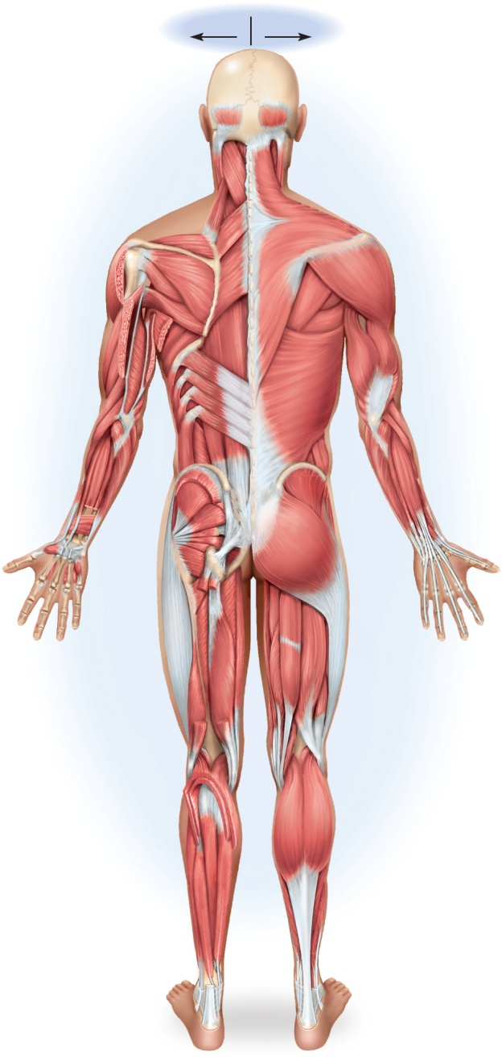
The Muscular System
Copyright © The McGraw-Hill Companies, Inc. Permission required for reproduction or display.
Copyright © The McGraw-Hill Companies, Inc. Permission required for reproduction or display.
Superficial
Deep
Deep
Superficial
Frontalis
Orbicularis oculi
Masseter
Occipitalis
Zygomaticus major
Orbicularis oris
Semispinalis capitis
Sternocleidomastoid
Sternocleidomastoid
Platysma
Trapezius
Splenius capitis
Trapezius
Levator scapulae
Pectoralis minor
Supraspinatus
Deltoid
Coracobrachialis
Rhomboideus minor
Pectoralis major
Serratus anterior
Rhomboideus major
Infraspinatus
Deltoid (cut)
Teres minor
Biceps brachii
Brachialis
Infraspinatus
Teres major
Rectus abdominis
Serratus anterior
Triceps brachii
Supinator
Triceps brachii (cut)
Latissimus dorsi
Flexor digitorum
profundus
Serratus posterior inferior
Extensor carpi
radialis longus
and brevis
Brachioradialis
Flexor pollicis longus
External abdominal oblique
Flexor carpi radialis
Transverse abdominal
Internal abdominal oblique
External abdominal oblique
External abdominal
oblique
Internal abdominal
oblique
Erector spinae
Extensor digitorum
Tensor
fasciae latae
Flexor carpi ulnaris
Gluteus medius
Pronator quadratus
Extensor digitorum (cut)
Extensor carpi ulnaris
Gluteus minimus
Gluteus maximus
Lateral rotators
Adductor longus
Adductor
magnus
Sartorius
Adductors
Gracilis
Rectus femoris
Vastus lateralis
Iliotibial band
Semitendinosus
Vastus lateralis
Vastus intermedius
Semimembranosus
Iliotibial band
Vastus medialis
Gracilis
Biceps femoris
Biceps femoris
Gastrocnemius (cut)
Fibularis longus
Gastrocnemius
Soleus (cut)
Gastrocnemius
Tibialis posterior
Tibialis anterior
Soleus
Flexor digitorum longus
Soleus
Extensor digitorum
Extensor hallucis longus
Extensor digitorum longus
longus
Fibularis longus
Calcaneal tendon
Figure 10.4a
Figure 10.4b
(a) Anterior view
(b) Posterior view

Slide 17
Muscles of Facial Expression
muscles that insert in the dermis and subcutaneous tissues
tense the skin and produce facial expressions
innervated by facial nerve (CN VII)
paralysis causes face to sag
found in scalp, forehead, around the eyes, nose and mouth, and in the neck

Slide 18
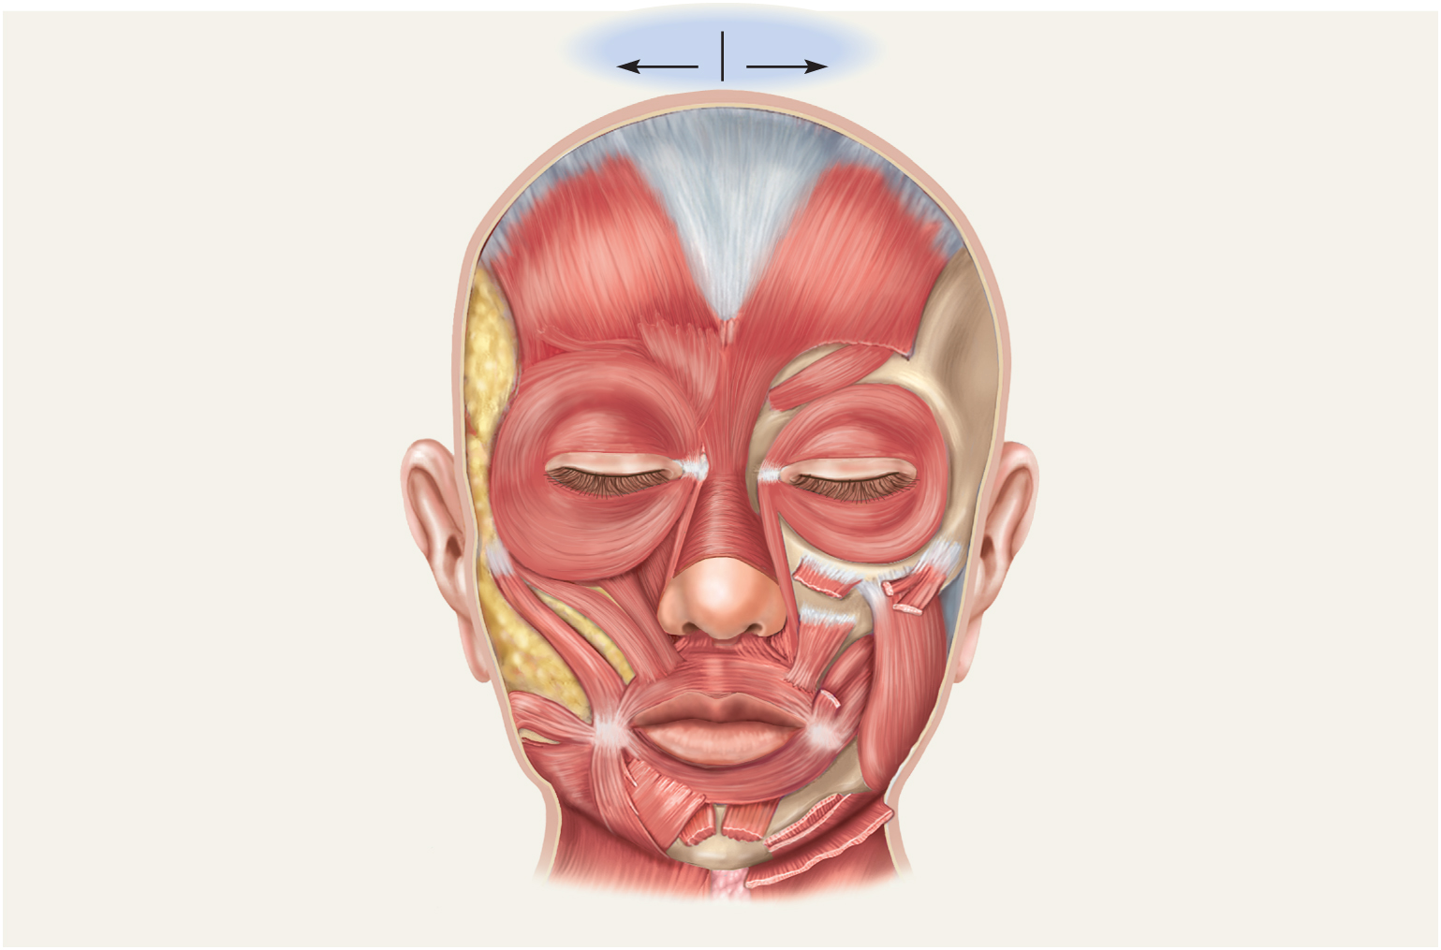
Muscles in Facial Expression
Copyright © The McGraw-Hill Companies, Inc. Permission required for reproduction or display.
Superficial Deep
Galea aponeurotica
Frontalis
Corrugator supercilii
Orbicularis oculi
Nasalis
Levator labii superioris
Levator anguli oris
Zygomaticus minor
Zygomaticus major
Masseter
Risorius
Buccinator
Modiolus
Depressor anguli oris
Orbicularis oris
Depressor labii inferioris
Mentalis (cut)
Platysma
(a) Anterior view
Figure 10.7a

Slide 19
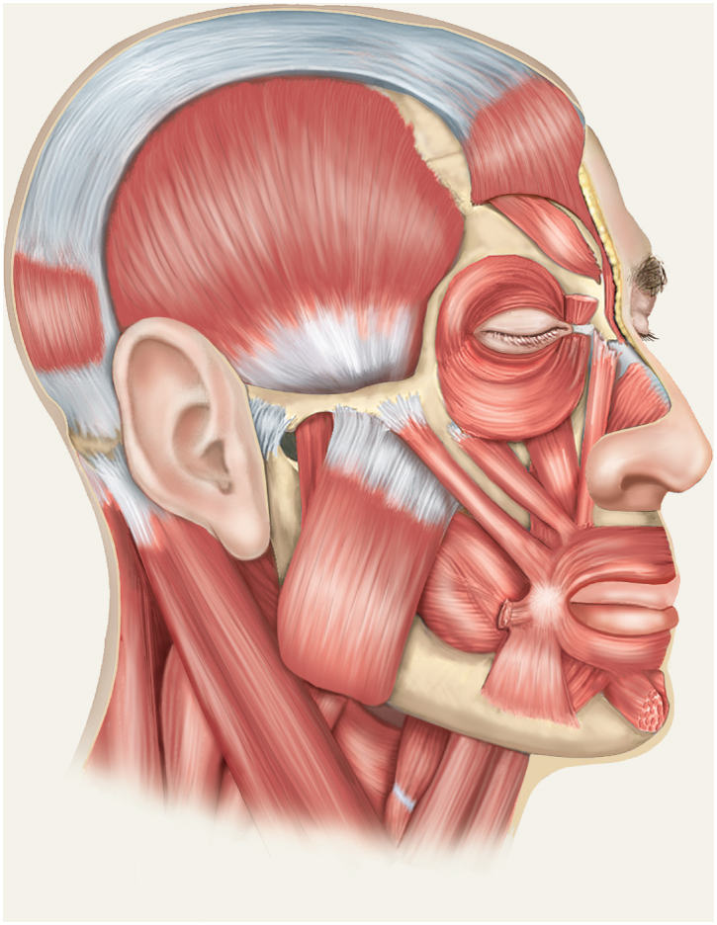
Muscles in Facial Expression
Copyright © The McGraw-Hill Companies, Inc. Permission required for reproduction or display.
Galea aponeurotica
Frontalis (cut)
Temporalis
Corrugator supercilii
Orbicularis oculi
Occipitalis
Nasalis
Levator labii superioris
Zygomatic arch
Zygomaticus minor
Zygomaticus major
Orbicularis oris
Masseter
Sternocleidomastoid
Levator scapulae
Modiolus
Inferior pharyngeal
constrictor
Risorius (cut)
Thyrohyoid
Mentalis
Sternothyroid
Depressor labii
inferioris
Omohyoid
Depressor anguli oris
Sternohyoid
(b) Lateral view
Buccinator
Figure 10.7b

Slide 20
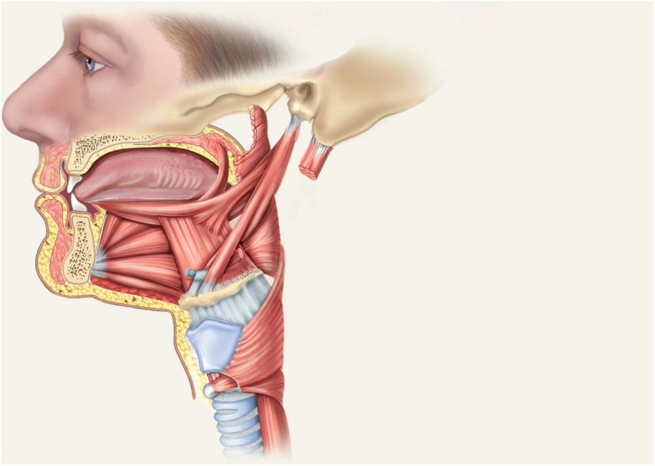
Muscles of Chewing and Swallowing
extrinsic muscles of the tongue
tongue is very agile organ
pushes food between molars for chewing (mastication)
forces food into the pharynx for swallowing (deglutition)
crucial importance to speech
intrinsic muscles of tongue
vertical, transverse, and longitudinal fascicles
Copyright © The McGraw-Hill Companies, Inc. Permission required for reproduction or display.
Palatoglossus
Styloid process
Mastoid process
Styloglossus
Posterior belly of digastric (cut)
Inferior longitudinal
muscle of tongue
Superior pharyngeal constrictor (cut)
Stylohyoid
Genioglossus
Middle pharyngeal constrictor
Hyoglossus
Mylohyoid (cut)
Hyoid bone
Geniohyoid
Larynx
Inferior pharyngeal constrictor
Trachea
Esophagus
Figure 10.8

Slide 21
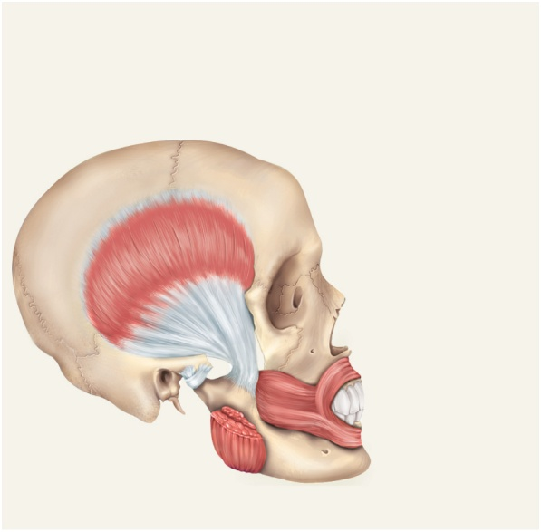
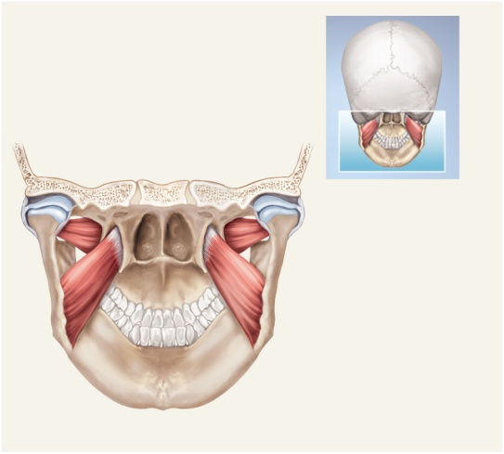
Muscles of Chewing
Copyright © The McGraw-Hill Companies, Inc. Permission required for reproduction or display.
four pairs of muscles produce the biting and chewing movements of the mandible
depression – to open mouth
elevation – biting and grinding
protraction – incisors can cut
retraction – make rear teeth meet
lateral and medial excursion – grind food
temporalis, masseter, medial pterygoid, lateral pterygoid
innervated by mandibular nerve which is a branch of the trigeminal (V)
Temporalis
Orbicularis oris
Buccinator
Masseter (cut)
(a) Lateral view
Lateral pterygoid plate
Medial pterygoid plate
Lateral pterygoid muscle
Medial pterygoid muscle
Interior of oral cavity
(b) Posterior view
Figure 10.9

Slide 22
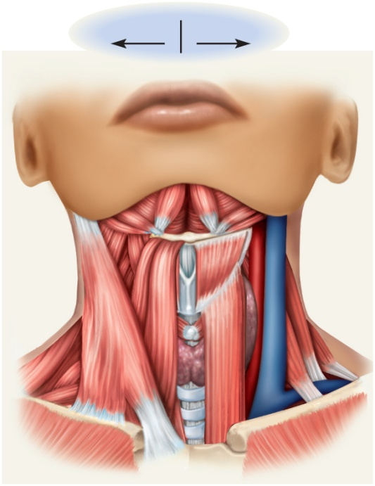
Hyoid Muscles – Suprahyoid Group
aspects of chewing, swallowing, and vocalizing
eight pairs of hyoid muscles associated with hyoid bone
digastric - opens mouth widely
geniohyoid – depresses mandible
mylohyoid – elevates floor of mouth at beginning of swallowing
stylohyoid – elevates hyoid
Copyright © The McGraw-Hill Companies, Inc. Permission required for reproduction or display.
Superficial
Deep
Digastric:
Anterior belly
Suprahyoid
group
Posterior belly
Stylohyoid
Hyoid bone
Mylohyoid
Common carotid artery
Levator scapulae
Internal jugular vein
Sternohyoid
Omohyoid:
Thyrohyoid
Infrahyoid
group
Infrahyoid
group
Superior belly
Sternothyroid
Inferior belly
Sternocleidomastoid
Clavicle
(a) Anterior view
Figure 10.10a

Slide 23
Hyoid Muscles – Infrahyoid Group
fix hyoid bone from below…allowing suprahyoid muscles to open mouth
omohyoid – depresses hyoid after elevation
sternohyoid – depresses hyoid after elevation
thyrohyoid – depresses hyoid and elevates larynx
sternothyroid – depresses larynx after elevation
Copyright © The McGraw-Hill Companies, Inc. Permission required for reproduction or display.
Superficial
Deep
Digastric:
Anterior belly
Suprahyoid
group
Posterior belly
Stylohyoid
Hyoid bone
Mylohyoid
Common carotid artery
Levator scapulae
Internal jugular vein
Sternohyoid
Omohyoid:
Thyrohyoid
Infrahyoid
group
Infrahyoid
group
Superior belly
Sternothyroid
Inferior belly
Sternocleidomastoid
Clavicle
(a) Anterior view
Figure 10.10a

Slide 24
Muscles of Pharynx
Copyright © The McGraw-Hill Companies, Inc. Permission required for reproduction or display.
Styloid process
Palatoglossus
Mastoid process
Styloglossus
Posterior belly of digastric (cut)
Superior pharyngeal constrictor (cut)
Inferior longitudinal
muscle of tongue
Stylohyoid
Genioglossus
Middle pharyngeal constrictor
Hyoglossus
Mylohyoid (cut)
Hyoid bone
Geniohyoid
Larynx
Inferior pharyngeal constrictor
Figure 10.8
Trachea
Esophagus
three pairs pharyngeal constrictors
encircle pharynx forming a muscular funnel
during swallowing drive food into the esophagus

Slide 25
Muscles Acting on the Head
originate on the vertebral column, thoracic cage, and pectoral girdle
insert on the cranial bones
actions
flexion (tipping head forward)
extension (holding the head erect)
lateral flexion (tipping head to one side)
rotation (turning the head to the left and right)
may cause contralateral movement – movement of the head toward the opposite side
may cause ipsilateral movement – movement of the head toward the same side
neck flexors
sternocleidomastoid
scalenes
neck extensors
trapezius
splenius capitis
semispinalis capitis

Slide 26
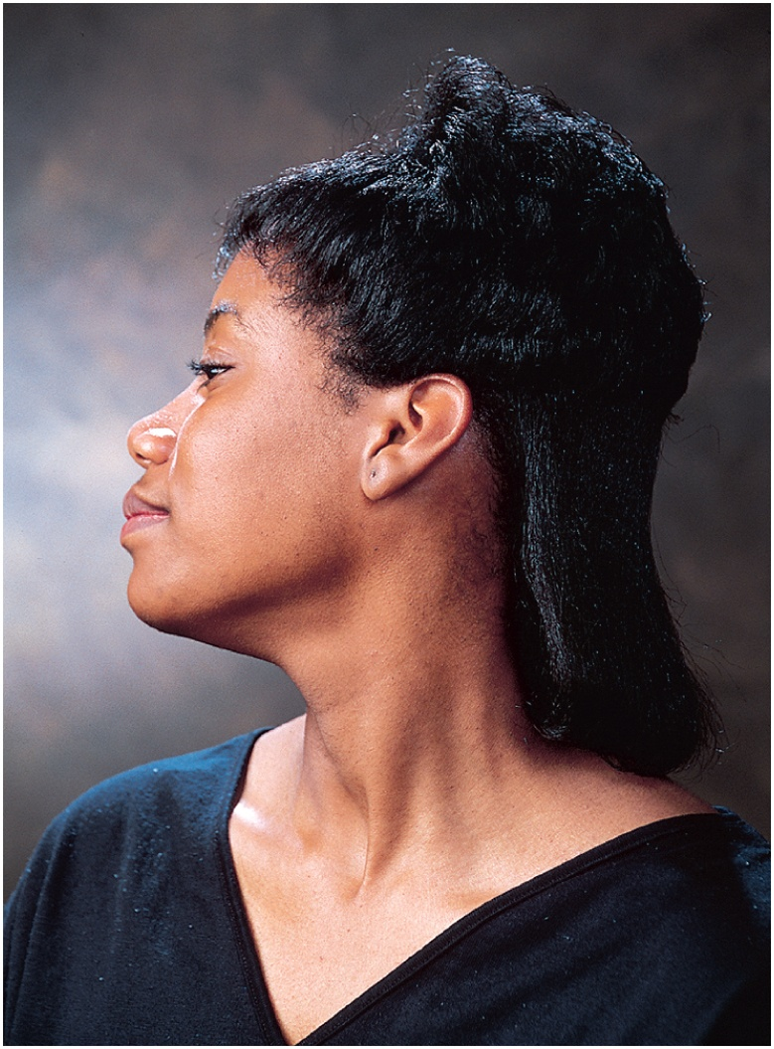
Triangles of the Neck
Copyright © The McGraw-Hill Companies, Inc. Permission required for reproduction or display.
Anterior triangles
A1. Muscular
A2. Carotid
A3. Submandibular
A3
A4. Suprahyoid
A4
A2
P1
Posterior triangles
A1
P1. Occipital
P2. Omoclavicular
P2
Figure 10.11
Sternocleidomastoid
© The McGraw-Hill Companies, Inc./Joe DeGrandis, photographer

Slide 27
Muscles of the Trunk
three functional groups
muscles of respiration
muscles that support abdominal wall and pelvic floor
movement of vertebral column

Slide 28
Muscles of Respiration
breathing requires the use of muscles enclosing thoracic cavity
diaphragm, external intercostal, internal intercostal, and innermost intercostal muscles
inspiration – air intake
expiration – expelling air
other muscles of chest and abdomen that contribute to breathing
sternocleidomastoid, scalenes of neck
pectoralis major and serratus anterior of chest
latissimus dorsi of back
abdominal muscles – internal and external obliques, and transverse abdominis
some anal muscles

Slide 29
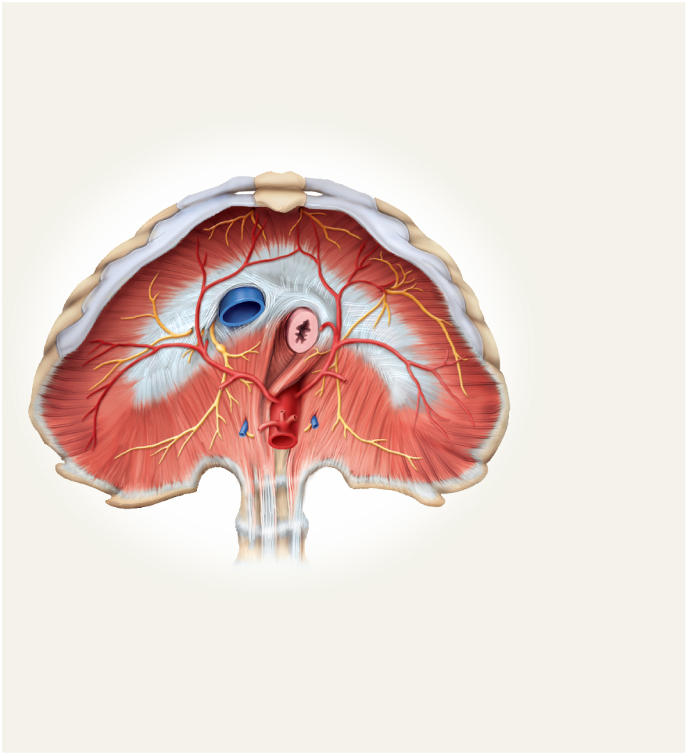
Muscles of Respiration - diaphragm
Copyright © The McGraw-Hill Companies, Inc. Permission required for reproduction or display.
muscular dome between thoracic and abdominal cavities
muscle fascicles extend to a fibrous central tendon
contraction flattens diaphragm
enlarges thoracic cavity (inspiration)
in relaxation of diaphragm it rises
shrinks the thoracic cavity (expiration)
Xiphoid process
of sternum
Inferior
vena cava
Ribs
Esophagus
Central tendon of diaphragm
Aorta
Vertebral
column
(b) Inferior view of diaphragm
Figure 10.13b

Slide 30
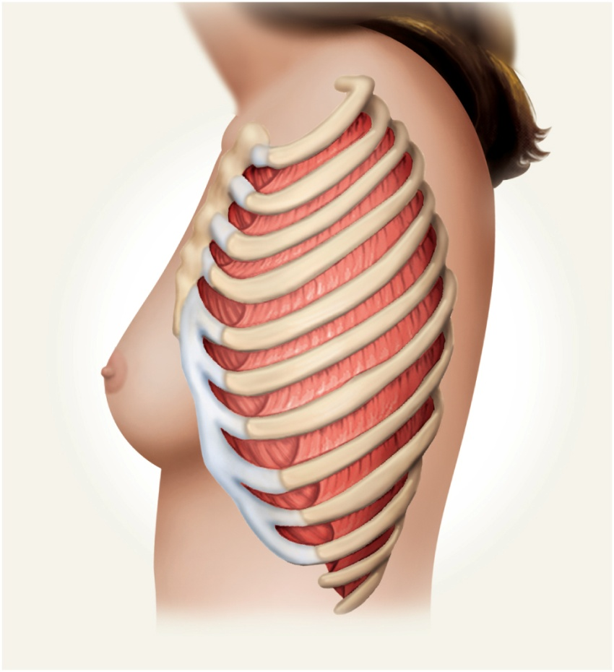
Muscles of Respiration - intercostals
Copyright © The McGraw-Hill Companies, Inc. Permission required for reproduction or display.
external intercostals
elevates ribs
expand thoracic cavity
create partial vacuum causing inflow of air
internal intercostals
depresses and retracts ribs
compresses thoracic cavity
expelling air
innermost intercostals
same action as internal intercostals
External
intercostals
Internal
intercostals
(a) Lateral view of intercostal muscles
Figure 10.13a

Slide 31
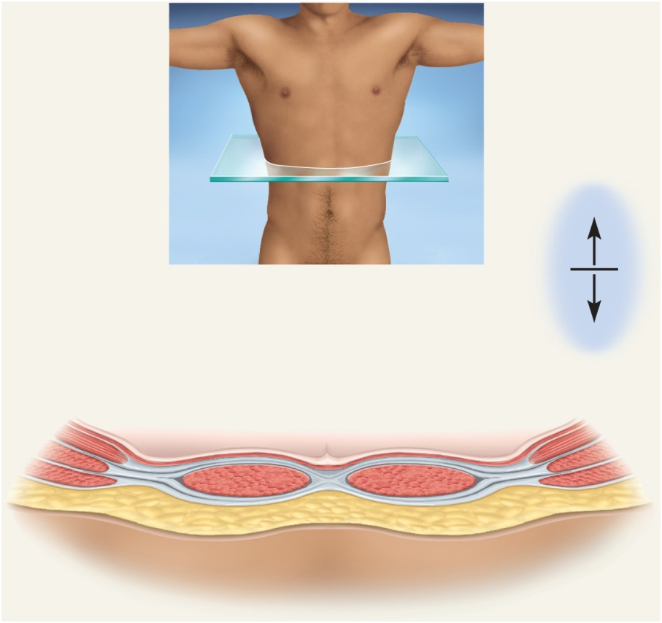
Muscles of the Anterior Abdominal Wall
four pairs of sheetlike muscles
external abdominal oblique
internal abdominal oblique
transverse abdominal
rectus abdominis
strengthen abdominal wall
Copyright © The McGraw-Hill Companies, Inc. Permission required for reproduction or display.
Posterior
Muscles:
External abdominal oblique
Anterior
Internal abdominal oblique
Peritoneum
Transverse abdominal
Rectus abdominis
Rectus sheath
Subcutaneous fat
Linea alba
Skin
Aponeurosis of
Transverse abdominal
Internal abdominal oblique
Figure 10.14
External abdominal oblique

Slide 32
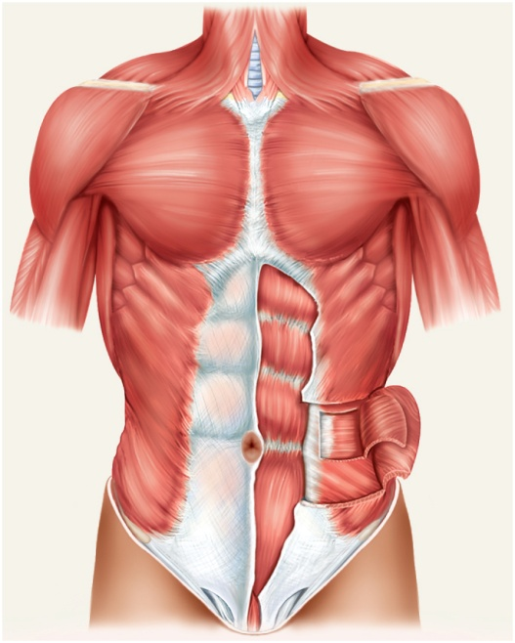
external abdominal oblique
most superficial of lateral abdominal muscles
supports abdominal viscera against pull of gravity
stabilizes vertebral column during heavy lifting
maintains posture
compresses abdominal organs
aids in forced expiration
rotation at waist
Copyright © The McGraw-Hill Companies, Inc. Permission required for reproduction or display.
Pectoralis major
Latissimus dorsi
Serratus anterior
Tendinous
intersections
Rectus sheath (cut edges)
Rectus sheath
Transverse abdominal
Umbilicus
Internal abdominal oblique (cut)
Linea semilunaris
Linea alba
External abdominal oblique (cut)
Aponeurosis of
external abdominal
oblique
Rectus abdominis
Inguinal ligament
Figure 10.15a
(a) Superficial

Slide 33
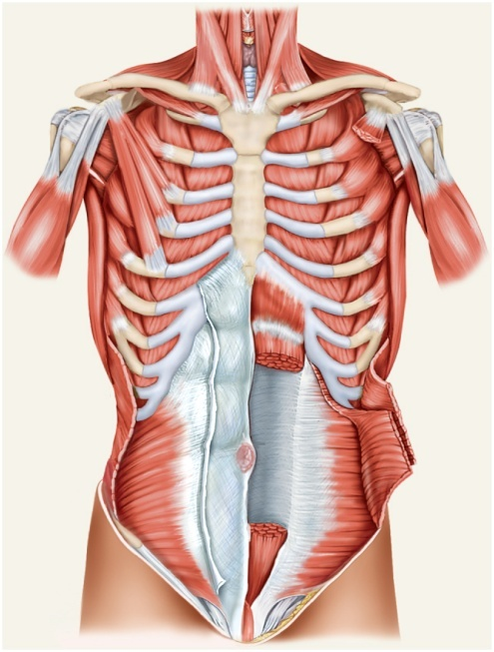
internal abdominal oblique
intermediate layer of lateral abdominal muscles
unilateral contraction causes ipsilateral rotation of waist
aponeurosis – tendons of oblique and transverse muscles –broad, fibrous sheets
Copyright © The McGraw-Hill Companies, Inc. Permission required for reproduction or display.
Subclavius
Pectoralis minor (cut)
Pectoralis minor
Internal intercostals
Serratus anterior
External intercostals
Rectus abdominis (cut)
Rectus sheath
External abdominal
oblique (cut)
Internal abdominal
oblique
Internal abdominal
oblique (cut)
Posterior wall of rectus sheath
(rectus abdominis removed)
Inguinal ligament
Transverse abdominal (cut)
(b) Deep
Figure 10.15b

Slide 34
transverse abdominal
deepest of lateral abdominal muscles
horizontal fibers
compresses abdominal contents
contributes to movements of vertebral column
Copyright © The McGraw-Hill Companies, Inc. Permission required for reproduction or display.
Subclavius
Pectoralis minor (cut)
Pectoralis minor
Internal intercostals
Serratus anterior
External intercostals
Rectus abdominis (cut)
Rectus sheath
External abdominal
oblique (cut)
Internal abdominal
oblique
Internal abdominal
oblique (cut)
Posterior wall of rectus sheath
(rectus abdominis removed)
Inguinal ligament
Transverse abdominal (cut)
(b) Deep
Figure 10.15b

Slide 35
rectus abdominis
flexes lumbar region of vertebral column
produces forward bending at the waist
extends from sternum to pubis
rectus sheath encloses muscle
three transverse tendinous intersections divide rectus abdominis into segments – “six pack”
Copyright © The McGraw-Hill Companies, Inc. Permission required for reproduction or display.
Pectoralis major
Latissimus dorsi
Serratus anterior
Tendinous
intersections
Rectus sheath (cut edges)
Rectus sheath
Transverse abdominal
Umbilicus
Internal abdominal oblique (cut)
Linea semilunaris
Linea alba
External abdominal oblique (cut)
Aponeurosis of
external abdominal
oblique
Rectus abdominis
Inguinal ligament
Figure 10.15a
(a) Superficial

Slide 36
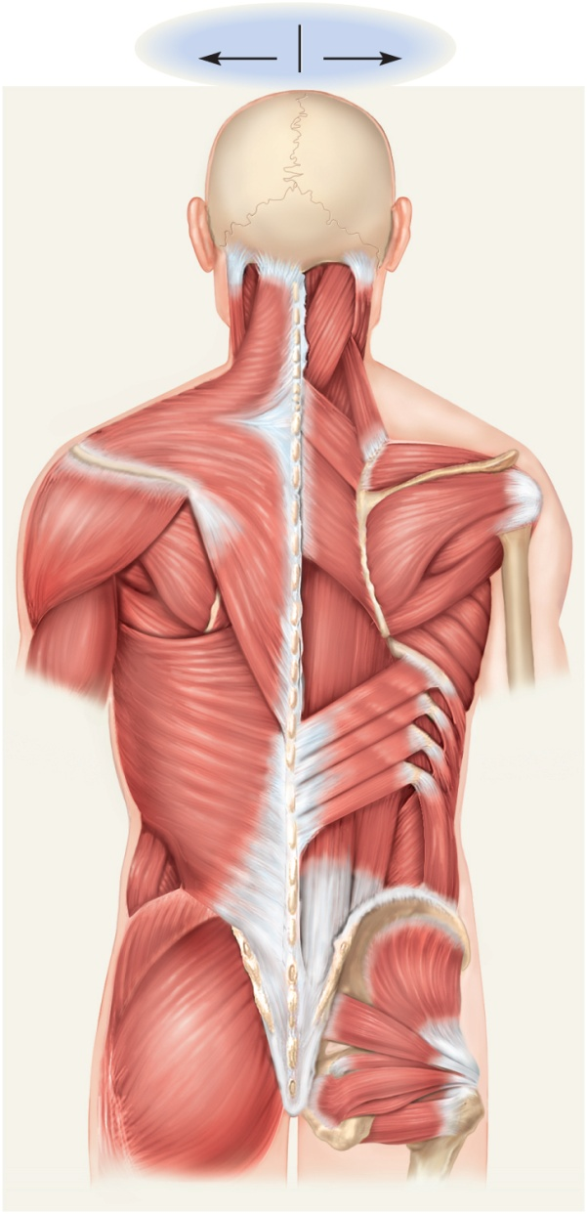
Superficial Muscles of Back
Copyright © The McGraw-Hill Companies, Inc. Permission required for reproduction or display.
Superficial
Deep
Sternocleidomastoid
Semispinalis capitis
Trapezius
Splenius capitis
Levator scapulae
extend, rotate, and laterally flex vertebral column
upper limb movement
Rhomboideus minor
Rhomboideus major
Supraspinatus
Deltoid
Infraspinatus
Teres minor
Teres major
Erector spinae
Serratus anterior
Serratus posterior
inferior
Latissimus
dorsi
External abdominal
oblique
External abdominal
oblique
Internal abdominal
oblique
Thoracolumbar
fascia
Gluteus medius
Gluteus minimus
Gluteus maximus
Lateral rotators
Figure 10.17

Slide 37
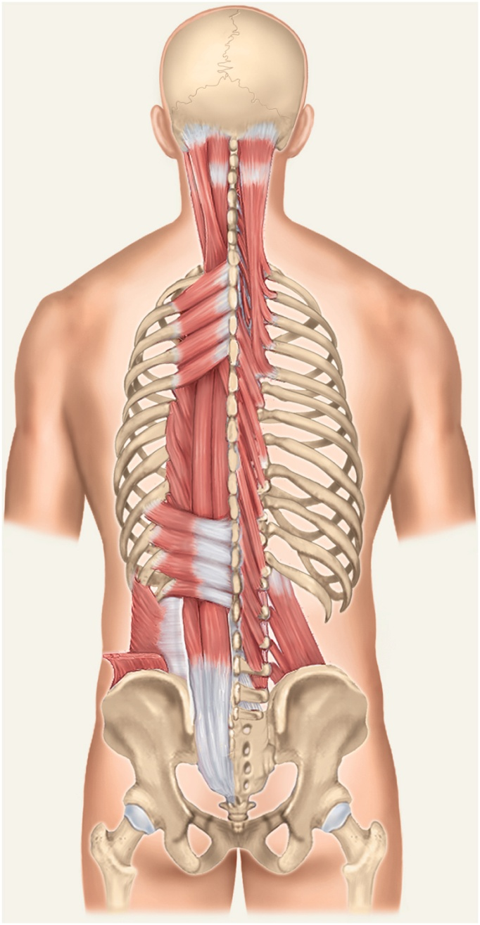
Deep Muscles of the Back
Copyright © The McGraw-Hill Companies, Inc. Permission required for reproduction or display.
erector spinae
iliocostalis, longissimus, spinalis
from cranium to sacrum
extension and lateral flexion of vertebral column
semispinalis thoracis
extension and contralateral rotation of vertebral column
quadratus lumborum
aids respiration
ipsilateral flexion of lumbar vertebral column
multifidus
stabilizes adjacent vertebrae
maintains posture
Superior nuchal line
Longissimus capitis
Semispinalis capitis
Splenius capitis
Semispinalis cervicis
Serratus posterior
superior
Splenius cervicis
Semispinalis
thoracis
Erector spinae:
Iliocostalis
Longissimus
Spinalis
Serratus posterior inferior
Internal abdominal
oblique
Multifidus
Quadratus lumborum
External abdominal
oblique (cut)
Figure 10.18

Slide 38
Muscles of the Pelvic Floor
three layers of muscles and fasciae that span pelvic outlet
penetrated by anal canal, urethra, and vagina
perineum – diamond-shaped region between the thighs
bordered by four bony landmarks
pubic symphysis anteriorly
coccyx posteriorly
ischial tuberosities laterally
urogenital triangle – anterior half of perineum
anal triangle – posterior half of perineum
three layers or compartments of the perineum
superficial perineal space – three muscles
ischiocavernosus, bulbospongiosus, superficial transverse peritoneal
middle compartment - spanned by urogenital diaphragm
composed of a fibrous membrane and two or three muscles
deep transverse perineal muscle, external urethral and anal sphincters
compressor urethrae in females only
pelvic diaphragm – deepest layer consists of two muscle pairs
levator ani and coccygeus

Slide 39
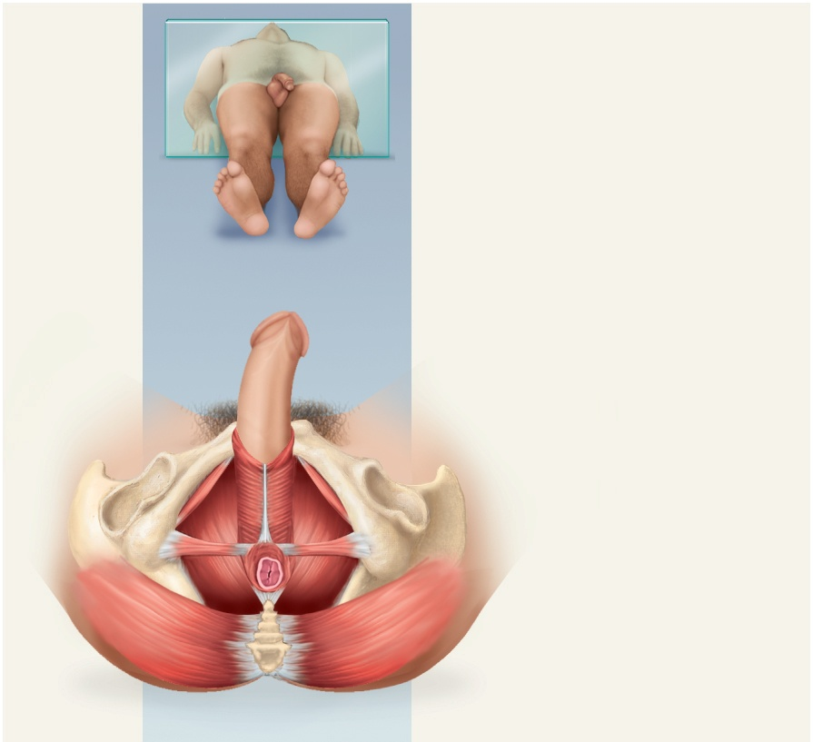
Superficial Perineal Space
Copyright © The McGraw-Hill Companies, Inc. Permission required for reproduction or display.
Male
Ischiocavernosus
Perineal raphe
Bulbospongiosus
Figure 10.20a
Superficial transverse
perineal muscle
Levator ani
Gluteus maximus
(a) Superficial perineal space, inferior view
© The McGraw-Hill Companies, Inc./Rebecca Gray, photographer/Don Kincaid, dissections
three muscles found just deep to the skin
ischiocavernosus – maintains erection
bulbospongiosus – aids in erection, expels remaining urine
superficial transverse perineal – not always present

Slide 40
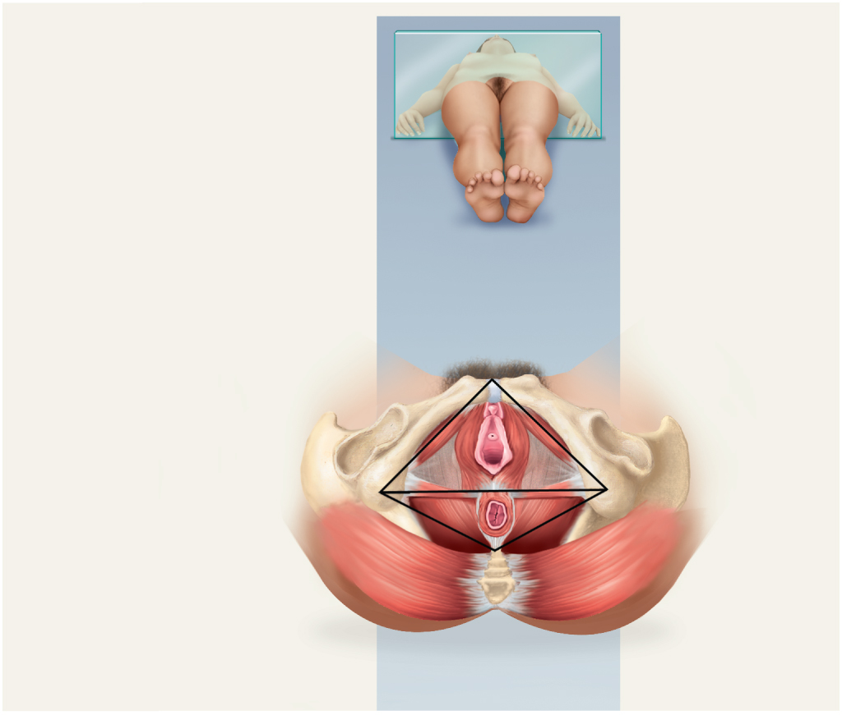
Muscles of Middle Compartment
Copyright © The McGraw-Hill Companies, Inc. Permission required for reproduction or display.
Female
Ischiocavernosus
Urogenital
triangle
Perineal raphe
Urethra
Bulbospongiosus
Vagina
Superficial transverse
perineal muscle
Levator ani
Anus
Gluteus maximus
Anal triangle
Figure 10.20b
(a) Superficial perineal space, inferior view
© The McGraw-Hill Companies, Inc./Rebecca Gray, photographer/Don Kincaid, dissections
middle layer of pelvic floor contains urogenital diaphragm and external urethral and anal sphincters

Slide 41
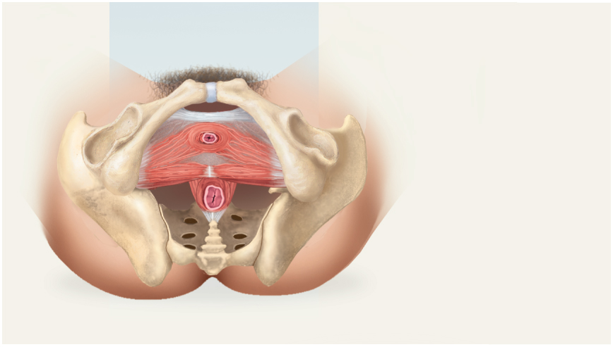
Muscles of Pelvic Diaphragm
Copyright © The McGraw-Hill Companies, Inc. Permission required for reproduction or display.
Pubic symphysis
Pubic ramus
External urethral
sphincter
Deep transverse
perineal muscle
Perineal body
External anal sphincter
Figure 10.20c
(b) Urogenital diaphragm, inferior view
deepest compartment of the perineum
pelvic diaphragm – two muscle pairs
levator ani - supports viscera and defecation
coccygeus - supports and elevates pelvic floor

Slide 42
Hernias
hernia – any condition in which the viscera protrudes through a weak point in the muscular wall of the abdominopelvic cavity
inguinal hernia
most common type of hernia (rare in women)
viscera enter inguinal canal or even the scrotum
hiatal hernia
stomach protrudes through diaphragm into thorax
overweight people over 40
umbilical hernia
viscera protrude through the navel

Slide 43
Muscles Acting on Shoulder and Upper Limb
compartments – spaces in which muscles are organized and are separated by fibrous connective tissue sheets (fasciae)
each compartment contains one or more functionally related muscles along with their nerve and blood supplies
muscles of upper limbs divided into anterior and posterior compartments
muscles of lower limbs divided into anterior, posterior, medial, and lateral compartments
intermuscular septa (thick fascia) separates compartments
compartment syndrome – one of the muscles or blood vessels in a compartment is injured

Slide 44
Compartment Syndrome
fasciae of arms and legs enclose muscle compartments very snugly
if a blood vessel in a compartment is damaged, blood and tissue fluid accumulate in the compartment
fasciae prevent compartment from expanding with increasing pressure
compartment syndrome – mounting pressure on the muscles, nerves and blood vessel triggers a sequence of degenerative events
blood flow to compartment is obstructed by pressure
if ischemia (poor blood flow) persists for more than 2 – 4 hours, nerves begin to die
after 6 hours, muscles begin to die
nerves can regenerate after pressure relieved, but muscle damage is permanent
myoglobin in urine indicates compartment syndrome
treatment – immobilization of limb and fasciotomy – incision to relieve compartment pressure

Slide 45
Muscles Acting on the Shoulder
originate on the axial skeleton
insert on clavicle and scapula
scapula loosely attached to thoracic cage
capable of great movement
rotation, elevation, depression, protraction, retraction
clavicle braces the shoulder and moderates movements

Slide 46
Anterior Group of Muscles of Pectoral Girdle
pectoralis minor
ribs 3-5 to coracoid process of scapula
draws scapula laterally
serratus anterior
ribs 1-9 to medial border of scapula
abducts and rotates or depresses scapula
Copyright © The McGraw-Hill Companies, Inc. Permission required for reproduction or display.
Subclavius
Pectoralis minor (cut)
Pectoralis minor
Internal intercostals
Serratus anterior
External intercostals
Rectus abdominis (cut)
Rectus sheath
External abdominal
oblique (cut)
Internal abdominal
oblique
Internal abdominal
oblique (cut)
Posterior wall of rectus sheath
(rectus abdominis removed)
Inguinal ligament
Transverse abdominal (cut)
Figure 10.15b
(b) Deep

Slide 47
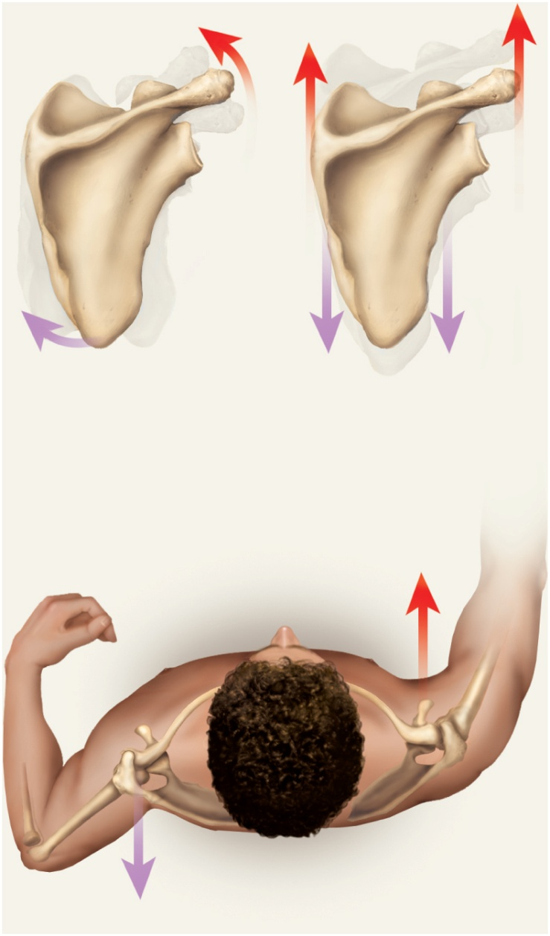
Muscles Acting on Scapula
Copyright © The McGraw-Hill Companies, Inc. Permission required for reproduction or display.
Lateral rotation
Elevation
Trapezius (superior part)
Levator scapulae
Serratus anterior
Trapezius (superior part)
Rhomboideus major
Rhomboideus minor
Medial rotation
Depression
Levator scapulae
Trapezius (inferior part)
Rhomboideus major
Serratus anterior
Rhomboideus minor
Retraction
Protraction
Rhomboideus major
Pectoralis minor
Rhomboideus minor
Serratus anterior
Trapezius
Figure 10.23

Slide 48
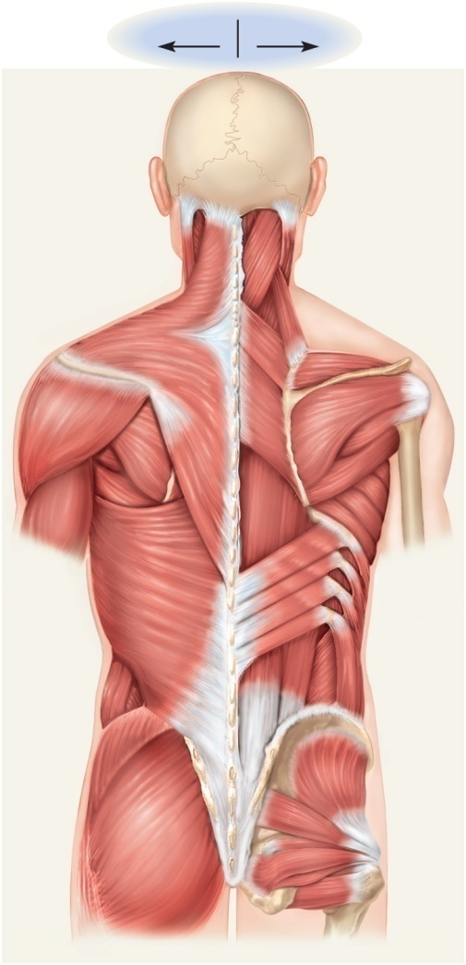
Posterior Group of Muscles of Pectoral Girdle
four muscles of posterior group
trapezius - superficial
levator scapulae, rhomboideus minor, and rhomboideus major - deep
trapezius
stabilizes scapula and shoulder
elevates and depresses shoulder apex
levator scapulae
elevates scapula
flexes neck laterally
rhomboideus minor
retracts scapula and braces shoulder
rhomboideus major
same as rhomboideus minor
Copyright © The McGraw-Hill Companies, Inc. Permission required for reproduction or display.
Superficial
Deep
Sternocleidomastoid
Semispinalis capitis
Trapezius
Splenius capitis
Levator scapulae
Rhomboideus minor
Rhomboideus major
Supraspinatus
Deltoid
Infraspinatus
Teres minor
Teres major
Erector spinae
Serratus anterior
Serratus posterior
inferior
Latissimus
dorsi
External abdominal
oblique
External abdominal
oblique
Internal abdominal
oblique
Thoracolumbar
fascia
Gluteus medius
Gluteus minimus
Gluteus maximus
Lateral rotators
Figure 10.17

Slide 49
Posterior Scapular Muscles
Copyright © The McGraw-Hill Companies, Inc. Permission required for reproduction or display.
Superficial
Deep
Sternocleidomastoid
Semispinalis capitis
Trapezius
Splenius capitis
Levator scapulae
Rhomboideus minor
Rhomboideus major
Supraspinatus
Deltoid
Infraspinatus
Teres minor
Teres major
Erector spinae
Serratus anterior
Serratus posterior
inferior
Latissimus
dorsi
External abdominal
oblique
External abdominal
oblique
Internal abdominal
oblique
Thoracolumbar
fascia
Gluteus medius
Gluteus minimus
Gluteus maximus
Lateral rotators
Figure 10.17

Slide 50
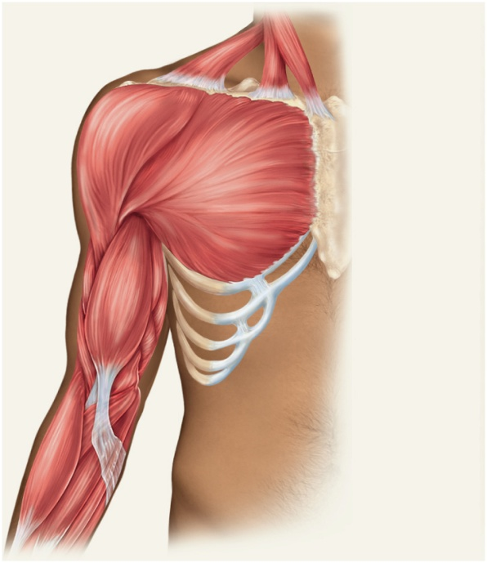
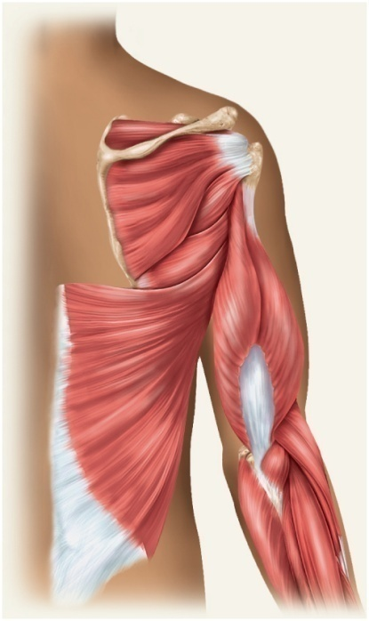
Muscles Acting on Arm
nine muscles cross the shoulder joint and insert on humerus
two are axial muscles because they originate on axial skeleton
pectoralis major – flexes, adducts, and medially rotates humerus
latissimus dorsi – adducts and medially rotated humerus
Copyright © The McGraw-Hill Companies, Inc. Permission required for reproduction or display.
Copyright © The McGraw-Hill Companies, Inc. Permission required for reproduction or display.
Clavicle
Supraspinatus
Spine of scapula
Sternum
Greater tubercle
of humerus
Deltoid
Infraspinatus
Pectoralis major
Humerus
Teres minor
Teres major
Triceps brachii:
Coracobrachialis
Triceps brachii:
Lateral head
Lateral head
Long head
Long head
Medial head
Biceps brachii
Latissimus dorsi
Brachialis
Brachioradialis
(a) Anterior view
(b) Posterior view
Figure 10.24a
Figure 10.24b

Slide 51
Muscles Acting on Arm
Copyright © The McGraw-Hill Companies, Inc. Permission required for reproduction or display.
seven scapular muscles
originate on scapula
deltoid
rotates and abducts arm
intramuscular injection site
teres major
extension and medial rotation of humerus
coracobrachialis
flexes and medially rotates arm
remaining four form the rotator cuff that reinforce the shoulder joint
Clavicle
Sternum
Deltoid
Pectoralis major
Triceps brachii:
Coracobrachialis
Lateral head
Long head
Medial head
Biceps brachii
Brachialis
Brachioradialis
Figure 10.24a
(a) Anterior view
Copyright © The McGraw-Hill Companies, Inc. Permission required for reproduction or display.
Supraspinatus
Spine of scapula
Greater tubercle
of humerus
Infraspinatus
Humerus
Teres minor
Teres major
Triceps brachii:
Lateral head
Long head
Latissimus dorsi
Figure 10.24b
(b) Posterior view

Slide 52
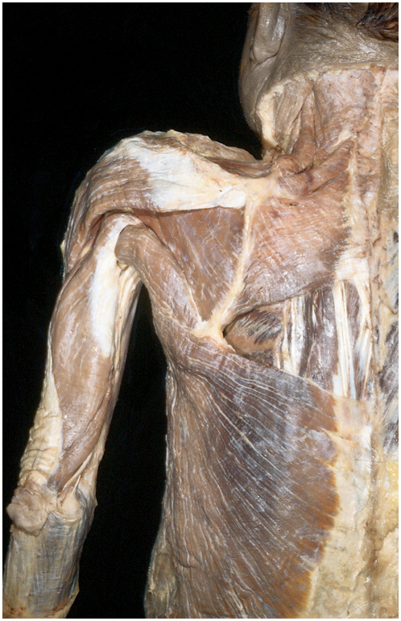
Back Muscles of Cadaver
Copyright © The McGraw-Hill Companies, Inc. Permission required for reproduction or display.
Levator scapulae
Rhomboideus
minor
Rhomboideus
major
Deltoid
Infraspinatus
Teres minor
Medial border
of scapula
Teres major
Triceps brachii:
Lateral head
Long head
Latissimus dorsi
(b) Posterior view
© The McGraw-Hill Companies, Inc./Rebecca Gray, photographer/Don Kincaid, dissections
Figure 10.25b

Slide 53
Rotator Cuff Muscles
tendons of the remaining four scapular muscles form the rotator cuff
“SITS” muscles – for the first letter of their names
supraspinatus
infraspinatus
teres minor
subscapularis
tendons of these muscles merge with the joint capsule of the shoulder as they cross it in route to the humerus
holds head of humerus into glenoid cavity
supraspinatus tendon most easily damaged

Slide 54
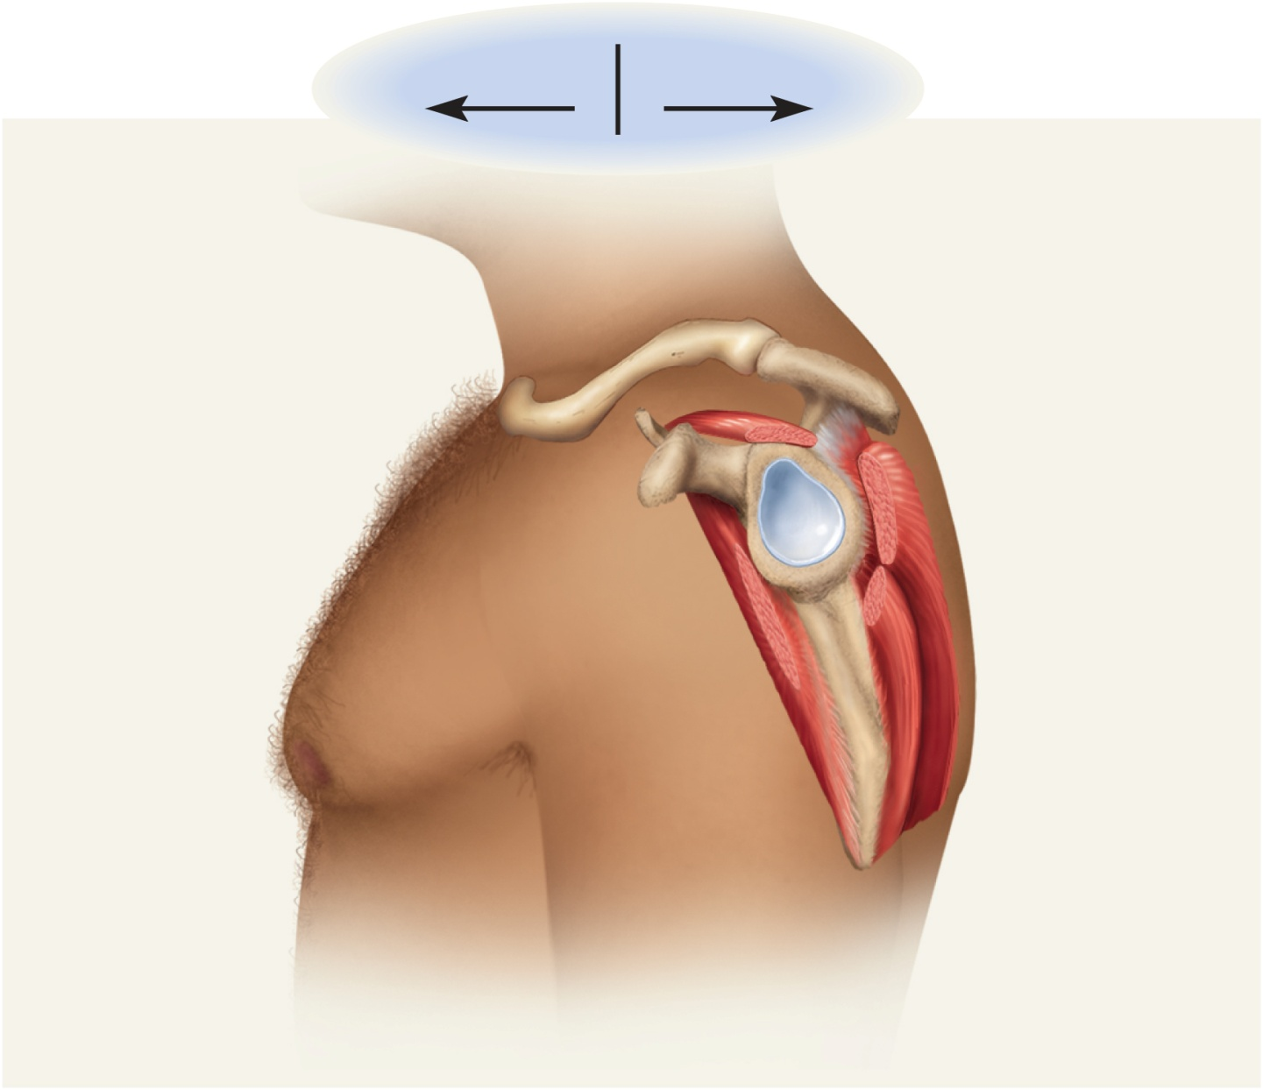
Rotator Cuff Muscles
Copyright © The McGraw-Hill Companies, Inc. Permission required for reproduction or display.
Anterior
Posterior
Clavicle
Rotator cuff (SITS)
muscles:
Acromion
Supraspinatus
Coracoid
process
Infraspinatus
Glenoid cavity
Teres minor
Subscapularis
Inferior angle
Figure 10.26

Slide 55
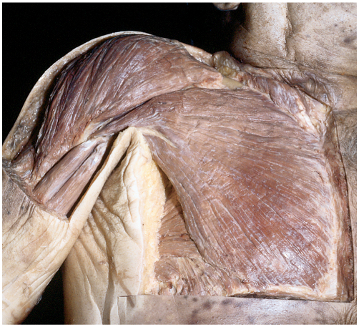
Anterior View of Cadaver Chest
Copyright © The McGraw-Hill Companies, Inc. Permission required for reproduction or display.
Deltoid
Pectoralis major
Biceps brachii:
Long head
Short head
Serratus anterior
External
abdominal
oblique
(a) Anterior view
© The McGraw-Hill Companies, Inc./Rebecca Gray, photographer/Don Kincaid, dissections
Figure 10.25a

Slide 56
Muscles Acting on Forearm
elbow and forearm capable of flexion, extension, pronation, and supination
carried out by muscles in both brachium (arm) and antebrachium (forearm)
muscles with bellies in the arm (brachium)
principal elbow flexors – anterior compartment
brachialis and biceps brachii
brachialis produces 50% more power than biceps brachii
brachialis is prime mover of elbow flexion
principal elbow extensor – posterior compartment
triceps brachii
prime mover of elbow extension

Slide 57
Muscles Acting on Forearm
muscles with bellies in the forearm (antebrachium)
most forearm muscles act on the hand and wrist
brachioradialis – flexes elbow
anconeus – extends elbow
pronator quadratus – prime mover in forearm pronation
pronator teres – assists pronator quadratus in pronation
supinator – supinates the forearm

Slide 58
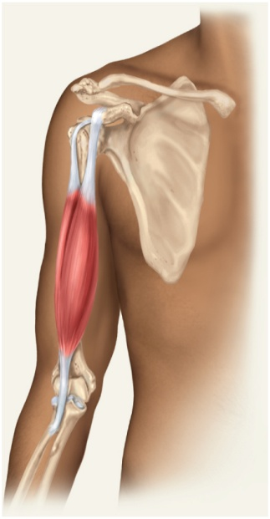
Muscles Acting on Forearm
Copyright © The McGraw-Hill Companies, Inc. Permission required for reproduction or display.
principal flexor
brachialis
synergistic flexors
biceps brachii
brachioradialis
principal extensor
triceps brachii
Figure 10.24c
Biceps brachii:
Long head
Short head
Copyright © The McGraw-Hill Companies, Inc. Permission required for reproduction or display.
Clavicle
Sternum
Deltoid
Pectoralis major
Triceps brachii:
Coracobrachialis
(c) Anterior view
Lateral head
Long head
Medial head
Biceps brachii
Copyright © The McGraw-Hill Companies, Inc. Permission required for reproduction or display.
Brachialis
Brachioradialis
Supraspinatus
Spine of scapula
Greater tubercle
of humerus
Infraspinatus
(a) Anterior view
Humerus
Teres minor
Figure 10.24a
Teres major
Triceps brachii:
Lateral head
Long head
Figure 10.24b
Latissimus dorsi
(b) Posterior view

Slide 59
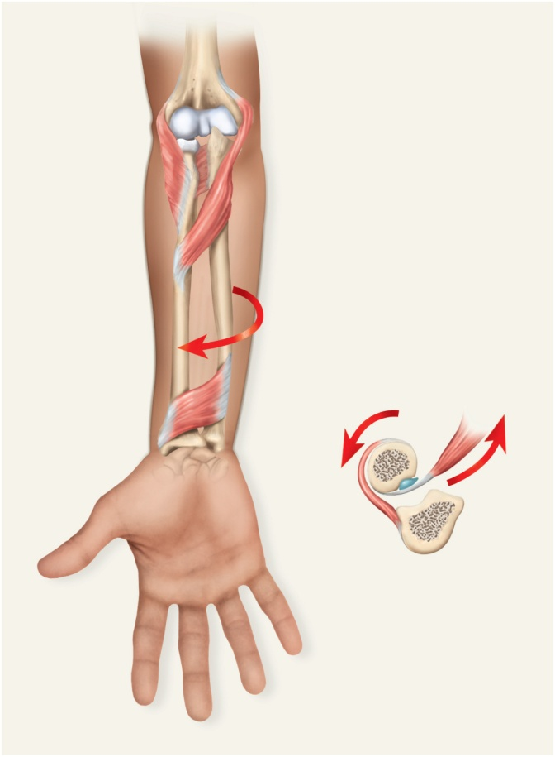
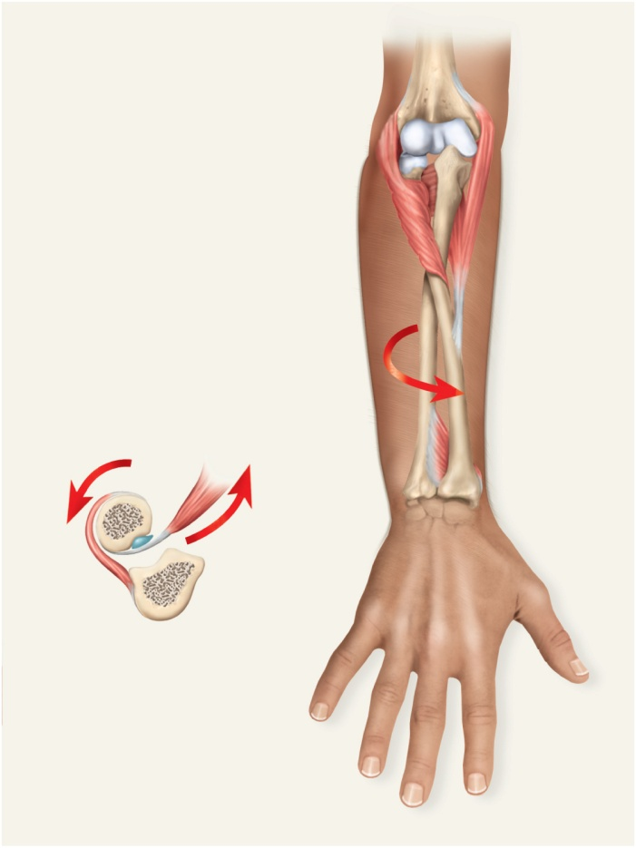
Supination and Pronation
Copyright © The McGraw-Hill Companies, Inc. Permission required for reproduction or display.
Copyright © The McGraw-Hill Companies, Inc. Permission required for reproduction or display.
Lateral epicondyle
Lateral epicondyle
Medial epicondyle
Medial epicondyle
Supinator
Supinator
Pronator teres
Pronator teres
Ulna
Ulna
Radius
Radius
Pronator quadratus
Pronator quadratus
Biceps
brachii
Biceps
brachii
Radius
Radius
Supinator
Bursa
Supinator
Bursa
Ulna
Ulna
(b) Muscle actions
in supination
(b) Muscle actions
in supination
(a) Supination
(c) Pronation
Figure 10.27a
Figure 10.27c
supination
supinator muscle
palm facing anteriorly or superiorly
pronation
pronator quadratus and pronator teres
palm faces posteriorly or inferiorly

Slide 60
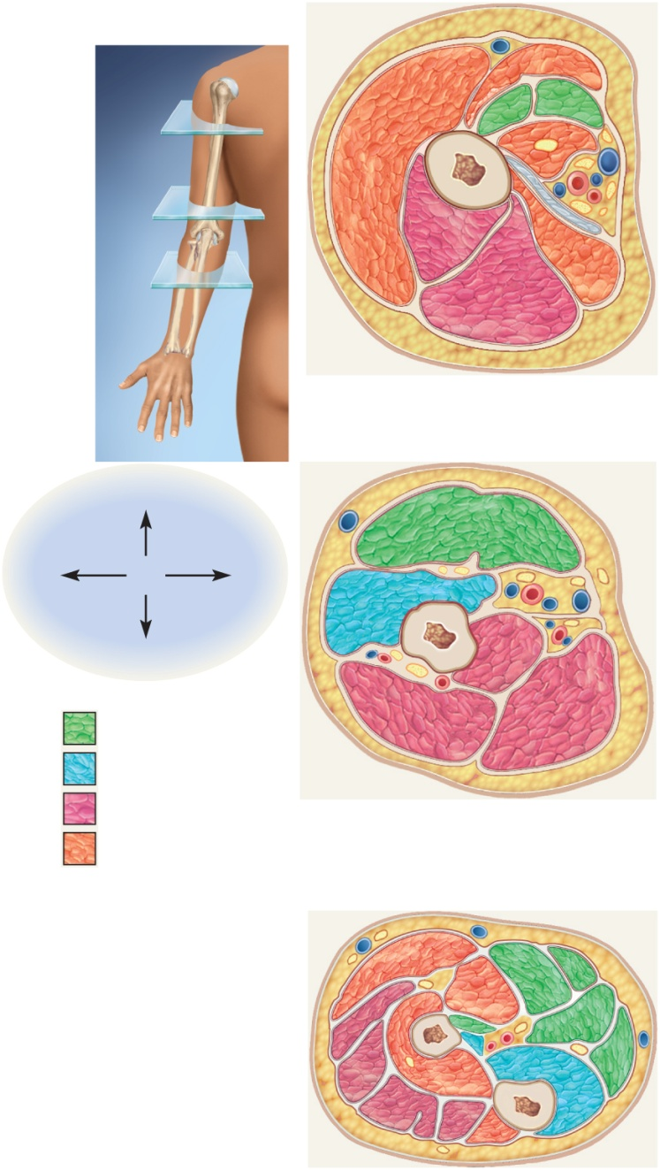
Cross Section of Upper Limb
Copyright © The McGraw-Hill Companies, Inc. Permission required for reproduction or display.
Deltoid
Pectoralis major
Biceps brachii:
Short head
Long head
(a)
Coracobrachialis
Humerus
(b)
Latissimus dorsi tendon
Teres major
(c)
Triceps brachii:
Lateral head
Long head
(a)
Anterior
Lateral
Medial
Biceps brachii
Brachialis
Posterior
Triceps brachii:
Key
Medial head
Anterior (flexor)
compartment, superficial
Long head
Anterior (flexor)
compartment, deep
Lateral head
Posterior (extensor)
compartment
(b)
Other muscles
Brachioradialis
Pronator teres
Flexor carpi radialis
Supinator
Palmaris longus
Radius
Flexor digitorum superficialis
Extensor carpi radialis longus
Flexor pollicis longus
Extensor carpi radialis brevis
Flexor carpi ulnaris
Extensor digitorum
Flexor digitorum profundus
Extensor digiti minimi
Ulna
Figure 10.28
Extensor carpi ulnaris
Anconeus
(c)

Slide 61
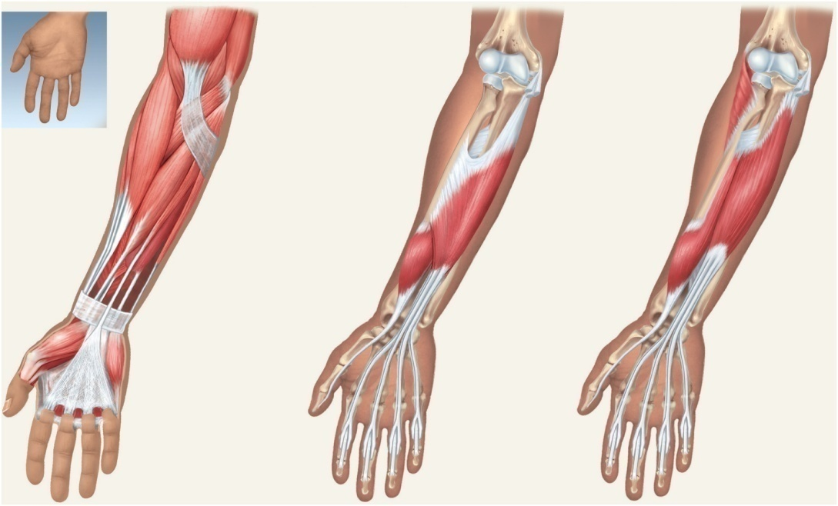
Anterior Muscles Acting on Wrist and Hand
extrinsic muscles of the forearm
intrinsic muscles in the hand itself
extrinsic muscle actions
flexion and extension of wrist and digits
radial and ulnar flexion
finger abduction and adduction
thumb opposition
Copyright © The McGraw-Hill Companies, Inc. Permission required for reproduction or display.
Biceps brachii
Triceps brachii
Brachialis
Common flexor
tendon
Common flexor tendon
Supinator
Pronator teres
Anterior view
Aponeurosis of biceps
brachii
Interosseous
membrane
Brachioradialis
Flexor carpi radialis
Flexor
digitorum
superficialis
Flexor
digitorum
profundus
Palmaris longus
Flexor carpi ulnaris
Extensor carpi radialis
longus and brevis
Flexor
pollicis longus
Flexor
pollicis
longus
Flexor digitorum
superficialis
Figure 10.29
Flexor
retinaculum
Flexor
digitorum
superficialis
tendons
Flexor
digitorum
superficialis
tendons
Palmar
aponeurosis
Flexor
digitorum
profundus
tendons
Flexor
digitorum
profundus
tendons
(a) Superficial flexors
(b) Intermediate flexor
(c) Deep flexors

Slide 62
Anterior Muscles Acting on Wrist and Hand
Anterior (Flexor) Compartment – superficial layer
flexor carpi radialis
flexor carpi ulnaris
flexor digitorum superficialis
palmaris longus
Anterior (Flexor) Compartment – deep layer
flexor digitorum profundus
flexor pollicis longus

Slide 63
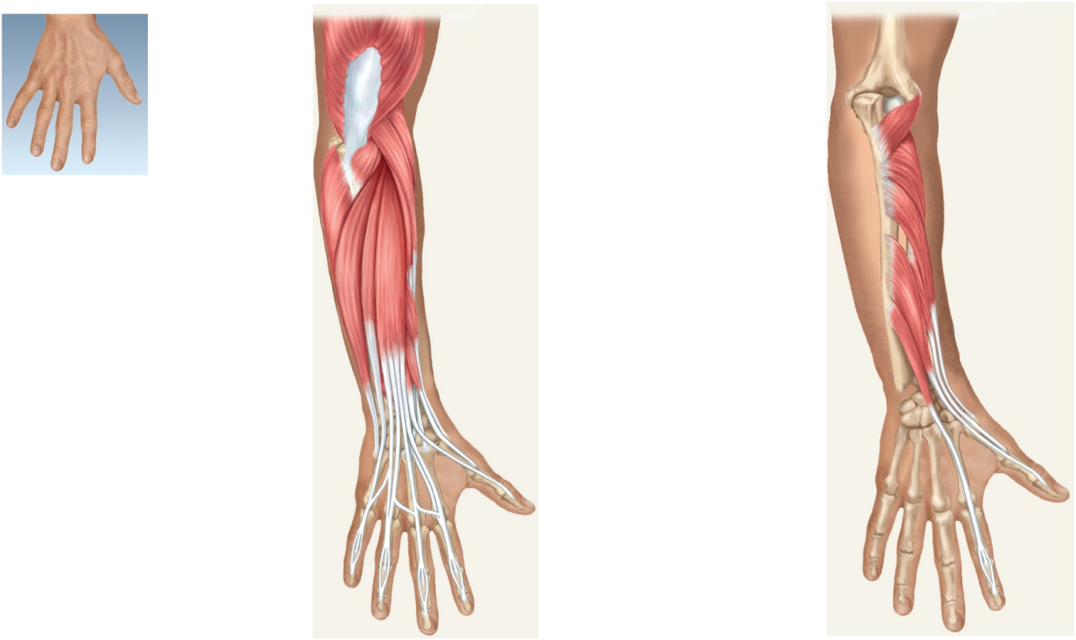
Posterior Muscles Acting on Wrist & Hand
extension of wrist and fingers, adduct / abduct wrist
extension and abduction of thumb (pollicis)
brevis - short, ulnaris - on ulna side of forearm
Copyright © The McGraw-Hill Companies, Inc. Permission required for reproduction or display.
Triceps brachii
Brachioradialis
Olecranon
Extensor carpi
radialis longus
Anconeus
Anconeus
Supinator
Posterior view
Flexor carpi
ulnaris
Extensor carpi
radialis brevis
Abductor pollicis
longus
Extensor carpi
ulnaris
Extensor digitorum
Extensor digiti
minimi
Abductor pollicis
longus
Extensor pollicis
longus
Extensor pollicis
brevis
Extensor pollicis
brevis
Extensor indicis
Tendon of
extensor indicis
Extensor pollicis
longus
Tendons of extensor
carpi radialis longus
and brevis
Tendons of extensor
digitorum
Figure 10.30
(a) Superficial extensors
(b) Deep extensors

Slide 64
Posterior Muscles Acting on Wrist and Hand
Posterior (Extensor) Compartment – superficial layer
extensor carpi radialis longus
extensor carpi radialis brevis
extensor digitorum
extensor digiti minimi
extensor carpi ulnaris
Posterior (Extensor) Compartment – deep layer
abductor pollicis longus
extensor pollicis brevis
extensor pollicis longus
extensor indicis

Slide 65
Carpal Tunnel Syndrome
flexor retinaculum – bracelet-like fibrous sheet that the flexor tendons of the extrinsic muscles that flex the wrist pass on their way to their insertions
carpal tunnel – tight space between the flexor retinaculum and the carpal bones
flexor tendons passing through the tunnel are enclosed in tendon sheaths
enable tendons to slide back and forth quite easily
carpal tunnel syndrome - prolonged, repetitive motions of wrist and fingers can cause tissues in the carpal tunnel to become inflamed, swollen, or fibrotic
puts pressure on the median nerve of the wrist that passes through the carpal tunnel along with the flexor tendons
tingling and muscular weakness in the palm and medial side of the hand
pain may radiate to arm and shoulder
treatment – anti-inflammatory drugs, immobilization of the wrist, and sometimes surgery to remove part or all of flexor retinaculum

Slide 66
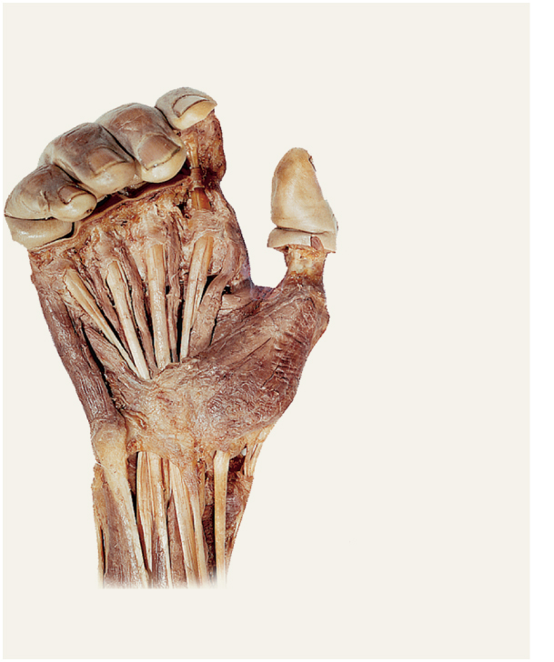
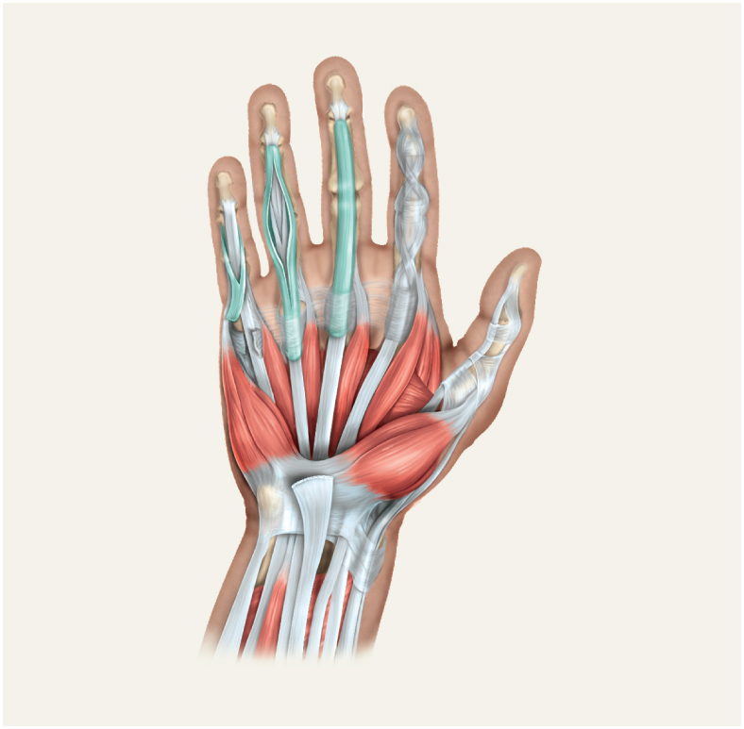
Carpal Tunnel Syndrome
Copyright © The McGraw-Hill Companies, Inc. Permission required for reproduction or display.
repetitive motions cause inflammation and pressure on median nerve
Tendon of flexor
digitorum
superficialis
Lumbrical
Opponens
digiti minimi
Copyright © The McGraw-Hill Companies, Inc. Permission required for reproduction or display.
Flexor digiti
minimi brevis
Adductor
pollicis
Flexor pollicis
brevis
Tendon sheath
First dorsal
interosseous
Abductor digiti
minimi
Tendon of flexor
digitorum profundus
Adductor
pollicis
Abductor pollicis
brevis
Tendon of flexor
digitorum superficialis
Tendon of flexor
pollicis longus
Pisiform bone
Lumbricals
Tendon of extensor
pollicis brevis
Opponens
digiti minimi
Flexor pollicis
brevis
Flexor digitorum
superficialis
Flexor digiti
minimi brevis
Abductor pollicis
brevis
Tendon of flexor
carpi radialis
Abductor digiti
minimi
Opponens pollicis
Flexor retinaculum
Tendons of:
(b) Palmar dissection, superficial
Tendons of:
Abductor pollicis
longus
Figure 10.32b
Flexor carpi ulnaris
Flexor carpi
radialis
Flexor digitorum
superficialis
Palmaris longus
Flexor pollicis
longus
(a) Palmar aspect, superficial
Figure 10.32a
10-66

Slide 67
Intrinsic Hand Muscles
thenar group – form thick, fleshy mass at base of thumb
adductor pollicis
abductor pollicis brevis
flexor pollicis brevis
opponens pollicis
Hypothenar group - fleshy base of the little finger
abductor digiti minimi
flexor digiti minimi brevis
opponens digiti minimi
Midpalmar group – hollow of palm
dorsal interosseous muscles (4)
palmar interosseous muscles (3)
lumbricals (4 muscles)
Copyright © The McGraw-Hill Companies, Inc. Permission required for reproduction or display.
Tendon sheath
First dorsal
interosseous
Tendon of flexor
digitorum profundus
Adductor
pollicis
Tendon of flexor
digitorum superficialis
Tendon of flexor
pollicis longus
Lumbricals
Opponens
digiti minimi
Flexor pollicis
brevis
Flexor digiti
minimi brevis
Abductor pollicis
brevis
Abductor digiti
minimi
Opponens pollicis
Flexor retinaculum
Tendons of:
Tendons of:
Abductor pollicis
longus
Flexor carpi ulnaris
Flexor carpi
radialis
Flexor digitorum
superficialis
Palmaris longus
Flexor pollicis
longus
(a) Palmar aspect, superficial
Figure 10.32a
10-67

Slide 68
Muscles Acting on the Hip and Lower Limb
largest muscles found in lower limb
less for precision, more for strength needed to stand, maintain balance, walk, and run
several cross and act on two or more joints
leg – the part of the limb between the knee and ankle
foot – includes tarsal region (ankle), metatarsal region, and the toes

Slide 69
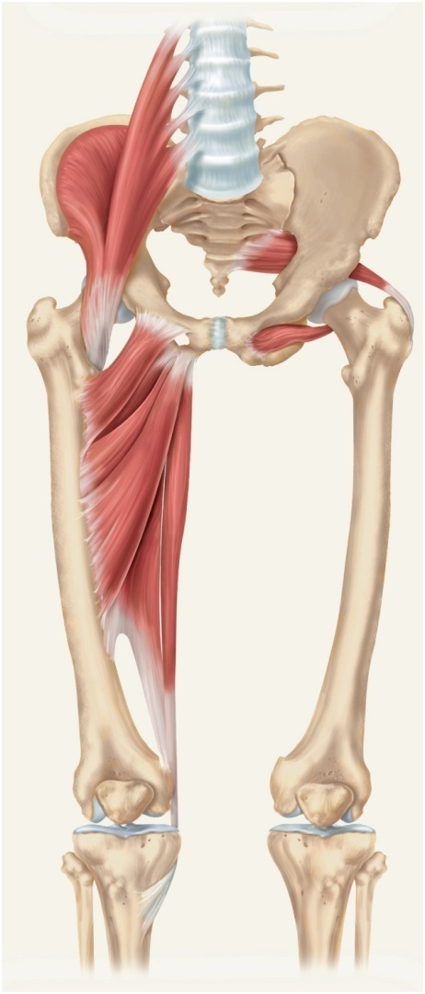
Muscles Acting on the Hip and Femur
Copyright © The McGraw-Hill Companies, Inc. Permission required for reproduction or display.
anterior muscles of the hip
iliacus
flexes thigh at hip
iliacus portion arises from iliac crest and fossa
psoas major
flexes thigh at hip
arises from lumbar vertebrae
they share a common tendon on the femur
Iliopsoas:
Iliacus
Psoas
major
Piriformis
Pectineus
Adductor
magnus
Obturator
externus
Adductor
brevis
Adductor
longus
Gracilis
Insertion of
gracilis on
tibia
Figure 10.33

Slide 70
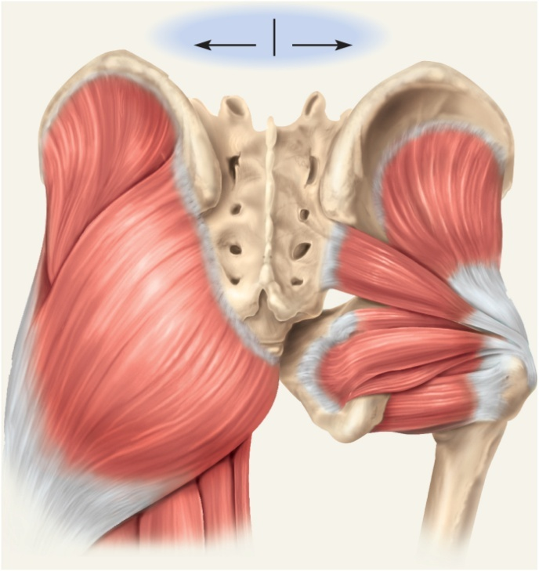
Posterior Muscles Acting on Hip and Femur
lateral and posterior muscles of the hip
tensor fasciae latae
extends knee, laterally rotates knee
gluteus maximus
forms mass of the buttock
prime hip extensor
provides most of lift when you climb stairs
gluteus medius and minimus
abduct and medially rotate thigh
Copyright © The McGraw-Hill Companies, Inc. Permission required for reproduction or display.
Superficial
Deep
Iliac crest
Gluteus
minimus
Gluteus
medius
Sacrum
Lateral rotators:
Gluteus
maximus
Piriformis
Gemellus
superior
Coccyx
Obturator
internus
Obturator
externus
Ischial
tuberosity
Gemellus
inferior
Quadratus
femoris
Figure 10.34

Slide 71
Posterior Muscles Acting on Hip and Femur
lateral rotators - six muscles inferior to gluteus minimus
deep to the two other gluteal muscles
gemellus superior
gemellus inferior
obturator externus
obturator internus
piriformis
quadratus femoris
Copyright © The McGraw-Hill Companies, Inc. Permission required for reproduction or display.
Superficial
Deep
Iliac crest
Gluteus
minimus
Gluteus
medius
Sacrum
Lateral rotators:
Gluteus
maximus
Piriformis
Gemellus
superior
Coccyx
Obturator
internus
Obturator
externus
Ischial
tuberosity
Gemellus
inferior
Quadratus
femoris
Figure 10.34

Slide 72
Muscles Acting on Hip and Femur
Copyright © The McGraw-Hill Companies, Inc. Permission required for reproduction or display.
medial (adductor) compartment of thigh
five muscles act as primary adductors of the thigh
adductor brevis
adductor longus
adductor magnus
gracilis
pectineus
Iliopsoas:
Iliacus
Psoas
major
Piriformis
Pectineus
Adductor
magnus
Obturator
externus
Adductor
brevis
Adductor
longus
Gracilis
Insertion of
gracilis on
tibia
Figure 10.33

Slide 73
Muscles Acting on the Knee and Leg
anterior (extensor) compartment of the thigh
contains large quadriceps femoris muscle
prime mover of knee extension
most powerful muscle in the body
has four heads – rectus femoris, vastus lateralis, vastus medialis, and vastus intermedius
all converge on single quadriceps (patellar) tendon
extends to patella
then continues as patellar ligament
inserts on tibial tuberosity
sartorius – longest muscle in the body
tailor’s muscle

Slide 74
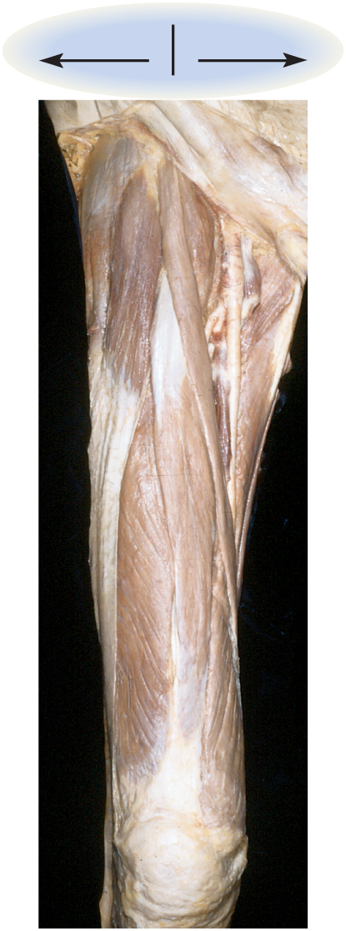
Anterior Thigh Cadaver Muscles
Copyright © The McGraw-Hill Companies, Inc. Permission required for reproduction or display.
Lateral
Medial
Tensor fasciae latae
Iliopsoas
Femoral vein
Femoral artery
Sartorius
Pectineus
Adductor longus
Iliotibial band
Quadriceps femoris:
Gracilis
Rectus femoris
Vastus lateralis
Vastus medialis
Quadriceps tendon
Patella
© The McGraw-Hill Companies, Inc./Rebecca Gray, photographer/Don Kincaid, dissections
Figure 10.35

Slide 75
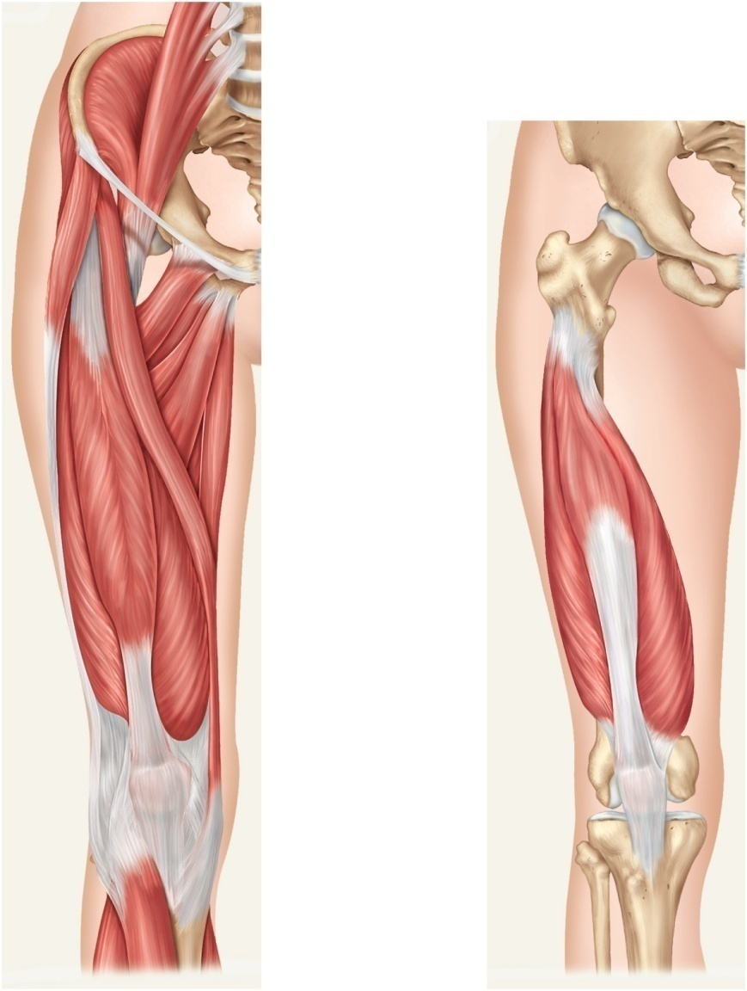
Muscles Acting on the Knee and Leg
Copyright © The McGraw-Hill Companies, Inc. Permission required for reproduction or display.
Iliac crest
Iliopsoas:
Iliacus
Psoas major
L5
Anterior superior
iliac spine
Tensor fasciae
latae
Medial compartment:
Adductor magnus
Pectineus
Iliotibial band
Adductor brevis
Adductor longus
Gracilis
Anterior compartment:
Sartorius
Quadriceps femoris:
Vastus
intermedius
Rectus femoris
Vastus lateralis
Vastus medialis
Quadriceps
femoris tendont
Patella
Patellar
ligament
(a) Superficial
(b) Deep
Figure 10.36

Slide 76
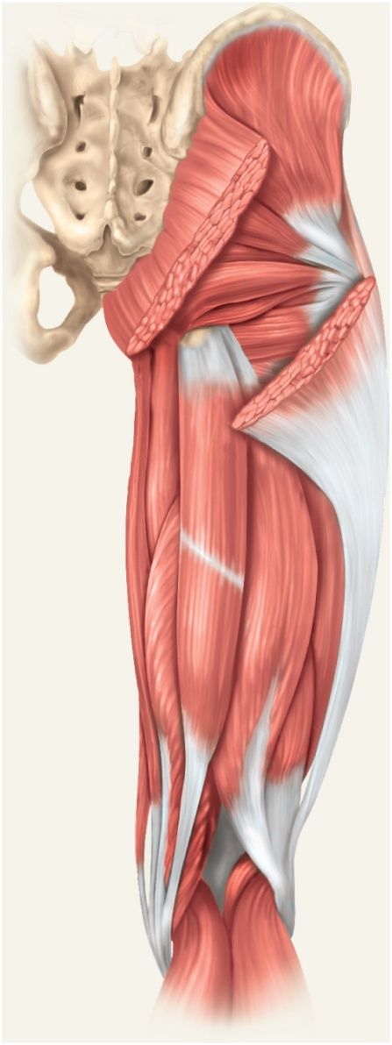
Muscles Acting on the Knee and Leg
Copyright © The McGraw-Hill Companies, Inc. Permission required for reproduction or display.
posterior (flexor) compartment of the thigh
contains hamstring muscles
from lateral to medial;
biceps femoris
semitendinosus
semimembranosus
Gluteus medius
Gluteus maximus
Gracilis
Adductor magnus
Iliotibial band
Vastus lateralis
Hamstring group:
Biceps femoris
Long head
Short head
Semitendinosus
Semimembranosus
Figure 10.37

Slide 77
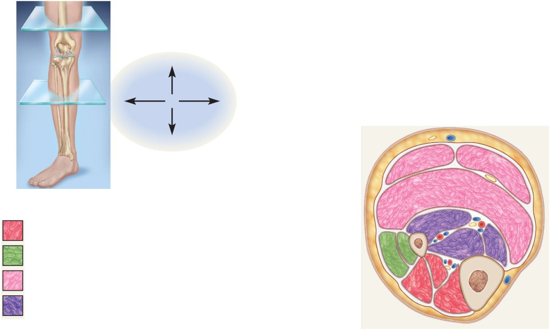
Muscles of the Leg
Copyright © The McGraw-Hill Companies, Inc. Permission required for reproduction or display.
(a)
Posterior
(b)
Lateral
Medial
Anterior
Gastrocnemius
(lateral head)
Gastrocnemius
(medial head)
Soleus
Key b
Fibula
Flexor hallucis longus
Anterior (extensor)
compartment
Fibularis longus
Flexor digitorum longus
Lateral (fibular) compartment
Fibularis brevis
Tibialis posterior
Posterior (flexor)
compartment, superficial
Extensor hallucis longus
Tibia
Posterior (flexor
compartment, deep)
Extensor digitorum longus
Tibialis anterior
(b)
Figure 10.42b
crural muscles, acting on the foot, are separated into 3 compartments.
anterior compartment (red)
fibular (lateral) compartment (green)
posterior (superficial = pink) (deep = purple)

Slide 78
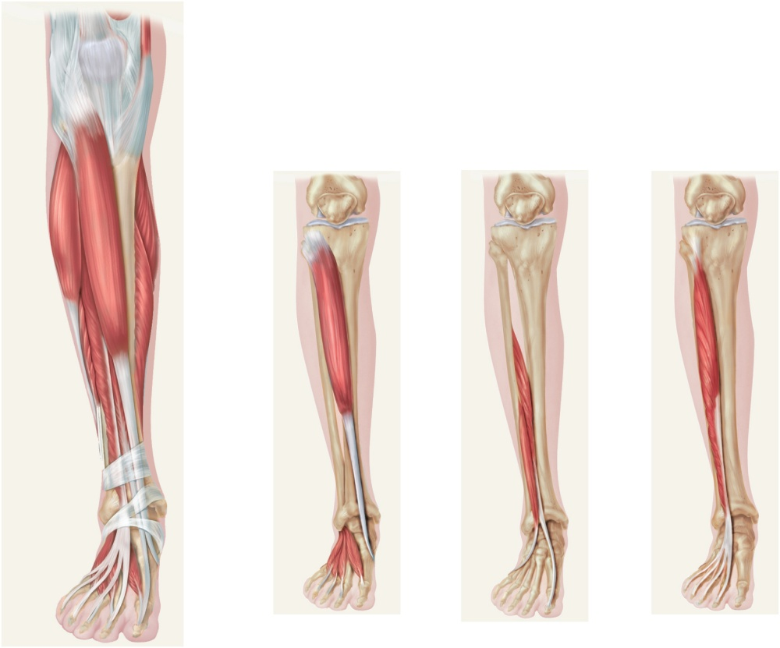
Anterior Compartment of Leg
Copyright © The McGraw-Hill Companies, Inc. Permission required for reproduction or display.
Patella
Patellar
ligament
Tibia
Fibularis
longus
Gastrocnemius
Soleus
Fibularis
brevis
Tibialis
anterior
Extensor
digitorum longus
Tibialis
anterior
Extensor
hallucis
longus
Extensor
digitorum
longus
Extensor retinacula
Fibularis
tertius
Extensor
hallucis brevis
Extensor
digitorum
brevis
Figure 10.39
(a)
(b)
(c)
(d)
anterior (extensor) compartment of the leg
dorsiflex the ankle
prevent toes from scuffing when walking
fibularis (peroneus) tertius
extensor digitorum longus
extensor hallucis longus
tibialis anterior

Slide 79
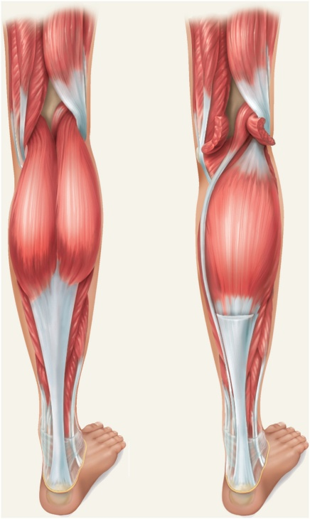
Posterior Compartment of Leg Superficial Group
Copyright © The McGraw-Hill Companies, Inc. Permission required for reproduction or display.
Plantaris
Heads of
gastrocnemius
(cut)
Popliteus
Fibularis
longus
Gastrocnemius:
Soleus
Medial head
Lateral head
Tendon of
plantaris
Gastrocnemius
(cut)
Tendon of
gastrocnemius
Fibularis
longus
Flexor
digitorum
longus
Fibularis
brevis
Flexor
hallucis
longus
Calcaneal tendon
Figure 10.40
Calcaneus
(a)
(b)
three muscles of the superficial group
gastrocnemius - plantar flexes foot, flexes knee
soleus – plantar flexes foot
plantaris - weak synergist of triceps surae
triceps surae – collective name for gastrocnemius and soleus
inserts on calcaneus by way of the calcaneal (Achilles) tendon
strongest tendon in the body

Slide 80
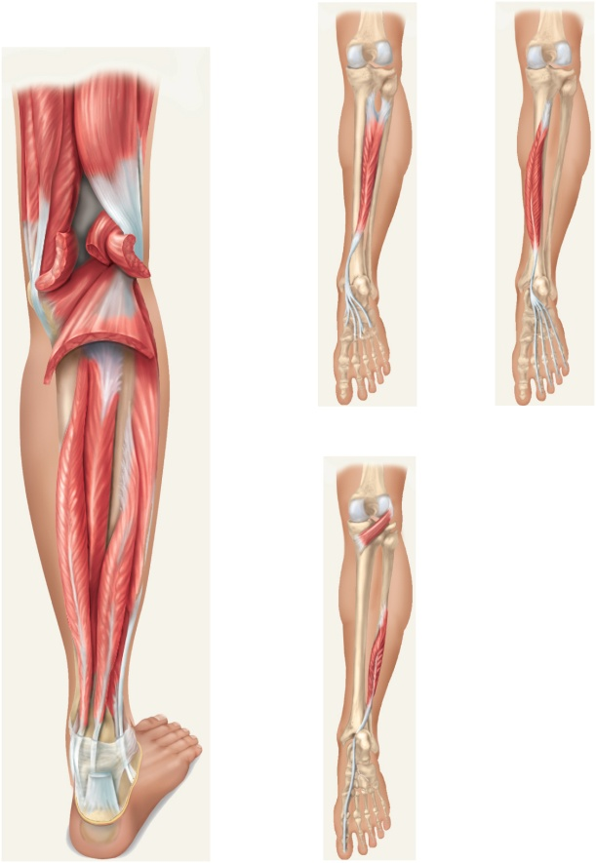
Posterior Compartment of Leg Deep Group
Copyright © The McGraw-Hill Companies, Inc. Permission required for reproduction or display.
Tibialis
posterior
Flexor
digitorum
longus
Plantaris (cut)
Popliteus
Gastrocne -mius (cut)
Soleus (cut)
Fibula
(b)
(c)
Tibialis
posterior
Flexor digitorum
longus
Fibularis
longus
Popliteus
Flexor hallucis
longus
Fibularis
brevis
Flexor
hallucis
longus
Calcaneal tendon
(cut)
Plantar surface
of the foot
Figure 10.41
Calcaneus
(a)
(d)
four muscles in the deep group
flexor digitorum longus – flexes phalanges
flexor hallucis longus – flexes great toe
tibialis posterior – inverts foot
popliteus – acts on knee

Slide 81
Lateral (Fibular) Compartment of the Leg
Copyright © The McGraw-Hill Companies, Inc. Permission required for reproduction or display.
two muscles in this compartment
fibularis longus
fibularis brevis
both plantar flex and evert the foot
provides lift and forward thrust
Plantaris (cut)
Popliteus
Gastrocnemius (cut)
Soleus (cut)
Fibula
Tibialis
posterior
Flexor digitorum
longus
Fibularis
longus
Flexor hallucis
longus
Fibularis
brevis
Calcaneal tendon
(cut)
Calcaneus
Figure 10.41a
(a)

Slide 82
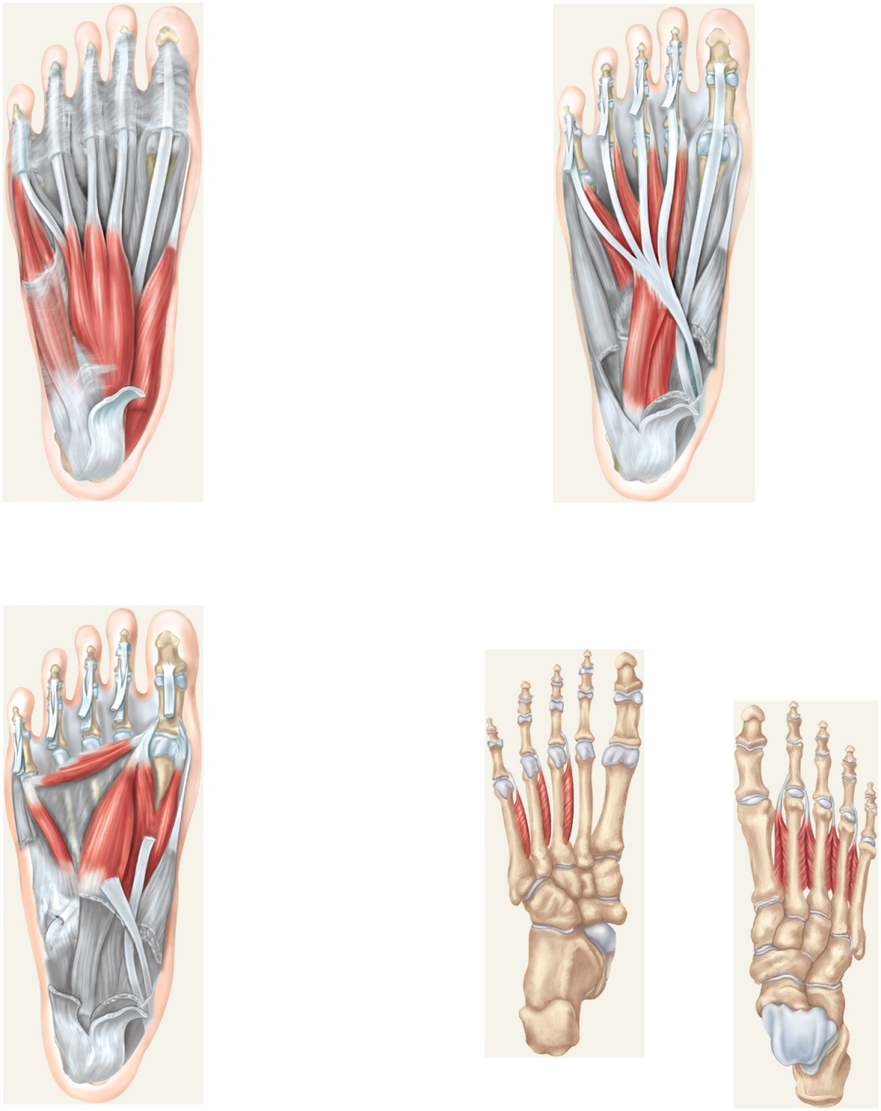
Intrinsic Muscles of Foot
Copyright © The McGraw-Hill Companies, Inc. Permission required for reproduction or display.
four ventral muscle layers
support for arches
abduct and adduct the toes
flex the toes
one dorsal muscle
extensor digitorum brevis extends toes
Lumbricals
Flexor digiti
minimi brevis
Flexor hallucis
longus tendon
Abductor digiti
minimi
Abductor hallucis
Flexor digitorum
longus tendon
Flexor digitorum
brevis
Quadratus plantae
Abductor hallucis
(cut)
Plantar aponeurosis
(cut)
Flexor digitorum
brevis (cut)
Calcaneus
(a) Layer 1, plantar view
(b) Layer 2, plantar view
Figure 10.43
Adductor hallucis
Flexor hallucis brevis
Plantar
interosseous
Flexor digiti
minimi brevis
Dorsal
interosseous
Flexor hallucis
longus tendon (cut)
Quadratus plantae
(cut)
Abductor hallucis (cut)
dorsal view
Flexor digitorum
longus tendon (cut)
(c) Layer 3, plantar view
(d) Layer 4, plantar view
(e) Layer 4, dorsal view

Slide 83
Athletic Injuries
muscles and tendons are vulnerable to sudden and
intense stress
proper conditioning and warm-up needed
common injuries;
compartment syndrome
shinsplints
pulled hamstrings
tennis elbow
pulled groin
rotator cuff injury
treat with rest, ice, compression and elevation
“no pain, no gain” is a dangerous misconception

