Slide 1
Female Reproductive System
Reproductive Anatomy
Puberty and Menopause
Oogenesis and the Sexual Cycle
Female Sexual Response
Pregnancy and Childbirth
Lactation

Slide 2
Female Reproductive System
more complex than the males because it serves more purposes
produce and deliver gametes, provide nutrition and safe harbor for fetal development, gives birth, and nourish the infant
more cyclic, and female hormones secreted in a more complex sequence than the relatively steady secretion in the male

Slide 3
Sexual Differentiation
the two sexes indistinguishable for first 8 to 10 weeks of development
female reproductive tract develops from the paramesonephric ducts
not because of the positive action of any hormone
because of the absence of testosterone and müllerian-inhibiting factor (MIF)
without testosterone:
causes mesonephric ducts to degenerate
genital tubercle becomes the glans clitoris
urogenital folds become the labia minora
labioscrotal folds develop into the labia majora
without MIF:
paramesonephric ducts develop into the uterine tubes, uterus, and vagina

Slide 4
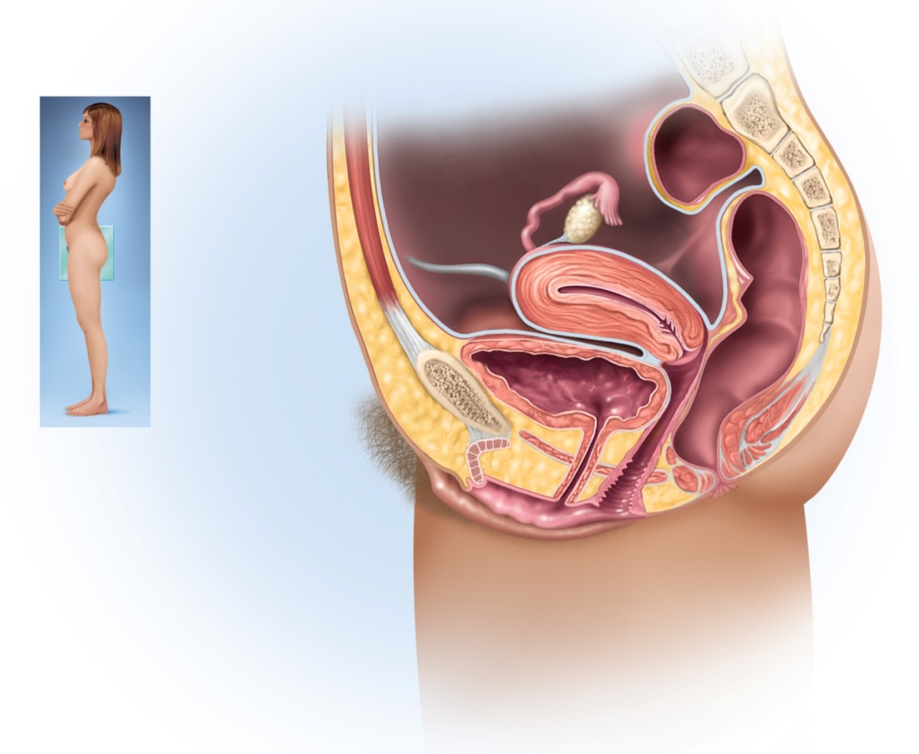
Female Reproductive System
internal genitalia
ovaries, uterine tubes, uterus and vagina
external genitalia
clitoris, labia minora, and labia majora
occupy the perineum
primary sex organs
ovaries
secondary sex organs
other internal and external genitalia
Copyright © The McGraw-Hill Companies, Inc. Permission required for reproduction or display.
Uterine tube
Fimbriae
Ovary
Round ligament
Vesicouterine
pouch
Uterus
Rectouterine
pouch
Peritoneum
Posterior fornix
Urinary bladder
Cervix of uterus
Pubic symphysis
Anterior fornix
Mons pubis
Rectum
Urethra
Anus
Clitoris
Prepuce
Vaginal rugae
Labium minus
Vaginal orifice
Labium majus
Figure 28.1

Slide 5
The Ovaries
ovaries – female gonads which produce egg cells (ova) and sex hormones
almond-shaped and nestled in the ovarian fossa
depression in the posterior pelvic wall
tunica albuginea capsule like on testes
outer cortex where germ cells develop
inner medulla occupied by major arteries and veins
lacks ducts, instead each egg develops in its own fluid-filled follicle
ovulation – bursting of the follicle and releasing the egg
ovarian ligaments
attached to uterus by ovarian ligament
attached to pelvic wall by suspensory ligament
contains ovarian artery, vein and nerves
anchored to broad ligament by mesovarium

Slide 6
The Ovaries
ovary receives blood from two arteries:
ovarian branch of the uterine artery
ovarian artery
equivalent to testicular artery in male
ovarian and uterine arteries anastomose along margin of ovary
give off multiple small arteries that enter the ovary
ovarian veins, lymphatics, and nerves also travel through the suspensory ligaments

Slide 7
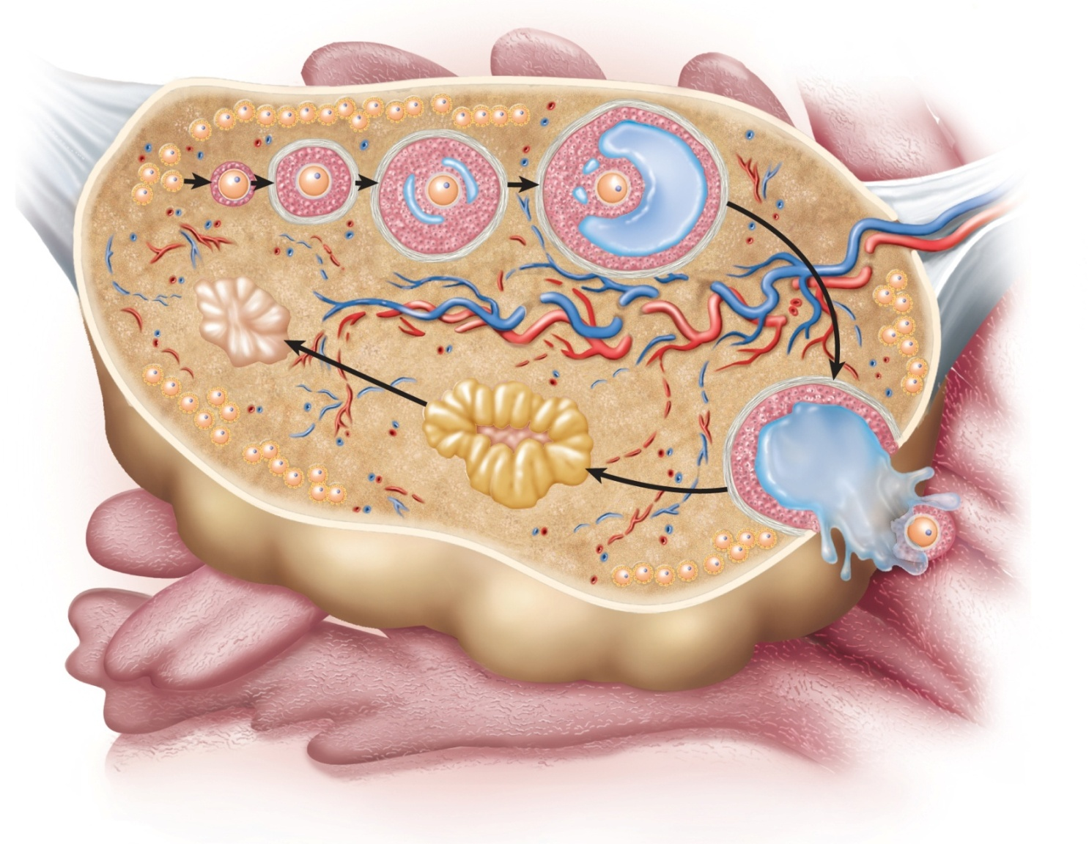
Anatomy of Ovary
Copyright © The McGraw-Hill Companies, Inc. Permission required for reproduction or display.
Primordial
follicles
Primary
follicles
Secondary
follicle
Mature
follicle
Oocyte
Suspensory ligament
and blood vessels
Ovarian
ligament
Medulla
Cortex
Tunica
albuginea
Corpus
albicans
Corpus
luteum
Fimbriae
of uterine
tube
Ovulated
oocyte
Figure 28.2

Slide 8
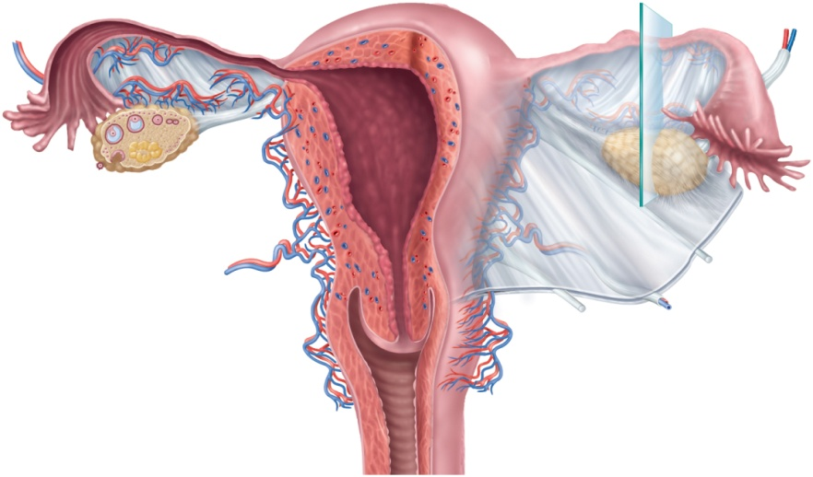
The Uterine Tubes
uterine tube (oviduct) or (fallopian tube)
canal about 10 cm long from ovary to uterus
muscular tube lined with ciliated cells
highly folded into longitudinal ridges
major portions:
infundibulum – flared, trumpet-shaped distal (ovarian) end
fimbriae – feathery projections on infundibulum
ampulla – middle and longest part
isthmus – narrower end toward uterus
mesosalpinx – the superior portion of the broad ligament that enfolds uterine tube
Copyright © The McGraw-Hill Companies, Inc. Permission required for reproduction or display.
Infundibulum
Ampulla
Isthmus
Fundus
Body
Ovarian
ligament
Mesosalpinx
Uterine
tube
Ovarian artery
Ovarian vein
Suspensory
ligament
Fimbriae
Myometrium
Ovary
Endometrium
Mesometrium
Internal os
Round
ligament
Cervical canal
Cardinal
ligament
Lateral fornix
Uterosacral
ligament
Cervix
Vagina
External os
(a)
Figure 28.3a

Slide 9
The Uterus
uterus – thick muscular chamber that opens into the roof of the vagina
usually tilts forward over the urinary bladder
harbors fetus, provides a source of nutrition, and expels the fetus at the end of its development
pear-shaped organ
fundus – broad superior curvature
body (corpus) – middle portion
cervix – cylindrical inferior end
lumen is roughly triangular
upper two corners are the openings to the uterine tube
lower apex is internal os
not a hollow cavity, but a potential space in the non-pregnant uterus
cervical canal connects the lumen to vagina
internal os – superior opening of the canal into the body of the uterus
external os – inferior opening of the canal into the vagina
cervical glands – secretes mucus that prevents the spread of microorganisms from the vagina to the uterus

Slide 10
Uterus
Copyright © The McGraw-Hill Companies, Inc. Permission required for reproduction or display.
Infundibulum
Ampulla
Isthmus
Fundus
Body
Ovarian
ligament
Mesosalpinx
Uterine
tube
Ovarian artery
Ovarian vein
Suspensory
ligament
Fimbriae
Ovary
Myometrium
Mesometrium
Endometrium
Internal os
Round
ligament
Cervical canal
Cardinal
ligament
Lateral fornix
Uterosacral
ligament
Cervix
External os
Vagina
(a)
Figure 28.3a

Slide 11
PAP Smears and Cervical Cancer
Copyright © The McGraw-Hill Companies, Inc. Permission required for reproduction or display.
(a) Normal cells
20 µm
(b) Malignant (CIN III) cells
20 µm
Figure 28.5 a-b
© SPL/Photo Researchers, Inc.
cervical cancer common among women 30-50
smoking, early age sexual activity, STDs ,and human papillomavirus
usually begins in epithelial cells in lower cervix
best protection against cervical cancer is early detection by PAP smear
cells removed from cervix and vagina and microscopically examined
three grades of cervical intraepithelial neoplasia
class I mild dysplasia, class II calls for a biopsy, class III results may call for radiation therapy or hysterectomy

Slide 12
Uterine Wall
perimetrium - external serosa layer
myometrium - middle muscular layer
constitutes most of the uterine wall
composed mainly of smooth muscle
sweep downward from fundus and spiral around the body
less muscular and more fibrous near cervix
produces labor contractions, expels fetus
endometrium – inner mucosa
simple columnar epithelium, compound tubular glands, and a stroma populated with leukocytes, macrophages, and other cells.
stratum functionalis – superficial half, shed each menstrual period
stratum basalis - deep layer, stays behind and regenerates a new stratum functionalis with each menstrual cycle
during pregnancy, the endometrium is the site of attachment of the embryo and forms the maternal part of the placenta from which the fetus is nourished

Slide 13
Ligaments
uterus is supported by the muscular floor of the pelvic outlet and folds of peritoneum that form ligaments around the organ
broad ligament has two parts
mesosalpinx
mesometrium on each side of the uterus
cardinal (lateral cervical) ligaments – supports the cervix and superior part of the vagina extending to the pelvic wall
uterosacral ligaments – paired and attach posterior side of the uterus to the sacrum
round ligaments – paired and arise from the anterior surface of the uterus, pass through inguinal canals, and terminate in the labia majoris
much like the gubernaculum terminating in the male scrotum

Slide 14
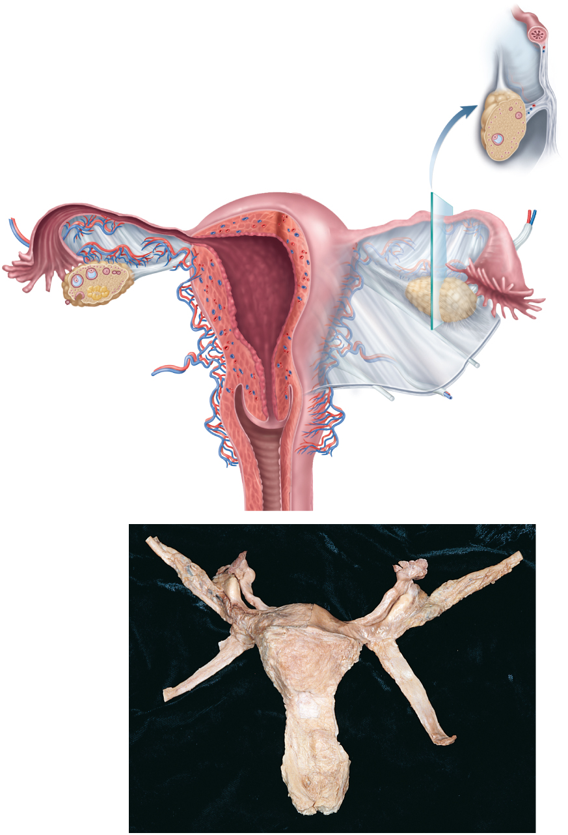
Ligaments of Reproductive Tract
Copyright © The McGraw-Hill Companies, Inc. Permission required for reproduction or display.
Uterine tube
Mesovarium
Broad ligament:
Ovary
Mesosalpinx
Mesometrium
Ovarian
ligament
Mesosalpinx
(b)
Infundibulum
Ampulla
Isthmus
Fundus
Body
Uterine
tube
Ovarian artery
Ovarian vein
Suspensory
ligament
Fimbriae
Ovary
Myometrium
Mesometrium
Endometrium
Internal os
Round
ligament
Cervical canal
Lateral fornix
Cardinal
ligament
Cervix
Uterosacral
ligament
External os
Vagina
(a)
Suspensory ligament
Uterine tube:
Fimbriae
Infundibulum
Ampulla
Ovary
Ovarian ligament
Round ligament
Uterus:
Figure 28.3
Fundus
Body
Cervix
Vagina
(c)
c: © The McGraw-Hill Companies, Inc./Rebecca Gray, photographer/Don Kincaid, dissections

Slide 15
Blood Supply
uterine blood supply is important to the menstrual cycle and pregnancy
uterine artery arises from each internal iliac artery
travels and gives off several branches that penetrate myometrium
lead to arcuate arteries
each travels in a circle around the uterus
anastomose with arcuate artery on the other side
spiral arteries penetrate through the myometrium into the endometrium
wind between endometrial glands toward surface of mucosa
rhythmically constrict and dilate making the mucosa alternately blanch and flush with blood

Slide 16
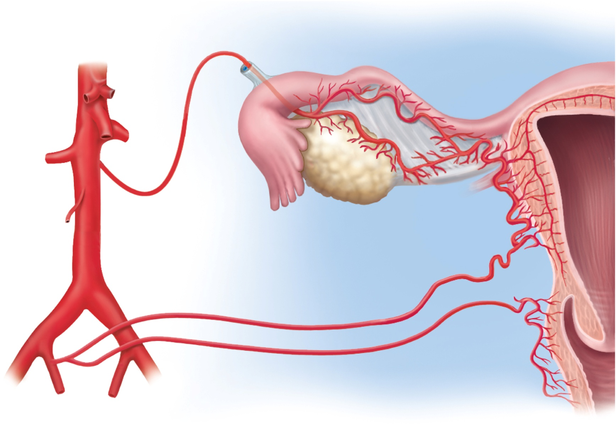
Vessels of Reproductive Tract
Copyright © The McGraw-Hill Companies, Inc. Permission required for reproduction or display.
Ovarian branch
of uterine artery
Arcuate artery
Suspensory
ligament
Aorta
Mesosalpinx
Uterine
artery
Common
iliac artery
Ovarian
artery
Ovary
Vaginal
artery
Internal iliac artery
Spiral arteries
Figure 28.7

Slide 17
Vagina
vagina (birth canal) – 8 -10 cm distensible muscular tube
allows for discharge of menstrual fluid, receipt of penis and semen, and birth of baby
outer adventitia, middle muscularis, and inner mucosa
tilted posteriorly between rectum and urethra
vagina has no glands
transudation lubricates vagina – “vaginal sweating”
serous fluid through its walls and by mucus from the cervical gland above it
fornices – blind-ended spaces formed from the vagina extends slightly beyond the cervix
transverse friction ridges (vaginal rugae) at lower end
mucosal folds form hymen across vaginal opening
vaginal epithelium
childhood - simple cuboidal
puberty - estrogens transform to stratified squamous
bacteria ferment glycogen rich cells producing acidic pH in vagina
an example of metaplasia – the transformation of one tissue type to another
antigen-presenting dendritic cells – route by which HIV from infected semen invades the female body

Slide 18
The External Genitalia
external genitalia are collectively called the vulva or pudendum
mons pubis - mound of fat over pubic symphysis bearing most of the pubic hair
labia majora – pair of thick folds of skin and adipose tissue inferior to the mons
pudendal cleft – slit between labia majora
labia minora – medial to labia majora are thin hairless folds
space between forms vestibule which contains urethral and vaginal openings
anterior margins of labia minora join to form hood-like prepuce over clitoris
clitoris - erectile, sensory organ with no urinary role
primary center for erotic stimulation
glans, body, and crura
vestibular bulbs - erectile tissue deep to the labia majora
cause the vagina to tighten around the penis, enhancing sexual stimulation
greater and lesser vestibular and paraurethral glands open into vestibule for lubrication

Slide 19
Female Perineum Showing Vulva
Copyright © The McGraw-Hill Companies, Inc. Permission required for reproduction or display.
Mons pubis
Prepuce
Labium majus
Clitoris
Labium minus
Urethral
orifice
Vaginal orifice
Hymen
Vestibule
Figure 28.8a
Perineal raphe
Anus
(a)

Slide 20
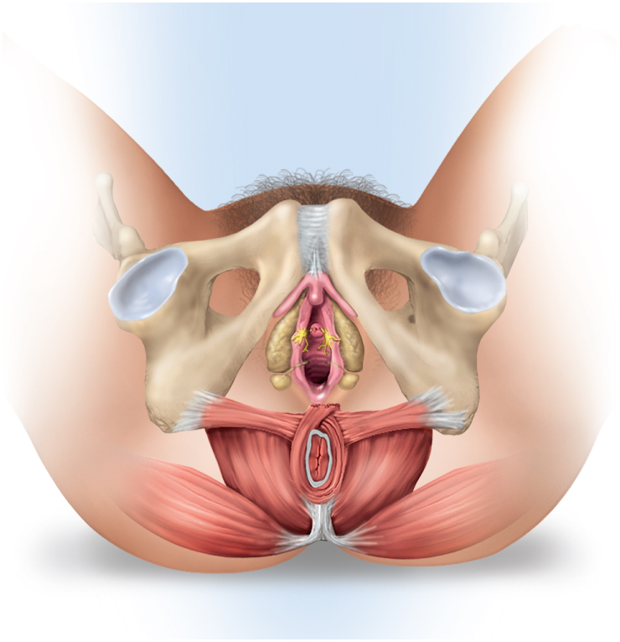
Components of Female Perineum
Copyright © The McGraw-Hill Companies, Inc. Permission required for reproduction or display.
Glans
Pubic symphysis
Clitoris
Crus
Ramus of
pubis
Urethral
orifice
Vestibular
bulb
Paraurethral
gland
Vaginal
orifice
Greater
vestibular
gland
Ischial
tuberosity
Anus
Figure 28.8b
(b)

Slide 21
Breasts and Mammary Glands
breast – mound of tissue overlying the pectoralis major
enlarges at puberty and remains so for life
most of the time it contains very little mammary gland
mammary gland – develops within the breast during pregnancy
remains active in the lactating breast
atrophies when a woman ceases to nurse
two principal regions of the breast:
body – conical to pendulous, with the nipple at its apex
axillary tail – extension toward the armpit
lymphatics in axillary tail are important as a route for breast cancer metastasis

Slide 22
Breasts and Mammary Glands
nipple surrounded by circular colored zone the areola
blood capillaries and nerves closer to skin surface – more sensitive
sensory nerve fibers of areola trigger a milk ejection reflex when an infant nurses
areolar glands – intermediate between sweat glands and mammary glands
secretions protect the nipple from chapping and cracking during nursing
smooth muscle fibers in dermis of areola that contract in response to cold, touch, and sexual arousal wrinkling the skin and erecting the nipple

Slide 23
Breasts and Mammary Glands
the nonlactating breast consists mostly of adipose and collagenous tissue
breast size determined by amount of adipose tissue
suspensory ligaments attach breast to dermis of overlying skin and fascia of the pectoralis major
system of ducts through fibrous stroma and converge on the nipple
mammary gland develops during pregnancy
15 to 20 lobes around the nipple
lactiferous duct drains each lobe
dilates to form lactiferous sinus which opens into the nipple

Slide 24
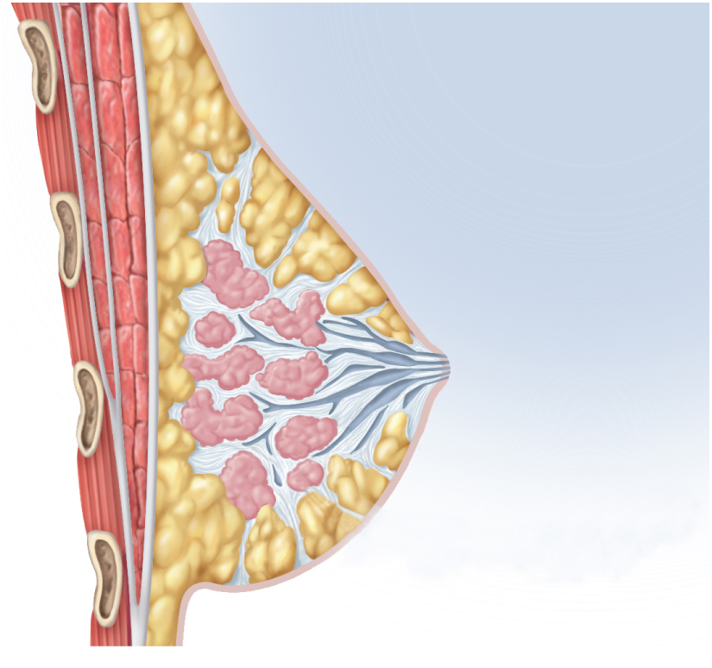
Anatomy of Lactating Breast
Copyright © The McGraw-Hill Companies, Inc. Permission required for reproduction or display.
Rib
Intercostal muscles
Pectoralis minor
Pectoralis major
Fascia
Suspensory ligament
Lobules
Lobe
Adipose tissue
Nipple
Lactiferous sinus
Lactiferous duct
Figure 28.9c
(c) Sagittal section

Slide 25
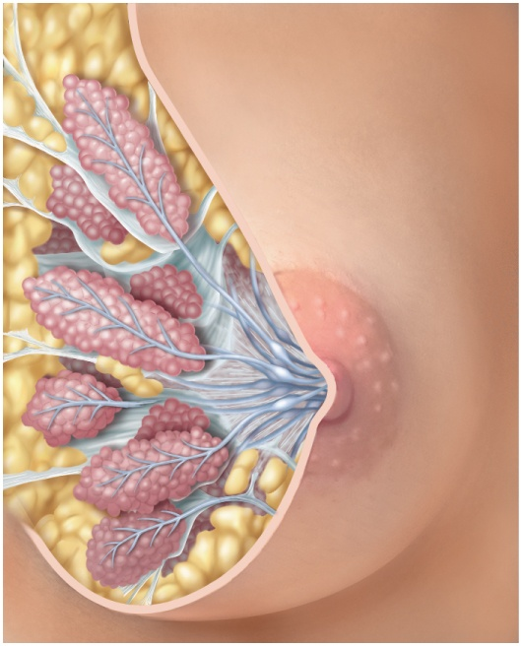
Anatomy of Lactating Breast
Copyright © The McGraw-Hill Companies, Inc. Permission required for reproduction or display.
Adipose tissue
Suspensory ligaments
Lobe
Lobules
Areolar glands
Areola
Nipple
Lactiferous sinus
Lactiferous ducts
Figure 28.9a
(a) Anterior view

Slide 26
Breast Cancer
breast cancer occurs in 1 out of 8 American women
tumors begin with cells from mammary ducts
may metastasize by mammary and axillary lymphatics
signs may include palpable lump (the tumor), skin puckering, changes in skin texture, and drainage from nipple
most breast cancer is nonhereditary
two breast cancer genes were discovered in the 1990s
BRCA1 and BRCA2
some stimulated long periods of fertility and estrogen exposure
risk factors include
aging, exposure to ionizing radiation, carcinogenic chemicals, excessive alcohol and fat intake, and smoking
70% of cases lack identifiable risk factors

Slide 27
Breast Cancer
tumor discovery usually during breast self-examination (BSE) – monthly for all women
mammograms (breast X-rays)
late 30s – baseline mammogram
40 - 49 - every two years
over 50 – yearly
treatment of breast cancer
lumpectomy – removal of tumor only
simple mastectomy – removal of the breast tissue only or breast tissue and some axillary lymph nodes
radical mastectomy – removal of breast, underlying muscle, fascia, and lymph nodes
surgery followed by radiation or chemotherapy
breast reconstruction from skin, fat, and muscle from other parts of the body

Slide 28
Puberty
puberty begins at age 8-10 for most girls in US
triggered by rising levels of GnRH
stimulates anterior lobe of pituitary to produce
follicle-stimulating hormone (FSH)
luteinizing hormone (LH)
FSH stimulates developing ovarian follicles and they begin to secrete estrogen, progesterone, inhibin, and a small amount of androgen
estrogens are feminizing hormones with widespread effects on the body
estradiol (most abundant), estriol, and estrone

Slide 29
Puberty
thelarche – onset of breast development is the earliest noticeable sign of puberty
initial duct and lobule formation – estrogen, progesterone and prolactin
completion of duct and lobule formation – glucocorticoids and growth hormone
adipose and fibrous tissue complete breast enlargement by age 20
pubarche - appearance of pubic and axillary hair, sebaceous glands, and axillary glands
androgens from ovaries and adrenal cortex stimulates pubarche and libido
menarche - first menstrual period
requires at least 17% body fat in teenager, 22% in adult
improved nutrition has lowered age of onset to age 12
leptin stimulates gonadotropin secretion
if body fat and leptin levels drop too low, gonadotropin secretion declines and a female’s menstrual cycle might cease
first few menstrual cycles are anovulatory (no egg ovulated)
girls begin ovulating regularly about a year after they begin menstruating

Slide 30
Hormones of Puberty
estradiol
stimulates vaginal metaplasia
stimulates growth of ovaries and secondary sex organs
stimulates growth hormone secretion
increase in height and widening of the pelvis
responsible for feminine physique because it stimulates the deposition of fat
makes a girl’s skin thicker
but remains thinner, softer, and warmer than males of the corresponding age
progesterone
primarily acts on the uterus preparing it for possible pregnancy in the second half of the menstrual cycle
estrogens and progesterone suppress FSH and LH secretion through negative feedback
inhibin selectively suppresses FSH secretion
hormone secretion is distinctly cyclic and the hormones are secreted in sequence

Slide 31
Climacteric and Menopause
climacteric -midlife change in hormone secretion
accompanied by menopause – cessation of menstruation
female born with about 2 million eggs, climacteric begins when there are about 1000 follicles left
follicles less responsive to gonadotropins
less estrogen and progesterone secretion
uterus, vagina, and breast atrophy
intercourse becomes uncomfortable as vagina becomes thinner, less distensible, and drier
vaginal infections more common
skin becomes thinner
cholesterol levels rise increasing the risk of cardiovascular disease
bone mass declines producing increased risk for osteoporosis
blood vessels constrict and dilate in response to shifting hormone balances
hot flashes – spreading sense of heat from the abdomen to the thorax, neck, and face
hormone replacement therapy (HRT) – low doses of estrogen and progesterone to relieve some of these symptoms
risks and benefits are still being debated

Slide 32
Evolution of Menopause
theory – older mother would not live long enough to rear an infant to a survivable age
better to become infertile and help rear her grandchildren
Pleistocene ice age skeletons show early hominids rarely lived past age 40
menopause may be an artifact of modern nutrition and medicine allowing us to live longer than our ancestors

Slide 33
Oogensis and Sexual Cycle
reproductive cycle – sequence of events from fertilization to giving birth
sexual cycle - events that recur every month when pregnancy does not intervene
consists of two interrelated cycles controlled by shifting patterns of hormone secretion
ovarian cycle - events in ovaries
menstrual cycle - parallel changes in uterus

Slide 34
Oogenesis
oogenesis – egg production
produces haploid gametes by means of meiosis
distinctly cyclic event that normally releases one egg each month
accompanied by cyclic changes in hormone secretion
cyclic changes in histological structure of the ovaries and uterus
uterine changes result in monthly menstrual flow
embryonic development of ovary
female germ cells arise from yolk sac
colonize gonadal ridges the first 5 to 6 weeks of development
differentiate into oogonia and multiply until the fifth month
5 to 6 million in number
transform into primary oocytes - early meiosis I
most degenerate (atresia) by the time the girl is born
egg, or ovum – any stage from the primary oocyte to the time of fertilization
by puberty 400,000 oocytes remain
a lifetime supply – probably will ovulate around 480 times

Slide 35
Oogenesis
egg development resumes in adolescence
FSH stimulates monthly cohorts of oocytes to complete meiosis I
each oocyte divides into two haploid daughter cells of unequal size and different destinies
important to produce an egg with as much cytoplasm as possible
if fertilized, it must divide repeatedly and produce numerous daughter cells
secondary oocyte – large daughter cell that is the product of meiosis I
first polar body – smaller one that sometimes undergoes meiosis II, but ultimately disintegrates
merely a means of discarding the extra set of haploid chromosomes
secondary oocyte proceeds as far as metaphase II
arrests until after ovulation
if not fertilized, it dies and never finishes meiosis
if fertilized, it completes meiosis II and casts off a second polar body
chromosomes of the large remaining egg unite with those of the sperm

Slide 36
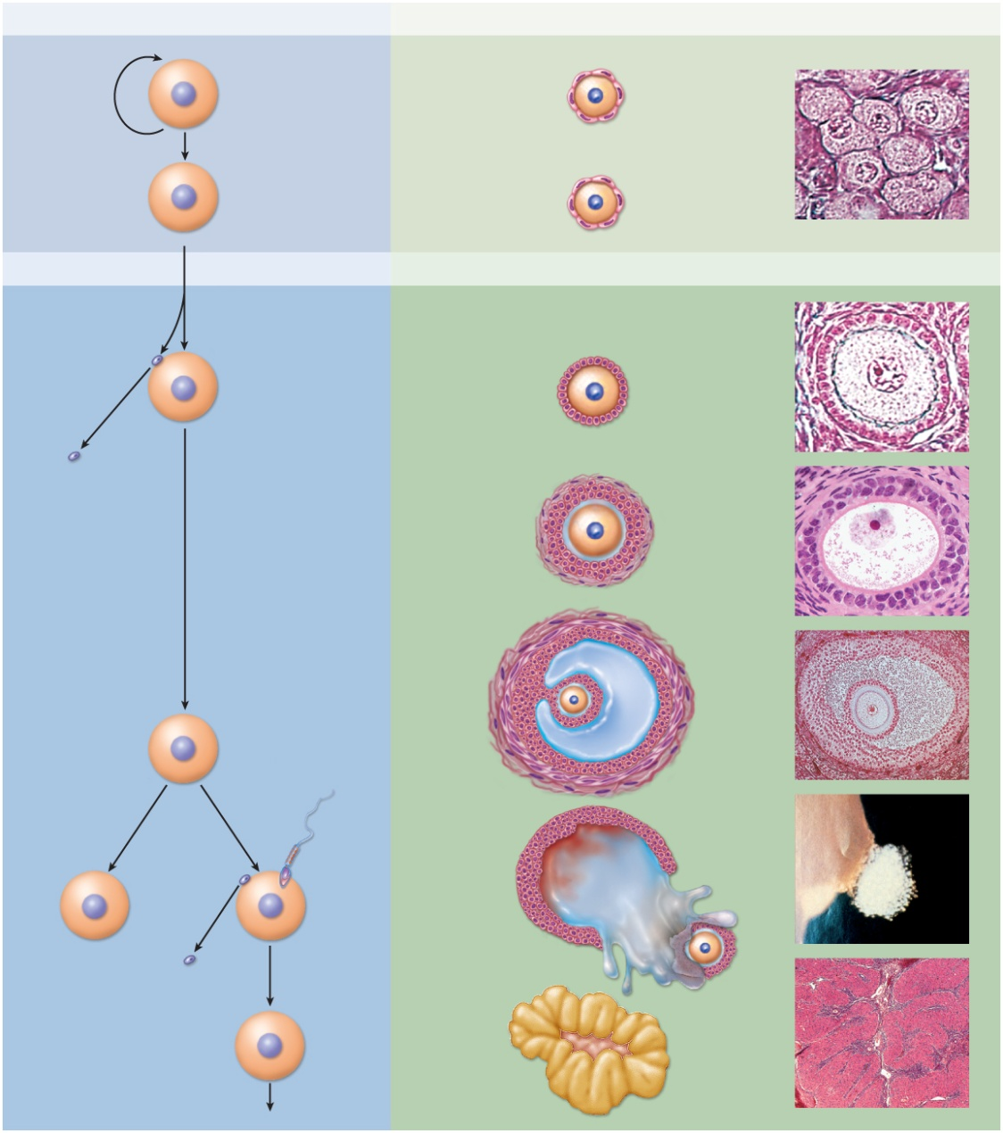
Oogenesis and Follicle Development
Copyright © The McGraw-Hill Companies, Inc. Permission required for reproduction or display.
Development of egg (oogenesis)
Development of follicle (folliculogenesis)
Before birth
Mitosis
2n
Multiplication
of oogonia
Oocyte
Primordial follicle
Nucleus
Follicular
cells
2n
Primary oocyte
No change
Adolescence to menopause
Meiosis I
n
Secondary oocyte
Granulosa cells
Primary follicle
n
First polar
body (dies)
Granulosa cells
Secondary follicle
Zona pellucida
Theca folliculi
Antrum
Tertiary follicle
Cumulus
oophorus
Secondary oocyte
(ovulated)
Theca
interna
n
Theca
externa
If not fertilized
If fertilized
Ovulation of
mature
(graafian)
follicle
Bleeding into
antrum
Figure 28.11
n
n
n
Ovulated
oocyte
Dies
n
Meiosis II
Follicular fluid
Second polar
body (dies)
2n
Corpus luteum
Zygote
Embryo
(Primordial & Primary follicle): © Ed Reschke;(Secondary follicle): © The McGraw-Hill Companies, Inc./Photo by Dr. Alvin Telser; (Tertiary follicle): Manfred Kage/Peter Arnold, Inc.; (Graafian): Landrum Dr. Shettles; (Corpus luteum): © The McGraw-Hill Companies, Inc./Photo by Dr. Alvin Telser

Slide 37
Ovarian Follicles
Copyright © The McGraw-Hill Companies, Inc. Permission required for reproduction or display.
Tunica albuginea
of ovary
Primordial follicles
Granulosa cells
Follicular cells
Oocyte (egg)
Oocyte nucleus
Primary follicles
Zona pellucida
Cumulus oophorus
Oocytes
Antrum
Theca folliculi
(a)
50 µm
(b)
100 µm
a: © Ed Reschke; b: Manfred Kage/Peter Arnold, Inc
Figure 28.12 a-b

Slide 38
Folliculogenesis
folliculogenesis – the development of the follicles around the egg than undergoes oogenesis
primordial follicles
consists of a primary oocyte in early meiosis
surrounded by a single layer of squamous follicular cells
follicular cells connected to the oocyte by fine cytoplasmic processes for passage of nutrients and chemical signals
concentrated in the cortex of the ovary
most wait 13 to 50 years before they develop further
adult ovary has 90% to 95% primordial follicles
primary follicles
have larger oocytes and follicular cells that still form a single layer
secondary follicles
still larger oocytes and follicular cells now stratified (granulosa cells)
zona pellucida – layer of glycoprotein gel secreted by granulosa cells around the oocyte
theca folliculi – connective tissue around the granulosa cells condenses to form a fibrous husk

Slide 39
Folliculogenesis
tertiary follicles
granulosa cells begin secreting follicular fluid
accumulate in little pools in the follicular wall - this defines the tertiary follicles
as they enlarge, the pools merge forming a single fluid-filled cavity, the antrum
antral follicles – tertiary and mature follicles
preantral follicles – earlier stages of the follicles
cumulus oophorus – a mound of granulosa cells on one side of the antrum that covers the oocyte and secures it to the follicular wall
corona radiata – innermost layer of cells in the cumulus surrounding the zona pellucida and the oocyte
protective barrier around the egg with a similar function as the blood-testis barrier
theca folliculi continues to differentiate forming two layers
theca externa – outer fibrous capsule rich in blood vessels
theca interna – inner cellular, hormone secreting layer producing androgens (androstenedione and testosterone), and granulosa cells converts them to estradiol
mature (graafian) follicles
normally only one follicle from each month’s cohort becomes a mature follicle destined to ovulate
remainder degenerate

Slide 40
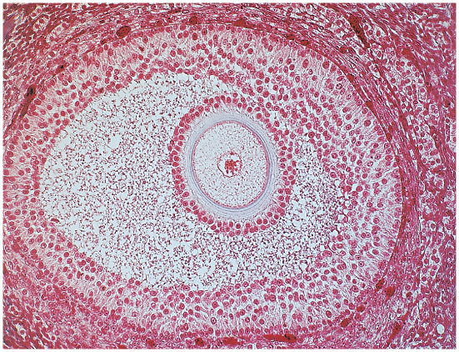
Histology of Ovarian Follicles
Copyright © The McGraw-Hill Companies, Inc. Permission required for reproduction or display.
Granulosa cells
Oocyte (egg)
Oocyte nucleus
Zona pellucida
Cumulus oophorus
Antrum
Theca folliculi
(b)
100 µm
Manfred Kage/Peter Arnold, Inc
Figure 28.12b

Slide 41
The Sexual Cycle
sexual cycle averages 28 days, varies from 20 to 45 days
hormones of the hypothalamus regulate the pituitary gland
pituitary hormones regulate the ovaries
ovaries secrete hormones that regulate the uterus
basic hierarchy of hormonal control
hypothalamus→ pituitary → ovaries → uterus
ovaries exert feedback control over hypothalamus and pituitary
cycle begins with 2 week follicular phase
menstruation occurs during first 3 to 5 days of cycle
uterus replaces lost tissue by mitosis and cohort of follicles grow
ovulation around day 14 –remainder the of follicle becomes corpus luteum
next 2 weeks the luteal phase
corpus luteum stimulates endometrial secretion and thickening
if pregnancy does not occur, endometrium breaks down in the last 2 days
menstruation begins and the cycle starts over

Slide 42
The Ovarian Cycle
ovarian cycle – in three principal steps
follicular phase, ovulation, and luteal phase
this cycle reflects what happens in the ovaries and their relationship to the hypothalamus and pituitary
much remains unknown about the timing of folliculogenesis

Slide 43
Follicular Phase
follicular phase extends from the beginning of menstruation until ovulation
day 1 to day 14 of an average cycle
preovulatory phase – from the end of menstruation until ovulation
most variable part of the cycle and it is seldom possible to reliably predict the date of ovulation
preparation for the follicular phase begins almost two month earlier
shortly after ovulation a new cohort of preantral follicles descend form the cortex deeper into the ovary
begins to grow and each develops an antrum
selection window of 5 days in which one of them is selected as the dominant follicle to mature and ultimately ovulate in the next cycle
FSH stimulates continued growth of the cohort, but the dominant follicle above all
FSH stimulates the granulosa cells of the antral follicles to secrete estradiol
dominant follicle becomes more sensitive to FSH and LH
grows and becomes mature (graafian) follicle while others degenerate

Slide 44
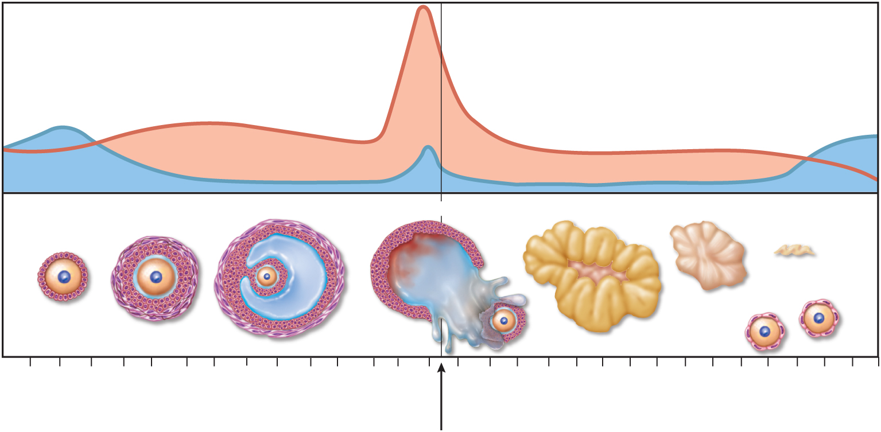
Ovarian Cycle - Follicular Phase
Copyright © The McGraw-Hill Companies, Inc. Permission required for reproduction or display.
(a) Ovarian cycle
LH
Gonadotropin secretion
FSH
Developing follicles
Tertiary
Ovulation
Corpus luteum
Involution
Corpus
albicans
Primary
Secondary
Ovarian events
New primordial
follicles
Days
1
3
5
7
9
1
1
13
15
17
19
21
23
25
27
1
Follicular phase
Luteal phase
Figure 28.14a

Slide 45
Ovulation
ovulation – the rupture of the mature follicle and the release of its egg and attendant cells
typically around day 14
estradiol stimulates a surge of LH and a lesser spike of FSH by anterior pituitary
LH induces several events
primary oocyte completes meiosis I
produces secondary oocyte and first polar body
follicular fluid builds rapidly and follicle swells
looks like a blister on the ovary surface
follicular wall weakened by inflammation and proteolytic enzymes
mature follicle approaches rupture
ovulation takes only 2 or 3 minutes
nipple-like stigma appears on ovary surface over follicle
seeps follicular fluid for 1 or 2 minutes
follicle bursts and remaining fluid oozes out carrying the secondary oocyte and cumulus oophorus
normally swept up by ciliary current and taken into the uterine tube

Slide 46
Ovulation and Uterine Tube
uterine tube prepares to catch the oocyte when it emerges
it swells with edema
its fimbriae envelop and caress the ovary in synchrony with the woman’s heartbeat
cilia create gentle current in the nearby peritoneal fluid
many oocytes fall into the pelvic cavity and die

Slide 47
Signs of Ovulation
couples attempting to conceive a child or avoid pregnancy need to be able to tell when ovulation occurs
cervical mucus becomes thinner and more stretchy
resting body temperature rises 0.4° to 0.6° F
best measured first thing in the morning before arising from bed
record for several days to see the difference
LH surge occurs about 24 hours prior to ovulation
detected with home testing kit
twinges of ovarian pain (mittelschmerz)
lasts from a few hours to a day or so at the time of ovulation
best time for conception
within 24 hours after the cervical mucus changes and the basal temperature rises

Slide 48
Ovarian Cycle - Ovulation
Copyright © The McGraw-Hill Companies, Inc. Permission required for reproduction or display.
(a) Ovarian cycle
LH
Gonadotropin secretion
FSH
Developing follicles
Tertiary
Ovulation
Corpus luteum
Involution
Corpus
albicans
Primary
Secondary
Ovarian events
New primordial
follicles
Days
1
3
5
7
9
1
1
13
15
17
19
21
23
25
27
1
Follicular phase
Luteal phase
Figure 28.14a

Slide 49
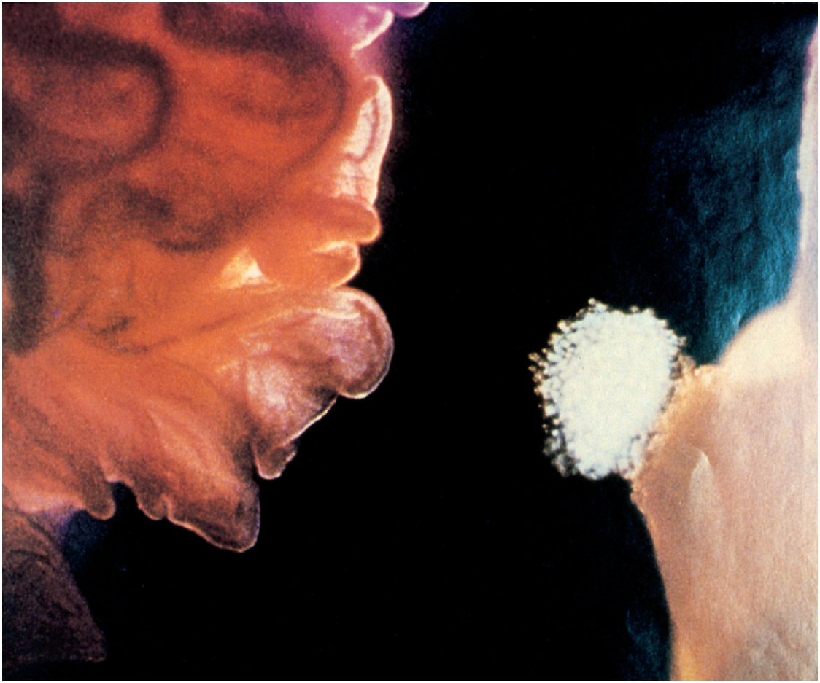
Endoscopic View of Ovulation
Copyright © The McGraw-Hill Companies, Inc. Permission required for reproduction or display.
Infundibulum of
uterine tube
Fimbriae
Cumulus
oophorus
Oocyte
Stigma
Ovary
0.1 mm
© Landrum B. Shettles, MD
Figure 28.15

Slide 50
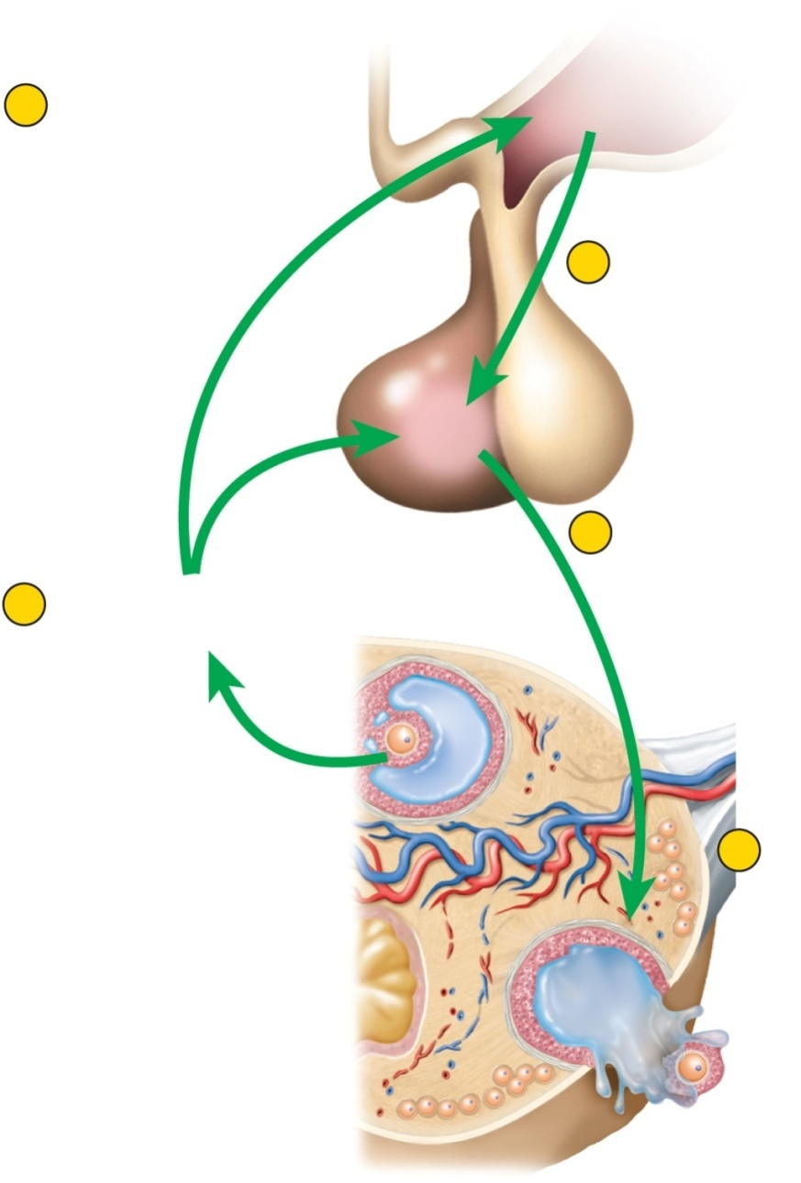
Pituitary-Ovarian Axis
Copyright © The McGraw-Hill Companies, Inc. Permission required for reproduction or display.
2
Estradiol stimulates
hypothalamus and
anterior pituitary
GnRH
Hypothalamus
Anterior
pituitary
3
Hypothalamus secretes GnRH
LH
FSH
4
GnRH and estradiol
stimulate pituitary
to secrete LH and FSH
1
Maturing follicle secretes
estradiol
5
Oocyte completes
meiosis I; follicle
rapidly enlarges and
then ovulates
Figure 28.13
Ovulated
secondary
oocyte

Slide 51
Luteal (Postovulatory) Phase
luteal (postovulatory) phase - days 15 to day 28, from just after ovulation to the onset of menstruation
if pregnancy does not occur, events happen as follows:
when follicle ruptures it collapses and bleeds into antrum
clotted blood is slowly absorbed
granulosa and theca interna cells multiply and fill antrum
dense bed of capillaries grows amid them
ovulated follicle has now become the corpus luteum
named for a yellow lipid that accumulates in the theca interna cells
cells now called lutein cells

Slide 52
Luteal (Postovulatory) Phase
transformation from ruptured follicle to corpus luteum is regulated by LH
LH stimulates the corpus luteum to continue to grow and secrete rising levels of estradiol and progesterone
10 fold increase in progesterone is the most important aspect of the luteal phase
progesterone has a crucial role in preparing the uterus for the possibility of pregnancy
LH and FSH secretion declines over the rest of the cycle
high levels of estradiol and progesterone, along with inhibin from the corpus luteum has a negative feedback effect on the pituitary
if pregnancy does not occur, the corpus luteum begins the process of involution (shrinkage)
beginning about day 22 (8 days after ovulation)
by day 26 involution is complete and becomes inactive bit of scar tissue, the corpus albicans
with diminishing ovarian steroid secretion, FSH levels rise ripening a new cohort of follicles
ovaries usually alternate from month to month

Slide 53
Ovarian Cycle - Luteal Phase
Copyright © The McGraw-Hill Companies, Inc. Permission required for reproduction or display.
(a) Ovarian cycle
LH
Gonadotropin secretion
FSH
Developing follicles
Tertiary
Ovulation
Corpus luteum
Involution
Corpus
albicans
Primary
Secondary
Ovarian events
New primordial
follicles
Days
1
3
5
7
9
1
1
13
15
17
19
21
23
25
27
1
Follicular phase
Luteal phase
Figure 28.14a

Slide 54
Menstrual Cycle
menstrual cycle - consists of a buildup of the endometrium during most of the sexual cycle, followed by its breakdown and vaginal discharge
divided into four phases: proliferative phase, secretory phase, premenstrual phase, and menstrual phase
first day of noticeable vaginal discharge is defined as day 1 of the sexual cycle
averages 5 days long
proliferative phase – layer of endometrial tissue (stratum functionalis) lost in the last menstruation is rebuilt
at day 5 of menstruation, the endometrium is about 0.5 mm thick
consists only of stratum basalis
as new cohort of follicles develop, they secrete more and more estrogen
estrogen stimulates mitosis in the stratum basalis and the prolific regrowth of blood vessels regenerating the functionalis
by day 14 is 2 to 3 mm thick
estrogen also stimulates endometrial cells to produce progesterone receptors

Slide 55
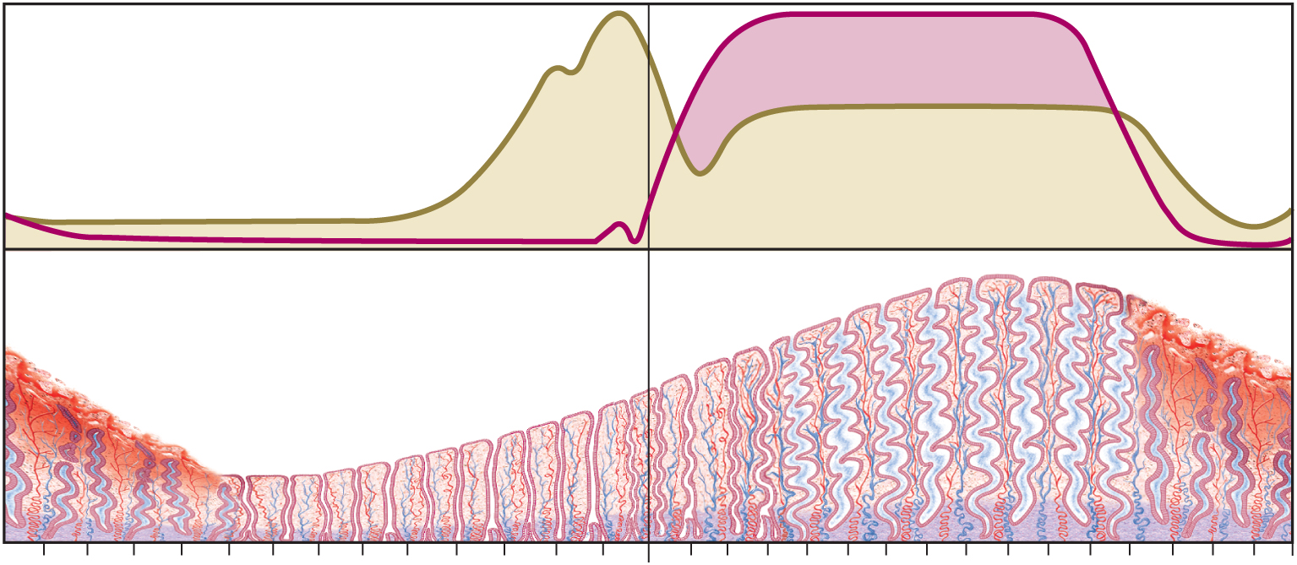
Menstrual Cycle - Proliferative Phase
Copyright © The McGraw-Hill Companies, Inc. Permission required for reproduction or display.
(b) Menstrual cycle
Progesterone
Ovarian hormone secretion
Estradiol
Menstrual
fluid
Thickness of endometrium
Days
1
3
5
7
9
11
13
15
17
19
21
23
25
27
1
Menstrual phase
Proliferative phase
Secretory phase
Premenstrual
phase
Figure 28.14b
day 6-14 rebuild endometrial tissue
result of estrogen from developing follicles

Slide 56
Menstrual Cycle
secretory phase – endometrium thickens still more in response to progesterone from corpus luteum
day 15 to day 26
secretion and fluid accumulation rather than mitosis
progesterone stimulates endometrial glands to secrete glycogen
glands grow wider, longer and more coiled
endometrium 5 to 6 mm thick
a soft, wet, nutritious bed available for embryonic development
premenstrual phase – period of endometrial degeneration
last 2 days of the cycle
corpus luteum atrophies and progesterone levels fall sharply
triggers spasmodic contractions of spiral arteries
causes endometrial ischemia (interrupted blood flow)
brings about tissue necrosis and menstrual cramps
pools of blood accumulate in stratum functionalis
necrotic endometrium mixes with blood and serous fluid – menstrual fluid

Slide 57
Menstrual Cycle - Secretory Phase
Copyright © The McGraw-Hill Companies, Inc. Permission required for reproduction or display.
(b) Menstrual cycle
Progesterone
Ovarian hormone secretion
Estradiol
Menstrual
fluid
Thickness of endometrium
Days
1
3
5
7
9
11
13
15
17
19
21
23
25
27
1
Menstrual phase
Proliferative phase
Figure 28.14b
Secretory phase
Premenstrual
phase
further thickening of endometrium due to secretion and fluid accumulation - not mitosis
due to progesterone stimulation of glands

Slide 58
Menstrual Cycle Premenstrual Phase
Copyright © The McGraw-Hill Companies, Inc. Permission required for reproduction or display.
(b) Menstrual cycle
Progesterone
Ovarian hormone secretion
Estradiol
Menstrual
fluid
Thickness of endometrium
Days
1
3
5
7
9
11
13
15
17
19
21
23
25
27
1
Menstrual phase
Proliferative phase
Secretory phase
Premenstrual
phase
Figure 28.14b
involution of corpus luteum, progesterone falls
spiral arteries constrict causes endometrial ischemia
stratum functionalis sloughs

Slide 59
Menstrual Cycle
menstrual phase – discharge of menstrual fluid from the vagina (menses)
first day of discharge is day 1 of the new cycle
average woman expels about 40 mL of blood and 35 mL of serous fluid over a 5 day period
contains fibrinolysin so it does not clot

Slide 60
Menstrual Cycle - Menstrual Phase
Copyright © The McGraw-Hill Companies, Inc. Permission required for reproduction or display.
(b) Menstrual cycle
Progesterone
Ovarian hormone secretion
Estradiol
Menstrual
fluid
Thickness of endometrium
Days
1
3
5
7
9
11
13
15
17
19
21
23
25
27
1
Menstrual phase
Proliferative phase
Secretory phase
Premenstrual
phase
Figure 28.14b
blood, serous fluid and endometrial tissue are discharged

Slide 61
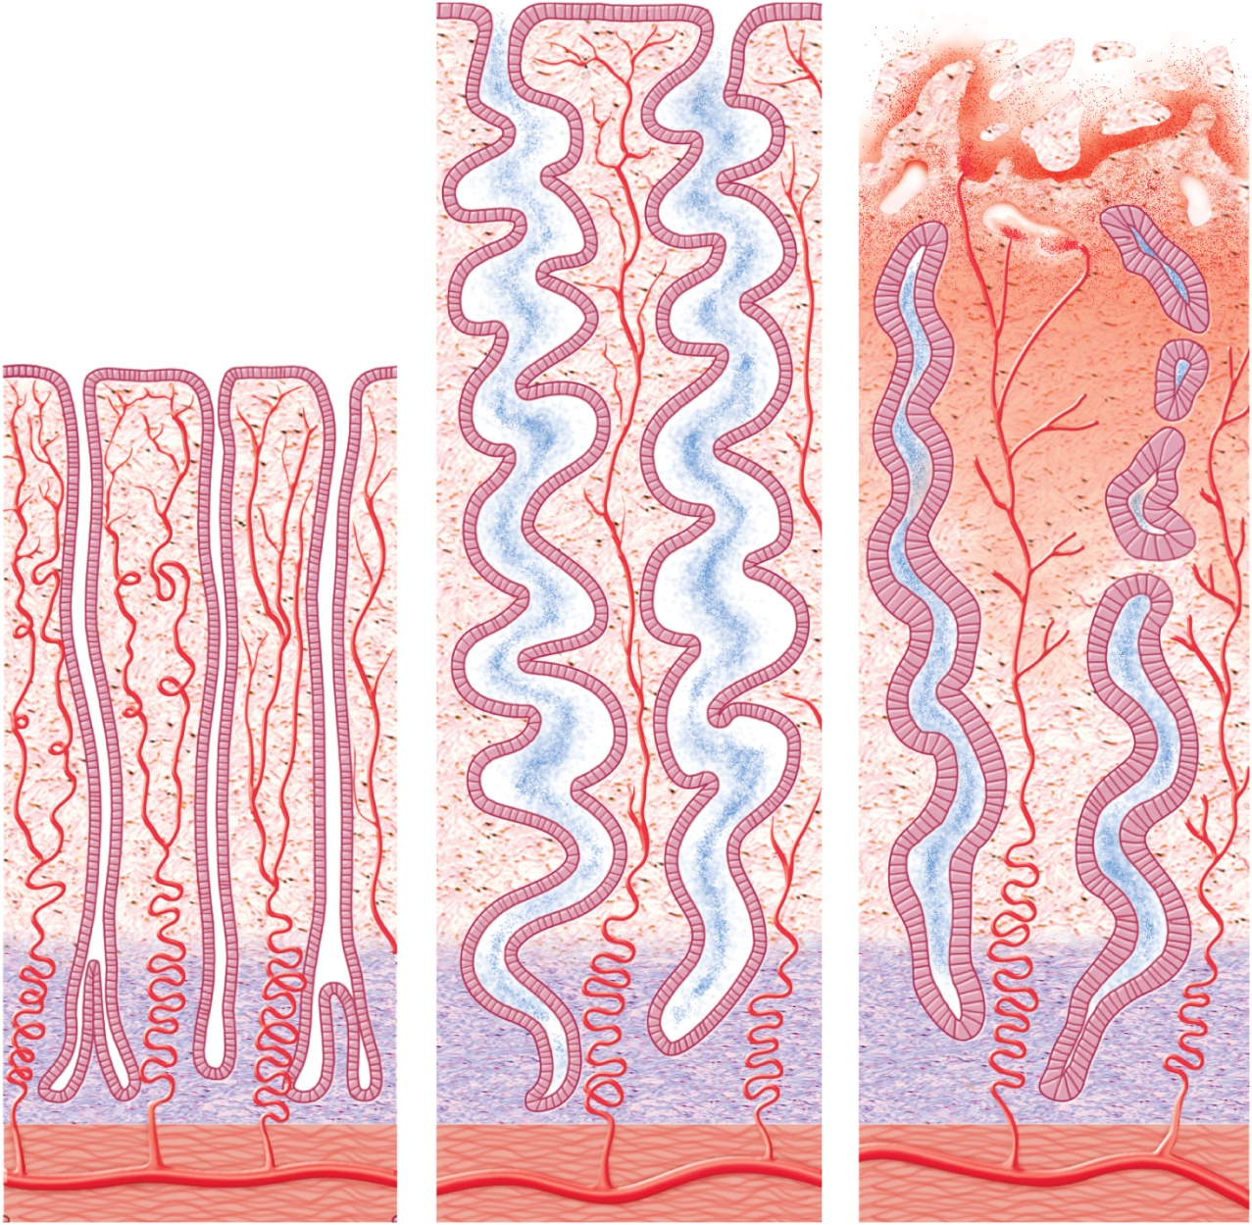
Endometrial Changes
Copyright © The McGraw-Hill Companies, Inc. Permission required for reproduction or display.
Secretion
Endometrial
gland
Stratum
functionalis
Spiral artery
Stratum
basalis
Myometrium
(a) Proliferative phase
(b) Secretory phase
(c) Menstrual phase
Figure 28.16

Slide 62
Pregnancy and Childbirth
pregnancy from a maternal standpoint
adjustments of the woman’s body to pregnancy
mechanism of childbirth
gestation (pregnancy)
lasts an average of 266 days from conception to childbirth
gestational calendar measured from first day of the woman’s last menstrual period (LMP)
birth predicted 280 days (40 weeks) from LMP
term – the duration of pregnancy
3 three month intervals called trimesters

Slide 63
Prenatal Development
conceptus – all products of conception – the embryo or fetus, the placenta, and associated membranes
blastocyst – the developing individual is a hollow ball the first 2 weeks
embryo - from day 16 through 8 weeks
fetus – beginning of week 9 to birth
attached by way of an umbilical cord to a disc-shaped placenta
provides fetal nutrition and waste disposal, secretes hormones that regulate pregnancy, mammary development, and fetal development
neonate - newborn to 6 weeks

Slide 64
Hormones of Pregnancy
hormones with the strongest influence on pregnancy are:
estrogens
progesterone
human chorionic gonadotropin
human chorionic somatomammotropin
all primarily secreted by the placenta
corpus luteum is important source for the first several weeks
if corpus luteum removed before 7 weeks, abortion
from week 7 to 17, the corpus luteum degenerates and placenta takes over its endocrine function

Slide 65
Hormones of Pregnancy
human chorionic gonadotropin (HCG)
secreted by blastocyst and placenta
detectable in urine 8 to 9 days after conception by home pregnancy test kits
stimulates growth of corpus luteum
secretes increasing amounts of progesterone and estrogen
estrogens
increases to 30 times normal by the end of gestation
corpus luteum is source for first 12 weeks until placenta takes over gradually from weeks 7 to 17
causes tissue growth in the fetus and the mother
mother’s uterus and external genitalia enlarge
mammary ducts grow, breasts increase to nearly twice normal size
relaxed pubic symphysis and widens pelvis

Slide 66
Hormones of Pregnancy
progesterone
secreted by placenta and corpus luteum
suppresses secretion of FSH and LH preventing follicular development during pregnancy
suppresses uterine contractions
prevents menstruation, thickens endometrium
promotes proliferation of decidual cells of the endometrium on which the blastocyst feeds
stimulates development of acini in breast in another step toward lactation
human chorionic somatomammotropin (HCS)
placenta begins its secretion about 5th week
increases steadily until term in proportion to placental size
effects seem similar to growth hormone, but weaker
seems to reduce the mother’s insulin sensitivity and glucose usage leaving more for the fetus

Slide 67
Other Hormones of Pregnancy
woman’s pituitary gland grows about 50% larger during pregnancy
produces markedly elevated levels of thyrotropin, prolactin, and ACTH
thyroid gland becomes 50% larger under influence of HCG, pituitary thyrotropin, and human chorionic thyrotropin from placenta
increases metabolic rate of mother and fetus
parathyroid glands enlarge and increase osteoclast activity
ACTH stimulates glucocorticoid secretion
serve primarily to mobilize amino acids for fetal protein synthesis
aldosterone secretion rises promoting fluid retention increasing mother’s blood volume
relaxin, secreted by corpus luteum and placenta
synergizes progesterone in stimulating the multiplication of decidual cells
promotes growth of blood vessels in the pregnant uterus

Slide 68
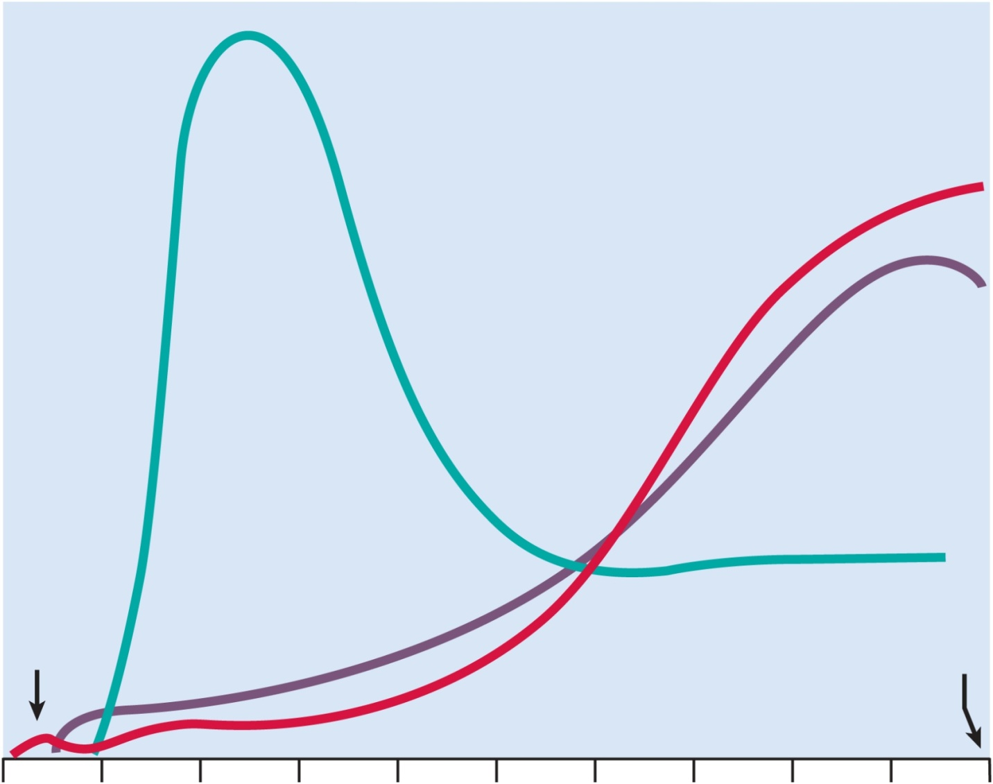
Hormone Levels and Pregnancy
Copyright © The McGraw-Hill Companies, Inc. Permission required for reproduction or display.
Human
chorionic
gonadotropin
Relative hormone levels
Estradiol
Progesterone
Ovulation
Parturition
Figure 28.18
0
4
8
12
16
20
24
28
32
36
40
Weeks after beginning of last menstrual period

Slide 69
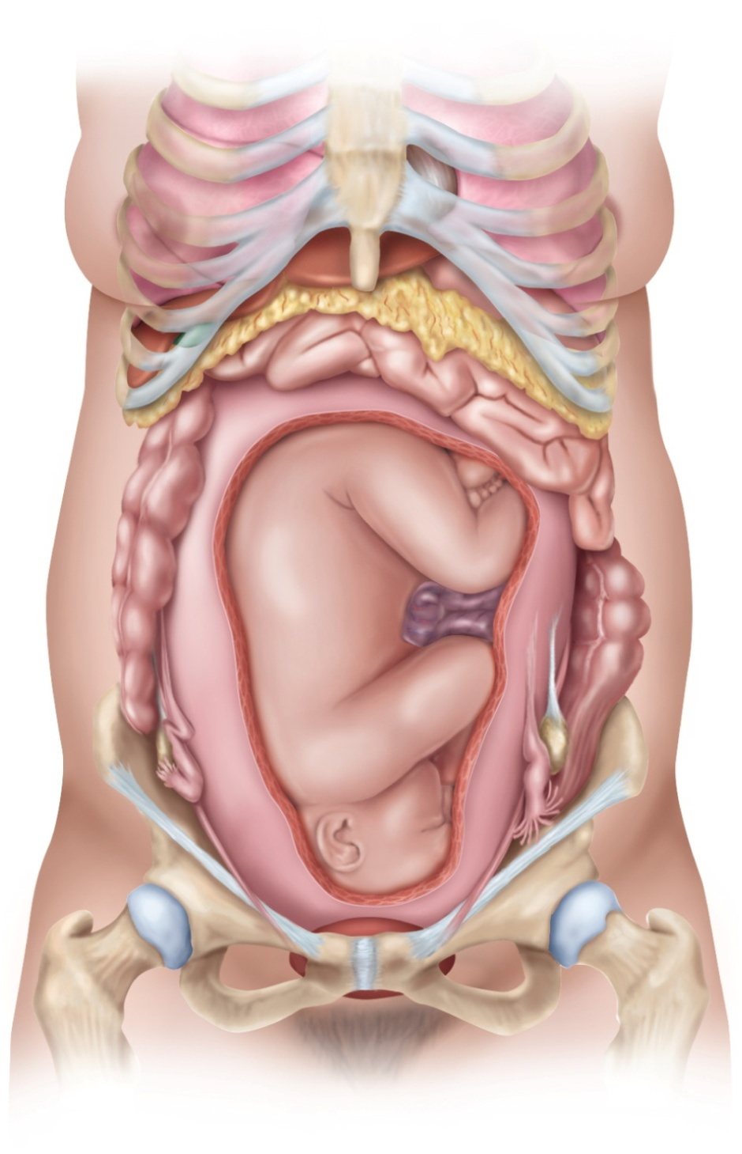
Adjustments to Pregnancy
Copyright © The McGraw-Hill Companies, Inc. Permission required for reproduction or display.
Lung
Xiphoid process
Pericardium
Breast
Liver
Stomach
Gallbladder
Greater omentum
Small intestine
Ascending colon
Descending colon
Uterus
Umbilical cord
Ovary
Ilium
Ovary
Inguinal ligament
Uterine tube
Round ligament of uterus
Urinary bladder
Figure 28.19
Pubic symphysis

Slide 70
Adjustments to Pregnancy
digestive system
morning sickness – nausea especially arising from bed in the first few months of gestation
unknown cause
constipation and heartburn due to:
reduced intestinal motility
pressure on stomach causing reflux of gastric contents into the esophagus
metabolism
basal metabolic rate (BMR) – rises about 15% in second half of gestation
appetite may be strongly stimulated
healthy average weight gain – 24 lbs.

Slide 71
Adjustments to Pregnancy
nutrition
placenta stores nutrients in early gestation and releases them in the last trimester
demand especially high for protein, iron, calcium, and phosphates
needs extra iron during late pregnancy or will become anemic
vitamin K given in late pregnancy to promote prothrombin synthesis in the fetus
minimizes risk of neonatal hemorrhage especially in the brain
vitamin D supplements help insure adequate calcium absorption to meet fetal demand
folic acid reduces the risk of neurological fetal disorders
spina bifida, anencephaly
supplements must be started before pregnancy

Slide 72
Adjustments to Pregnancy
circulatory system
by full term, placenta requires 625 mL of blood per minute from the mother
mother’s blood volume rises about 30% during pregnancy
due to fluid retention and hemopoiesis
mother has about 1 to 2 L of extra blood
mother’s cardiac output rises 30% to 40% above normal by week 27
falls almost to normal during the last 8 weeks
pregnant uterus puts pressure on large pelvic blood vessels that interferes with venous return from the legs
can result in hemorrhoids, varicose veins, and edema of the feet

Slide 73
Adjustments to Pregnancy
respiratory system
respiratory rate remains constant
tidal volume and minute ventilation increases about 40%
two reasons for this:
oxygen demand rises in proportion to the woman’s increase in metabolic rate and the increasing needs of the fetus
progesterone increases the sensitivity of the woman’s chemoreceptors to carbon dioxide
ventilation is adjusted to keep her arterial Pco₂ lower than normal
promotes CO₂ diffusion from fetal blood stream into maternal blood
‘air hungry’ from pressure on the diaphragm from growing uterus
breathes more easily in the last month due to pelvic expansion causing the fetus to drop lower in the pelvic cavity taking pressure off the diaphragm

Slide 74
Adjustments to Pregnancy
urinary system
aldosterone and the steroids of pregnancy promote water and salt retention by the kidneys
glomerular filtration rate increases 50% and urine output is slightly elevated
enables the woman to dispose of both her own and the fetus’s metabolic wastes
pregnant uterus compresses the bladder and reduces its capacity
frequent urination and uncontrollable leakage of urine (incontinence)

Slide 75
Adjustments to Pregnancy
integumentary system
skin grows to accommodate expansion of the abdomen and breasts
added fat deposition in hips and thighs
striae or stretch marks can result from tearing the stretched connective tissue
reddish at first, but fade after pregnancy
melanocyte activity increases in some areas
darkening of the areolae and linea alba (linea nigra)
temporary blotchy darkening of the skin over the nose and cheeks
‘mask of pregnancy’ or chloasma
disappears after pregnancy

Slide 76
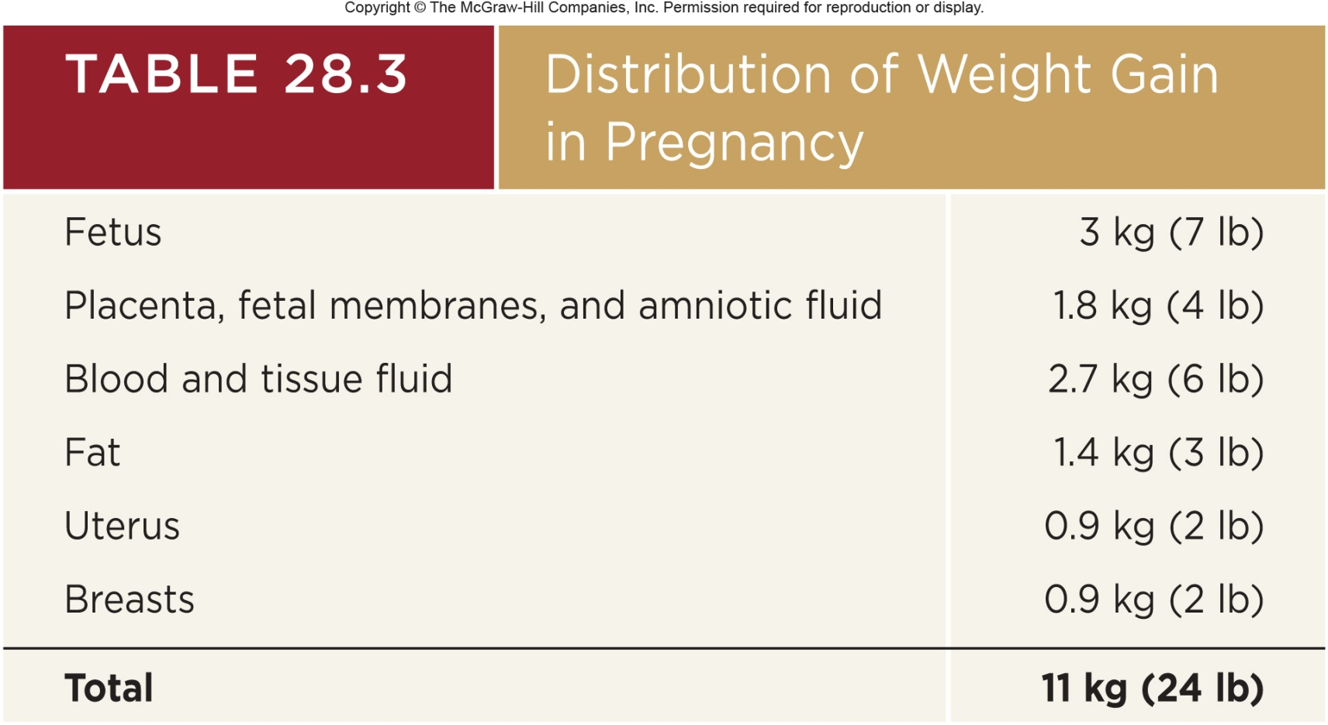
Uterine Growth and Weight Gain
uterus weighs about 50 g when not pregnant
weighs about 900 g at the end of pregnancy
reaches almost to the xiphoid process

Slide 77
Childbirth
in the seventh month of gestation, the fetus normally turns into the head-down vertex position
most babies born head first
head acting as a wedge that widens the mother’s cervix, vagina, and vulva during birth
fetus is a passive player in its own birth
expulsion achieved by contractions of mother’s uterine and abdominal muscles
fetus may play a role chemically by stimulating labor contractions
sending chemical messages that signify when it is developed enough to be born

Slide 78
Uterine Contractility
Braxton Hicks contractions – relatively weak contractions of the uterus over the course of gestation
strengthen late in pregnancy - false labor
contractions transform suddenly into more powerful labor contractions
parturition - the process of giving birth
marked by the onset of true labor contractions
progesterone and estradiol balance may be one factor in this pattern of increasing contractility
progesterone inhibits uterine contractions, but declines after 6 months
estradiol stimulates uterine contractions, and continues to rise

Slide 79
Uterine Contractility
as pregnancy nears full term - posterior pituitary releases more oxytocin (OT), uterus produces more OT receptors
oxytocin promotes labor in two ways:
directly stimulates muscles of myometrium
stimulates fetal membranes to produce prostaglandins, which are synergists of oxytocin in producing labor contractions
conceptus may produce chemical stimuli promoting its own birth
fetal cortisol rises and may increase estrogen secretion by the placenta
fetal pituitary produces oxytocin, but may stimulate fetal membranes to produce prostaglandin
uterine stretching thought to play a role in initiating labor
stretching of smooth muscle increases contractility of smooth muscle
role in initiating labor

Slide 80
Labor Contractions
labor contractions begin about 30 minutes apart and eventually occur every 1 to 3 minutes
periodically relax to increase blood flow and oxygen delivery to placenta and fetus
contractions strongest in fundus and body of uterus
weakest in the cervix
pushes fetus downward
positive feedback theory of labor
labor induced by stretching of cervix
triggers a reflex contraction of the uterine body
pushes the fetus downward
stretches the cervix even more
self-amplifying cycle of stretch and contraction

Slide 81
Labor Contractions
cervical stretching induces a neuroendocrine reflex through the spinal cord, hypothalamus, and the posterior pituitary
posterior pituitary releases oxytocin
carried by the blood and stimulates uterine muscles
directly and through the action of prostaglandin
cervical stretching → oxytocin secretion → uterine contraction →cervical stretching
woman feels need to “bear down”
contraction of these muscles aids in expelling the fetus
especially when combined with the Valsalva maneuver for increasing intra-abdominal pressure

Slide 82
Pain of Labor
pain of labor is due at first mainly to ischemia of the myometrium
muscles hurt when they are deprived of blood
each contraction temporarily restricts uterine circulation
as fetus enters the vaginal canal, the pain becomes stronger
stretching of the cervix, vagina, and perineum
sometimes tearing of the vaginal tissue
episiotomy may be necessary – an incision in the vulva to widen the vaginal orifice to prevent random tearing
pain an evolutionary product of two factors:
unusually large brain and head of the human infant
narrowing of the pelvic outlet which helped humans adapt to bipedal locomotion

Slide 83
Stages of Labor
labor occurs in three stages:
dilation
expulsion
placental stage
duration of each stage tends to be longer in primipara
woman giving birth for the first time
than in multipara
woman who has previously given birth

Slide 84
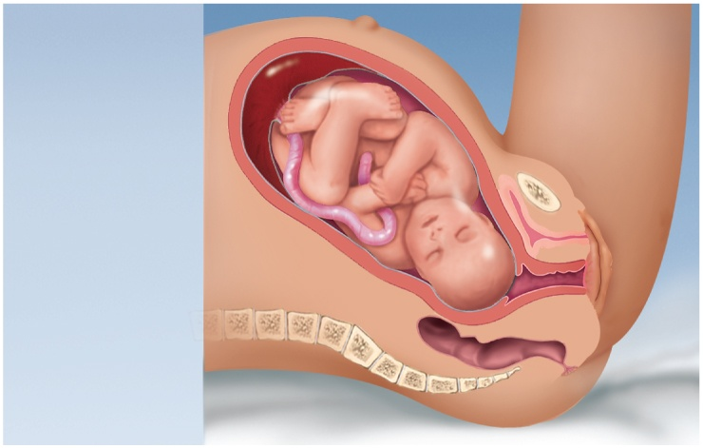
Stages of Labor - Early Dilation
Copyright © The McGraw-Hill Companies, Inc. Permission required for reproduction or display.
(a) Early dilation
stage
Uterus
Placenta
Umbilical
cord
Figure 28.20a
Cervix
Vagina
longest stage – lasting 8 to 24 hours
dilation of cervical canal and effacement (thinning) of cervix to reach 10 cm - diameter of fetal head
rupture of fetal membranes and loss of amniotic fluid
“breaking of the waters”

Slide 85
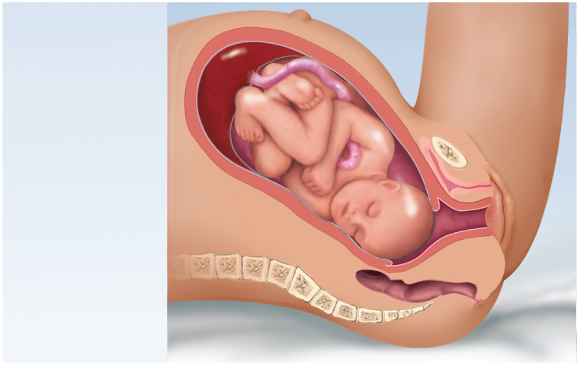
Stages of Labor -- Late Dilation
Copyright © The McGraw-Hill Companies, Inc. Permission required for reproduction or display.
(b) Late dilation
stage
Pubic
symphysis
Figure 28.20b
dilation reaches 10 cm in 24 hours or less in primipara (first baby) and in as little as few minutes in multipara

Slide 86
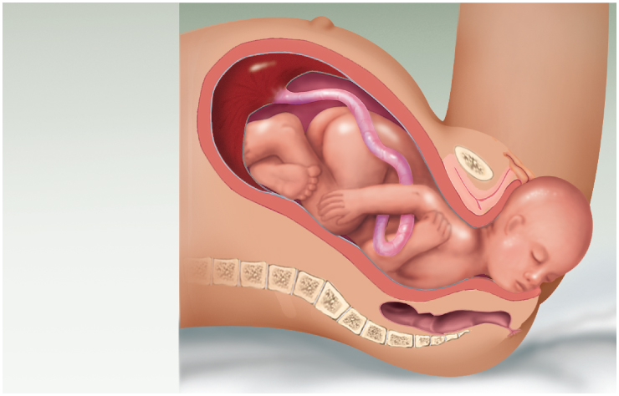
Stages of Labor - Expulsion
Copyright © The McGraw-Hill Companies, Inc. Permission required for reproduction or display.
(c) Expulsion
stage
Figure 28.20c
begins when the baby’s head enters vagina lasts until the baby is expelled
up to 30 minutes
crowning – when the baby’s head is visible
delivery of the head is the most difficult part
nose and mouth suctioned before delivery to clear airway
after expulsion, attendant drains blood from umbilical vein into baby
clamps umbilical cord in two places, and cuts cord between clamps

Slide 87
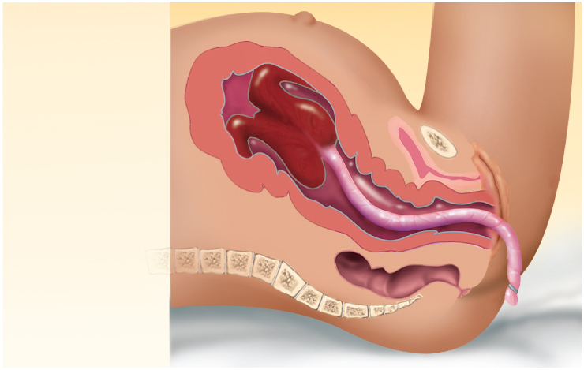
Placental Stage
Copyright © The McGraw-Hill Companies, Inc. Permission required for reproduction or display.
(d) Placental
stage
Uterus
Placenta
(detaching)
Umbilical
cord
Figure 28.20d
uterine contractions continue causing placental separation
membranes (afterbirth) inspected to be sure everything has been expelled

Slide 88
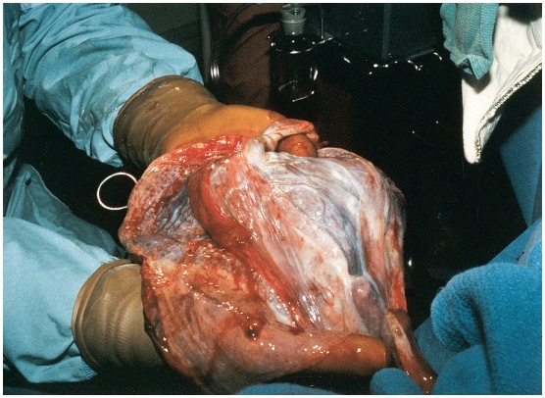
Placental Stage
Copyright © The McGraw-Hill Companies, Inc. Permission required for reproduction or display.
Visuals Unlimited
Figure 28.21c

Slide 89
Lactation
lactation – the synthesis and ejection of milk from the mammary glands
lasts as little as a week in women who do not breast-feed their infants
can continue for many years as long as the breast is stimulated by a nursing infant or a mechanical device (breast pump)
women traditionally nurse their infants until a median age of about 2.8 years

Slide 90
Mammary Gland Development
high estrogen level in pregnancy causes the ducts of the mammary glands to grow and branch extensively
growth hormone, insulin, glucocorticoids, and prolactin contribute to this development
progesterone stimulates the budding and development of acini at the end of the ducts
acini organized into grape-like clusters (lobules) within each breast lobe

Slide 91
Colostrum and Milk Synthesis
colostrum forms in late pregnancy
similar to breast milk in protein and lactose, but contains 1/3 less fat
first 1 to 3 days after birth
thin watery consistency and a cloudy yellow color
contains IgA to protection the baby from gastroenteritis
prolactin (from anterior pituitary) promotes milk synthesis
inhibited by dopamine when not pregnant
synthesis of hormone begins 5 weeks into pregnancy, by full term it is 10 to 20 times normal level
little effect on mammary glands until after birth
steroid hormones from placenta oppose prolactin until birth
milk synthesis also requires growth hormone, cortisol, insulin, and parathyroid hormone to mobilize necessary amino acids, fatty acids, glucose, and calcium

Slide 92
Colostrum and Milk Synthesis
at birth, prolactin secretion drops to nonpregnancy levels
every time the infant nurses prolactin levels jump to 10 to 20 times this level for the next hour
stimulates the synthesis of milk for the next feeding
without nursing, milk production stops in 1 week
only 5-10% of women become pregnant while breast-feeding
inhibition of GnRH and reduced ovarian cycling
natural means of spacing births

Slide 93
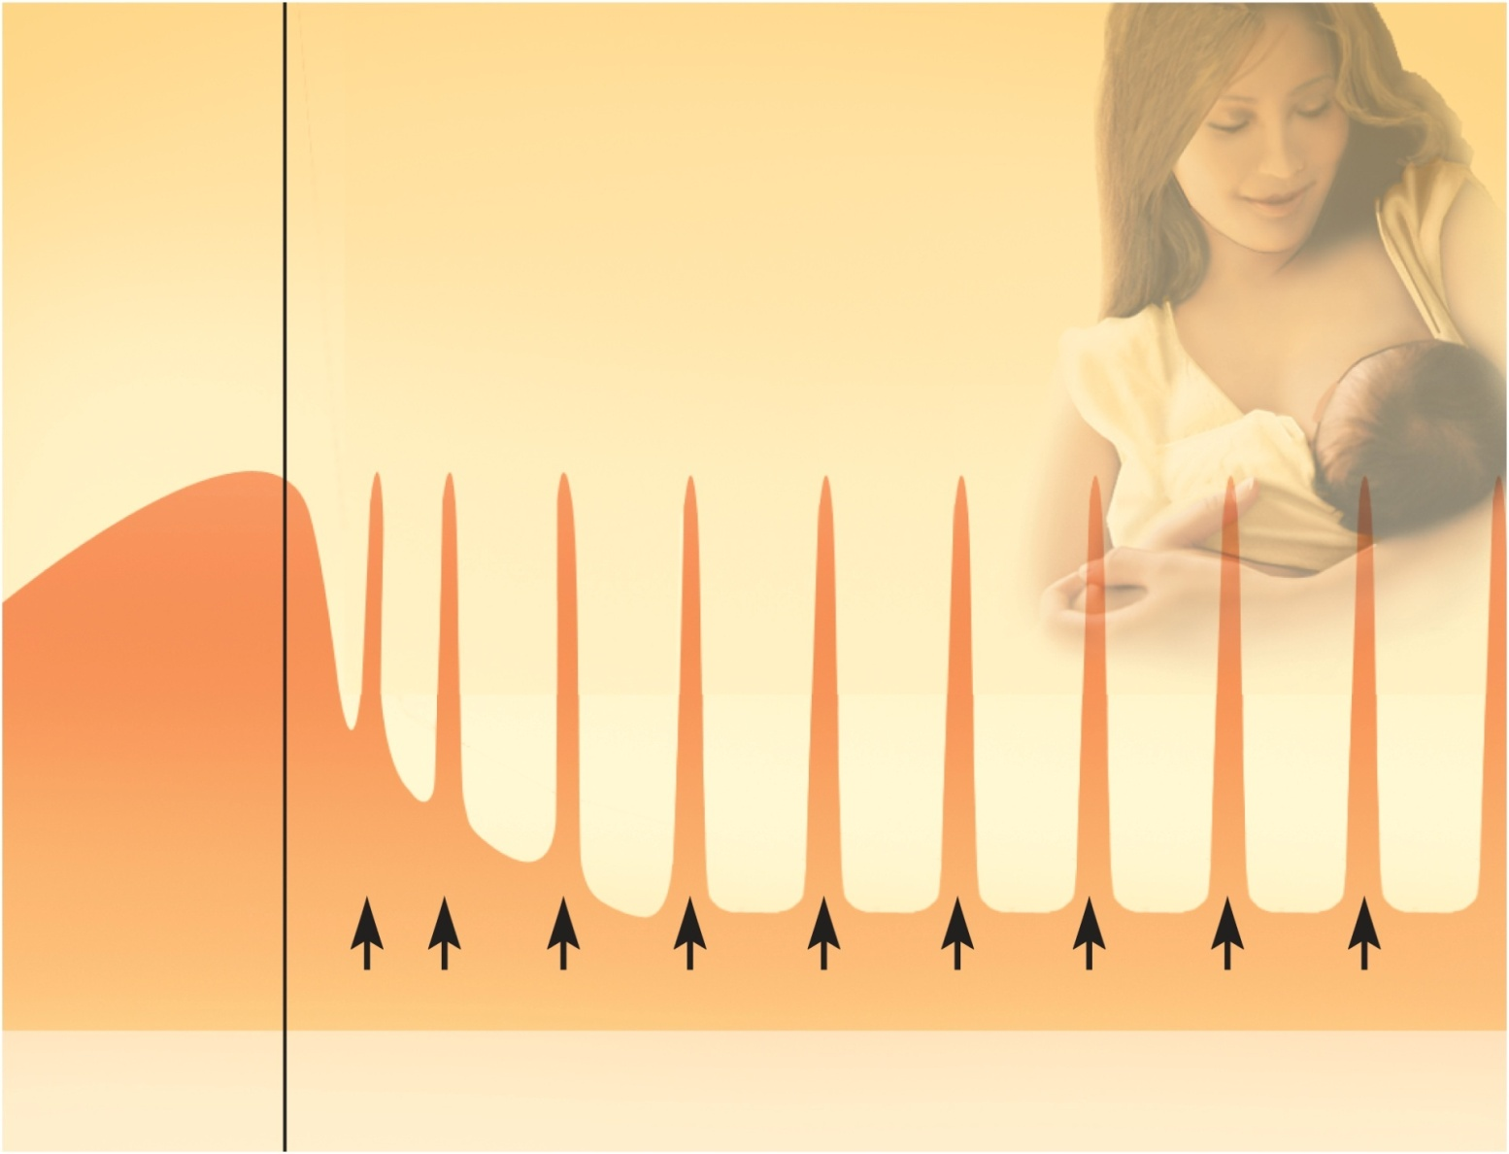
Prolactin and Lactation
Copyright © The McGraw-Hill Companies, Inc. Permission required for reproduction or display.
Prolactin surges
Feedings
Pregnancy
Lactation
Figure 28.22

Slide 94
Milk Ejection
milk is continually secreted into the mammary acini, but does not easily flow into the ducts
milk ejection (letdown) is controlled by a neuroendocrine reflex
infant’s suckling stimulates sensory receptors in nipple, signaling hypothalamus and posterior pituitary to release oxytocin
oxytocin stimulates myoepithelial cells around each acinus
contract to squeeze milk into duct
milk flow within 30-60 seconds after suckling begins

Slide 95
Breast Milk
breast milk changes composition over the first two weeks
varies from one time of day to another
at the end of a feeding there is less lactose and protein, but six times the fat
cow’s milk not a good substitute
1/3 less lactose but 3 times as much protein
harder to digest and more nitrogenous waste (diaper rash)
colostrum and milk have a laxative effect that clears intestine of meconium (green, bile-filled fecal material in newborn)
supplies antibodies and colonizes intestine with beneficial bacteria
nursing woman can produce 1.5L per day

