Slide 1
Male Reproductive System
Sexual Reproduction and Development
Male Reproductive Anatomy
Puberty and Climacteric
Sperm and Semen
Male Sexual Response

Slide 2
The Two Sexes
essence of sexual reproduction is that it is biparental – offspring receive genes from two parents
offspring not genetically identical to either one
we will die, but our genes will live on in a different container, our offspring
gametes (sex cells) produced by each parent
zygote (fertilized egg) has combination of both parent’s genes

Slide 3
Two Sexes
male and female gametes (sex cells) combine their genes to form a zygote (fertilized egg )
one gamete has motility, sperm (spermatozoon)
parent producing sperm considered male
parent with a Y chromosome is male
other gamete, egg or (ovum) contains nutrients for developing embryo
parent producing eggs considered female
anyone lacking a Y chromosome is female
in mammals, female is the parent that provides a sheltered internal environment and prenatal nutrition of the embryo
males have a copulatory organ (penis) for introducing his gametes into the female reproductive tract
females have a copulatory organ (vagina) for receiving the sperm

Slide 4
Overview of Reproductive System
male reproductive system serves to produce sperm and introduce them into the female body
female reproductive system produces eggs, receives sperm, provides for the union of the gametes, harbors the fetus, and nourishes the offspring
reproductive system consists of primary and secondary sex organs
primary sex organs (gonads)
produce gametes (testes or ovaries)
secondary sex organs – organs other than the gonads that are necessary for reproduction
male – system of ducts, glands, penis deliver sperm cells
female - uterine tubes, uterus, and vagina receive sperm and harbor developing fetus

Slide 5
Overview of Reproductive System
external genitalia – located in the perineum
most are externally visible
except accessory glands of the female perineum
internal genitalia – located mainly in the pelvic cavity
except tor testes and some associated ducts in the scrotum
secondary sex characteristics – features that further distinguish the sexes and play a role in mate attraction
develop at puberty to attract a mate
both sexes
pubic and axillary hair and their associated scent glands, and the pitch of the voice
male
facial hair, coarse and visible hair on the torso and limbs, relatively muscular physique
female
distribution of body fat, breast enlargement, and relatively hairless appearance of the skin

Slide 6
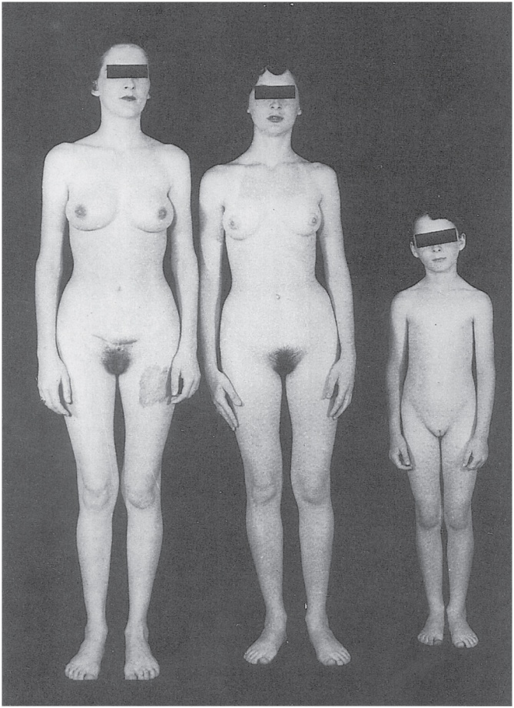
Androgen-Insensitivity Syndrome
occasionally, a girl shows all the usual changes of puberty, but fail to menstruate
presence of testes in the abdomen
karyotype of XY chromosomes of a male
testes produce normal male levels of testosterone
target cells lack receptors for it
external genitalia develop female anatomy as if no testosterone were present
no uterus or menstruation
Copyright © The McGraw-Hill Companies, Inc. Permission required for reproduction or display.
Courtesy Mihaly Bartalos, from M. Bartalos and T.A. Baramki, 1967 Medical Cytogenetics, Williams & Wilkins
Figure 27.1

Slide 7
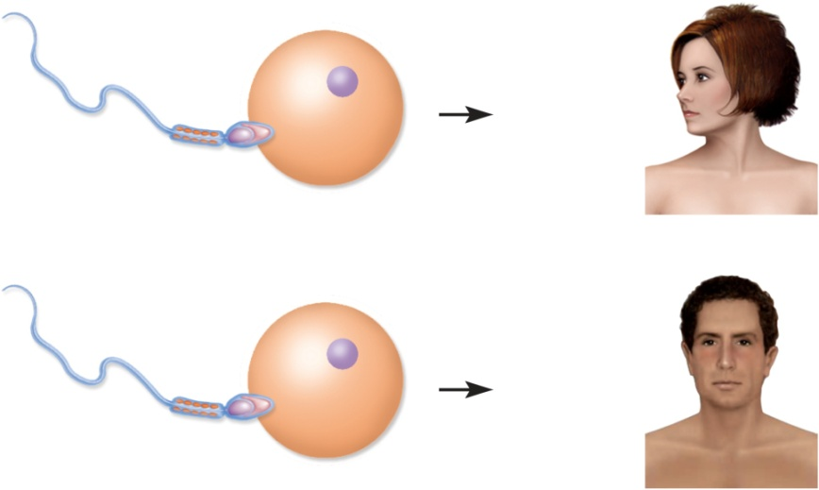
Chromosomal Sex Determination
our cells contain 23 pairs of chromosomes
22 pairs of autosomes
1 pair of sex chromosomes (XY males: XX females)
males produce half Y carrying sperm and half X carrying sperm
all eggs carry the X chromosome
sex of child determined by type of sperm that fertilizes mother’s egg
X-carrying sperm fertilizes the egg – female
Y-carrying sperm fertilizes the egg - male
Copyright © The McGraw-Hill Companies, Inc. Permission required for reproduction or display.
X
X
XX = female
Sperm
Egg
Y
X
XY = male
Figure 27.2

Slide 8
Prenatal Hormones and Sex Differentiation
initially, a fetus is sexually undifferentiated as to which sex it will become
gonads begin to develop at 5 or 6 weeks as gonadal ridges
two sets of ducts adjacent to each gonadal ridge
mesonephric ducts develop into male reproductive system
paramesonephric ducts degenerate
paramesonephric ducts (müllerian ducts) develop into female reproductive tract
mesonephric ducts degenerate
SRY gene (sex-determining region of Y chromosome)
in males, codes for a protein, testes-determining factor (TDF), that initiates development of testes
begin to secrete testosterone 8 to 9 weeks
stimulates mesonephric ducts to develop into the male anatomy
at same time the testes secrete müllerian-inhibiting factor causing degeneration of the paramesonephric ducts
estrogen levels are always high in pregnancy
if estrogen was the hormone that directed the female development, all fetuses would be feminized
female development occurs in absence of androgen hormones

Slide 9
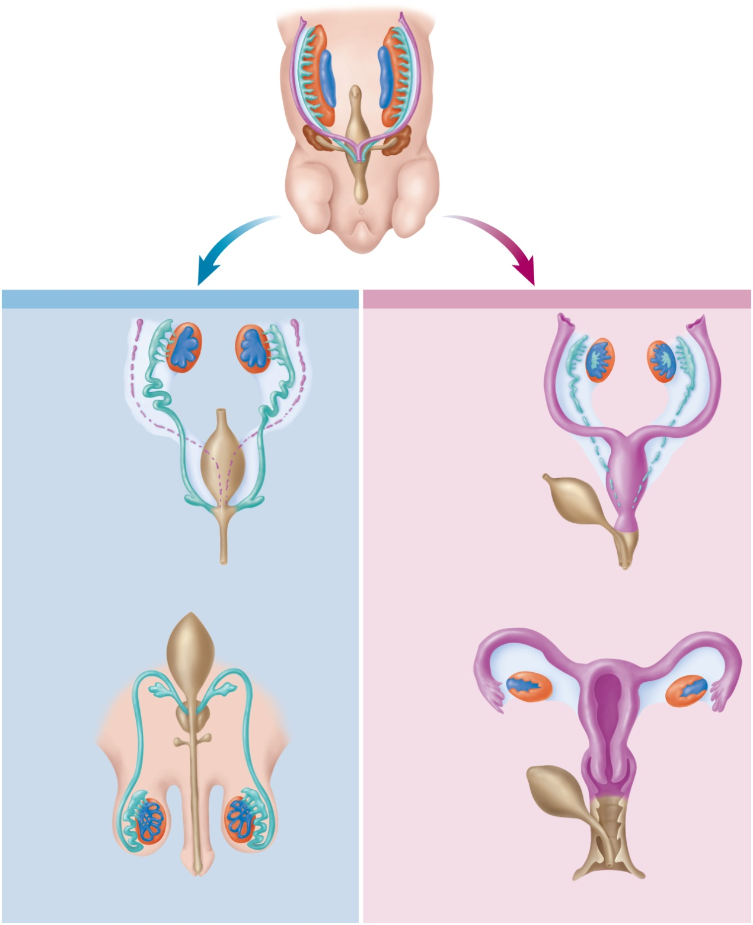
Development of Reproductive Tracts
Copyright © The McGraw-Hill Companies, Inc. Permission required for reproduction or display.
Mesonephros
Mesonephric duct
Gonadal ridge
Paramesonephric
(müllerian) duct
Kidney
Cloaca
5- to 6-week embryo;
sexually indifferent stage
Male
Female
Testes
Ovaries
Efferent ductules
Paramesonephric
duct forming the
uterine tube
Epididymis
Paramesonephric
duct (degenerating)
Mesonephric duct
(degenerating)
Mesonephric duct
forming the
ductus deferens
Fused paramesonephric
ducts forming
the uterus
Urinary bladder
Urinary bladder
(moved aside)
Seminal vesicle
Urogenital sinus
forming the urethra
Urogenital sinus
forming the urethra
and lower vagina
7 to 8 weeks
8 to 9 weeks
Urinary
bladder
Uterine
tube
Seminal
vesicle
Ovary
Prostate gland
Uterus
Bulbourethral
gland
Ductus deferens
Urinary bladder
(moved aside)
Epididymis
Vagina
Testis
Urethra
Figure 27.3
Urethra
Hymen
Penis
Vestibule
At birth
At birth

Slide 10
Development of External Genitalia
similarity of external genitalia of both sexes :
genital tubercle becomes the head (glans) of the penis or glans clitoris
pair of urogenital folds encloses urethra of male forming the penis or forms the labia minora
pair of labioscrotal folds becomes either scrotum or labia majora
by week 12, either male or female genitalia are distinctly formed
male and female organs that develop from the same embryonic structure are homologous
penis is homologous to the clitoris
scrotum is homologous to the labia majora

Slide 11
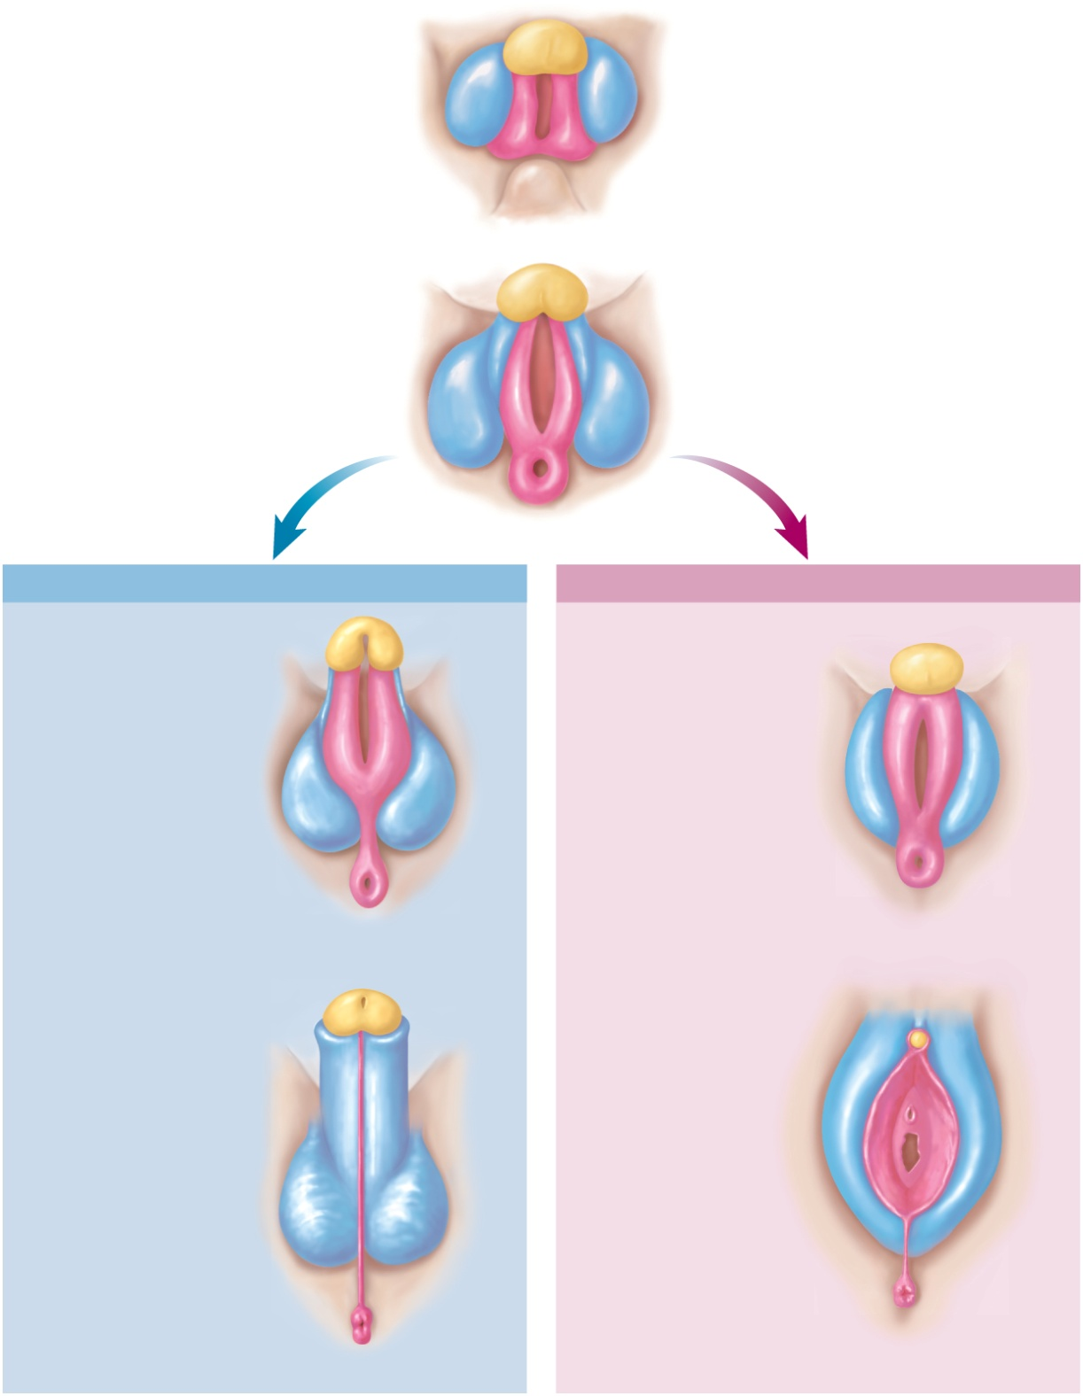
Development of External Genitalia
Copyright © The McGraw-Hill Companies, Inc. Permission required for reproduction or display.
Genital tubercle
Urogenital fold
Labioscrotal fold
Tail
6 weeks
8 weeks
Male
Female
Phallus:
Developing glans
of penis
Developing glans
of clitoris
Urethral groove
Labia minora
Urethral groove
Labia majora
Anus
Anus
10 weeks
10 weeks
Urethral orifice
Glans of penis
Prepuce
Prepuce
Glans of clitoris
Urethral orifice
Scrotum
Vaginal orifice
Perineal raphe
Perineal raphe
Figure 27.4
Anus
Anus
12 weeks
12 weeks

Slide 12
Descent of Testes
both male and female gonads initially develop high in the abdominal cavity near the kidneys, and migrate into the pelvic cavity (ovaries) or scrotum (testes)
gubernaculum – a connective tissue cord extends from the gonad to the floor of the pelvic cavity
in the male, passes between the internal and external abdominal oblique muscles into the scrotal swelling
vaginal process – fold of the peritoneum that extends into the scrotum
inguinal canal – pathway of low resistance through the groin created by gubernaculum and vaginal process
most common site of herniation in boys and men – inguinal hernia

Slide 13
Descent of Testes
descent of the testes begins as early as 6 weeks
in 7th month testes abruptly pass through the inguinal canal into the scrotum guided by the gubernaculum
testes accompanied by elongating testicular arteries and veins, lymphatic vessels, nerves, spermatic ducts, and extensions of internal abdominal oblique muscle
cryptorchidism – boys born with undescended testes
occurs in about 3% of male births
most cases the testes descend during the first year of infancy
if not, testosterone injection or simple surgery to draw testes into the scrotum
uncorrected cases lead to sterility or testicular cancer
ovaries descend to lesser extent
lodge on inferior brim of the lesser pelvis
gubernaculum becomes a pair of ligaments that supports the ovary and the uterus

Slide 14
Descent of Testis
Copyright © The McGraw-Hill Companies, Inc. Permission required for reproduction or display.
3-month fetus
8-month fetus
1-month-old infant
Parietal
peritoneum
Muscular wall
of abdomen
Closed proximal
portion of
vaginal process
Epididymis
Testis
Inguinal canal
Ductus deferens
Spermatic cord
Pubic symphysis
Vaginal process
Tunica vaginalis
Vaginal process
Gubernaculum
Scrotum
Scrotal swelling
Penis
Gubernaculum
Figure 27.5

Slide 15
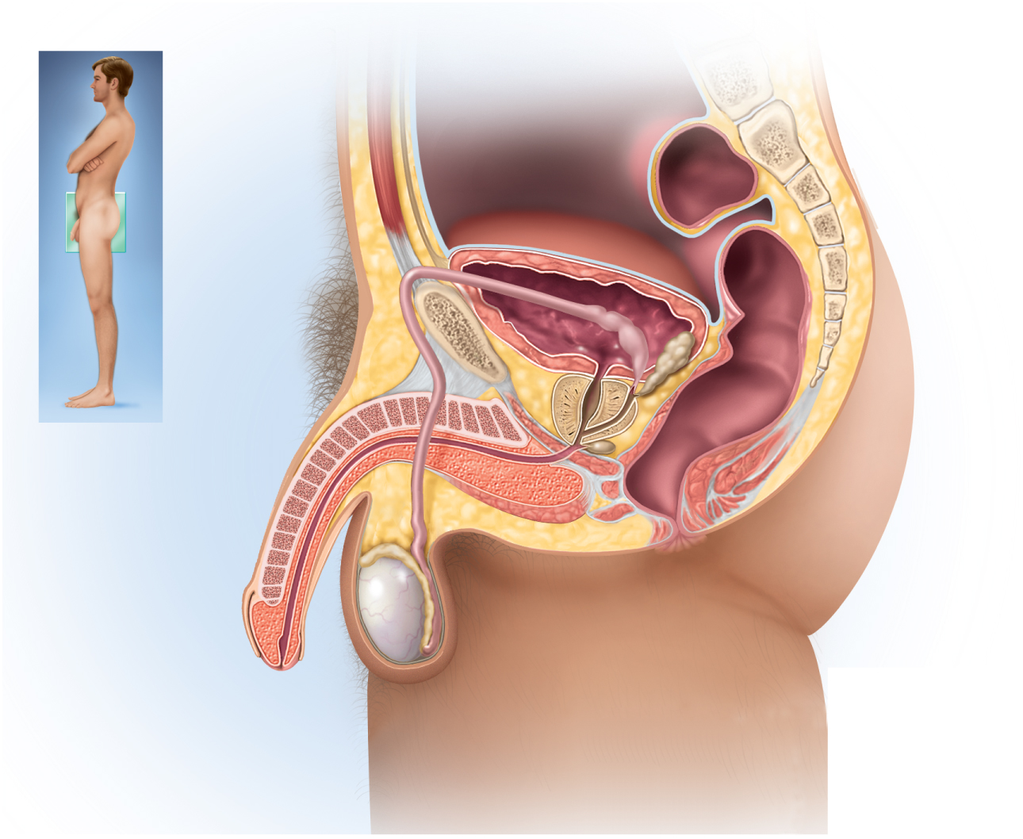
Male Reproductive System
Copyright © The McGraw-Hill Companies, Inc. Permission required for reproduction or display.
Urinary
bladder
Pubic
symphysis
Rectum
Ampulla of ductus deferens
Root of
penis
Seminal vesicle
Ejaculatory duct
Ductus (vas) deferens
Prostate gland
Shaft of penis
Bulbourethral
gland
Corpus cavernosum
Bulbospongiosus
muscle
Corpus spongiosum
Urethra
Epididymis
Glans of penis
Prepuce
Testis
Scrotum
(a) Sagittal section
Figure 27.11a

Slide 16
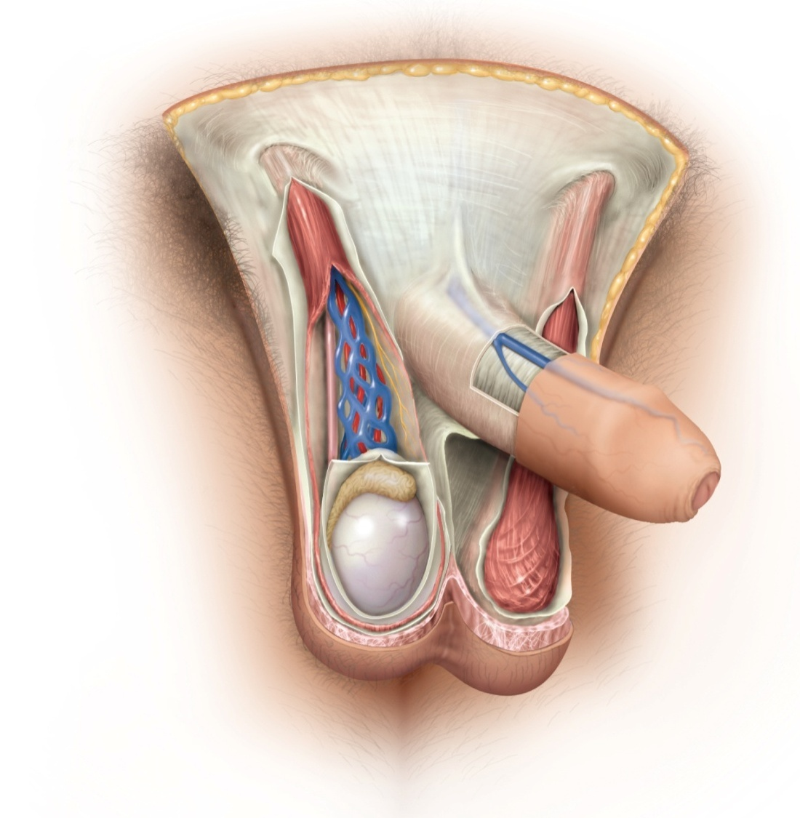
The Scrotum and Spermatic Cord
Copyright © The McGraw-Hill Companies, Inc. Permission required for reproduction or display.
External inguinal ring
Spermatic cord:
Cremaster muscle
Testicular artery
Fascia of spermatic cord
Ductus deferens
Superficial fascia of penis
Deep fascia of penis
Pampiniform plexus
Prepuce (foreskin)
Epididymis
Glans
Tunica vaginalis
Median septum of scrotum
Testis
Cremaster muscle
Dartos muscle
Scrotal skin
Figure 27.7

Slide 17
Scrotum
external genitalia of the male – scrotum and penis
occupy the perineum – diamond-shaped area between the thighs
bordered by the pubic symphysis, ischial tuberosities, and coccyx
scrotum – pouch of skin, muscle, and fibrous connective tissue containing the testes
left testicle usually descends lower than the right so the two are not compressed against each other
skin has sebaceous glands, sparse hair, rich sensory innervation, somewhat darker pigmentation than skin elsewhere
internal median septum divides scrotum into right and left compartments
perineal raphae – medial seam located on the scrotum extending anteriorly along ventral side of penis and posteriorly to anus

Slide 18
Male Reproductive Anatomy
Copyright © The McGraw-Hill Companies, Inc. Permission required for reproduction or display.
Location of pubic
symphysis
Perineal raphe
Figure 27.6
Urogenital triangle
Location of
coccyx
Location of ischial
tuberosity
Anal triangle
Anus

Slide 19
Spermatic Cord
spermatic cord – bundle of fibrous connective tissue containing the ductus deferens, blood and lymphatic vessels, and testicular nerve
continues through 4 cm inguinal canal into the pelvic cavity
external inguinal ring – inferior entrance to the inguinal canal
internal inguinal ring – superior exit to the pelvic cavity
the human testes reside in the scrotum because they have adapted to this cooler environment
cannot produce sperm at core body temperature of 37° C
must be held at about 35° C

Slide 20
Spermatic Cord
scrotum has three mechanisms to regulate the temperature of the testes
cremaster muscle – strips of the internal abdominal oblique muscle
enmesh the spermatic cord
in cold temperatures, contracts and draws testes upward toward body
in warm temperatures relaxes suspending testes further from the body
dartos muscle – subcutaneous layer of smooth muscle
contracts when it is cold, wrinkling the scrotum, holding testes against warm body
reducing surface area of the scrotum and reducing heat loss
pampiniform plexus – an extensive network of veins from the testes that surround the testicular artery and spermatic cord
countercurrent heat exchanger – without the pampiniform plexus, warm arterial blood would heat the testis and inhibit sperm production
removes heat from the descending arterial blood
by the time it reaches the testis, the blood is 1.5° - 2.5° cooler

Slide 21
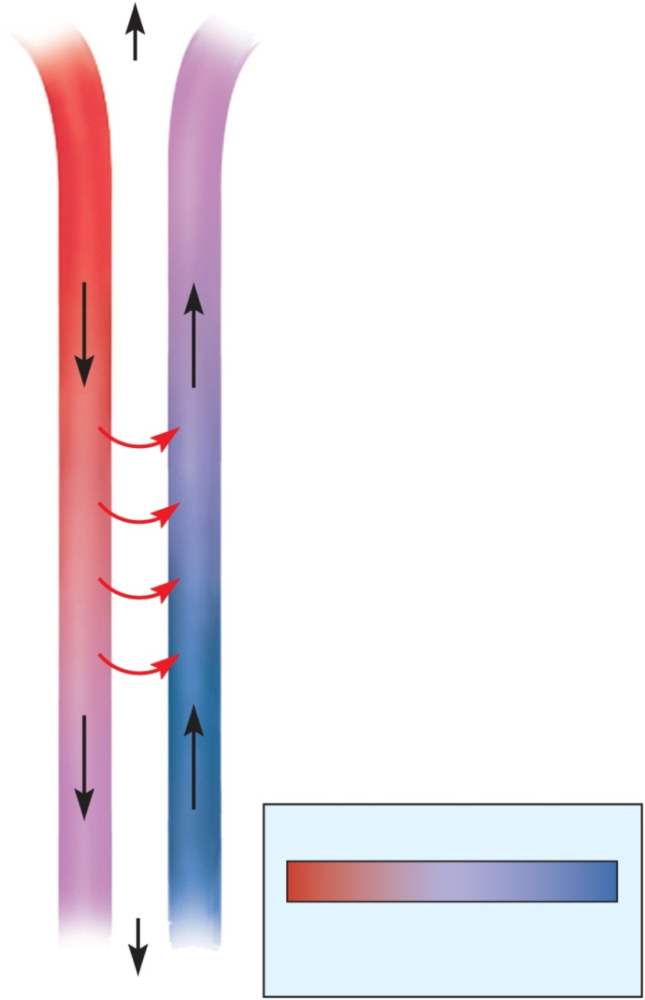
Countercurrent Heat Exchanger
Copyright © The McGraw-Hill Companies, Inc. Permission required for reproduction or display.
Pelvic cavity
37°C
Testicular artery
Pampiniform plexus
Blood flow
Blood flow
Heat transfer
Arterial blood cools
as it descends
Venous blood carries
away heat as it ascends
Key
35°C
Figure 27.8
Warmest
blood
Coolest
blood
Testis

Slide 22
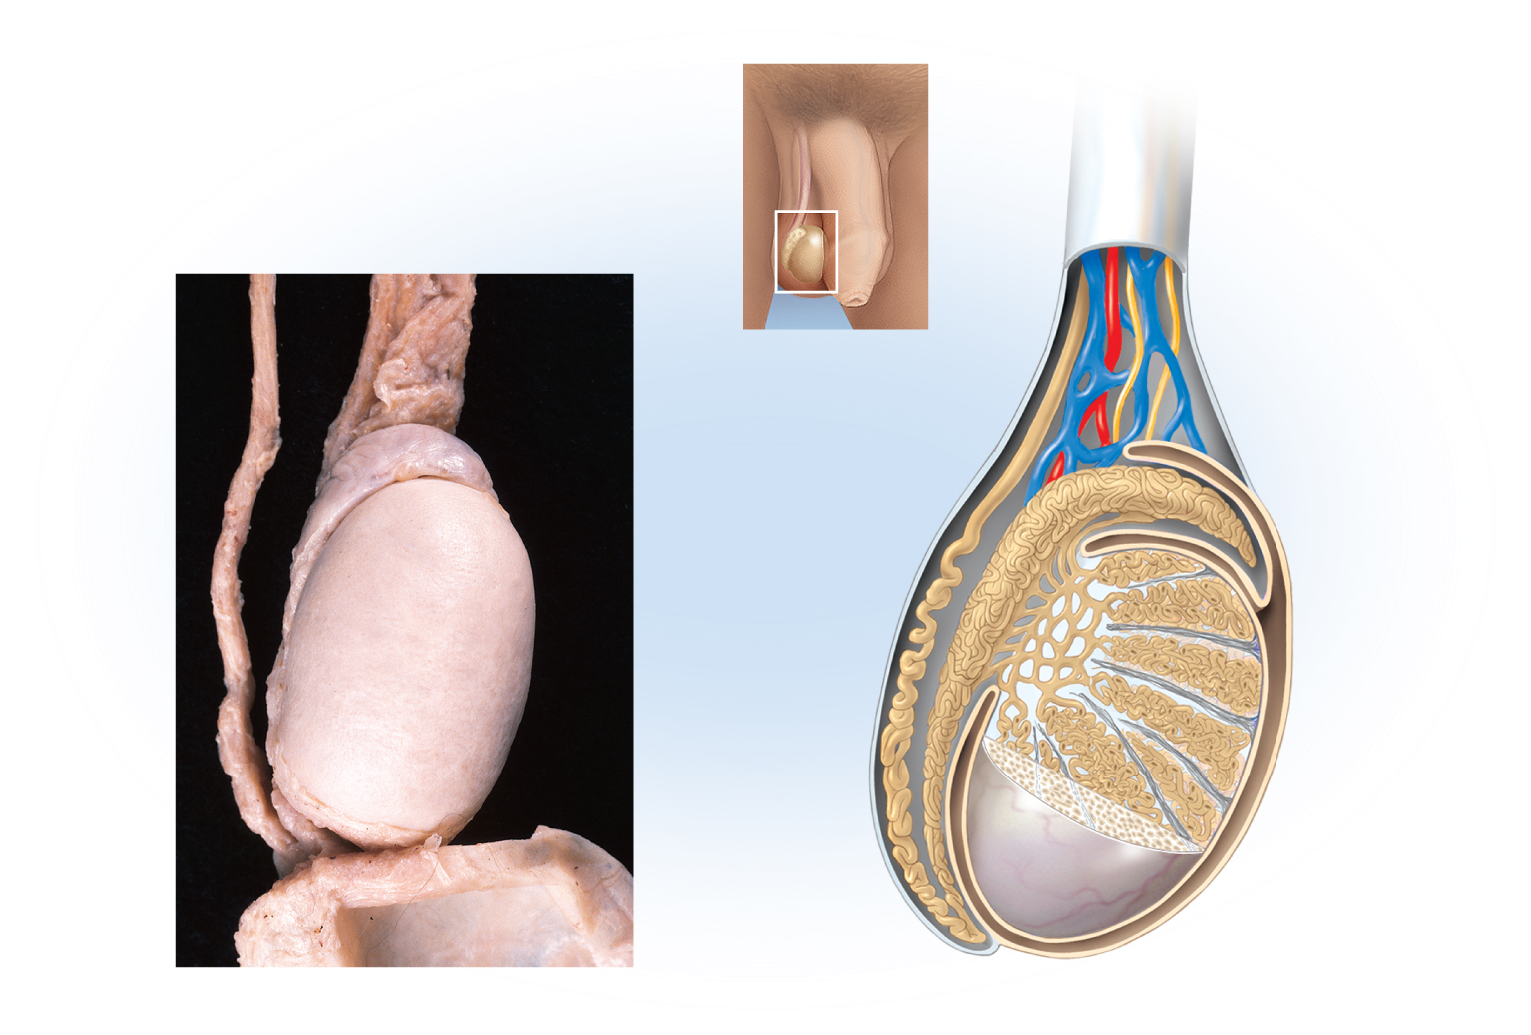
Scrotum and Spermatic Cord
Copyright © The McGraw-Hill Companies, Inc. Permission required for reproduction or display.
Spermatic cord
Spermatic
cord
Ductus deferens
Blood vessels
and nerves
Head of
epididymis
Head of
epididymis
Ductus
deferens
Efferent
ductule
Seminiferous
tubule
Rete testis
Septum
Testis, covered
by tunica
albuginea
Body of
epididymis
Lobule
Tunica
vaginalis
Tail of epididymis
Scrotum
(folded down)
Tunica
albuginea
Tail of
epididymis
(a)
2 cm
(b)
Figure 27.9
a: © The McGraw-Hill Companies, Inc./Dennis Strete, photographer

Slide 23
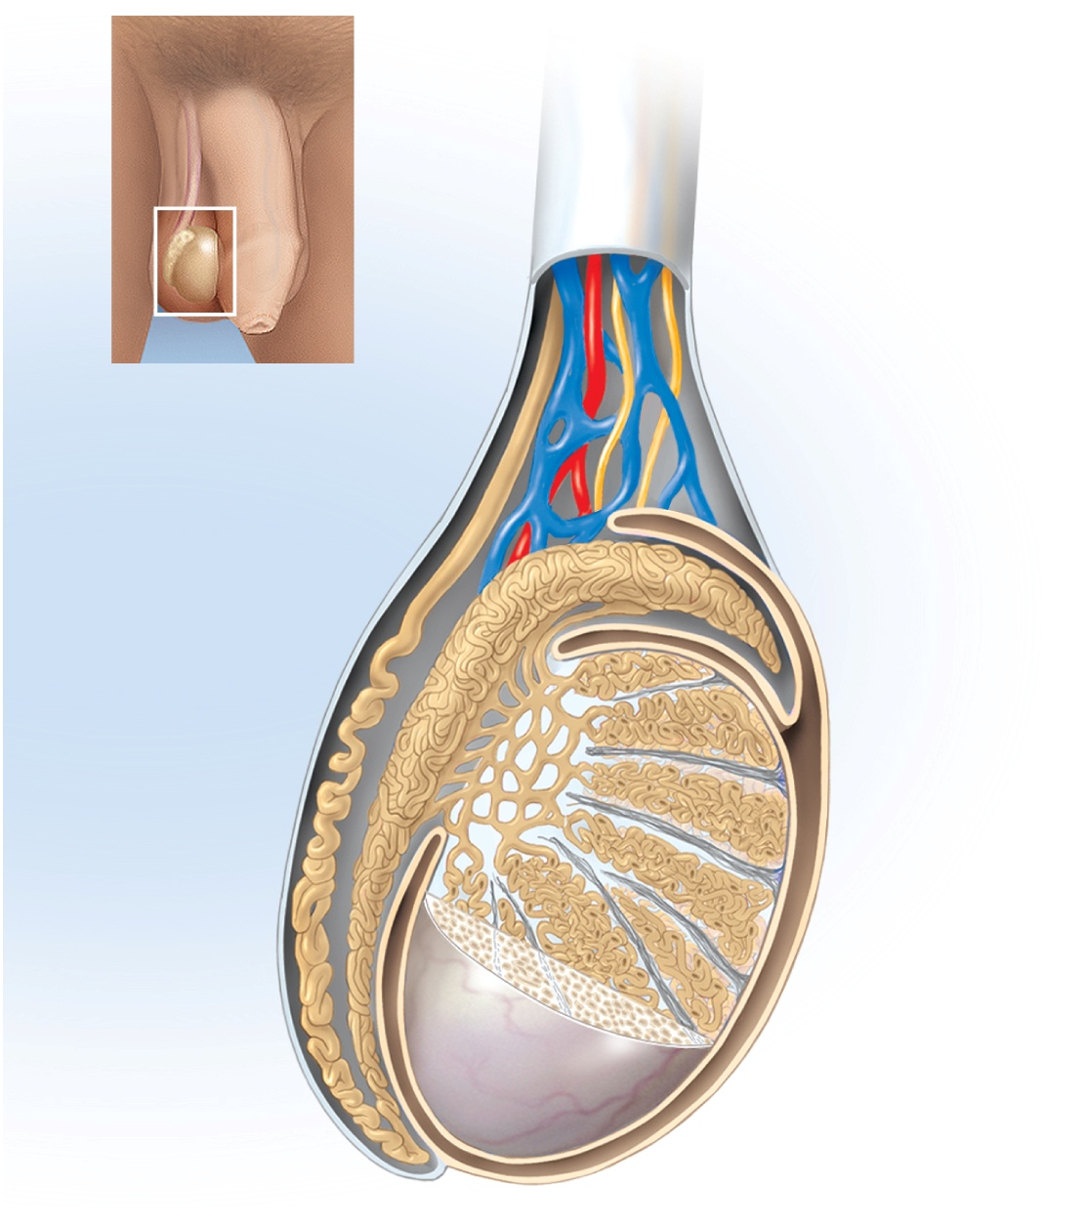
Testis and Associated Structures
Copyright © The McGraw-Hill Companies, Inc. Permission required for reproduction or display.
Spermatic
cord
Blood vessels
and nerves
Head of
epididymis
Ductus
deferens
Efferent
ductule
Seminiferous
tubule
Rete testis
Septum
Body of
epididymis
Lobule
Tunica
vaginalis
Tunica
albuginea
Figure 27.9b
Tail of
epididymis
(b)

Slide 24
Testes
testes (testicles) – combined endocrine and exocrine glands that produce sex hormones and sperm
oval and slightly flattened, 4 cm long x 2.5 cm in diameter
covered anteriorly and laterally by tunica vaginalis
tunica albuginea white fibrous capsule on testes
connective tissue septa divides testes into 250 to 300 wedge-shaped lobules
seminiferous tubules
one to three in each lobule
each tubule lined with a thick germinal epithelium for sperm generation
interstitial (Leydig) cells between tubules produce testosterone
sustentacular (Sertoli) cells in between germ cells
protect the germ cells, and promote their development
germ cells depend on them for nutrients, waste removal, growth factors, and other needs

Slide 25
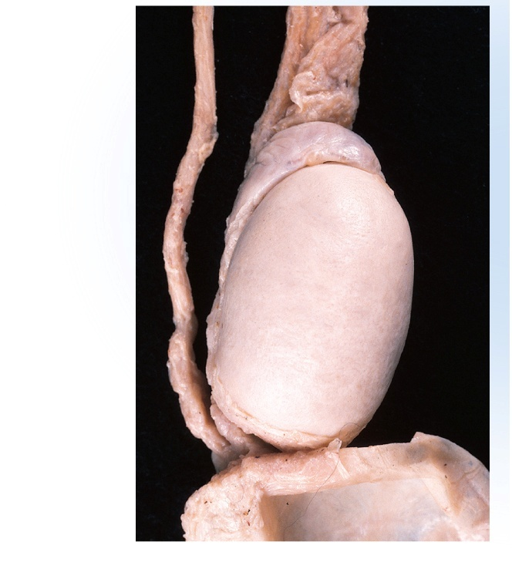
Testis and Associated Structures
Spermatic cord
Ductus deferens
Head of
epididymis
Testis, covered
by tunica
albuginea
Tail of epididymis
Scrotum
(folded down)
Figure 27.9a
(a)
2 cm
© The McGraw-Hill Companies, Inc./Dennis Strete, photographer

Slide 26
Blood-Testis Barrier (BTB)
blood-testis barrier - formed by tight junctions between sustentacular cells
separating sperm from immune system
prevents antibodies and other large molecules in the blood from getting to germ cells
germ cells are immunologically different from body cells and would be attacked by immune system

Slide 27
Testis and Associated Structures
rete testis – a network embedded in the capsule on the posterior side of the testis collect sperm from seminiferous tubules
move with flow of fluid secreted by the sustentacular cells
sperm do not swim while they are in the male reproductive tract
testicular artery supplies each testis
low BP of testicular artery results in poor O₂ supply to the testes
sperm develop very large mitochondria helping them survive hypoxic environment of female reproductive tract
blood leaves the testes through the pampiniform plexus which converge to form the testicular veins
right testicular vein drain to inferior vena cava
left one drains into left renal vein
testicular nerves from spinal cord segments T10 and T11
carrying sensory fibers concerned with pain and motor fibers regulating blood flow

Slide 28
Spermatic Ducts
spermatic ducts from testis to the urethra
efferent ductules
about 12 small ciliated ducts collecting sperm from rete testes and transporting it to epididymis
duct of the epididymis (head, body and tail)
site of sperm maturation and storage (fertile for 40 to 60 days)
contains a single 6 m long coiled duct adhering to posterior of testis
sperm mature as they travel through the duct
if not ejaculated, they disintegrate and epididymis reabsorbs them
ductus (vas) deferens
muscular tube 45 cm long passing up from scrotum through inguinal canal to posterior surface of bladder
duct widens behind the bladder and widens into the terminal ampulla
duct ends by uniting with the duct of the seminal vesicle
thick wall of smooth muscle well innervated by sympathetic nerve fibers
ejaculatory duct
2 cm duct formed from ductus deferens and seminal vesicle and passing through prostate to empty into urethra

Slide 29
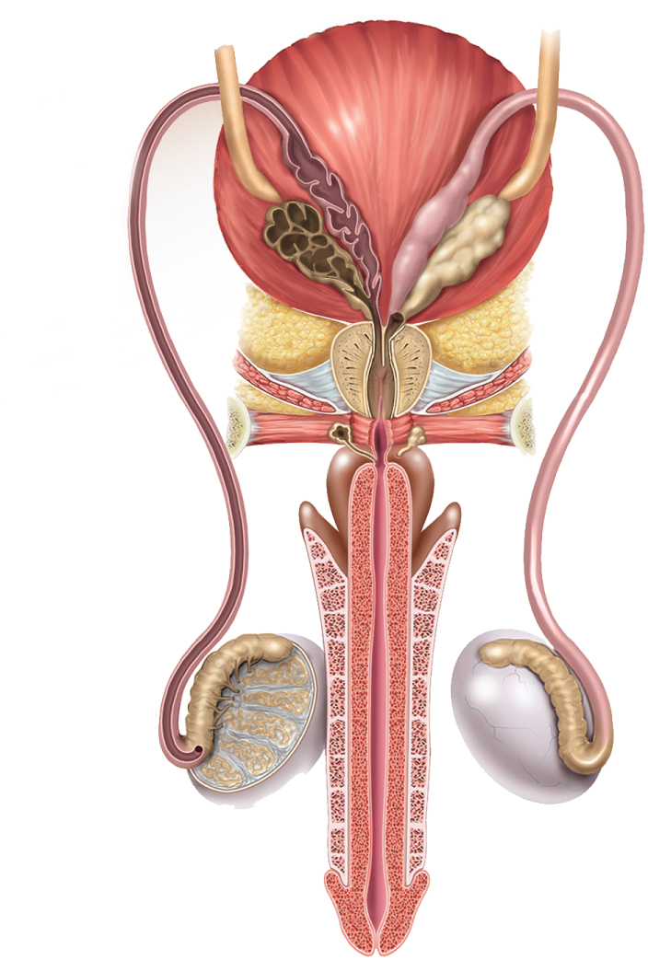
Male Duct System
Copyright © The McGraw-Hill Companies, Inc. Permission required for reproduction or display.
Ureter
Urinary
bladder
Ampulla
Seminal
vesicle
Prostate
gland
Ejaculatory
duct
Prostatic
urethra
Bulbourethral
gland
Membranous
urethra
Bulb
Crus
Ductus deferens
Corpus
spongiosum
Corpus
cavernosum
Efferent
ductules
Testis
Epididymis
Spongy (penile)
urethra
Glans of penis
Figure 27.11b
(b) Posterior view
Penis

Slide 30
Male Urethra
Copyright © The McGraw-Hill Companies, Inc. Permission required for reproduction or display.
Figure 27.11a
Urinary
bladder
Pubic
symphysis
Rectum
Ampulla of ductus deferens
Root of
penis
Seminal vesicle
Ejaculatory duct
Ductus (vas) deferens
Prostate gland
Shaft of penis
Bulbourethral
gland
Corpus cavernosum
Bulbospongiosus
muscle
Corpus spongiosum
Urethra
Epididymis
Glans of penis
Prepuce
Testis
Scrotum
(a) Sagittal section
18 cm long male urethra is shared by the reproductive and urinary systems
consists of three regions: prostatic, membranous, and spongy (penile) urethra

Slide 31
Accessory Glands
there are three sets of glands in the male reproductive system
seminal vesicles
pair of glands posterior to bladder
empties into ejaculatory duct
forms 60% of semen
prostate gland
surrounds urethra and ejaculatory duct just inferior to the bladder
30 to 50 compound tubuloacinar glands
empty through about 20 pores in the prostatic urethra
thin milky secretion forms 30% of semen
bulbourethral (Cowper) glands
near bulb of penis
during sexual arousal, they produce a clear slippery fluid that lubricates the head of the penis in preparation for intercourse
protects the sperm by neutralizing the acidity of residual urine in the urethra

Slide 32
Prostate Diseases
benign prostatic hyperplasia (BPH) – noncancerous enlargement of the prostate
compresses urethra and obstructs flow of urine
promotes bladder and kidney infections
prostate cancer
second most common cancer in men after lung cancer
tend to be near the periphery of the gland where they do not obstruct urine flow
go unnoticed until they cause pain
metastasized to nearby lymph nodes and then to the lungs and other organs
digital rectal exam (DRE) – palpated through rectal wall to check for tumors
diagnosed from elevated levels of serine protease (PSA) and acid phosphatase in the blood

Slide 33
Penis
penis serves to deposit semen in the vagina
half of the penis is an internal root
half is an externally visible shaft
external portion 4 in. long when flaccid (nonerect)
5 – 7 inches long when erect
skin over shaft loosely attached allows expansion
extends over glans as prepuce (foreskin)
removed by circumcision
smegma – waxy secretion produced by the sebaceous glands in the glans and facing surface of the prepuce

Slide 34
Penis
three cylindrical bodies of erectile tissue which fill with blood during sexual arousal and account for its enlargement and erection
single corpus spongiosum along ventral side of penis
encloses spongy (penile) urethra
distal end enlarges and forms the glans penis
proximal end ends as a dilated bulb ensheathed by bulbospongiosus muscle
two corpora cavernosa
diverge like arms of a Y
each arm called a crus attaches the penis to pubic arch
covered with ischiocavernosus muscle
the three cylinders of erectile tissue are spongy
contain many blood sinuses called lacunae
trabeculae – partitions between lacunae

Slide 35
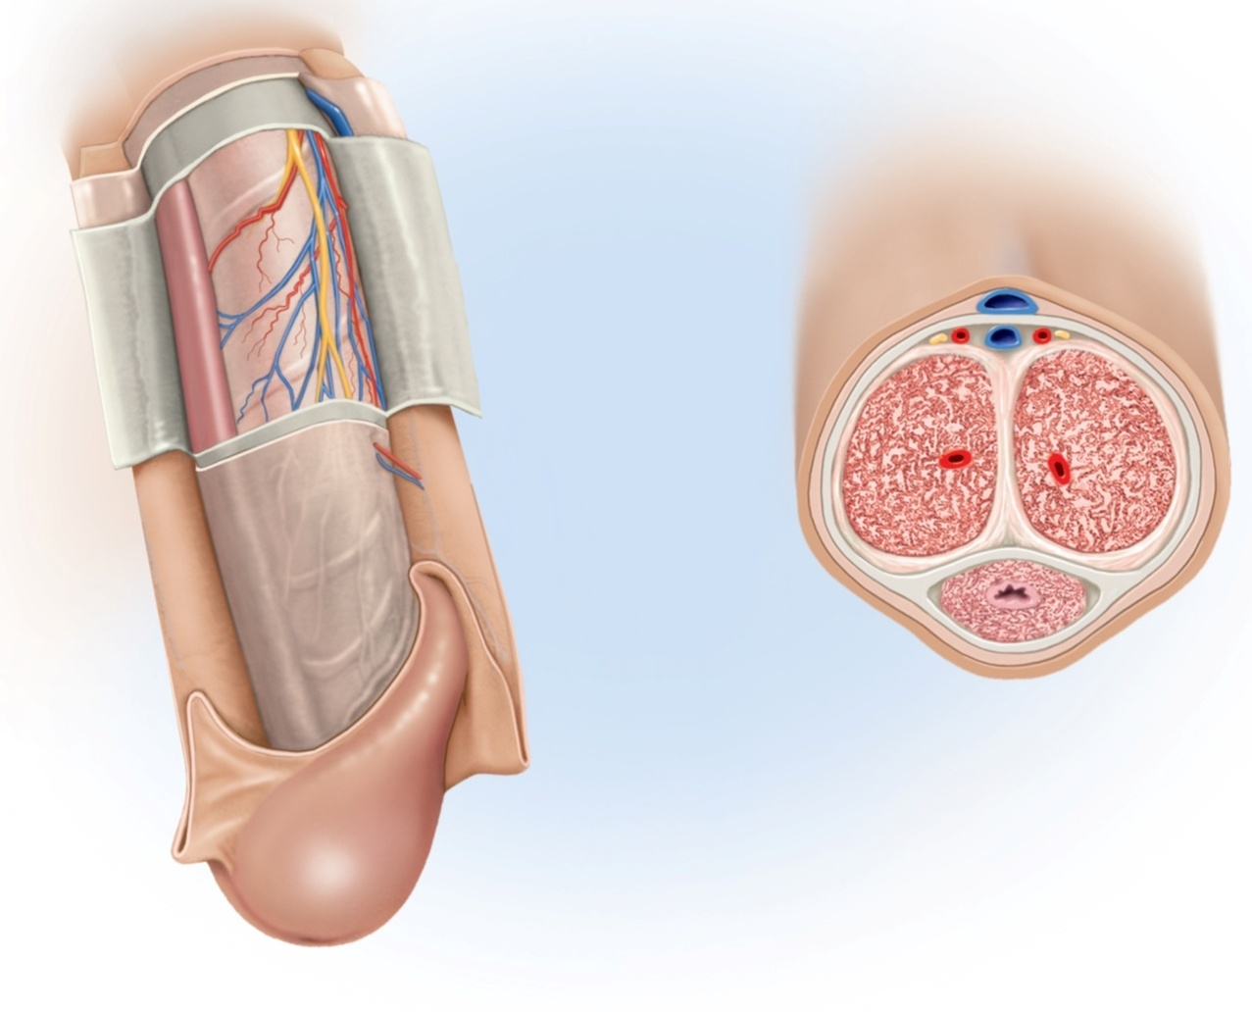
Anatomy of Penis
Copyright © The McGraw-Hill Companies, Inc. Permission required for reproduction or display.
Dorsal vein
Dorsal
Dorsal artery
Dorsal nerve
Corpus spongiosum
Corpus cavernosum
Deep artery
Deep fascia
Tunica
albuginea
Superficial fascia
Skin
Lacunae
Urethra
Median septum
Corpus spongiosum
Prepuce
(b)
Ventral
Glans of penis
External urethral orifice
(a)
Figure 27.12 a-b

Slide 36
Puberty and Climacteric
reproductive system remains dormant for several years after birth
10-12 years in most boys and 8-10 years in most girls
surge of pituitary gonadotropins awakens the reproductive system – onset of puberty
adolescence – the period from the onset of gonadotropin secretion and reproductive development until a person attains full adult height
puberty – first few years of adolescence, until the first menstrual period in girls or the first ejaculation of viable sperm in boys
typically around age 12 in girls and age 13 in boys

Slide 37
Endocrine Control of Puberty
testes secrete substantial amounts of testosterone in first trimester (3 months) of fetal development in levels about as high as they are in midpuberty
then testes becomes dormant until puberty
from puberty through adulthood, reproductive function is regulated by hormonal links between the hypothalamus, pituitary gland, and the gonads
as hypothalamus matures it produces gonadotropin-releasing hormone (GnRH)
GnRH stimulates anterior pituitary cells (gonadotropes) to secrete:
follicle stimulating hormone (FSH)
stimulates sustentacular cells to secrete androgen-binding protein that binds testosterone keeping it in the seminiferous tubule lumen to stimulate spermatogenesis and raising sperm count
luteinizing hormone (LH) sometimes called interstitial cell-stimulating hormone (ICSH)
stimulates interstitial cells to produce testosterone

Slide 38
Other Hormone Effects
puberty
enlargement of secondary sexual organs
penis, testes, scrotum, ducts, glands
testosterone stimulates a burst of generalized body growth
limbs elongate, muscle mass increases, and the larynx enlarges
erythropoiesis, basal metabolic rate, and increase in appetite
pubic hair, scent and sebaceous glands develop in response to dihydrotestosterone (DHT)
stimulates sperm production and libido (sex drive)
adulthood
testosterone sustains the male reproductive tract, sperm production, and libido
inhibin from sustentacular cells suppresses FSH output from the pituitary reducing sperm production without reducing LH and testosterone secretion

Slide 39
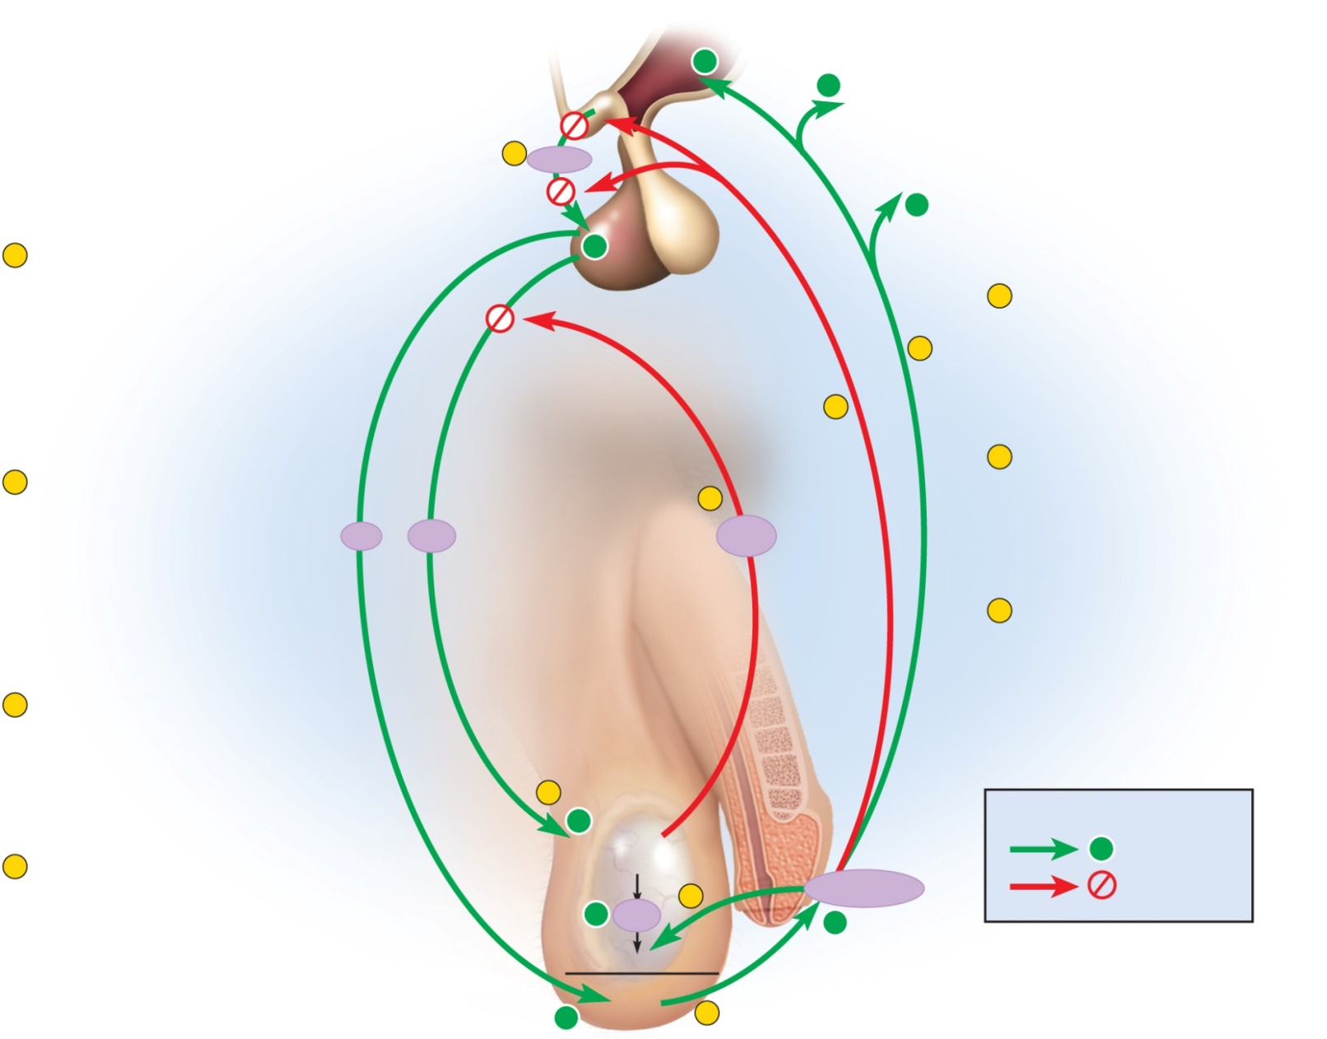
Hormones and Endocrine Control
Copyright © The McGraw-Hill Companies, Inc. Permission required for reproduction or display.
+
+
Hypothalamus
Libido
Secondary
sex organs
1
GnRH
Secondary sex
characteristics
+
1
GnRH from hypothalamus stimulates the
anterior pituitary to secrete FSH and LH.
+
Pituitary gland
5
Testosterone also stimulates the
libido and the development of
secondary sex organs and
characteristics.
5
6
2
6
Testosterone has negative
feedback effects that reduce GnRH
secretion and pituitary sensitivity
to GnRH.
FSH stimulates sustentacular
cells to secrete androgen-binding
protein (ABP).
7
LH
FSH
Inhibin
7
Sustentacular cells also secrete
inhibin, which selectively inhibits
FSH secretion and thus reduces
sperm production without reducing
testosterone secretion.
3
LH stimulates interstitial cells to
secrete testosterone (androgen).
2
+
Key
T
estis
Sustentacular
cells
+
Stimulation
4
In the presence of ABP,
testosterone stimulates
spermatogenesis.
Testosterone
Inhibition
+
ABP
4
+
Spermatogenesis
Figure 27.13
+
Interstitial
cells
3

Slide 40
Aging and Sexual Function
decline in testosterone secretion
peak secretion at 7 mg/day at age 20
declines to 1/5 of that by age 80
decline in the number and activity of interstitial cells (testosterone) and sustentacular cells (inhibin)
rise in FSH and LH secretion after age 50 produces male climacteric (andropause)
little or no effect to:
mood changes, hot flashes and “illusions of suffocation”
erectile dysfunction (impotence)– the inability to produce or maintain an erection sufficient for intercourse
20% of men in 60s to 50% of those in 80s

Slide 41
Spermatogenesis and Meiosis
spermatogenesis - process of sperm production in seminiferous tubules
involves three principal events:
remodeling of large germ cells into small, mobile sperm cells with flagella
reduction of chromosome number by one-half in sperm cells (unites with egg to return to 46)
shuffling of genes so new combinations exist in the sperm that are different from the parents
ensures genetic variation in the offspring
four sperm cells produced from one germ cell by meiosis

Slide 42
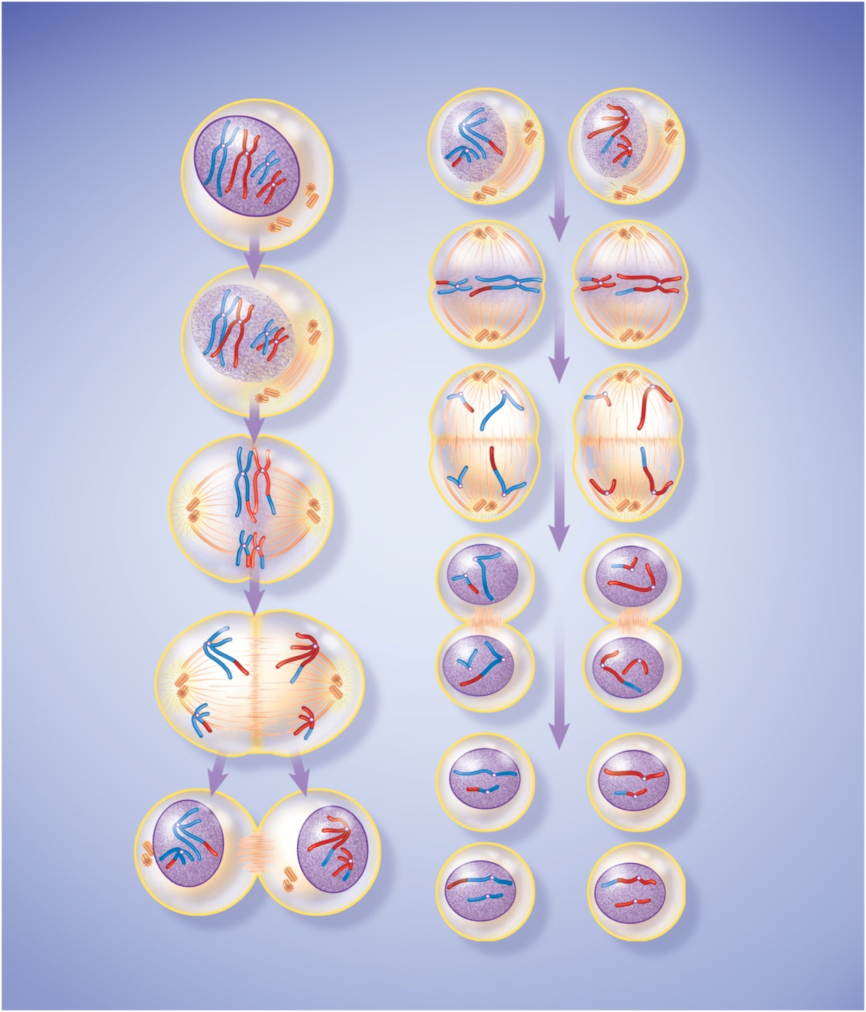
Meiosis
Copyright © The McGraw-Hill Companies, Inc. Permission required for reproduction or display.
Meiosis I (first division)
Meiosis II (second division)
Early prophase I
Chromatin condenses to
form visible chromosomes;
each chromosome has 2
chromatids joined by a
centromere.
Chromosome
Prophase II
Nuclear envelopes
disintegrate again;
chromosomes still
consist of 2 chromatids.
New spindle forms.
Nucleus
Centromere
Centrioles
Mid- to late prophase I
Homologous chromosomes
form pairs called tetrads.
Chromatids often break
and exchange segments
(crossing-over). Centrioles
produce spindle fibers.
Nuclear envelope
disintegrates.
Tetrad
Metaphase II
Chromosomes align on
equatorial plane.
Crossing-over
Spindle
fibers
Anaphase II
Centromeres divide;
sister chromatids
migrate to opposite
poles of cell. Each
chr omatid now constitutes
a single-stranded
chromosome.
Metaphase I
Tetrads align on
equatorial plane of
cell with centromeres
attached to spindle
fibers.
Centromere
Chromatid
Equatorial
plane
Telophase II
New nuclear envelopes
form around chromosomes;
chromosomes uncoil and
become less visible;
cytoplasm divides.
Anaphase I
Homologous
chromosomes
separate and
migrate to opposite
poles of the cell.
Telophase I
New nuclear
envelopes
form around
chromosomes;
cell undergoes
cytoplasmic
division
(cytokinesis).
Each cell is
now haploid.
Final product is 4
haploid cells with
single-stranded
chromosomes.
Figure 27.14
Cleavage furrow

Slide 43
Meiosis versus Mitosis
mitosis - a body cell doubles its DNA and then divides to produce two genetically identical daughter cells
basis for division of the single-cell fertilized egg, growth of an embryo, all postnatal growth, and tissue repair
consists of four stages: prophase, metaphase, anaphase, and telophase
meiosis produces four gametes (haploid cells), each with only half the DNA of the diploid body cells
combining male and female gametes with half the genetic material produces an embryo with the same number of chromosomes as each of the parents
meiosis is sometimes called reduction division

Slide 44
Meiosis versus Mitosis
meiosis has two cell divisions (following one replication of DNA) with each division having four stages
meiosis I - prophase I , metaphase I, anaphase I, and telophase I
before this begins, the DNA is doubled….
prophase I each pair of homologous chromosomes lines up side by side and form tetrad
crossing-over creates new combinations of genes
after meiosis I, each cell has 23 chromosomes, but each is double-stranded
interkinesis
meiosis II - prophase II , metaphase II, anaphase II, and telophase II
more like mitosis
each of the double-stranded chromosomes divides into two chromatids and resulting four cells are truly haploid with 23 chromosomes

Slide 45
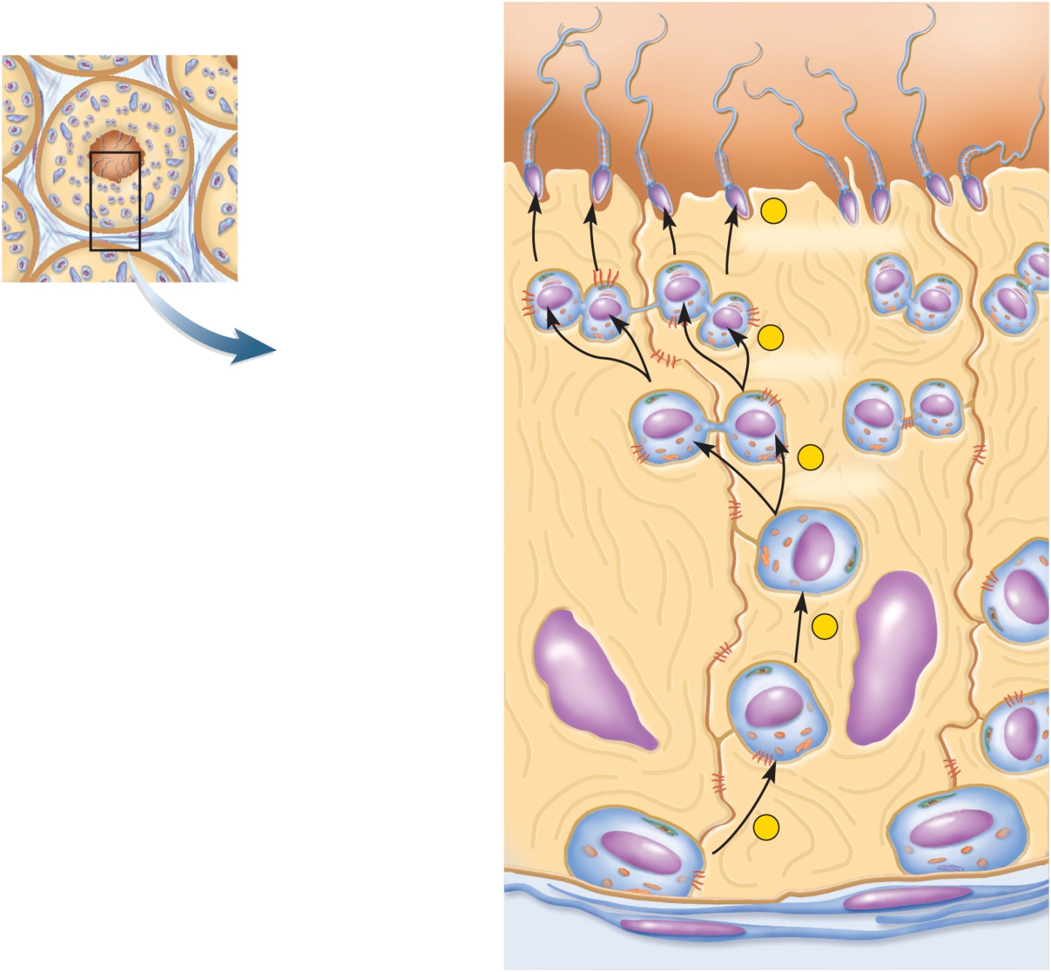
Spermatogenesis
Copyright © The McGraw-Hill Companies, Inc. Permission required for reproduction or display.
Cross section of
seminiferous tubules
Lumen of
seminiferous tubule
Sperm
5
Spermiogenesis
Spermatid
n
n
n
n
4
Meiosis II
Secondary spermatocyte
n
n
3
Blood–testis barrier
Meiosis I
Primary
spermatocyte
2n
Sustentacular cell
2
Type B spermatogonium
2n
Figure 27.15
Tight junction
Type A spermatogonium
2n
1
Basement membrane
of seminiferous tubule

Slide 46
Spermatogenesis
primordial germ cells form in the yolk sac of the embryo
they colonize the gonadal ridges and become spermatogonia
puberty brings on spermatogenesis
spermatogonia lie along the periphery of the seminiferous tubules and divide by mitosis
one daughter cell of each division remains in the tubule wall as stem cell - type A spermatogonium
other daughter cell migrates slightly away from the wall and is on its way to producing sperm – type B spermatogonium
type B spermatogonium enlarges and becomes a primary spermatocyte
sustentacular cells protect it from the body’s immune system – blood-testis barrier (BTB)
primary spermatocyte undergoes meiosis I which gives rise to two equal-size, haploid, genetically unique secondary spermatocytes
each secondary spermatocyte undergoes meiosis II dividing into two spermatids – a total of four for each spermatogonium
spermiogenesis – four spermatids divide no further, but undergo a transformation in which it differentiates into a spermatozoon

Slide 47
Blood-Testis Barrier
once the primary spermatocyte undergoes meiosis, it becomes genetically different and needs to be protected from the immune system
the primary spermatocyte moves towards the lumen of the seminiferous tubule and a new tight junction between sustentacular cells forms behind it
now protected by the blood-testis barrier closing behind it
Copyright © The McGraw-Hill Companies, Inc. Permission required for reproduction or display.
Cross section of
seminiferous tubules
Lumen of
seminiferous tubule
Sperm
5
Spermiogenesis
Spermatid
n
n
n
n
4
Meiosis II
Secondary spermatocyte
n
n
3
Blood–testis barrier
Meiosis I
Primary
spermatocyte
2n
Sustentacular cell
2
Type B spermatogonium
2n
Tight junction
Type A spermatogonium
2n
1
Basement membrane
of seminiferous tubule
Figure 27.15

Slide 48
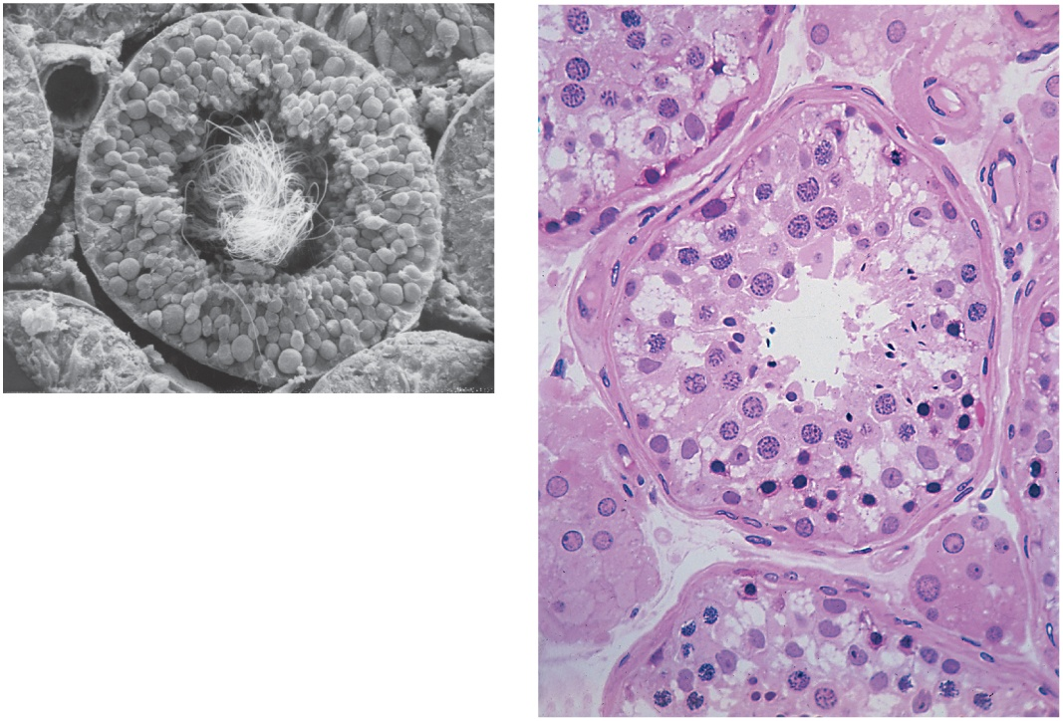
Histology of Testis
Copyright © The McGraw-Hill Companies, Inc. Permission required for reproduction or display.
Interstitial cells
Blood vessel
Germ cells
Blood vessel
Sustentacular cell
Seminiferous
tubule
Tails of spermatozoa
Spermatids
Sustentacular
cell nuclei
Tubule lumen
(a)
Germ cells
Connective tissue
wall of tubule
Interstitial cells
(b)
50 µm
a: Copyright by R.G. Kessel and R.H. Kardon, Tissues and Organs: A Text-Atlas of Scanning Electron Microscopy, 1979, W.H. Freeman, All rights reserved; b: © Ed Reschke
Figure 27.10 a-b

Slide 49
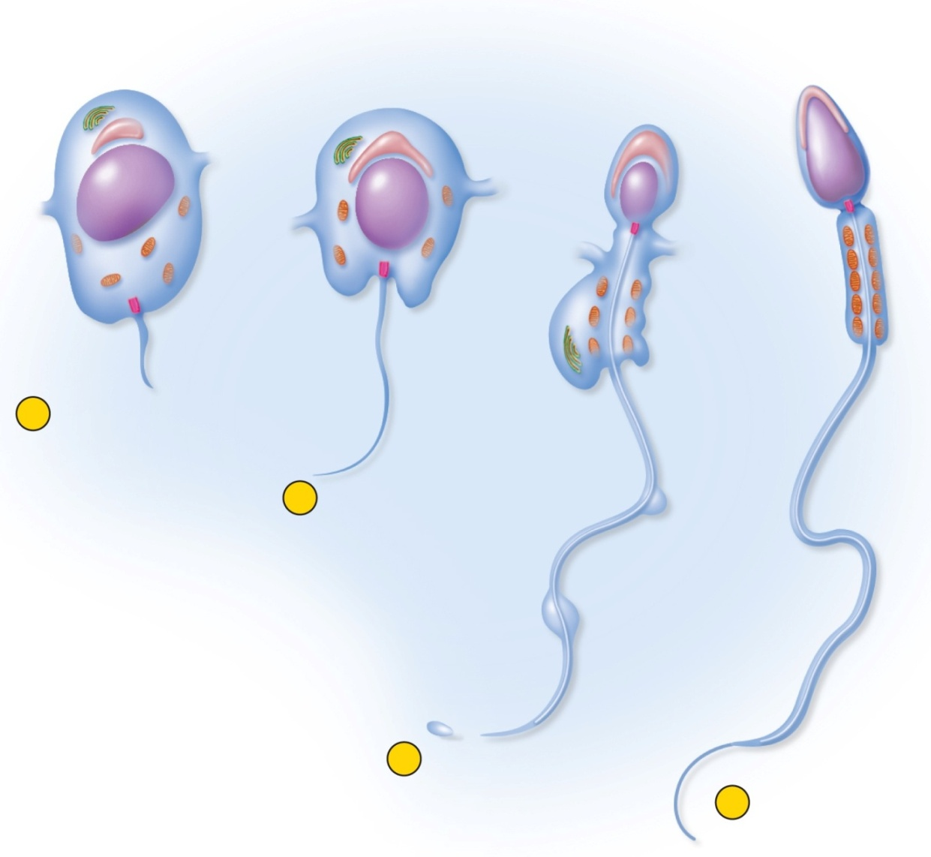
Spermiogenesis
Copyright © The McGraw-Hill Companies, Inc. Permission required for reproduction or display.
Golgi complex
Bridge to
adjacent
spermatid
Acrosome
spermiogenesis - changes that transform spermatids into spermatozoa
discarding excess cytoplasm and growing tails
Acrosomal
vesicle
Nucleus
Head
Axoneme
Basal
body
Mitochondria
Midpiece
of tail
Flagellum
Excess
cytoplasm
1
Appearance of
acrosomal vesicle
and flagellum in
spermatid
2
Growth of
acrosome
and flagellum
3
Shedding of
excess
cytoplasm
4
Mature sperm
Figure 27.16

Slide 50
Spermatozoon
spermatozoon two parts: head and tail
head is pear-shaped
4 to 5 microns long structure containing the nucleus, acrosome and basal body of the tail flagella
nucleus contains haploid set of chromosomes
acrosome – enzyme cap over the apical half of the nucleus that contains enzymes that penetrate the egg
basal body – indentation in the basal end of the nucleus where flagellum attaches
tail is divided into 3 regions:
midpiece contains mitochondria around axoneme of the flagella, produces ATP for flagellar movement
principal piece is axoneme surrounded by sheath of supporting fibers
constitutes most of tail
endpiece is very narrow tip of flagella

Slide 51
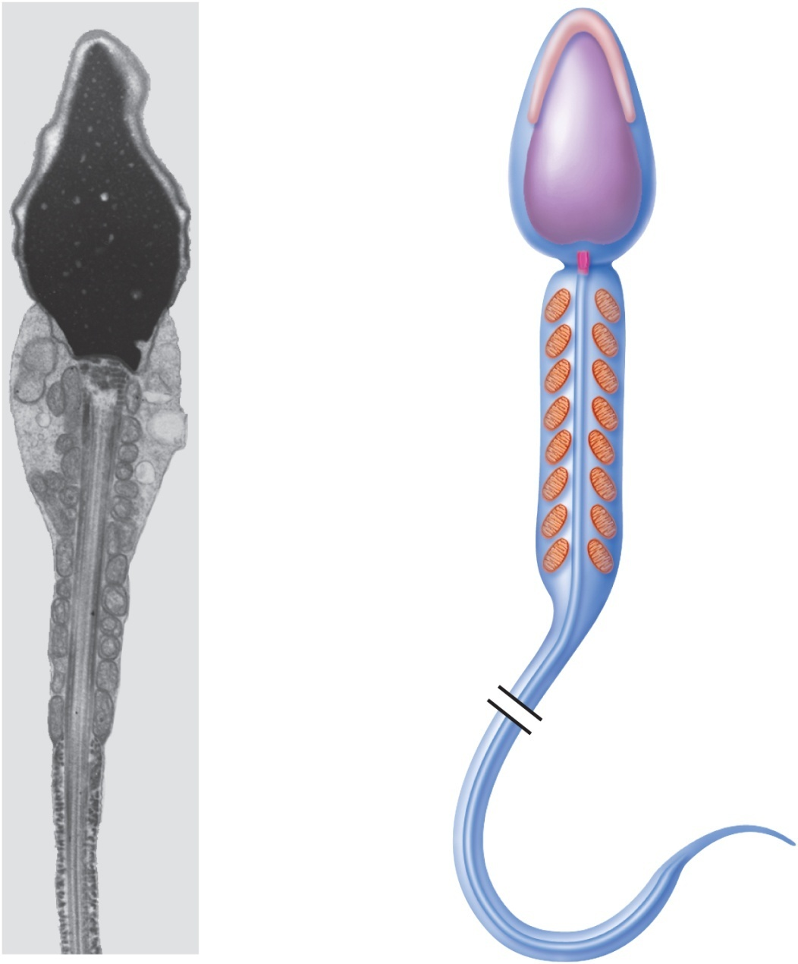
Spermatozoon
Copyright © The McGraw-Hill Companies, Inc. Permission required for reproduction or display.
Acrosome
Head
Nucleus
Basal body
Mitochondrion
Midpiece
of tail
Axoneme
Figure 27.17 a-b
Principal
piece of
tail
Endpiece
of tail
2 µm
(a)
(b)
a: Visuals Unlimited

Slide 52
Semen
semen (seminal fluid) – fluid expelled during orgasm
2-5 mL of fluid expelled during ejaculation
60% seminal vesicle fluid, 30% prostatic fluid, and 10% sperm and spermatic duct secretions
normal sperm count 50-120 million/mL
lower than 20 to 25 million/mL – infertility
prostate produces a thin, milky white fluid
contains calcium, citrate, and phosphate ions
a clotting enzyme
protein-hydrolyzing enzyme called serine protease (prostate-specific antigen)
seminal vesicles contribute viscous yellowish fluid
contains fructose and other carbohydrates, citrate, prostaglandins, and protein called proseminogelin

Slide 53
Semen
stickiness of semen promotes fertilization
clotting enzyme from prostate activates proseminogelin
converts it to a sticky fibrin-like protein – seminogelin
entangles the sperm
sticks to the inner wall of the vagina and cervix
ensures that the semen does not drain back into the vagina
promotes uptake of sperm-laden clots of semen into the uterus
20 to 30 minutes after ejaculation, serine protease from prostatic fluid breaks down seminogelin, and liquifies the semen
sperm become active
prostaglandins thin the mucus of the cervix, stimulates peristaltic waves in uterus and uterine tubes
two requirements for sperm motility – elevated pH and an energy source
prostatic fluid buffers vaginal acidity from 3.5 to 7.5
seminal vesicles provide fructose and other sugars to the mitochondria

Slide 54
Male Sexual Response
publication of research by William Masters and Virginia Johnson (1966)
divided intercourse into four recognizable phases
excitement
plateau
orgasm
resolution
led to therapy for sexual dysfunction
sexual intercourse is also known as coitus, coition, or copulation

Slide 55
Anatomy of Male Sexual Response
internal pudendal (penile) artery enters the root of the penis and divides in two:
dorsal artery – travels under skin on dorsal surface
supplies blood to skin, fascia, and corpus spongiosum
deep artery travels through the core of the corpus cavernosa
gives off smaller helicine arteries that penetrate the trabeculae and enter lacunae
dilation of deep artery fills lacunae causing an erection
when penis is flaccid, most blood comes from the dorsal artery
many anastomoses unite deep and dorsal arteries
deep dorsal vein drains blood from penis

Slide 56
Anatomy of Male Sexual Response
innervation of penis
the glans has an abundance of tactile, pressure, and temperature receptors
dorsal nerve of penis and internal pudendal nerves lead to integrating center in sacral spinal cord
both autonomic and somatic motor fibers carry impulses from integrating center to penis
sympathetics induce an erection in response to input from the special senses and to sexual thoughts
parasympathetics induce an erection in response to direct stimulation of the penis

Slide 57
Excitement and Plateau
excitement phase is characterized by vasocongestion (swelling of the genitals with blood), myotonia (muscle tension), and increases in heart rate, blood pressure, and pulmonary ventilation
bulbourethral glands secrete their fluid
initiated by a broad spectrum of erotic stimuli
erection of penis is due to parasympathetic triggering of nitric oxide (NO) secretion
causing dilation of deep arteries and filling of lacunae with blood
vasocongestion can also cause the testicles to be come 50% larger during excitement
plateau phase – the variables such as respiratory rate, heart rate, and blood pressure stay increased
marked increased vasocongestion and myotonia
lasts for a few seconds or a few minutes before orgasm

Slide 58
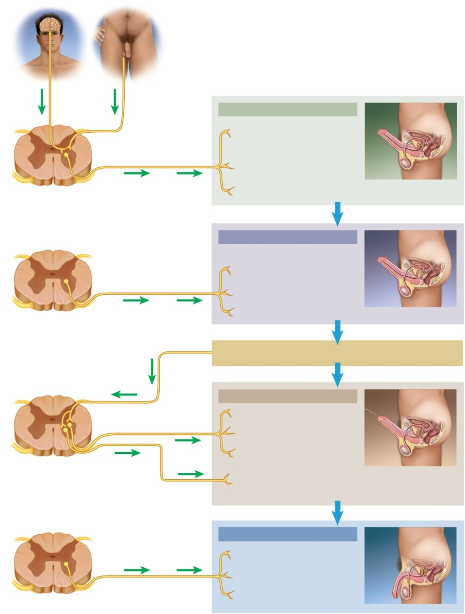
Sexual Response
Copyright © The McGraw-Hill Companies, Inc. Permission required for reproduction or display.
Stimulation
of genital
region,
especially
glans
V isual,
mental,
and other
stimuli
Internal
pudendal
nerve
Excitement
Deep artery of penis dilates; erectile
tissues engorge with blood; penis
becomes erect
Pelvic nerve
Trabecular muscle of erectile tissues
relaxes; allows engorgement of
erectile tissues; penis become erect
Spinal cord (sacral)
Efferent
parasympathetic
signals
Bulbourethral gland secretes
bulbourethral fluid
Orgasm
— emission stage
Ductus deferens exhibits peristalsis;
sperm are moved into ampulla; ampulla
contracts; sperm are moved into urethra
Prostate secretes components of the
seminal fluid
Spinal cord (L1–L2)
Efferent
sympathetic
signals
Seminal vesicles secrete components of
the seminal fluid
Semen in urethra
Afferent
signals
Efferent
sympathetic
signals
Orgasm — expulsion stage
Prostate releases additional secretion
Seminal vesicles release additional
secretion
Efferent
somatic
signals
Internal urethral sphincter contracts;
urine is retained in bladder
Spinal cord (L1–S4)
Bulbocavernosus muscle contracts, and
rhythmically compresses bulb and root of
penis; semen is expelled (ejaculation
occurs)
Resolution
Internal pudendal artery constricts;
reduces blood flow into penis
Figure 27.18
Efferent
sympathetic
signals
Trabecular muscles contract;
squeeze blood from erectile tissues
Spinal cord (L1–L2)
Penis becomes flaccid (detumescent)
parasympathetic signals produce an erection with direct stimulation of penis or perineal organs

Slide 59
Orgasm and Ejaculation
orgasm or climax – a short but intense reaction that is usually marked by the discharge of semen
lasts 3 to 15 seconds
heart rate, blood pressure, and breathing greatly elevate
ejaculation occurs in two stages:
emission - sympathetic nervous system stimulates peristalsis which propels sperm through ducts as glandular secretions are added
expulsion - semen in urethra activates somatic and sympathetic reflexes that stimulate muscular contractions that lead to expulsion
sympathetic reflex constricts internal urethral sphincter so urine cannot enter the urethra and semen can not enter the bladder
ejaculation and orgasm are not the same
can occur separately

Slide 60
Resolution
resolution phase – body variables return to pre-excitement state
sympathetic signals constrict internal pudendal artery and reduce blood flow to penis
penis becomes soft and flaccid (detumescence)
cardiovascular and respiratory responses return to normal
refractory period – period following resolution in which it is usually impossible for a male to attain another erection or orgasm
may last from 10 minutes to a few hours

Slide 61
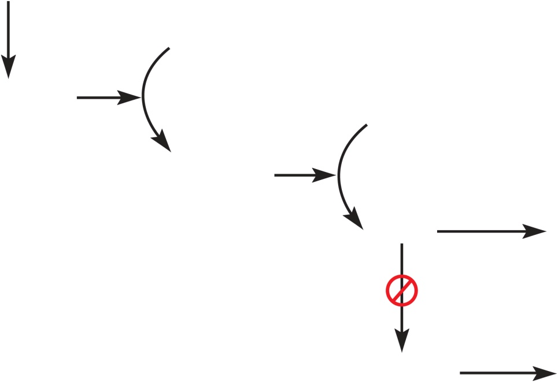
How Viagra Prolongs Erection
Copyright © The McGraw-Hill Companies, Inc. Permission required for reproduction or display.
Sexual
stimulation
Inactive
guanylate
cyclase
Nitric oxide
GTP
Active
guanylate
cyclase
cGMP
Vasodilation
and erection
Phosphodiesterase
inhibitors
Degraded
by PDE5
Loss of
erection
Figure 27.19
treatments - Viagra, Levitra, and Cialis
phosphodiesterase inhibitors
sexual stimulation triggers nitric oxide secretion, which activates cGMP, which increases blood flow into erectile tissue
this drugs slow down the breakdown of cGMP by phosphodiesterase type 5 and prolongs the duration of the erection

Slide 62
Sexually Transmitted Diseases
STDs have an incubation period in which the pathogen multiplies with no symptoms and a communicable period in which the disease can be transmitted to others
symptomless carriers do exist
bacterial STDs
chlamydia – may cause urethral discharge and testicular pain
gonorrhea – pain and pus discharge – may result in sterility from pelvic inflammatory disease
syphilis – hard lesions (chancres) at site of infection
disappearance of chancres ends first stage
second stage is widespread pink rash
neurosyphilis is third stage with cardiovascular damage and brain lesions
viral STDs
genital herpes – most common STD in US
blisters and pain
genital warts – warts on perineal region, cervix, anus
hepatitis B and C – inflammatory liver disease

