Slide 1
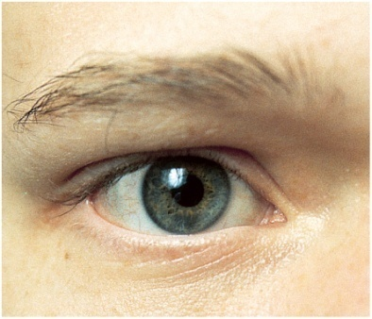
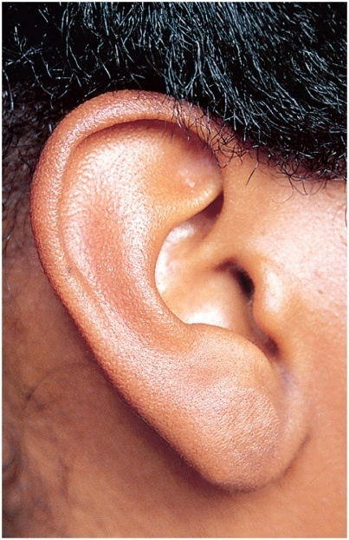
Sense Organs
Copyright © The McGraw-Hill Companies, Inc. Permission required for reproduction or display.
Properties and Types of Sensory Receptors
General Senses
Chemical Senses
Hearing and Equilibrium
Vision
Superciliary
ridge
Pupil
Superior
palpebral
sulcus
Eyebrow
Upper
eyelid
Eyelashes
Iris
Palpebral
fissure
Sclera
Medial
commissure
Lateral
commissure
Lower
eyelid
Tarsal plate
Inferior
palpebral
sulcus
© The McGraw-Hill Companies, Inc./Joe DeGrandis, photographer
Figure 16.22
Copyright © The McGraw-Hill Companies, Inc. Permission required for reproduction or display.
Helix
Triangular fossa
Antihelix
Concha
External acoustic meatus
Tragus
Antitragus
Figure 16.10
Lobule (earlobe)
© The McGraw-Hill Companies, Inc./Joe DeGrandis, photographer

Slide 2
Definitions
sensory input is vital to the integrity of personality and intellectual function
sensory deprivation – withholding sensory stimulation
sensory receptor - a structure specialized to detect a stimulus
bare nerve ending
sense organs - nerve tissue surrounded by other tissues that enhance response to certain type of stimulus
added epithelium, muscle or connective tissue

Slide 3
General Properties of Receptors
transduction – the conversion of one form of energy to another
fundamental purpose of any sensory receptor
conversion of stimulus energy (light, heat, touch, sound, etc.) into nerve signals
sense organ, gasoline engine, light bulb are all transducers
receptor potential – small, local electrical change on a receptor cell brought about by an initial stimulus
results in release of neurotransmitter or a volley of action potentials that generates nerve signals to the CNS
sensation – a subjective awareness of the stimulus
most sensory signals delivered to the CNS produce no conscious sensation
filtered out in the brainstem
some do not require conscious awareness like pH and body temperature

Slide 4
Receptors Transmit Four Kinds of Information
Modality - type of stimulus or the sensation it produce
vision, hearing, taste
labeled line code – all action potentials are identical. Each nerve pathway from sensory cells to the brain is labeled to identify its origin, and the brain uses these labels to interpret what modality the signal represents
Location – encoded by which nerve fibers are issuing signals to the brain
receptive field – area that detects stimuli for a sensory neuron
receptive fields vary in size – fingertip versus skin on back
two-point touch discrimination
sensory projection - brain identifies site of stimulation
projection pathways – the pathways followed by sensory signals to their ultimate destination in the CNS

Slide 5
Receptors Transmit Four Kinds of Information
Intensity – encoded in 3 ways:
brain can distinguish intensity by:
which fibers are sending signals
how many fibers are doing so
how fast these fibers are firing
Duration – how long the stimulus lasts
change in firing frequency over time
sensory adaptation – if stimulus is prolonged, the firing of the neuron gets slower over time, and we become less aware of the stimulus
phasic receptor – generate a burst of action potentials when first stimulated, then quickly adapt and sharply reduce or stop signaling even though the stimulus continues
smell, hair movement, and cutaneous pressure
tonic receptor - adapt slowly, generate nerve signals more steadily
proprioceptors - body position, muscle tension, and joint motion

Slide 6
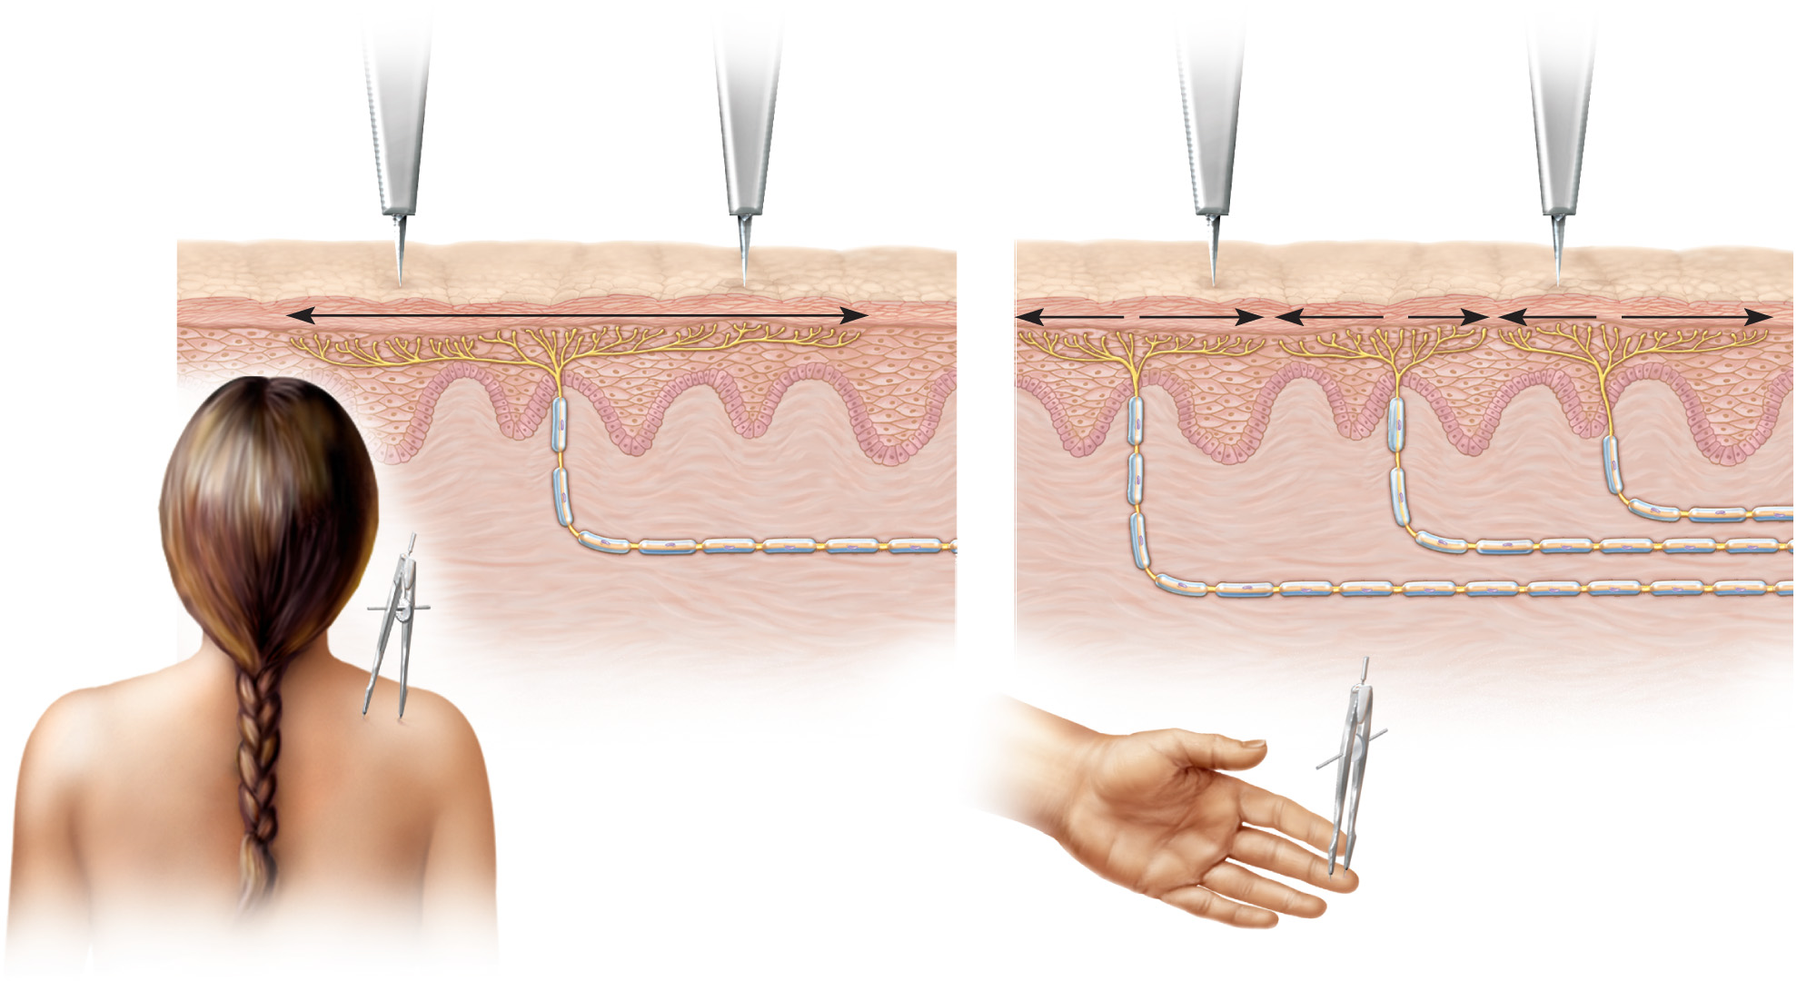
Receptive Fields
Copyright © The McGraw-Hill Companies, Inc. Permission required for reproduction or display.
1
2
3
Neuron 3
Neuron
Neuron 2
Neuron 1
(a) One large receptive field (arrow)
(b) Three small receptive
fields (arrows)
Figure 16.1

Slide 7
Classification of Receptors
by modality:
thermoreceptors, photoreceptors, nociceptors, chemoreceptors, and mechanoreceptors
by origin of stimuli
exteroceptors - detect external stimuli
interoceptors - detect internal stimuli
proprioceptors - sense body position and movements
by distribution
general (somesthetic) senses - widely distributed
special senses - limited to head
vision, hearing, equilibrium, taste, and smell

Slide 8
General Senses
structurally simple receptors
one or a few sensory fibers and a little connective tissue
unencapsulated nerve endings
free nerve endings
tactile (Merkel) discs
hair receptors (peritrichial endings)
encapsulated nerve endings
tactile (Meissner) corpuscles
Krause end bulbs
bulbous (Ruffini) corpuscles
lamellar (pacinian) corpuscles
muscle spindles
golgi tendon organs
physiologically simple receptors

Slide 9
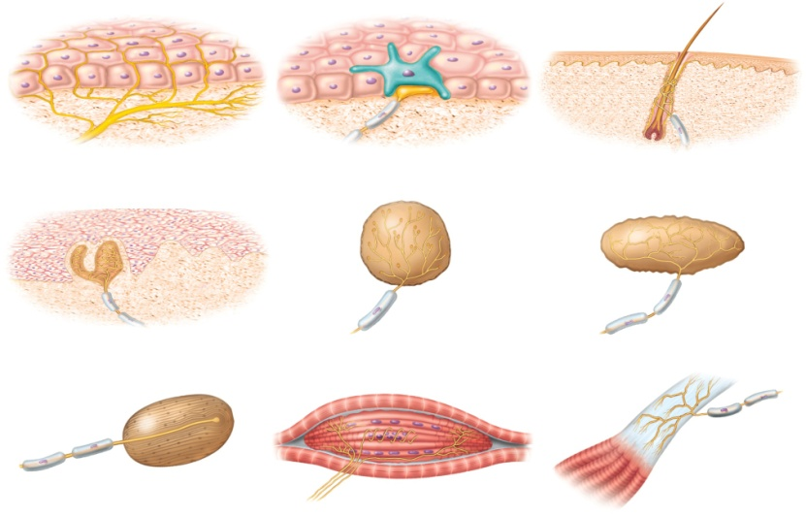
Unencapsulated Nerve Endings
dendrites not wrapped in connective tissue
free nerve endings
for pain and temperature
skin and mucous membrane
tactile discs
for light touch and texture
associated with Merkel cells at base of epidermis
hair receptors
wrap around base hair follicle
monitor movement of hair
Copyright © The McGraw-Hill Companies, Inc. Permission required for reproduction or display.
Tactile cell
Nerve ending
Free nerve endings
Tactile disc
Hair receptor
Tactile corpuscle
End bulb
Bulbous corpuscle
Lamellar corpuscle
Muscle spindle
Tendon organ
Figure 16.2

Slide 10
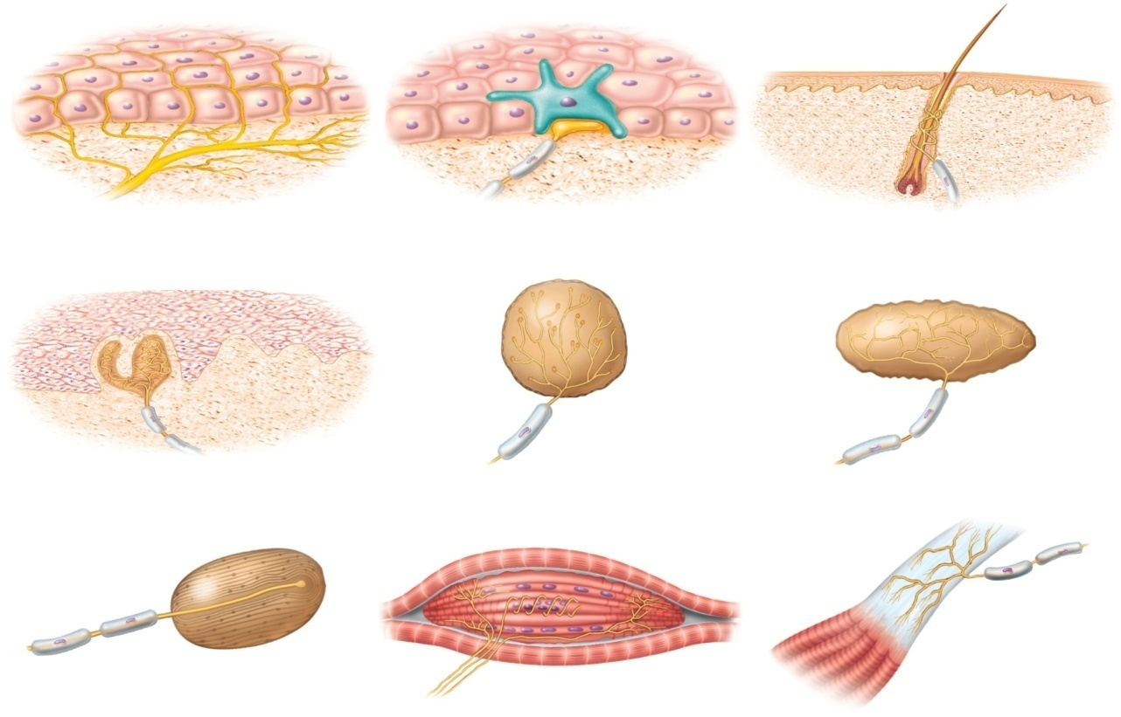
Encapsulated Nerve Endings
Copyright © The McGraw-Hill Companies, Inc. Permission required for reproduction or display.
Tactile cell
Nerve ending
Free nerve endings
Tactile disc
Hair receptor
Tactile corpuscle
End bulb
Bulbous corpuscle
Figure 16.2
Lamellar corpuscle
Muscle spindle
Tendon organ
dendrites wrapped by glial cells or connective tissue
connective tissue enhances sensitivity or selectivity of response

Slide 11
Encapsulated Nerve Endings
tactile (Meissner) corpuscles
light touch and texture
dermal papillae of hairless skin
Krause end bulb
tactile; in mucous membranes
lamellated (pacinian) corpuscles - phasic
deep pressure, stretch, tickle and vibration
periosteum of bone, and deep dermis of skin
bulbous (Ruffini) corpuscles - tonic
heavy touch, pressure, joint movements and skin stretching

Slide 12
Somesthetic Projection Pathways
from receptor to final destination in the brain, most somesthetic signals travel by way of three neurons
1st order neuron (afferent neuron)
from body, enter the dorsal horn of spinal cord via spinal nerves
from head, enter pons and medulla via cranial nerve
touch, pressure and proprioception on large, fast, myelinated axons
heat and cold on small, unmyelinated, slow fibers
2nd order neuron
decussation to opposite side in spinal cord, medulla, or pons
end in thalamus, except for proprioception, which ends in cerebellum
3rd order neuron
thalamus to primary somesthetic cortex of cerebrum

Slide 13
Pain
pain – discomfort caused by tissue injury or noxious stimulation, and typically leading to evasive action
important since helps protect us
lost in diabetes mellitus – diabetic neuropathy
nociceptors – two types providing different pain sensations
fast pain travels in myelinated fibers at 12 - 30 m/sec
sharp, localized, stabbing pain perceived with injury
slow pain travels unmyelinated fibers at 0.5 - 2 m/sec
longer-lasting, dull, diffuse feeling
somatic pain - from skin, muscles and joints
visceral pain - from the viscera
stretch, chemical irritants or ischemia of viscera (poorly localized)
injured tissues release chemicals that stimulate pain fibers
bradykinin - most potent pain stimulus known
makes us aware of injury and activates cascade or reactions that promote healing
histamine, prostaglandin & serotonin also stimulate nociceptors

Slide 14
Projection Pathway for Pain
two main pain pathways to brain, and multiple subroutes
pain signals from head
first-order neuron cell bodies in dorsal root ganglion of spinal nerves or cranial nerves V, VII, IX, and X
second-order neurons decussate and send fibers up spinothalamic tract or through medulla to thalamus
gracile fasciculus carries visceral pain signals
third-order neurons from thalamus reach postcentral gyrus of cerebrum
pain signals from neck down
travel by way of three ascending tracts:
spinothalamic tract – most significant pain pathway
carries most somatic pain signals
spinoreticular tract – carries pain signals to reticular formation
activate visceral, emotional and behavioral reactions to pain
gracile fasciculus – carries signals to the thalamus for visceral pain

Slide 15
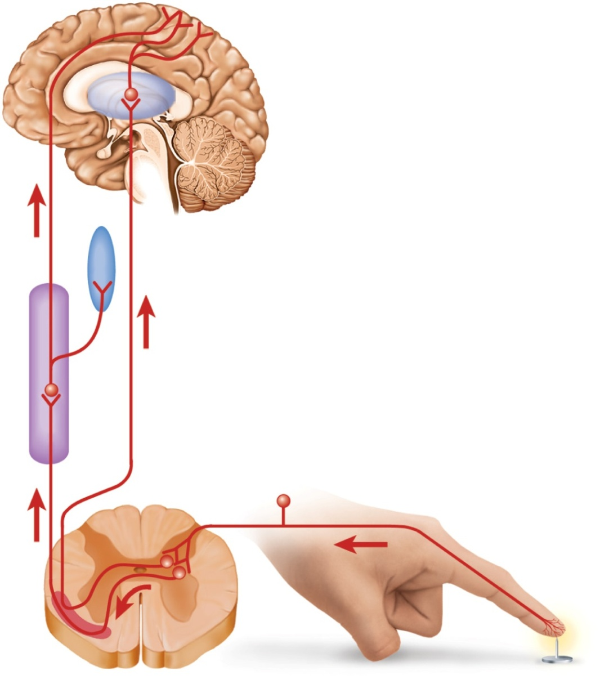
Pain Signal Destinations
Copyright © The McGraw-Hill Companies, Inc. Permission required for reproduction or display.
Primary somesthetic cortex
Somesthetic association area
Thalamus
Third-order nerve fibers
Hypothalamus and
limbic system
Reticular formation
Second-order nerve fibers
Spinothalamic tract
Figure 16.3
Spinoreticular tract
First-order
nerve fiber
Spinal cord
Nociceptor
Anterolateral system

Slide 16
Referred Pain
referred pain – pain in viscera often mistakenly thought to come from the skin or other superficial site
results from convergence of neural pathways in CNS
brain “assumes” visceral pain is coming from skin
brain can not distinguish source
heart pain felt in shoulder or arm because both send pain input to spinal cord segments T1 to T5

Slide 17
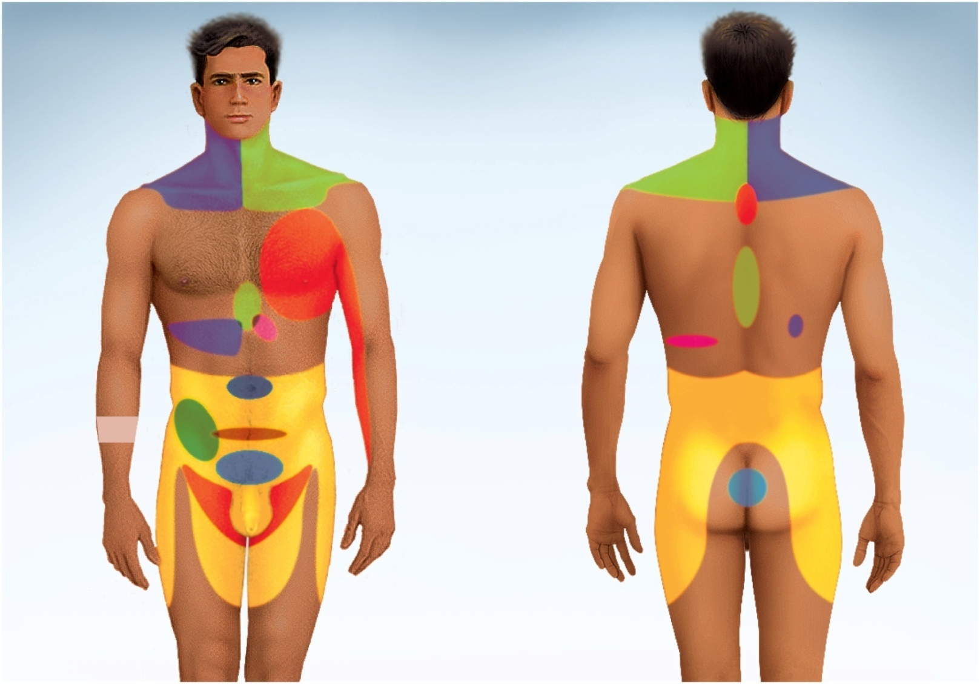
Referred Pain
Copyright © The McGraw-Hill Companies, Inc. Permission required for reproduction or display.
Liver and
gallbladder
Liver and
gallbladder
Lung and diaphragm
Heart
Stomach
Pancreas
Small intestine
Appendix
Colon
Urinary
bladder
Ureter
Kidney
Figure 16.4

Slide 18
CNS Modulation of Pain
analgesic (pain-relieving) mechanisms of CNS just beginning to be understood
tied to receptor sites for opium, morphine & heroin in the brain
enkephalins - two analgesic oligopeptides with 200 times the potency of morphine
endorphins and dynorphins – larger analgesic neuropeptides discovered later
endogenous opioids – internally produced opium-like substances
enkephalins, endorphins, and dynorphins
secreted by the CNS, pituitary gland, digestive tract, and other organs
neuromodulators that can block the transmission of pain signals and produce feelings of pleasure and euphoria

Slide 19
Spinal Gating
spinal gating - stops pain signals at the posterior horn of the spinal cord
descending analgesic fibers arise in brain stem
travel down the spinal cord in the reticulospinal tract
block pain signals from traveling up the cord to the brain
normal pain pathway
nociceptor stimulates second-order nerve fiber
substance P is neurotransmitter at this synapse
second-order fiber transmits signal up the spinothalamic tract to the thalamus
thalamus relays the signals through third order neurons to the cerebral cortex where one becomes conscious of the pain

Slide 20
Spinal Gating
pathway for pain blocking (modulation)
signals from the hypothalamus and cerebral cortex feed into the central gray matter of the midbrain
allows both autonomic and conscious influences on pain perception
midbrain relays signals to certain nuclei in the reticular formation of the medulla oblongata
medulla issues descending, serotonin-secreting analgesic fibers to the spinal cord
terminate in the posterior horn at all levels of the spinal cord
in posterior horn, descending analgesic fibers synapse on short spinal interneurons
the interneurons synapse on the second-order pain fiber
secrete enkephalins to inhibit the second-order neuron
some fibers from the medulla also exert presynaptic inhibition by synapsing on the axons of nociceptors and blocking the release of substance P
another pathway of spinal gating – rubbing or massaging injury
pain-inhibiting neurons of the posterior horn receive input from mechanoreceptors in the skin and deeper tissues
rubbing stimulates mechanoreceptors which stimulates spinal interneurons to secrete enkephalins that inhibit second-order pain neurons

Slide 21
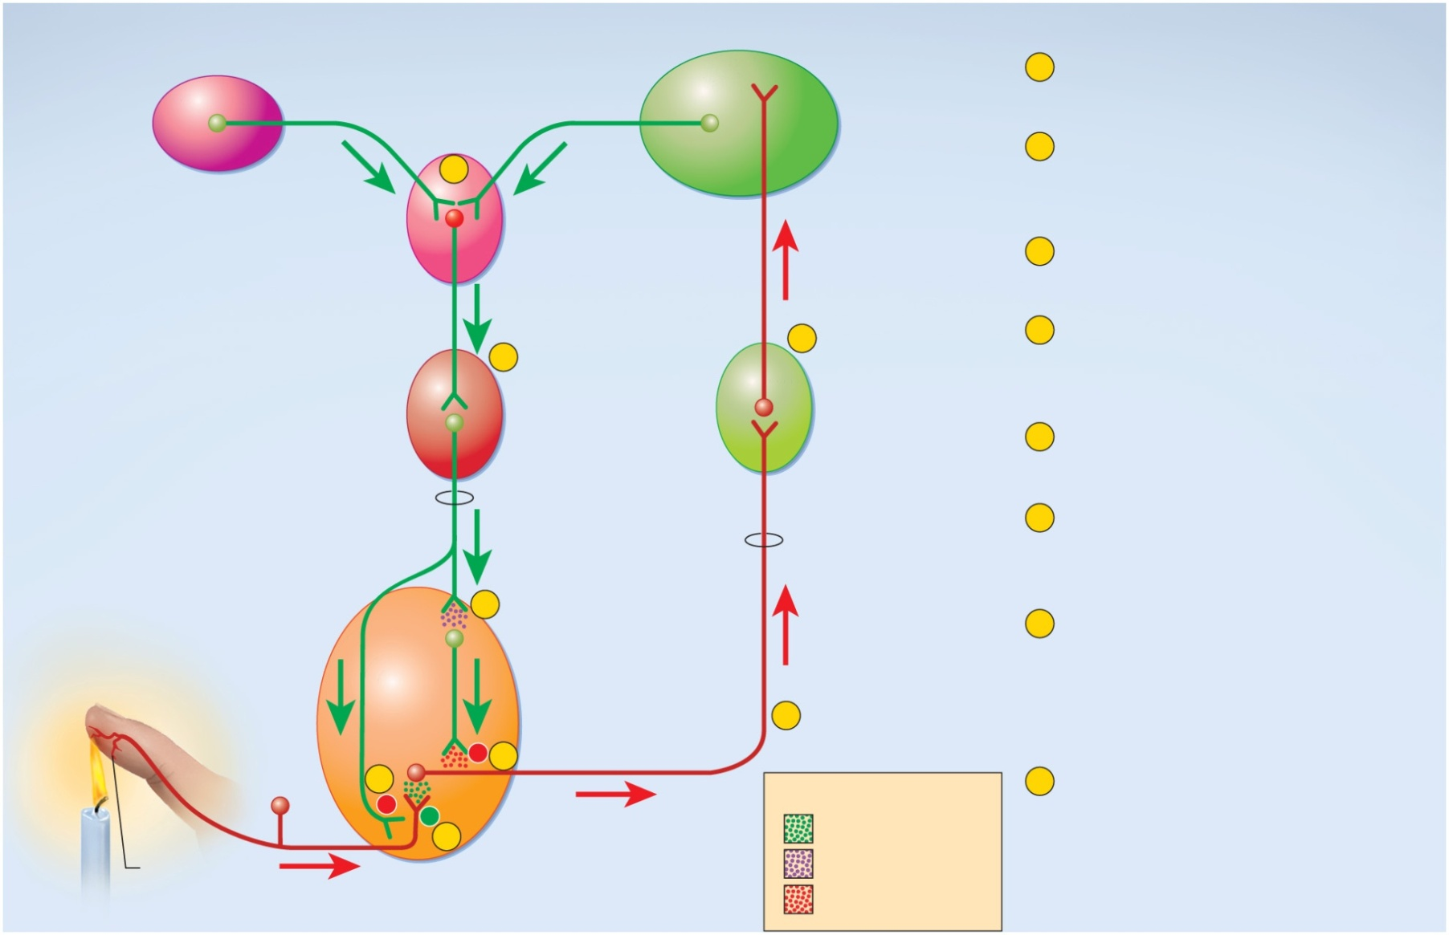
Spinal Gating of Pain Signals
Copyright © The McGraw-Hill Companies, Inc. Permission required for reproduction or display.
Hypothalamus
1
Nociceptor releases substance P
onto spinal interneuron.
Cerebral
cortex
2
Second-order neuron transmits
signal up spinothalamic tract to
thalamus.
4
Midbrain
3
Third-order neuron relays signal to
somesthetic cortex.
3
4
Input from hypothalamus and
cerebral cortex converges on
central gray matter of midbrain.
5
Medulla oblongata
Thalamus
5
Midbrain relays signal to reticular
formation of medulla oblongata.
Reticulospinal tract
6
Some descending analgesic
fibers from medulla secrete
serotonin onto inhibitory spinal
interneurons.
Spinothalamic
tract
Dorsal horn of
spinal cord
6
7
Spinal interneurons secrete
enkephalins, blocking pain
transmission by means of
postsynaptic inhibition of
second-order pain neuron.
2
−
7
8
Neurotransmitters
8
Other descending analgesic fibers
synapse on first-order pain fiber,
blocking pain transmission by
means of presynaptic inhibition.
−
+
Substance P
Nociceptor
1
Serotonin
Enkephalins
Figure 16.5

Slide 22
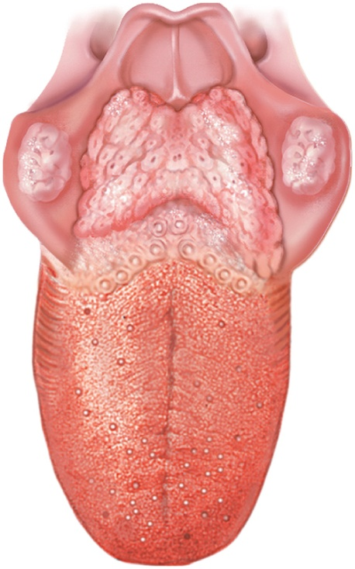
Chemical Sense - Taste
gustation (taste) – sensation that results from action of chemicals on taste buds
4000 - taste buds mainly on tongue
inside cheeks, and on soft palate, pharynx, and epiglottis
lingual papillae
filiform - no taste buds
important for food texture
foliate - no taste buds
weakly developed in humans
fungiform
at tips and sides of tongue
vallate (circumvallate)
at rear of tongue
contains 1/2 of all taste buds
Copyright © The McGraw-Hill Companies, Inc. Permission required for reproduction or display.
Epiglottis
Lingual tonsil
Palatine tonsil
Vallate
papillae
Foliate
papillae
Fungiform
papillae
(a) Tongue
Figure 16.6a

Slide 23
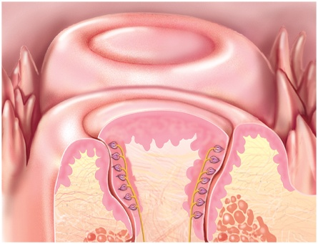
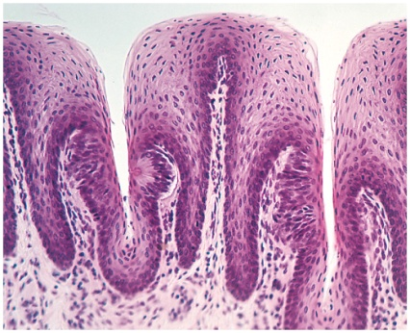
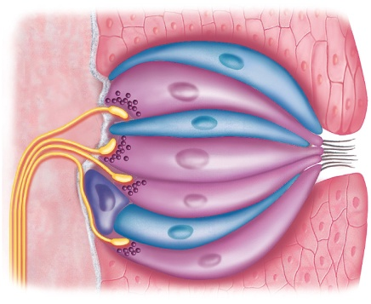
Taste Bud Structure
all taste buds look alike
lemon-shaped groups of 40 – 60 taste cells, supporting cells, and basal cells
taste cells
have tuft of apical microvilli (taste hairs) that serve as receptor surface for taste molecules
taste pores – pit in which the taste hairs project
taste hairs are epithelial cells not neurons
synapse with and release neurotransmitters onto sensory neurons at their base
basal cells
stem cells that replace taste cells every 7 to 10 days
supporting cells
resemble taste cells without taste hairs, synaptic vesicles, or sensory role
Copyright © The McGraw-Hill Companies, Inc. Permission required for reproduction or display.
Vallate
papillae
Filiform
papillae
Taste
buds
(b) Vallate papillae
Figure 16.6b
Foliate
papilla
Taste pore
Taste bud
Figure 16.6c
(c) Foliate papillae
c: © Ed Reschke
100 µm
Synaptic
vesicles
Supporting
cell
Sensory
nerve
fibers
Taste
cell
Taste
pore
Basal
cell
Taste
hairs
Tongue
epithelium
(d) Taste bud
Figure 16.6d

Slide 24
Physiology of Taste
to be tasted, molecules must dissolve in saliva and flood the taste pore
five primary sensations
salty – produced by metal ions (sodium and potassium)
sweet – associated with carbohydrates and other foods of high caloric value
sour – acids such as in citrus fruits
bitter – associated with spoiled foods and alkaloids such as nicotine, caffeine, quinine, and morphine
umami – ‘meaty’ taste of amino acids in chicken or beef broth
taste is influenced by food texture, aroma, temperature, and appearance
mouthfeel - detected by branches of lingual nerve in papillae
hot pepper stimulates free nerve endings (pain), not taste buds
regional differences in taste sensations on tongue
tip is most sensitive to sweet, edges to salt and sour, and rear to bitter

Slide 25
Physiology of Taste
two mechanisms of action
activate 2nd messenger systems
sugars, alkaloids, and glutamate bind to receptors which activates G proteins and second-messenger systems within the cell
depolarize cells directly
sodium and acids penetrate cells and depolarize it directly
either mechanism results in release of neurotransmitters that stimulate dendrites at base of taste cells

Slide 26
Projection Pathways for Taste
facial nerve collects sensory information from taste buds over anterior two-thirds of tongue
glossopharyngeal nerve from posterior one-third of tongue
vagus nerve from taste buds of palate, pharynx and epiglottis
all fibers reach solitary nucleus in medulla oblongata
from there, signals sent to two destinations
hypothalamus and amygdala control autonomic reflexes – salivation, gagging and vomiting
thalamus relays signals to postcentral gyrus of cerebrum for conscious sense of taste
sent on to orbitofrontal cortex to be integrated with signals from nose and eyes - form impression of flavor and palatability of food

Slide 27
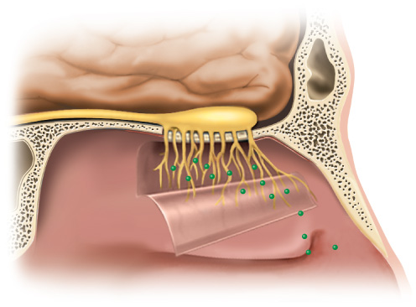
Smell - Anatomy
olfaction – sense of smell
olfactory mucosa
contains 10 to 20 million olfactory cells, which are neurons, as well as epithelial supporting cells and basal stem cells
mucosa of superior concha, nasal septum, and roof of nasal cavity covering about 5 cm²
on average 2000 to 4000 odors distinguished
Copyright © The McGraw-Hill Companies, Inc. Permission required for reproduction or display.
Olfactory tract
Olfactory bulb
Olfactory nerve
fascicle
Olfactory
mucosa (reflected)
(a)
Figure 16.7a

Slide 28
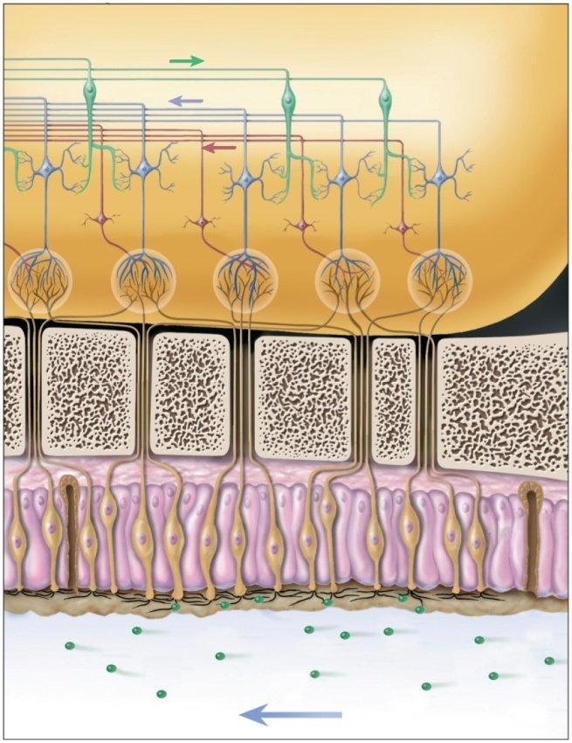
Smell - Anatomy
olfactory cells
are neurons
shaped like little bowling pins
head bears 10 – 20 cilia called olfactory hairs
have binding sites for odorant molecules and are nonmotile
lie in a tangled mass in a thin layer of mucus
basal end of each cell becomes the axon
axons collect into small fascicles and leave cranial cavity through the cribriform foramina in the ethmoid bone
fascicles are collectively regarded as Cranial Nerve I
Copyright © The McGraw-Hill Companies, Inc. Permission required for reproduction or display.
Olfactory bulb
Granule cell
Olfactory tract
Mitral cell
Tufted cell
Glomerulus
Olfactory
nerve fascicle
Cribriform
plate of
ethmoid bone
Basal cell
Supporting
cells
Olfactory cell
Olfactory gland
Olfactory hairs
Mucus
Odor
molecules
Airflow
(b)
Figure 16.7b

Slide 29
Olfactory Cells
Copyright © The McGraw-Hill Companies, Inc. Permission required for reproduction or display.
only neurons in the body directly exposed to the external environment
have a lifespan of only 60 days
basal cells continually divide and differentiate into new olfactory cells
supporting cells
basal cells
divide and differentiate to replace olfactory cells
Olfactory bulb
Granule cell
Olfactory tract
Mitral cell
Tufted cell
Glomerulus
Olfactory
nerve fascicle
Cribriform
plate of
ethmoid bone
Basal cell
Supporting
cells
Olfactory cell
Olfactory gland
Olfactory hairs
Mucus
Odor
molecules
Airflow
(b)
Figure 16.7b

Slide 30
Smell - Physiology
humans have a poorer sense of smell than most other mammals
women more sensitive to odors than men
highly important to social interaction
odorant molecules bind to membrane receptor on olfactory hair
hydrophilic - diffuse through mucus
hydrophobic - transported by odorant-binding protein in mucus
activate G protein and cAMP system
opens ion channels for Na⁺ or Ca²⁺
depolarizes membrane and creates receptor potential

Slide 31
Smell - Physiology
action potential travels to brain
olfactory receptors adapt quickly
due to synaptic inhibition in olfactory bulbs
some odorants act on nociceptors of the trigeminal nerve
ammonia, menthol, chlorine, and capsaicin of hot peppers
Human Pheromones
human body odors may affect sexual behavior
a person’s sweat and vaginal secretions affect other people’s sexual physiology
dormitory effect
presence of men seems to influence female ovulation
ovulating women’s vaginal secretions contain pheromones called copulines, that have been shown to raise men’s testosterone level

Slide 32
Olfactory Projection Pathways
olfactory cells synapse in olfactory bulb
on dendrites of mitral and tufted cells
dendrites meet in spherical clusters called glomeruli
each glomeruli dedicated to single odor because all fibers leading to one glomerulus come from cells with same receptor type
tufted and mitral cell axons form olfactory tracts
reach primary olfactory cortex in the inferior surface of the temporal lobe
secondary destinations –hippocampus, amygdala, hypothalamus, insula, and orbitofrontal cortex
identify odors, integrate smell with taste, perceive flavor, evoke memories and emotional responses, and visceral reactions
fibers reach back to olfactory bulbs where granule cells inhibit the mitral and tufted cells
reason why odors change under different conditions
food smells more appetizing when you are hungry

Slide 33
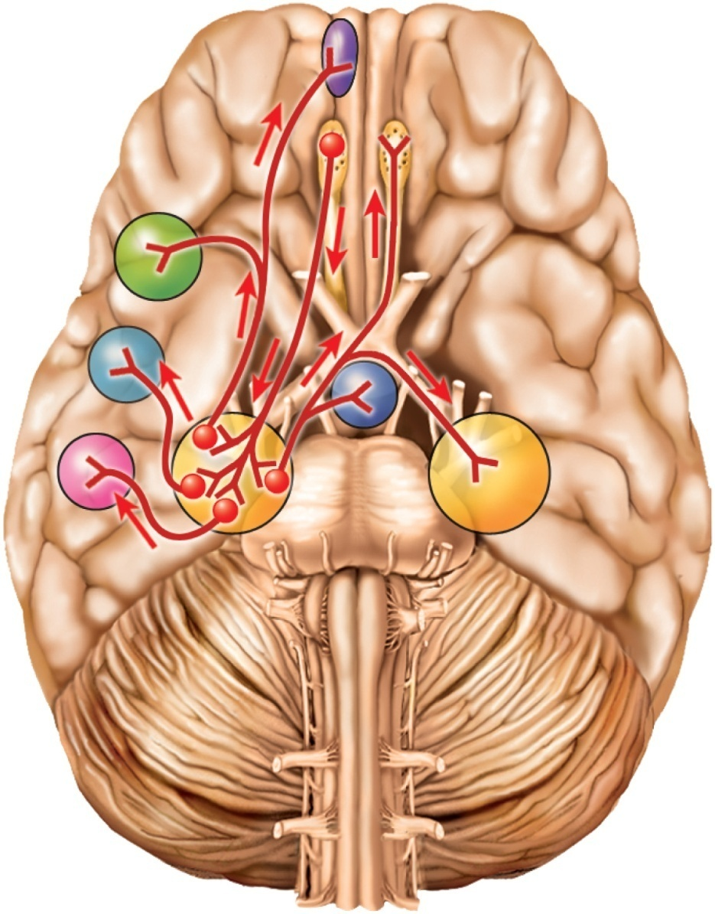
Olfactory Projection Pathways
Copyright © The McGraw-Hill Companies, Inc. Permission required for reproduction or display.
Orbitofrontal cortex
Olfactory bulb
Olfactory tract
Insula
Hypothalamus
Amygdala
Primary
olfactory cortex
Hippocampus
Figure 16.8

Slide 34
Hearing and Equilibrium
hearing – a response to vibrating air molecules
equilibrium – the sense of motion, body orientation, and balance
both senses reside in the inner ear, a maze of fluid-filled passages and sensory cells
fluid is set in motion and how the sensory cells convert this motion into an informative pattern of action potentials

Slide 35
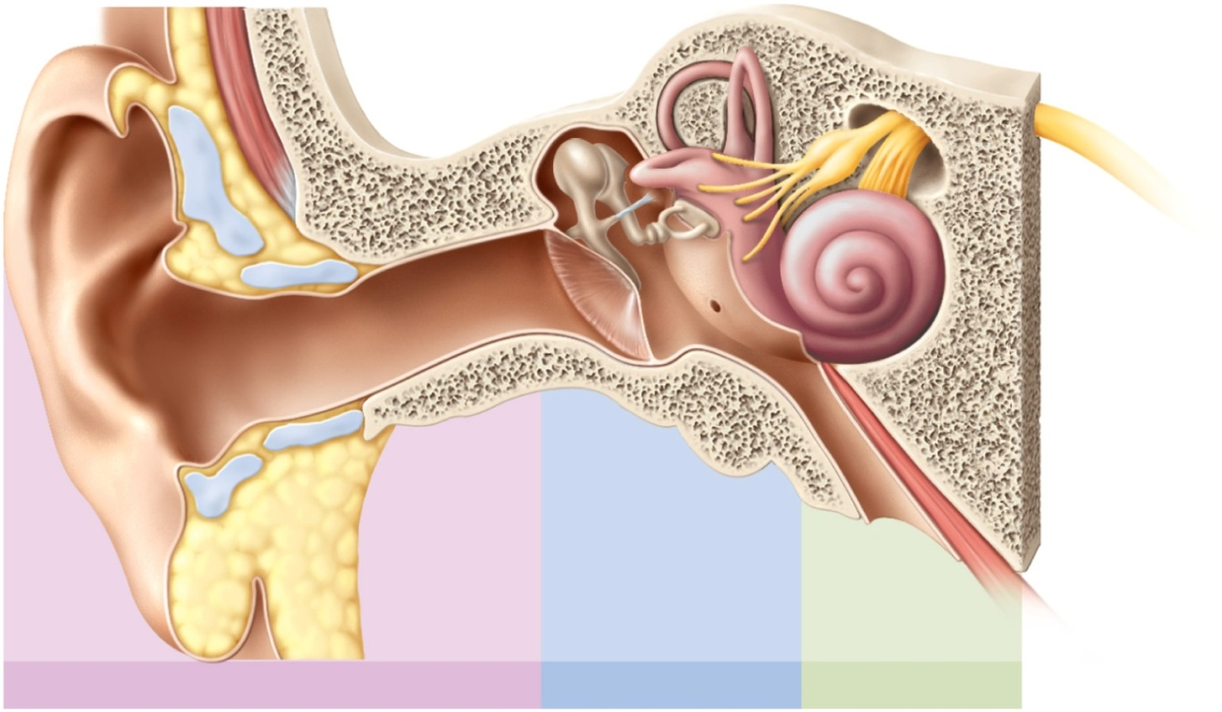
The Nature of Sound
sound – any audible vibration of molecules
a vibrating object pushes on air molecules
in turn push on other air molecules
air molecules hitting eardrum cause it to vibration
Copyright © The McGraw-Hill Companies, Inc. Permission required for reproduction or display.
Ossicles:
Semicircular ducts
Helix
Stapes
Oval window
Incus
Vestibular nerve
Malleus
Cochlear nerve
Vestibule
Auricle
Cochlea
Tympanic
membrane
Round window
Auditory
canal
Tympanic cavity
Tensor tympani
muscle
Auditory tube
Lobule
Figure 16.11
Outer ear
Middle ear
Inner ear

Slide 36
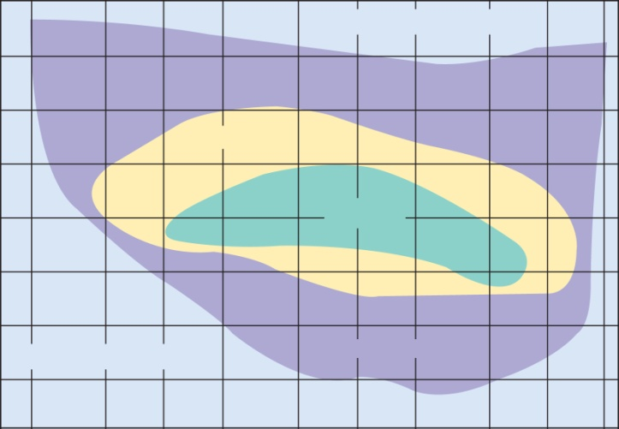
Pitch and Loudness
Copyright © The McGraw-Hill Companies, Inc. Permission required for reproduction or display.
Threshold of pain
120
100
80
Music
60
Speech
Loudness (decibels)
40
20
All sound
Figure 16.9
0
Threshold of hearing
20
50
100
200
500
1,000
2,000
5,000
10,000
20,000
Frequency (hertz)
pitch – our sense of whether a sound is ‘high’ or ‘low’
determined by the frequency - cycles/sec – cps or hertz, Hz
human hearing range is 20 Hz - 20,000 Hz (cycles/sec)
infrasonic frequencies below 20 Hz
ultrasonic frequencies above 20,000 Hz
speech is 1500-5000 where hearing is most sensitive
hearing loss with age is 250 to 2,050 Hz
loudness – the perception of sound energy, intensity, or amplitude of the vibration
expressed in decibels (dB)
prolonged exposure to sounds > 90dB can cause damage

Slide 37
Anatomy of Ear
ear has three sections outer, middle, and inner ear
first two are concerned only with the transmission of sound to the inner ear
inner ear – vibrations converted to nerve signals
Copyright © The McGraw-Hill Companies, Inc. Permission required for reproduction or display.
Ossicles:
Semicircular ducts
Helix
Stapes
Oval window
Incus
Vestibular nerve
Malleus
Cochlear nerve
Vestibule
Auricle
Cochlea
Tympanic
membrane
Round window
Auditory
canal
Tympanic cavity
Tensor tympani
muscle
Auditory tube
Lobule
Figure 16.11
Outer ear
Middle ear
Inner ear

Slide 38
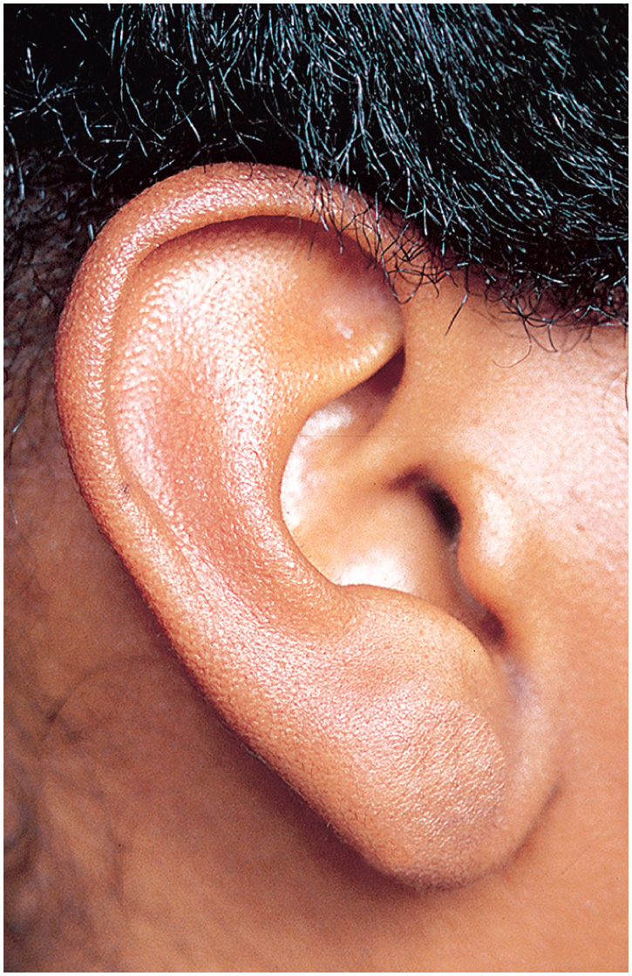
Outer Ear
Copyright © The McGraw-Hill Companies, Inc. Permission required for reproduction or display.
Helix
Triangular fossa
Antihelix
Concha
External acoustic meatus
Tragus
Antitragus
Lobule (earlobe)
Figure 16.10
© The McGraw-Hill Companies, Inc./Joe DeGrandis, photographer

Slide 39
Outer (External) Ear
outer ear – a funnel for conducting vibrations to the tympanic membrane (eardrum)
auricle (pinna) directs sound down the auditory canal
shaped and supported by elastic cartilage
auditory canal – passage leading through the temporal bone to the tympanic membrane
external acoustic meatus – slightly s-shaped tube that begins at the external opening and courses for about 3 cm
guard hairs protect outer end of canal
cerumen (earwax) – mixture of secretions of ceruminous and sebaceous glands and dead skin cells
sticky and coats guard hairs
contains lysozyme with low pH that inhibits bacterial growth
water-proofs canal and protects skin
keeps tympanic membrane pliable

Slide 40
Anatomy of Middle Ear
Copyright © The McGraw-Hill Companies, Inc. Permission required for reproduction or display.
Ossicles:
Semicircular ducts
Helix
Stapes
Oval window
Incus
Vestibular nerve
Malleus
Cochlear nerve
Vestibule
Auricle
Cochlea
Tympanic
membrane
Round window
Auditory
canal
Tympanic cavity
Tensor tympani
muscle
Auditory tube
Lobule
Outer ear
Middle ear
Inner ear
Figure 16.11

Slide 41
Middle Ear
middle ear - located in the air-filled tympanic cavity in temporal bone
tympanic membrane (eardrum) – closes the inner end of the auditory canal
separates it from the middle ear
about 1 cm in diameter
suspended in a ring-shaped groove in the temporal bone
vibrates freely in response to sound
innervated by sensory branches of the vagus and trigeminal nerves
highly sensitive to pain
tympanic cavity is continuous with mastoid air cells
space only 2 to 3 mm wide between outer and inner ears
contains auditory ossicles
auditory (eustachian) tube connects middle ear cavity to nasopharynx
equalizes air pressure on both sides of tympanic membrane
normally flattened and closed and swallowing and yawning opens it
allows throat infections to spread to the middle ear
auditory ossicles
malleus - attached to inner surface of tympanic membrane
incus - articulates in between malleus and stapes
stapes - footplate rests on oval window – inner ear begins
stapedius and tensor tympani muscles attach to stapes and malleus

Slide 42
Middle-Ear Infection
Otitis media (middle ear infection) is common in children
auditory tube is short and horizontal
infections easily spread from throat to tympanic cavity and mastoid air cells
symptoms:
fluid accumulates in tympanic cavity producing pressure, pain, and impaired hearing
can spread leading to meningitis
can cause fusion of ear ossicles and hearing loss
tympanostomy – lancing tympanic membrane and draining fluid from tympanic cavity
inserting a tube to relieve the pressure and allow infection to heal

Slide 43
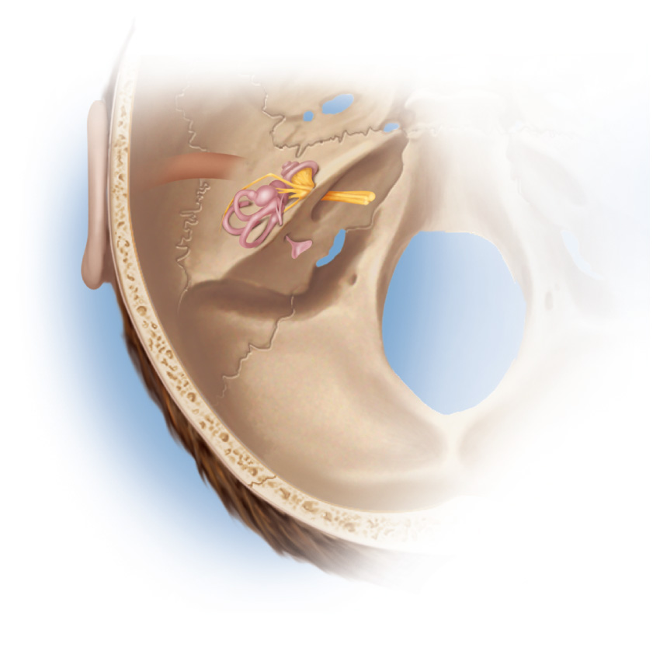
Anatomy of Inner Ear
Copyright © The McGraw-Hill Companies, Inc. Permission required for reproduction or display.
Temporal
bone
Figure 16.12a
(a)

Slide 44
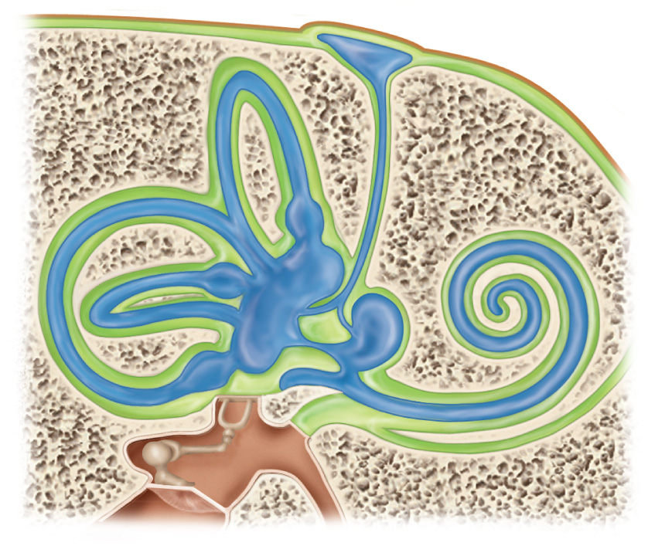
Inner (Internal) Ear
bony labyrinth - passageways in temporal bone
membranous labyrinth - fleshy tubes lining the bony labyrinth
filled with endolymph - similar to intracellular fluid
floating in perilymph - similar to cerebrospinal fluid
Copyright © The McGraw-Hill Companies, Inc. Permission required for reproduction or display.
Temporal bone
Endolymphatic
sac
Semicircular ducts:
Dura mater
Anterior
Figure 16.12c
Posterior
Lateral
Scala vestibuli
Semicircular canal
Scala tympani
Ampulla
Cochlear duct
Vestibule:
Saccule
Tympanic
membrane
Utricle
Stapes
in oval window
Secondary tympanic membrane
in round window
(c)

Slide 45
Structure of Inner Ear
Copyright © The McGraw-Hill Companies, Inc. Permission required for reproduction or display.
Endolymphatic
sac
Temporal bone
Semicircular ducts:
Dura mater
Anterior
Posterior
Lateral
Scala vestibuli
Semicircular canal
Scala tympani
Cochlear duct
Ampulla
Vestibule:
Saccule
Tympanic
membrane
Utricle
Stapes
in oval window
Secondary tympanic membrane
in round window
(c)
Figure 16.12c

Slide 46
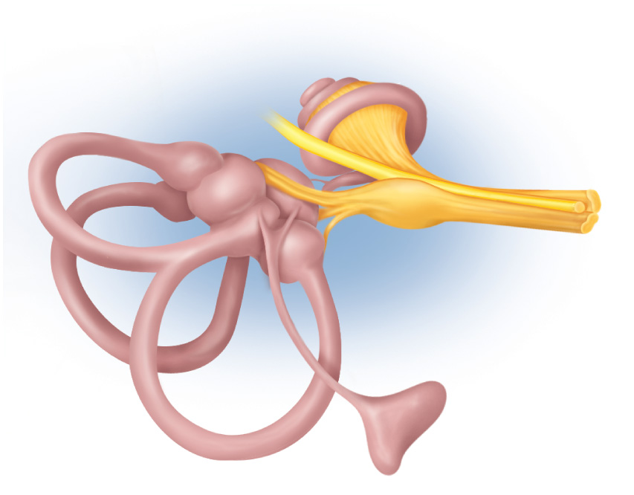
Details of Inner Ear
Copyright © The McGraw-Hill Companies, Inc. Permission required for reproduction or display.
Figure 16.12b
Vestibule:
Saccule
Cochlea
Utricle
Spiral ganglion
of cochlea
Ampullae
Cochlear nerve
Facial nerve
Vestibular nerve
Semicircular ducts:
Vestibular
ganglion
Anterior
Lateral
Posterior
Endolymphatic
sac
(b)
labyrinth - vestibule and three semicircular ducts
cochlea - organ of hearing
2.5 coils around an screwlike axis of spongy bone, the modiolus
– threads of the screw form a spiral platform that supports the fleshy tube of the cochlea

Slide 47
Anatomy of Cochlea
cochlea has three fluid-filled chambers separated by membranes:
scala vestibuli – superior chamber
filled with perilymph
begins at oval window and spirals to apex
scala tympani – inferior chamber
filled with perilymph
begins at apex and ends at round window
secondary tympanic membrane – membrane covering round window
scala media (cochlear duct) – triangular middle chamber
filled with endolymph
separated from:
scala vestibuli by vestibular membrane
scala tympani by thicker basilar membrane
contains spiral organ - organ of Corti - acoustic organ – converts vibrations into nerve impulses

Slide 48
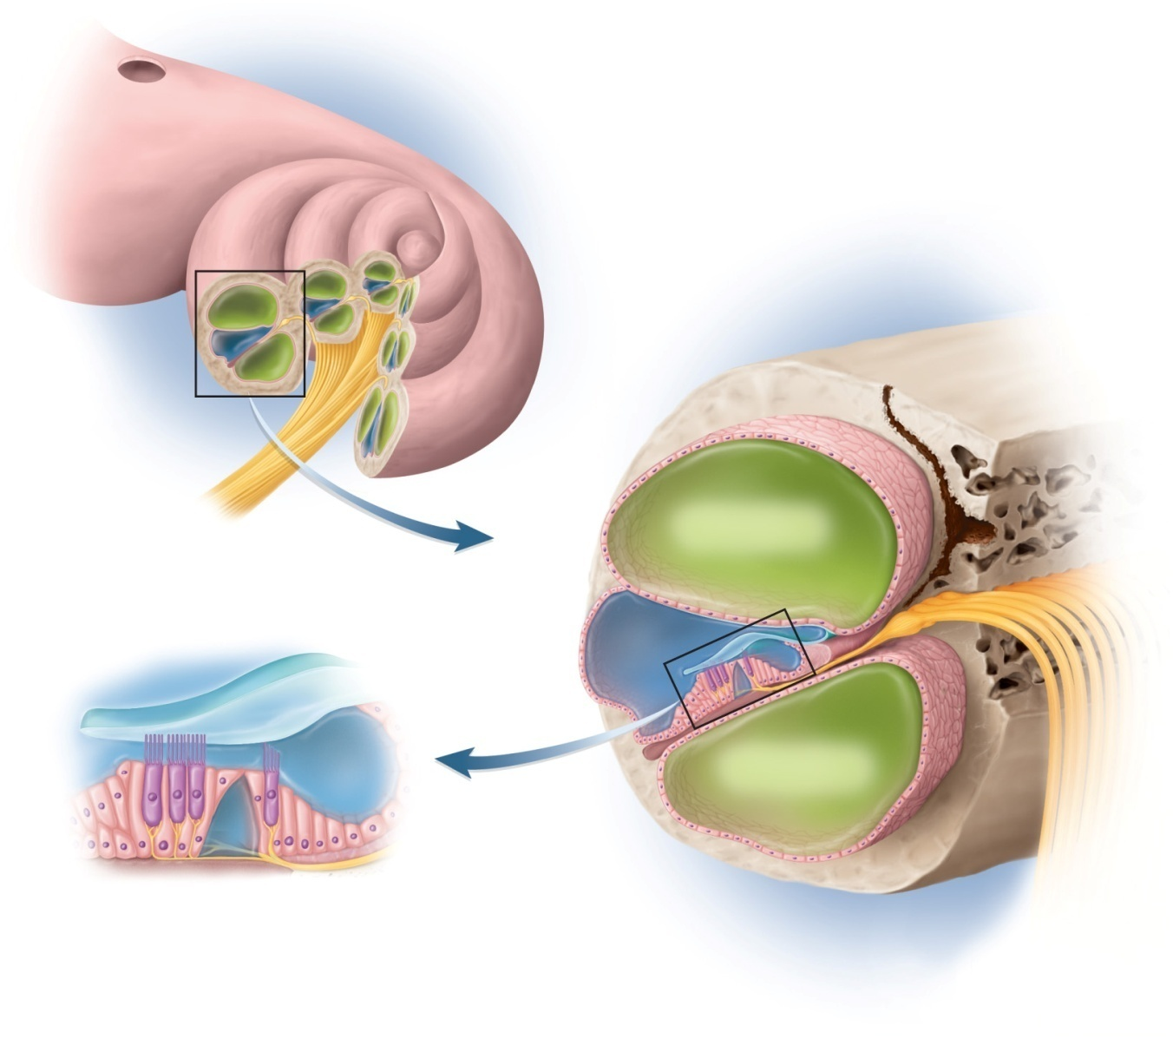
Cochlea, Cochlear Duct and Spiral Organ
Copyright © The McGraw-Hill Companies, Inc. Permission required for reproduction or display.
Oval window
Figure 16.13
Vestibular
membrane
Cochlear duct
(scala media)
Spiral ganglion
Cochlear nerve
(a)
Scala vestibuli
(with perilymph)
Vestibular
membrane
Tectorial
membrane
Cochlear duct
(with
endolymph)
Hairs
(stereocilia)
Scala tympani
(with perilymph)
Outer
hair cells
Supporting
cells
Tectorial
membrane
Basilar
membrane
Spiral
organ
Inner hair
cell
Basilar
membrane
Fibers of
cochlear nerve
(b)
(c)

Slide 49
Spiral Organ (Organ of Corti)
spiral organ has epithelium composed of hair cells and supporting cells
hair cells have long, stiff microvilli called stereocilia on apical surface
gelatinous tectorial membrane rests on top of stereocilia
spiral organ has four rows of hair cells spiraling along its length
inner hair cells – single row of about 3500 cells
provides for hearing
outer hair cells – three rows of about 20,000 cells
adjusts response of cochlea to different frequencies
increases precision

Slide 50
SEM of Cochlear Hair Cells

Slide 51
Physiology of Hearing - Middle Ear
tympanic membrane
has 18 times area of oval window
ossicles concentrate the energy of the vibrating tympanic membrane on an area 1/18 the size
ossicles create a greater force per unit area at the oval window and overcomes the inertia of the perilymph
ossicles and their muscles have a protective function
lessen the transfer of energy to the inner ear
tympanic reflex
during loud noise, the tensor tympani pulls the tympanic membrane inward and tenses it
stapedius muscle reduces the motion of the stapes
muffles the transfer of vibration from the tympanic membrane to the oval window
middle ear muscles also help to coordinate speech with hearing
dampens the sound of your own speech

Slide 52
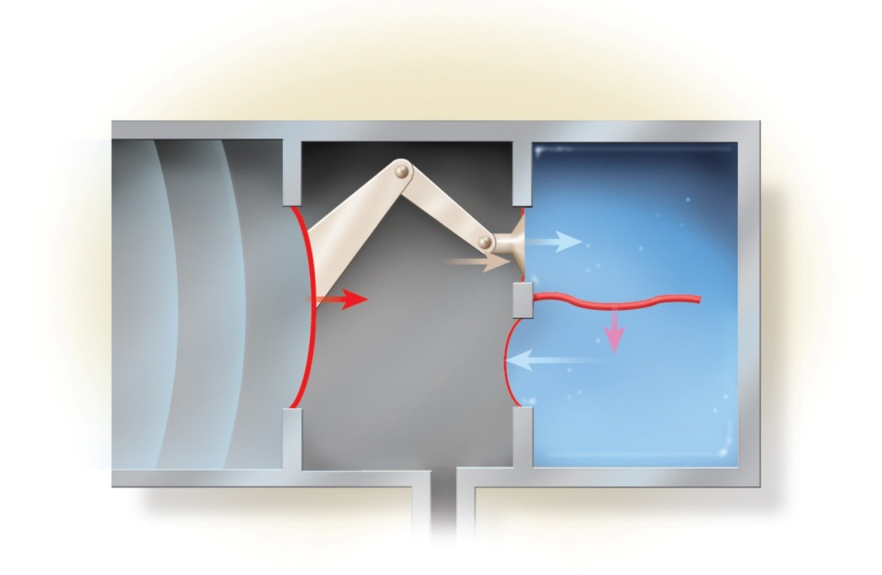
Stimulation of Cochlear Hair Cells
vibration of ossicles causes vibration of basilar membrane under hair cells
as often as 20,000 times per second
hair cells move with basilar membrane
Copyright © The McGraw-Hill Companies, Inc. Permission required for reproduction or display.
Outer ear
Middle ear
Inner ear
Stapes
Oval
window
Incus
Malleus
Figure 16.15
Sound
wave
Basilar
membrane
Tympanic
membrane
Secondary
tympanic
membrane
(in round
window)
Air
Fluid
Auditory
tube

Slide 53
Excitation of Cochlear Hair Cells
stereocilia of outer hair cells
bathed in high K⁺ fluid, the endolymph
creating electrochemical gradient
outside of cell is +80 mV and inside about – 40 mV
tip embedded in tectorial membrane
stereocilium on inner hair cells
single transmembrane protein at tip that functions as a mechanically gated ion channel
stretchy protein filament (tip link) connects ion channel of one stereocilium to the sidewall of the next taller stereocilium
tallest one is bent when basilar membrane rises up towards tectorial membrane
pulls on tip links and opens ion channels
K⁺ flows in – depolarization causes release of neurotransmitter
stimulates sensory dendrites and generates action potential in the cochlear nerve
16-53

Slide 54
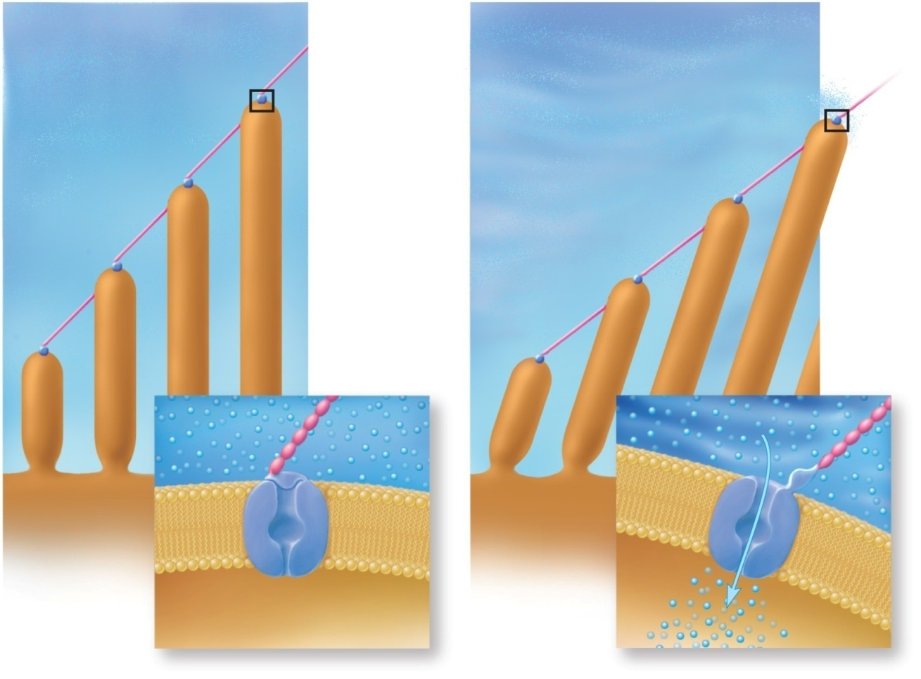
Potassium Gates
Copyright © The McGraw-Hill Companies, Inc. Permission required for reproduction or display.
Unstimulated
Stimulated
Tip link
Mechanically
gated K⁺
channel
Stereocilia
K⁺
Surface of
hair cell
K⁺
K⁺ gate
closed
K⁺ gate
open
Figure 16.16

Slide 55
Sensory Coding
for sounds to carry meaning, we must distinguish between loudness and pitch
variations in loudness (amplitude) cause variations in the intensity of cochlear vibrations
soft sound produces relatively slight up-and-down motion of the basilar membrane
louder sounds make the basilar membrane vibrate more vigorously
triggers higher frequency of action potentials
brain interprets this as louder sound
pitch depends on which part of basilar membrane vibrates
at basal end, membrane attached, narrow and stiff
brain interprets signals as high-pitched
at distal end, 5 times wider and more flexible
brain interprets signals as low-pitched

Slide 56
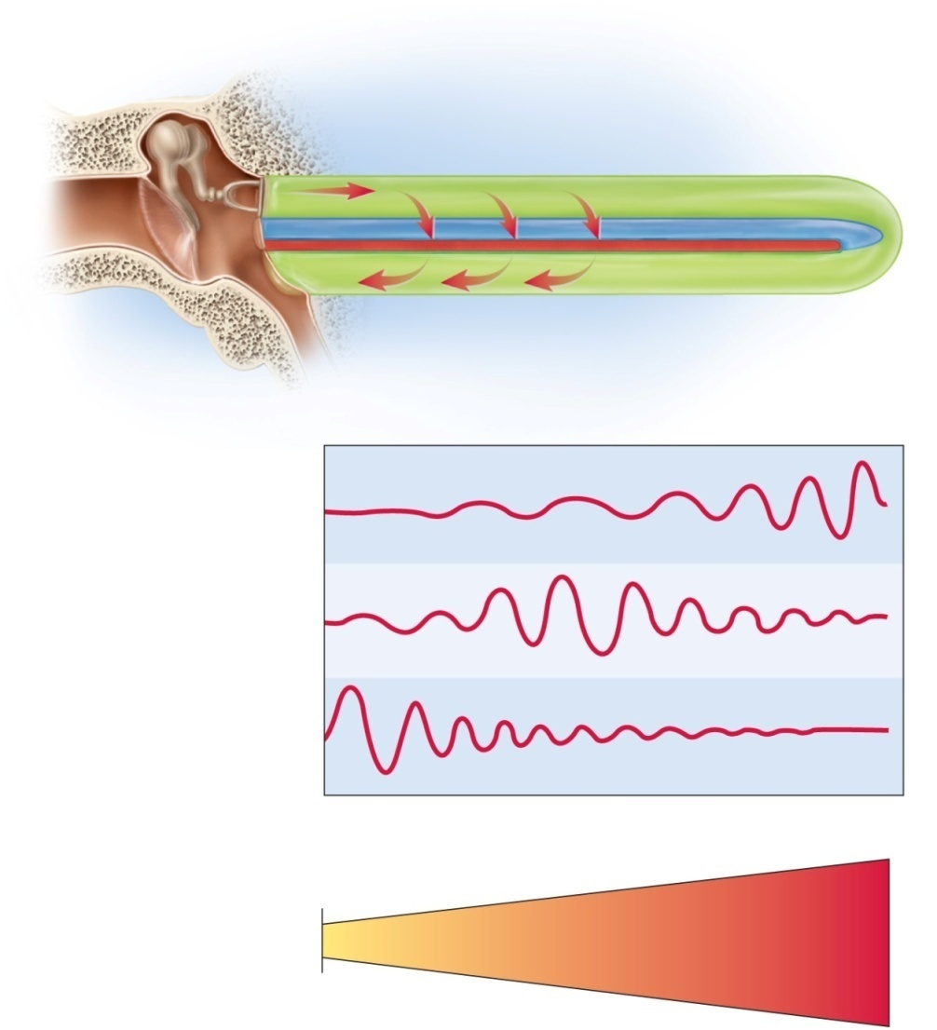
Basilar Membrane Frequency Response
Copyright © The McGraw-Hill Companies, Inc. Permission required for reproduction or display.
Tympanic membrane (vibrating)
Stapes footplate (vibrating)
Scala vestibuli
Scala tympani
Cochlear
duct
Secondary
tympanic
membrane
Basilar
membrane
(vibrating)
Helicotrema
(a)
Low-frequency sound
(20–800 Hz)
Medium-frequency sound
(1,500–4,000 Hz)
High-frequency sound
(7,000–20,000 Hz)
Figure 16.17
(b)
Proximal end
(attached)
Distal end
(free)
(c)
20,000
5,000
1,000
500
200 Hz
notice high and low frequency ends

Slide 57
Cochlear Tuning
increases ability of cochlea to receive some sound frequencies
outer hair cells shorten (10 to 15%) reducing basilar membrane’s mobility
fewer signals from that area allows brain to distinguish between more and less active areas of cochlea
pons has inhibitory fibers that synapse near the base of inner hair cells
inhibiting some areas and increases contrast between regions of cochlea

Slide 58
Deafness
deafness – hearing loss
conductive deafness - conditions interfere with transmission of vibrations to inner ear
damaged tympanic membrane, otitis media, blockage of auditory canal, and otosclerosis
otosclerosis - fusion of auditory ossicles that prevents their free vibration
sensorineural (nerve) deafness - death of hair cells or any nervous system elements concerned with hearing
factory workers, musicians and construction workers

Slide 59
Innervation of Internal Ear
Copyright © The McGraw-Hill Companies, Inc. Permission required for reproduction or display.
Figure 16.12b
Vestibule:
Saccule
Cochlea
Utricle
Spiral ganglion
of cochlea
Ampullae
Cochlear nerve
Facial nerve
Vestibular nerve
Semicircular ducts:
Vestibular
ganglion
Anterior
Lateral
Posterior
Endolymphatic
sac
(b)
vestibular ganglia - visible lump in vestibular nerve
spiral ganglia - buried in modiolus of cochlea

Slide 60
Auditory Projection Pathway
sensory fibers begin at the bases of the hair cells
somas form the spiral ganglion around the modiolus
axons lead away from the cochlea as the cochlear nerve
joins with the vestibular nerve to form the vestibulocochlear nerve, Cranial Nerve VIII
each ear sends nerve fibers to both sides of the pons
end in cochlear nuclei
synapse with second-order neurons that ascend to the nearby superior olivary nucleus
superior olivary nucleus issues efferent fibers back to the cochlea
involved with cochlear tuning
binaural hearing – comparing signals from the right and left ears to identify the direction from which a sound is coming
function of the superior olivary nucleus

Slide 61
Auditory Projection Pathway
fibers ascend to the inferior colliculi of the midbrain
helps to locate the origin of the sound, processes fluctuation in pitch, and mediate the startle response and rapid head turning in response to loud noise
third-order neurons begin in the inferior colliculi and lead to the thalamus
fourth-order neurons complete the pathway from thalamus to primary auditory complex
involves four neurons instead of three unlike most sensory pathways
primary auditory cortex lies in the superior margin of the temporal lobe
site of conscious perception of sound
because of extensive decussation of the auditory pathway, damage to right or left auditory cortex does not cause unilateral loss of hearing

Slide 62
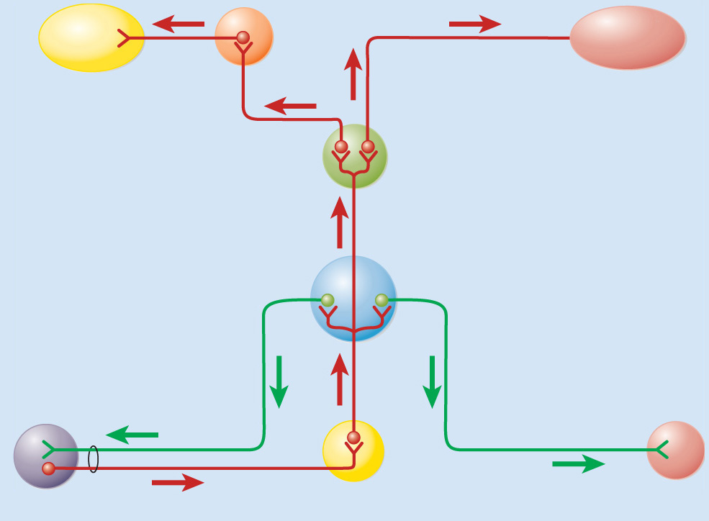
Auditory Pathway
Copyright © The McGraw-Hill Companies, Inc. Permission required for reproduction or display.
Primary
auditory
cortex
Auditory
reflex (head
turning)
Neck
muscles
Temporal
lobe of
cerebrum
Medial
geniculate
nucleus of
thalamus
Inferior colliculus
of midbrain
Superior olivary
nucleus of pons
Cranial nerves
V₃ and VII
Cochlea
Tensor tympani and
stapedius muscles
Cochlear tuning
Tympanic reflex
Cochlear nuclei
of pons
Cranial nerve VIII
(a)
Figure 16.18a

Slide 63
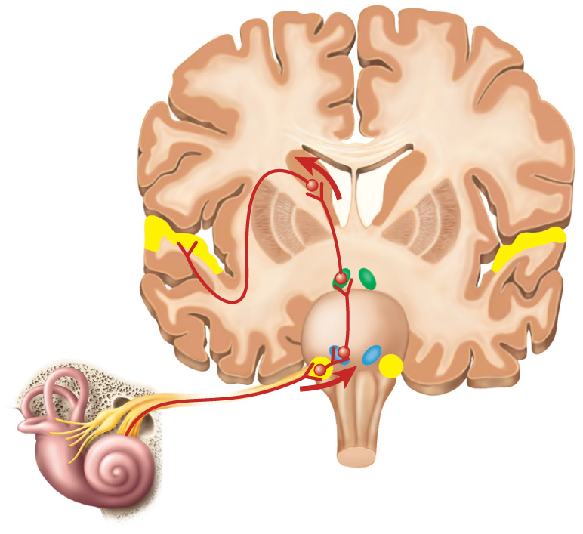
Auditory Processing Centers
Copyright © The McGraw-Hill Companies, Inc. Permission required for reproduction or display.
Thalamus
Figure 16.18b
Primary auditory
cortex
Inferior colliculus
Superior olivary
nucleus
Cochlear nucleus
Cranial
nerve VIII
Medulla oblongata
(b)
Cochlea

Slide 64
Equilibrium
equilibrium – coordination, balance, and orientation in three-dimensional space
vestibular apparatus – constitutes receptors for equilibrium
three semicircular ducts
detect only angular acceleration
two chambers
anterior saccule and posterior utricle
responsible for static equilibrium and linear acceleration
static equilibrium – the perception of the orientation of the head when the body is stationary
dynamic equilibrium - perception of motion or acceleration
linear acceleration - change in velocity in a straight line (elevator)
angular acceleration - change in rate of rotation (car turns a corner)

Slide 65
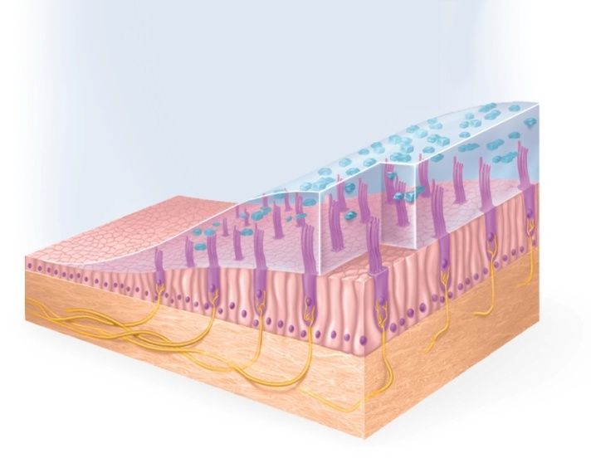
Saccule and Utricle
macula – 2 by 3 mm patch of hair cells and supporting cells in the saccule and utricle
macula sacculi – lies vertically on wall of saccule
macula utriculi – lies horizontally on floor of utricle
each hair cell has 40 to 70 stereocilia and one true cilium - kinocilium embedded in a gelatinous otolithic membrane
otoliths - calcium carbonate-protein granules that add to the weight and inertia and enhance the sense of gravity and motion
Copyright © The McGraw-Hill Companies, Inc. Permission required for reproduction or display.
Otoliths
Hair cell
Supporting cell
Otolithic
membrane
Vestibular
nerve
Figure 16.19b
(b)

Slide 66
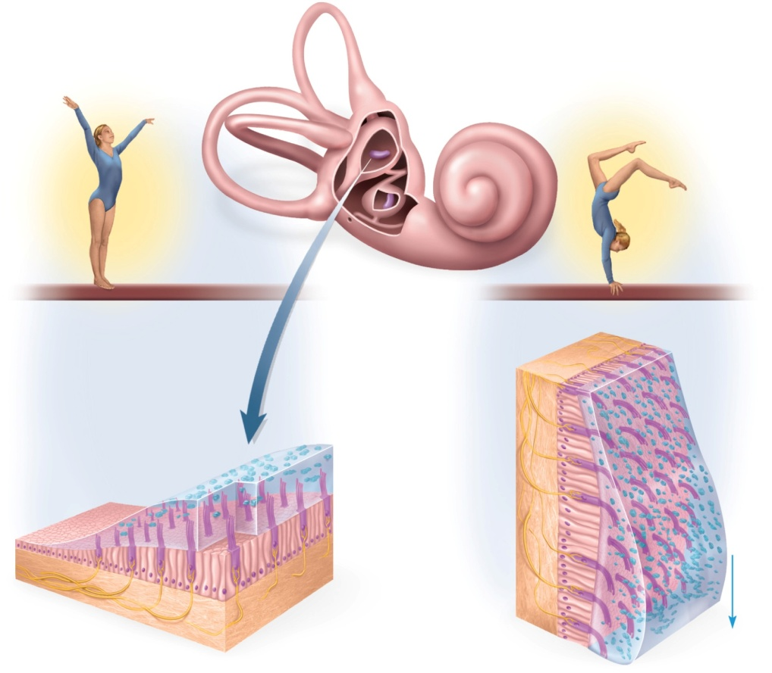
Macula Utriculi and Macula Sacculi
Copyright © The McGraw-Hill Companies, Inc. Permission required for reproduction or display.
Macula utriculi
Macula sacculi
(a)
Figure 16.19
Otoliths
Supporting cell
Stereocilia
of hair
cells bend
Vestibular
nerve
Hair cell
Otolithic
membrane
Otolithic
membrane
sags
(b)
(c)
Gravitational force
static equilibrium - when head is tilted, heavy otolithic membrane sags, bending the stereocilia, and stimulating the hair cells
dynamic equilibrium – in car, linear acceleration detected as otoliths lag behind, bending the stereocilia, and stimulating the hair cells
because the macula sacculi is nearly vertical, it responds to vertical acceleration and deceleration

Slide 67
Semicircular Ducts
Copyright © The McGraw-Hill Companies, Inc. Permission required for reproduction or display.
Vestibule:
Saccule
Cochlea
Utricle
Spiral ganglion
of cochlea
Ampullae
Cochlear nerve
Facial nerve
Vestibular nerve
Semicircular ducts:
Vestibular
ganglion
Anterior
Lateral
Posterior
Figure 16.12b
Endolymphatic
sac
(b)
rotary movements detected by the three semicircular ducts
bony semicircular canals of temporal bone hold membranous semicircular ducts
each duct filled with endolymph and opens up as a dilated sac (ampulla) next to the utricle
each ampulla contains crista ampullaris, mound of hair cells and supporting cells

Slide 68
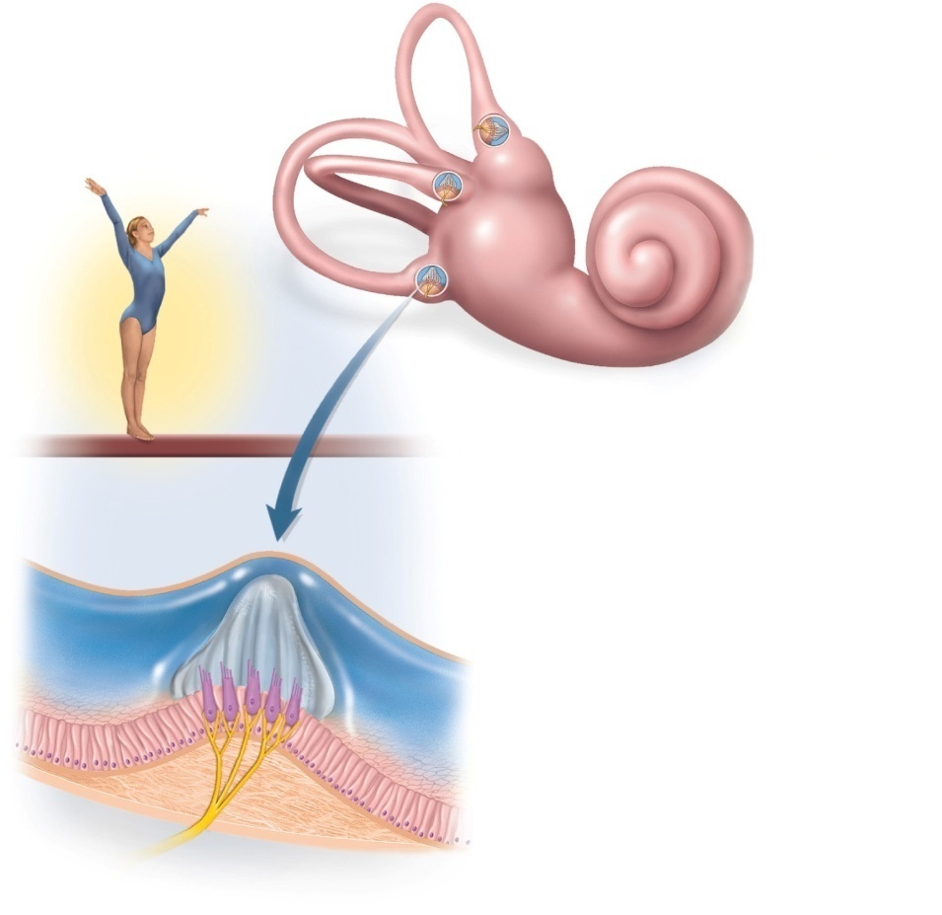
Crista Ampullaris
Copyright © The McGraw-Hill Companies, Inc. Permission required for reproduction or display.
Semicircular ducts:
Anterior
Posterior
Lateral
Crista ampullaris
and cupula
Ampullae
(a)
Cupula
Hair cells
Endolymph
Supporting
cells
Crista
ampullaris
Figure 16.20 a-b
Sensory
nerve fibers
(b)
consists of hair cells with stereocilia and a kinocilium buried in a mound of gelatinous membrane called the cupula (one in each duct)
orientation causes ducts to be stimulated by rotation in different planes

Slide 69
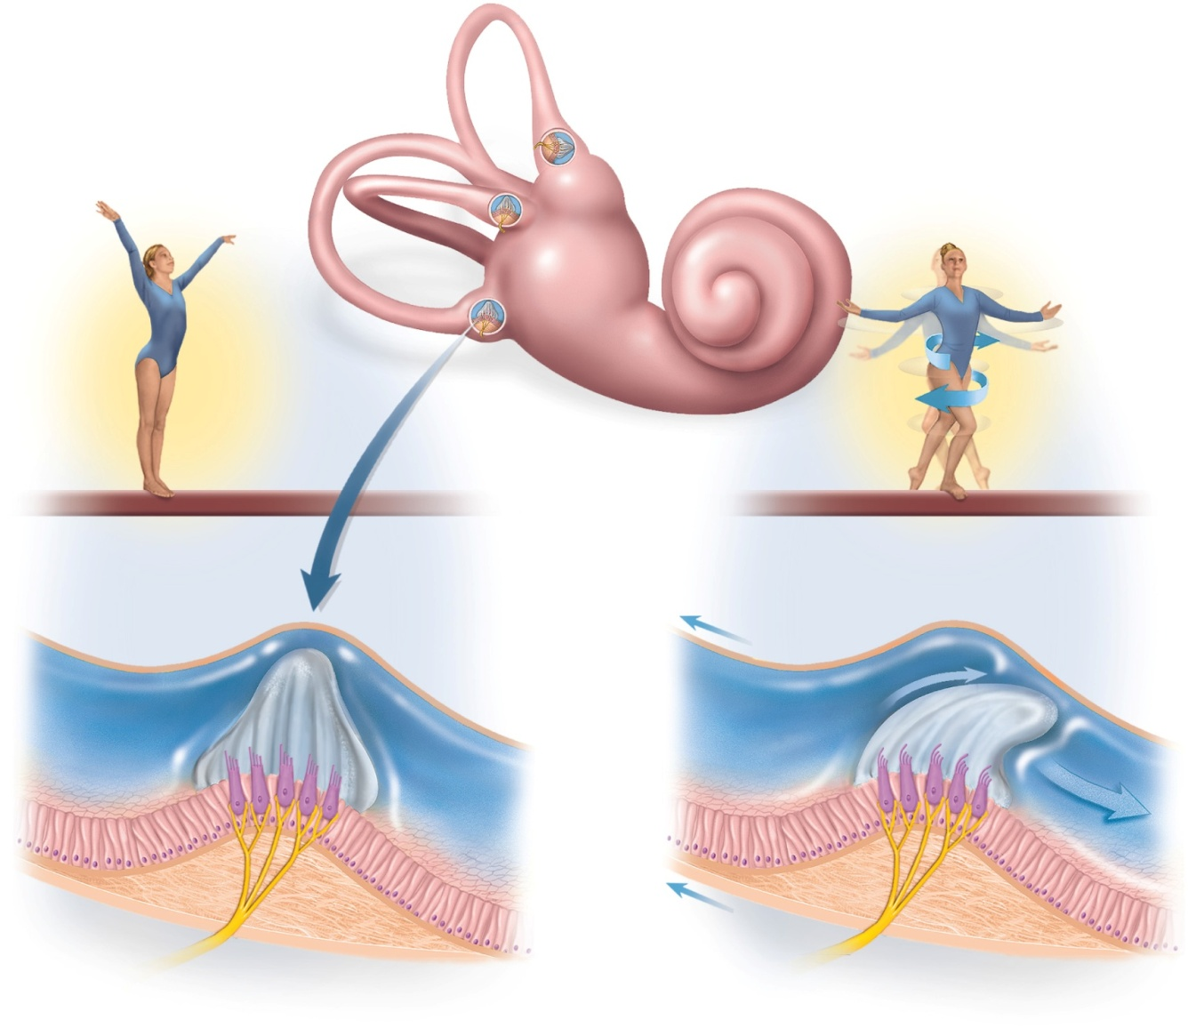
Crista Ampullaris - Head Rotation
Copyright © The McGraw-Hill Companies, Inc. Permission required for reproduction or display.
Semicircular ducts:
Anterior
Posterior
Figure 16.20
Lateral
Crista ampullaris
and cupula
Ampullae
(a)
Cupula
Direction of
head rotation
Cupula is
pushed over
and stimulates
hair cells
Hair cells
Endolymph
Supporting
cells
Crista
ampullaris
Endolymph lags
behind due
to inertia
Sensory
nerve fibers
(b)
(c)
as head turns, endolymph lags behind, pushes cupula, stimulates hair cells

Slide 70
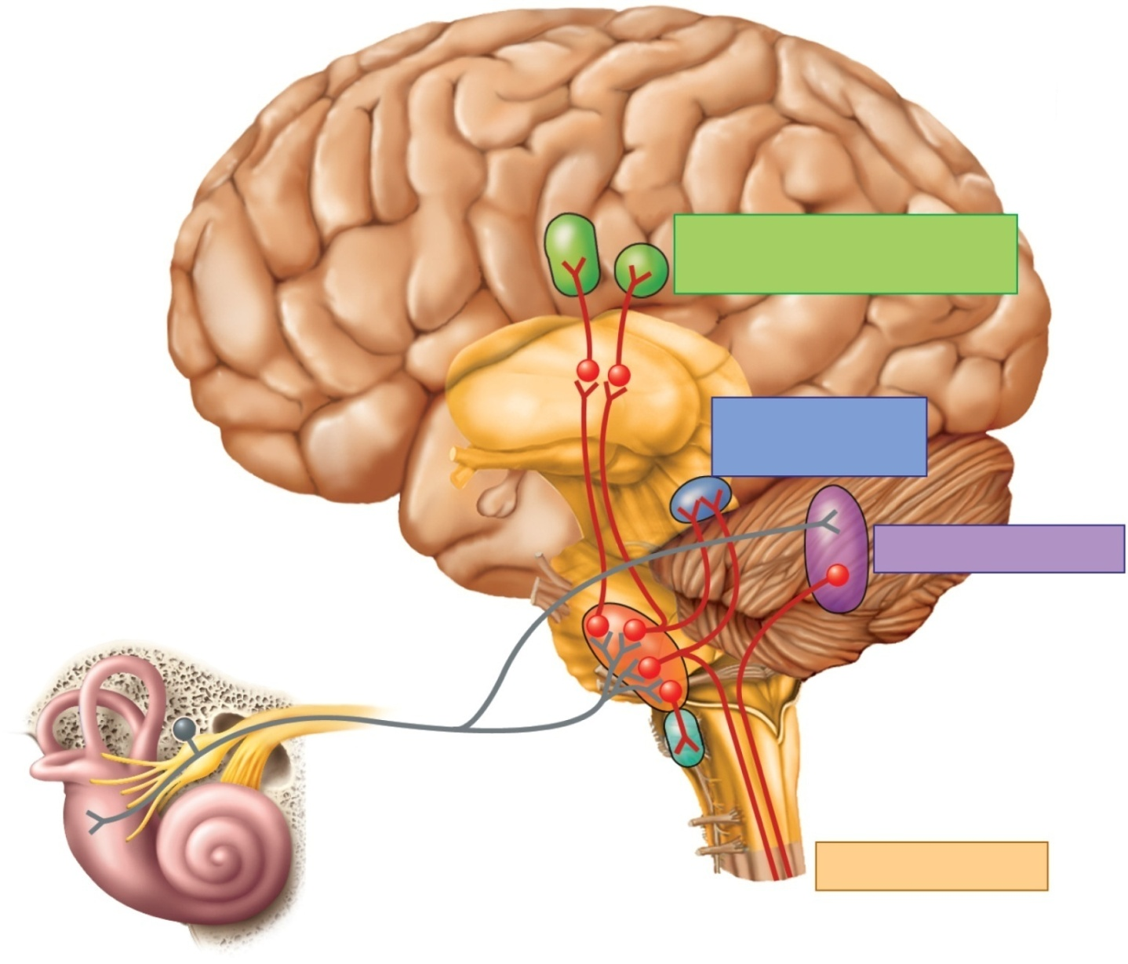
Vestibular Projection Pathways
Copyright © The McGraw-Hill Companies, Inc. Permission required for reproduction or display.
Central sulcus
Postcentral
gyrus
Vestibular
cortex
Figure 16.21
Awareness of spatial
orientation and movement
Thalamus
Compensatory
eye movements
Nuclei for
eye movement
Cerebellum
Motor coordination
Vestibulocochlear nerve
Vestibular
nuclei
Vestibulospinal
tracts
Reticular
formation
Postural reflexes
Vestibular apparatus

Slide 71
Equilibrium Projection Pathways
hair cells of macula sacculi, macula utriculi and semicircular ducts synapse on vestibular nerve (part of CN VIII)
fibers end in a complex of four vestibular nuclei on each side of the pons and medulla
left and right nuclei receive input from both ears
process signals about the position and movement of the body and relay information to 5 target areas:

Slide 72
Equilibrium Projection Pathways
information sent to five targets:
cerebellum – integrates vestibular information into its control of head and eye movements, muscle tone, and posture
nuclei of oculomotor, trochlear, and abducens nerves (CN III, IV, and VI) to produce vestibulo-ocular reflex – keeps your vision fixed on distant object while you are walking
reticular formation – thought to adjust blood circulation and breathing to postural changes
spinal cord – descend through two vestibulospinal tracts of spinal cord and innervate extensor (antigravity) muscles
thalamus - thalamic relay to cerebral cortex for awareness of position and motor control of head and body

Slide 73
Vision and Light
vision (sight) – perception of objects in the environment by means of the light that they emit or reflect
light – visible electromagnetic radiation
human vision - limited to wavelengths of light from 400 -750 nm
ultraviolet radiation - < 400 nm; has too much energy and destroys macromolecules
infrared radiation - > 750 nm; too little energy to cause photochemical reaction, but does warm the tissues
light must cause a photochemical reaction to produce a nerve signal

Slide 74
External Anatomy of Eye
Copyright © The McGraw-Hill Companies, Inc. Permission required for reproduction or display.
Superciliary
ridge
Pupil
Superior
palpebral
sulcus
Eyebrow
Upper
eyelid
Eyelashes
Iris
Palpebral
fissure
Sclera
Medial
commissure
Lateral
commissure
Figure 16.22
Lower
eyelid
Inferior
palpebral
sulcus
Tarsal plate
© The McGraw-Hill Companies, Inc./Joe DeGrandis, photographer

Slide 75
Eyebrows and Eyelids
eyebrows provide facial expression
protect eyes from glare and perspiration
eyelids (palpebrae)
block foreign objects, help with sleep, blink to moisten
meet at corners (commissures)
consist of orbicularis oculi muscle and tarsal plate covered with skin outside and conjunctiva inside
tarsal glands secrete oil that reduces tear evaporation
eyelashes help keep debris from eye

Slide 76
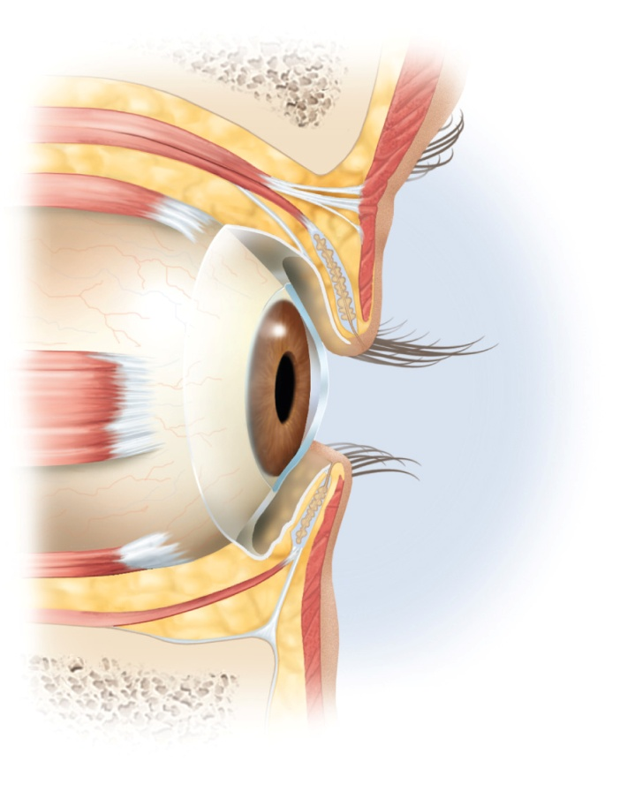
Conjunctiva
Copyright © The McGraw-Hill Companies, Inc. Permission required for reproduction or display.
Frontal bone
Levator palpebrae
superioris muscle
Figure 16.23a
Orbicularis
oculi muscle
Superior rectus
muscle
Tarsal plate
Tarsal glands
Cornea
Conjunctiva
Lateral rectus
muscle
Inferior rectus
muscle
(a)
conjunctiva – a transparent mucous membrane that lines eyelids and covers anterior surface of eyeball, except cornea
richly innervated and vascular (heals quickly)
secretes a thin mucous film that prevents the eyeball from drying

Slide 77
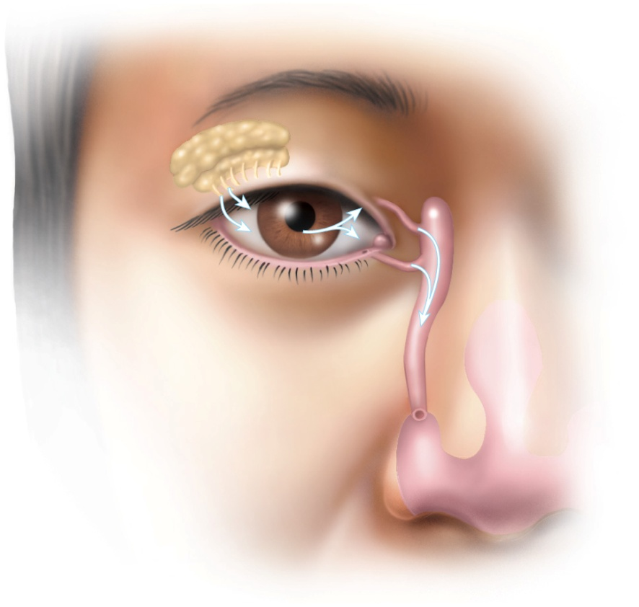
Lacrimal Apparatus
Copyright © The McGraw-Hill Companies, Inc. Permission required for reproduction or display.
Lacrimal
gland
Figure 16.23b
Ducts
Lacrimal
sac
Lacrimal
punctum
Lacrimal
canal
Nasolacrimal
duct
Inferior
meatus
of nasal
cavity
Nostril
(b)
tears flow across eyeball help to wash away foreign particles, deliver O₂ and nutrients, and prevent infection with a bactericidal lysozyme
tears flow through lacrimal punctum (opening on edge of each eyelid) to the lacrimal sac, then into the nasolacrimal duct emptying into nasal cavity

Slide 78
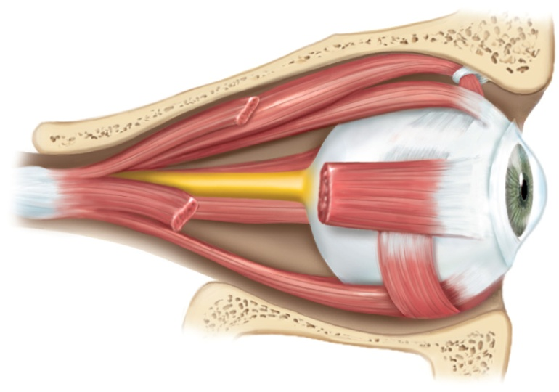
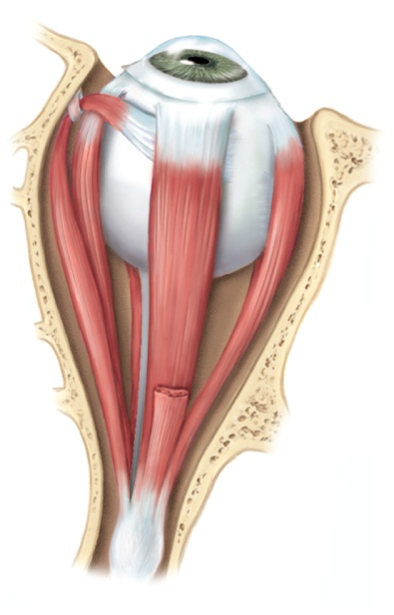
Extrinsic Eyes Muscles
Copyright © The McGraw-Hill Companies, Inc. Permission required for reproduction or display.
Trochlea
Optic nerve
Trochlea
Superior oblique
tendon
Muscles:
Muscles:
Superior oblique
Superior oblique
Superior rectus
Medial rectus
Muscles:
Medial rectus
Superior rectus
Lateral rectus
Lateral rectus
Inferior rectus
Inferior oblique
Levator palpebrae
superioris (cut)
Inferior rectus
(a) Lateral view
(b) Superior view
Figure 16.24a
Figure 16.24b
6 muscles attached to exterior surface of eyeball
superior, inferior, lateral, and medial rectus muscles, superior and inferior oblique muscles
innervated by cranial nerves III, IV and VI

Slide 79
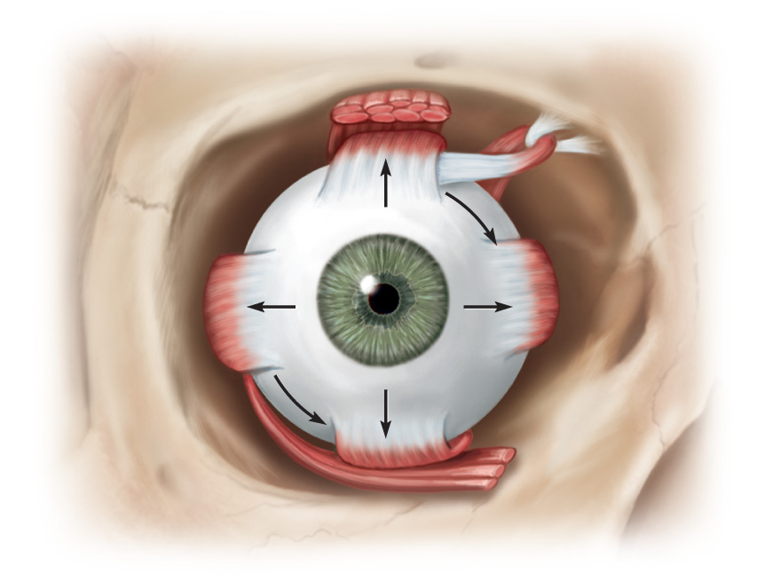
Innervation of Extrinsic Eye Muscles
Copyright © The McGraw-Hill Companies, Inc. Permission required for reproduction or display.
Superior
oblique
muscle
Levator palpebrae
superioris muscle
Trochlear nerve (IV)
Superior rectus
muscle
Lateral
rectus
muscle
Medial rectus
muscle
Abducens nerve (VI)
Oculomotor nerve (III)
Inferior rectus
muscle
Figure 16.24c
Inferior oblique
muscle
(c) Frontal view
superior, inferior, medial and lateral rectus muscles move the eye up, down, medially & laterally
superior and inferior oblique mm. turn the “twelve o’clock pole” of each eye toward or away from the nose
orbital fat – surrounds sides and back of eye, cushions eye and allows free movement, protects blood vessels, and nerves

Slide 80
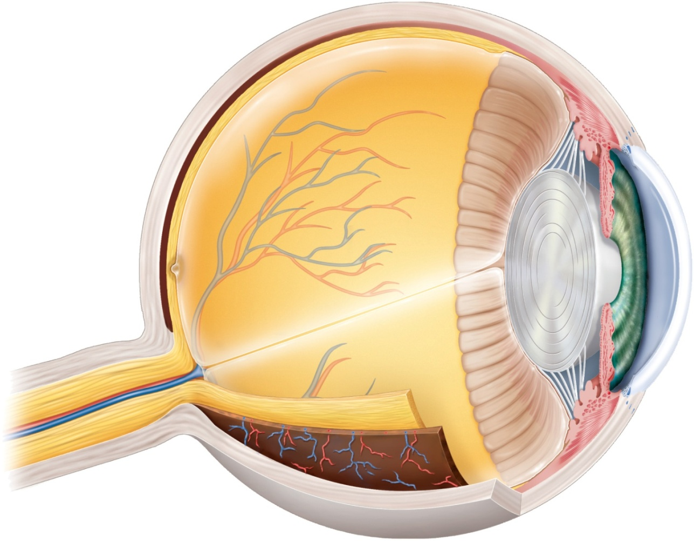
Anatomy of the Eyeball
Copyright © The McGraw-Hill Companies, Inc. Permission required for reproduction or display.
Sclera
Ora serrata
Choroid
Retina
Ciliary body
Macula lutea
Suspensory
ligament
Fovea centralis
Optic disc
(blind spot)
Iris
Cornea
Optic nerve
Pupil
Central artery
and vein
of retina
Lens
Anterior
chamber
Posterior
chamber
Figure 16.25
Hyaloid canal
Vitreous body
three principal components of the eyeball
three layers (tunics) that form the wall of the eyeball
optical component – admits and focuses light
neural component – the retina and optic nerve

Slide 81
Tunics of the Eyeball
tunica fibrosa – outer fibrous layer
sclera – dense, collagenous white of the eye
cornea - transparent area of sclera that admits light into eye
tunica vasculosa (uvea) – middle vascular layer
choroid – highly vascular, deeply pigmented layer behind retina
ciliary body – extension of choroid that forms a muscular ring around lens
supports lens and iris
secretes aqueous humor
iris - colored diaphragm controlling size of pupil, its central opening
melanin in chromatophores of iris - brown or black eye color
reduced melanin – blue, green, or gray color
tunica interna - retina and beginning of optic nerve

Slide 82
Optical Components
transparent elements that admit light rays, refract (bend) them, and focus images on the retina
cornea
transparent cover on anterior surface of eyeball
aqueous humor
serous fluid posterior to cornea, anterior to lens
reabsorbed by scleral venous sinus (canal of Schlemm)
produced and reabsorbed at same rate
lens
lens fibers – flattened, tightly compressed, transparent cells that form lens
suspended by suspensory ligaments from ciliary body
changes shape to help focus light
rounded with no tension or flattened with pull of suspensory ligaments
vitreous body (humor) fills vitreous chamber
jelly fills space between lens and retina

Slide 83
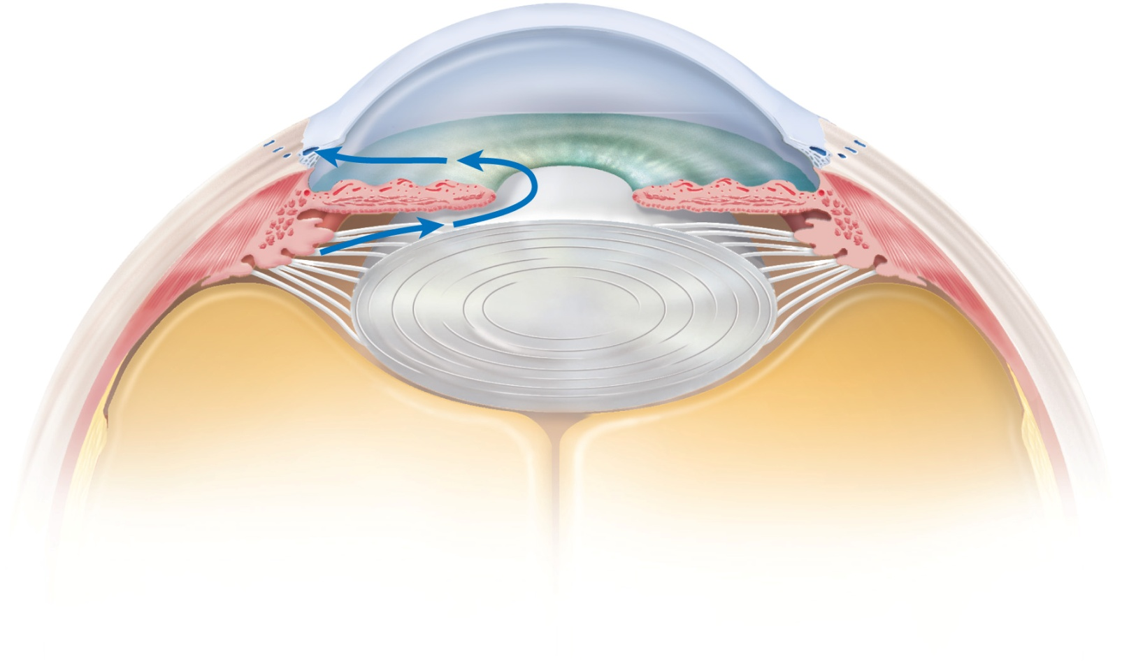
Aqueous Humor
Copyright © The McGraw-Hill Companies, Inc. Permission required for reproduction or display.
Cornea
Anterior chamber
Scleral
venous sinus
Iris
Ciliary body:
Posterior
chamber
Ciliary
process
Lens
Ciliary
muscle
Vitreous
body
Figure 16.26
released by ciliary body into posterior chamber, passes through pupil into anterior chamber - reabsorbed into canal of Schlemm

Slide 84
Neural Components
includes retina and optic nerve
retina
forms as an outgrowth of the diencephalon
attached to the rest of the eye only at optic disc and at ora serrata
pressed against rear of eyeball by vitreous humor
detached retina causes blurry areas in field of vision and leads to blindness
examine retina with opthalmoscope
macula lutea – patch of cells on visual axis of eye
fovea centralis – pit in center of macula lutea
blood vessels of the retina

Slide 85
Cataracts and Glaucoma
cataract - clouding of lens
lens fibers darken with age, fluid-filled bubbles and clefts filled with debris appear between the fibers
induced by diabetes, smoking, drugs, ultraviolet radiation, and certain viruses
replace natural lens with plastic one
glaucoma - elevated pressure within the eye due to obstruction of scleral venous sinus and improper drainage of aqueous humor
death of retinal cells due to compression of blood vessels and lack of oxygen
illusory flashes of light are an early symptom
colored halos around lights are late symptom
lost vision can not be restored
intraocular pressure measured with tonometer

Slide 86
Formation of an Image
light passes through lens to form tiny inverted image on retina
iris diameter controlled by two sets of contractile elements
pupillary constrictor - smooth muscle encircling the pupil
parasympathetic stimulation narrows pupil
pupillary dilator - spokelike myoepithelial cells
sympathetic stimulation widens pupil
pupillary constriction and dilation occurs in two situations
when light intensity changes
when our gaze shifts between distant and nearby objects
photopupillary reflex – pupillary constriction in response to light
consensual light reflex because both pupils constrict even if only one eye is illuminated

Slide 87
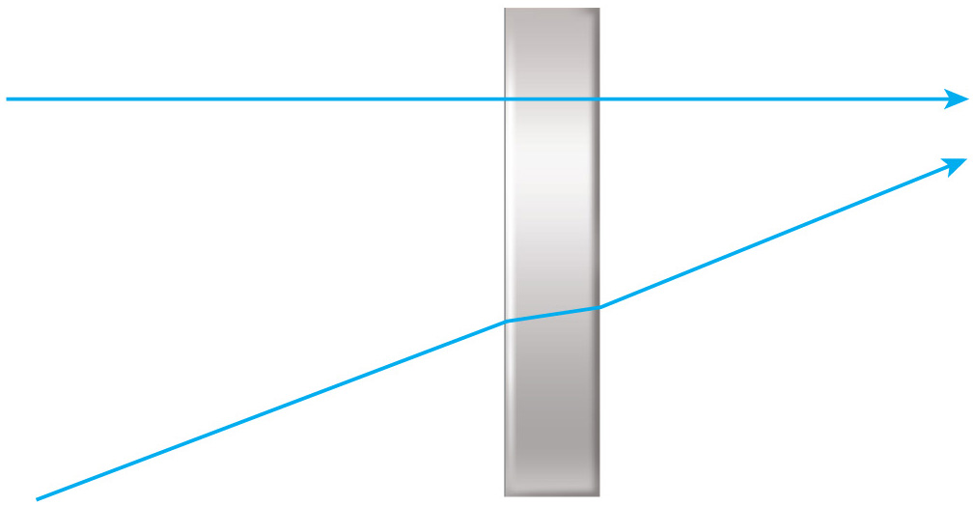
Principle of Refraction
Copyright © The McGraw-Hill Companies, Inc. Permission required for reproduction or display.
(a)
Figure 16.30a
refraction – the bending of light rays
light slows down from 300,000 km/sec in air, water, glass or other media
refractive index of a medium is a measure of how much it retards light rays relative to air
angle of incidence at 90° light slows but does not change course
any other angle, light rays change direction (it is refracted)
greater the refractive index and greater the angle of incidence, the more refraction

Slide 88
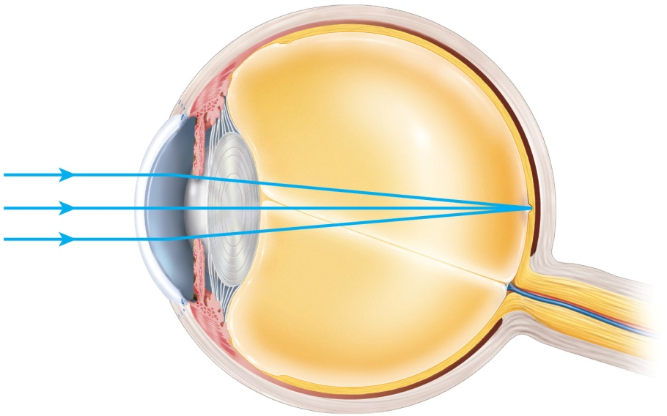
Refraction in the Eye
light passing through the center of the cornea is not bent
light striking off-center is bent towards the center
aqueous humor and lens do not greatly alter the path of light
cornea refracts light more than lens does
lens merely fine-tunes the image
lens becomes rounder to increase refraction for near vision
Copyright © The McGraw-Hill Companies, Inc. Permission required for reproduction or display.
Air
n = 1.00
Lens
n = 1.40
Vitreous body
n = 1.33
Retina
Cornea
n = 1.38
Aqueous humor
n = 1.33
(b)
Figure 16.30b

Slide 89
The Near Response
emmetropia – state in which the eye is relaxed and focused on an object more than 6 m (20 ft) away
light rays coming from that object are essentially parallel
rays focused on retina without effort
light rays coming from a closer object are too divergent to be focused without effort
near response – adjustments to close range vision requires three processes
convergence of eyes
eyes orient their visual axis towards object
constriction of pupil
blocks peripheral light rays and reduces spherical aberration (blurry edges)
accommodation of lens – change in the curvature of the lens that enables you to focus on nearby objects
ciliary muscle contracts, lens takes convex shape
light refracted more strongly and focused onto retina
near point of vision – closest an object can be and still come into focus

Slide 90
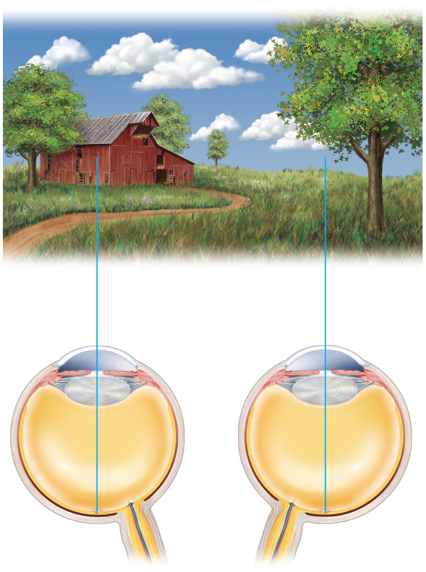
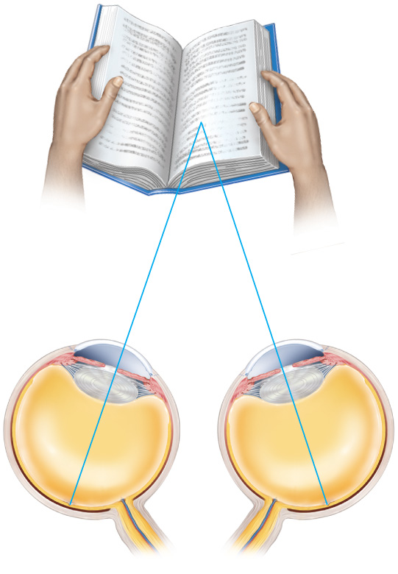
Emmetropia and Near Response
Copyright © The McGraw-Hill Companies, Inc. Permission required for reproduction or display.
(a)
Emmetropia
Convergence
distant object
close object
Figure 16.31a

Slide 91
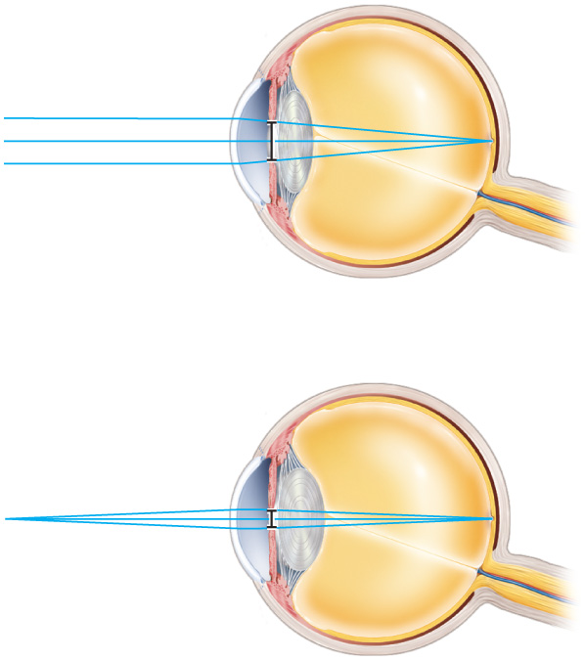
Emmetropia and Near Response
Copyright © The McGraw-Hill Companies, Inc. Permission required for reproduction or display.
Relatively
thin lens
Fovea
Relatively
dilated pupil
Emmetropia
Figure 16.31b
Relatively
thick lens
Relatively
constricted pupil
Pupillary miosis and
lens accommodation
(b)

Slide 92
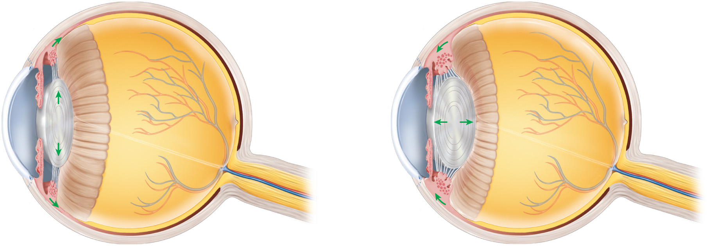
Accommodation of Lens
Copyright © The McGraw-Hill Companies, Inc. Permission required for reproduction or display.
Ciliary muscle
relaxed
Ciliary muscle
contracted
Suspensory
ligament taut
Suspensory
ligament relaxed
Lens thins
Lens thickens
(a) Distant vision (emmetropia)
(b) Near vision (accommodation)
lens flatter
lens thicker
Figure 16.32 a-b

Slide 93
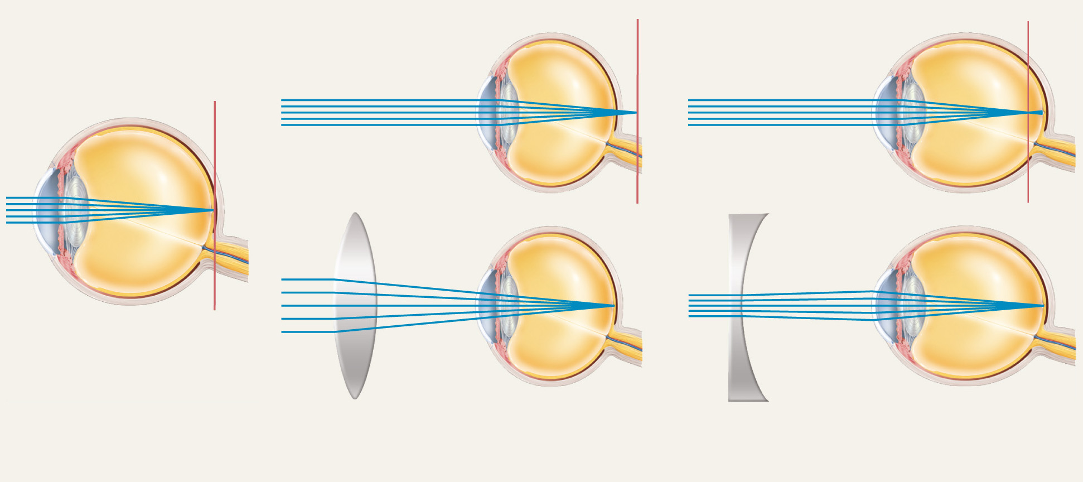
Common Defects of Image Formation
Copyright © The McGraw-Hill Companies, Inc. Permission required for reproduction or display.
Focal plane
Focal plane
Focal plane
Uncorrected
Uncorrected
Convex lens
Corrected
Concave lens
Corrected
(a) Emmetropia (normal)
(b) Hyperopia (farsightedness)
(c) Myopia (nearsightedness)
Figure 16.33

Slide 94
Sensory Transduction in the Retina
conversion of light energy into action potentials occurs in the retina
structure of retina
pigment epithelium – most posterior part of retina
absorbs stray light so visual image is not degraded
neural components of the retina from the rear of the eye forward
photoreceptor cells – absorb light and generate a chemical or electrical signal
rods, cones, and certain ganglion cells
only rods and cones produce visual images
bipolar cells – synapse with rods and cones and are first-order neurons of the visual pathway
ganglion cells – largest neurons in the retina and are the second-order neurons of the visual pathway

Slide 95
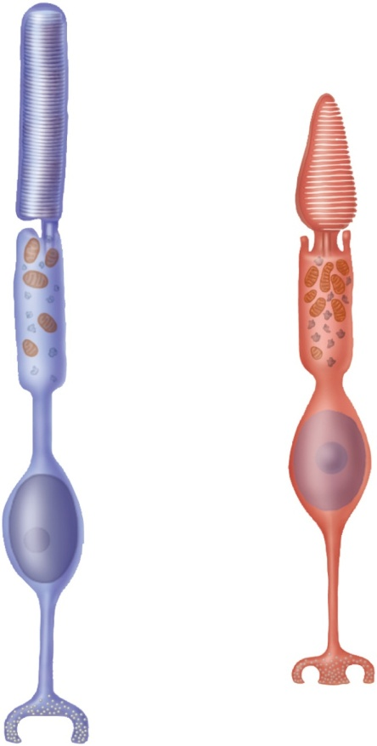
Photoreceptor Cells
light absorbing cells
derived from same stem cells as ependymal cells of the brain
rod cells (night - scotopic vision or monochromatic vision)
outer segment – modified cilium specialized to absorb light
stack of 1,000 membranous discs studded with globular proteins, the visual pigment, rhodopsin
inner segment – contains organelles sitting atop cell body with nucleus
cone cells (color, photopic, or day vision)
similar except outer segment tapers
outer segment tapers to a point
plasma membrane infoldings form discs
Copyright © The McGraw-Hill Companies, Inc. Permission required for reproduction or display.
Rod
Cone
Outer
segment
Stalk
Inner
segment
Mitochondria
Cell
body
Nucleus
Synaptic
vesicles
(b)
Figure 16.35b

Slide 96
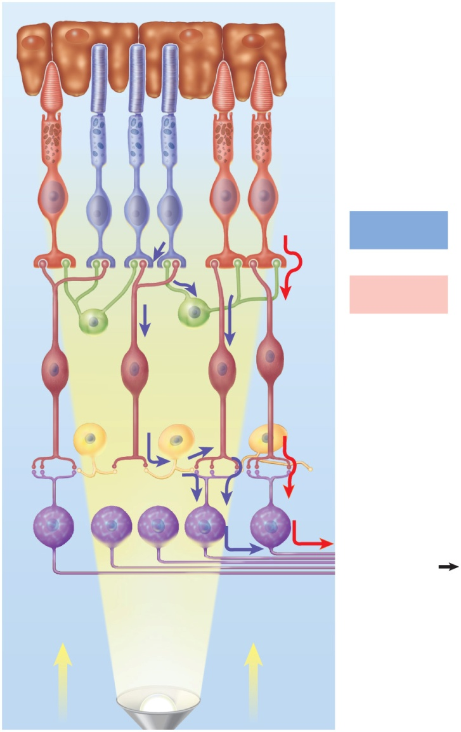
Schematic Layers of the Retina
Copyright © The McGraw-Hill Companies, Inc. Permission required for reproduction or display.
Back of eye
130 million rods and 6.5 million cones in retina
only 1.2 million nerve fibers in optic nerve
neuronal convergence and information processing in retina before signals reach brain
multiple rod or cone cells synapse on one bipolar cell
multiple bipolar cells synapse on one ganglion cell
Pigment
epithelium
Photoreceptors:
Rod
Cone
Transmission
of rod signals
Transmission
of cone signals
Horizontal cell
Bipolar cell
Amacrine cell
Ganglion cell
To optic nerve
Nerve fibers
Direction of light
(b)
Figure 16.34b

Slide 97
Nonreceptor Retinal Cells
horizontal cells and amacrine cells
do not form layers within retina
horizontal and amacrine cells form horizontal connections between cone, rod and bipolar cells
enhance perception of contrast, the edges of objects, moving objects, and changes in light intensity
much of the mass of the retina is astrocytes and other glial cells

Slide 98
Visual Pigments
rods contain visual pigment - rhodopsin (visual purple)
two major parts of molecule
opsin - protein portion embedded in disc membrane of rod’s outer segment
retinal (retinene) - a vitamin A derivative
has absorption peak at wavelength of 500 nm
can not distinguish one color from another
cones contain photopsin (iodopsin)
retinal moiety same as in rods
opsin moiety contain different amino acid sequences that determine wavelengths of light absorbed
3 kinds of cones, identical in appearance, but absorb different wavelengths of light to produce color vision

Slide 99
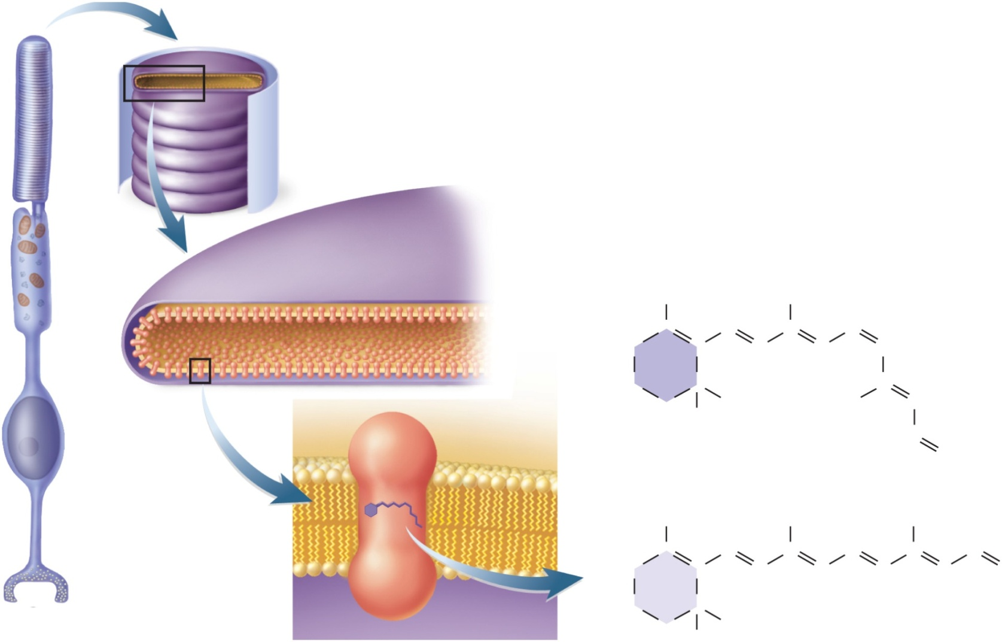
Location of Visual Pigments
Copyright © The McGraw-Hill Companies, Inc. Permission required for reproduction or display.
Figure 16.36 a-f
Disc
Cell membrane
(b)
Pigment
molecule
CH₃
H
C
CH₃
H
C
H₂C
C
C
C
H
C
CH
C
H₂C
C
H
C
H₂
C
CH
(c)
CH₃
CH₃
H₃C
Pigment
molecule
HC
(e)
Cis-retinal
O
Retinal
CH₃
CH₃
H
C
CH₃
H
C
C
H
H₂C
C
C
C
H
C
C
H
C
H
C
C
H
O
Opsin
H₂C
C
(a)
C
H₂
CH₃
CH₃
(d)
(f)
Trans-retinal
(bleached)

Slide 100
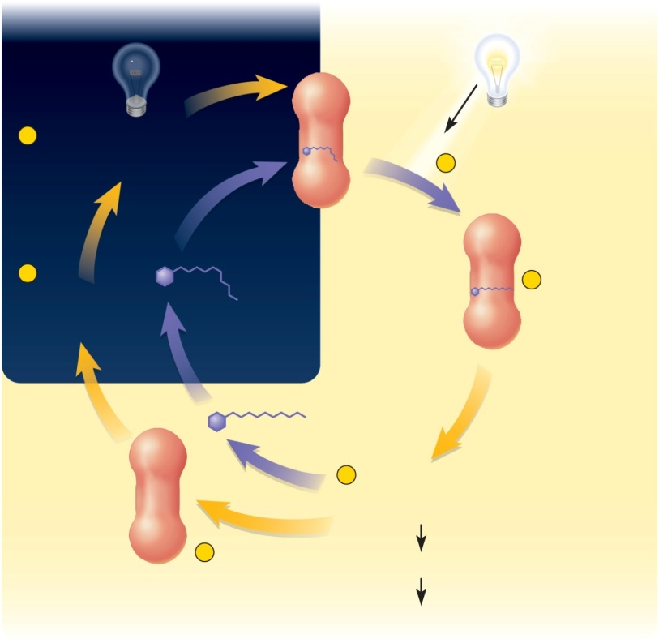
Generating the Optic Nerve Signal Rhodopsin Bleaching/Regeneration
Copyright © The McGraw-Hill Companies, Inc. Permission required for reproduction or display.
In the dark
In the light
Opsin
6
Opsin and cis-retinal
enzymatically combine
to regenerate rhodopsin
Rhodopsin absorbs
photon of light
cis-retinal
1
Figure 16.37
5
Trans-retinal is
enzymatically
converted back
to cis-retinal
2
Cis-retinal
isomerizes to
trans-retinal
3
Opsin triggers reaction
cascade that breaks
down cGMP
4
Trans-retinal
separates
from opsin
Cessation of dark current
Signals created in optic nerve
rhodopsin absorbs light, converted from bent shape in dark (cis-retinal) to straight (trans-retinal)
retinal dissociates from opsin (bleaching)
5 minutes to regenerate 50% of bleached rhodopsin
cones are faster to regenerate their photopsin – 90 seconds for 50%

Slide 101
Generating Visual Signals
Copyright © The McGraw-Hill Companies, Inc. Permission required for reproduction or display.
1
Rhodopsin
absorbs no light
1
Rhodopsin
absorbs light
Figure 16.38
Rod cell
2
Rod cell releases
glutamate
2
Glutamate
secretion
ceases
3
Bipolar cell
inhibited
Bipolar cell
3
Bipolar cell
no longer
inhibited
4
No synaptic
activity here
4
Bipolar cell
releases
neurotransmitter
Ganglion cell
5
No signal in
optic nerve fiber
5
Signal in
optic nerve fiber
(a) In the dark
(b) In the light

Slide 102
Generating Optic Nerve Signals
in dark, rods steadily release the neurotransmitter, glutamate from basal end of cell
when rods absorb light, glutamate secretion ceases
bipolar cells sensitive to these on and off pulses of glutamate secretion
some bipolar cells inhibited by glutamate and excited when secretion stops
these cells excited by rising light intensities
other bipolar cells are excited by glutamate and respond when light intensity drops
when bipolar cells detect fluctuations in light intensity, they stimulate ganglion cells directly or indirectly
ganglion cells are the only retinal cells that produce action potentials
ganglion cells respond to the bipolar cells with rising and falling firing frequencies
via optic nerve, these changes provide visual signals to the brain

Slide 103
Light and Dark Adaptation
light adaptation (walk out into sunlight)
pupil constriction and pain from over stimulated retinas
pupils constrict to reduce pain & intensity
color vision and acuity below normal for 5 to 10 minutes
time needed for pigment bleaching to adjust retinal sensitivity to high light intensity
rod vision nonfunctional
dark adaptation (turn lights off)
dilation of pupils occurs
rod pigment was bleached by lights
in dark, rhodopsin regenerates faster than it bleaches
in a minute or two night (scotopic) vision begins to function
after 20 to 30 minutes the amount of regenerated rhodopsin is sufficient for your eyes to reach maximum sensitivity

Slide 104
Dual Visual System
duplicity theory of vision explains why we have both rods and cones
a single type of receptor can not produce both high sensitivity and high resolution
it takes one type of cell and neural circuit for sensitive night vision
it takes a different cell type and neuronal circuit for high resolution daytime vision

Slide 105
Duplicity Theory
Copyright © The McGraw-Hill Companies, Inc. Permission required for reproduction or display.
2 μm²
of retina
1 mm² of retina
Rods
Cones
Bipolar
cells
Bipolar
cells
Ganglion
cells
Ganglion
cell
Optic
nerve
fibers
Optic
nerve
fiber
(a) Scotopic system
(b) Photopic system
Figure 16.39 a-b

Slide 106
Scotopic System (Night Vision)
rods sensitive – react even in dim light
extensive neuronal convergence
600 rods converge on 1 bipolar cell
many bipolar converge on each ganglion cell
results in high degree of spatial summation
one ganglion cells receives information from 1 mm² of retina producing only a coarse image
edges of retina have widely-spaced rod cells, act as motion detectors
low resolution system only
cannot resolve finely detailed images

Slide 107
Color Vision Photopic System (Day Vision)
fovea contains only 4000 tiny cone cells (no rods)
no neuronal convergence
each foveal cone cell has “private line to brain”
high-resolution color vision
little spatial summation so less sensitivity to dim light

Slide 108
Color Vision
primates have well developed color vision
nocturnal vertebrates
have only rods
three types of cones are named for absorption peaks of their photopsins
short-wavelength (S) cones peak sensitivity at 420 nm
medium-wavelength (M) cones peak at 531 nm
long-wavelength (L) cones peak at 558 nm
color perception based on mixture of nerve signals representing cones of different absorption peaks
Copyright © The McGraw-Hill Companies, Inc. Permission required for reproduction or display.
S cones
420 nm
Rods
500 nm
M cones
531 nm
L cones
558 nm
100
80
60
40
20
400
500
600
700
Wavelength (nm)
Wavelength
(nm)
Percentage of maximum
cone response
( S : M : L )
Perceived hue
400
50 : 0 : 0
Violet
450
72 : 30 : 0
Blue
500
20 : 82 : 60
Blue-green
550
0 : 85 : 97
Green
625
0 : 3 : 35
Orange
675
0 : 0 : 5
Red
Figure 16.40

Slide 109
Color Blindness
color blindness – have a hereditary atteration or lack of one photopsin or another
most common is red-green color blindness
results from lack of either L or M cones
causes difficulty distinguishing these related shades from each other
occurs in 8% of males, and 0.5% in females (sex-linkage)

Slide 110
Stereoscopic Vision (Stereopsis)
stereoscopic vision is depth perception - ability to judge distance to objects
requires two eyes with overlapping visual fields which allows each eye to look at the same object from different angles
panoramic vision has eyes on sides of head (horse or rodents – alert to predators but no depth perception)
fixation point - point in space in which the eyes are focused
looking at object within 100 feet, each eye views from slightly different angle
provides brain with information used to judge position of objects relative to fixation point

Slide 111
Retinal Basis of Stereoscopic Vision
Copyright © The McGraw-Hill Companies, Inc. Permission required for reproduction or display.
Distant object
D
Fixation
point
F
Figure 16.42
Near
object
N
N
F
F
N
D
D

Slide 112
Visual Projection Pathway
bipolar cells of retina are first-order neurons
retinal ganglion cells are second-order neurons whose axons form optic nerve
two optic nerves combine to form optic chiasm
half the fibers cross over to the opposite side of the brain (hemidecussation) and chiasm splits to form optic tracts
right cerebral hemisphere sees objects in the left visual field because their images fall on the right half of each retina
each side of brain sees what is on side where it has motor control over limbs

Slide 113
Visual Projection Pathway
optic tracts pass laterally around the hypothalamus with most of their axons ending in the lateral geniculate nucleus of the thalamus
third-order neurons arise here and form the optic radiation of fibers in the white matter of the cerebrum
project to primary visual cortex of occipital lobe where conscious visual sensation occurs
a few optic nerve fibers project to midbrain and terminate in the superior colliculi and pretectal nuclei
superior colliculi controls visual reflexes of extrinsic eye muscles
pretectal nuclei are involved in photopupillary and accommodation reflexes

Slide 114
Visual Projection Pathway
Copyright © The McGraw-Hill Companies, Inc. Permission required for reproduction or display.
Copyright © The McGraw-Hill Companies, Inc. Permission required for reproduction or display.
Uncrossed
(ipsilateral)
fiber
Crossed
(contralateral)
fiber
Optic radiation
Right eye
Fixation
point
Occipital lobe
(visual cortex)
Left eye
Optic
nerve
Optic
chiasm
Pretectal
nucleus
Lateral
geniculate
nucleus of
thalamus
Superior
colliculus
Optic tract
Figure 16.43

Slide 115
Visual Information Processing
some processing begins in retina
adjustments for contrast, brightness, motion and stereopsis
primary visual cortex is connected by association tracts to visual association areas in parietal and temporal lobes which process retinal data from occipital lobes
object location, motion, color, shape, boundaries
store visual memories (recognize printed words)

Slide 116
Anesthesia
trephination – cutting a hole in the skull to let out ‘evil spirits’
three things needed for effective surgery
better knowledge of anatomy
asepsis – control of infection
anesthesia – the control of pain
ether and chloroform gave way to safer anesthetics such as cyclopropane, ethylene, and nitrous oxide
general anesthetics - cross blood-brain barrier and block nervous transmission through the brainstem
local anesthetics – Novocain, tetracaine selectively deaden specific nerves

