Slide 1
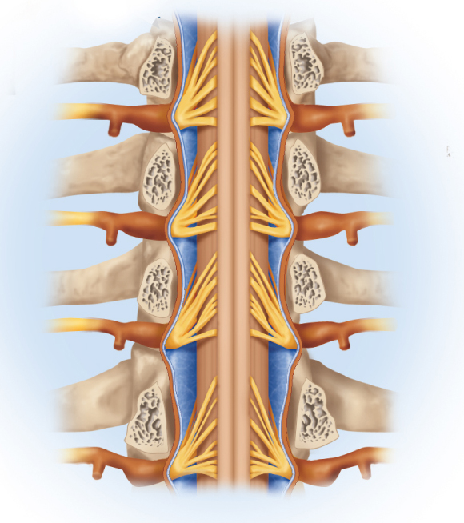
Spinal Cord, Spinal Nerves, and Somatic Reflexes
Copyright © The McGraw-Hill Companies, Inc. Permission required for reproduction or display.
Spinal cord
spinal cord
spinal nerves
somatic reflexes
Vertebra (cut)
Spinal nerve
Spinal nerve rootlets
Posterior median sulcus
Subarachnoid space
Epidural space
Posterior root ganglion
Rib
Arachnoid mater
Dura mater
(b)
Figure 13.1b

Slide 2
Damage to Spinal Cord
accidents damage the spinal cord of thousands of people every year
paraplegia - paralysis of lower limbs
quadriplegia – paralysis of all four limbs
respiratory paralysis, loss of sensation or motor control
disorders of bladder, bowel and sexual function
damage to spinal cord from strokes or other brain injuries
hemiplegia – paralysis of one side of the body only

Slide 3
Functions of the Spinal Cord
conduction
bundles of fibers passing information up and down spinal cord, connecting different levels of the trunk with each other and with the brain
locomotion
walking involves repetitive, coordinated actions of several muscle groups
central pattern generators are pools of neurons providing control of flexors and extensors that cause alternating movements of the lower limbs
reflexes
involuntary, stereotyped responses to stimuli
withdrawal of hand from pain
involves brain, spinal cord and peripheral nerves

Slide 4
Surface Anatomy
spinal cord – cylinder of nervous tissue that arises from the brainstem at the foramen magnum of the skull
passes through the vertebral canal
inferior margin ends at L1 or a little beyond
averages 1.8 cm thick and 45 cm long
occupies the upper two-thirds of the vertebral canal
gives rise to 31 pair of spinal nerves
first pair passes between the skull and C1
rest pass through intervertebral foramina
segment – part of the spinal cord supplied by each pair of spinal nerves

Slide 5
Surface Anatomy
longitudinal grooves on anterior and posterior sides
anterior median fissure and posterior median sulcus
spinal cord divided into the cervical, thoracic, lumbar, and sacral regions
two areas of the cord are thicker than elsewhere
cervical enlargement – nerves to upper limb
lumbar enlargement – nerves to pelvic region and lower limbs
medullary cone (conus medullaris) – cord tapers to a point inferior to lumbar enlargement
cauda equina – bundle of nerve roots that occupy the vertebral canal from L2 to S5

Slide 6
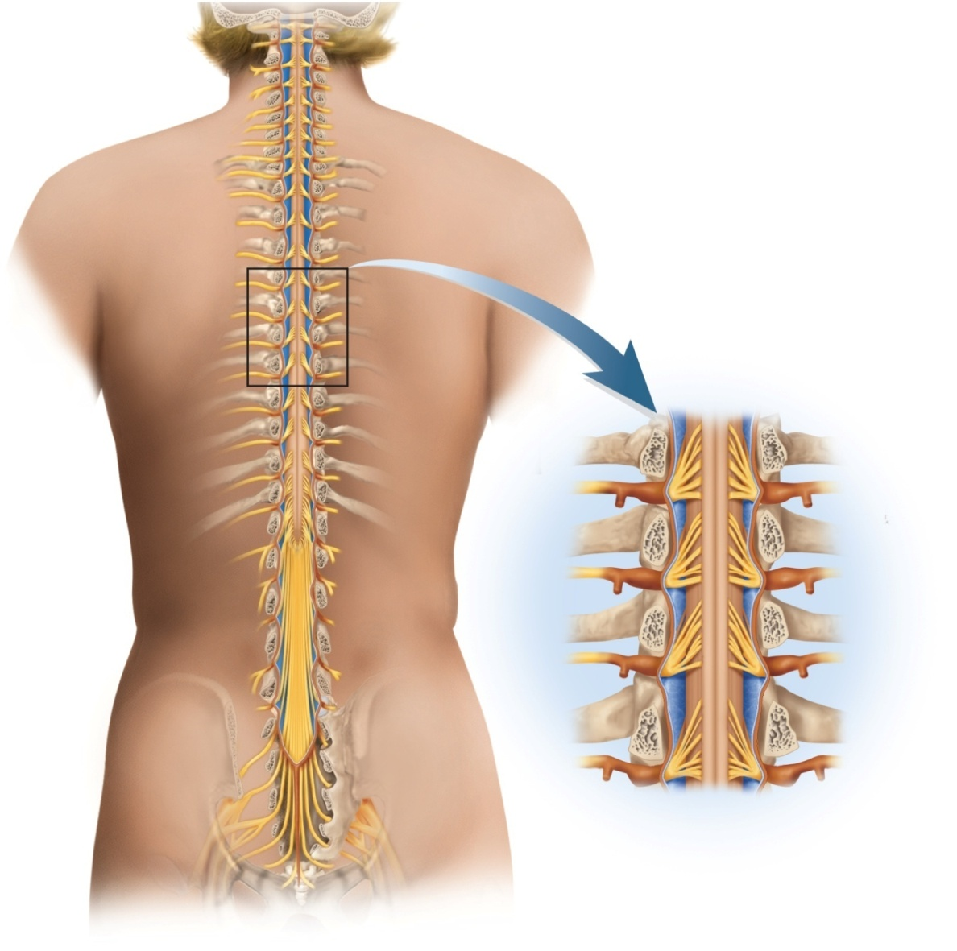
Anatomy of Lower Spinal Cord
Copyright © The McGraw-Hill Companies, Inc. Permission required for reproduction or display.
C1
Cervical
enlargement
Cervical
spinal
nerves
C7
Dural
sheath
Subarachnoid
space
Thoracic
spinal
nerves
Spinal cord
Lumbar
enlargement
Vertebra (cut)
T12
Spinal nerve
Medullary
cone
Spinal nerve rootlets
Posterior median sulcus
Lumbar
spinal
nerves
Subarachnoid space
Cauda equina
Epidural space
Posterior root ganglion
L5
Rib
Arachnoid mater
Dura mater
Terminal
filum
Sacral
spinal
nerves
(b)
S5
Col
(a)
Figure 13.1

Slide 7
Meninges of the Spinal Cord
meninges – three fibrous connective tissue membranes that enclose the brain and spinal cord
separate soft tissue of central nervous system from bones of cranium and vertebral canal
from superficial to deep – dura mater, arachnoid mater, and pia mater

Slide 8
Meninges of the Spinal Cord
dura mater
forms loose-fitting sleeve around spinal cord – dural sheath
tough, collagenous membrane surrounded by epidural space filled with fat, blood vessels, and loose connective tissue
epidural anesthesia utilized during childbirth
arachnoid mater
arachnoid membrane - layer of simple squamous epithelium lining dura mater and a loose mesh of collagenous and elastic fibers spanning the gap between the arachnoid membrane and the pia mater
subarachnoid space – gap between arachnoid membrane and the pia mater
filled with cerebrospinal fluid (CSF)
lumbar cistern – subarachnoid space inferior to medullary cone that contains cauda equina and CSF
pia mater
delicate, translucent membrane that follows the contours of the spinal cord
terminal filum – fibrous strand of pia mater that extends beyond the medullary cone within the lumbar cistern
coccygeal ligament – formed from fusion of terminal filum and dura mater
anchors the cord and meninges to vertebra Co1
denticulate ligaments – extend through the arachnoid to the dura
anchors spinal cord to limit side to side movement

Slide 9
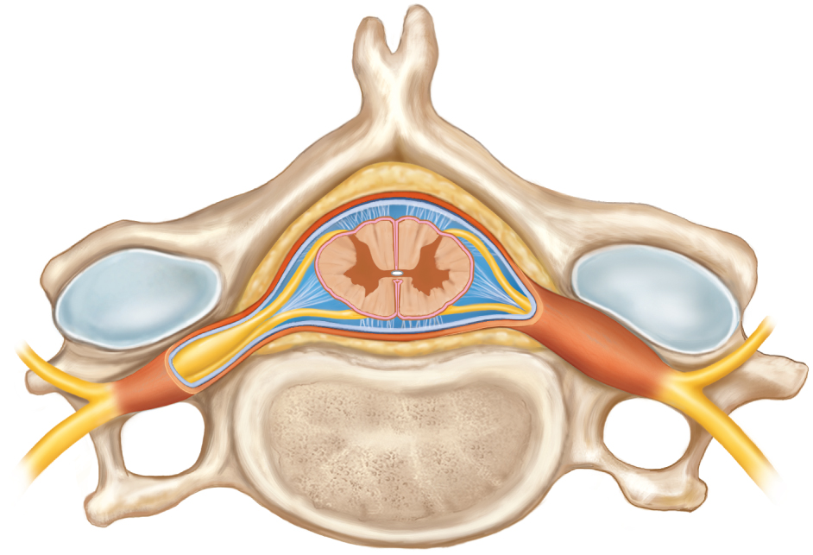
Meninges of Vertebra and Spinal Cord
Copyright © The McGraw-Hill Companies, Inc. Permission required for reproduction or display.
Posterior
Spinous process of vertebra
Meninges:
Dura mater (dural sheath)
Arachnoid mater
Fat in epidural space
Pia mater
Subarachnoid space
Spinal cord
Denticulate ligament
Posterior root ganglion
Spinal nerve
Vertebral body
(a) Spinal cord and vertebra (cervical)
Anterior
Figure 13.2a

Slide 10
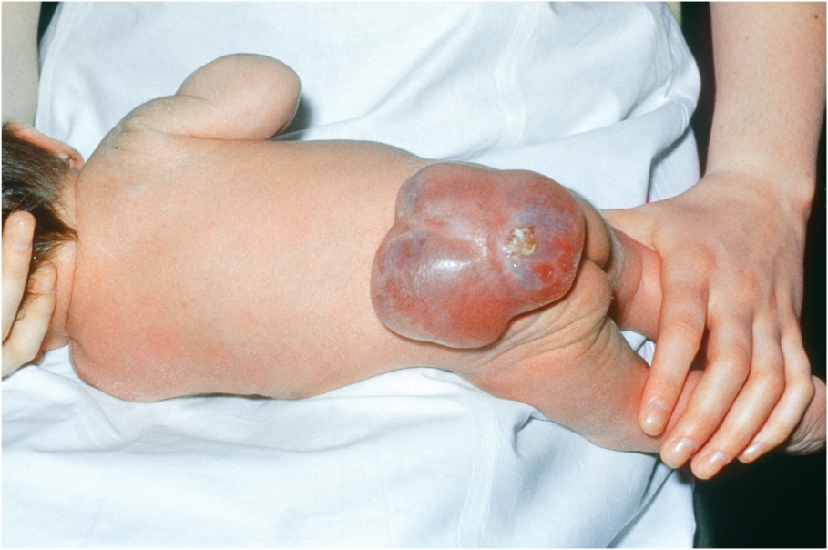
Spina Bifida
spina bifida – congenital defect in which one or more vertebrae fail to form a complete vertebral arch for enclosure of the spinal cord
in 1 baby out of 1000
common in lumbosacral region
spina bifida occulta and spina bifida cystica
folic acid (a B vitamin) as part of a healthy diet for all women of childbearing age reduces risk
defect occurs during the first four weeks of development, so folic acid supplementation must begin 3 months before conception
Copyright © The McGraw-Hill Companies, Inc. Permission required for reproduction or display.
Figure 13.3
Biophoto Associates/Photo Researchers, Inc.

Slide 11
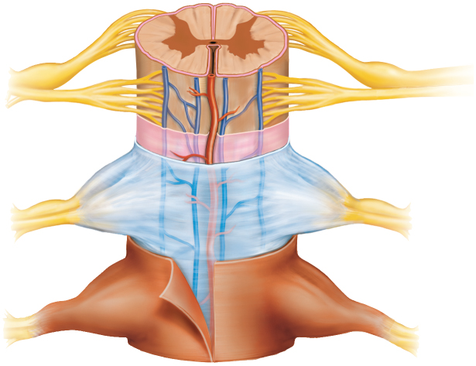
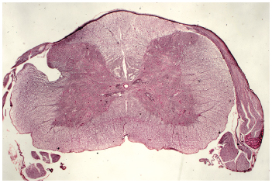
Cross-Sectional Anatomy of the Spinal Cord
Copyright © The McGraw-Hill Companies, Inc. Permission required for reproduction or display.
Gray matter:
Central canal
Posterior
median sulcus
White matter:
Posterior horn
Posterior column
Gray commissure
Lateral column
Lateral horn
Anterior column
Anterior horn
Posterior root of spinal nerve
Posterior root ganglion
Spinal nerve
Anterior median fissure
Anterior root
of spinal nerve
Meninges:
Pia mater
Arachnoid mater
Figure 13.2b & c
Dura mater (dural sheath)
(b) Spinal cord and meninges (thoracic)
c: Sarah Werning
(c) Lumbar spinal cord
central area of gray matter shaped like a butterfly and surrounded by white matter in 3 columns
gray matter - neuron cell bodies with little myelin
site of information processing – synaptic integration
white matter – abundantly myelinated axons
carry signals from one part of the CNS to another

Slide 12
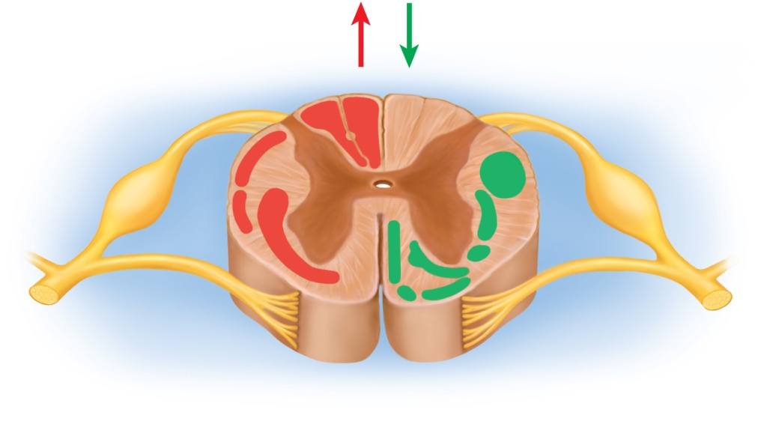
Gray Matter in the Spinal Cord
spinal cord has a central core of gray matter that looks like a butterfly- or H-shaped in cross section
pair of posterior (dorsal) horns
posterior (dorsal) root of spinal nerve carries only sensory fibers
pair of thicker anterior (ventral) horns
anterior (ventral) root of spinal nerve carries only motor fibers
gray commissure connects right and left sides
punctured by a central canal lined with ependymal cells and filled with CSF
lateral horn – visible from T2 through L1
contains neurons of sympathetic nervous system
Copyright © The McGraw-Hill Companies, Inc. Permission required for reproduction or display.
Ascending
tracts
Descending
tracts
Posterior column:
Gracile fasciculus
Cuneate fasciculus
Anterior corticospinal tract
Posterior spinocerebellar tract
Lateral
corticospinal tract
Anterior spinocerebellar tract
Lateral reticulospinal tract
Figure 13.4
Anterolateral system
(containing
spinothalamic
and spinoreticular
tracts)
Tectospinal tract
Medial reticulospinal tract
Lateral vestibulospinal tract
Medial vestibulospinal tract

Slide 13
White Matter in the Spinal Cord
white matter of the spinal cord surrounds the gray matter
consists of bundles of axons that course up and down the cord
provide avenues of communication between different levels of the CNS
columns or funiculi – three pair of these white matter bundles
posterior (dorsal), lateral, and anterior (ventral) columns on each side
tracts or fasciculi – subdivisions of each column
Copyright © The McGraw-Hill Companies, Inc. Permission required for reproduction or display.
Ascending
tracts
Descending
tracts
Posterior column:
Gracile fasciculus
Cuneate fasciculus
Anterior corticospinal tract
Posterior spinocerebellar tract
Lateral
corticospinal tract
Anterior spinocerebellar tract
Lateral reticulospinal tract
Figure 13.4
Anterolateral system
(containing
spinothalamic
and spinoreticular
tracts)
Tectospinal tract
Medial reticulospinal tract
Lateral vestibulospinal tract
Medial vestibulospinal tract

Slide 14
Spinal Tracts
Copyright © The McGraw-Hill Companies, Inc. Permission required for reproduction or display.
Ascending
tracts
Descending
tracts
Posterior column:
Gracile fasciculus
Cuneate fasciculus
Anterior corticospinal tract
Posterior spinocerebellar tract
Lateral
corticospinal tract
Anterior spinocerebellar tract
Lateral reticulospinal tract
Figure 13.4
Anterolateral system
(containing
spinothalamic
and spinoreticular
tracts)
Tectospinal tract
Medial reticulospinal tract
Lateral vestibulospinal tract
Medial vestibulospinal tract
ascending tracts – carry sensory information up the spinal cord
descending tracts – carry motor information down the spinal cord
all nerve fibers in a given tract have a similar origin, destination, and function
decussation – as the fibers pass up or down the brainstem and spinal cord they cross over from the left to the right side and vise versa
contralateral – when the origin and destination of a tract are on opposite sides of the body
ipsilateral – when the origin and destination of a tract are on the same side of the body
does not decussate

Slide 15
Ascending Tracts
ascending tracts carry sensory signals up the spinal cord
sensory signals travel across three neurons from origin in receptors to the destination in the sensory areas of the brain
first order neurons – detect stimulus and transmit signal to spinal cord or brainstem
second order neurons – continues to the thalamus at the upper end of the brainstem
third order neurons – carries the signal the rest of the way to the sensory region of the cerebral cortex

Slide 16
Major Ascending Tracts
gracile fasciculus
cuneate fasciculus
spinothalamic tract
spinoreticular tract
posterior (dorsal) and anterior (ventral) spinocerebellar tracts

Slide 17
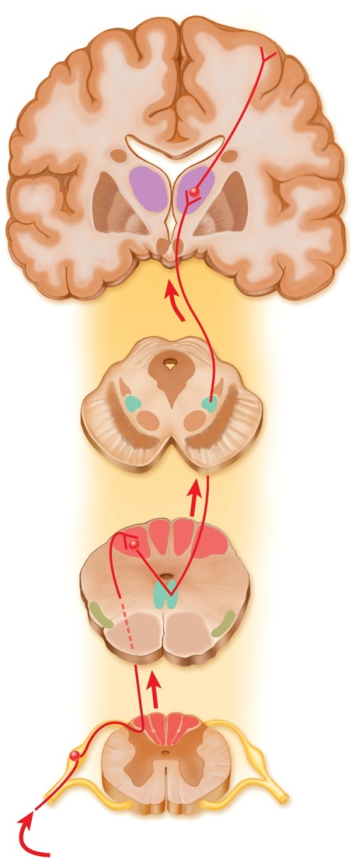
Gracile Fasciculus
carries signals from midthoracic and lower parts of the body
below T6, it composes the entire posterior column
at T6 joins cuneate fasciculus
consists of first-order nerve fibers that travel up the ipsilateral side of the spinal cord
terminates at the gracile nucleus of the medulla oblongata
carries signals for vibration, visceral pain, deep and discriminative touch, and proprioception from lower limbs and lower trunk
proprioception – nonvisual sense of the position and movements of the body
Copyright © The McGraw-Hill Companies, Inc. Permission required for reproduction or display.
Somesthetic cortex
(postcentral gyrus)
Third-order
neuron
Thalamus
Cerebrum
Midbrain
Medial
lemniscus
Gracile
nucleus
Second-order
neuron
Cuneate
nucleus
Medulla
Medial
lemniscus
First-order
neuron
Gracile fasciculus
Cuneate fasciculus
Spinal cord
Receptors for body movement, limb positions,
fine touch discrimination, and pressure
(a)
Figure 13.5a

Slide 18
Cuneate Fasciculus
joins gracile fasciculus at T6
occupies lateral portion of the posterior column
forces gracile fasciculus medially
carries the same type of sensory signals
originate from the level of T6 and up
upper limb and chest
fibers end in the cuneate nucleus on the ipsilateral side of the medulla oblongata
medial lemniscus – formed from the second-order neurons of gracile and cuneate systems that decussate in the medulla
tracts of these nerve fibers lead the rest of the way to the thalamus
third-order neurons go from thalamus to cerebral cortex
carry signals to contralateral cerebral hemisphere
Copyright © The McGraw-Hill Companies, Inc. Permission required for reproduction or display.
Somesthetic cortex
(postcentral gyrus)
Third-order
neuron
Thalamus
Cerebrum
Midbrain
Medial
lemniscus
Gracile
nucleus
Second-order
neuron
Cuneate
nucleus
Medulla
Medial
lemniscus
First-order
neuron
Gracile fasciculus
Cuneate fasciculus
Spinal cord
Receptors for body movement, limb positions,
fine touch discrimination, and pressure
(a)
Figure 13.5a

Slide 19
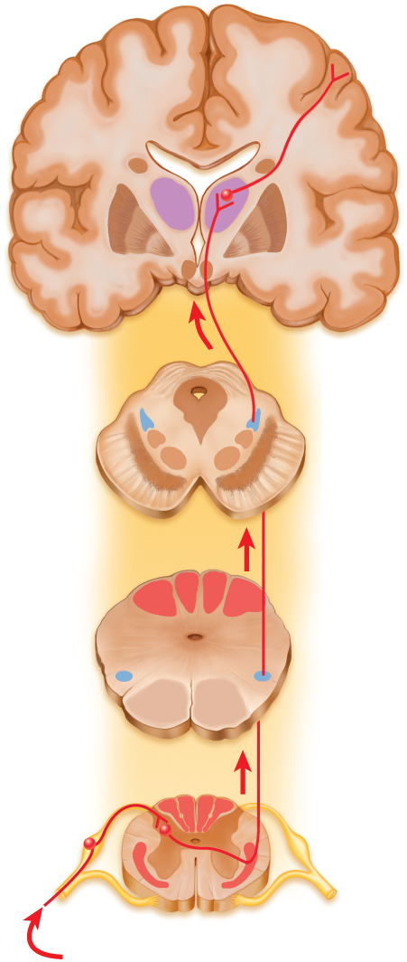
Spinothalamic Pathway
Copyright © The McGraw-Hill Companies, Inc. Permission required for reproduction or display.
one of the smaller tracts of the anterolateral system
passes up the anterior and lateral columns of the spinal cord
carry signals for pain, pressure, temperature, light touch, tickle, and itch
first-order neurons end in posterior horn of spinal cord
synapse with second-order neurons which decussate to other side of spinal cord and form the ascending spinothalamic tract
third-order neurons continue from there to cerebral cortex
sends signals to the contralateral cerebral hemisphere
Somesthetic cortex
(postcentral gyrus)
Third-order
neuron
Thalamus
Cerebrum
Midbrain
Second-order
neuron
Medulla
Spinothalamic
tract
Spinal cord
First-order
neuron
Anterolateral system
Receptors for pain, heat, and cold
(b)
Figure 13.5b

Slide 20
Spinoreticular Tract
travel up the anterolateral system
carries pain signals resulting from tissue injury
first-order neurons enter posterior horn and immediately synapse with second-order neurons
decussate to opposite anterolateral system
ascend the cord
end in reticular formation – loosely organized core of gray matter in the medulla and pons
third-order neurons continue from the pons to the thalamus
fourth-order neurons complete the path to the cerebral cortex

Slide 21
Spinocerebellar Tracts
travel through lateral column
carry proprioceptive signals from limbs and trunk up to the cerebellum
first-order neurons originate in the muscles and tendons
end in posterior horn of the spinal cord
second-order nerves ascend spinocerebellar tracts and end in cerebellum
fibers of the posterior tract travel up the ipsilateral side of the spinal cord
fibers of the anterior tract cross over and travel up the contralateral side
cross back in the brainstem to enter the ipsilateral side of the cerebellum
provide cerebellum with feedback needed to coordinate muscle actions

Slide 22
Descending Tracts
descending tracts - carry motor signals down the brainstem and spinal cord
involves two neurons
upper motor neuron originate in cerebral cortex or brainstem and terminates on a lower motor neuron
lower motor neuron in brainstem or spinal cord
axon of lower motor neuron leads the rest of the way to the muscle or other target organ

Slide 23
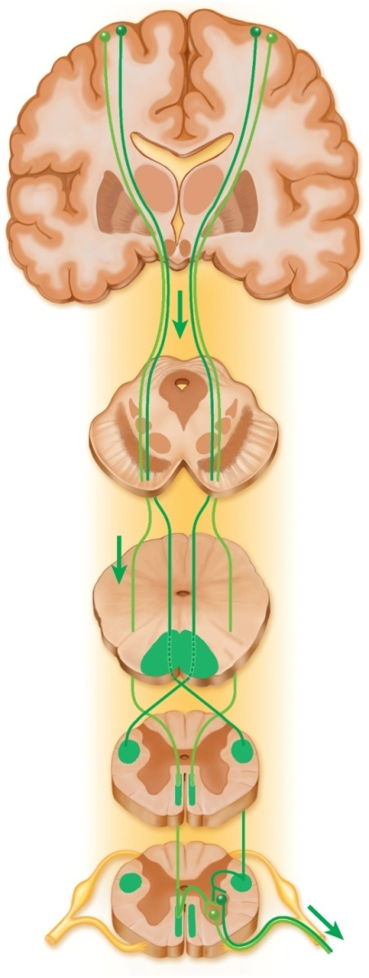
Corticospinal Tracts
Copyright © The McGraw-Hill Companies, Inc. Permission required for reproduction or display.
from cerebral cortex for precise, finely coordinated limb movements
pyramids – ridges on anterior surface of the medulla oblongata formed from fibers of this system
decussate in lower medulla
lateral corticospinal tract on contralateral side of spinal cord
anterior (ventral) corticospinal tract on ipsilateral side of spinal cord
two neuron pathway
upper motor neuron in cerebral cortex
lower motor neuron in spinal cord
Motor cortex
(precentral gyrus)
Internal
capsule
Cerebrum
Midbrain
Cerebral
peduncle
Upper motor
neurons
Medulla
Medullary
pyramid
Decussation
in medulla
Lateral
corticospinal
tract
Spinal cord
Anterior
corticospinal
tract
Decussation in
spinal cord
Spinal cord
Lower motor
neurons
To skeletal muscles
Figure 13.6

Slide 24
Descending Motor Tracts
tectospinal tract – begins in midbrain region (tectum)
crosses to contralateral side of midbrain
reflex turning of head in response to sights and sounds
lateral and medial reticulospinal tract
originate in the reticular formation of brainstem
controls muscles of upper and lower limbs
especially those for posture and balance
contain descending analgesic pathways
reduce the transmission of pain signals to brain
lateral and medial vestibulospinal tract
begins in brainstem vestibular nuclei
receives impulses for balance from inner ear
controls extensor muscles of limbs for balance control

Slide 25
Poliomyelitis and ALS
both diseases cause destruction of motor neurons and production of skeletal muscle atrophy from lack of innervation
poliomyelitis
caused by the poliovirus
destroys motor neurons in brainstem and anterior horn of spinal cord
signs of polio include muscle pain, weakness, and loss of some reflexes
followed by paralysis, muscular atrophy, and respiratory arrest
virus spreads by fecal contamination of water
amyotrophic lateral sclerosis (ALS) – Lou Gehrig disease
destruction of motor neurons and muscular atrophy
also sclerosis (scarring) of lateral regions of the spinal cord
astrocytes fail to reabsorb the neurotransmitter glutamate from the tissue fluid
accumulate to toxic levels
early signs – muscular weakness, difficulty speaking, swallowing, and use of hands
sensory and intellectual functions remain unaffected

Slide 26
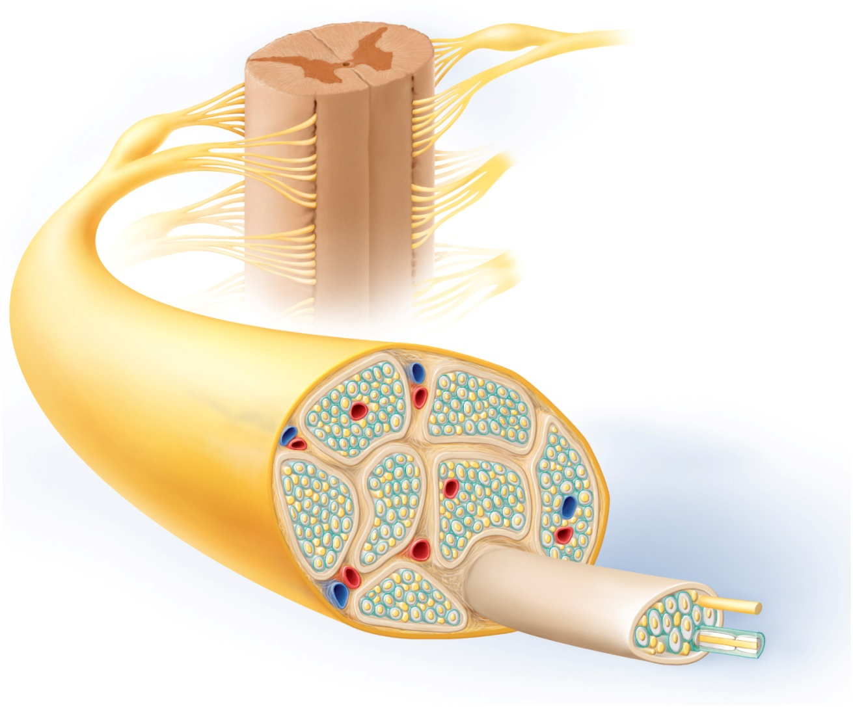
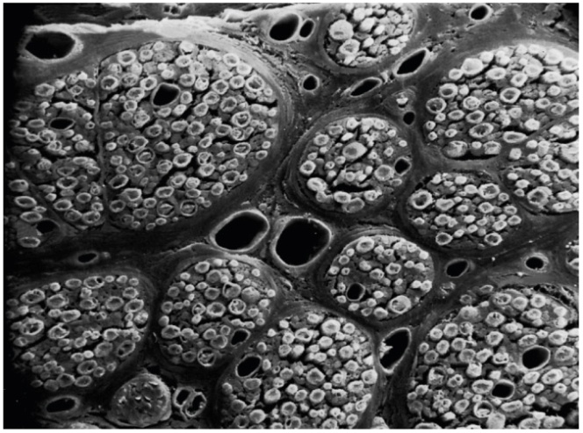
Anatomy of a Nerve
Copyright © The McGraw-Hill Companies, Inc. Permission required for reproduction or display.
Epineurium
Perineurium
Copyright © The McGraw-Hill Companies, Inc. Permission required for reproduction or display.
Endoneurium
Nerve
fiber
Rootlets
Posterior root
Fascicle
Posterior root
ganglion
Anterior
root
Blood
vessels
Spinal
nerve
(b)
Copyright by R.G. Kessel and R.H. Kardon, Tissues and Organs: A Text-Atlas of Scanning Electron Microscopy, 1979, W.H. Freeman, All rights reserved
Figure 13.8b
Blood
vessels
Fascicle
Epineurium
Perineurium
Unmyelinated nerve fibers
(a)
Myelinated nerve fibers
Endoneurium
Myelin
Figure 13.8a

Slide 27
General Anatomy of Nerves and Ganglia
spinal cord communicates with the rest of the body by way of spinal nerves
nerve – a cordlike organ composed of numerous nerve fibers (axons) bound together by connective tissue
mixed nerves contain both afferent (sensory) and efferent (motor) fibers
composed of thousands of fibers carrying currents in opposite directions
nerves of peripheral nervous system are ensheathed in Schwann cells
forms neurilemma and often a myelin sheath around the axon
external to neurilemma, each fiber is surrounded by basal lamina and then a thin sleeve of loose connective tissue – endoneurium
fascicles – nerve fibers gathered in bundles
perineurium – wraps fascicles
composed of up to 20 layers of overlapping, squamous , epithelium-like cells
epineurium – bundles numerous fascicles that constitutes whole nerve
composed of dense irregular connective tissue
protects nerve from stretching and injury
blood vessels penetrate connective tissue coverings
nerves have high metabolic rate and need plentiful blood supply

Slide 28
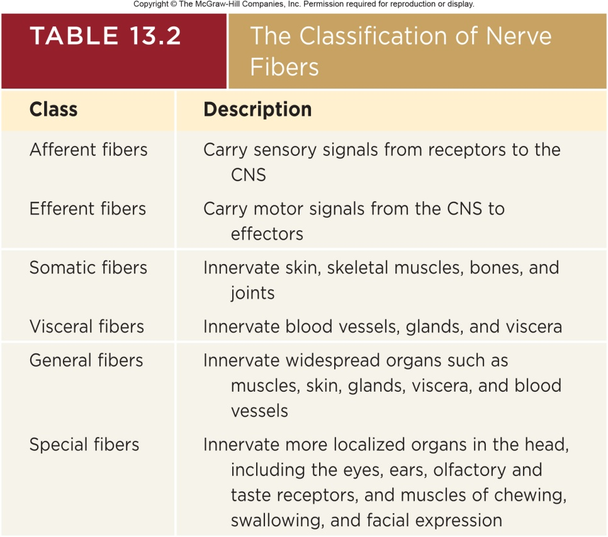
Classification of Nerve Fibers
sensory (afferent) nerves
carry signals from sensory receptors to the CNS
motor (efferent) nerves
carry signals from CNS to muscles and glands
mixed nerves
consists of both afferent and efferent fibers
conduct signals in two directions
both sensory and motor fibers can also be described as:
somatic or visceral
general or special

Slide 29
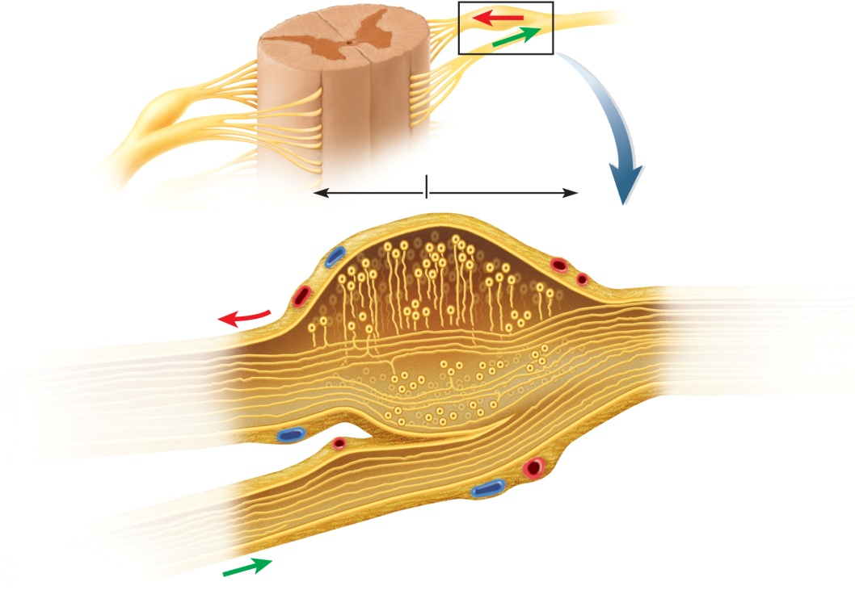
Anatomy of Ganglia in the PNS
Copyright © The McGraw-Hill Companies, Inc. Permission required for reproduction or display.
Direction of
signal transmission
Spinal cord
Posterior root
ganglion
Anterior root
To peripheral
receptors and effectors
To spinal cord
Posterior root ganglion
Somatosensory
neurons
Sensory
pathway
Spinal nerve
Figure 13.9
Posterior root
Epineurium
Blood vessels
Anterior root
Sensory nerve fibers
Motor
pathway
Motor nerve fibers
ganglion - cluster of neurosomas outside the CNS
enveloped in an endoneurium continuous with that of the nerve
among neurosomas are bundles of nerve fibers leading into and out of the ganglion
posterior root ganglion associated with spinal nerves

Slide 30
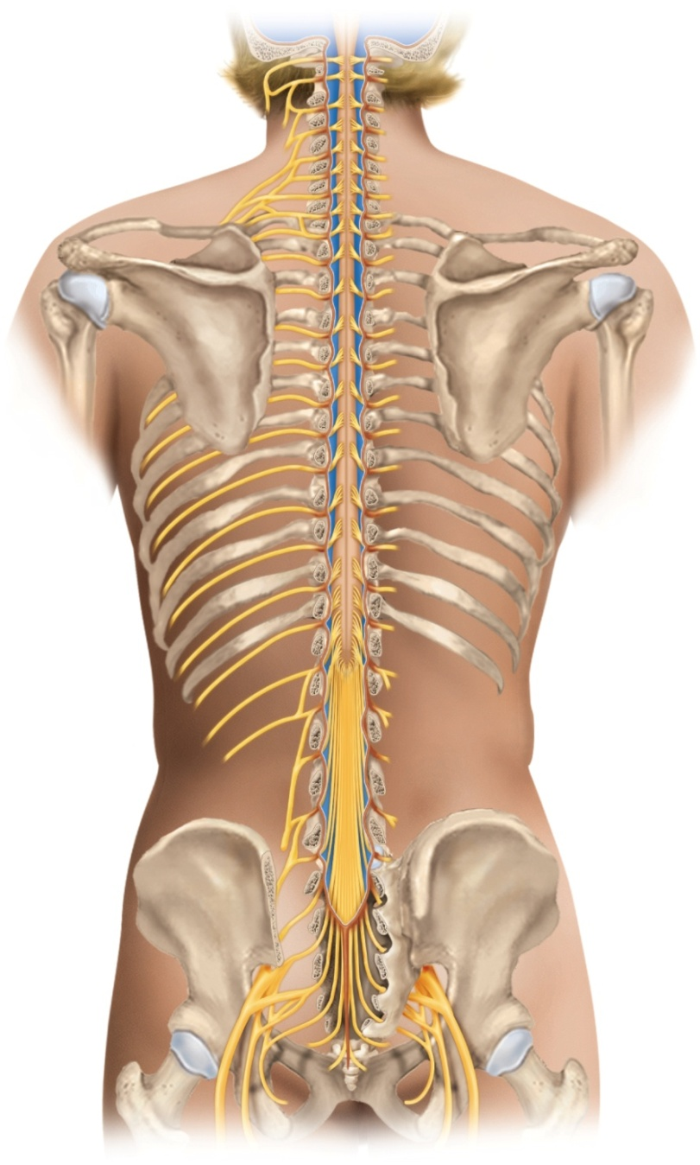
Spinal Nerve Roots and Plexuses
Copyright © The McGraw-Hill Companies, Inc. Permission required for reproduction or display.
Vertebra C1 (atlas)
C1
Cervical plexus (C1–C5)
C2
C3
Cervical nerves (8 pairs)
C4
Cervical enlargement
C5
C6
Brachial plexus (C5–T1)
C7
C8
T1
Vertebra T1
T2
T3
T4
T5
T6
T7
Thoracic nerves (12 pairs)
Intercostal (thoracic)
nerves (T1–T12)
T8
T9
Lumbar enlargement
T10
T11
Vertebra L1
T12
Medullary cone
L1
Lumbar plexus (L1–L4)
L2
L3
Lumbar nerves (5 pairs)
L4
Cauda equina
L5
Figure 13.10
Sacral plexus (L4–S4)
S1
S2
Sacral nerves (5 pairs)
S3
Coccygeal plexus
(S4–Co1)
S4
S5
Coccygeal nerves (1 pair)
Sciatic nerve

Slide 31
Spinal Nerves
31 pairs of spinal nerves (mixed nerves)
8 cervical (C1 – C8) C1 between skull and atlas
others exiting at intervertebral foramen
12 thoracic (T1 – T12)
5 lumbar (L1 – L5)
5 sacral (S1 – S5)
1 coccygeal (Co)
proximal branches forming spinal nerves
each spinal nerve has two points of attachment to the spinal cord
posterior (dorsal) root is sensory input to spinal cord
posterior (dorsal) root ganglion – contains the somas of sensory neurons carrying signals to the spinal cord
six to eight rootlets that enter posterior horn of cord
anterior (ventral) root is motor output out of spinal cord
six to eight rootlets that leave spinal cord and converge to form anterior root
these merge to form spinal nerve proper that enters intervertebral foramen
cauda equina – formed from roots that arise from L2 to Co

Slide 32
Spinal Nerves
distal branches of spinal nerves
distal to vertebral foramen, the nerve divides into:
anterior ramus – innervates the anterior and lateral skin and muscles of the trunk
gives rise to nerves of the limbs
posterior ramus – innervates the muscles and joints in that region of the spine and the skin of the back
meningeal branch – reenters the vertebral canal and innervates the meninges, vertebrae and spinal ligaments

Slide 33
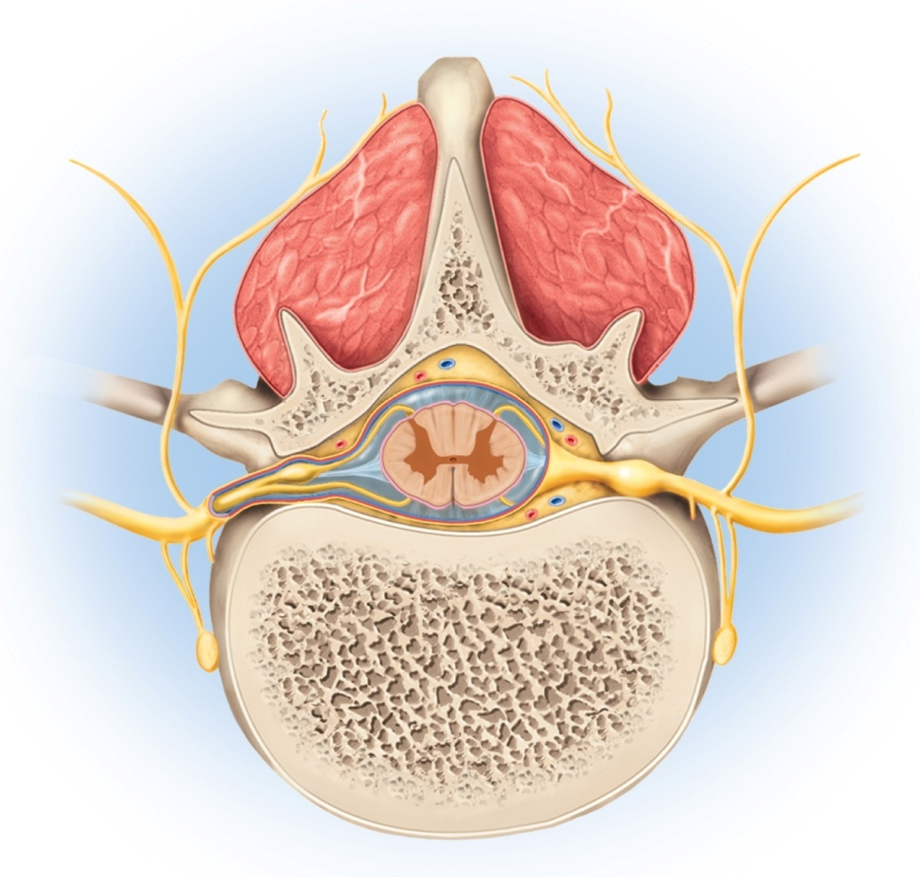
Spinal Nerves
Copyright © The McGraw-Hill Companies, Inc. Permission required for reproduction or display.
Posterior
Spinous process
of vertebra
Posterior root
Deep muscles of back
Posterior ramus
Spinal cord
Transverse process
of vertebra
Posterior root ganglion
Spinal nerve
Anterior ramus
Meningeal branch
Communicating rami
Anterior root
Vertebral body
Sympathetic ganglion
Anterior
Figure 13.11

Slide 34
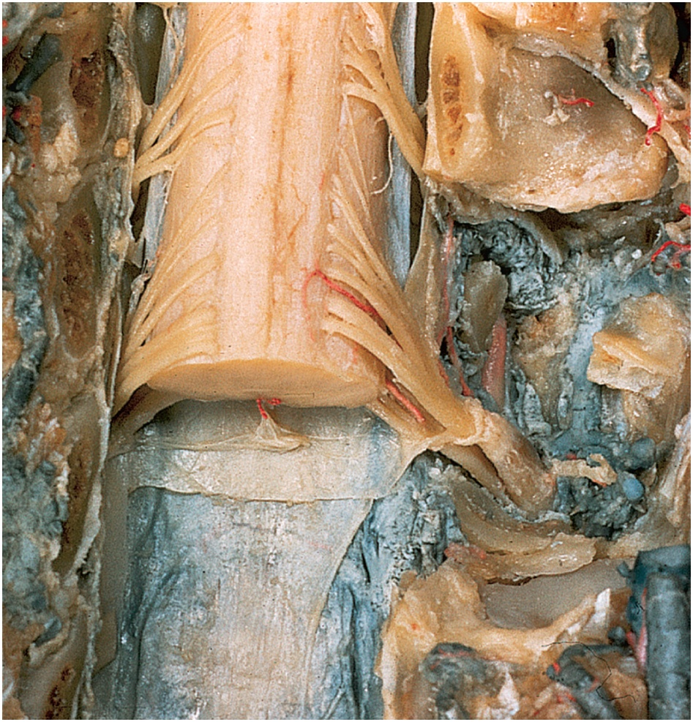
Dissection of Spinal Nerve
Copyright © The McGraw-Hill Companies, Inc. Permission required for reproduction or display.
Posterior median
sulcus
Gracile fasciculus
Neural arch of
vertebra C3 (cut)
Cuneate
fasciculus
Lateral column
Spinal nerve C4
Segment C5
Vertebral artery
Spinal nerve C5:
Cross section
Rootlets
Arachnoid
mater
Posterior root
Dura mater
Posterior root
ganglion
Anterior root
© From A Stereoscopic Atlas of Anatomy by David L. Basett. Courtesy of Dr. Robert A. Chase, MD
Figure 13.12

Slide 35
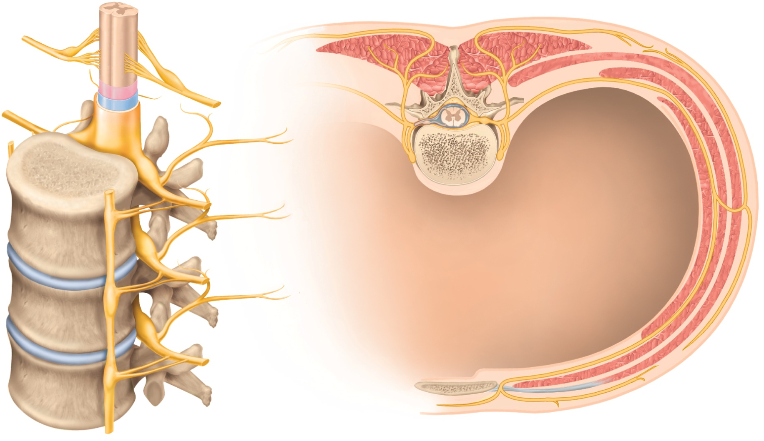
Rami of Spinal Nerves
Copyright © The McGraw-Hill Companies, Inc. Permission required for reproduction or display.
Posterior and anterior rootlets
of spinal nerve
Spinal nerve
Posterior ramus
Anterior ramus
Posterior root
Communicating
rami
Posterior root ganglion
Intercostal nerve
Anterior root
Sympathetic
chain ganglion
Spinal nerve
Anterior ramus
of spinal nerve
Thoracic cavity
Sympathetic chain
ganglion
Lateral
cutaneous nerve
Posterior ramus
of spinal nerve
Intercostal
muscles
Communicating rami
Anterior
cutaneous nerve
(a) Anterolateral view
(b) Cross section
Figure 13.13

Slide 36
Nerve Plexuses
anterior rami branch and anastomose repeatedly to form five nerve plexuses:
cervical plexus in the neck, C1 to C5
supplies neck and phrenic nerve to the diaphragm
brachial plexus near the shoulder, C5 to T1
supplies upper limb and some of shoulder and neck
median nerve – carpal tunnel syndrome
lumbar plexus in the lower back, L1 to L4
supplies abdominal wall, anterior thigh and genitalia
sacral plexus in the pelvis, L4, L5 and S1 to S4
supplies remainder of lower trunk and lower limb
coccygeal plexus, S4, S5 and C0
somatosensory function – carry sensory signals from bones, joints, muscles, and the skin
proprioception –brain receives information about body position and movements from nerve endings in muscles, tendons, and joints
motor function – primarily to stimulate muscle contraction

Slide 37
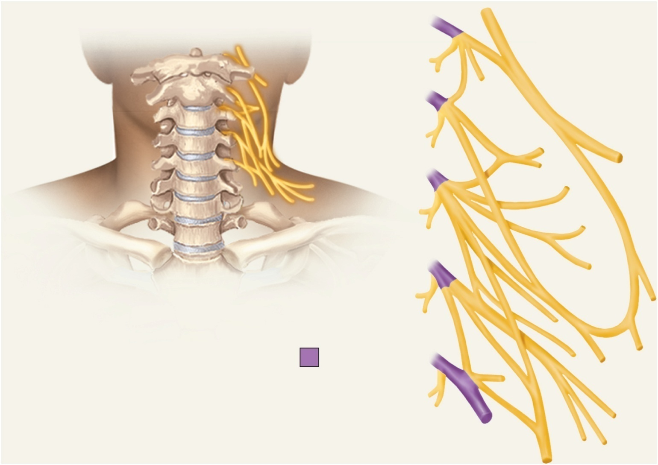
The Cervical Plexus
Copyright © The McGraw-Hill Companies, Inc. Permission required for reproduction or display.
C1
Hypoglossal
nerve (XII)
C2
Lesser occipital nerve
C3
Great auricular nerve
Transverse cervical nerve
C4
Ansa cervicalis:
Anterior root
Posterior root
Roots
C5
Supraclavicular nerves
Phrenic nerve
Figure 13.14

Slide 38
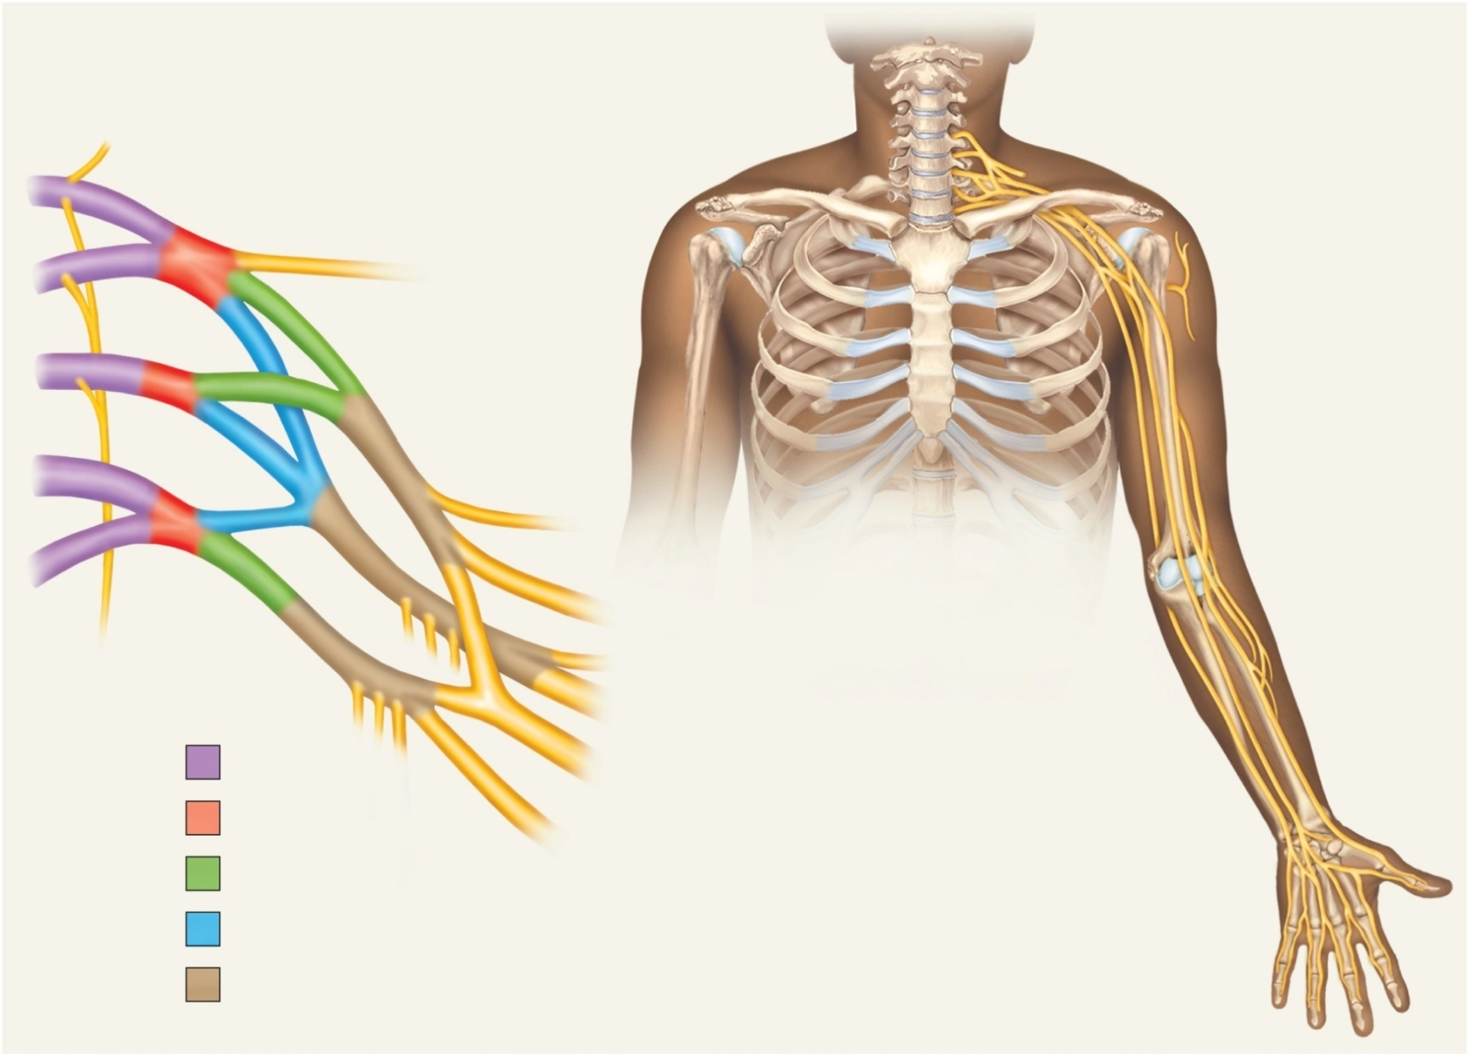
The Brachial Plexus
Copyright © The McGraw-Hill Companies, Inc. Permission required for reproduction or display.
C5
Posterior scapular nerve
Suprascapular nerve
Lateral cord
Posterior cord
C6
Medial cord
Axillary nerve
C7
Lateral cord
Musculocutaneous
nerve
Posterior cord
Medial cord
Median nerve
C8
Radial nerve
T1
Musculocutaneous nerve
Ulna
Axillary nerve
Ulnar nerve
Long thoracic
nerve
Radial nerve
Median nerve
Roots
Median nerve
Radial nerve
Radius
Trunks
Ulnar nerve
Anterior divisions
Superficial branch
of ulnar nerve
Posterior divisions
Digital branch
of ulnar nerve
Cords
Digital branch
of median nerve
Figure 13.15

Slide 39
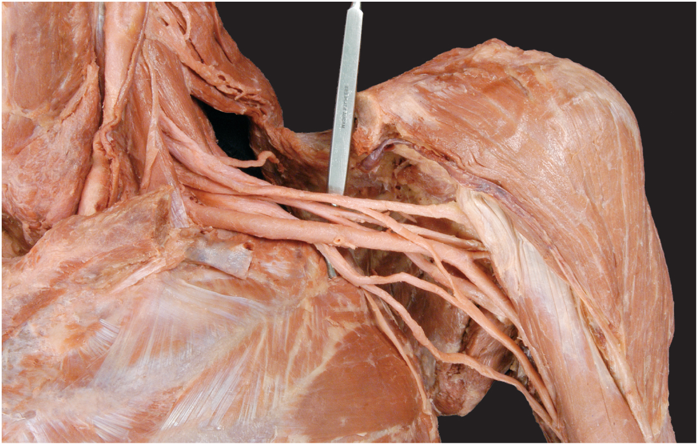
Dissection of Brachial Plexus
Copyright © The McGraw-Hill Companies, Inc. Permission required for reproduction or display.
Lateral cord
Posterior cord
Musculocutaneous
nerve
Axillary nerve
Medial cord
Radial nerve
Median nerve
Ulnar nerve
Long thoracic
nerve
© The McGraw-Hill Companies, Inc./Photo and Dissection by Chrstine Eckel
Figure 13.16

Slide 40
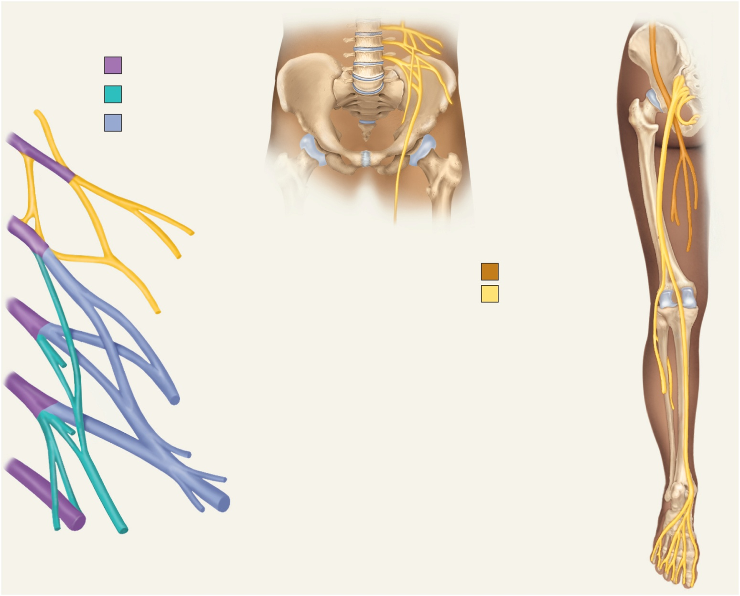
The Lumbar Plexus
Copyright © The McGraw-Hill Companies, Inc. Permission required for reproduction or display.
Hip bone
Roots
Sacrum
Anterior divisions
Femoral nerve
L1
Posterior divisions
Pudendal nerve
Sciatic nerve
L2
Femur
Iliohypogastric
nerve
Ilioinguinal nerve
Anterior view
L3
From lumbar plexus
Tibial nerve
Genitofemoral nerve
From sacral plexus
Obturator nerve
Common fibular nerve
L4
Superficial fibular nerve
Lateral femoral cutaneous nerve
Deep fibular nerve
L5
Fibula
Femoral nerve
Tibia
Tibial nerve
Obturator nerve
Medial plantar nerve
Lumbosacral trunk
Lateral plantar nerve
Posterior view
Figure 13.17

Slide 41
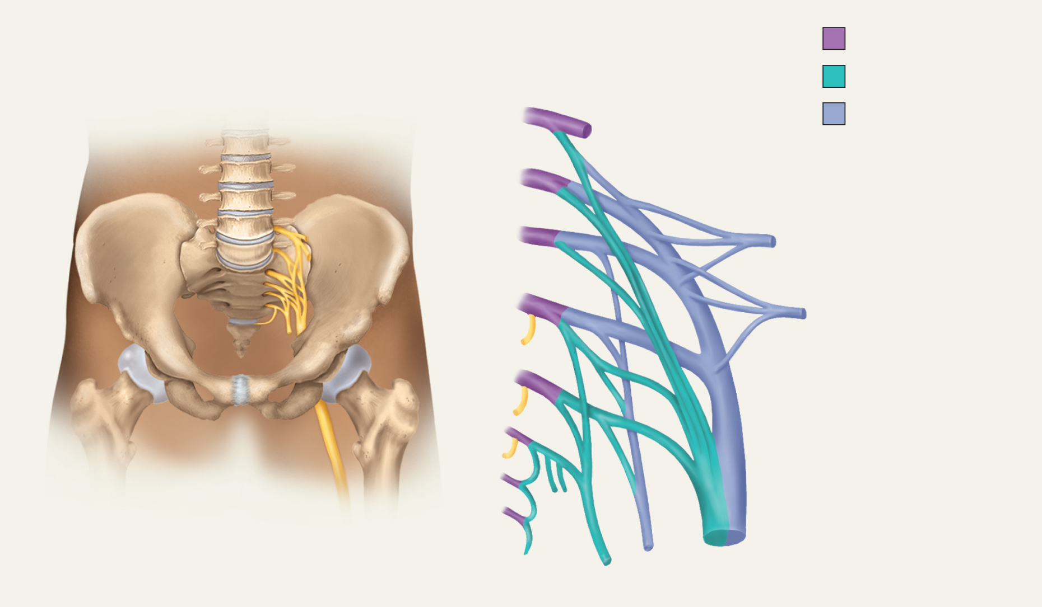
Sacral and Coccygeal Plexuses
Copyright © The McGraw-Hill Companies, Inc. Permission required for reproduction or display.
Lumbosacral
trunk
Roots
Anterior divisions
L4
Posterior divisions
L5
S1
Superior gluteal nerve
S2
Inferior gluteal nerve
S3
S4
Sciatic nerve:
S5
Common fibular nerve
Tibial nerve
Co1
Posterior cutaneous
nerve
Pudendal nerve
Figure 13.18

Slide 42
Spinal Nerve Injuries
radial nerve injury
passes through axilla
crutch paralysis
wrist drop
sciatic nerve injury
sciatica – sharp pain that travels from gluteal region along the posterior side of the thigh and leg to ankle
ninety percent of cases result from herniated intervertebral disc or osteoporosis of lower spine

Slide 43
Shingles
chickenpox - common disease of early childhood
caused by varicella-zoster virus
produces itchy rash that clears up without complications
virus remains for life in the posterior root ganglia
kept in check by the immune system
shingles (herpes zoster) – localized disease caused by the virus traveling down the sensory nerves by fast axonal transport when immune system is compromised
common after age of 50
painful trail of skin discoloration and fluid-filled vesicles along path of nerve
usually in chest and waist on one side of the body
pain and itching
childhood chicken pox vaccinations reduce the risk of shingles later in life

Slide 44
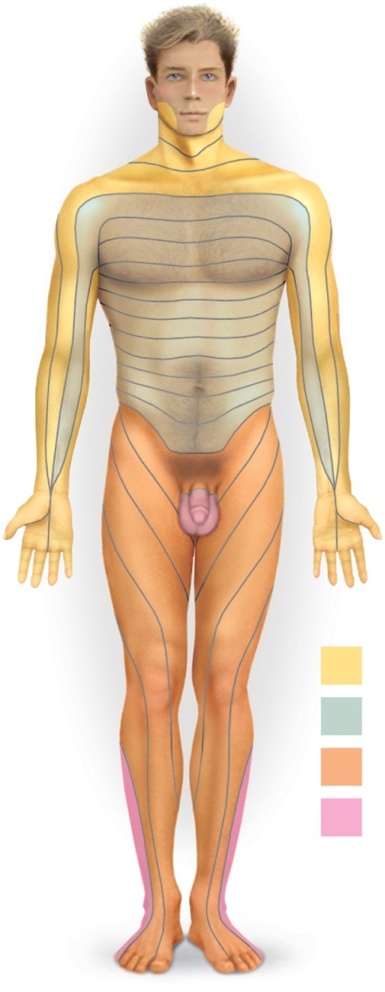
Cutaneous Innervation and Dermatomes
Copyright © The McGraw-Hill Companies, Inc. Permission required for reproduction or display.
dermatome – a specific area of the skin that receives sensory input from a pair of spinal nerves
dermatome map – a diagram of the cutaneous regions innervated by each spinal nerve
dermatomes overlap their edges as much as 50%
necessary to sever or anesthetize three successive spinal nerves to produce a total loss of sensation in one dermatome
C2
Figure 13.19
C4
C3
C5
T1
T2
T3
T4
C6
T5
T6
C5
T7
C8
T8
T9
T1
T10
T11
T12
L1
L2
C7
L3
S2
S3
L4
Cervical nerves
L5
Thoracic nerves
Lumbar nerves
S1
Sacral nerves

Slide 45
Nature of Reflexes
reflexes - quick, involuntary, stereotyped reactions of glands or muscle to stimulation
automatic responses to sensory input that occur without our intent or often even our awareness
four important properties of a reflex
reflexes require stimulation
not spontaneous actions, but responses to sensory input
reflexes are quick
involve few if any interneurons and minimum synaptic delay
reflexes are involuntary
occur without intent and difficult to suppress
automatic response
reflexes are stereotyped
occur essentially the same way every time

Slide 46
Nature of Reflexes
reflexes include glandular secretion and contraction of all three types of muscle
include some learned responses – conditioned reflexes
we are dealing with unlearned skeletal muscle reflexes mediated by the brainstem and spinal cord
somatic reflexes – since they involve the somatic nervous system

Slide 47
Nature of Reflexes
pathway of reflex arc
somatic receptors
in skin, muscles, or tendons
afferent nerve fibers
carry information from receptors to posterior horn of spinal cord or the brainstem
integrating center
a point of synaptic contact between neurons in the gray matter of the spinal cord or brainstem
determines whether the efferent neurons issue a signal to the muscles
efferent nerve fibers
carry motor impulses to skeletal muscle
skeletal muscles
the somatic effectors carry out the response

Slide 48
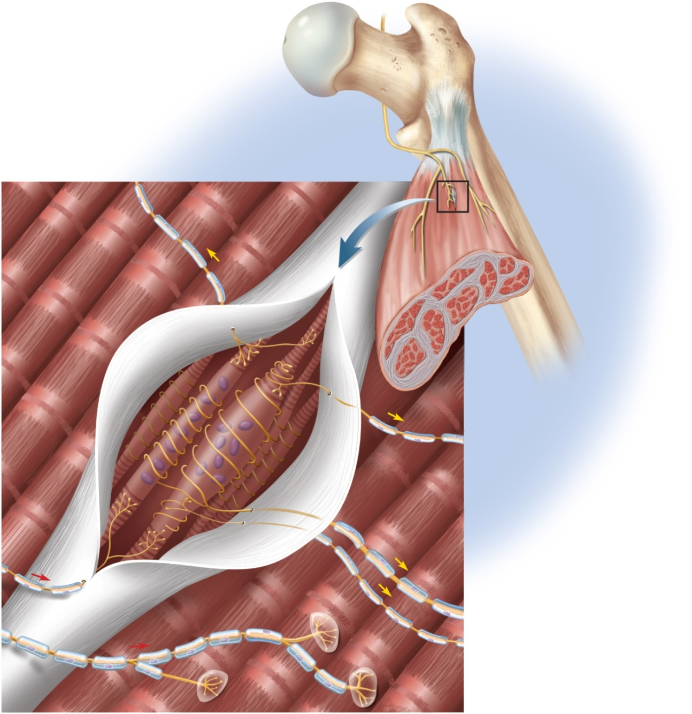
Muscle Spindle
Copyright © The McGraw-Hill Companies, Inc. Permission required for reproduction or display.
Figure 13.20
Bone
Peripheral nerve
(motor and sensory
nerve fibers)
Tendon
Secondary
afferent fiber
Muscle spindle
Skeletal muscle
Extrafusal
muscle fibers
Connective tissue
sheath (cut open)
Intrafusal
muscle fibers:
Nuclear chain
fiber
Nuclear bag
fiber
Motor nerve fibers:
Gamma
Sensory nerve fibers:
Alpha
Primary
Secondary

Slide 49
Muscle Spindle
muscle spindle – stretch receptors embedded in skeletal muscles
proprioceptors – specialized sense organs to monitor the position and movement of the body parts
muscle spindles inform the brain of muscle length and body movement
enables brain to send motor commands back to the muscles that control coordinated movement, corrective reflexes, muscle tone, and posture
intrafusal fibers – muscle fibers within spindle
nuclear chain fibers
nuclear bag fibers
nerve fibers in muscle spindle
primary afferent (group Ia) fiber
secondary afferent (group II) fibers
gamma motor neurons

Slide 50
The Stretch Reflex
stretch (myotatic) reflex - when a muscle is stretched, it ‘fights back’ and contracts which maintains increased tonus, making it stiffer than unstretched muscle
helps maintain equilibrium and posture
head starts to tip forward as you fall asleep
muscles contract to raise the head
stabilize joints by balancing tension in extensors and flexors smoothing muscle actions
stretch reflex is mediated primarily by the brain
not strictly a spinal reflex
tendon reflex – reflexive contraction of a muscle when its tendon is tapped
knee-jerk (patellar) reflex is monosynaptic reflex
one synapse between the afferent and efferent neurons
testing somatic reflexes helps diagnose many diseases
reciprocal inhibition - reflex phenomenon that prevents muscles from working against each other by inhibiting the antagonist

Slide 51
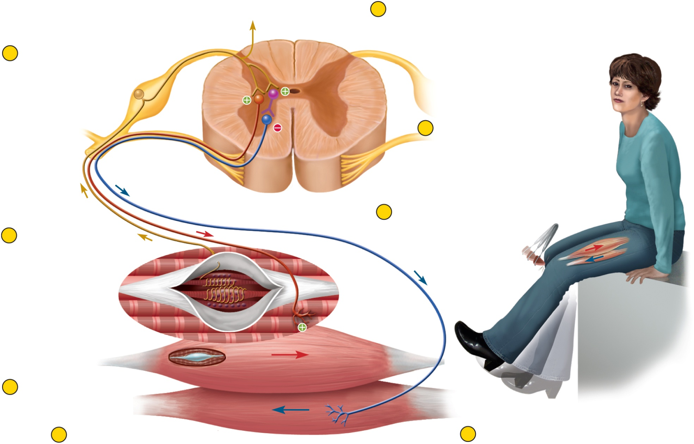
Patellar Tendon Reflex Arc
Copyright © The McGraw-Hill Companies, Inc. Permission required for reproduction or display.
6
Primary afferent
neuron stimulates
inhibitory interneuron
To brain
4
Primary afferent
neuron stimulates
alpha motor neuron
to extensor muscle
7
Interneuron inhibits
alpha motor neuron
to flexor muscle
5
Alpha motor neuron
stimulates extensor
muscle to contract
3
Primary afferent
neuron excited
2
Muscle spindle
stimulated
Figure 13.21
1
Extensor muscle
stretched
8
Flexor muscle
(antagonist) relaxes

Slide 52
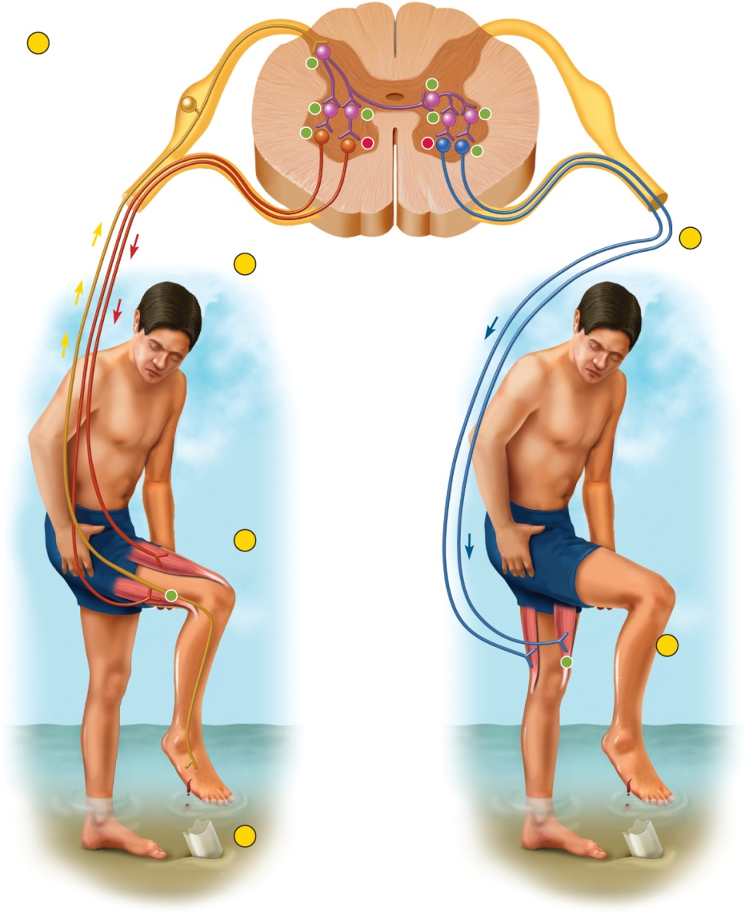
The Flexor (Withdrawal) Reflexes
Copyright © The McGraw-Hill Companies, Inc. Permission required for reproduction or display.
2
Sensory neuron
activates multiple
interneurons
+
flexor reflex – the quick contraction of flexor muscles resulting in the withdrawal of a limb from an injurious stimulus
requires contraction of the flexors and relaxation of the extensors in that limb
polysynaptic reflex arc – pathway in which signals travel over many synapses on their way back to the muscle
+
+
+
+
+
+
+
5
3
Ipsilateral motor
neurons to flexor
excited
Contralateral
motor neurons
to extensor
excited
4
Ipsilateral flexor
contracts
+
+
6
Contralateral
extensor
contracts
1
Stepping on glass
stimulates pain receptors
in right foot
ithdrawal of right leg
(flexor reflex)
Extension of left leg
(crossed extension reflex)
Figure 13.22

Slide 53
The Crossed Extensor Reflex
Copyright © The McGraw-Hill Companies, Inc. Permission required for reproduction or display.
crossed extension reflex - the contraction of extensor muscles in the limb opposite of the one that is withdrawn
maintains balance by extending other leg
ipsilateral reflex arc – one in which the sensory input and the motor output are on the same sides of the spinal cord
flexor reflex
contralateral reflex arc – one in which the input and output are on opposite sides
crossed extension reflex
intersegmental reflex – one in which the input and output occur at different levels (segments) of the spinal cord
2
Sensory neuron
activates multiple
interneurons
+
+
+
+
+
+
+
+
3
Ipsilateral motor
neurons to flexor
excited
5
Contralateral
motor neurons
to extensor
excited
4
Ipsilateral flexor
contracts
+
+
6
Contralateral
extensor
contracts
1
Stepping on glass
stimulates pain receptors
in right foot
ithdrawal of right leg
(flexor reflex)
Extension of left leg
(crossed extension reflex)
Figure 13.22

Slide 54
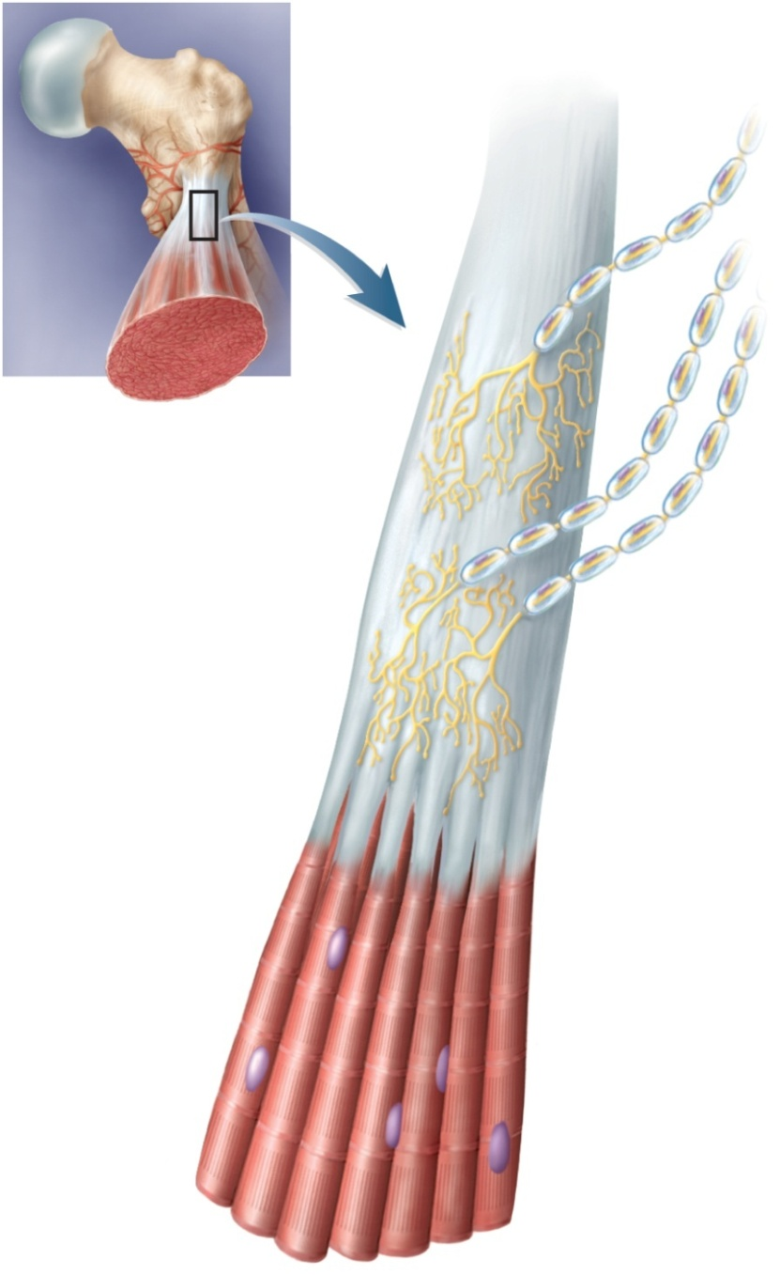
The Tendon Reflex
Copyright © The McGraw-Hill Companies, Inc. Permission required for reproduction or display.
tendon organs – proprioceptors in a tendon near its junction with a muscle
Golgi tendon organ - 1mm long, nerve fibers entwined in collagen fibers of the tendon
tendon reflex – in response to excessive tension on the tendon
inhibits muscle from contracting strongly
moderates muscle contraction before it tears a tendon or pulls it loose from the muscle or bone
Nerve fibers
Tendon organ
Tendon bundles
Muscle fibers
Figure 13.23

Slide 55
Spinal Cord Trauma
10,000 -12,000 people paralyzed each year by spinal cord trauma
usually by vertebral fractures
highest risk group – males 16 – 30 years old
55% occur in automobile or motorcycle accidents
complete transection – complete severance of cord
immediate loss of motor control below level of injury
above C4 poses the threat of respiratory failure
spinal shock
paralysis
paraplegia – paralysis of both lower limbs
quadriplegia – paralysis of all four limbs
hemiplegia – paralysis on one side of the body
paresis – partial paralysis or weakness of the limbs

