Slide 1
The Urinary System
functions of urinary system
anatomy of kidney
urine formation
glomerular filtration
tubular reabsorption and secretion
water conservation
urine and renal function tests
urine storage and elimination

Slide 2
Waste Products & Kidney Function
‘to live is to metabolize’, and metabolism creates a variety of toxic waste products
removed from the body by various systems
respiratory, digestive, sweat glands and urinary
urinary system – principal means of waste removal
kidney functions
regulate blood volume and pressure, erythrocyte count, blood gases, blood pH, and electrolyte and acid base balance
urinary system is closely associated with reproductive system
‘urogenital system’
share embryonic development
share adult anatomical relationship
male urethra serves as a common passage for urine and sperm
urologists – treat both urinary and reproductive disorders

Slide 3
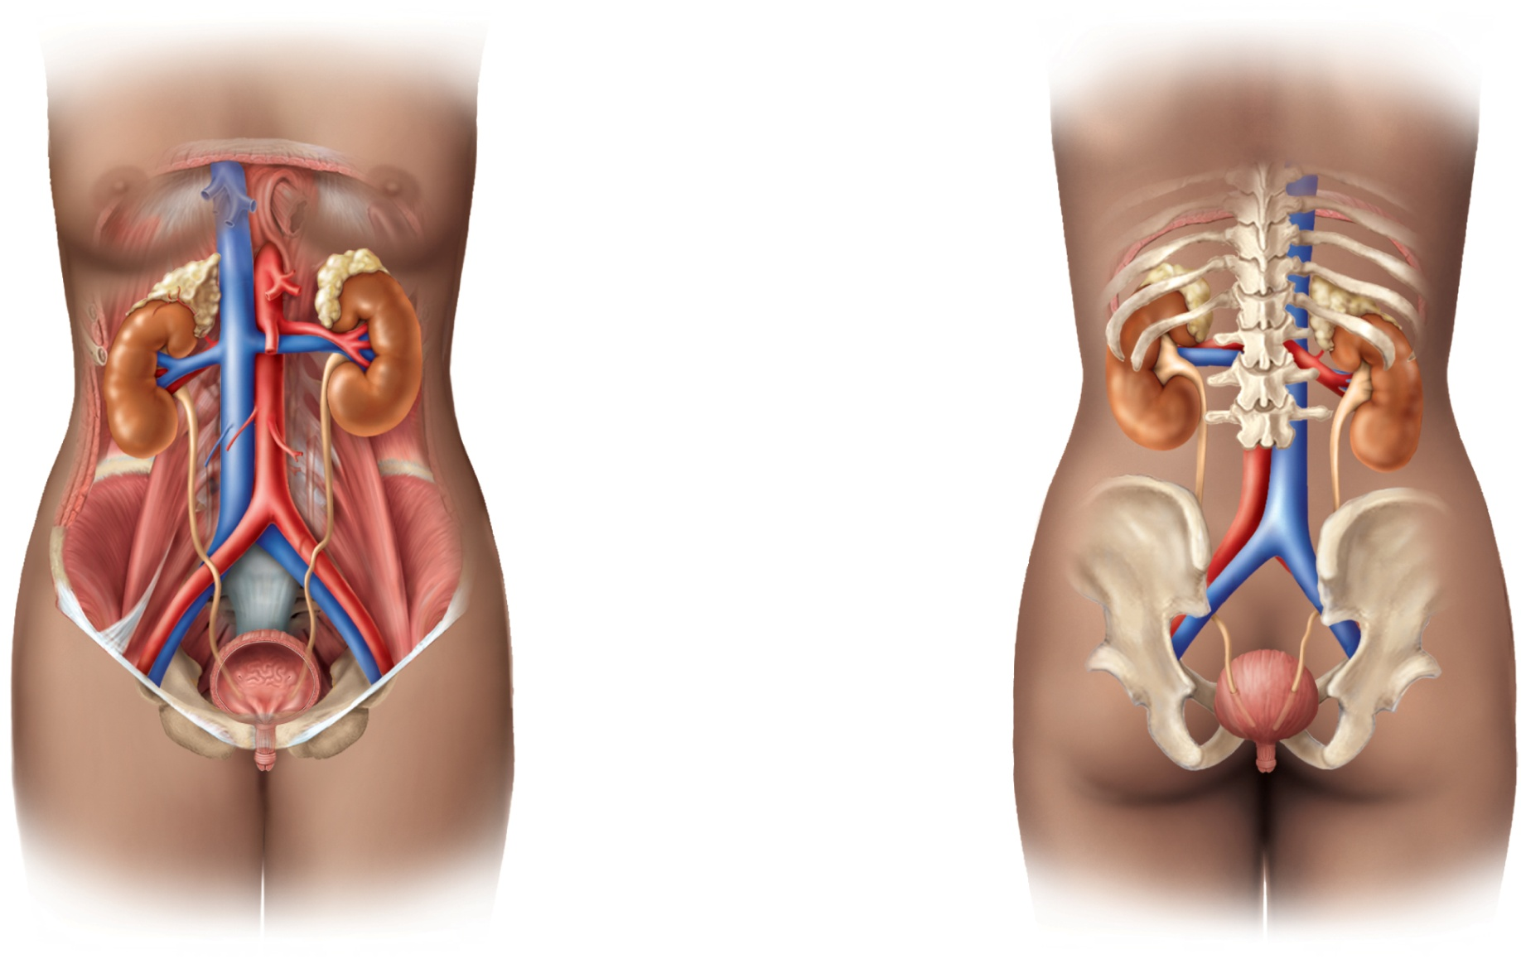
Urinary System
Copyright © The McGraw-Hill Companies, Inc. Permission required for reproduction or display.
Diaphragm
11th and 12th ribs
Adrenal gland
Renal artery
Renal vein
Kidney
Vertebra L2
Aorta
Inferior vena cava
Ureter
Urinary bladder
Urethra
(a) Anterior view
(b) Posterior view
urinary system consists of 6 organs: 2 kidneys, 2 ureters, urinary bladder, and urethra
Figure 23.1a-b

Slide 4
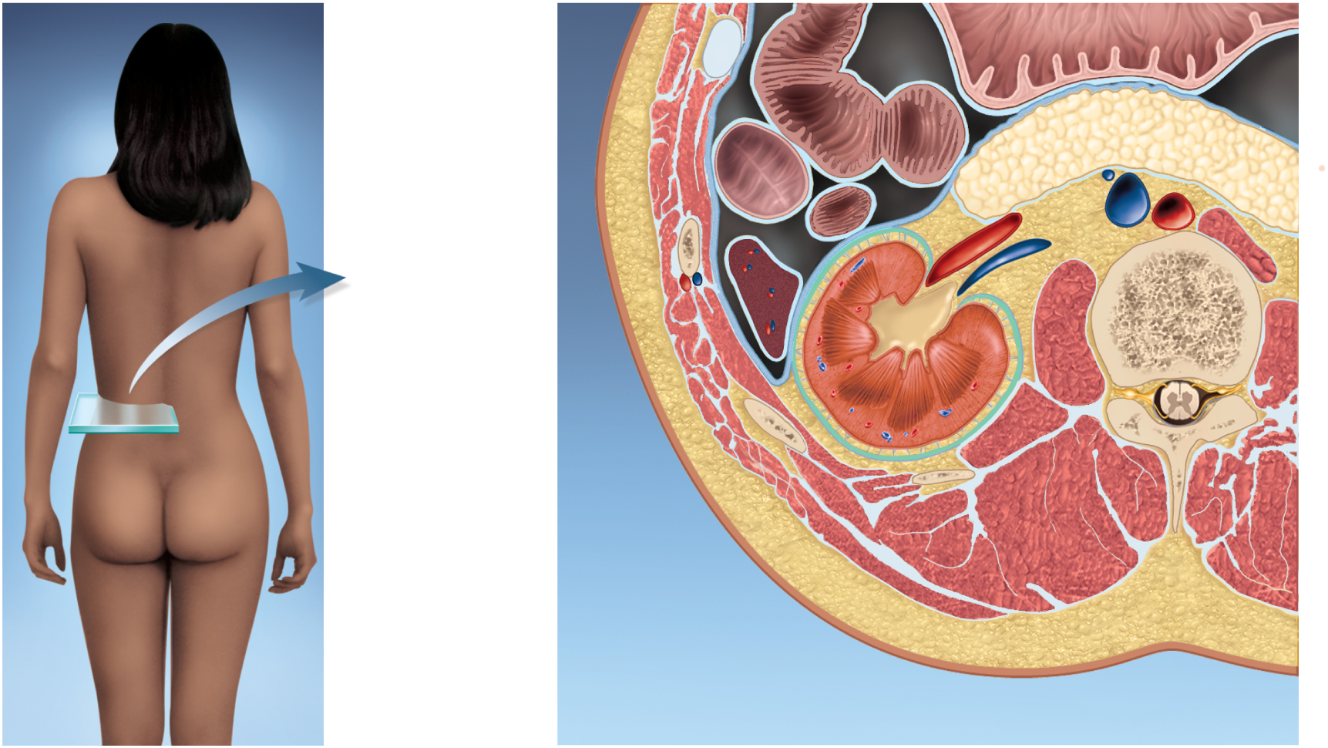
Kidney Location
Copyright © The McGraw-Hill Companies, Inc. Permission required for reproduction or display.
Anterior
Small intestine
Stomach
Colon
Pancreas
Renal artery
and vein
Inferior vena cava
Aorta
Peritoneum
L1
Spleen
Ureter
Kidney
Hilum
Fibrous capsule
Perirenal
fat capsule
Renal fascia
Lumbar muscles
Posterior
Figure 23.3 a-b

Slide 5
Functions of the Kidney
filters blood plasma, separates waste from useful chemicals, returns useful substances to blood, eliminates wastes
regulate blood volume and pressure by eliminating or conserving water
regulate the osmolarity of the body fluids by controlling the relative amounts of water and solutes eliminated
secretes enzyme, renin, which activates hormonal mechanisms that control blood pressure and electrolyte balance
secretes the hormone, erythropoietin, which stimulates the production of red blood cells
collaborate with the lungs to regulate the PCO₂ and acid-base balance of body fluids
final step in synthesizing hormone, calcitriol, which contributes to calcium homeostasis
gluconeogenesis from amino acids in extreme starvation

Slide 6
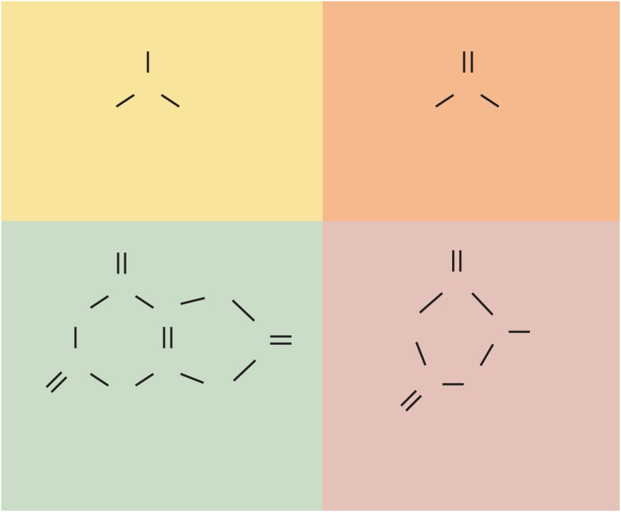
Nitrogenous Wastes
waste – any substance that is useless to the body or present in excess of the body’s needs
metabolic waste – waste substance produced by the body
urea formation
proteins→ amino acids → NH₂ removed → forms ammonia, liver converts to urea
uric acid
product of nucleic acid catabolism
creatinine
product of creatine phosphate catabolism
blood urea nitrogen (BUN) – expression of the level of nitrogenous waste in the blood
normal concentration of blood urea is 10 – 20 mg/dl
azotemia – elevated BUN
indicates renal insufficiency
uremia – syndrome of diarrhea, vomiting, dyspnea, and cardiac arrhythmia stemming from the toxicity of nitrogenous waste
treatment – hemodialysis or organ transplant
Copyright © The McGraw-Hill Companies, Inc. Permission required for reproduction or display.
H
O
N
H₂N
C
NH₂
H
H
Ammonia
Urea
O
H
NH
C
C
N
C
HN
HN
N
CH₃
C
O
C
N
C
N
C
CH₂
O
H
H
O
Uric acid
Creatinine
Figure 23.2

Slide 7
Excretion
excretion - separation of wastes from body fluids and eliminating them
four body systems carry out excretion
respiratory system
CO₂ , small amounts of other gases, and water
integumentary system
water, inorganic salts, lactic acid, urea in sweat
digestive system
water, salts, CO₂, lipids, bile pigments, cholesterol, other metabolic waste, and food residue
urinary system
many metabolic wastes, toxins, drugs, hormones, salts, H⁺ and water

Slide 8
Anatomy of Kidney
position, weight and size
lie against posterior abdominal wall at level of T12 to L3
right kidney is slightly lower due to large right lobe of liver
rib 12 crosses the middle of the left kidney
retroperitoneal along with ureters, urinary bladder, renal artery and vein, and adrenal glands
shape and size
about size of bar of bath soap
lateral surface is convex and medial is concave with a slit, hilum
receives renal nerves, blood vessels, lymphatics, and ureter
three protective connective tissue coverings
renal fascia immediately deep to parietal peritoneum
binds it to abdominal wall
perirenal fat capsule - cushions kidney and hold it into place
fibrous capsule encloses kidney protecting it from trauma and infection
collagen fibers extend from fibrous capsule to renal fascia
still drop about 3 cm when go from lying down to standing up

Slide 9
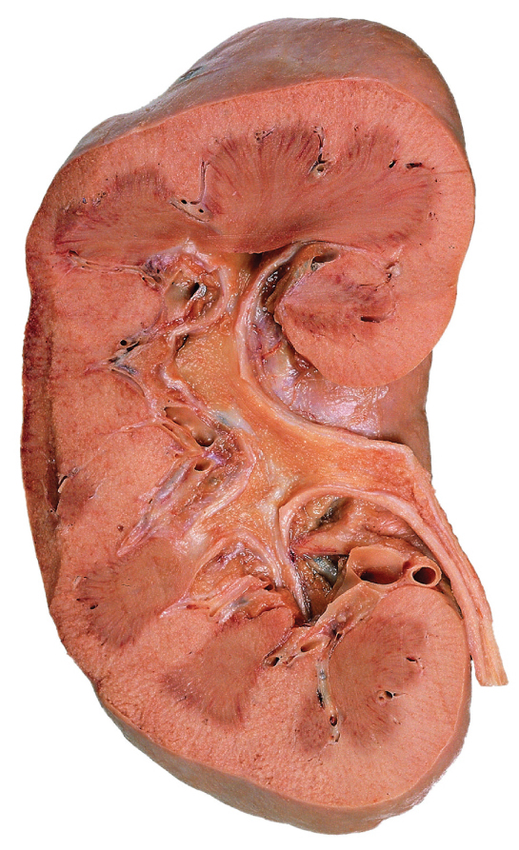
Gross Anatomy of Kidney
Copyright © The McGraw-Hill Companies, Inc. Permission required for reproduction or display.
Fibrous capsule
Renal cortex
Renal medulla
Renal papilla
Renal sinus
Adipose tissue
in renal sinus
Renal pelvis
Major calyx
Minor calyx
Renal column
Renal pyramid
Ureter
Renal blood
vessels
(a)
Figure 23.4a
Ralph Hutchings/Visuals Unlimited

Slide 10
Anatomy of Kidney
renal parenchyma – glandular tissue that forms urine
appears C-shaped in frontal section
encircles the renal sinus
renal sinus – contains blood and lymphatic vessels, nerves, and urine- collecting structures
adipose fills the remaining cavity and holds structures into place
two zones of renal parenchyma
outer renal cortex
inner renal medulla
renal columns – extensions of the cortex that project inward toward sinus
renal pyramids – 6 to 10 with broad base facing cortex and renal papilla facing sinus
lobe of the kidney – one pyramid and its overlying cortex
minor calyx – cup that nestles the papilla of each pyramid
collects its urine
major calyces - formed by convergence of two or three minor calyces
renal pelvis – formed by convergence of two or three major calyces
ureter - a tubular continuation of the pelvis and drains the urine down to the urinary bladder

Slide 11
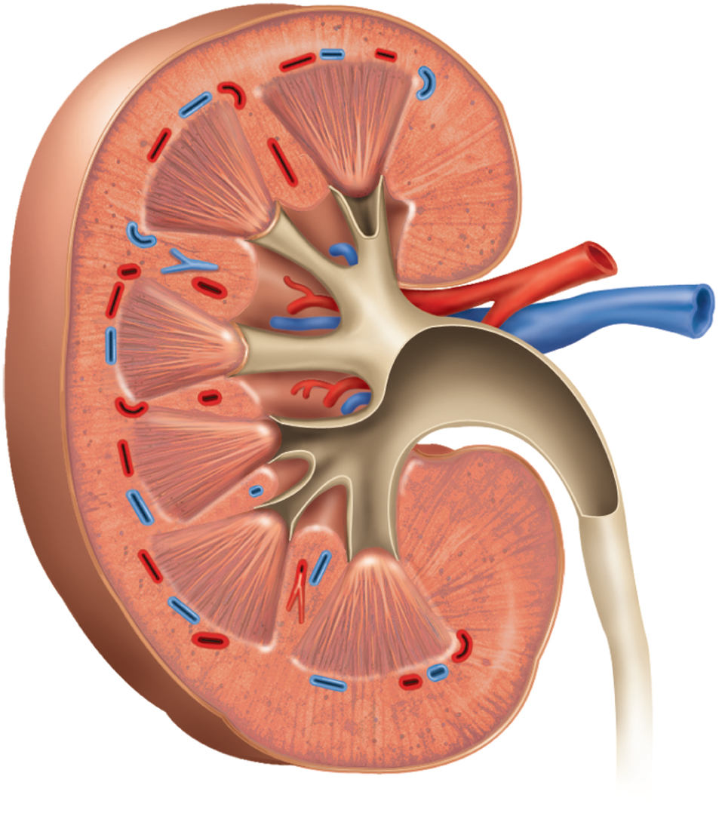
Anatomy of Kidney
Copyright © The McGraw-Hill Companies, Inc. Permission required for reproduction or display.
Fibrous capsule
Renal cortex
Renal medulla
Renal papilla
Renal sinus
Renal pelvis
Major calyx
Minor calyx
Renal column
Renal pyramid
Ureter
Renal blood
vessels
(b)
Figure 23.4b

Slide 12
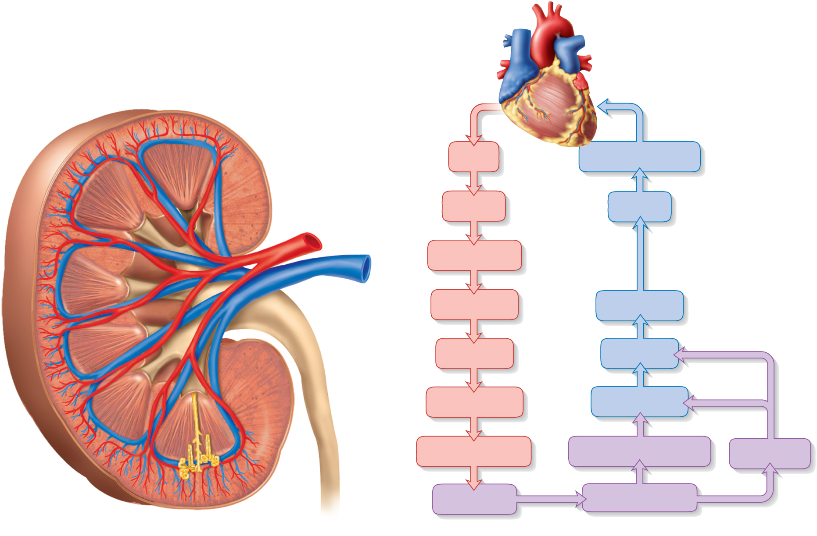
Blood Supply Diagram
Copyright © The McGraw-Hill Companies, Inc. Permission required for reproduction or display.
Interlobular
artery and vein
Interlobar
artery and vein
Aorta
Inferior vena cava
Segmental
artery
Renal a.
Renal v.
Renal
medulla
Segmental a.
Renal
artery
and
vein
Interlobar a.
Interlobar v.
Renal
cortex
Arcuate a.
Arcuate v.
Interlobular a.
Interlobular v.
Arcuate
artery
and vein
Afferent arteriole
Peritubular capillaries
Vasa recta
Glomerulus
Efferent arteriole
(a)
(b)
kidneys receive 21% of cardiac output
Figure 23.5 a-b

Slide 13
Renal Circulation
kidneys account for only 0.4% of body weight, they receive about 21% of the cardiac output (renal fraction)
renal artery divides into segmental arteries that give rise to
- interlobar arteries - up renal columns, between pyramids
- arcuate arteries - over pyramids
- interlobular arteries - up into cortex
- branch into afferent arterioles - each supplying one nephron
- leads to a ball of capillaries - glomerulus
- blood is drained from the glomerulus by efferent arterioles
- lead to either peritubular capillaries or vasa recta around portion of the renal tubule
interlobular veins or directly into arcuate veins - interlobar veins
renal vein empties into inferior vena cava

Slide 14
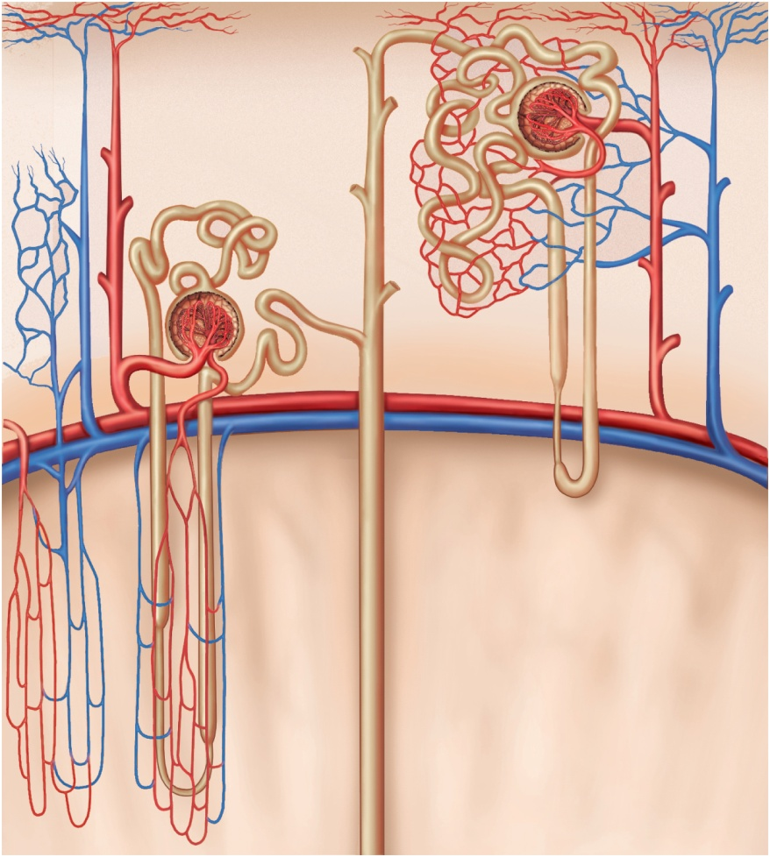
Microcirculation of the Kidney
in the cortex, peritubular capillaries branch off of the efferent arterioles supplying the tissue near the glomerulus, the proximal and distal convoluted tubules
in medulla, the efferent arterioles give rise to the vasa recta, supplying the nephron loop portion of the nephron.
Copyright © The McGraw-Hill Companies, Inc. Permission required for reproduction or display.
Cortical nephron
Afferent arteriole
Juxtamedullary nephron
Glomerulus
Cortex
Efferent arteriole
PCT
DCT
Interlobular artery
Peritubular
capillaries
Interlobular vein
Corticomedullary
junction
Arcuate artery
Vasa recta
Arcuate vein
Medul
la
Collecting duct
Nephron loop
Figure 23.6

Slide 15
The Nephron
each kidney has about 1.2 million nephrons
each composed of two principal parts:
renal corpuscle – filters the blood plasma
renal tubule – long coiled tube that converts the filtrate into urine
renal corpuscle consists of the glomerulus and a two-layered glomerular (Bowman) capsule that encloses glomerulus
parietal (outer) layer of Bowman capsule is simple squamous epithelium
visceral (inner) layer of Bowman capsule consists of elaborate cells called podocytes that wrap around the capillaries of the glomerulus
capsular space separates the two layers of Bowman capsule
vascular pole – the side of the corpuscle where the afferent arterial enter the corpuscle and the efferent arteriole leaves
urinary pole – the opposite side of the corpuscle where the renal tubule begins

Slide 16
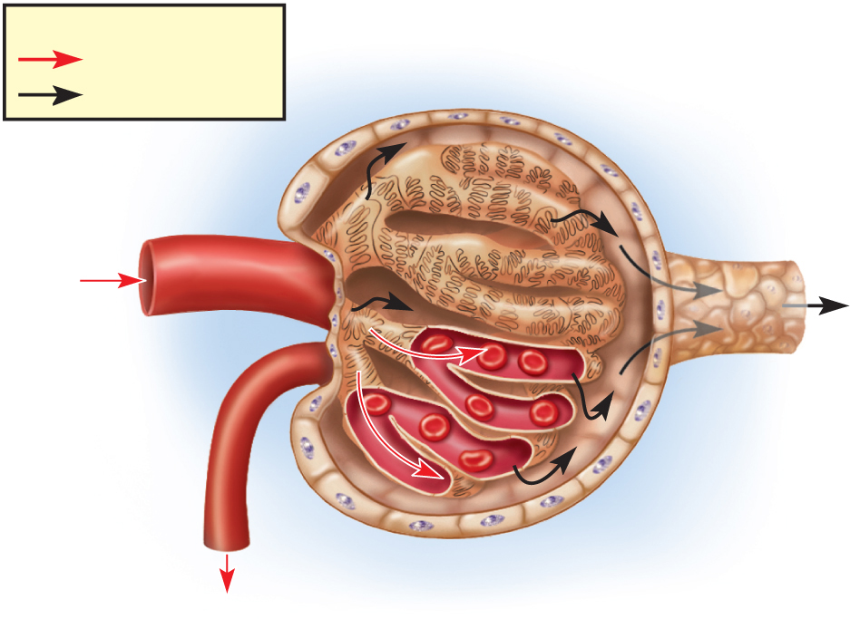
Renal Corpuscle
Copyright © The McGraw-Hill Companies, Inc. Permission required for reproduction or display.
Glomerular capsule:
Key
Parietal layer
Flow of blood
Capsular
space
Flow of filtrate
Podocytes of
visceral layer
Afferent
arteriole
Glomerulus
Blood
flow
Figure 23.7a
Proximal
convoluted
tubule
Efferent
arteriole
Glomerular
capillaries
(podocytes
and capillary
wall
removed)
Blood flow
(a)
glomerular filtrate collects in capsular space, flows into proximal convoluted tubule. Note the vascular and urinary poles. Note the afferent arteriole is larger than the efferent arteriole.

Slide 17
Renal Tubule
renal (uriniferous) tubule – a duct that leads away from the glomerular capsule and ends at the tip of the medullary pyramid
divided into four regions –
proximal convoluted tubule, nephron loop, distal convoluted tubule – parts of one nephron
collecting duct receives fluid from many nephrons
proximal convoluted tubule (PCT) – arises from glomerular capsule
longest and most coiled region
simple cuboidal epithelium with prominent microvilli for majority of absorption
nephron loop (loop of Henle) – long U-shaped portion of renal tubule
descending limb and ascending limb
thick segments have simple cuboidal epithelium
initial part of descending limb and part or all of the ascending limb
heavily engaged in the active transport of salts and have many mitochondria
thin segment has simple squamous epithelium
forms lower part of descending limb
cells very permeable to water

Slide 18
Renal Tubule
distal convoluted tubule (DCT) – begins shortly after the ascending limb reenters the cortex
shorter and less coiled that PCT
cuboidal epithelium without microvilli
DCT is the end of the nephron
collecting duct – receives fluid from the DCTs of several nephrons as it passes back into the medulla
numerous collecting ducts converge toward the tip of the medullary pyramid
papillary duct – formed by merger of several collecting ducts
30 papillary ducts end in the tip of each papilla
collecting and papillary ducts lined with simple cuboidal epithelium
flow of fluid from the point where the glomerular filtrate is formed to the point where urine leaves the body:
glomerular capsule → proximal convoluted tubule → nephron loop → distal convoluted tubule → collecting duct → papillary duct → minor calyx → major calyx → renal pelvis → ureter → urinary bladder → urethra

Slide 19
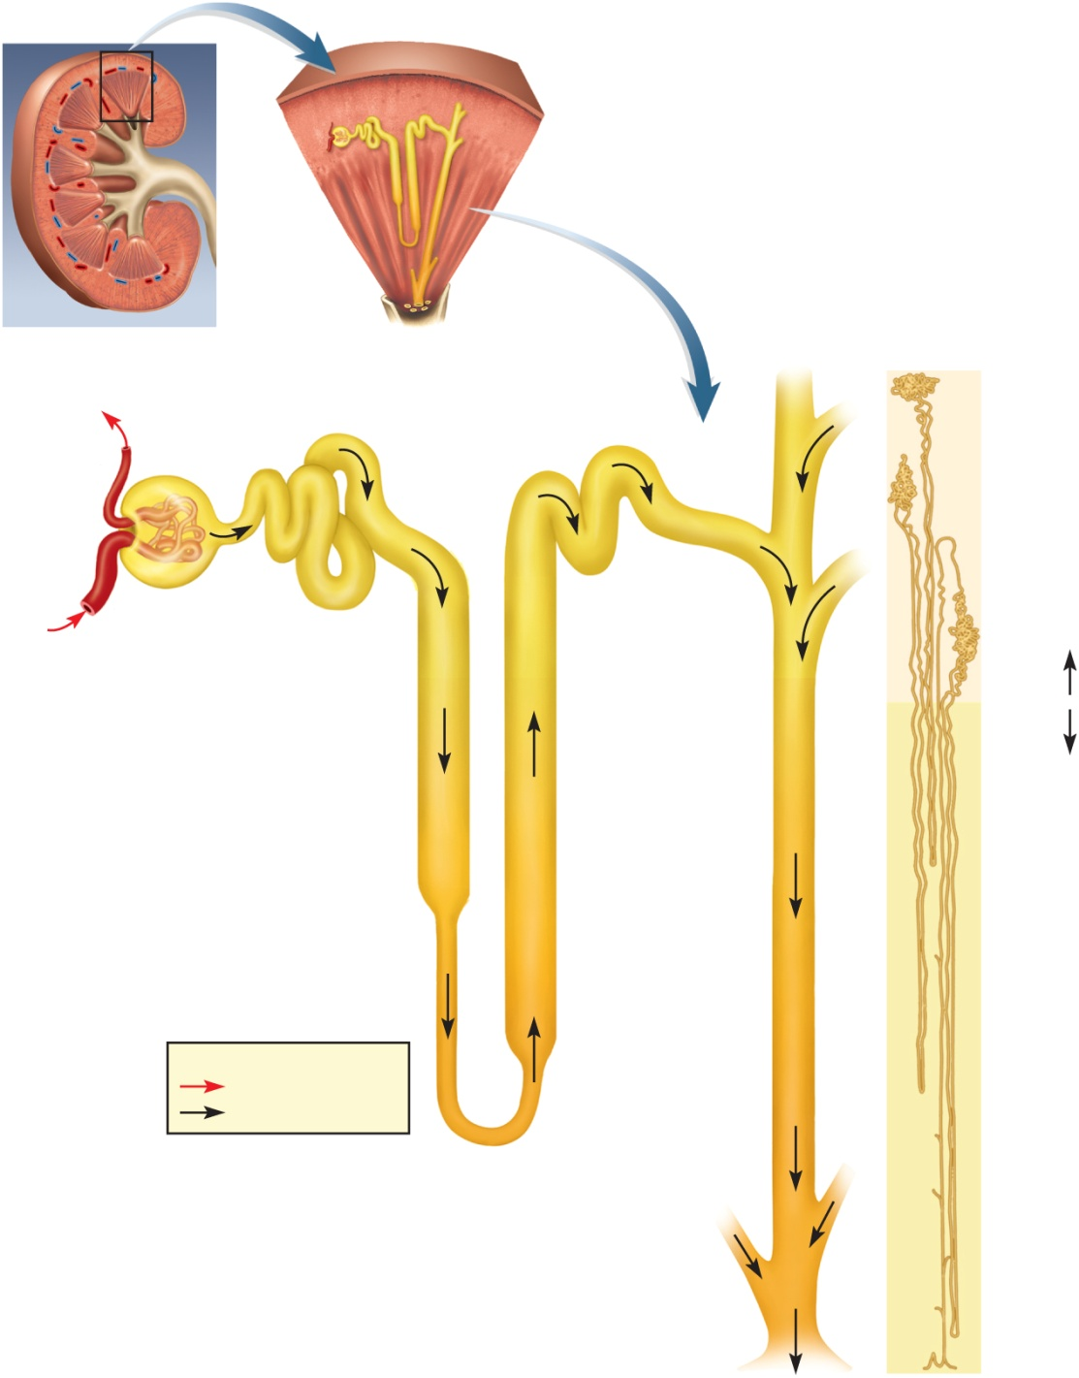
The Nephron
Copyright © The McGraw-Hill Companies, Inc. Permission required for reproduction or display.
Renal capsule
Renal
cortex
Nephron
Collecting duct
Renal
medulla
(a)
Minor
calyx
Renal
papilla
Renal corpuscle:
Cortical nephron
Glomerular capsule
Glomerulus
Efferent
arteriole
Convoluted tubules
(PCT and DCT)
Afferent
arteriole
Juxtamedullary
nephron
Proximal
convoluted
tubule (PCT)
Distal
convoluted
tubule (DCT)
Cortex
Medulla
Nephron loop:
Descending limb
Ascending limb
Collecting
duct (CD)
Thick segment
Thin segment
Key
Nephron
loops
Flow of blood
Flow of tubular fluid
(b)
Collecting
duct
Figure 23.8
Papillary
duct
(c)

Slide 20
Cortical and Juxtamedullary Nephrons
cortical nephrons
85% of all nephrons
short nephron loops
efferent arterioles branch into peritubular capillaries around PCT and DCT
juxtamedullary nephrons
15% of all nephrons
very long nephron loops, maintain salinity gradient in the medulla and helps conserve water
efferent arterioles branch into vasa recta around long nephron loop
Copyright © The McGraw-Hill Companies, Inc. Permission required for reproduction or display.
Cortical nephron
Afferent arteriole
Juxtamedullary nephron
Glomerulus
Cortex
Efferent arteriole
PCT
DCT
Interlobular artery
Peritubular
capillaries
Interlobular vein
Corticomedullary
junction
Arcuate artery
Arcuate vein
Medul
la
Vasa recta
Collecting duct
Nephron loop
Figure 23.6

Slide 21
Renal Innervation
renal plexus – nerves and ganglia wrapped around each renal artery
follows branches of the renal artery into the parenchyma of the kidney
issues nerve fibers to the blood vessels and convoluted tubules of the nephron
carries sympathetic innervation from the abdominal aortic plexus
stimulation reduces glomerular blood flow and rate of urine production
respond to falling blood pressure by stimulating the kidneys to secrete renin, an enzyme that activates hormonal mechanisms to restore blood pressure
carries parasympathetic innervation from the vagus nerve – increases rate of urine production

Slide 22
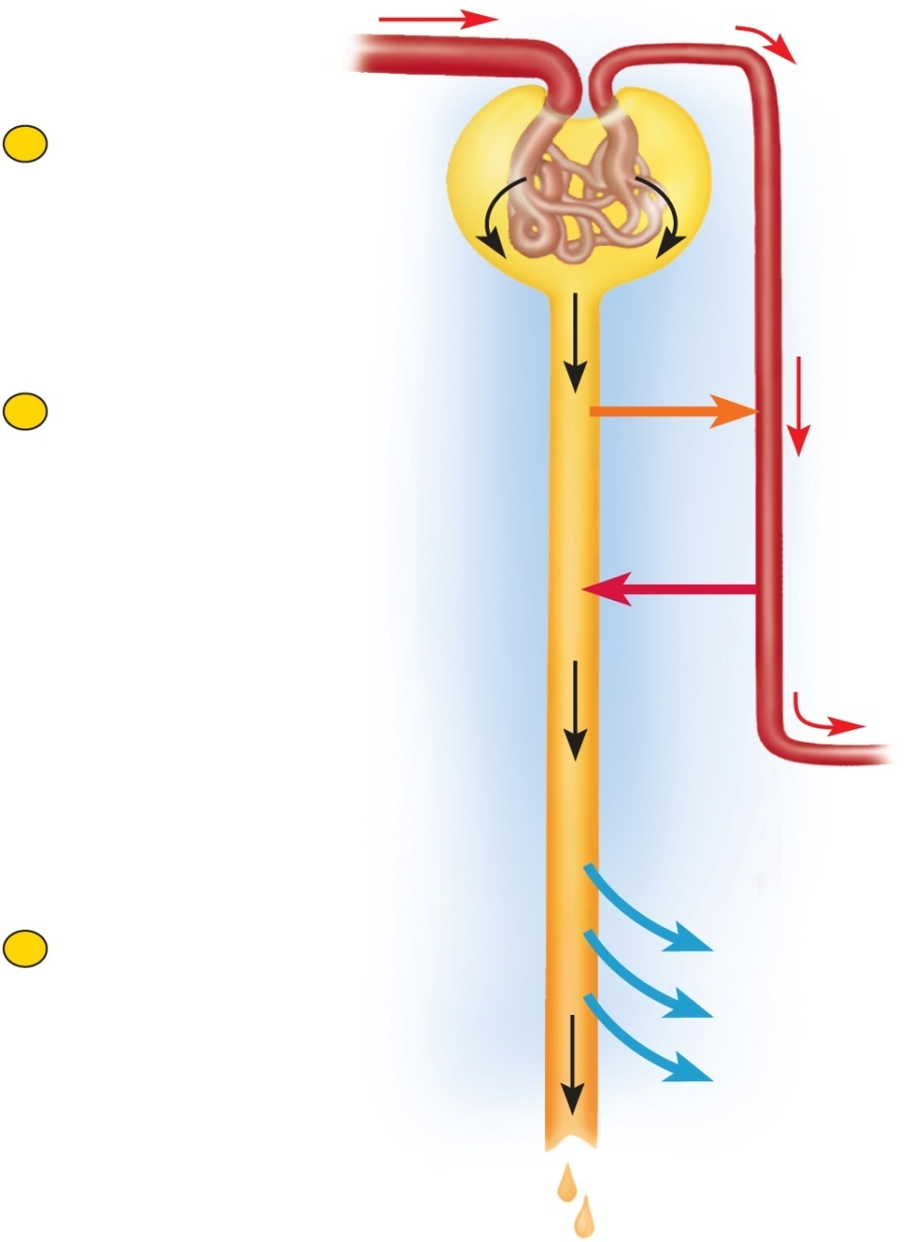
Overview of Urine Formation
Copyright © The McGraw-Hill Companies, Inc. Permission required for reproduction or display.
kidneys convert blood plasma to urine in three stages
glomerular filtration
tubular reabsorption and secretion
water conservation
glomerular filtrate
fluid in capsular space
blood plasma without protein
tubular fluid
fluid in renal tubule
similar to above except tubular cells have removed and added substances
urine
once it enters the collecting duct
only remaining change is water content
Blood flow
1
Glomerular filtration
Creates a plasmalike
filtrate of the blood
Rental Corpuscle
Flow of filtrate
2
Tubular reabsorption
Removes useful solutes
from the filtrate, returns
them to the blood
Peritubular
Capillaries
and
Tubular secretion
Removes additional
wastes from theblood,
adds them to the filtrate
Rental tubule
3
water conservation
Removes water from the
urine and returns it to
blood; cincentrates
wastes
H₂O
H₂O
H₂O
Figure 23.9
Urine

Slide 23
Urine Formation I: Glomerular Filtration
kidneys convert blood plasma to urine in three stages
glomerular filtration
tubular reabsorption and secretion
water conservation
glomerular filtrate – the fluid in the capsular space
similar to blood plasma except that is has almost no protein
tubular fluid – fluid from the proximal convoluted tubule through the distal convoluted tubule
substances have been removed or added by tubular cells
urine – fluid that enters the collecting duct
undergoes little alteration beyond this point except for changes in water content

Slide 24
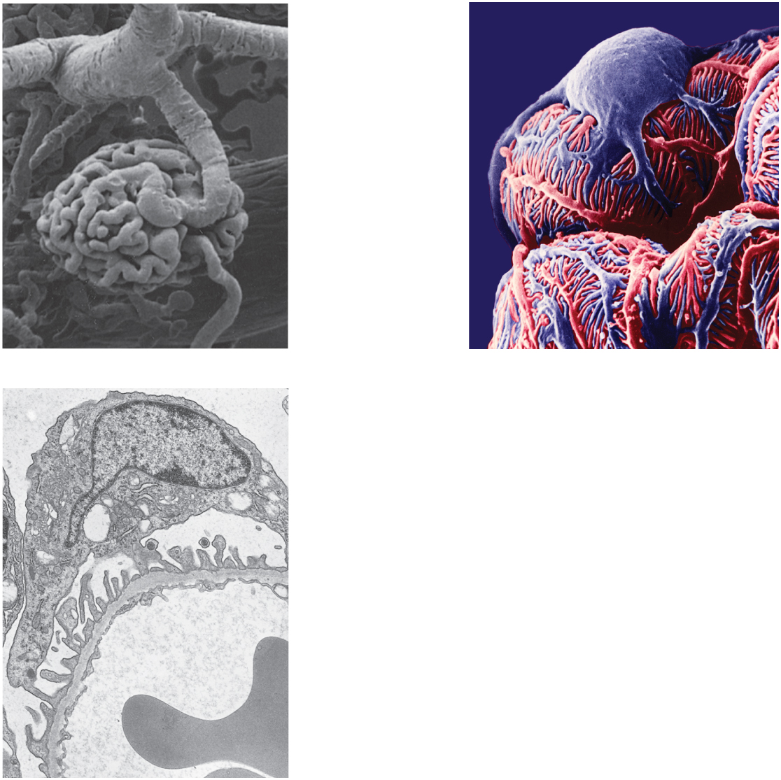
Structure of Glomerulus
Copyright © The McGraw-Hill Companies, Inc. Permission required for reproduction or display.
Podocyte
cell body
Interlobular
artery
Afferent
arteriole
Glomerulus
Foot processes
(separated by
narrow
filtration slits)
Efferent
arteriole
(a)
100 µm
(b)
5 µm
Capsular space
Podocyte
Foot processes
Filtration slits
Basement membrane
Filtration pore
Endothelial cell
Blood plasma
Erythrocyte
Figure 23.10 a-c
(c)
0.5 µm
a: Copyright by R.G. Kessel and R.H. Kardon, Tissues and Organs: A Text-Atlas of Scanning Electron Microscopy, 1979, W.H. Freeman, All rights reserved; b: © Don Fawcett/Photo Researchers, Inc.; c: © Barry F. King/Biological Photo Service

Slide 25
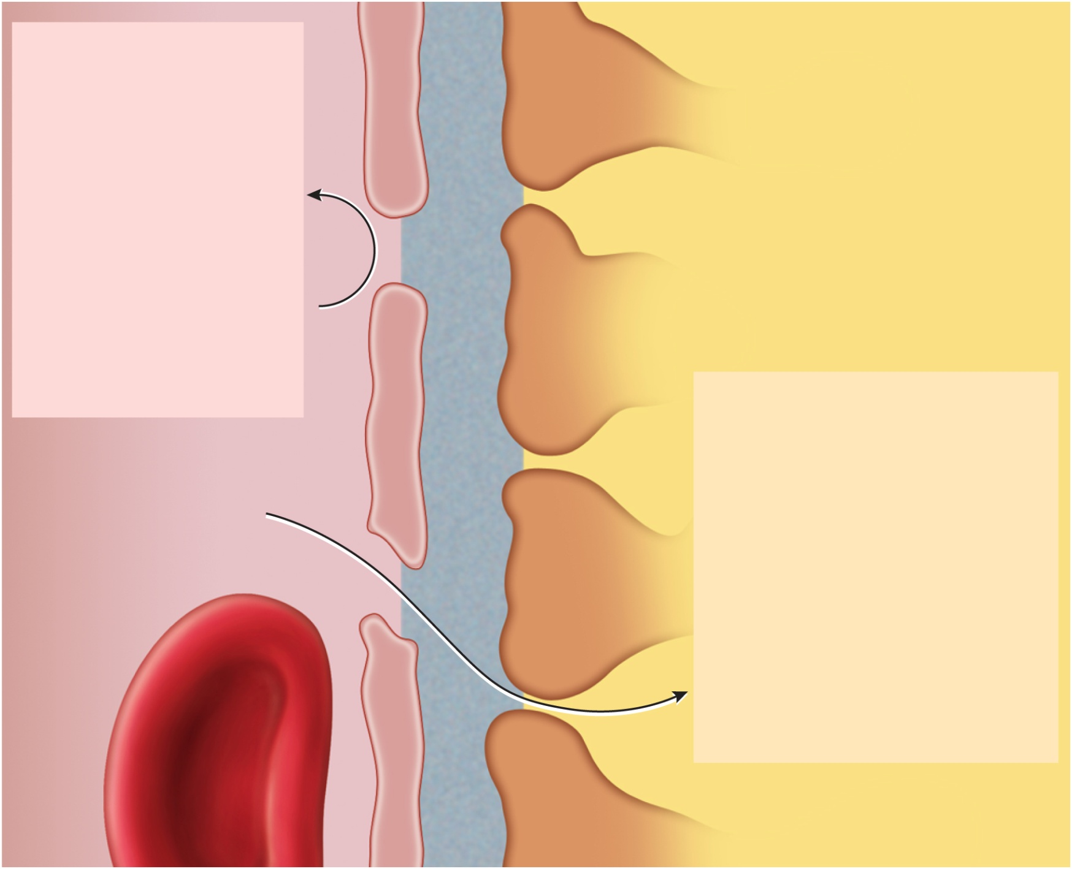
Filtration Pores and Slits
Copyright © The McGraw-Hill Companies, Inc. Permission required for reproduction or display.
Turned back:
Endothelial cell of
glomerular capillary
Blood cells
Plasma proteins
Basement membrane
Large anions
Protein-bound
Filtration slit
minerals and
hormones
Filtration pore
Most molecules
Foot process of
podocyte
> 8 nm in
diameter
Passed through filter:
Water
Electrolytes
Glucose
Amino acids
Fatty acids
Figure 23.11
Vitamins
Urea
Uric acid
Creatinine
Bloodstream
Capsular space

Slide 26
Filtration Membrane
glomerular filtration – a special case of the capillary fluid exchange process in which water and some solutes in the blood plasma pass from the capillaries of the glomerulus into the capsular space of the nephron
filtration membrane – three barriers through which fluid passes
fenestrated endothelium of glomerular capillaries
70-90 nm filtration pores exclude blood cells
highly permeable
basement membrane
proteoglycan gel, negative charge, excludes molecules greater than 8nm
albumin repelled by negative charge
blood plasma is 7% protein, the filtrate is only 0.03% protein
filtration slits
podocyte cell extensions (pedicels) wrap around the capillaries to form a barrier layer with 30 nm filtration slits
negatively charged which is an additional obstacle for large anions

Slide 27
Filtration Membrane
almost any molecule smaller than 3 nm can pass freely through the filtration membrane
water, electrolytes, glucose, fatty acids, amino acids, nitrogenous wastes, and vitamins
some substances of low molecular weight are bound to the plasma proteins and cannot get through the membrane
most calcium, iron, and thyroid hormone
unbound fraction passes freely into the filtrate
kidney infections and trauma can damage the filtration membrane and allow albumin or blood cells to filter.
proteinuria (albuminuria) – presence of protein in the urine
hematuria – presence of blood in the urine
distance runners and swimmers often experience temporary proteinuria or hematuria
prolonged, strenuous exercise greatly reduces profusion of kidney
glomerulus deteriorates under prolonged hypoxia

Slide 28
Filtration Pressure
blood hydrostatic pressure (BHP)
much higher in glomerular capillaries (60 mm Hg compared to 10 to 15 in most other capillaries)
because afferent arteriole is larger than efferent arteriole
larger inlet and smaller outlet
hydrostatic pressure in capsular space
18 mm Hg due to high filtration rate and continual accumulation of fluid in the capsule
colloid osmotic pressure (COP) of blood
about the same here as elsewhere - 32 mm Hg
glomerular filtrate is almost protein-free and has no significant COP
higher outward pressure of 60 mm Hg, opposed by two inward pressures of 18 mm Hg and 32 mm Hg
net filtration pressure - 60_{out} – 18_{in} – 32_{in} = 10 mm Hg_{out}

Slide 29
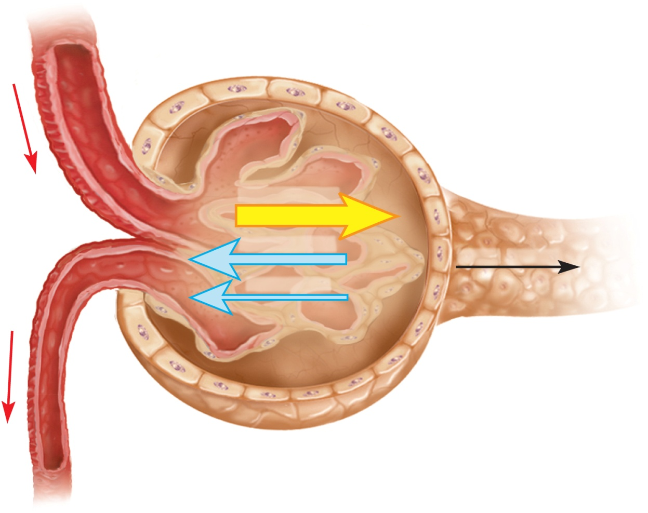
Filtration Pressure
Copyright © The McGraw-Hill Companies, Inc. Permission required for reproduction or display.
high BP in glomerulus makes kidneys vulnerable to hypertension
it can lead to rupture of glomerular capillaries, produce scarring of the kidneys (nephrosclerosis), and atherosclerosis of renal blood vessels, ultimately leading to renal failure
BHP 60 out
COP 32 in
NFP 10 out
CP 18 in
Blood hydrostatic pressure (BHP)
60 mm Hg_{out}
Colloid osmotic pressure (COP)
−32 mm Hg_{in}
Capsular pressure (CP)
−18 mm Hg_{in}
Net filtration pressure (NFP)
10 mm Hg_{out}
Figure 23.12

Slide 30
Glomerular Filtration Rate (GFR)
glomerular filtration rate (GFR) – the amount of filtrate formed per minute by the 2 kidneys combined
GFR = NFP x K_{f} ≈125 mL / min or 180 L / day, male
GFR = NFP x K_{f} ≈105 mL / min or 150 L / day, female
net filtration pressure (NFP)
filtration coefficient (K_{f}) depends on permeability and surface area of filtration barrier
total amount of filtrate produced equals 50 to 60 times the amount of blood in the body
99% of filtrate is reabsorbed since only 1 to 2 liters urine excreted / day

Slide 31
Regulation of Glomerular Filtration
GFR too high
fluid flows through the renal tubules too rapidly for them to reabsorb the usual amount of water and solutes
urine output rises
chance of dehydration and electrolyte depletion
GFR too low
wastes reabsorbed
azotemia may occur
GFR controlled by adjusting glomerular blood pressure from moment to moment
GFR control is achieved by three homeostatic mechanisms
renal autoregulation
sympathetic control
hormonal control

Slide 32
Renal Autoregulation of GFR
renal autoregulation – the ability of the nephrons to adjust their own blood flow and GFR without external (nervous or hormonal) control
enables them to maintain a relatively stable GFR in spite of changes in systemic arterial blood pressure
two methods of autoregulation: myogenic mechanism and tubuloglomerular feedback
myogenic mechanism – based on the tendency of smooth muscle to contract when stretched
increased arterial blood pressure stretches the afferent arteriole
arteriole constricts and prevents blood flow into the glomerulus from changing much
when blood pressure falls
the afferent arteriole relaxes
allows blood flow more easily into glomerulus
filtration remains stable

Slide 33
Renal Autoregulation of GFR
tubuloglomerular feedback – mechanism by which glomerulus receives feedback on the status of the downstream tubular fluid and adjust filtration to regulate the composition of the fluid, stabilize its own performance, and compensate for fluctuation in systemic blood pressure
juxtaglomerular apparatus – complex structure found at the very end of the nephron loop where it has just reentered the renal cortex
loop comes into contact with the afferent and efferent arterioles at the vascular pole of the renal corpuscle

Slide 34
Renal Autoregulation of GFR
three special kind of cells occur in the juxtaglomerular apparatus:
macula densa – patch of slender, closely spaced epithelial cells at end of the nephron loop on the side of the tubules facing the arterioles
senses variations in flow or fluid composition and secretes a paracrine that stimulates JG cells
juxtaglomerular (JG) cells – enlarged smooth muscle cells in the afferent arteriole directly across from macula densa
when stimulated by the macula
they dilate or constrict the arterioles
they also contain granules of renin, which they secrete in response to drop in blood pressure
mesangial cells – in the cleft between the afferent and efferent arterioles and among the capillaries of the glomerulus
connected to macula densa and JG cells by gap junctions and communicate by means of paracrines
build supportive matrix for glomerulus, constrict or relax capillaries to regulate flow

Slide 35
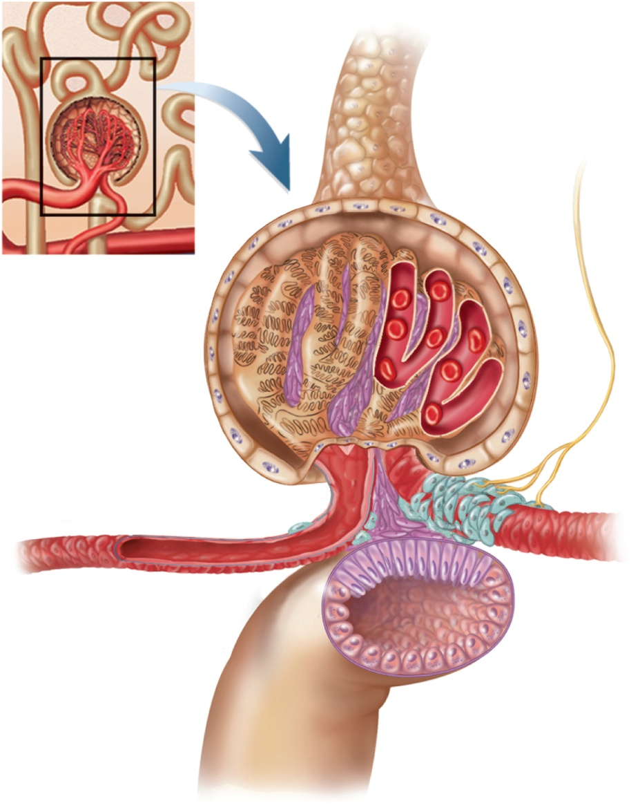
Juxtaglomerular Apparatus
Copyright © The McGraw-Hill Companies, Inc. Permission required for reproduction or display.
if GFR rises
the flow of tubular fluid increases and more NaCl is reabsorbed
macula densa stimulates JG cells with a paracrine
JG cells contract which constricts afferent arteriole, reducing GFR to normal OR
mesangial cells may contract, constricting the capillaries and reducing filtration
if GFR falls
macula relaxes afferent arterioles and mesangial cells
blood flow increases and GFR rises back to normal.
Sympathetic
nerve fiber
Podocytes
Mesangial cells
Juxtaglomerular
cells
Efferent arteriole
Afferent arteriole
Smooth muscle
cells
Macula densa
Nephron
loop
Figure 23.13

Slide 36
Effectiveness of Autoregulation
maintains a dynamic equilibrium - GFR fluctuates within narrow limits only
blood pressure changes do affect GFR and urine output somewhat
renal autoregulation can not compensate for extreme blood pressure variation
over a MAP range of 90 – 180 mm Hg, the GFR remains quite stable
below 70 mm Hg, glomerular filtration and urine output cease
occurs in hypovolemic shock

Slide 37
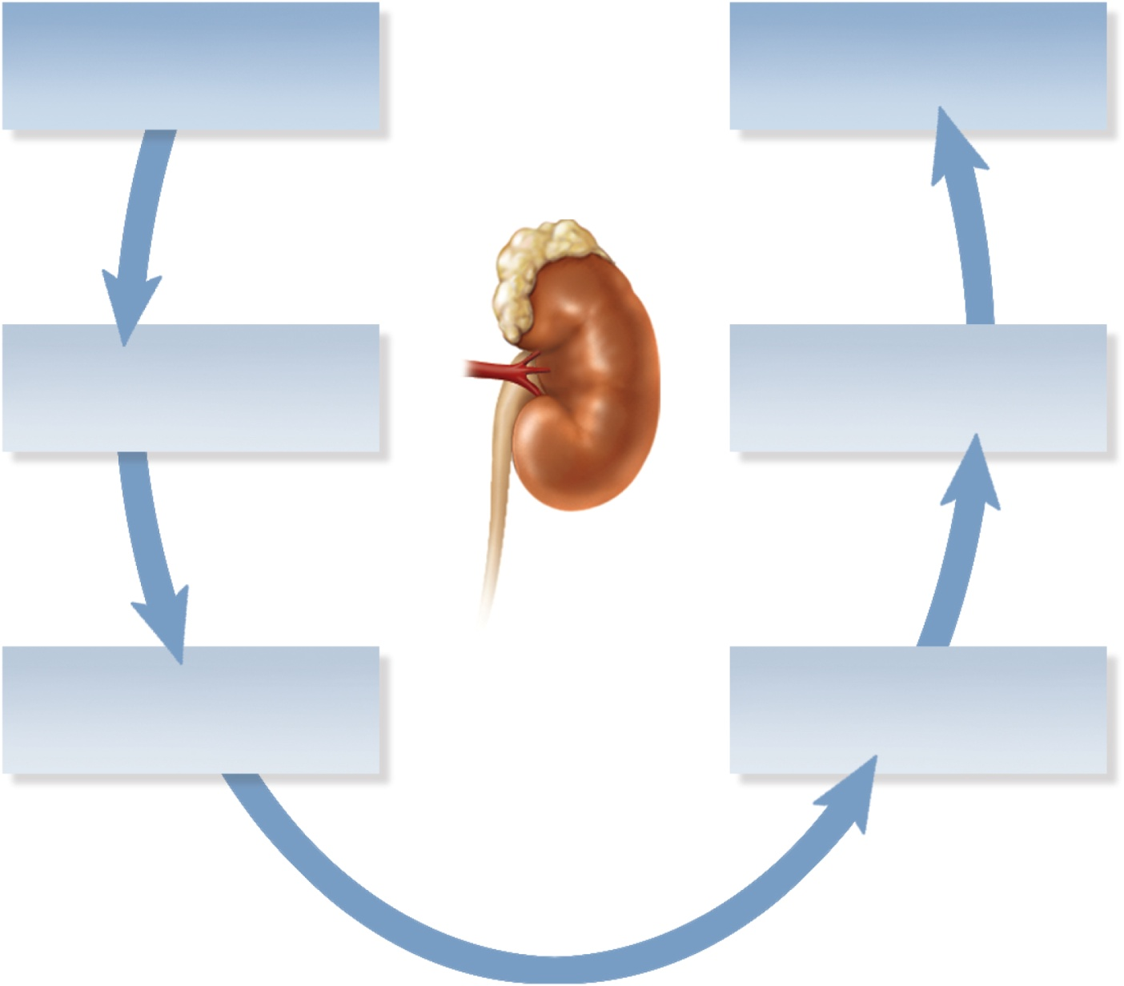
Negative Feedback Control of GFR
Copyright © The McGraw-Hill Companies, Inc. Permission required for reproduction or display.
High GFR
Reduced GFR
Rapid flow of
filtrate in renal tubules
Constriction of
afferent arteriole
Sensed by
macula densa
Paracrine
secretion
Figure 23.14

Slide 38
Sympathetic Control of GFR
sympathetic nerve fibers richly innervate the renal blood vessels
sympathetic nervous system and adrenal epinephrine constrict the afferent arterioles in strenuous exercise or acute conditions like circulatory shock
reduces GFR and urine output
redirects blood from the kidneys to the heart, brain, and skeletal muscles
GFR may be as low as a few milliliters per minute

Slide 39
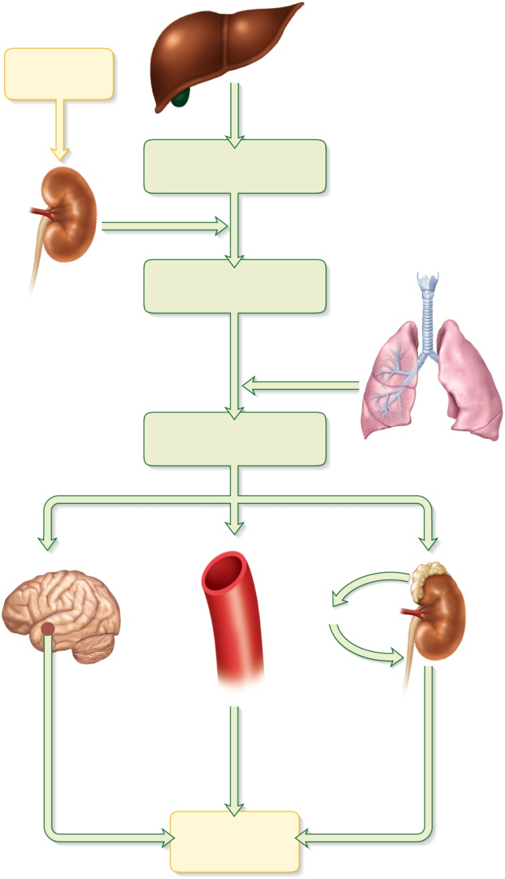
Renin-Angiotensin-Aldosterone Mechanism
Copyright © The McGraw-Hill Companies, Inc. Permission required for reproduction or display.
renin secreted by juxtaglomerular cells if BP drops dramatically
renin converts angiotensinogen, a blood protein, into angiotensin I
in the lungs and kidneys, angiotensin-converting enzyme (ACE) converts angiotensin I to angiotensin II, the active hormone
works in several ways to restore fluid volume and BP
Drop in blood
pressure
Liver
Angiotensinogen
(453 amino acids long)
Renin
Kidney
Angiotensin I
(10 amino acids long)
Angiotensin-
converting
enzyme (ACE)
Angiotensin II
(8 amino acids long)
Lungs
Hypothalamus
Cardiovascular
system
Adrenal
cortex
Aldosterone
Kidney
Vasoconstriction
Thirst and
drinking
Sodium and
water retention
Elevated blood
pressure
Figure 23.15

Slide 40
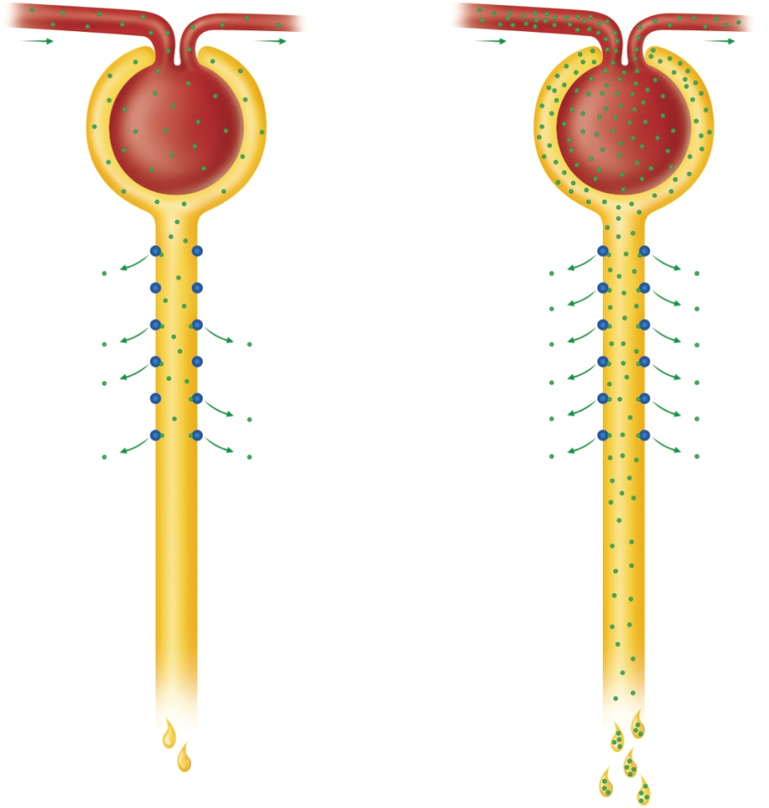
Falling BP & Angiotensin II
Copyright © The McGraw-Hill Companies, Inc. Permission required for reproduction or display.
potent vasoconstrictor raising BP throughout body
constricts efferent arteriole raising GFR despite low BP
lowers BP in peritubular capillaries enhancing reabsorption of NaCl & H₂O
angiotensin II stimulates adrenal cortex to secrete aldosterone promoting Na⁺ and H₂O reabsorption in DCT and collecting duct
stimulates posterior pituitary to secrete ADH which promotes water reabsorption by collecting duct
stimulates thirst & H₂O intake
Normoglycemia
Hyperglycemia
Glomerular
filtration
Glucose
transport
protein
Glucose reabsorption
(a)
Normal
urine volume,
glucose-free
(b)
Increased
urine volume,
with glycosuria
Figure 23.18

Slide 41
Urine Formation II: Tubular Reabsorption and Secretion
Copyright © The McGraw-Hill Companies, Inc. Permission required for reproduction or display.
conversion of glomerular filtrate to urine involves the removal and addition of chemicals by tubular reabsorption and secretion
occurs through PCT to DCT
tubular fluid is modified
steps involved include:
tubular reabsorption
tubular secretion
water conservation
Blood flow
1
Glomerular filtration
Creates a plasmalike
filtrate of the blood
Rental Corpuscle
Flow of filtrate
2
Tubular reabsorption
Removes useful solutes
from the filtrate, returns
them to the blood
Peritubular
Capillaries
and
Tubular secretion
Removes additional
wastes from theblood,
adds them to the filtrate
Rental tubule
3
water conservation
Removes water from the
urine and returns it to
blood; cincentrates
wastes
H₂O
H₂O
H₂O
Figure 23.9
Urine

Slide 42
Proximal Convoluted Tubule
PCT reabsorbs about 65% of glomerular filtrate, removes some substances from the blood, and secretes them into the tubular fluid for disposal in urine
prominent microvilli and great length
abundant mitochondria provide ATP for active transport
PCTs alone account for about 6% of one’s resting ATP and calorie consumption
tubular reabsorption – process of reclaiming water and solutes from the tubular fluid and returning them to the blood
two routes of reabsorption
transcellular route
substances pass through the cytoplasm of the PCT epithelial cells and out their base
paracellular route
substances pass between PCT cells
junctions between epithelial cells are quite leaky and allow significant amounts of water to pass through
solvent drag – water carries with it a variety of dissolved solutes
taken up by peritubular capillaries

Slide 43
Sodium Chloride
sodium reabsorption is the key to everything else
creates an osmotic and electrical gradient that drives the reabsorption of water and other solutes
most abundant cation in filtrate
creates steep concentration gradient that favors its diffusion into the epithelial cells
two types of transport proteins in the apical cell surface are responsible for sodium uptake
symports that simultaneously bind Na⁺ and another solute such as glucose, amino acids or lactate
a Na⁺ - H⁺ antiport that pulls Na⁺ into the cell while pumping out H⁺ into tubular fluid
sodium is prevented from accumulating in the epithelial cells by Na⁺ - K⁺ pumps in the basal surface of the epithelium
pumps Na⁺ out into the extracellular fluid
picked up by peritubular capillaries and returned to the blood stream
ATP consuming active transport pumps
secondary active transport – Na⁺ transporting symports in apical cell membrane do not consume ATP, are considered an example of secondary active transport for their dependence on the Na⁺ - K⁺ pumps at the base of the cell
negative chloride ions follow the positive sodium ions by electrical attraction
various antiports in the apical cell membrane that absorb Cl⁻ in exchange for other anions they eject into the tubular fluid – K⁺ - Cl⁻ symport

Slide 44
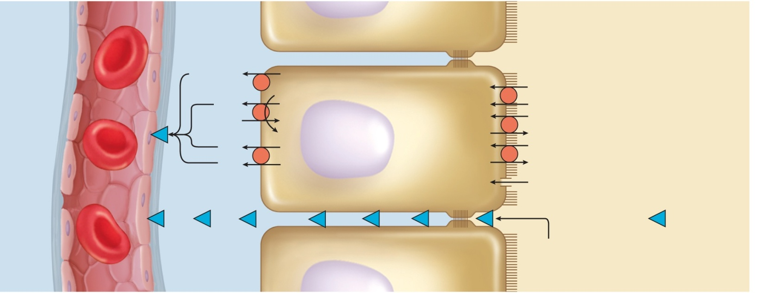
Reabsorption in the PCT Other Electrolytes
potassium, magnesium, and phosphate ions diffuse through the paracellular route with water
phosphate is also cotransported into the epithelial cells with Na⁺
some calcium is reabsorbed through the paracellular route in the PCT, but most Ca⁺² occurs later in the nephron
glucose is cotransported with Na⁺ by sodium-glucose transport (SGLT) proteins.
urea diffuses through the tubule epithelium with water – reabsorbs 40 – 60% in tubular fluid
kidneys remove about half of the urea from the blood - creatinine is not reabsorbed at all
Copyright © The McGraw-Hill Companies, Inc. Permission required for reproduction or display.
Peritubular
capillary
Tissue
fluid
Tubule epithelial cells
Tubular fluid
Glucose
Sodium–glucose
transport protein
(SGLT) (Symport)
ATP
Na⁺
Na⁺
Na⁺–K⁺ pump
Glucose
K⁺
Na⁺
Na⁺–H⁺ antiport
K⁺
ADP + P_{i}
H⁺
Cl–
Anions
Cl–
Cl––anion antiport
Figure 23.16
K⁺–Cl–
symport
H₂O
Aquaporin
Tight junction
Solvent drag
Transcellular route
Brush
border
H₂O, urea, uric acid,
Na⁺, K⁺, Cl–, Mg²⁺, Ca ²⁺, P_{i}
Paracellular route

Slide 45
Water Reabsorption
kidneys reduce 180 L of glomerular filtrate to 1 or 2 liters of urine each day
two-thirds of water in filtrate is reabsorbed by the PCT
reabsorption of all the salt and organic solutes makes the tubule cells and tissue fluid hypertonic
water follows solutes by osmosis through both paracellular and transcellular routes through water channels called aquaporins
in PCT, water is reabsorbed at constant rate called obligatory water reabsorption

Slide 46
Uptake by the Peritubular Capillaries
after water and solutes leave the basal surface of the tubular epithelium, they are reabsorbed by the peritubular capillaries
reabsorbed by osmosis and solvent drag
three factors promote osmosis into the capillaries
accumulation of reabsorbed fluid around the basolateral sides of epithelial cell creates high interstitial fluid pressure that drives water into the capillaries
narrowness of efferent arterioles lowers blood hydrostatic pressure in peritubular capillaries so there is less resistance to absorption
proteins remain in blood after filtration, which elevates colloid osmotic pressure
high COP and low BHP in the capillaries and high hydrostatic pressure in the tissue fluid, the balance of forces in the peritubular capillaries favors absorption

Slide 47
Transport Maximum of Glucose
Copyright © The McGraw-Hill Companies, Inc. Permission required for reproduction or display.
there is a limit to the amount of solute that the renal tubules can reabsorb
limited by the number of transport proteins in the plasma membrane
if all transporters are occupied as solute molecules pass
excess solutes appear in urine
transport maximum is reached when transporters are saturated
each solute has its own transport maximum
any blood glucose level above 220 mg/dL results in glycosuria
Normoglycemia
Hyperglycemia
Glomerular
filtration
Glucose
transport
protein
Glucose reabsorption
(a)
Normal
urine volume,
glucose-free
(b)
Increased
urine volume,
with glycosuria
Figure 23.18

Slide 48
Tubular Secretion
tubular secretion – process in which the renal tubule extracts chemicals from the capillary blood and secretes them into tubular fluid
two purposes in proximal convoluted tubule and nephron loop
waste removal
urea, uric acid, bile acids, ammonia, catecholamines, prostaglandins and a little creatinine are secreted into the tubule
secretion of uric acid compensates for its reabsorption earlier in PCT
clears blood of pollutants, morphine, penicillin, aspirin, and other drugs
explains need to take prescriptions 3 to 4 times/day to keep pace with the rate of clearance
acid-base balance
secretion of hydrogen and bicarbonate ions help regulate the pH of the body fluids

Slide 49
Function of Nephron Loop
primary function of nephron loop is to generate salinity gradient that enables collecting duct to concentrate the urine and conserve water
electrolyte reabsorption from filtrate
thick segment reabsorbs 25% of Na⁺, K⁺, and Cl⁻
ions leave cells by active transport and diffusion
NaCl remains in the tissue fluid of renal medulla
water can not follow since thick segment is impermeable
tubular fluid very dilute as it enters distal convoluted tubule

Slide 50
DCT and Collecting Duct
fluid arriving in the DCT still contains about 20% of the water and 7% of the salts from glomerular filtrate
if this were all passed as urine, it would amount to 36 L/day
DCT and collecting duct reabsorb variable amounts of water salt and are regulated by several hormones
aldosterone, atrial natriuretic peptide, ADH, and parathyroid hormone
two kinds of cells in the DCT and collecting duct
principal cells
most numerous
have receptors for hormones
involved in salt and water balance
intercalated cells
involved in acid/base balance by secreting H⁺ into tubule lumen and reabsorbing K⁺

Slide 51
DCT and Collecting Duct
aldosterone - the “salt-retaining” hormone
steroid secreted by the adrenal cortex
when blood Na⁺ concentration falls or
when K⁺ concentration rises
or drop in blood pressure → renin release → angiotensin II formation → stimulates adrenal cortex to secrete aldosterone
functions of aldosterone
acts on thick segment of nephron loop, DCT, and cortical portion of collecting duct
stimulates the reabsorption of more Na⁺ and secretion of K⁺
water and Cl⁻ follow the Na⁺
net effect is that the body retains NaCl and water
helps maintain blood volume and pressure
the urine volume is reduced
the urine has an elevated K⁺ concentration

Slide 52
DCT and Collecting Duct
atrial natriuretic peptide (ANP) - secreted by atrial myocardium of the heart in response to high blood pressure
has four actions that result in the excretion of more salt and water in the urine, thus reducing blood volume and pressure
dilates afferent arteriole, constricts efferent arteriole - ↑ GFR
inhibits renin and aldosterone secretion
inhibits secretion of ADH
inhibits NaCl reabsorption by collecting duct

Slide 53
DCT and Collecting Duct
antidiuretic hormone (ADH) secreted by posterior lobe of pituitary
in response to dehydration and rising blood osmolarity
stimulates hypothalamus
hypothalamus stimulates posterior pituitary
action - make collecting duct more permeable to water
water in the tubular fluid reenters the tissue fluid and bloodstream rather than being lost in urine

Slide 54
DCT and Collecting Duct
parathyroid hormone (PTH) secreted from parathyroid glands in response to calcium deficiency (hypocalcemia)
acts on PCT to increase phosphate excretion
acts on the thick segment of the ascending limb of the nephron loop, and on the DCT to increase calcium reabsorption
increases phosphate content and lowers calcium content in urine
because phosphate is not retained, the calcium ions stay in circulation rather than precipitating into the bone tissue as calcium phosphate
PTH stimulates calcitriol synthesis by the epithelial cells of the PCT

Slide 55
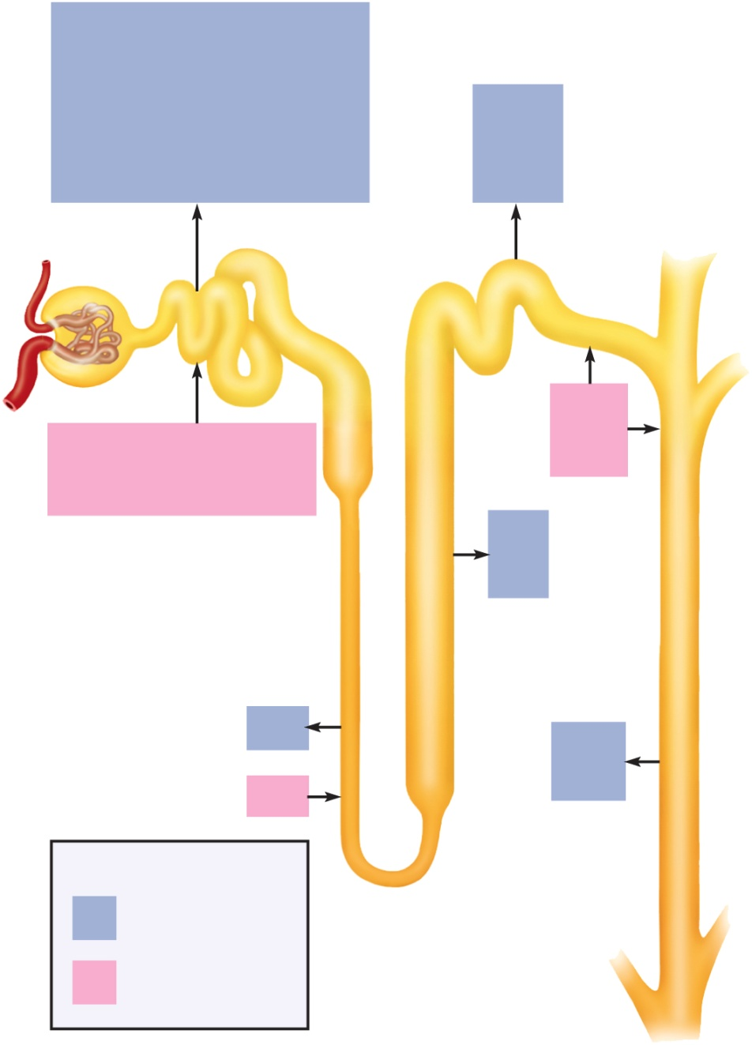
Summary of Tubular Reabsorption and Secretion
Copyright © The McGraw-Hill Companies, Inc. Permission required for reproduction or display.
PCT reabsorbs 65% of glomerular filtrate and returns it to peritubular capillaries
much reabsorption by osmosis & cotransport mechanisms linked to active transport of sodium
nephron loop reabsorbs another 25% of filtrate
DCT reabsorbs Na⁺, Cl⁻ and water under hormonal control, especially aldosterone and ANP
the tubules also extract drugs, wastes, and some solutes from the blood and secrete them into the tubular fluid
DCT completes the process of determining the chemical composition of urine
collecting duct conserves water
Glucose
Na⁺
Amino acids
K⁺
Protein
Ca²⁺
Vitamins
Mg²⁺
Na⁺
Lactate
Cl–
Cl–
Urea
HCO₃–
HCO₃–
Uric acid
H₂O
H₂O
PCT
DCT
H⁺
Urea
H⁺
K⁺
Uric acid
NH₄⁺
NH₄⁺
Creatinine Some drugs
Na⁺
K⁺
Nephron loop:
Cl–
Descending limb
Ascending limb
Collecting
duct
H₂O
H₂O
Urea
Urea
Key
Tubular
reabsorption
Tubular
secretion
Figure 23.22

Slide 56
Urine Formation III: Water Conservation
the kidney eliminates metabolic wastes from the body, but also prevents excessive water loss as well
as the kidney returns water to the tissue fluid and bloodstream, the fluid remaining in the renal tubules passes as urine, and becomes more concentrated

Slide 57
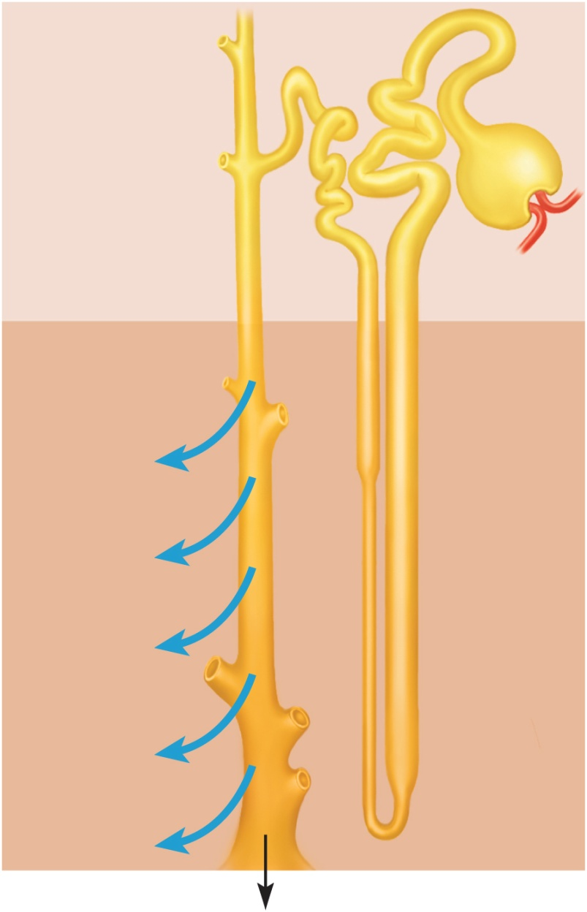
Collecting Duct Concentrates Urine
Copyright © The McGraw-Hill Companies, Inc. Permission required for reproduction or display.
collecting duct (CD) begins in the cortex where it receives tubular fluid from several nephrons
as CD passes through the medulla, it reabsorbs water and concentrates urine up to four times
medullary portion of CD is more permeable to water than to NaCl
as urine passes through the increasingly salty medulla, water leaves by osmosis concentrating urine
Tubular fluid
(300 mOsm/L)
300
Cortex
Medulla
600
H₂O
H₂O
Collecting
duct
Osmolarity of tissue fluid (mOsm/L)
900
H₂O
H₂O
Nephron
loop
1,200
H₂O
Urine
(up to 1,200 mOsm/L)
Figure 23.19

Slide 58
Control of Water Loss
how concentrated the urine becomes depends on body’s state of hydration
water diuresis – drinking large volumes of water will produce a large volume of hypotonic urine
cortical portion of CD reabsorbs NaCl, but it is impermeable to water
salt removed from the urine stays in the CD
urine concentration may be as low as 50 mOsm/L
producing hypertonic urine
dehydration causes the urine to become scanty and more concentrated
high blood osmolarity stimulates posterior pituitary to release ADH and then an increase in synthesis of aquaporin channels by renal tubule cells
more water is reabsorbed by collecting duct
urine is more concentrated
If BP is low in a dehydrated person, GFR will be low.
filtrate moves more slowly and more time for reabsorption –
more salt removed, more water reabsorbed and less urine produced

Slide 59
Countercurrent Multiplier
the ability of kidney to concentrate urine depends on salinity gradient in renal medulla
four times as salty in the renal medulla than the cortex
nephron loop acts as countercurrent multiplier
multiplier - continually recaptures salt and returns it to extracellular fluid of medulla which multiplies the salinity in adrenal medulla
countercurrent - because of fluid flowing in opposite directions in adjacent tubules of nephron loop
fluid flowing downward in descending limb
passes through environment of increasing osmolarity
most of descending limb very permeable to water but not to NaCl
water passes from tubule into the ECF leaving salt behind
concentrates tubular fluid to 1,200 mOsm/L at lower end of loop
fluid flowing upward in ascending limb
impermeable to water
reabsorbs Na⁺, K⁺, and Cl⁻ by active transport pumps into ECF
maintains high osmolarity of renal medulla
tubular fluid becomes hypotonic – 100 mOsm/L at top of loop
recycling of urea: lower end of CD permeable to urea
urea contributes to the osmolarity of deep medullary tissue
continually cycled from collecting duct to the nephron loop and back
urea remains concentrated in the collecting duct and some of it always diffuses out into the medulla adding to osmolarity

Slide 60
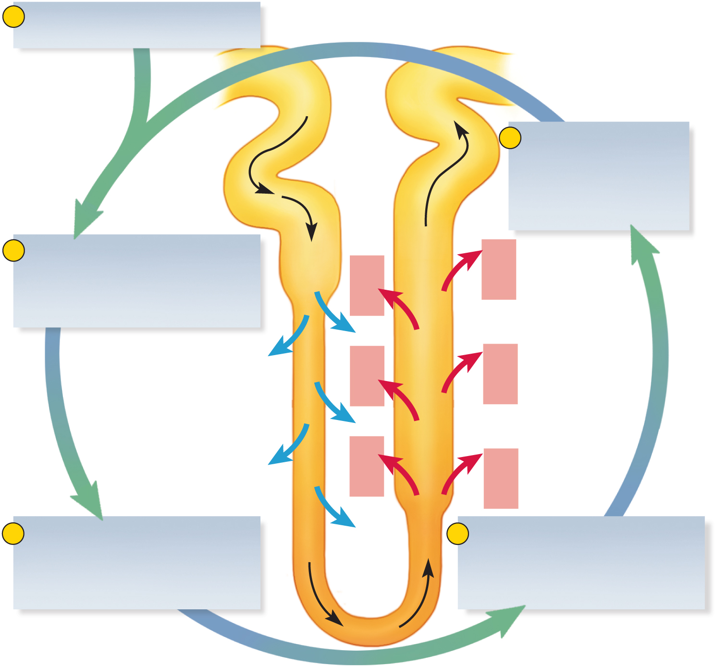
Countercurrent Multiplier of Nephron Loop
Copyright © The McGraw-Hill Companies, Inc. Permission required for reproduction or display.
1
More salt is continually
added by the PCT.
300
100
5
The more salt that
is pumped out of the
ascending limb, the
saltier the ECF is in
the renal medulla.
2
The higher the osmolarity
of the ECF, the more water
leaves the descending limb
by osmosis.
400
200
Na⁺
Na⁺
K⁺
K⁺
Cl–
Cl–
H₂O
H₂O
600
Na⁺
400
Na⁺
K⁺
K⁺
Cl–
Cl–
H₂O
H₂O
Na⁺
Na⁺
K⁺
K⁺
Cl–
Cl–
700
3
The more water that leaves
the descending limb, the
saltier the fluid is that
remains in the tubule.
900
H₂O
4
The saltier the fluid in the
ascending limb, the more
salt the tubule pumps into
the ECF.
1,200
Figure 23.20

Slide 61
Countercurrent Exchange System
vasa recta – capillary branching off efferent arteriole in medulla
provides blood supply to medulla and does not remove NaCl and urea from medullary ECF
countercurrent system - formed by blood flowing in opposite directions in adjacent parallel capillaries
descending capillaries
exchanges water for salt
water diffuses out of capillaries and salt diffuses in
as blood flows back up to the cortex the opposite occurs
ascending capillaries
exchanges salt for water
water diffuses into and NaCl diffuses out of blood
the vasa recta gives the salt back and does not subtract from the osmolarity of the medulla
absorb more water on way out than the way in, and thus they carry away water reabsorbed from the urine by collecting duct and nephron loop

Slide 62
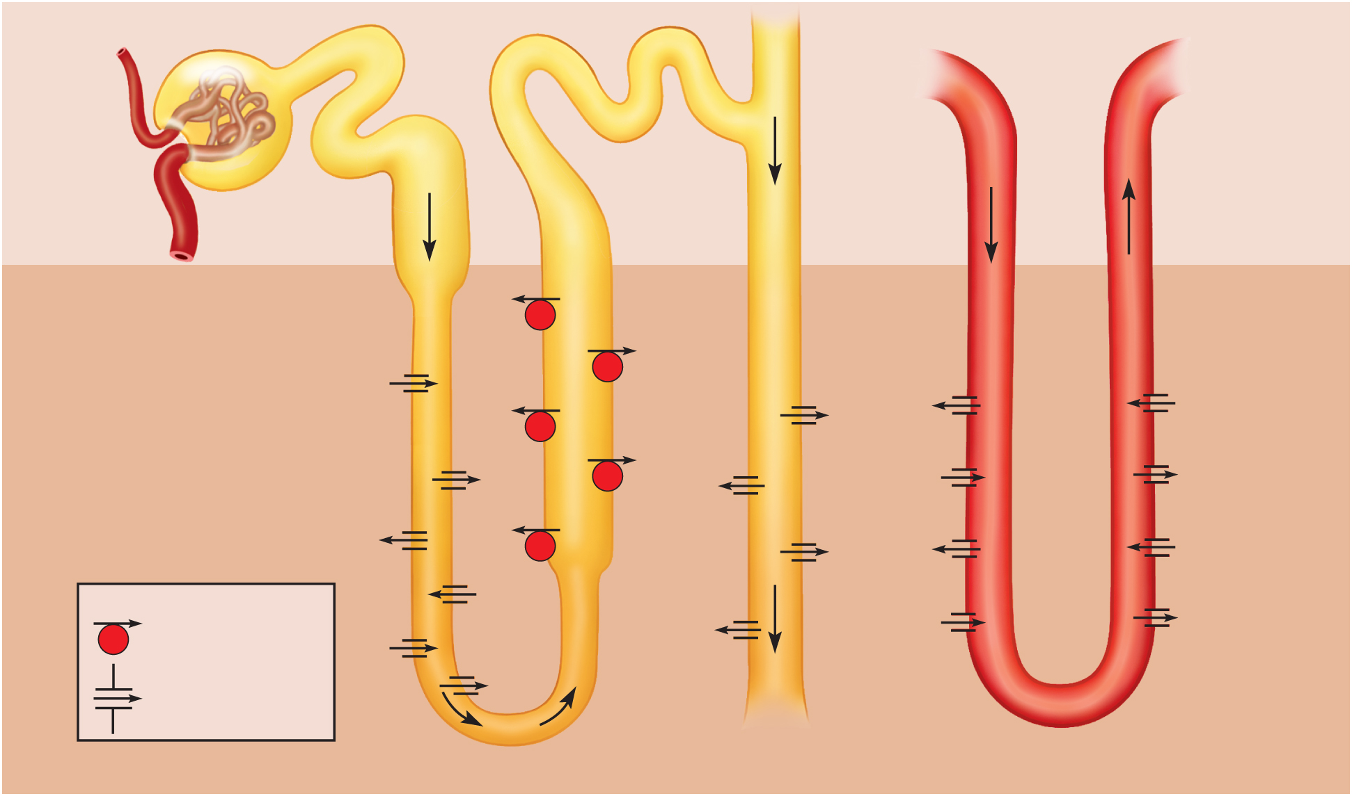
Maintenance of Osmolarity in Renal Medulla
Figure 23.21
Copyright © The McGraw-Hill Companies, Inc. Permission required for reproduction or display.
Osmolarity of
ECF
(mOsm/L)
300
300
100
300
300
300
100
300
Cortex
200
400
Medulla
400
Na⁺
400
K⁺
Cl–
200
Na⁺
K⁺
400
Urea
Na⁺
Cl–
500
600
K⁺
Urea
H₂O
H₂O
600
Cl–
400
Na⁺
600
K⁺
NaCl
NaCl
H₂O
Cl–
Urea
Na⁺
600
H₂O
K⁺
400
700
H₂O
H₂O
900
Cl–
Urea
Urea
900
Key
Key
700
900
NaCl
Active transport
900
Urea
NaCl
Urea
Diffusion through
a membrane channel
H₂O
1,200
1,200
1,200
1,200
23-62
Nephron loop
Collecting duct
Vasa recta

Slide 63
Summary of Tubular Reabsorption and Secretion
Copyright © The McGraw-Hill Companies, Inc. Permission required for reproduction or display.
Glucose
Na⁺
Amino acids
K⁺
Protein
Ca²⁺
Vitamins
Mg²⁺
Na⁺
Lactate
Cl–
Cl–
Urea
HCO₃–
HCO₃–
Uric acid
H₂O
H₂O
PCT
DCT
H⁺
Urea
H⁺
K⁺
Uric acid
NH₄⁺
NH₄⁺
Creatinine Some drugs
Na⁺
K⁺
Nephron loop:
Cl–
Descending limb
Collecting
duct
Ascending limb
H₂O
H₂O
Urea
Urea
Key
Tubular
reabsorption
Tubular
secretion
Figure 23.22

Slide 64
Composition and Properties of Urine
urinalysis – the examination of the physical and chemical properties of urine
appearance - clear, almost colorless to deep amber - yellow color due to urochrome pigment from breakdown of hemoglobin (RBCs) – other colors from foods, drugs or diseases
cloudiness or blood could suggest urinary tract infection, trauma or stones
pyuria – pus in the urine
hematuria – blood in urine due to urinary tract infection, trauma, or kidney stones
odor - bacteria degrade urea to ammonia, some foods impart aroma
specific gravity - compared to distilled water
density of urine ranges from 1.001 -1.028
osmolarity - (blood = 300 mOsm/L)
ranges from 50 mOsm/L to 1,200 mOsm/L in dehydrated person
pH - range: 4.5 to 8.2, usually 6.0 (mildly acidic)
chemical composition: 95% water, 5% solutes
normal to find - urea, NaCl, KCl, creatinine, uric acid, phosphates, sulfates, traces of calcium, magnesium, and sometimes bicarbonate, urochrome and a trace of bilirubin
abnormal to find – glucose, free hemoglobin, albumin, ketones, bile pigments

Slide 65
Urine Volume
normal volume for average adult - 1 to 2 L/day
polyuria - output in excess of 2 L/day
oliguria – output of less than 500 mL/day
anuria - 0 to 100 mL/day
low output from kidney disease, dehydration, circulatory shock, prostate enlargement
low urine output of less than 400 mL/day, the body cannot maintain a safe, low concentration of waste in the plasma

Slide 66
Diabetes
diabetes – any metabolic disorder resulting in chronic polyuria
at least four forms of diabetes
diabetes mellitus type 1, type 2, and gestational diabetes
high concentration of glucose in renal tubule
glucose opposes the osmotic reabsorption of water
more water passes in urine (osmotic diuresis)
glycosuria – glucose in the urine
diabetes insipidus
ADH hyposecretion causing not enough water to be reabsorbed in the collecting duct
more water passes in urine

Slide 67
Diuretics
diuretics – any chemical that increases urine volume
some increase GFR
caffeine dilates the afferent arteriole
reduce tubular reabsorption of water
alcohol inhibits ADH secretion
act on nephron loop (loop diuretic) - inhibit Na⁺ - K⁺ - Cl⁻ symport
impairs countercurrent multiplier reducing the osmotic gradient in the renal medulla
collecting duct unable to reabsorb as much water as usual
commonly used to treat hypertension and congestive heart failure by reducing the body’s fluid volume and blood pressure

Slide 68
Renal Function Tests
tests for diagnosing kidney disease
evaluating their severity
monitoring their progress
determine renal clearance
determine glomerular filtration rate

Slide 69
Renal Clearance
renal clearance – the volume of blood plasma from which a particular waste is completely removed in 1 minute
represents the net effect of three processes:
glomerular filtration of the waste
+ amount added by tubular secretion
amount removed by tubular reabsorption
renal clearance
determine renal clearance (C) by collecting blood and urine samples, measuring the waste concentration in each, and measuring the rate of urine output:
U - waste concentration in urine – 6.0 mg/mL (urea example)
V - rate of urine output – 2 mL/min
P - waste concentration in plasma – 0.2 mg/mL
C – renal clearance in mL/min of waste cleared
C = UV/P = 60 mL/min (60 mL of blood plasma is completely cleared of urea per minute
compare C to normal GFR of 125 mL/min to see if normal rate of clearance is occurring - 48% which is normal for urea

Slide 70
Glomerular Filtration Rate
kidney disease often results in lowering of GFR –need to measure patient’s GFR
can not use clearance rate of urea
some urea filtered by glomerulus is reabsorbed in the tubule
some urea is secreted into the tubule
need a substance that is not secreted or reabsorbed at all so that all of it in the urine gets there by glomerular filtration
use inulin, a plant polysaccharide to determine GFR
neither reabsorbed or secreted by the renal tubule
inulin GFR = renal clearance on inulin
clinically GFR is estimated from creatinine excretion
does not require injecting a substance or drawing blood to determine its blood concentration

Slide 71
Urine Storage and Elimination
urine is produced continually
does not drain continually from the body
urination is episodic – occurring when we allow it
made possible by storage apparatus
and neural controls of this timely release

Slide 72
The Ureter
ureters – retroperitoneal, muscular tube that extends from the kidney to the urinary bladder
about 25 cm long
passes posterior to bladder and enters it from below
flap of mucosa acts as a valve into bladder
keeps urine from backing up in the ureter when bladder contracts
3 layers of ureter
adventitia – connective tissue layer that connects ureter to surrounding structures
muscularis - 2 layers of smooth muscle with 3rd layer in lower ureter
urine enters, it stretches and contracts in peristaltic wave
mucosa - transitional epithelium
begins at minor calyces and extends through the bladder
lumen very narrow, easily obstructed kidney stones

Slide 73
Urinary Bladder
urinary bladder - muscular sac located on floor of pelvic cavity
inferior to peritoneum and posterior to pubic symphysis
3 layers
parietal peritoneum, superiorly, fibrous adventitia other areas
muscularis - detrusor muscle - 3 layers of smooth muscle
mucosa - transitional epithelium
rugae - conspicuous wrinkles in relaxed bladder
trigone – smooth-surfaced triangular area marked with openings of ureters and urethra
capacity - mod. full is 500 ml, max. is 700 - 800 ml
highly distensible
as it fills, it expands superiorly
rugae flatten
epithelium thins from five or six layers to two or three

Slide 74
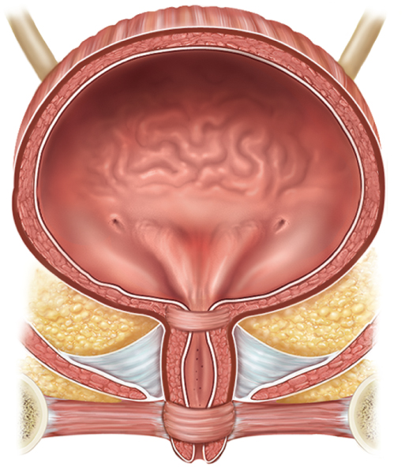
Urinary Bladder
Copyright © The McGraw-Hill Companies, Inc. Permission required for reproduction or display.
Ureter
Detrusor
muscle
Ureteral
openings
Trigone
Internal urethral
sphincter
Urethra
Urogenital
diaphragm
External urethral
orifice
External urethral
sphincter
(a) Female
Figure 23.23a

Slide 75
Kidney Stones
renal calculus (kidney stone) - hard granule of calcium phosphate, calcium oxalate, uric acid, or a magnesium salt called struvite
form in the renal pelvis
usually small enough to pass unnoticed in the urine flow
large stones might block renal pelvis or ureter and can cause pressure build up in kidney which destroys nephrons
passage of large jagged stones is excruciatingly painful and may damage ureter causing hematuria
causes include hypercalcemia, dehydration, pH imbalances, frequent urinary tract infections, or enlarged prostate gland causing urine retention
treatment includes stone dissolving drugs, often surgery, or lithotripsy –nonsurgical technique that pulverizes stones with ultrasound

Slide 76
Female Urethra
3 to 4 cm long
bound to anterior wall of vagina
external urethral orifice
between vaginal orifice and clitoris
internal urethral sphincter
detrusor muscle thickening
smooth muscle under involuntary control
external urethral sphincter
where the urethra passes through the pelvic floor
skeletal muscle under voluntary control
Copyright © The McGraw-Hill Companies, Inc. Permission required for reproduction or display.
Ureter
Detrusor
muscle
Ureteral
openings
Trigone
Internal urethral
sphincter
Urethra
Urogenital
diaphragm
External urethral
orifice
External urethral
sphincter
(a) Female
Figure 23.23a

Slide 77
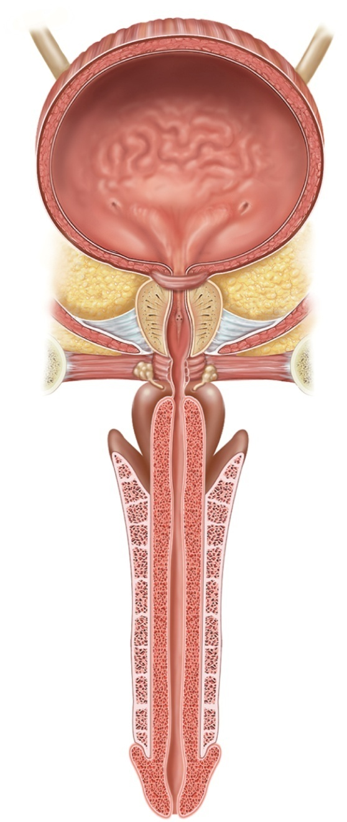
Male Urethra
Copyright © The McGraw-Hill Companies, Inc. Permission required for reproduction or display.
Ureter
18 cm long
3 regions of male urethra
prostatic urethra (2.5 cm)
passes through prostate gland
membranous urethra (.5 cm)
passes through muscular floor of pelvic cavity
spongy (penile) urethra (15 cm)
passes through penis in corpus spongiosum
internal urethral sphincter
detrusor muscle thickening
external urethral sphincter
part of skeletal muscle of pelvic floor
Rugae
Detrusor
muscle
Ureteral
openings
Trigone
Internal urethral
sphincter
Prostate gland
Prostatic urethra
Membranous
urethra
Urogenital
diaphragm
Bulbourethral
gland
External urethral
sphincter
Spongy (penile)
urethra
Penis
External urethral orifice
Figure 23.23b
(b) Male

Slide 78
Urinary Tract Infection (UTI)
cystitis – infection of the urinary bladder
especially common in females due to short urethra
frequently triggered by sexual intercourse
can spread up the ureter causing pyelitis
pyelitis – infection of the renal pelvis
pyelonephritis – infection that reaches the cortex and the nephrons
can result from blood-borne bacteria

Slide 79
Voiding Urine
between acts of urination, the bladder is filling
detrusor muscle relaxes
urethral sphincters are tightly closed
accomplished by sympathetic pathway from upper lumbar spinal cord
postganglionic fibers travel through the hypogastric nerve to the detrusor muscle (relax) and internal urethral sphincter (excite)
somatic motor fibers from upper sacral spinal cord through pudendal nerve to supply the external sphincter give us voluntary control
micturition – the act of urinating
micturition reflex - spinal reflex that partly controls urination

Slide 80
Voiding Urine – Micturition Reflex
involuntary control (steps 1 – 4)
filling of the bladder to about 200 mL excites stretch receptors in the bladder wall
send sensory signals through fibers in pelvic nerve to sacral spinal cord (S2 or S3)
motor signals travel back from the spinal cord to the bladder by way of motor fibers in pelvic nerve and parasympathetic ganglion in bladder wall
excites detrusor muscle and relaxes internal urethral sphincter
results in emptying bladder
if there was no voluntary control over urination, this reflex would be the only means of control

Slide 81
Voiding Urine – Micturition Reflex
voluntary control (steps 5 – 8)
micturition center - nucleus in the pons that receives some input from bladder stretch receptors that ascends the spinal cord
nucleus integrates information about bladder tension with information from other brain centers
urination can be prompted by fear
inhibited by knowledge that the circumstances are inappropriate for urination
fibers from micturition center descend the spinal cord
through reticulospinal tracts
some fibers inhibit sympathetic fibers than normally keep internal urethral sphincter contracted
others descend farther to sacral spinal cord
excite parasympathetic neurons that stimulate the detrusor to contract and relax the internal urethral sphincter
initial detrusor contraction raises pressure in bladder, stimulate stretch receptors, bringing about more forceful contraction
external urethral sphincter receives nerve fibers from cerebral cortex by way of corticospinal tract
inhibit somatic motor neurons that normally keep that sphincter constricted

Slide 82
Voiding Urine – Micturition Reflex
urge to urinate usually arises at an inconvenient time
one must suppress it
stretch receptors fatigue and stop firing
as bladder tension increases
signals return with increasing frequency and persistence
there are times when the bladder is not full enough to trigger the micturition reflex but one wishes to ‘go’ anyway
Valsalva maneuver used to compress bladder
excites stretch receptors early getting the reflex started

Slide 83
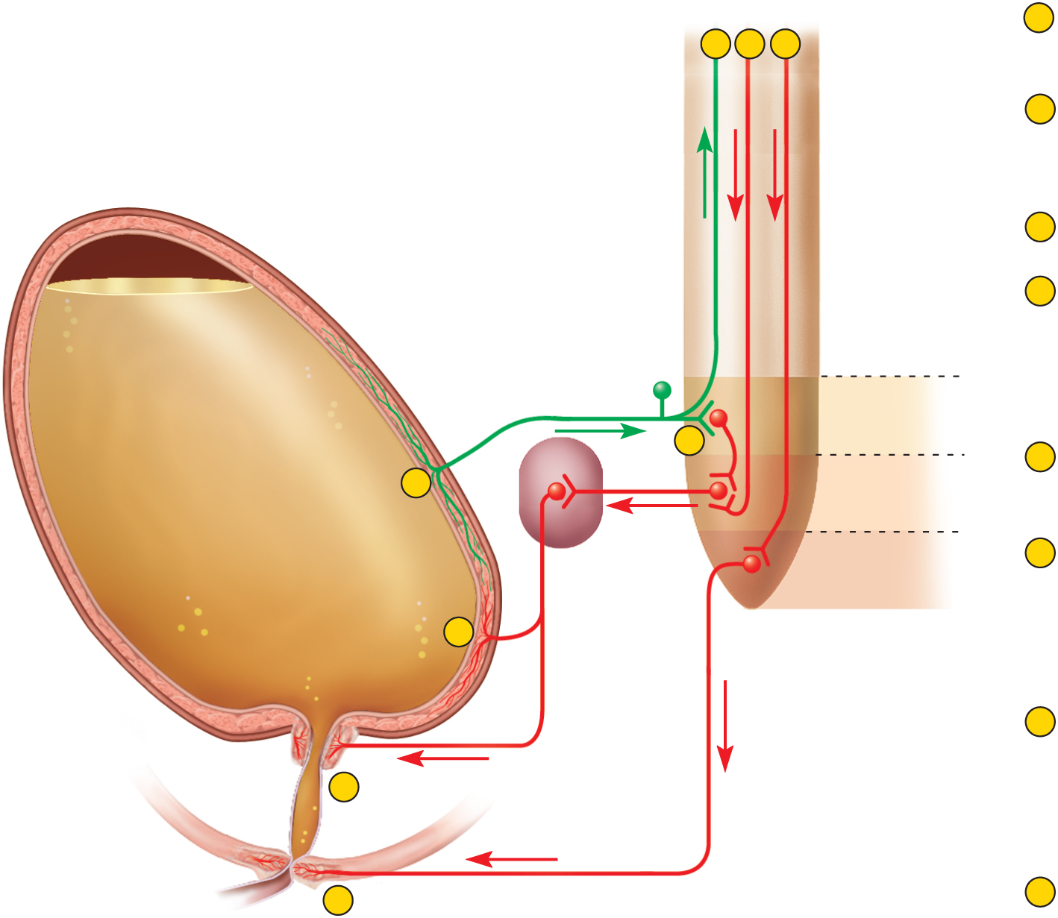
Neural Control of Micturition
Copyright © The McGraw-Hill Companies, Inc. Permission required for reproduction or display.
Involuntary micturition reflex
To pons
From pons
1
Stretch receptors detect filling
of bladder, transmit afferent
signals to spinal cord.
5
6
7
2
Signals return to bladder from
spinal cord segments S2 and S3
via parasympathetic fibers in
pelvic nerve.
Pelvic nerve
3
Efferent signals excite
detrusor muscle.
Sensory
fiber
Motor
fiber
4
Efferent signals relax internal
urethral sphincter. Urine is
involuntarily voided if not
inhibited by brain.
Full
urinary bladder
Sacral segments
of spinal cord
S2
Voluntary control
2
5
For voluntary control, micturition
center in pons receives signals
from stretch receptors.
1
S3
Para-
sympathetic
ganglion in
bladder wall
S4
6
If it is timely to urinate,
pons returns signals to
spinal interneurons that
excite detrusor and relax
internal urethral sphincter.
Urine is voided.
3
Stretch receptors
7
If it is untimely to urinate,
signals from pons excite
spinal interneurons that
keep external urethral
sphincter contracted. Urine
is retained in bladder.
Motor fibers to
detrusor muscle
4
Internal urethral
sphincter (involuntary)
Urethra
External urethral
sphincter (voluntary)
8
Somatic motor fiber
of pudendal nerve
8
If it is timely to urinate, signals
from pons cease and external
urethral sphincter relaxes. Urine
is voided.
Figure 23.24

Slide 84
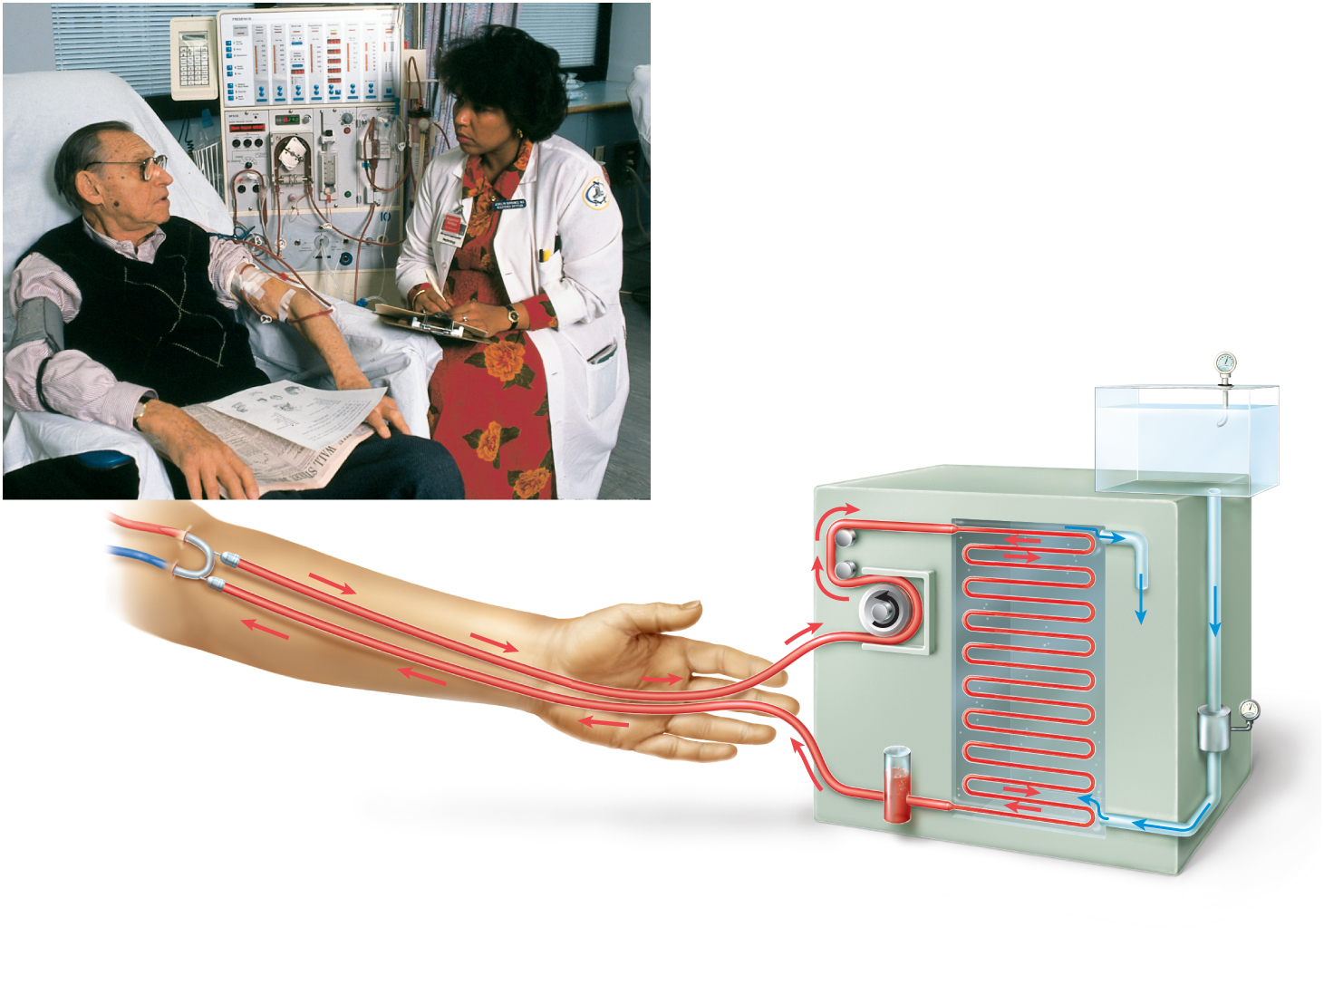
Hemodialysis
Copyright © The McGraw-Hill Companies, Inc. Permission required for reproduction or display.
Thermometer
Dialysis
tubing
Dialysis
fluid
Artery
Vein
Shunt
To
drain
Blood
pump
Flow
meter
Bubble
trap
Cutaway view
of dialysis
chamber
Figure 23.25
Hank Morgan/Photo Researchers, Inc.

Slide 85
Renal Insufficiency & Hemodialysis
renal insufficiency – a state in which the kidneys cannot maintain homeostasis due to extensive destruction of their nephrons
causes of nephron destruction
hypertension, chronic kidney infections, trauma, prolonged ischemia and hypoxia, poisoning by heavy metals or solvents, blockage of renal tubules in transfusion reaction, atherosclerosis, or glomerulonephritis
nephrons can regenerate and restore kidney function after short-term injuries
others nephrons hypertrophy to compensate for lost kidney function
can survive with one-third of one kidney
when 75% of nephrons are lost and urine output of 30 mL/hr is insufficient (normal 50 -60 mL/hr) to maintain homeostasis
causes azotemia, acidosis, and uremia develops, also anemia
hemodialysis – procedure for artificially clearing wastes from the blood
wastes leave bloodstream and enter the dialysis fluid as blood flows through a semipermeable cellophane tube; also removes excess body water

